Slide 1
An Evaluation of Superdupripine Outcome on Nosebleeds
Exploratory analysis of proof-of-concept outcome and suggestions to Phase III study
Bi Bozhu

Slide 2
Understanding the scenario
Data profiling and cleansing
Exploring the treatment efficacy
Data modeling and interpretation
Suggestions and simulations of Phase III
Key take-aways

Slide 3
Thinking flow of data modeling
a
Understanding the
scenarios
b
Data profiling and
cleansing
c
Explore the treatment efficacy
d
Data modelling and interpretation
Going through the related material
Desk research
Literature review
Structure the analysis scope and list questions to be addressed
Understand the predictors and response variable
Exploratory data analysis
Describe the categorical variables
Profile the distribution of the continuous variables
Identify the missing values and determine the imputation or not and corresponding methodology if yes.
Identify if any transformation is needed for all variables, e.g. log transformation or categorize the continuous variable
Define the response if needed
Explore the response and predictors, and the difference between active and placebo arms
Come up with exploratory insights
Select the appropriate model to fit the data
Understand the results and adjust the models if needed
Raise the potential limitations

Slide 4
Understanding the scenario
Overall Objective
Help project team analyze the small proof-of-concept data and determine if Phase III investment should be funded or not.
Trial profile
Drug | Superdupripine
Study type | Randomized
Enrollment | 444 patients
Arm | Active: Superdupripine Comparator: placebo
Targeting indication | Recurrent serious nosebleeds
Profile the available data
Explore the available data
Model the data and identify the risk factors or quantify the impact of predictors
Suggest whether phase III study is deserved and if yes, how to move ahead to phase III study
threshold of high mucus viscosity group
Paper tissue use group
Objective breakdown

Slide 5
Understanding the data
demographic data profiling
The patients recruitment covers 10 countries, and H, B, A are top 3 countries with the most patients.
Blue-eyes patients dominate the patients recruitment, and eye color of 10%+ patients are missing (36 from country G , and eye color of all patients in country G are missing)
No significance of difference is observed for countries distribution and eye color between 2 arms.
In total, 444 patients are enrolled, with balanced patients size across 2 arms.
Assuming the visit period is 365 days, ~87% of patients finished completed follow-up visits.
P=0.0779
P=0.7248

Slide 6
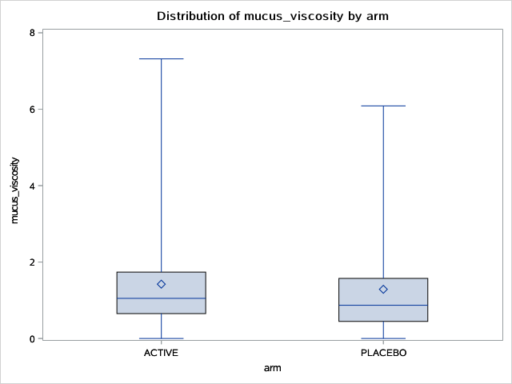
Understanding the data (contd)
Baseline info profiling
Continuous variables profiling
Categorical variables profiling
No significance of difference is observed in terms of nosebleeds at baseline between 2 arms.
Above 95% of patients suffer from 2-3 nosebleeds in previous year at baseline.
No significance of difference is observed in terms of tissue use and nosebleeds at baseline between 2 arms.
P=0.2402
P=0.9157
P=0.2865

Slide 7
Understanding the data (contd)
Interaction effect exploration of important variables
1
Mean of nasal mucus viscosity
Nosebleeds in visiting year
1
Right chart indicates the high heterogeneity of nasal mucus viscosity average, among different outcome groups between 2 arms. Thus, it is suspect that interaction of arm and mucus viscosity posed impact to nosebleeds.
2
Mean of nasal mucus viscosity
2
Right chart indicates relatively alignment, the mean of mucus viscosity of each nosebleed incidence for high tissue use is always higher than that of medium use, for both arms. No clear signal shows interaction of tissue use and mucus viscosity.
Nosebleeds in visiting year

Slide 8
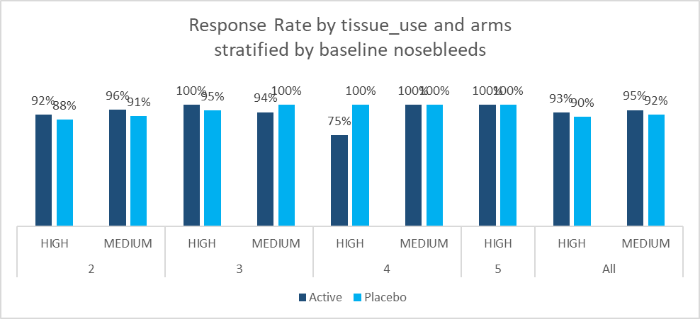
Exploring the treatment efficacy
Exploratory on the tissue use and response
Define the response
If nosebleeds of visiting year<nosebleeds of previous year, the patients are taken as response (response=1).
If nosebleeds of visiting year>=nosebleeds of previous year, the patients are taken as no response (response=0).
Basically, the response rate of medium tissue use is higher than that of high tissue use, which might CHALLENGE the considerations of medical team.
The response rate of active arm is higher than placebo arm, for both high and medium use groups.
Source: only the patients with 365 days duration were analyzed.

Slide 9
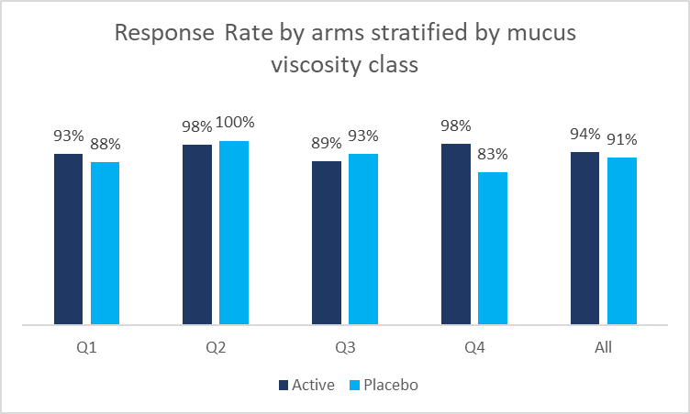
Exploring the treatment efficacy (contd)
Exploratory on the mucus viscosity and response
As first step, only 2 groups (>=median and < median ) were split, the response rate of active arm for high mucus viscosity (94%) is better than placebo (88%). The mucus viscosity >=1 is suggested to be taken as threshold.
With further breaking down high mucus viscosity group, high mucus viscosity classes (Q4) is the most medically significantly group.
Note: mucus viscosity was categorized into 4 classes by the quantile 25%, 50%, 75% and above. The value range is as right table:
Source: only the patients with 365 days duration were analyzed.

Slide 10
Modeling process
Overall decision making process to select the most appropriate model
Key considering
Facts
Analysis methods to consider
1
Time effect ?
No exact date event happened was provided.
No survival analysis could be done.
2
Data type of response variable?
The response variable is count of event incidence in specified window. It is integer with >=0.
The Poisson or Negative Binomial regression used to be applied.
3
Any data transformation or features selection process ?
Duration is not equal to 365 days for all patients.
4 categorical predictors (country, eye_colour, arm, tissue_use) and 2 continuous variables (previous year, mucus viscosity)
No obvious collinearity was detected.
Quick transformation for nosebleeds in visiting window is needed.
4
Overdispersion or zero-inflated?
The unconditional ratio table is
The unconditional ratio of variance and mean looks a bit over-dispersed but not significant. Thus, Poisson regression is suggested to be the first option and conditional dispersion would be monitored. And then further decide if negative binominal regression or zero inflated model is needed to avoid the overdispersion.

Slide 11
Modeling process (contd)
Model profile
As discussed earlier, the below modeling was run –
Predictors:
Response: nosebleeds
Variable transformation
Nosebleeds incidence rate was offset by duration, which means expected_nosebleeds=nosebleeds/duration*365
Model profile:
Pilot on Poisson regression firstly
Link function - Log
Note: eye color is not taken into modeling due to the missing value, this will be further analyzed as subgroup analysis if needed.

Slide 12
Modeling process (contd)
Modeling result understanding
Table 1
1
The value close to 1 indicated no significant overdispersion in a conditional way.
Poisson regression is OK to fit the data.
P-value is 0.99, which indicated good fitness of model.
1
1
4
4
Table 2
2
The interaction item is significant to be non-zero, however, the main effects, both arm and mucus_viscosity, are not significantly non-zero
2
3
2
3
3
2
However, removing the interaction item, both main effect are better to be of significance.
4
Considering no significant benefit from interaction inclusion (BIC value) and simplicity of model interpretation, the interaction item is removed.

Slide 13
Modeling process (contd)
Modeling result understanding
Arm
1
The expected log count for active is 0.31 lower than expected log count for placebo, which means that the nosebleeds of treatment is less than placebo keeping others constant. (exp(-0.31)=0.73)
P-value <0.05 indicates the active treatment significantly decreased the nosebleeds, comparing with placebo.
1
1
2
Tissue use
2
Similar result is for tissue use.
Significant higher nosebleeds for high tissue use is observed, comparing with medium use.
3
3
4
Mucus viscosity
3
the coefficient of mucus viscosity is -0.11, this means that expected decrease of log count for one unit increase in mucus viscosity is 0.11.
However, mucus viscosity is not significant enough, with p-value is 0.06 above 0.05. It was highly suspect due to the correlation between mucus viscosity and tissue use.
Previous year
4
No surprise that the nosebleeds at baseline is highly relevant to the nosebleeds, significantly with p-value<0.01

Slide 14
Modeling process (contd)
Things to consider and other pilots
From the data, the high incidence of zeros indicate possible ‘excessive’ zeros. But the conditional ratio of variance and mean does not indicate the overdispersion.
All the variables for zero-inflated model are not significant, the logistic model nested within zero inflated Poisson model are not statistically reasonable, and seems to be difficult to interpret either.
In this way, we still need to further discuss with project team on
Reasons / confounding to high zeros incidence
Predictors to ‘excess’ zeros group, if any

Slide 15
Limitations to confounding or omitted variables in the model
Hospitalization
Hospitalization for nosebleeds in local medical practices may differ a lot. That may impact the predictor, for example, the measurement for mucus viscosity tends to be higher than others.
In this case, fixed effects model is suggested to applied, in order to control the average differences across the hospitals in any observable or unobservable predictors.
Fixed effects greatly reduce the impact of omitted variable bias.
Other exposure or confounding are suggested to collect during the trial, for example –
Co-prescription:
Other drugs used along with targeting drug, especially high possibility with adverse events nosebleeds, such as large doses of aspirin
Other diseases causing the nosebleeds, such as upper respiratory infection
Any other random events, such as injury, exposure to allergy

Slide 16
Suggestions to go with Phase III trial
As learned from model, simulate below models
Patients with mucus viscosity >=1 (that is the median)
Patients with high tissue use
For 3 models, the expected mean of nosebleeds of active arm is significantly less than placebo arm.
The quantified effect is
Model 1: exp(-0.31)=0.73
Model 2: exp(-0.51)=0.60
Model 3: exp(-0.61)=0.54
Thus, the treatment benefit is more significant for serious mucus viscosity. It is lower risk to have significant result.
Overall, the model 2 is suggested balancing the medical efficacy and targeting patients.
The suggestion is based on current data, the medical consideration and targeting patients size should be taken into consideration to go ahead.
Winner
Note: no significance of difference was observed for the baseline of both model 2 and 3, by chi-square test for categorical variables and t-test for continuous variables.

Slide 17
Take-aways
In total, 444 patients were enrolled in this trial, ~13% of patients lost the visits within one year.
No significance of difference between 2 arms was observed for baseline, in terms of tissue use, nosebleeds of previous year, country, eye color, as well as the nasal mucus viscosity (NMV).
Potential interaction of arms and NMV was observed, while it was aligned pattern for tissue use and NMV, among different nosebleeds groups.
The response rate of treatment arm was higher than placebo, and response rate of high tissue use was higher than medium use.
The Poisson model results indicated the treatment efficacy, with expected average of nosebleeds 27% less than placebo.
Fixed effect was suggested to consider to cover observed and unobserved variables, considering the potential hospitalization heterogeneity.
To go ahead, below patients segmentations were suggested to mitigate the risk of trial failure –
Patients with mucus viscosity >=1 (that is the median)
Phase III trial was deserved from the data analysis results, but medical team’s input on the inclusion/exclusion criteria, as well as the commercial consideration on the balance of investment and targeting patients’ market, were still needed.

Slide 18
Thanks

