Slide 1
Segmentation of Static Scene and Moving Objects from Optical Flow Data
Semester Project
Dario Zehnder
Jonas Kühne, Dr. Seonyeong Heo

Slide 2



The Idea
Explain idea and camera
Usecase
Related work

Slide 3
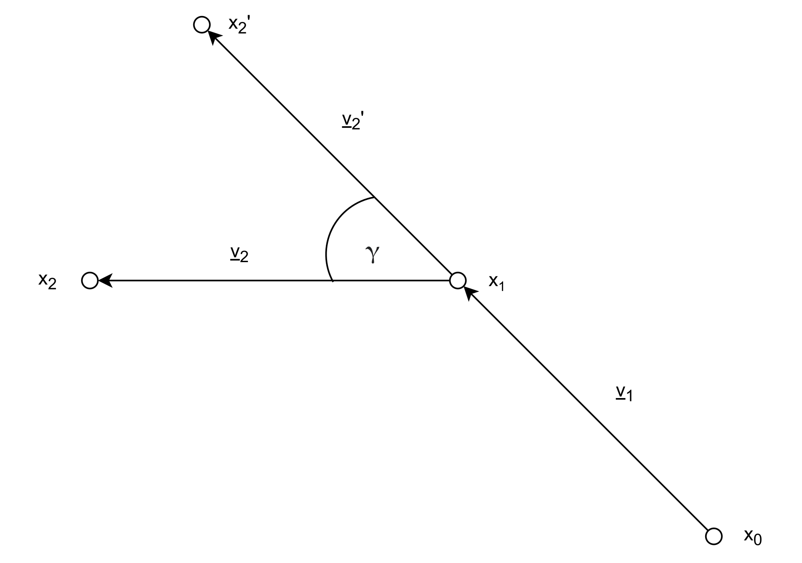
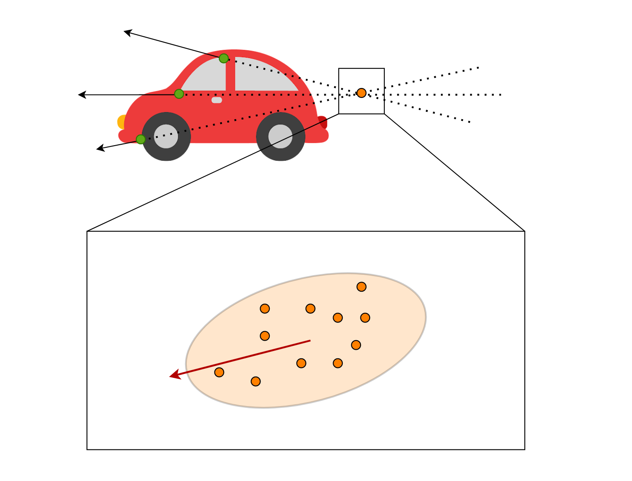
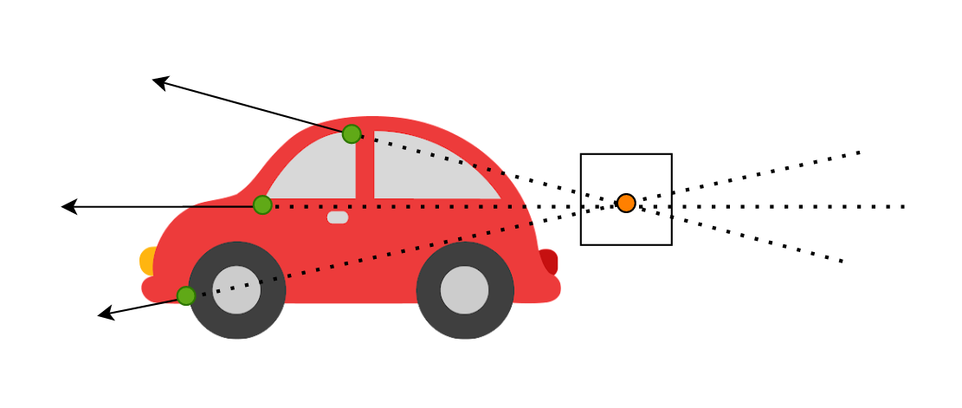
Algorithm
DIC and RT algo
Ego-motion-comp
Explain how they work

Slide 4
Ego-Motion-Compensation
RANSAC
Camera Matrix
Rotation Matrix
SVD
Fundamental Matrix
Translation Vector
8-Point-Algorithm

Slide 5
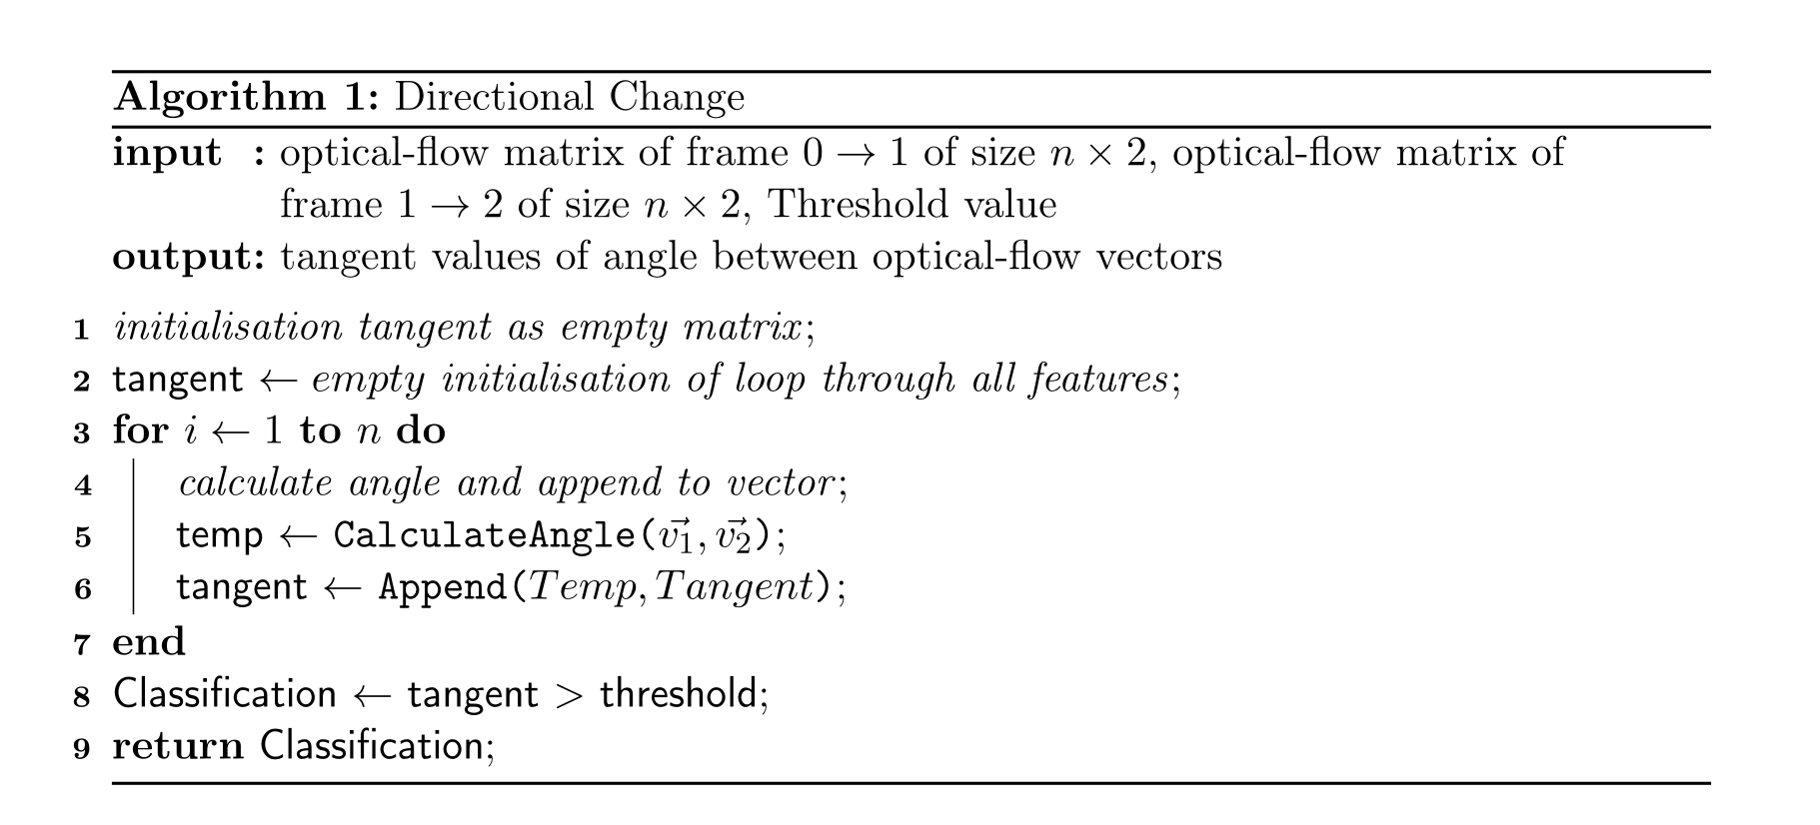
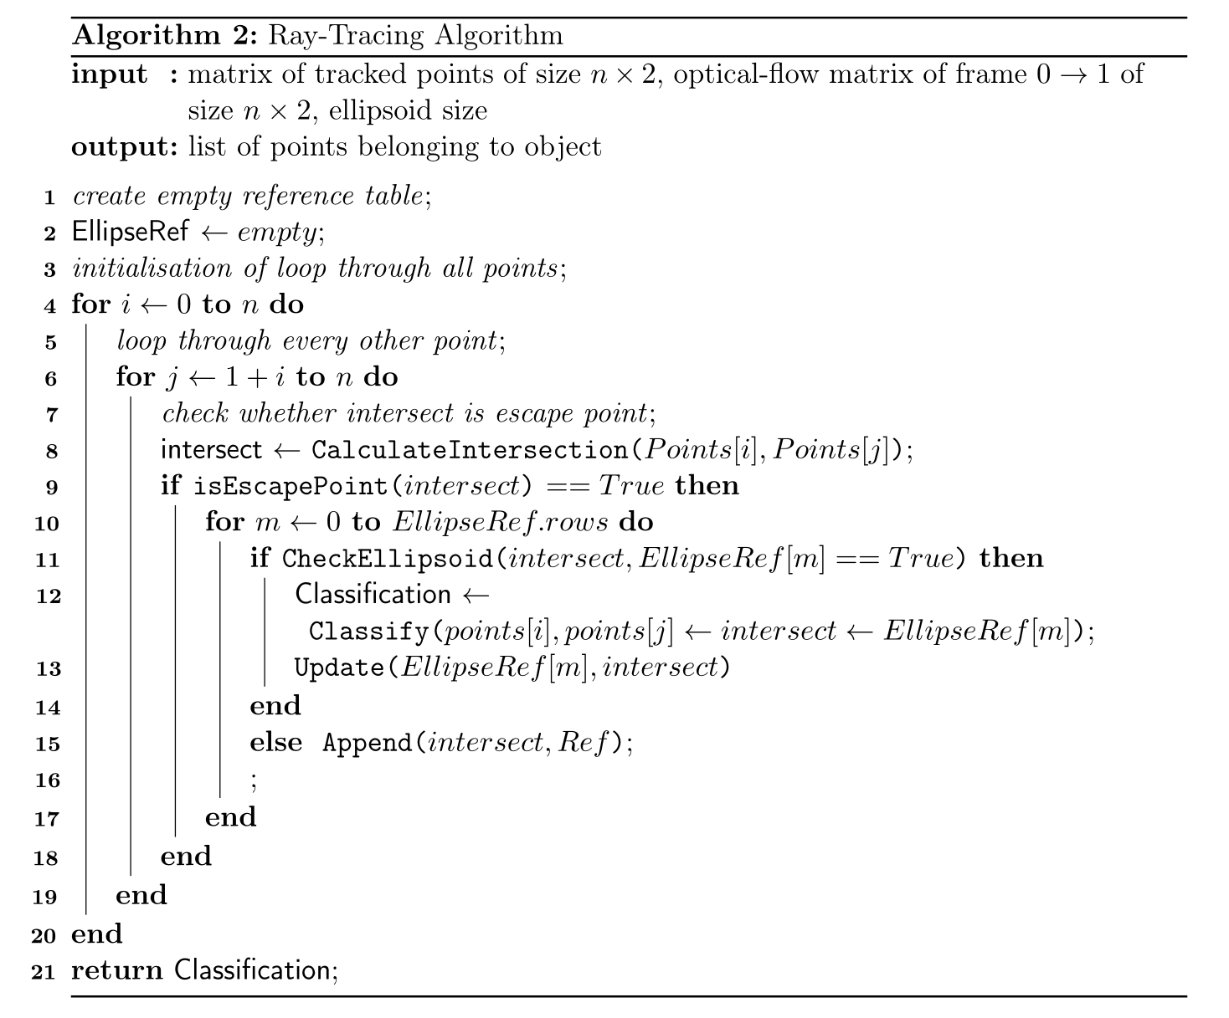
Implementation?
Implementation of the scoring system
How conf matrix works

Slide 6
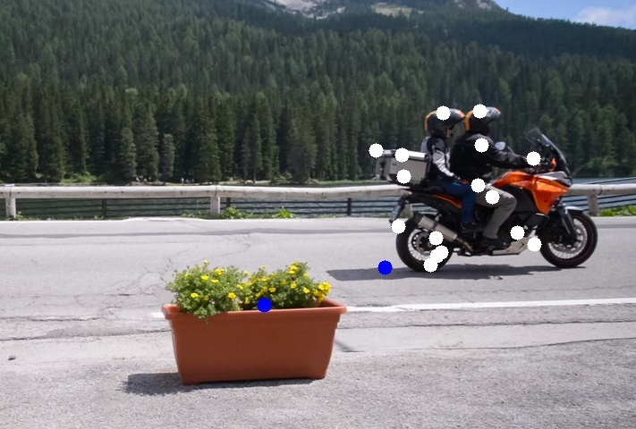

Confusion Matrix
16 | 2
5 | 24

Slide 7
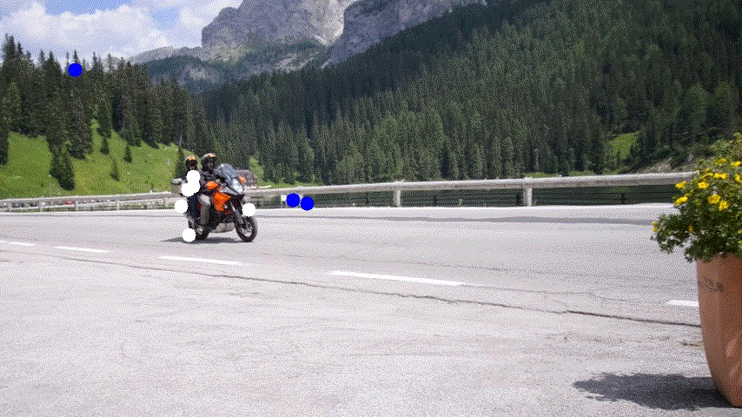
Testing
What scenes were chosen
How much noise was added
How was the time analysis done?

Slide 8
Time-Analysis
Pre-Processing
Feature Extraction
Ego-Motion-Compensation
Algorithm
Evaluation
Total Time per Frame

Slide 9
Results and Discussion
Show comparison of algo on davis
Show results on kitti w and wo EMC
Show noise analysis
Show time results

Slide 10
Conclusion

Slide 11
Questions?

