Slide 1
Project Topic City Similarity Test
PROJECT GUIDE
Dr. B.D.K. PATRO (H.O.D. of CSE DEPT.)
PRESENTED BY
AKASH TRIPATHI (1683910004)
GOPI GUPTA (1783910904)
SUMIT SINGH (1783910907)
REC KANNAUJ

Slide 2
Objective of the Project : Business Problem
A TATA, Wipro, New York Luxury Brand and other multi-national brands has built its business in several cities all over world. Due to its success and growing popularity in these cities, the CEO and his team wants to expand their business to other cities in the India, UK States, China, Japan and also explore their market in big cities in other countries. Now the CEO has hired a data scientist and assigned him/her a task to find out the similarity between different big cities in the world and group the cities into various clusters, so that the Board of Directors can make a better decision of which business mode to operate in new cities.

Slide 3
Brief of Base Reference Paper(Daniel Preo,tiuc-Pietro,Justin Cranshaw,Tae Yano,Exploring venue based city to city measures,2013)
Imagine two hypothetical cities, Concentralia and Dispersia, that are exactly the same in nearly every way, having exactly the same venues—the same universities, restaurants and parks. Suppose further that they only differ in the spatial arrangement of these venues, so that the venues in Dispersia are distributed uniformly throughout the city,and the venues in Concentralia are positioned more naturally— organically shaped alongside Concentralia’s economic, political, and cultural evolution.
With the growth of smart-phones,and location-based social networks, data is being generated about human activity in urban areas at a level of detail not seen before.
One issue in comparing spatial regions such as cities is the normalization of absolute data, since often raw data from two diﬀerent contexts are incomparable. Another challenge is the question of how to account for spatial eﬀects. In our hypothetical comparison, the only diﬀerence between Concentralia and Dispersia was in the spatial distribution of their venues.
we deﬁne the bag of venues representation of a spatial region r.
For the venues, we collected data from the widely used location-based Social Network (LBSN) Foursquare. Users of Foursquare“check-in” to their current location on their mobile device by selecting it from a list of nearby named venues.

Slide 4
LANGUAGE USED IN PROJECT
PYTHON
LIBRARIES USED IN PROJECT
pandas
numpy
matplotlib
geopy
folium
BeautifulSoup
PLATFORM USED IN PROJECT
IBM Watson Studio(Jupyter Notebook)
IBM CLOUD For storage of data

Slide 5
Modules of the Project
1.Data Sources
2.Data Acquisition
3.Data Cleaning
4.Clustering Model based on k-mean algorithm
5.Visulaization of data and result
6.Results and Discussions
7.Conclusion

Slide 6
Cities on which ‘City similarity Test’ will be performed
['New York', 'London','Edinburgh', 'Toronto', 'Sydney', 'Singapore', 'Melbourne', 'Hong Kong', 'Los Angeles', 'Chicago', 'Boston', 'San Francisco', 'Dublin', 'Washington','Beijing','Shanghai','Guangzhou', 'Shenzhen', 'Mumbai', 'Tokyo', 'Seoul–Incheon','Moscow','Paris', 'Taipei', 'Berlin', 'Jakarta', 'Mexico City','Delhi','Kolkata']

Slide 7
Data Acquisition
There are 3 data features used for the model
Venue-Category data:
FourSquare API requests
City GDP data:
Table on the Wikipedia Page – A list of GDP values for cities
https://en.wikipedia.org/wiki/List_of_cities_by_GDP
City Temperature data:
Table on the Wikipedia Page – A list of temperatures for cities
https://en.wikipedia.org/wiki/List_of_cities_by_average_temperature

Slide 8
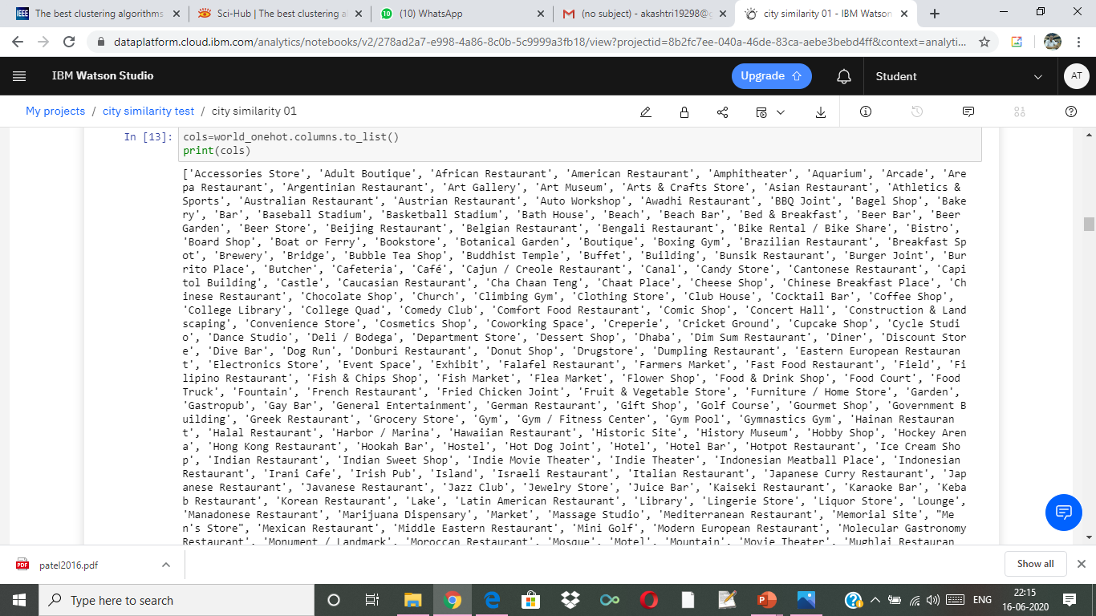

Slide 9
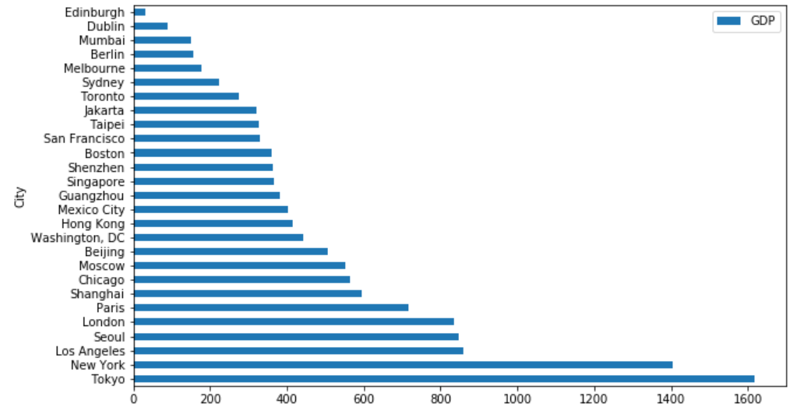
City Rankings in GDP

Slide 10
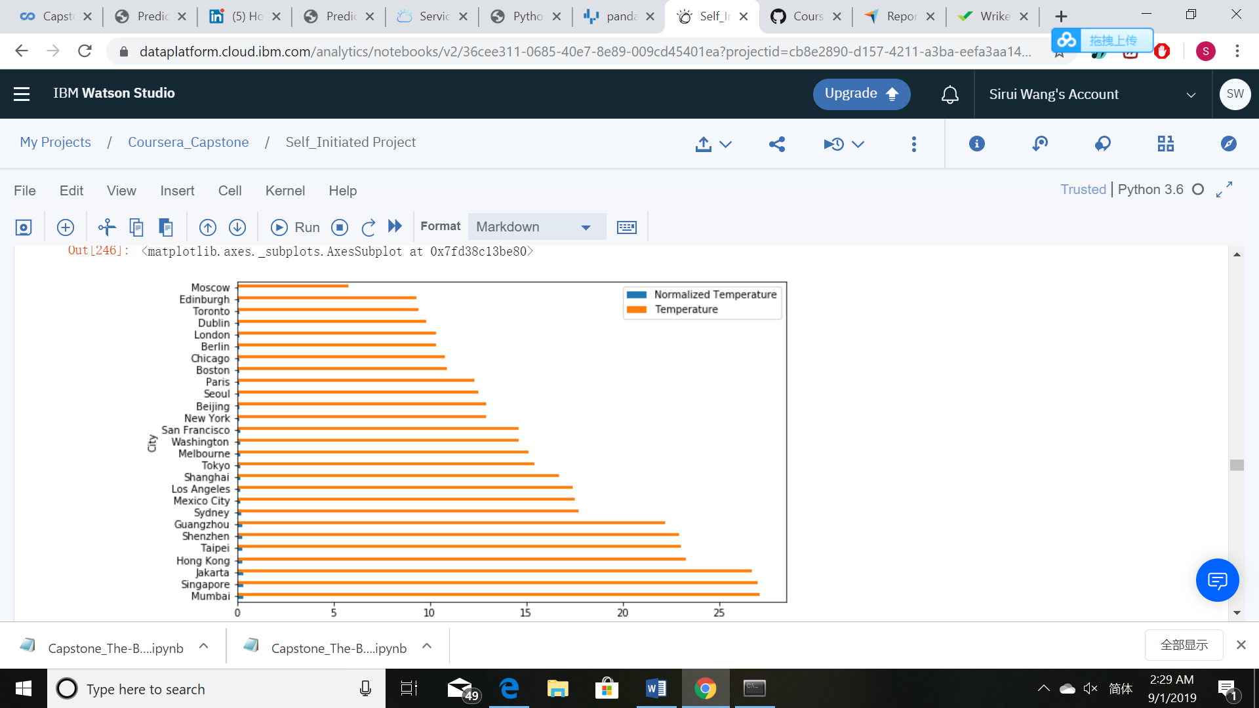
City Rankings in temperature

Slide 11
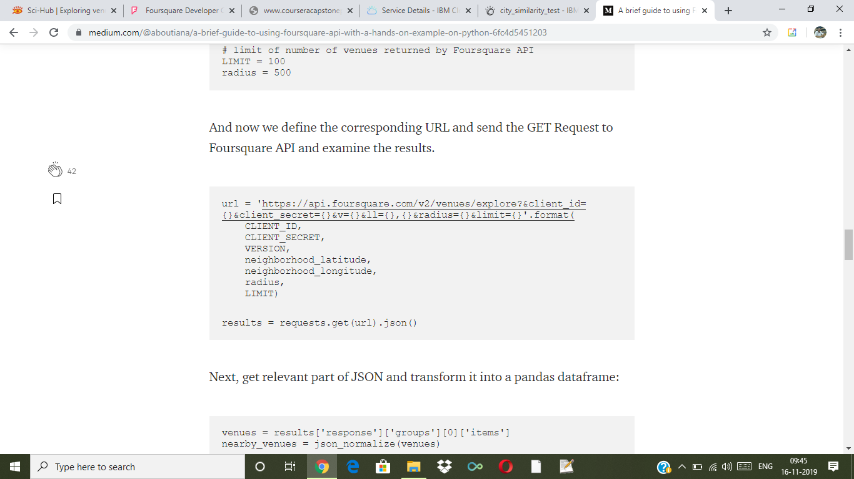

Slide 12
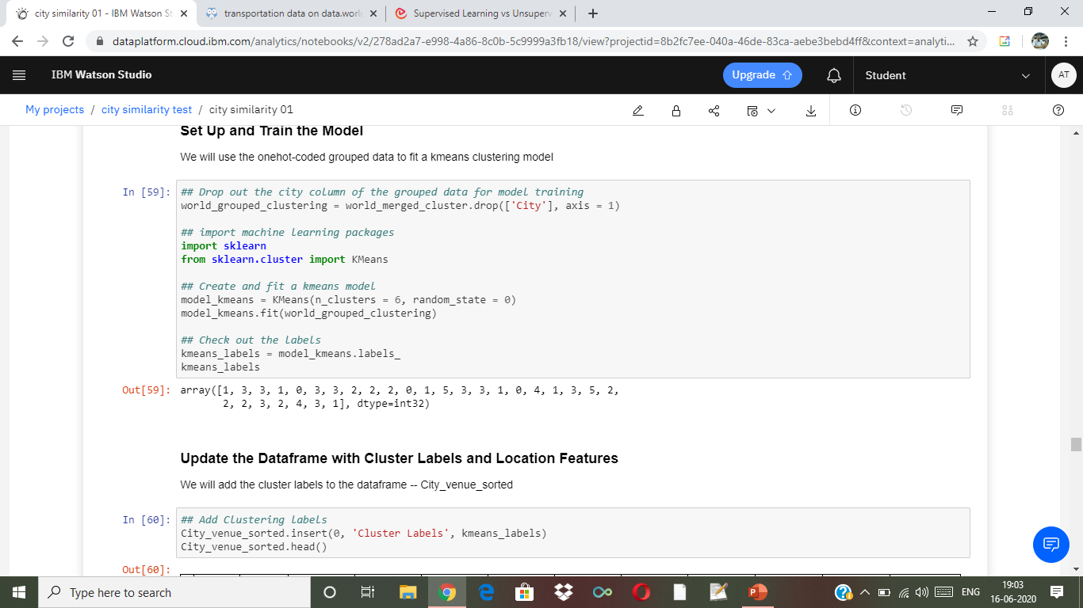

Slide 13
Output clusters that we are expecting using K-mean Clustering Algorithm
City_name | 1st most common venue | 2nd most common venue | …… | 10th most common venue | GDP | Average Temperature | Population | Crime_rate

Slide 14
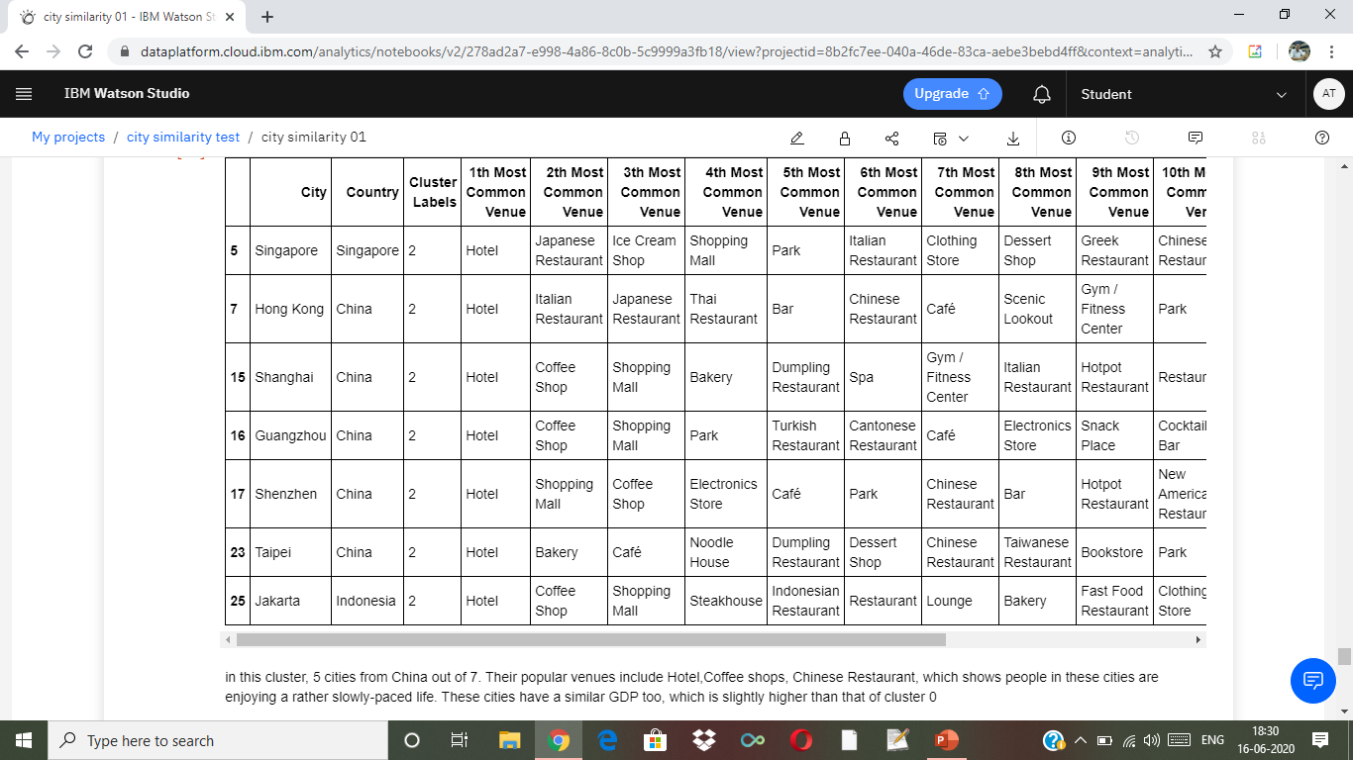
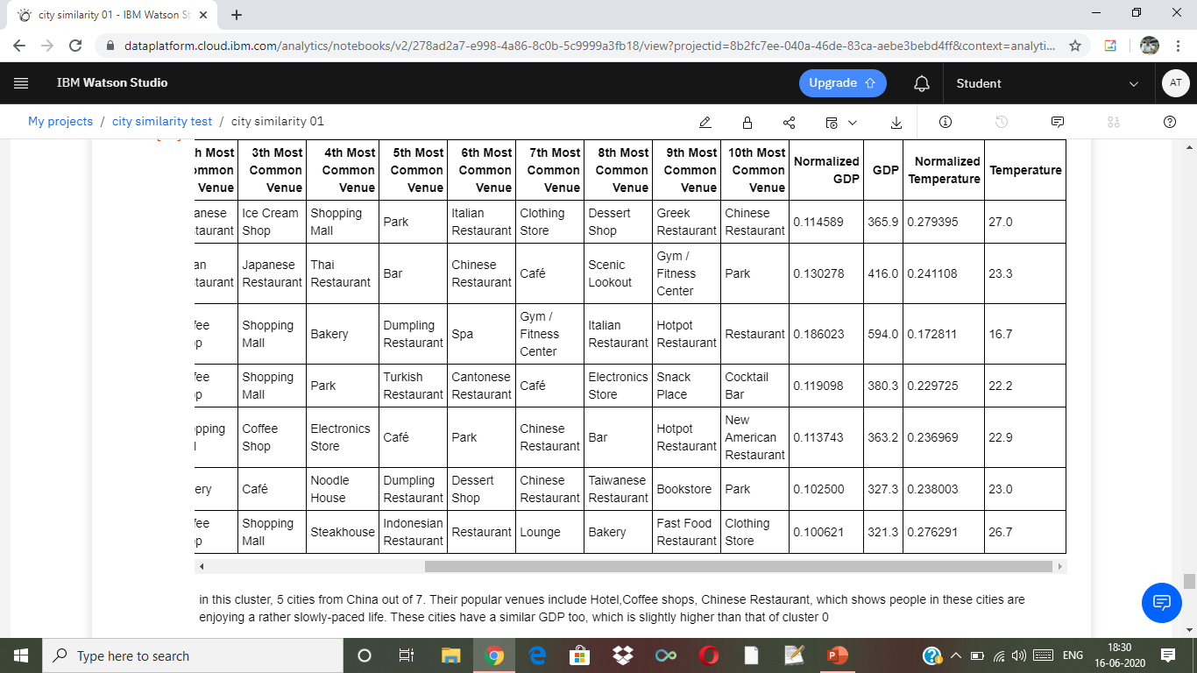

Slide 15
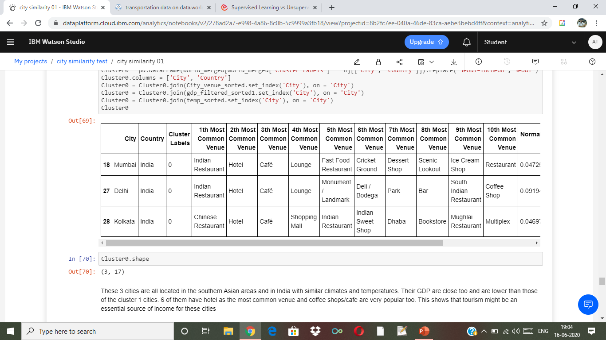

Slide 16
Why cluster cities?
Help making better decisions for business expansion into different cities
Similar cities >> consider similar business operation mode
Cities with unique features >> consider localized and customized business methods
Informed decisions on which cities to expand and how to operate business

Slide 17
CONCLUSION
In this assignment we have built up a clustering model to segment the major big cities into different groups.
There are three big parameters used for clustering is venues ,GDP and temperature but we would like to add few more parameters like populations, Average salary and crime rates.
The result could be a valuable reference to the Board of Directors when they are making decisions on their business expansions into these cities.
This result is straight-forward and takes different factors into account.
However, there is also room for improvement.
as there are a lot of features that influence the similarity between two cities and more variables could be included for higher accuracy of the clustering results.

Slide 18
Thank You

