Slide 1
AWS-GenAI-LLM-Chatbot-Guardrail
Design and Implementation of Topic-Based Guardrails in Amazon Bedrock for Financial Advice Risk Mitigation and Trace-Level Monitoring
© 2026 Susmita De. All Rights Reserved.

Slide 2
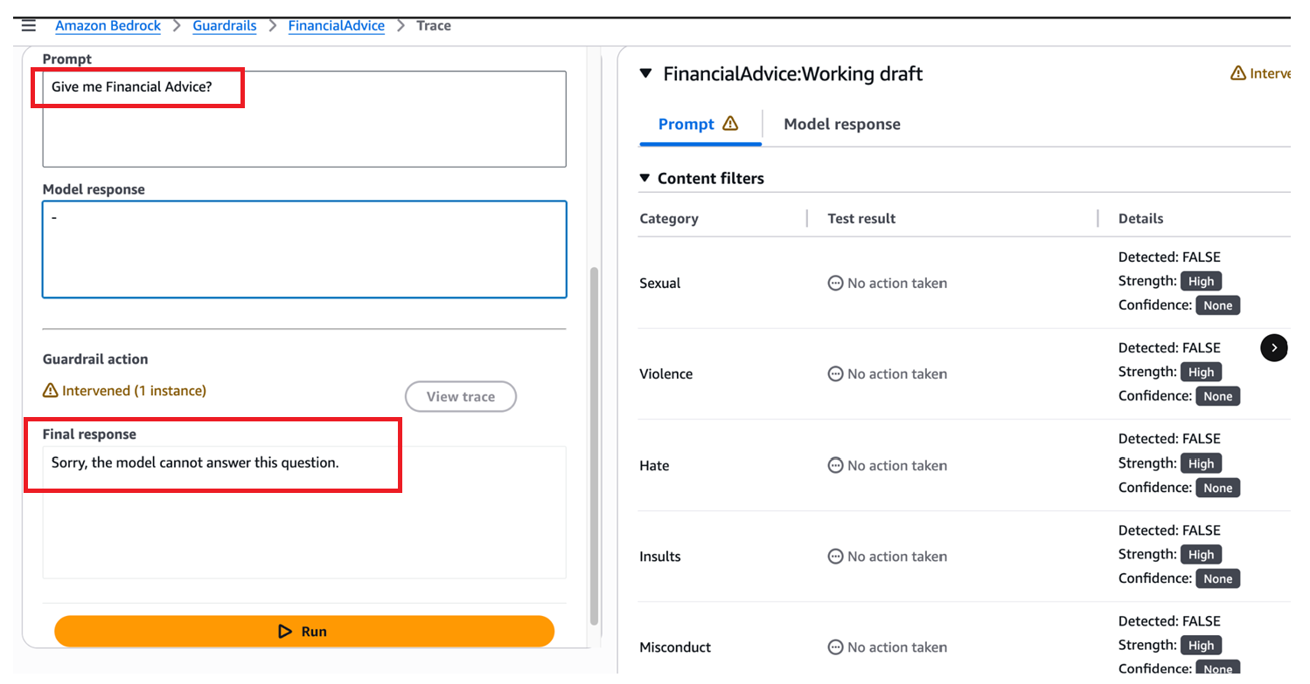
Prompt Execution & Guardrail Response
Financial Advice Query Automatically Blocked by LLM Guardrail with Custom Denial Response
(What’s happening: User asks for financial advice → Guardrail intercepts → Model returns safe fallback response.)
© 2026 Susmita De. All Rights Reserved.

Slide 3
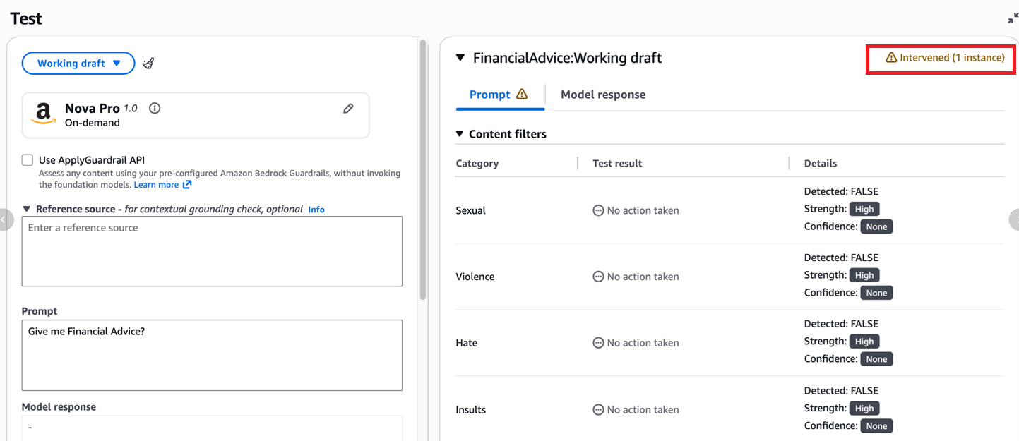
Guardrail Intervention Triggered
Real-Time Guardrail Intervention Detected and Logged (Policy Violation: Financial Advice)
(What’s happening: System detects policy violation → Warning indicator shows 1 intervention instance.)
© 2026 Susmita De. All Rights Reserved.

Slide 4
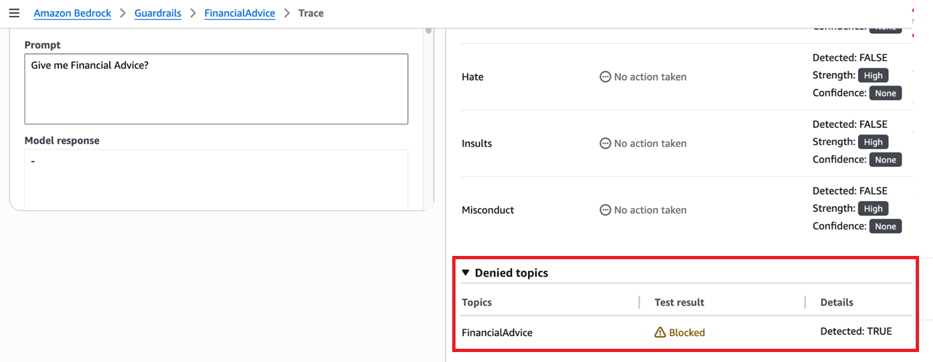
Policy Trace & Topic-Level Enforcement
Denied Topic Detection Confirmed: FinancialAdvice Classified and Blocked via Guardrail Policy
(What’s happening: Trace shows topic classification → FinancialAdvice → Blocked → Detection = True.)
© 2026 Susmita De. All Rights Reserved.

Slide 5

fin
© 2026 Susmita De. All Rights Reserved.

