Slide 1
Air-sea Transition Zone (ASTZ)
Ekman Advection
Simon de Szoeke

Slide 2
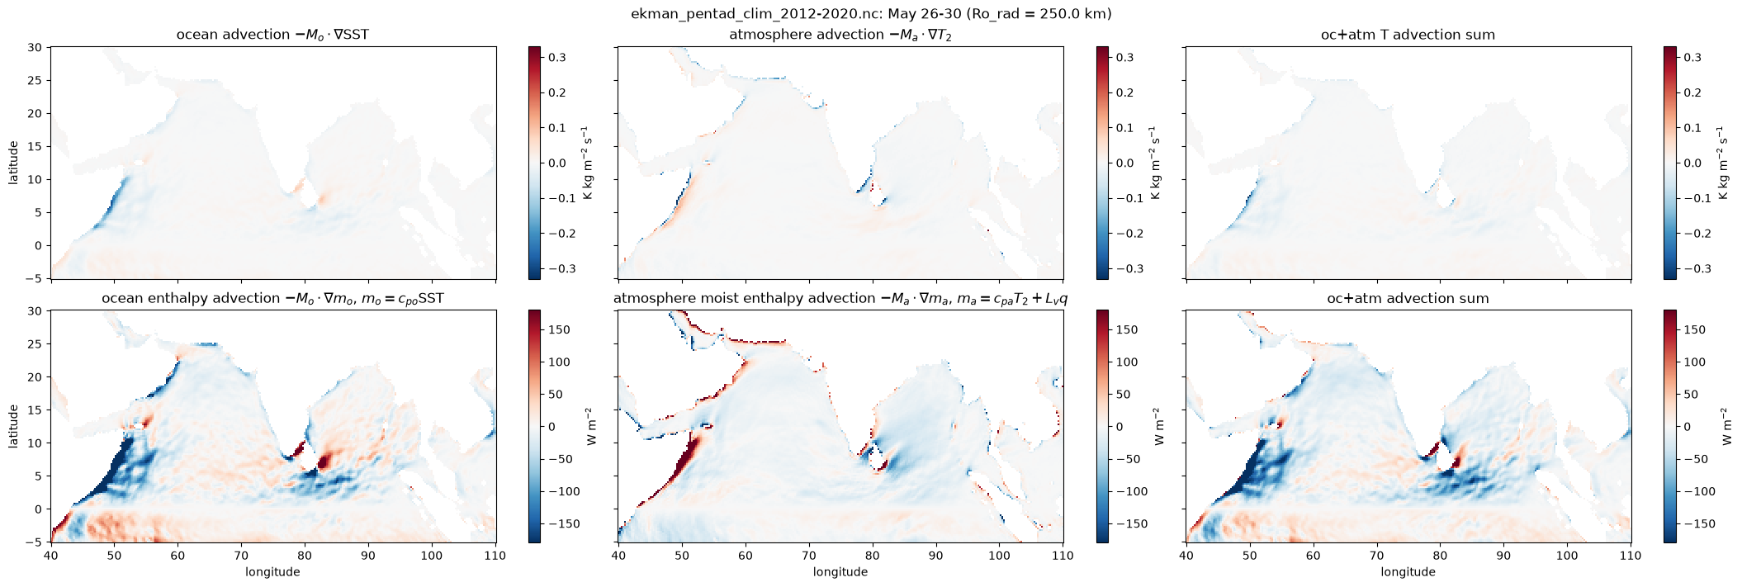
Mean pre-monsoon
(May 26-30 2012-2020, pentad 30)

Slide 3
Mean pre-monsoon
(May 26-30 2012-2020, pentad 30)

Slide 4
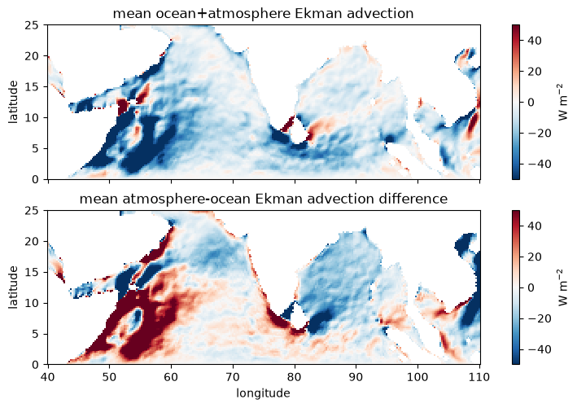
All BSISO phases equally weighted
oc + atm
sum
difference
Notes:
Differnece plot (lowest right) shows examples of 2 regimes:
(red) Ekman advection warms ocean relative to atmosphere. This reflects atmospheric cooling advection by baroclinic frictional wind, which flows down pressure gradients from cool T to warmer T. This is expected for SST driving the surface wind response in the atmosphere.
(blue) Ekamn advection cools ocean relative to atmosphere. This reflects ocean cooling by advection out of cool regions of SST by Ekman divergence and upwelling. This is the expected for wind stress driving the surface temperature response in the ocean.

Slide 5
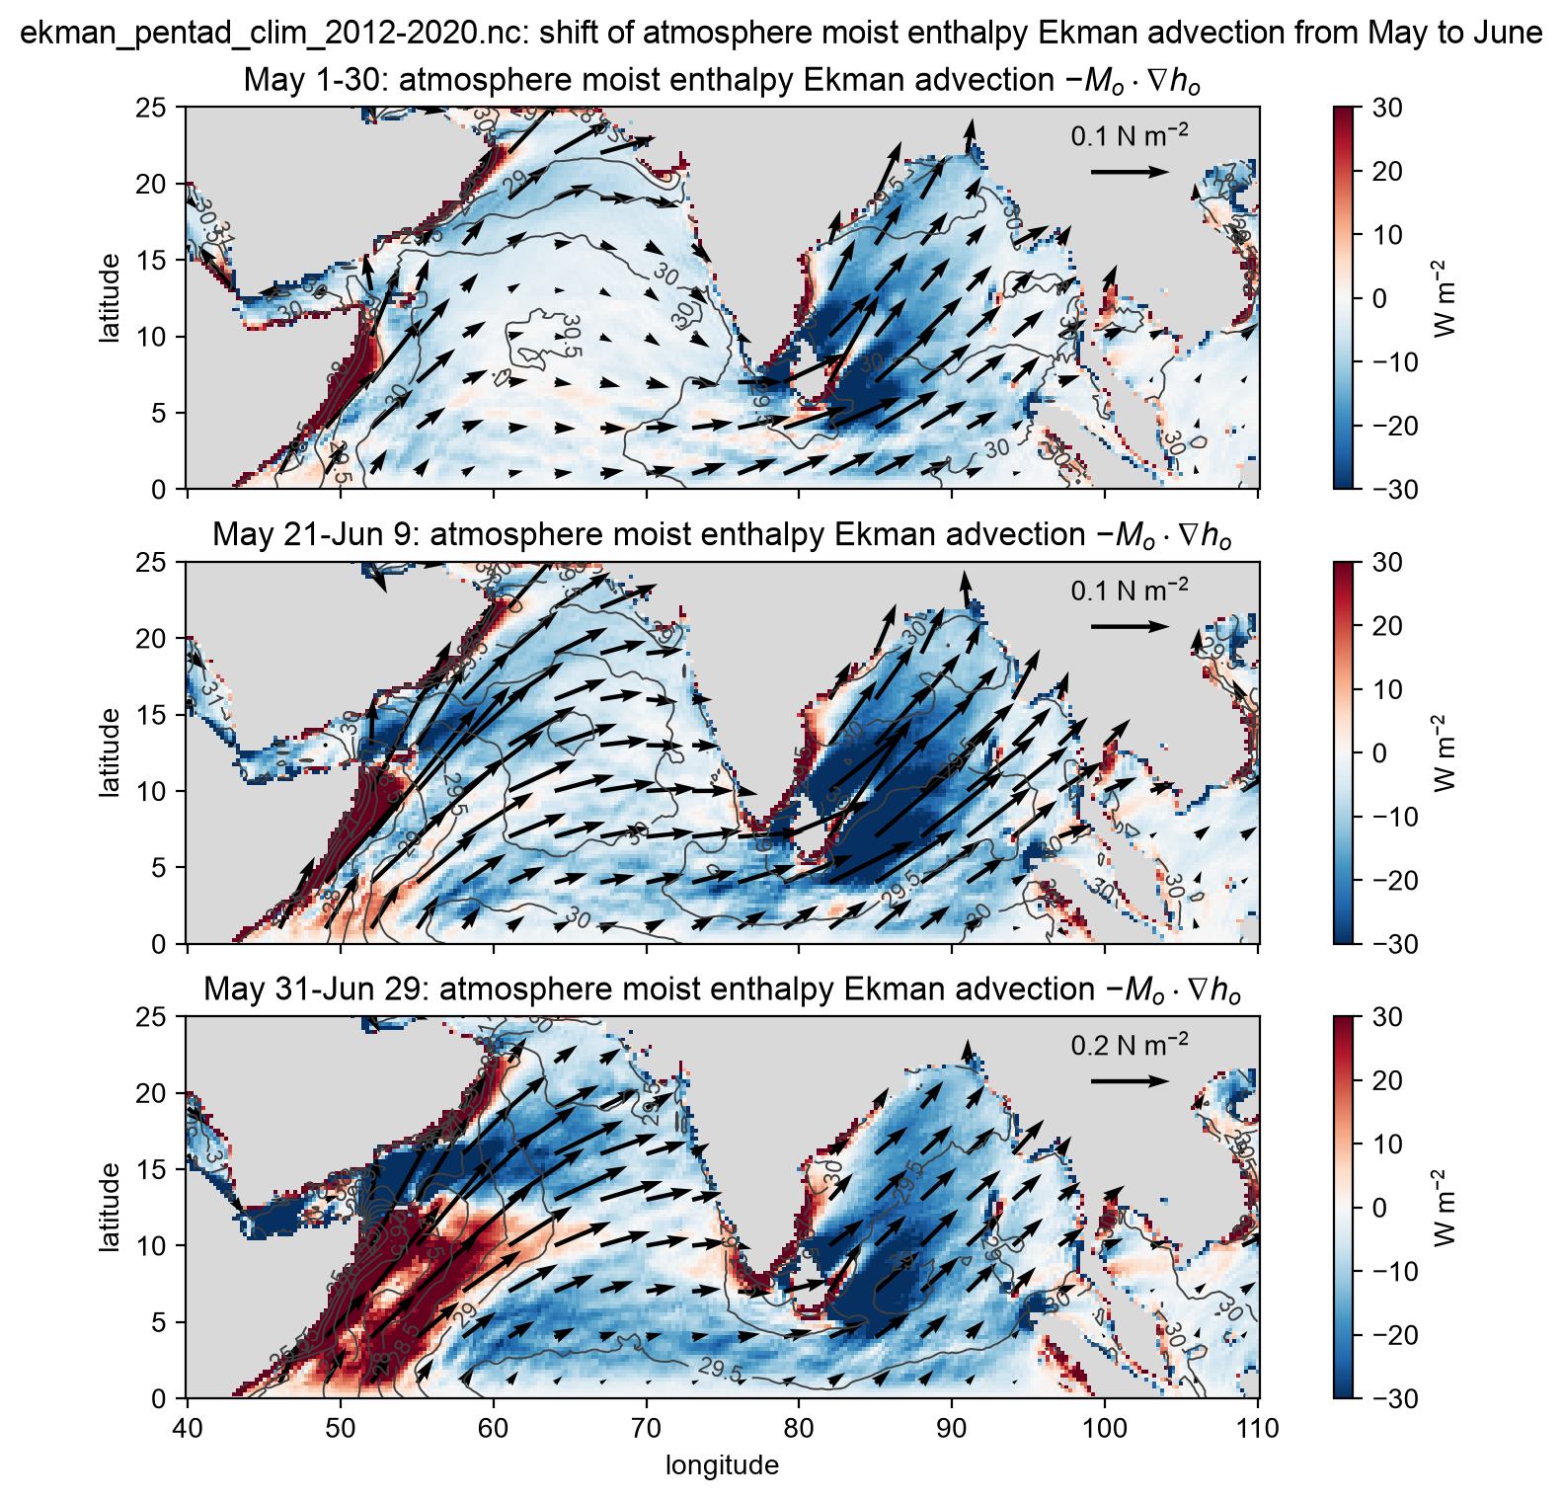
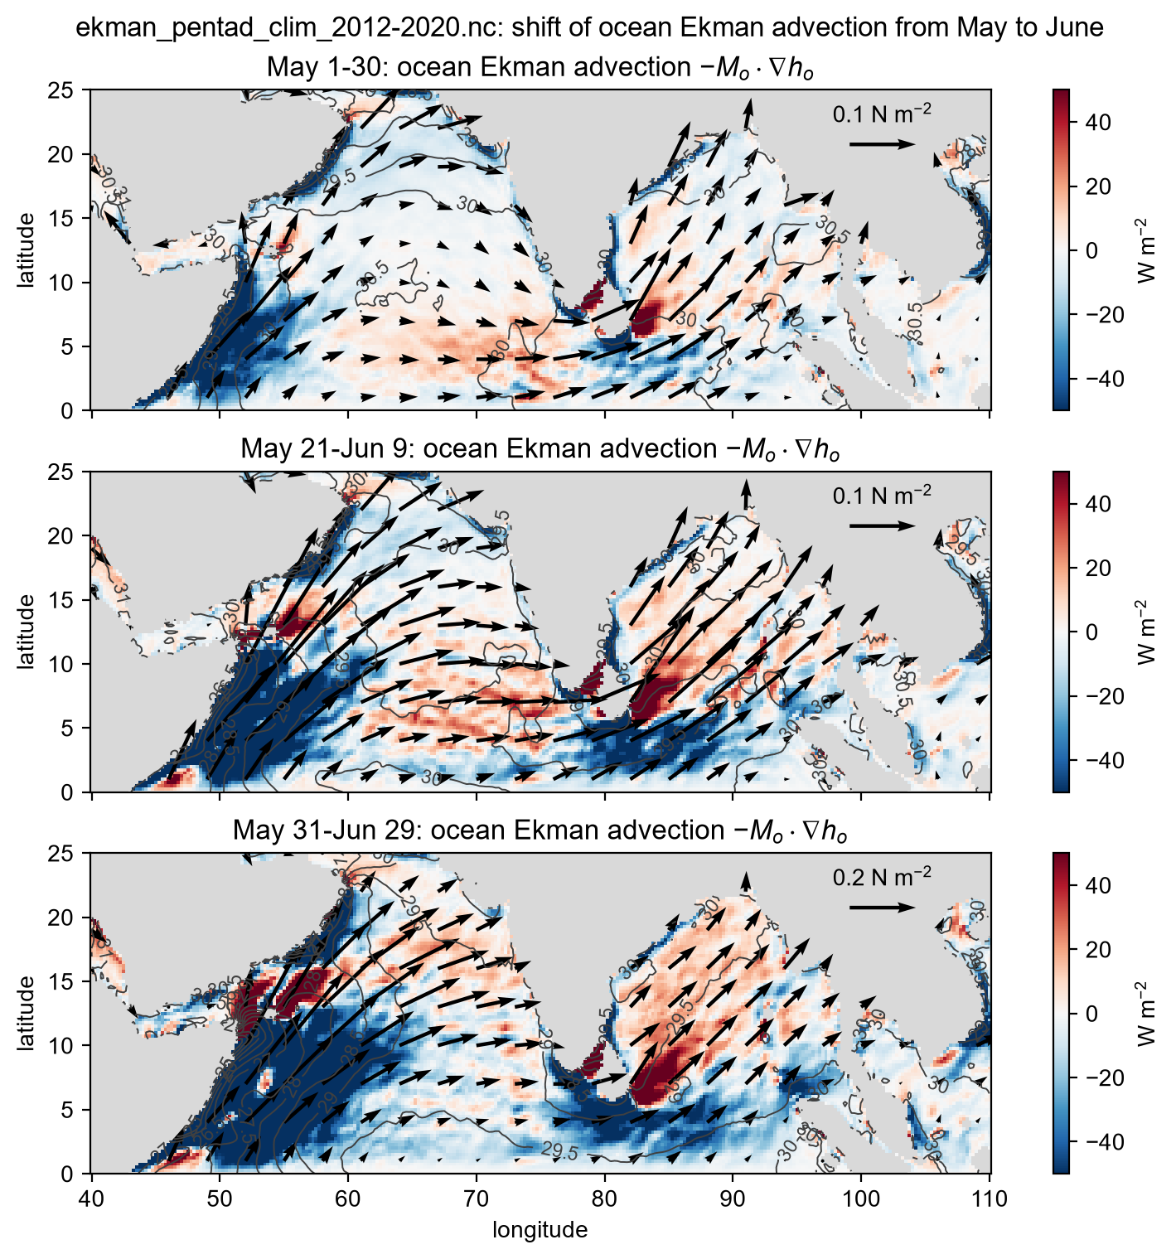
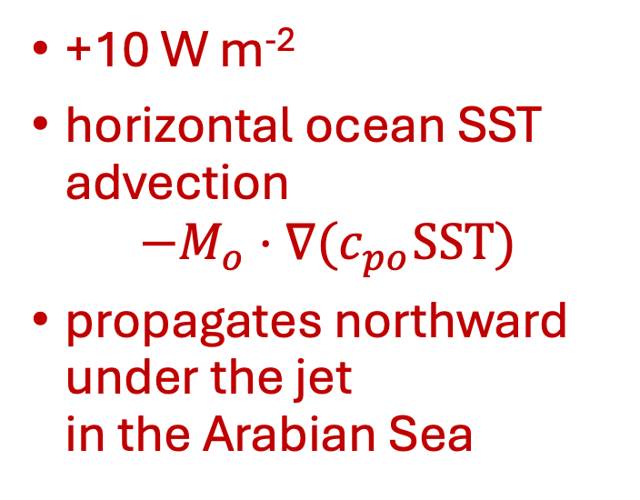
SST warming by monsoon
Ekman transport
wind stress
arrows
SST contours
time
+10 W m⁻²
horizontal ocean SST advection
$$−M_{o}⋅∇(c_{po}SST)$$
propagates northward
under the jet
in the Arabian Sea
Notes:
Advection of SST by Ekman transport in climatological averages from May-June. There's warm ocean advection under the monsoon wind stress, increasing in the BoB, and propagating under the Findlater jet in the Arabian Sea.
Atmospheric Ekman transport is equal and opposite that in the ocean, but atmospheric MSE advection does not have this pattern. Rather, it is uniformly negative (cooling+drying) everywhere, reflecting frictional flow down the pressure gradient toward warmer T and moister q.
I would be interested in knowing how this compares with other terms in the ASTZ heat budget. I'm in process of compositing surface fluxes from OAFlux and CERES.
Related, Napitu et al. (2026) find the Ekman convergence responsible for the deepening of the thermocline during the summer.
Napitu, A. M., Gordon, A. L., Pujiana, K., & Bohman, S. M. (2026). Evolution of the central Arabian Sea summer mixed layer. Journal of Geophysical Research: Oceans, 131, e2026JC024291. https://doi.org/10.1029/2026JC024291

Slide 6
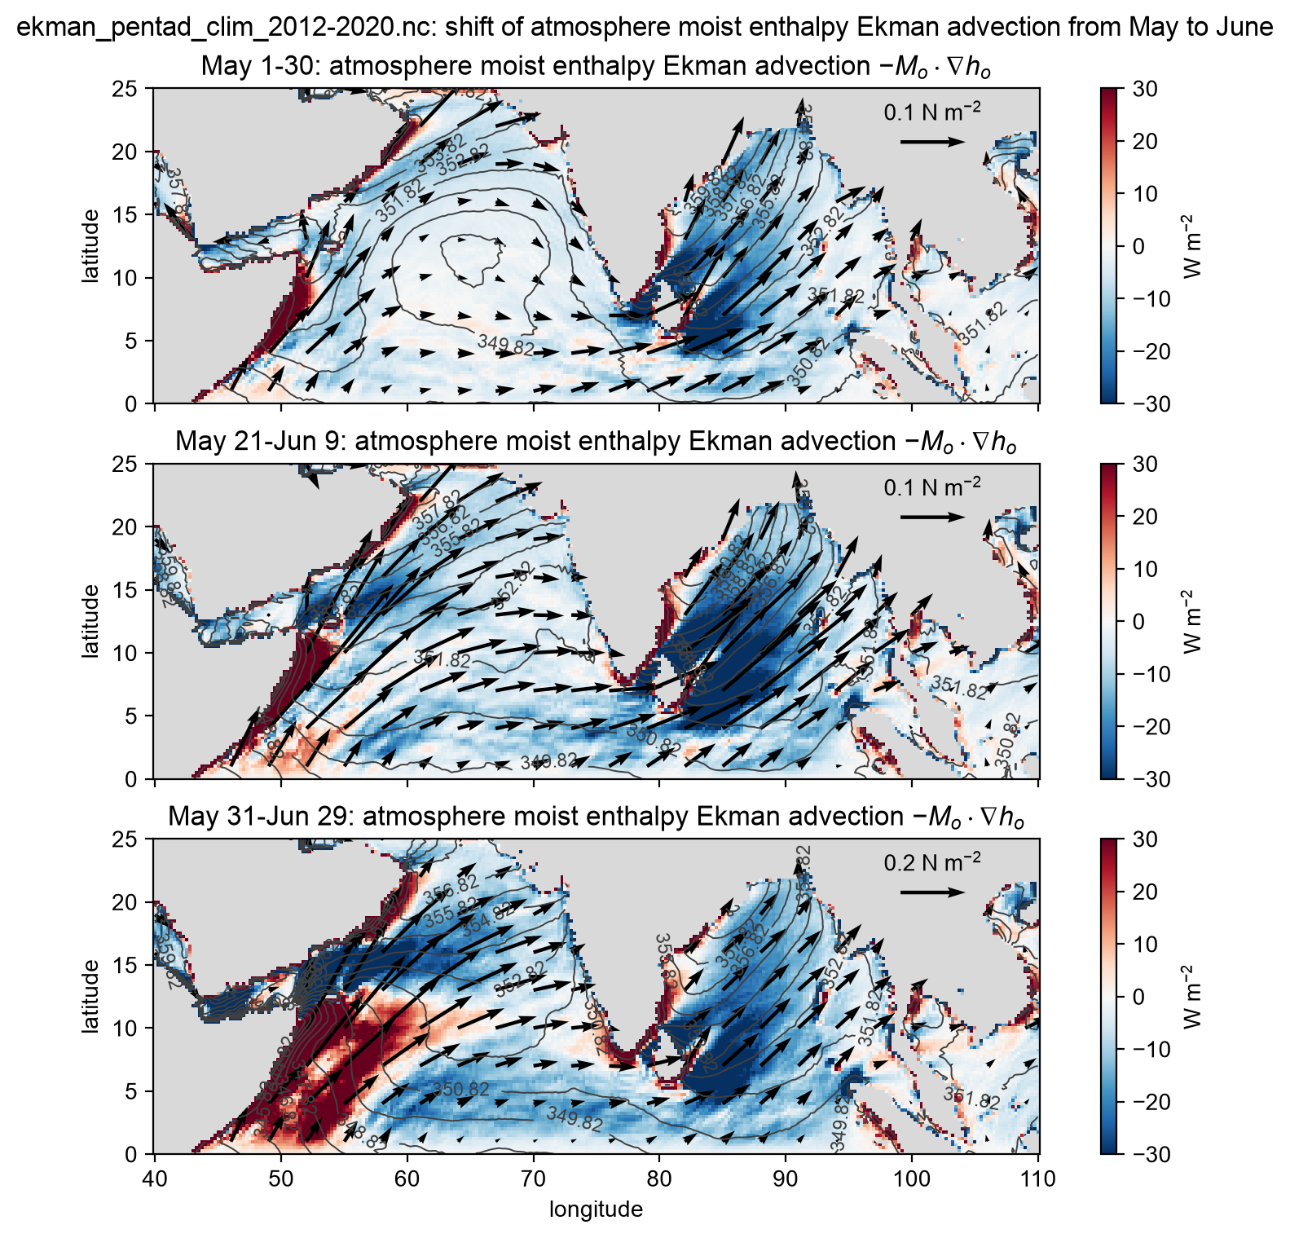
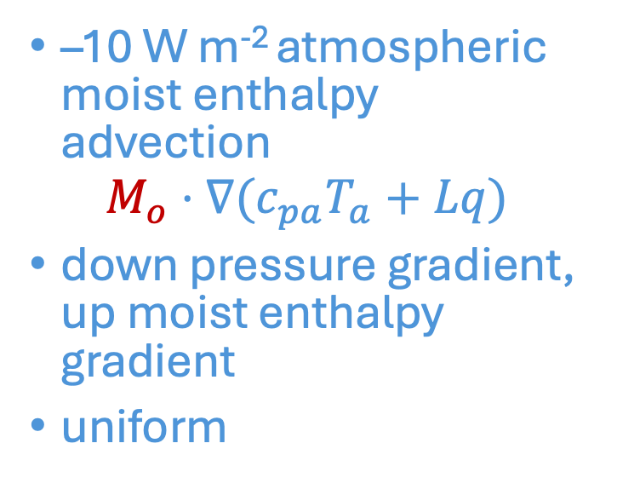
atmospheric cooling by
Ekman transport
wind stress
arrows
moist
enthalpy
contours
time
–10 W m⁻² atmospheric moist enthalpy advection
$$M_{o}⋅∇(c_{pa}T_{a}+Lq)$$
down pressure gradient, up moist enthalpy gradient
uniform
Notes:
Advection of SST by Ekman transport in climatological averages from May-June. There's warm ocean advection under the monsoon wind stress, increasing in the BoB, and propagating under the Findlater jet in the Arabian Sea.
Atmospheric Ekman transport is equal and opposite that in the ocean, but atmospheric MSE advection does not have this pattern. Rather, it is uniformly negative (cooling+drying) everywhere, reflecting frictional flow down the pressure gradient toward warmer T and moister q.
I would be interested in knowing how this compares with other terms in the ASTZ heat budget. I'm in process of compositing surface fluxes from OAFlux and CERES.
Related, Napitu et al. (2026) find the Ekman convergence responsible for the deepening of the thermocline during the summer.
Napitu, A. M., Gordon, A. L., Pujiana, K., & Bohman, S. M. (2026). Evolution of the central Arabian Sea summer mixed layer. Journal of Geophysical Research: Oceans, 131, e2026JC024291. https://doi.org/10.1029/2026JC024291

