Slide 1
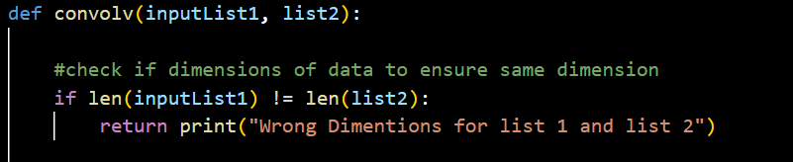
Define the function and a simple check
List 1 or inputList1 is the theory data
List2 is the step changing gaussian
2 | 3 | 4 | 5 | 2 | 4 | 2 | 3
0 | 0 | 2 | 4 | 4 | 2 | 0 | 0

Slide 2
This function pads the ends to assist with ease of indexing and calculating the product sum for energy levels.
0 | 0 | 0 | 0 | 0 | 0 | 0 | 0 | 2 | 3 | 4 | 5 | 2 | 4 | 2 | 3 | 0 | 0 | 0 | 0 | 0 | 0 | 0
Theory list
2 | 3 | 4 | 5 | 2 | 4 | 2 | 3
Gaussian at a single index

Slide 3
Now setting up the for loop to perform the convolution
This is the most confusing part of the function. This is the indexing to select a same convolution, however, simply changing our index to the length of our theory values will result in a “full” convolution. That is a problem as due to the dimensions of a full convolution includes new values and increasing the length of the array outside our energy levels.
However, the values from the “same” convolution are still within the “full” convolution. This indexing is an attempt to provide a general solution to the issue.
0 | 0 | 0 | 0 | 0 | 0 | 0 | 0 | 2 | 3 | 4 | 5 | 2 | 4 | 2 | 3 | 0 | 0 | 0 | 0 | 0 | 0 | 0
Full convolution, improper array length afterwords.
0 | 0 | 2 | 4 | 4 | 2 | 0 | 0
0 | 0 | 0 | 0 | 0 | 0 | 0 | 0 | 2 | 3 | 4 | 5 | 2 | 4 | 2 | 3 | 0 | 0 | 0 | 0 | 0 | 0 | 0
Same convolution, ideally proper array length but is troublesome.
0 | 0 | 2 | 4 | 4 | 2 | 0 | 0

Slide 4
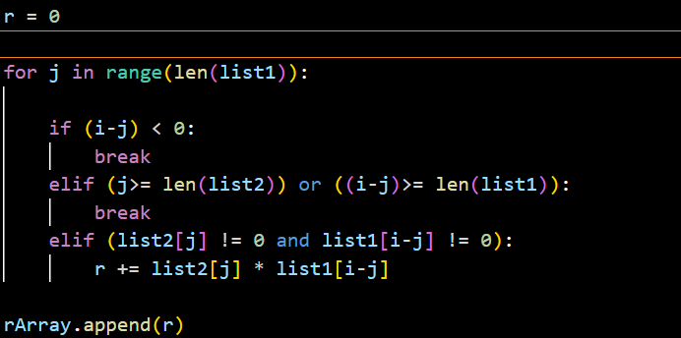
This is where we see the F(t)*G(u-t) with a summation of the products
For the first if statement, it attempts to prevent the code from using negative indexes as it would derive incorrect values due to wrapping.
Both if statements are an attempt to optimize the code and don’t play a roll in the convolution.
Final if statement to find the product of the of the values. Oddly enough the theory data starts from its last value and progress back through the index, ie -1,-2,-3.

Slide 5
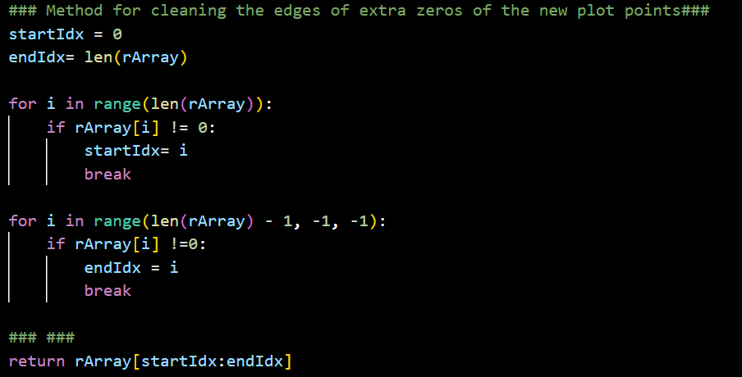
This part of the function is simply to clean the edges of the padded array that will result in zero values on the edges. Which if any values that zero at the end values can be ignored due to multiplication in the previous slide.
0 | 0 | 0 | 0 | 0 | 0 | 0 | 0 | 2 | 3 | 4 | 5 | 2 | 4 | 2 | 3 | 0 | 0 | 0 | 0 | 0 | 0 | 0
2 | 3 | 4 | 5 | 2 | 4 | 2 | 3
This is what the process above is visually

