Slide 1
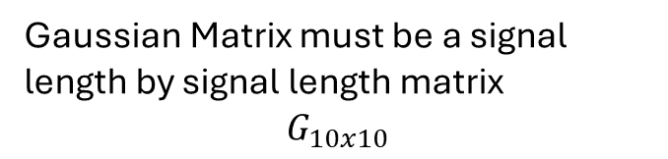
The energy is the x-axis, and must be a uniform change in energy due to potential “stalling” of the convolution where the gaussians no longer step across the signal array
1 | 2 | 3 | 4 | 5 | 6 | 7 | 8 | 9 | 10
Index 0 | 4 | 2 | 0 | 0 | 0 | 0 | 0 | 0 | 0 | 0
Index 1 | 4 | 4 | 2 | 0 | 0 | 0 | 0 | 0 | 0 | 0
Index 2 | 2 | 4 | 4 | 2 | 0 | 0 | 0 | 0 | 0 | 0
Index 3 | 0 | 2 | 4 | 4 | 2 | 0 | 0 | 0 | 0 | 0
Index 4 | 0 | 0 | 2 | 4 | 5 | 4 | 2 | 0 | 0 | 0
Index 5 | 0 | 0 | 0 | 1 | 2 | 4 | 5 | 4 | 2 | 0
Index 6 | 0 | 0 | 0 | 0 | 1 | 2 | 4 | 5 | 4 | 2
Index 7 | 0 | 0 | 0 | 0 | 1 | 1 | 2 | 4 | 5 | 2
Index 8 | 0 | 0 | 0 | 0 | 0 | 1 | 2 | 3 | 4 | 5
Index 9 | 0 | 0 | 0 | 0 | 0 | 0 | 1 | 2 | 3 | 4
This is the 2D Gaussian Matrix with each index being an individual gaussian curve
The input signal array
2 | 6 | 2 | 1 | 1 | 5 | 5 | 2 | 4 | 2
Gaussian Matrix must be a signal length by signal length matrix
$$G_{10x10}$$

Slide 2
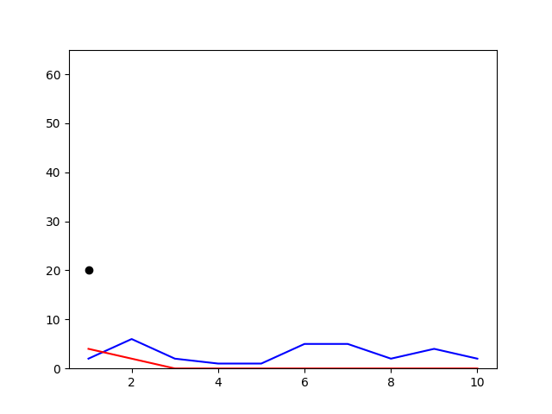
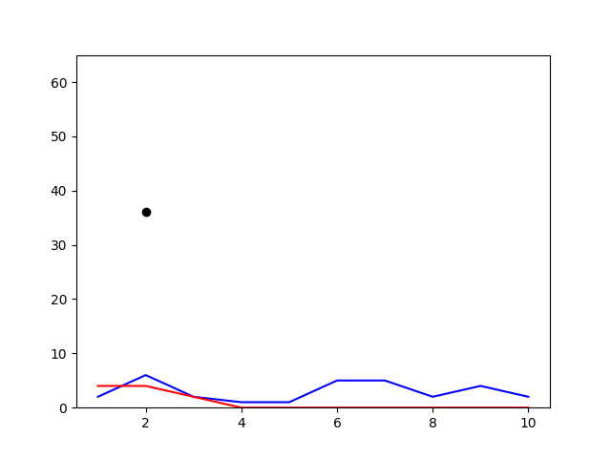
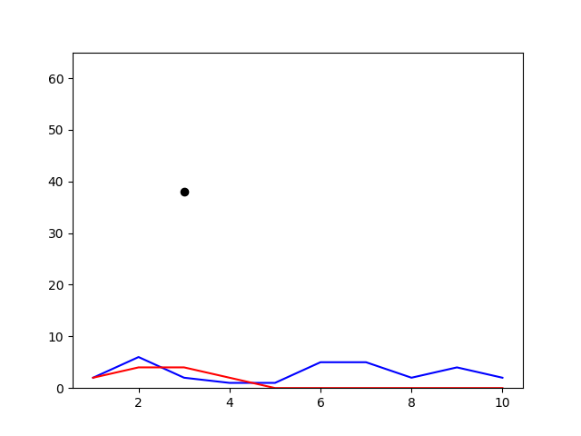
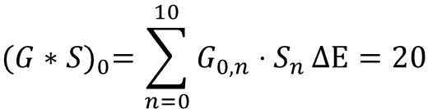
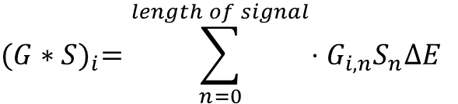

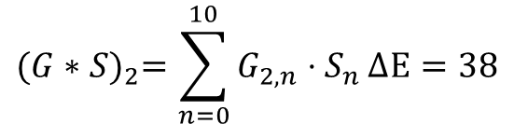

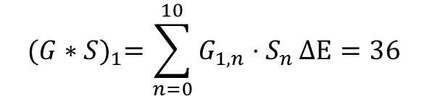

General formula in the code where G is the Gaussian matrix at index n with the dot product of the signal. The stepping that comes with the gaussian is already performed when making the gaussian matrix.
Index 0 | 4 | 2 | 0 | 0 | 0 | 0 | 0 | 0 | 0 | 0
Index 1 | 4 | 4 | 2 | 0 | 0 | 0 | 0 | 0 | 0 | 0
Index 2 | 2 | 4 | 4 | 2 | 0 | 0 | 0 | 0 | 0 | 0
Index 3 | 0 | 2 | 4 | 4 | 2 | 0 | 0 | 0 | 0 | 0
Index 4 | 0 | 0 | 2 | 4 | 5 | 4 | 2 | 0 | 0 | 0
Index 5 | 0 | 0 | 0 | 1 | 2 | 4 | 5 | 4 | 2 | 0
Index 6 | 0 | 0 | 0 | 0 | 1 | 2 | 4 | 5 | 4 | 2
Index 7 | 0 | 0 | 0 | 0 | 1 | 1 | 2 | 4 | 5 | 2
Index 8 | 0 | 0 | 0 | 0 | 0 | 1 | 2 | 3 | 4 | 5
Index 9 | 0 | 0 | 0 | 0 | 0 | 0 | 1 | 2 | 3 | 4
Each Gaussian is normalized, and the dot product is scaled by the energy step, which is used to create the gaussian matrix. The result from the dot product is the new value at the same index of the signal and gaussian.
$${(G∗S)}_{0}=\sum_{n=0}^{10}{G_{0,n}⋅S_{n}}∆E=20$$
4 | 2 | 0 | 0 | 0 | 0 | 0 | 0 | 0 | 0
2 | 6 | 2 | 1 | 1 | 5 | 5 | 2 | 4 | 2
$${(G∗S)}_{i}=\sum_{n=0}^{length of signal}{⋅G_{i,n}S_{n}∆E}$$
$${(G∗S)}_{1}=\sum_{n=0}^{10}{G_{1,n}⋅S_{n}}∆E=36$$
4 | 4 | 2 | 0 | 0 | 0 | 0 | 0 | 0 | 0
2 | 6 | 2 | 1 | 1 | 5 | 5 | 2 | 4 | 2
$${(G∗S)}_{2}=\sum_{n=0}^{10}{G_{2,n}⋅S_{n}}∆E=38$$
2 | 4 | 4 | 2 | 0 | 0 | 0 | 0 | 0 | 0
2 | 6 | 2 | 1 | 1 | 5 | 5 | 2 | 4 | 2
$${\left(G∗S\right) }_{0}$$
$${\left(G∗S\right) }_{1}$$
$${\left(G∗S\right) }_{2}$$

Slide 3
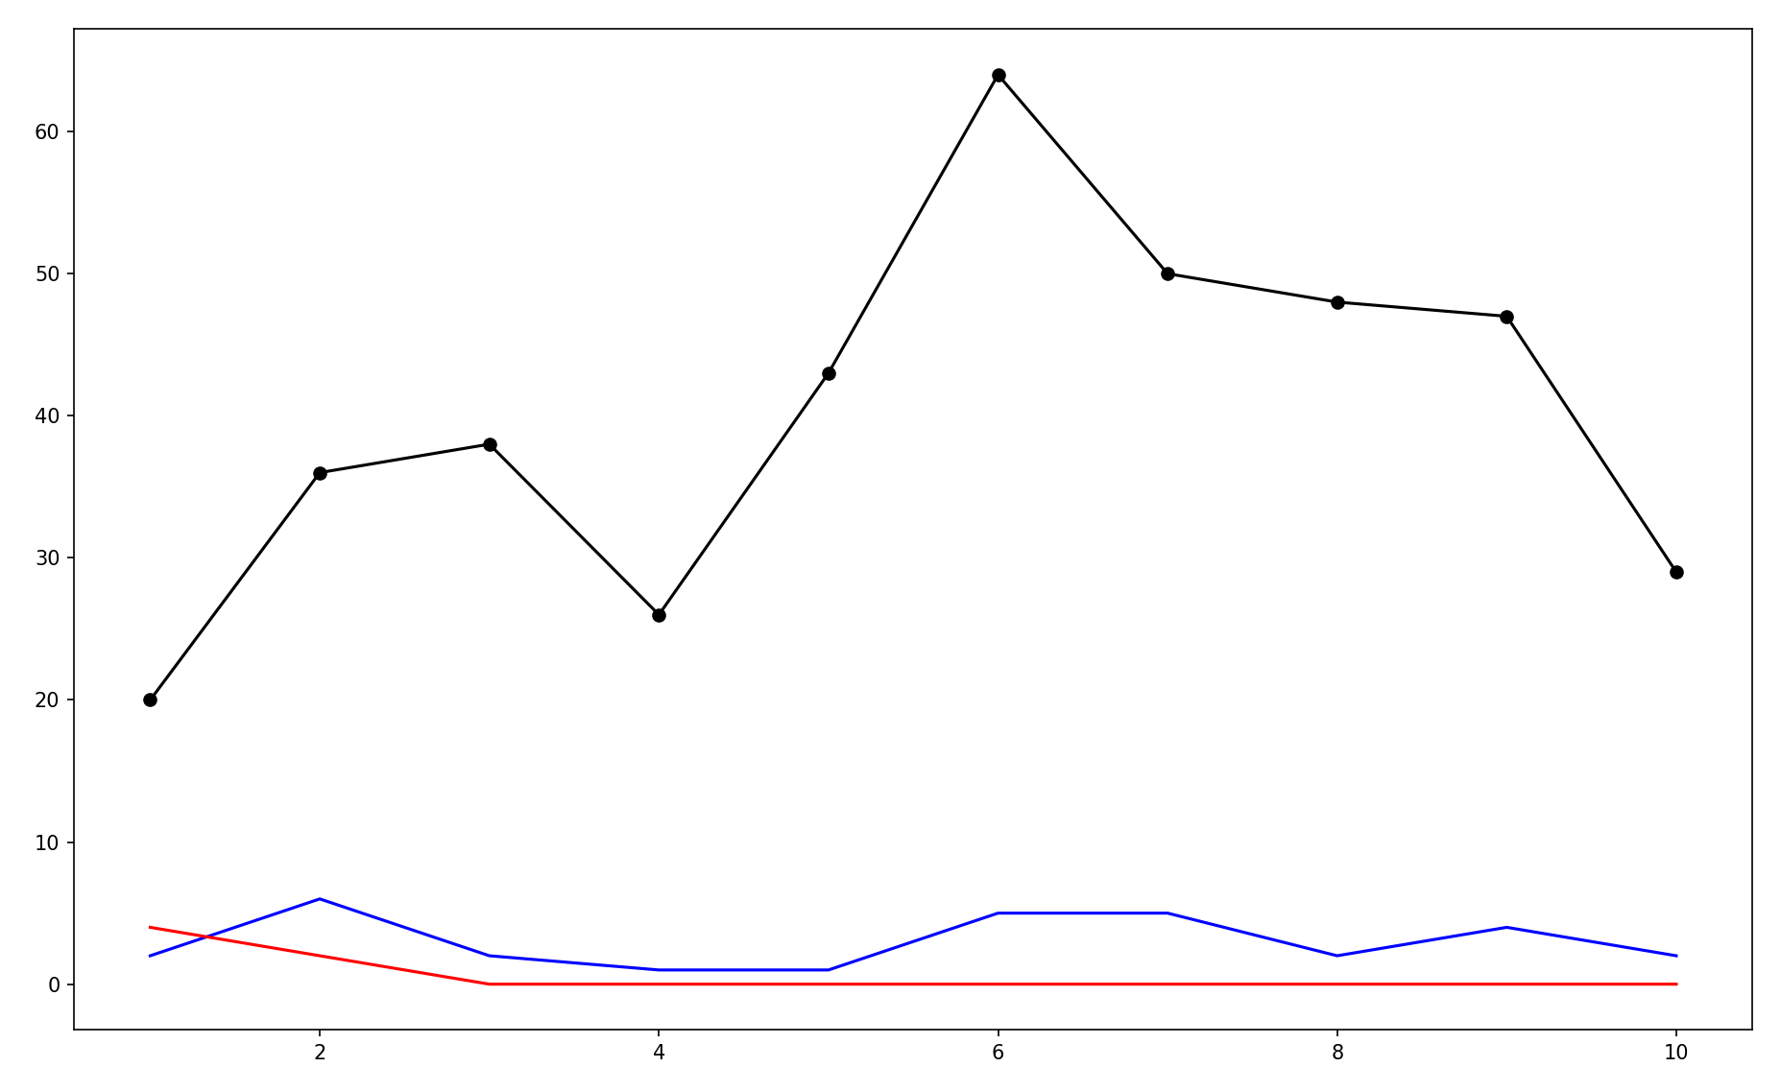



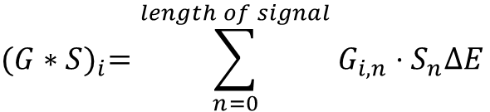










$${(G∗S)}_{i}=\sum_{n=0}^{length of signal}{G_{i,n}⋅S_{n}∆E}$$
Each point of the black plot is that of an induvial sum of the function above.
$${(G∗S)}_{0}$$
$${(G∗S)}_{0}$$
$${(G∗S)}_{1}$$
$${(G∗S)}_{2}$$
$${(G∗S)}_{3}$$
$$G_{9,n}$$
$$G_{4,n}$$
$$G_{5,n}$$
$$G_{6,n}$$
$$G_{7,n}$$
$$G_{8,n}$$
$${(G∗S)}_{0}$$
$${(G∗S)}_{0}$$
$${(G∗S)}_{0}$$
$${(G∗S)}_{0}$$
$${(G∗S)}_{0}$$

Slide 4

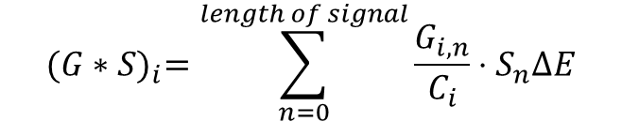
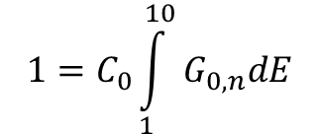
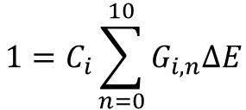


Gaussians need to be normalized. Where C is the normalization scaler
$$1=C_{0}\int_{1}^{10}{G_{0,n}dE}$$
$$G_{2,0}$$
$$\frac{1}{G_{0,n}⋅∆E}=C$$
$$ΔE$$
However, the data is discrete thus needs a discrete solution
$$1=C_{i}\sum_{n=0}^{10}{G_{i,n}ΔE}$$
Thus, the final solution for finding the points for the energy dependent convolution is
$${(G∗S)}_{i}=\sum_{n=0}^{length of signal}{\frac{G_{i,n}}{C_{i}}⋅S_{n}∆E}$$
Keep in mind, that while C is calculated from the same gaussian, it’s a scaler value for each gaussian in the gaussian matrix

Slide 5
This is a typical convolution, where the “kernal”, moves across the the “signal” and takes the dot product of each array. Resulting in a new point for the output array
0 | 0 | 2 | 4 | 5 | 4 | 2 | 0 | 0 | 0
2 | 6 | 2 | 1 | 1 | 5 | 5 | 2 | 4 | 2
0 | 0 | 2 | 4 | 5 | 4 | 2 | 0 | 0 | 0
2 | 6 | 2 | 1 | 1 | 5 | 5 | 2 | 4 | 2
0 | 0 | 2 | 4 | 5 | 4 | 2 | 0 | 0 | 0
2 | 6 | 2 | 1 | 1 | 5 | 5 | 2 | 4 | 2
0 | 0 | 2 | 4 | 5 | 4 | 2 | 0 | 0 | 0
2 | 6 | 2 | 1 | 1 | 5 | 5 | 2 | 4 | 2
0 | 0 | 2 | 4 | 5 | 4 | 2 | 0 | 0 | 0
2 | 6 | 2 | 1 | 1 | 5 | 5 | 2 | 4 | 2
Continues across
0 | 0 | 2 | 4 | 5 | 4 | 2 | 0 | 0 | 0
2 | 6 | 2 | 1 | 1 | 5 | 5 | 2 | 4 | 2

Slide 6

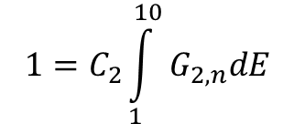
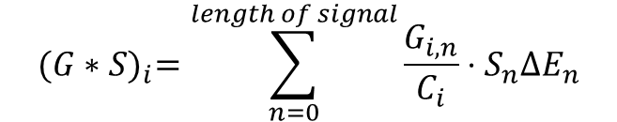
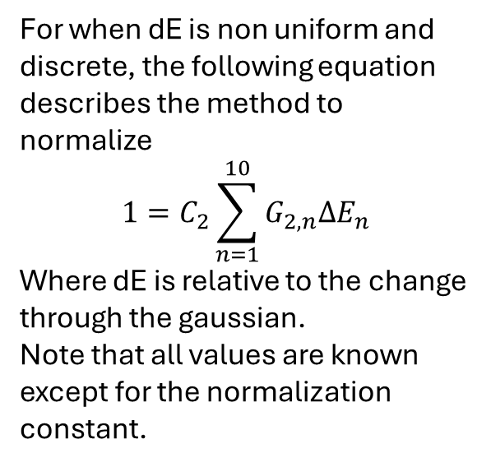

Gaussians need to be normalized. Where C is the normalization scaler
$$1=C_{2}\int_{1}^{10}{G_{2,n}dE}$$
$$G_{2,0}$$
However, this is for a continuous gaussian thus needs to be discrete.
$$ΔE_{1}$$
For when dE is non uniform and discrete, the following equation describes the method to normalize
$$1=C_{2}\sum_{n=1}^{10}{G_{2,n}∆E_{n}}$$
Where dE is relative to the change through the gaussian.
Note that all values are known except for the normalization constant.
OUTDATED SLIDE
Convolutions require a uniform axis and dE must be uniform
$${(G∗S)}_{i}=\sum_{n=0}^{length of signal}{\frac{G_{i,n}}{C_{i}}⋅S_{n}∆E_{n}}$$

