Slide 1

Because teachers know what teachers need

Slide 2

The Problem
STAT

Slide 3
Our findings
Word of mouth

Slide 4
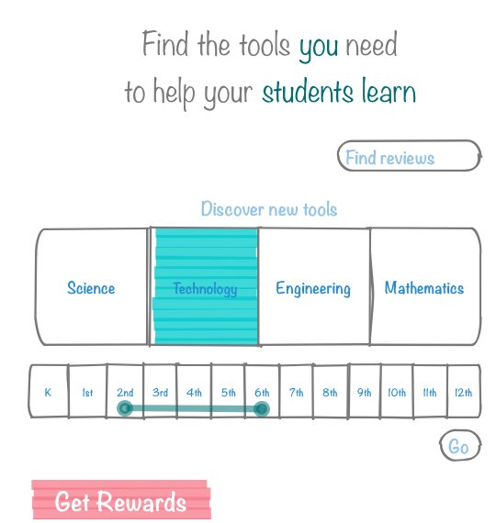
Learn more about a specific product
Find tools that fit your needs
Get incentives for being an active user

Slide 5
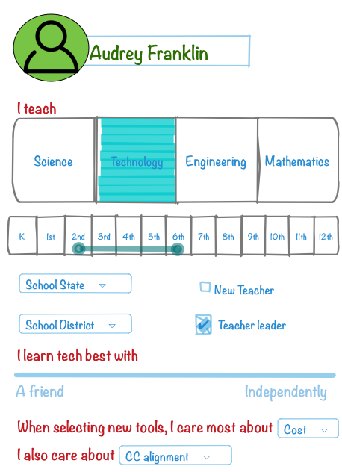
Creating an experience
Clean design
Intuitive interactions
Own the teacher experience
Build in capacity

Slide 6




Competitors

Slide 7

Invite all NYC Teachers
3 Tiers
of
Memberships
The First Year
STEM
Rewards Program

Slide 8








Way To Market
Add one more city and one more program.
Create a new Pro Membership which will allow teachers to sell online educational lessons.
Year 4
Future Plans
Year 2
Year 5
Year 3
Google Adwords
100,000 USERS In The First 5 Years
Guest Posts

Slide 9


Revenue Plans
FREEMIUM
STANDARD
PRO
$ 0
$ 1.99
$ 9.99
Per Month
Per Month
Per Month
Teachers can peruse the site in search for an online educational program that meets their needs by being able to easily find the highest rated programs.
Teachers create a username and password and the experience becomes more customizable and newer programs are always recommended.
Teachers are mandated to make at least 2 ratings and reviews a month, but this will offset the cost of standard membership so this essentially is FREE!
“Word of Mouth” emails are sent monthly with the best programs and how they are being used.
All of the same features of Standard, but videos are included showing teachers easily implement these programs in the classroom. Great for demo lessons!

Slide 10
Customers reaction & feedback to MVP

