Slide 1
A Computational Cognitive Model of Human Memory
PARTHAPRATIM CHATTERJEE
210705

Slide 2
INTRODUCTION
There are different theories as to how information is stored in the human brain
Unlike computers which store pixel by pixel information the human vision system extracts features and stores them in the human brain
The human eye captures details in 576 megapixels so its impossible that pixel by pixel information is stored in the brain
For the purpose of this the multi store model of human memory consisting of a sensory register, short term store and long term store is simulated

Slide 3
INFORMATION DECAY
In the project I try to simulate the realistic information decay which happens in human memory
If a memory trace has a strength < 0.5 its raw data gets modified to simulate decay
The first part involves selecting a list of random indexes from the feature matrix
The second part involves assigning random values between 0 and 1 to these random selected indexes in the feature matrix
Thus the more the decay wrt time as well as rate the effective encoded feature matrix in the memory resembles lesser of the original memory

Slide 4
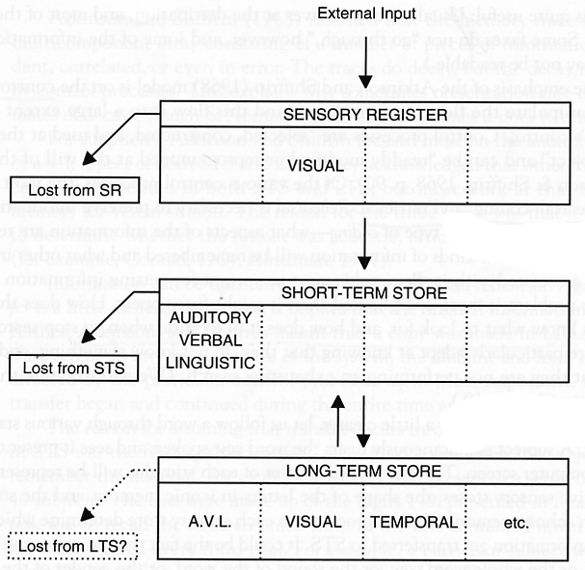
MULTI STORE MEMORY MODEL
Sensory register processes the incoming features from the human sensory system. Implemented as a FIFO register with a maximum size of 100.
Decay is not simulated in sensory register since information continuously flows in and out of it within a small duration.
Information unit organized into 3 parts:- raw data, information type and attention
Information type can be visual, olfactory, audio etc. For this project visual data is processed
Information units transferred to short term store if attention > 0.5
Source: Slides from Class

Slide 5
SHORT TERM STORE
Short term store simulated as a priority queue
It holds information for several seconds and if the memory is rehearsed enough it transfers it to long term store
The criteria for transferring to long term store as per paper is attention>1 however, I have set a criteria of 0.7 to simulate some memories which don’t require rehearsal to be transferred to long term store
The maximum capacity of the short term store is 7. If a new information unit comes which exceeds its capacity, the memory trace with the weakest strength is removed
Memory decays in the short term store as per the information decay logic

Slide 6
LONG TERM STORE
Long term store is simulated as adjacency lists to simulate that similar memories can have connections between them
Its simulated to store a large amount of memory possibly infinite
The decay parameter of information decay is very less in long term memory since information is not easily forgotten
When a memory is to be recalled, the memory traces in the long term memory are compared with the input feature and transfers it to the short term store based on shortest distance and a threshold. The connecting memories are also transferred to STS based on the strength and threshold

Slide 7
FEATURE EXTRACTION
For Feature extraction from images, the pretrained Resnet-50 model is used
The last fully connected layer is made into identity layer to make the Resnet-50 model act as feature extractor rather than a image classification model
This generates a 2048 feature matrix
Another way is to remove the average pooling layer before the last fully connected layer to capture more information
This generates a feature matrix of size 100352(2048*7*7)

Slide 8
Improvisations That were Tried
The criteria for transferring to long term store as per paper is attention>1 however, I have set a criteria of 0.7 to simulate some memories which don’t require rehearsal to be transferred to long term store
I have tried to simulate with different decay rates in STS and LTS and I found out that on increasing decay rates the similarity decreased between the retrieved encoded features and the original features.
Feature Extraction I have tried using both 2048 and 10032 sizes of tensors. Depending on different sizes of Matrices the algorithm needs to be fine tuned with different thresholds.

Slide 9
RESULTS
For the first experiment the decay rates are set as 0.05 for STS and 0.0005 for LTS
The results are presented for both 100352 feature matrix and 2048 feature matrix

Slide 10
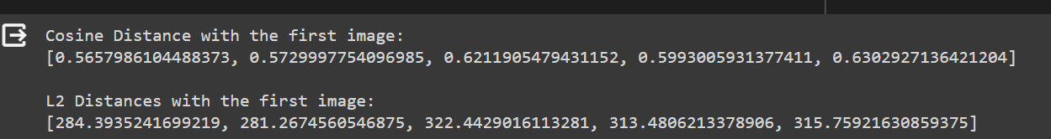
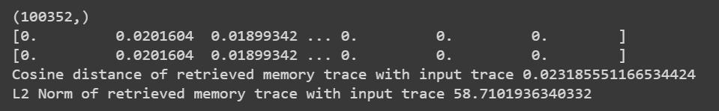
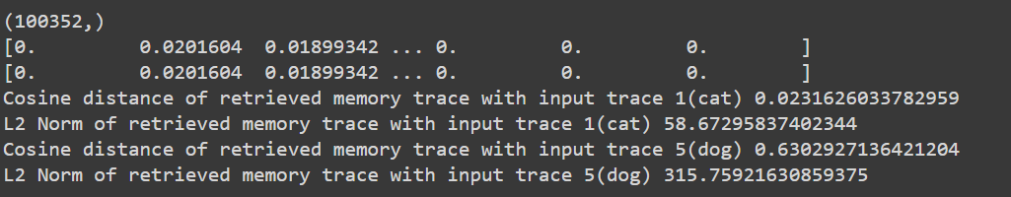
RESULTS:-100352

Slide 11
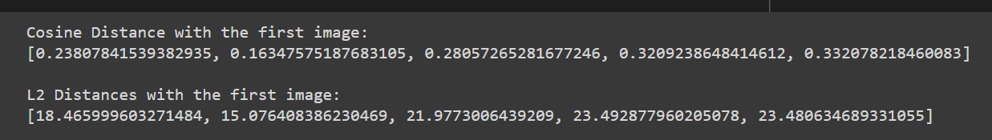
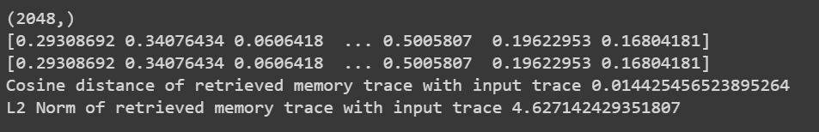
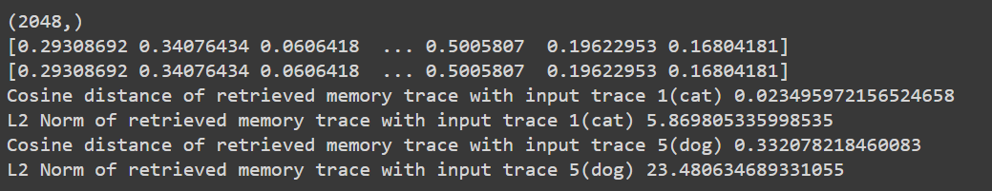
resULTS:- 2048

Slide 12
RESULTS
Next are the results with STS decay as 0.1 and LTS as 0.001

Slide 13
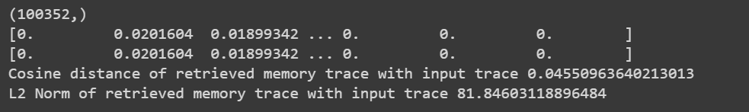
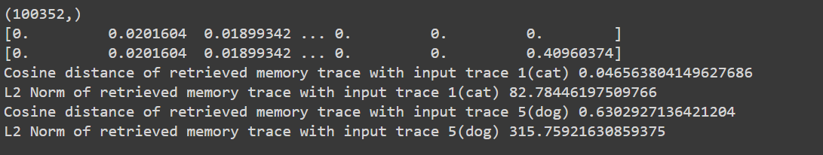
RESULTS:-100352

Slide 14
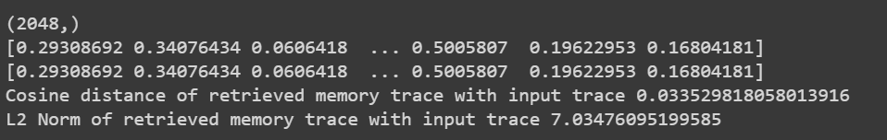
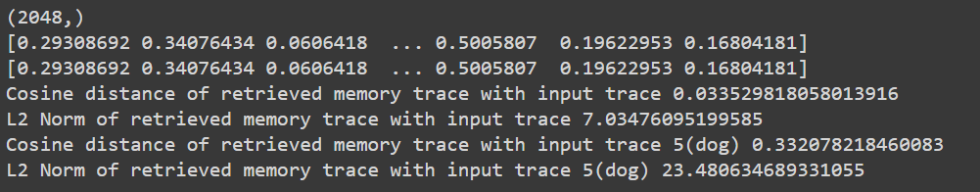
Results:-2048

Slide 15
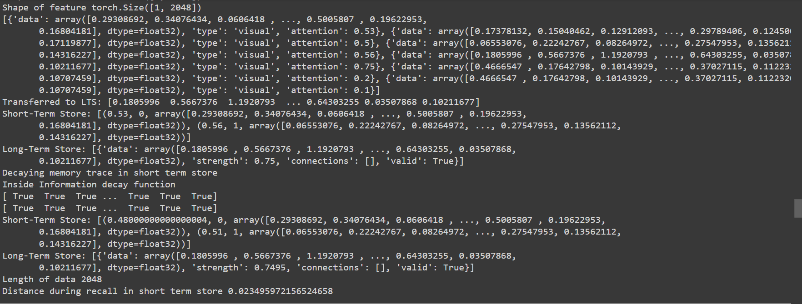
EXAMPLE OF INFORMATION STORED IN MEMORY

Slide 16
CONCLUSION
The project shows the implementation of a human memory model and how it can be simulated for a realistic decay and rehearsal of information in memory
Features are usually stored in human memory as compared to pixel by pixel information unlike computers
Future work involves using different feature extractors, using other decay algorithms and optimized approaches to construct the human memory model

Slide 17
REFERENCES
Zhang, Z. (2022, April 6). A Computational Cognitive Model of Human Memory Based on Invertible Neural Networks. https://doi.org/10.31219/osf.io/58adh
CGS Course slides

