Slide 1
Room Reservation
Ray Jiang
Last revised: January 22, 2022

Slide 2
Backend flowchart
Record management
IT
Login
date_range
data
Room view
Account setting
name
password
Account
permission
check
(Admin)
(User)
Room management
date_range
data
Reservation
Room view

Slide 3
Reservation behavior
Login
Room view
(User)
Only delete own room reservation
Only see period after this week
Allow user to reserve meeting room (from now on)
Room view
Can delete/edit all room reservation
Only see period after this week
Allow admin to reserve meeting room (from now on)
(Admin)

Slide 4
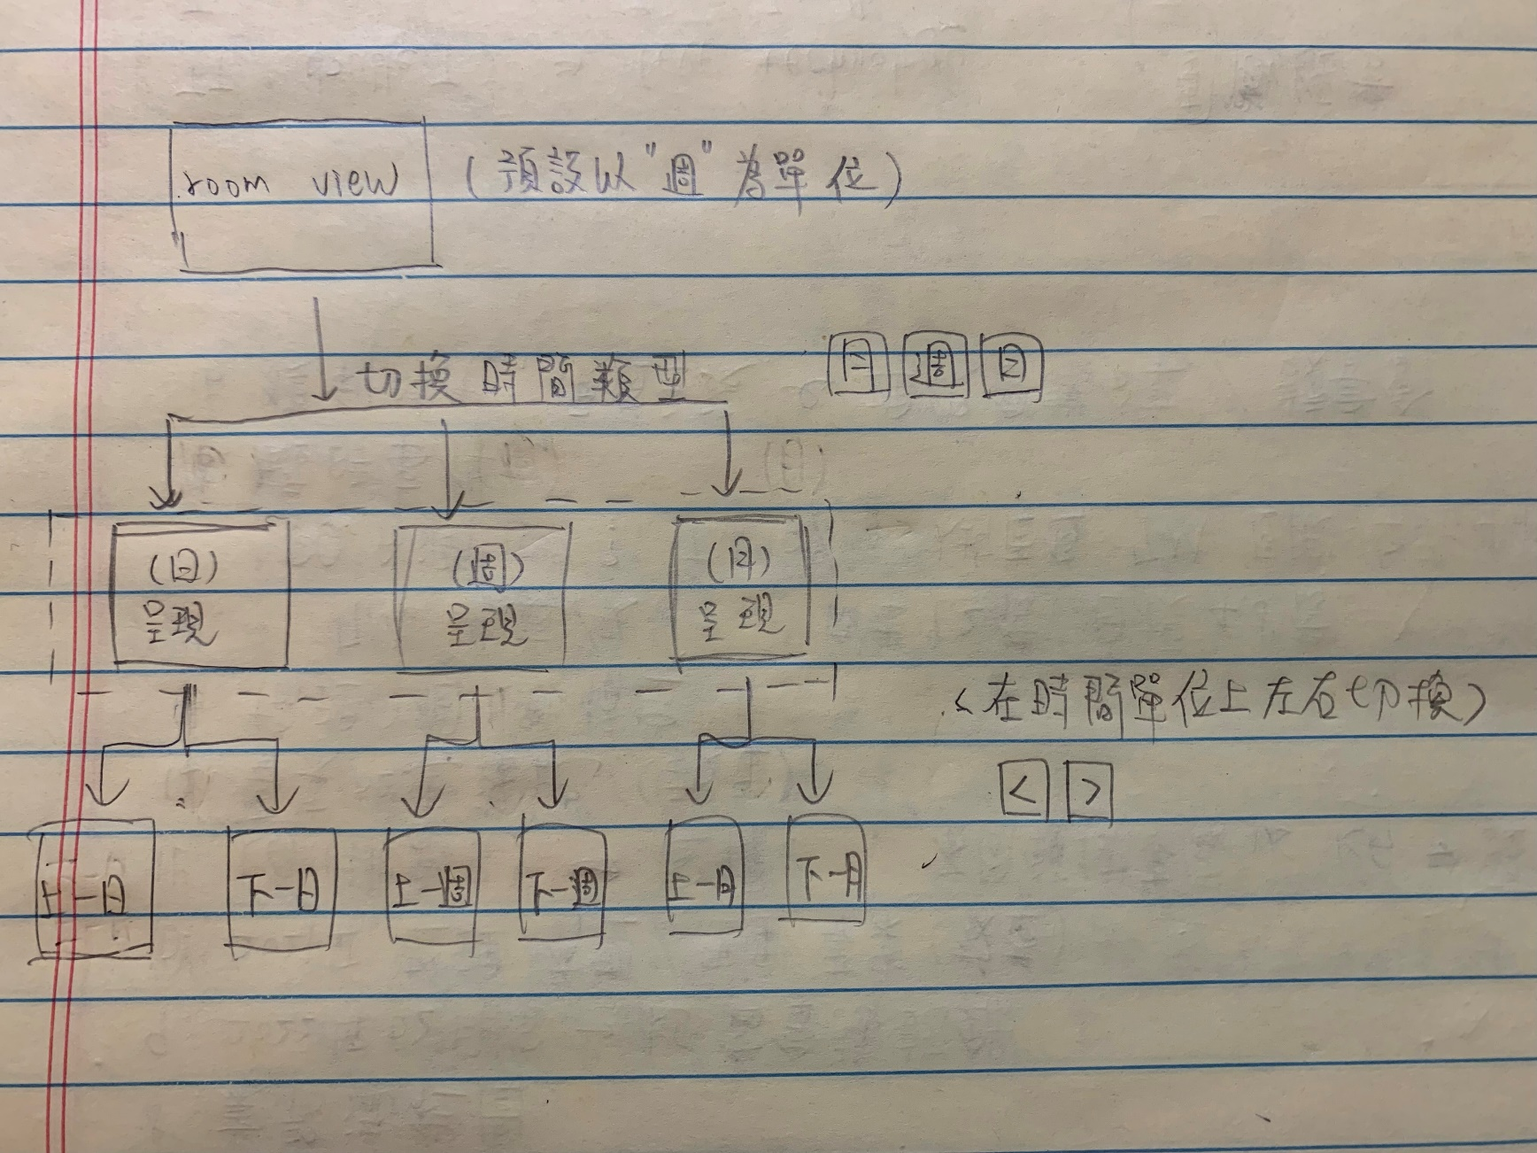
Wireframe – Date switch

Slide 5
DB Relationship
MIS DB
Our DB
User
1 to N
Reservation
1 to 1
Room
Admin

Slide 6
DB Schema – Reservation
Field Name | Type | Attribute | Annotation
id | Int | Primary Key | 1
room_id | Int | Foreign Key | 1
meeting_name | String |  | “idd處週會”
begin_time | DateTime |  | 2022-01-09 02:00
eng_time | DateTime |  | 2022-01-09 03:30
borrower_id | String |  | “21011234”
Borrower | String |  | “王小明”
borrower_department_code | String | Foreign Key | “idd”
create_time | DateTime |  | 2022-01-09 01:00
last_update_time | DateTime |  | 2022-01-09 01:10

Slide 7
DB Schema – Room
Field Name | Type | Attribute | Annotation
id | Int | Primary Key | 1
room_name | String |  | “第四實驗室”
room_department_code | Int |  | IDD
room_department | String |  | “智能推進處”
manager_id | String |  | “21011234”
manager | String |  | “王小明”
create_time | DateTime |  | 2022-01-09 02:00
last_update_time | DateTime |  | 2022-01-09 02:10

Slide 8
DB Schema – QMC (Organization)
Field Name | Type | Attribute | Annotation
department_code | String | Primary Key | IDD
department_name | String |  | “智能推進處”
create_time | DateTime |  | 2022-01-09 02:00
last_update_time | DateTime |  | 2022-01-09 02:10

Slide 9
DB Schema – Admin
Field Name | Type | Attribute | Annotation
id | Int | Primary Key | 1
user_id | Int |  | “21011234”
user_name | String |  | “王小明”
create_time | DateTime |  | 2022-01-09 02:00
last_update_time | DateTime |  | 2022-01-09 02:10

