Slide 1
Job Salary Prediction
By,
Ayush Sengupta
&
Devashish Thakur

Slide 2
Agenda
Data Feature set
Preprocessing
Classification Algorithm
Results of classification algorithm
K –Means clustering algorithm
Cluster analysis

Slide 3
Feature Description
Location
Job Description
Job Title
Job Category
Company Name
Contract Time
Salary

Slide 4


Preprocessing
Word vectors for each features
Count Vectorizer vs Tf-Idf Vectorizer
Tf IDf Vectorizer Formulae used
TF (Total Frequency ) x IDF(Inverse Document Frequency)
Threshold -Full Description – 10,000 , for other features 1000
Training Data Size – 246,380 x 18232
Test Data Size – 48,954 x 18232

Slide 5
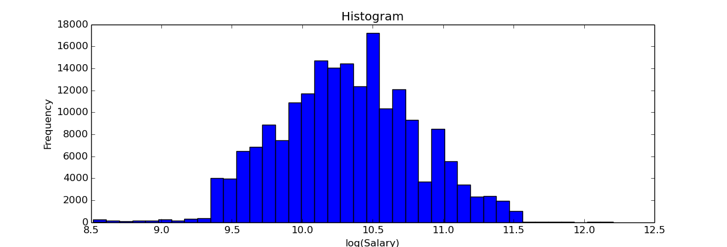
Regression to classification problem
Salary is a continuous input
Divided salary into three buckets
Bucket 1 - mean -1*sd to mean +1*sd , salary < mean - 1*sd , and salary > mean+1*sd
Cross validation Parameter – 5 fold

Slide 6
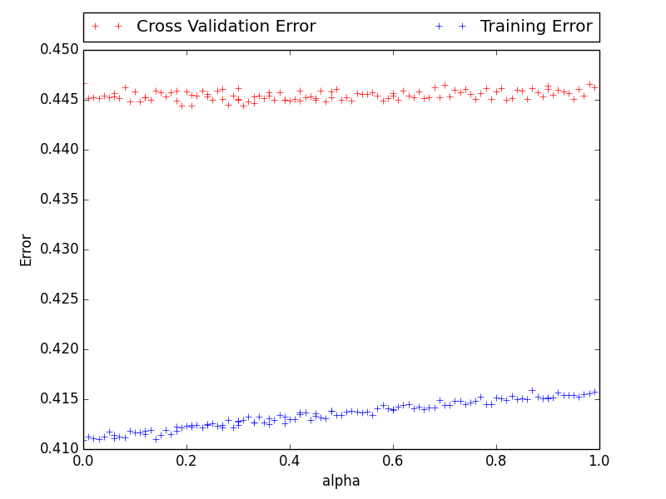
Linear Classifier – 1
Multinomial Naïve Bayes algorithm

Slide 7
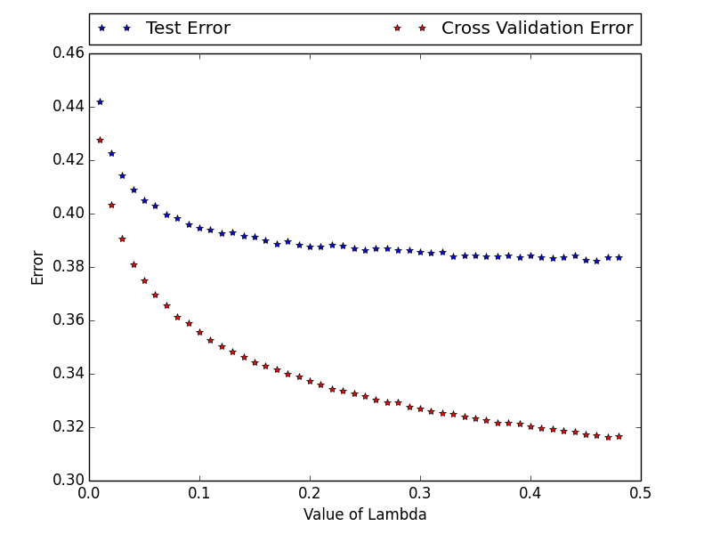
Linear Classifier -2
Logistic Regression

Slide 8
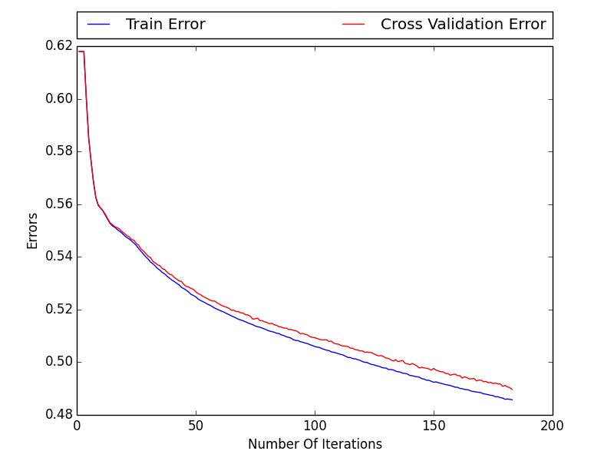
Non-Linear Classifier - 1
Adaboost (Weak Classifier - MNB)

Slide 9
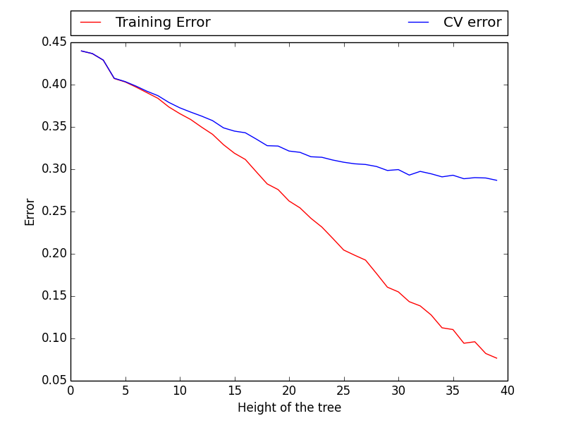
Non-Linear Classifier -2
Decision Tree

Slide 10
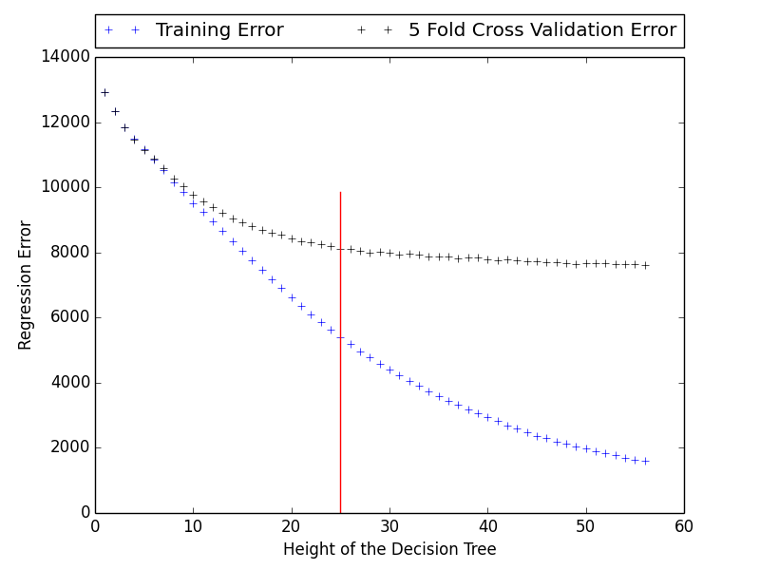
Regressor - 1
Decision Tree Regression

Slide 11
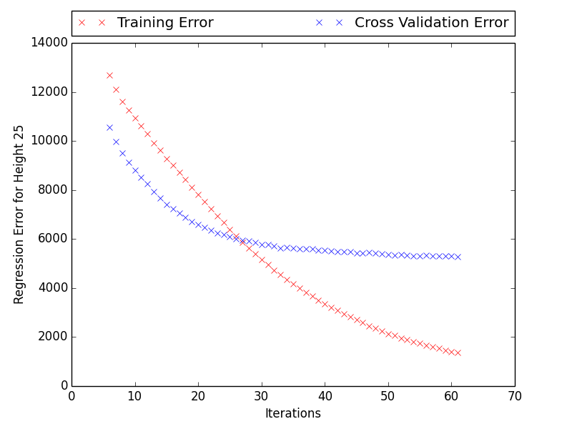
Regressor 2 (Ensemble Method)
Random Forest with Decision Tree of Height 25

Slide 12
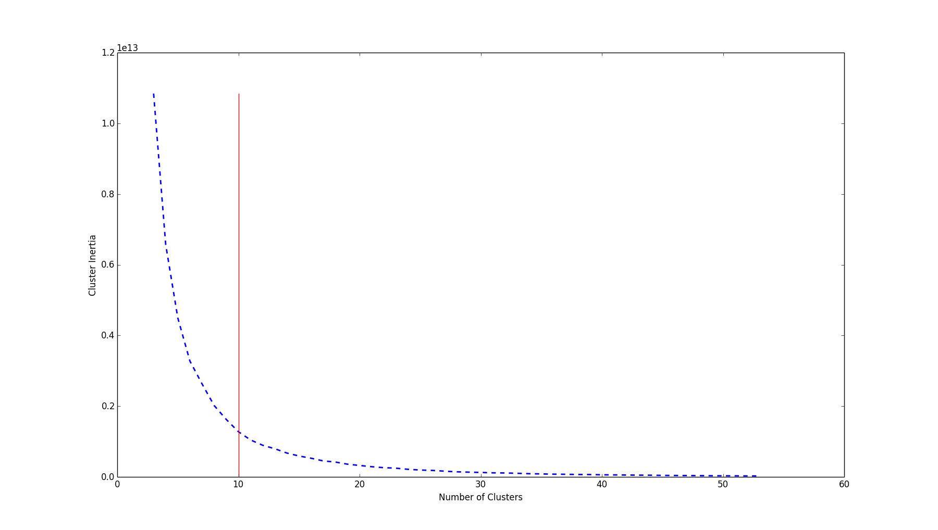
K-Means Classification
K-Means Algorithm. Ideal cluster size - 10
Trained Decision Tree Regressor for each cluster.
Train dataset was sent to the closest cluster and then regressed to get the final value

Slide 13
Test Dataset Results
Algorithm | Test Error (Mean Error)
K-Means + Decision Tree Regression | 1134.33
Random Forest (Height – 25 , Iterations - 40 ) | 1437.47
Decision Tree Regressor (Height 25) | 2949.65
Random Forest (Decision Stump + 50 iterations + Feature size – 100 + Count Vectorizer) | 2363.37
Mean Salary Regressor (34174) | 9349.27
The one marked in red are the baseline for comparison

Slide 14
Unsupervised Learning – Cluster Description
Cluster No. | Salary Range | Job Type | Job Source | Top Titles
0 | 5k – 18k | Permanent – 71% Contract – 28% | 146 Unique - cvjobstore.com | Cleaner, Administrator, Support Worker, Account assistant, Credit Controller, Receptionist, Labourer
1 | 18k – 24k | Permanent - 85% Contract – 15% | 150 Unique - None | Recruitment Controller, Credit controller, Store Manager, Staff Nurse
2 | 24k – 31k | Permanent - 86% Contract – 14% | 155 Unique - jobs.cabincrew.com | Business Development Manager, Account Manager, Sales executive, Recruitment Consultant
3 | 31k – 38k | Permanent - 87% Contract – 13% | 153 Unique - None | Quantity Surveyor, Quality Engineer, Marketing Manager
4 | 38k – 46k | Permanent – 90% Contract – 10% | 151 Unique - None | Project Manager, Business Development Manager, Financial Consultant
5 | 46k – 56k | Permanent - 87% Contract – 13% | 146 Unique - None | Project Manager, Business Development Manager, HR Manager, HR Business Partner
6 | 56k – 68k | Permanent - 82% Contract – 18% | 134 Unique - None | Financial Controller, Business Development Manager, Senior Product Manager
7 | 68k – 82k | Permanent - 74% Contract – 25% | 128 Unique - None | Financial Controller, Business Development Engineer, Finance director, Principal consultant , sales manager
8 | 82k – 115k | Permanent – 59% Contract – 40% | 119 Unique - None | Project Manager, Business Analyst, Finance Director, Financial Advisor
9 | 120k - 200k | Permanent – 33% Contract – 66% | 34 Unique - None | Doctor: GP Locum in ***

Slide 15
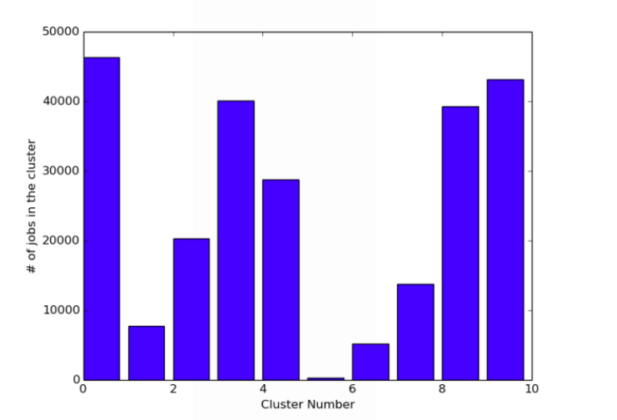
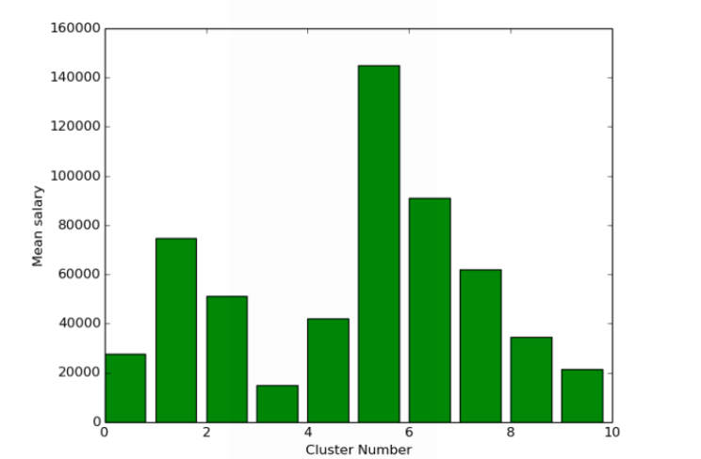
Relation between Job and Salary

Slide 16
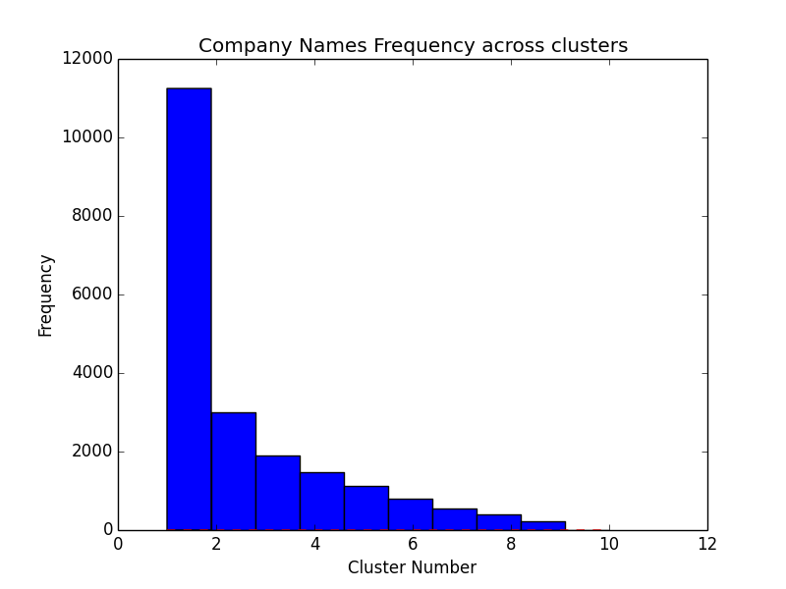
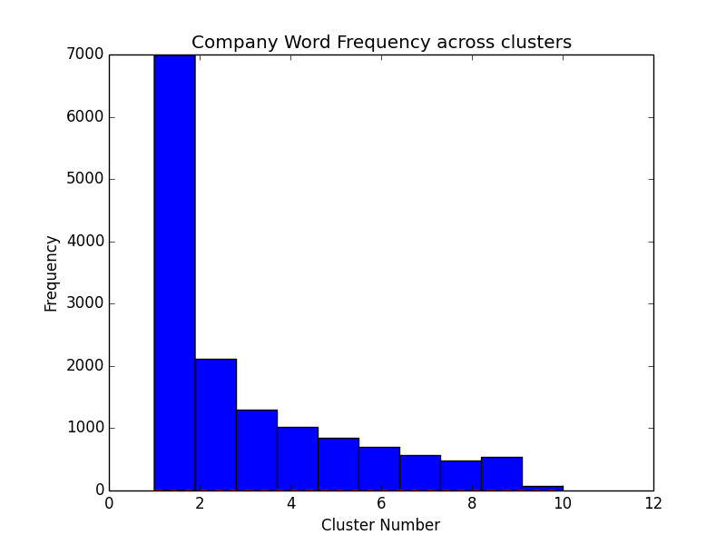
Companies Across Clusters
Jobs/Words that belong to one cluster
Jobs/Words of all salary range
Urban Interior Solutions Ltd - 4
Chameleon Recruitment Ltd - 3
JFL Legal Recruitment -9
Eden Medical Recruitment Ltd - 9
FireEdge -3
Maid2Clean Beds and North Herts Ltd - 0
Daniel Benson Resourcing -2
Peoplesource Consulting -1
Legal - 9
Locum -9
Medical -9
Thetrainline.com -2
Holifax.com -2
Huxley Associates
Haybrook IT Resourcing Ltd
JOBG8
Reed Specialist Recruitment
Candidate Source Ltd
Matchtech Group plc.
Associates
Resourcing
Management
Global
Limited
Candidate
Group
Monarch

Slide 17
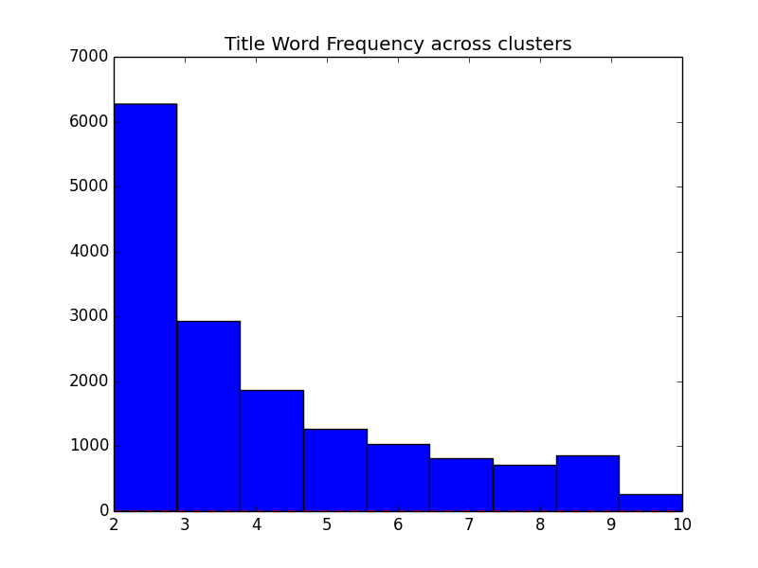
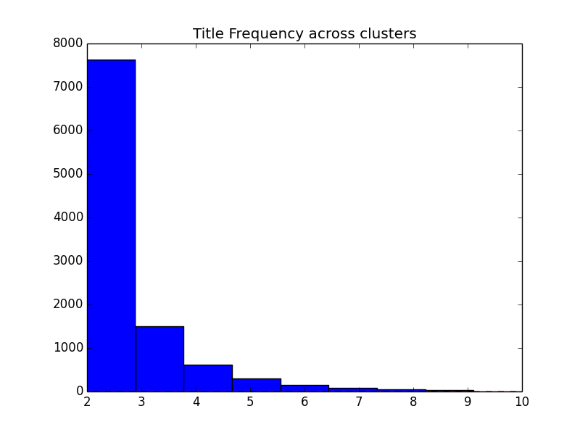
Job Title Across Clusters
Jobs/Words that belong to one cluster
Jobs/Words of all salary range
Learning Disability Support Worker - 3
Resident Dam Engineer French Speaking - 3
Sales Manager Asset -4 Optimisation
Software Design Team Leader - 5
loading shovel driver - 6
Data Insights Manager -8
Software/Firmware - 4
Construction/Consultancy - 3
Broker/Technican - 3
Peaediatrics - 9
Framework/PHP - 3
Ticketer - 4
Geometric - 7
Healthcare/Education - 9
Project Manager
Project Engineer
Example
Richest - Project Manager Private Banking Job London
Poorest - Sterile Project Manager CPGK , Graduate Project Manager, Waking Night Project Manager
Analytics
Application
Test
Director
Leading
Insurance
Safety
Chief
Professional

Slide 18
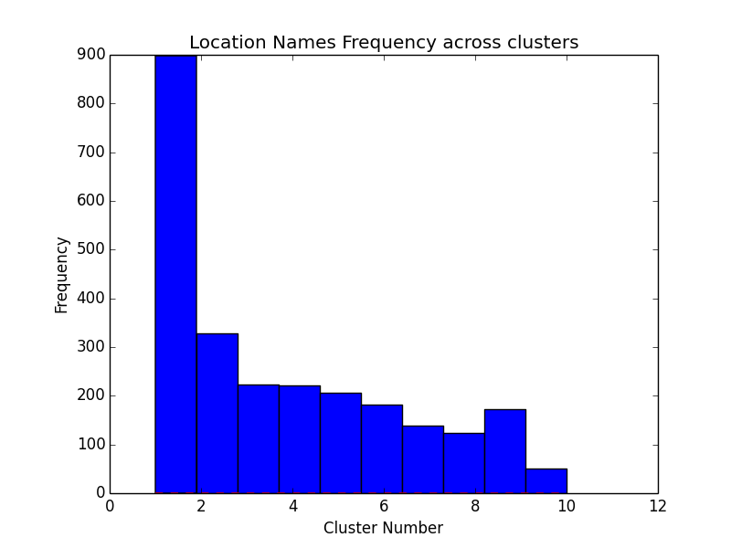
Job Location Across Clusters
Locations having only one salary ranges
Locations having all salary ranges
Howarth - 1
Elvington - 0
Eastgate - 0
Woolhampton - 2
Brookwood - 1
Maple - 1
Brightwell -3
Barnehurst -3
Wisley -1
Manchester
Suffolk
Glasgow
Humberside
Yorkshire
Leicester
Rochdale
Midlands
Bedfordshire

Slide 19
Job Description across clusters
Word | Meaning
Gp | Cluster 0 - “8k gp per month” , “paid on gp no threshold unless” Cluster 9 - “GP Unit Registered Nurse” The meaning changes from currency value to the word General Practitioner
Worksheets | Present in cluster 9 and 0 – Highest and Lowest paying jobs Highest – “Checking worksheets and auditing” Lowest – “Accurate completion of worksheets and creation of invoices” , “data entry in worksheets”
Notifications | Present in all clusters from 0 to 9 Highest Salary – “Analysis of notifications” ,”Designing of customer notifications”, “follow notifications” Lowest Salary – “Push timely notification” , “Input and completion of Inspection notifications in SAP”
Plastering | Unique to Cluster 0 and 1 (Low salary range) “small patch work plastering” , “include all aspect of plastering”
Genius | Unique to cluster 5 and 6 , 46-68k salary “aspiring web genius” , “linguistic genius”, “Photoshop genius”
Apodi | Health Care solutions. Only offers salary between 82k- 115k “please contact Apodi Ltd on” , “”
Ellie | Brokerage company that offers salary between 18k-24k “Brokerage Support Officer opportunities in your area contact Ellie”
inspections | Cluster 0 – “cleaning inspections” , “Arranging property viewings inspections” Cluster 5 – “3rd party inspections companies” , “audit and inspection” Cluster 9 - “Undertake worksite inspections” , “health inspections”
cache | Used only in Jobs which have Engineering as Job Category. Present only in cluster 5 and 6 “mem cache optimizer” , “android cache” , “Configuring caches and backend”
Vegetable | Found only in cluster 3 – salary 18—25k Related to catering and cooking jobs. All offers are from caterer.com.
nutitionist | Present only in cluster – 6 Salary 56-68k “Fertiliser Specialist, Crop nutitionist Crop”

Slide 20
Questions???

