Slide 1
Bias Analysis towards Fair AI in Education
By utilizing Student Score Prediction Dataset
Team: Multi-Agents
Artur Ganzha, Detijon Lushaj, Lasse Müller

Slide 2
Problem Definition
Identify potential inequalities in student performance based on race/ethnicity, parental education and gender.
Addressing unfair opportunities is crucial for creating a more equitable learning environment.
Target Group:
Educators, researchers, and students interested in educational equity.
Use of Insights:
Adjusting teaching strategies and student grouping to promote fairness.
Provides actionable insights to help create equitable educational environments.

Slide 3
Goals and Objectives
Showcase inequalities in student performance.
Provide data-driven insights to support fairer educational practices.
Validate through ML models
Key Questions:
Are there disparities in performance among different groups?
Could these disparities suggest unfair opportunities?
How can educators use this data to reduce bias?
Goals:
Highlight inequalities in student performance.
Provide insights for educators to enhance fairness in educational practices.

Slide 4
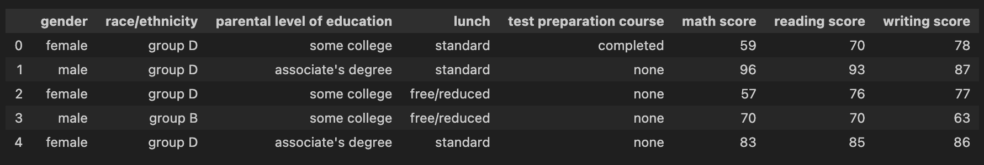
Student Performance Prediction dataset
Data Source: Kaggle - Student Performance Prediction dataset.
Gender
race/ethnicity
parental level of education
test scores across subjects (math, reading, writing)

Slide 5
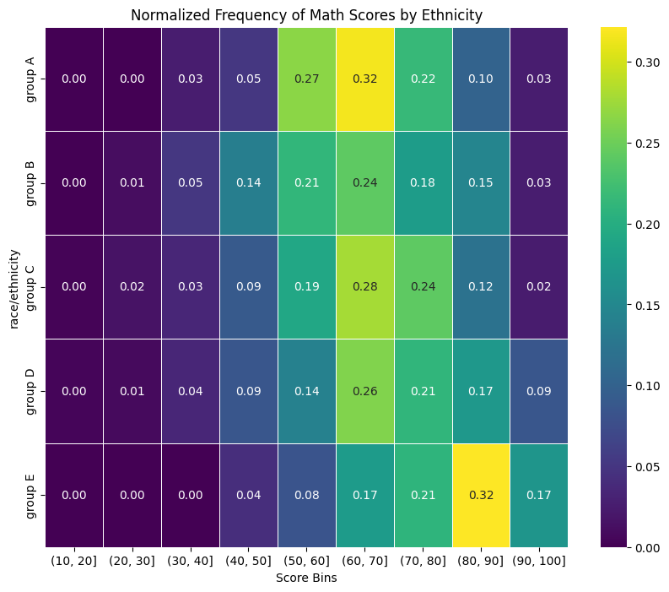
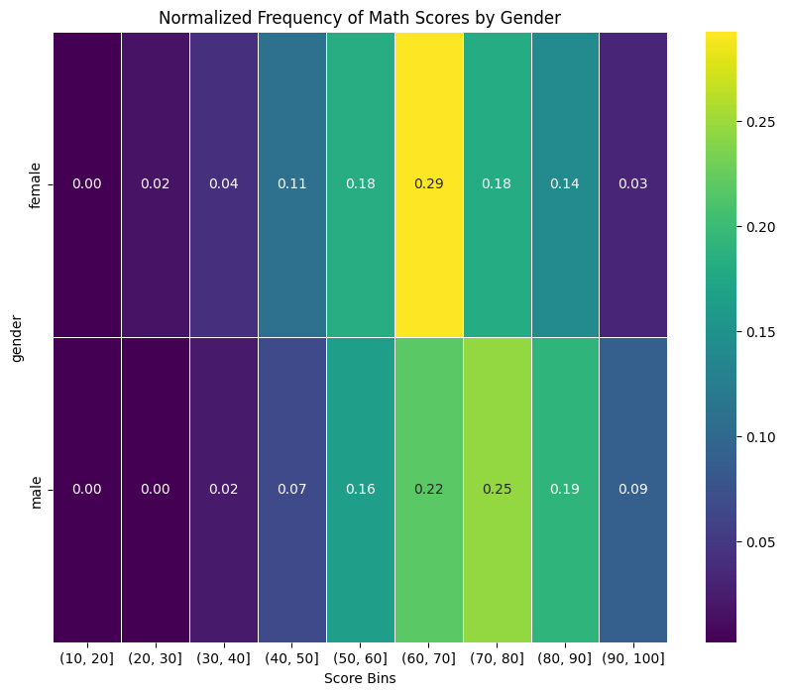
Student Performance Prediction dataset

Slide 6
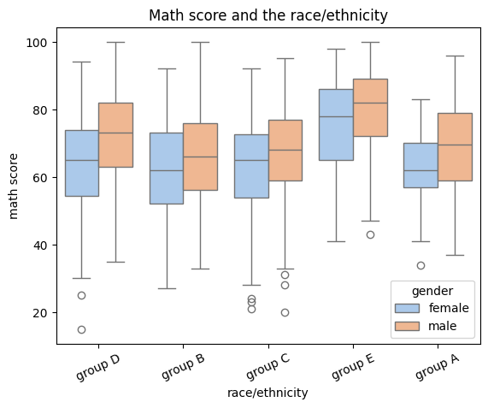
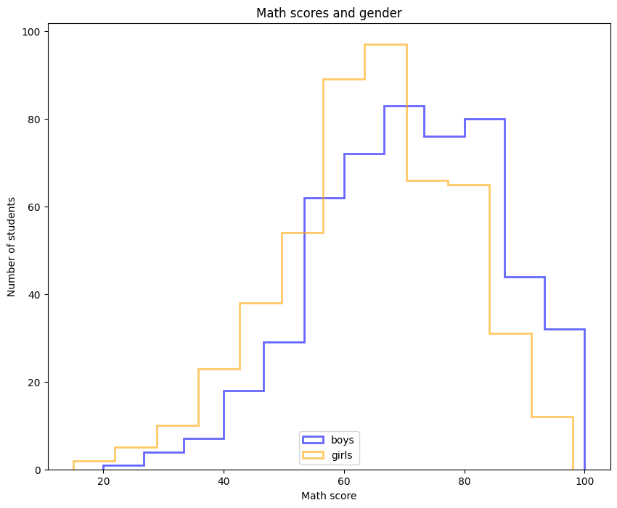
Student Performance Prediction dataset

Slide 7
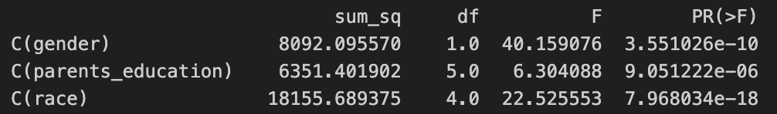
ANOVA Table
Gender (C(gender)):
F-statistic: 40.16, p-value: 3.55e-10
Strong evidence that gender impacts student performance.
Parental Education (C(parents_education)):
F-statistic: 6.30, p-value: 9.05e-06
Suggests a significant, but lesser impact compared to gender.
Race (C(race)):
F-statistic: 22.53, p-value: 7.97e-18
Indicates a strong influence of race on student performance.

Slide 8
Methodology
Data Preparation:
Trainings/Test split
Normalization of Data
Model Selection:
Linear Regression, Random Forests
Neural Networks
3 hidden layer, ReLU, Dropout-rate 0.2
Learning-rate 0.0005
Data Splitting:
K-Fold Cross-Validation
70-20-10 split
K = 5
Metrics for Evaluation:
R2 Score
MSE/MAE

Slide 9
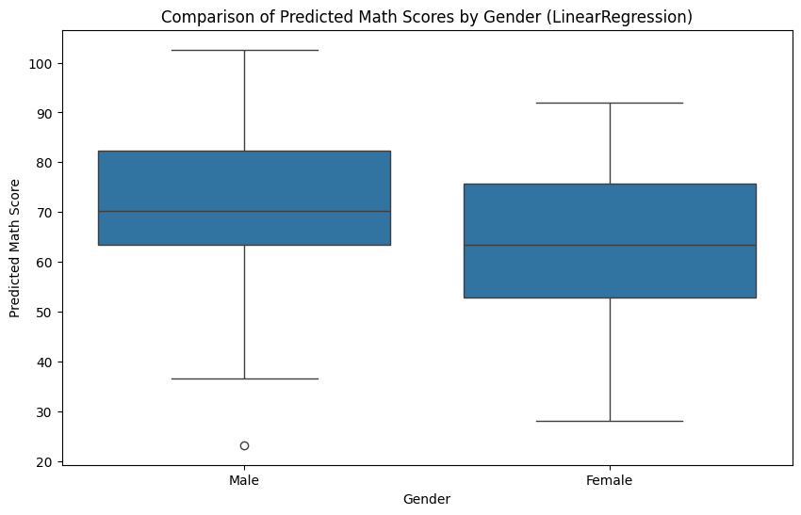
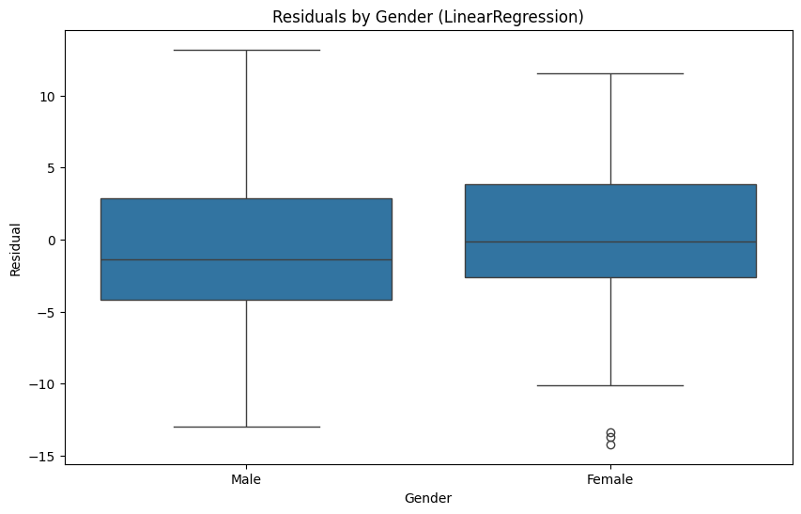
Linear Regression

Slide 10
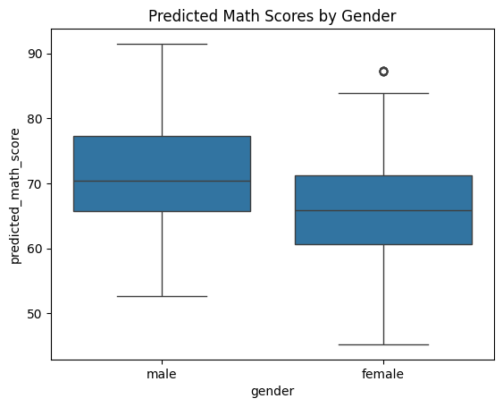
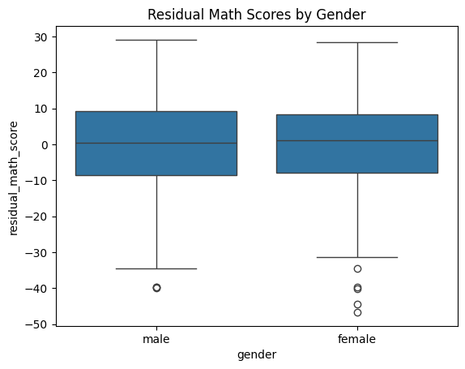
Neural Networks

Slide 11
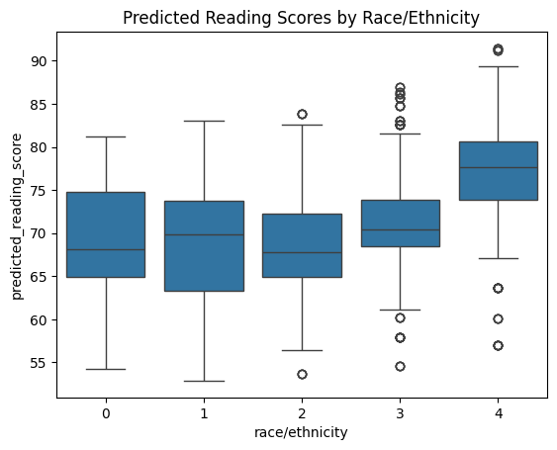
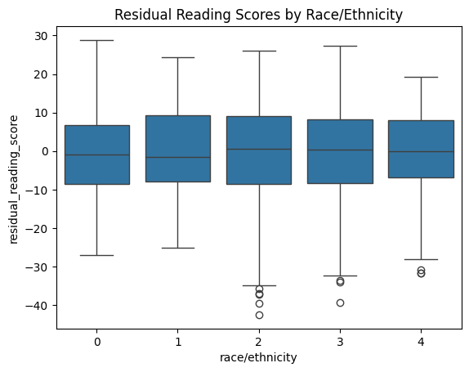
Neural Networks

Slide 12
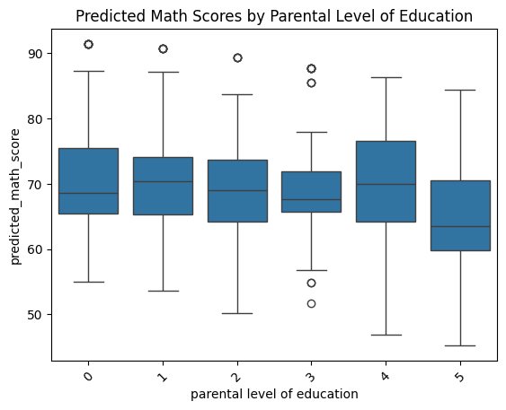
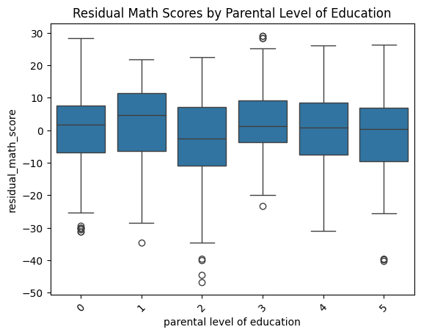
Neural Networks

Slide 13
Key Questions: Answers
Are there disparities in performance among different groups?
Yes there are disparities, but they are not necessarily caused by biases
Could these disparities suggest unfair opportunities?
These disparities do not favor / disfavor new students (backed by prediction results)
How can educators use this data to reduce bias?
Educators can shuffle student groups during task assignments to create more diversity

Slide 14
Results
The prediction models gave similar results
We decided going with neural networks, due to flexibility
There are disparities within gender and ethnicity
But the prediction models showed, that they have little to no residual
Hence we can conclude that the model reduces any bias as no class is favored / disfavored by the model
Key take aways: teachers can shuffle students who are performing well with students with worse performances to increase their respective influence

Slide 15
Review of the Hackathon
What went well?
Finding the right topic
Analyzing and understanding the dataset
Teamwork
What can we improve next time?
Dig deeper into the data
Environment setup
Incorporate fairness metrics

Slide 16
Thank you for your attention! https://github.com/arzx/bias-analysis-students

