Slide 1
Fun With Kubernetes
K8S Cluster Deployment Robert Detjens

Slide 2
Project Summary

Slide 3
Kubernetes Cluster on Raspberry Pi
Deployment pipeline for containerized applications
Web API for project management

Slide 4
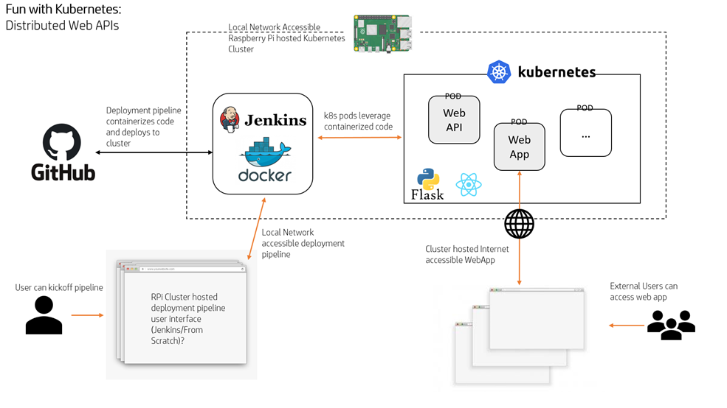
Project Overview

Slide 5
Goals

Slide 6
Make it easy for developers to deploy containerized applications to a K8S cluster
Operate at a lower operating cost compared to industry solutions
Provide scalability, either up or down
Intuitive and easy to use for end users

Slide 7
Deliverables

Slide 8
Kubernetes deployed on Raspberry Pi devices
Deployment pipeline running on a cluster of Raspberry Pi devices
Able to deploy a user’s service to the Kubernetes cluster from a user-provided config file
User must be able to access pipeline from local network
Service hosted on Raspberry Pi’s must be available on the internet

Slide 9
Requirements

Slide 10
Kubernetes Setup
Project Config File
Github Container Build Pipeline
Kubernetes Deployment Pipeline
Deployment UI Website
Final Integration
Beta Testing

Slide 11
Requirement Breakdown

Slide 12
1. Kubernetes Setup
Install Kubernetes on the Raspberry Pi (1-2 days)
Configure Kuberentes on the Raspberry Pi (1-2 days)
Connect to the Raspberry Pi Admin tools with K8S Lens (3 Days)
Test Kubernetes on the Raspberry Pi (3 days)
Code reviews and release (4-5 Days)

Slide 13
2. Kubernetes CI/CD Config File Integration
Research what settings are needed (2-3 days)
Work with Deployment UI Website team to define template format (4-6 days)
Create end-user documentation for config template (1 days)
Code reviews and release (4-5 Days)

Slide 14
3. Github Container Pipeline
Create build script to pull repo from user-provided repository (1 day)
Modify build script to build container image (1-3 days)
Coordinate with K8S Deployment team to define container handoff API (2-3 days)
Modify build script to send built image to K8S onboarding (1-2 days)
Modify script to ensure clean building environment (1-2 days)
Code Reviews and release (4-5 Days)

Slide 15
4. Kubernetes Deployment Pipeline
Watch the images in the deployment area (1-2 days)
Deploy a new image in the deployment area (2-3 Days)
Coordinate with Github Container Build team to define container handoff API (2-3 Days)
Testing (2-3 Days)
Code Reviews and release (4-5 Days)

Slide 16
5. User-facing Deployment UI Website
Create a clean and usable web UI (3-6 days)
Containerize the web UI and self-host on the cluster (1 day)
Create an interface to pass applications as well as necessary configuration settings to the pipeline for deployment (3-6 days)
Expose admin tools, such as Lens IDE (2-7 days)
Set up authentication (3-5 days)
Code reviews and release (4-5 days)
Set up an automated system for containerizing an application to be passed to the pipeline that is not yet containerized (2-4 days) [stretch]

Slide 17
6. Final Integration

Slide 18
7. Beta Testing

Slide 19
Tasks distribution

Slide 20
Phase 1: Mark - TM1 Phase 2: Jacob - TM2 Phase 3: Robert - TM3 Phase 4: Paul - TM4 Phase 5: Nathan - TM5

Slide 21
Component Interfaces

Slide 22
1.

Slide 23
2.
coordinate with Phase 5
site will take this data from user and generate template
specifics will be added when needed

Slide 24
3.
coordinate with Phase 4
Docker builds image and stores internally
needs to be passed to K8S somehow

Slide 25
4.

Slide 26
5.

Slide 27
Schedule

Slide 28
Fall term:
Sprint 2: phase 1
Sprint 3: phase 2 (1/2)

Slide 29
Winter term:
Sprint 4: phase 2 (2/2), phase 3 (1/2), phase 4, phase 5 (1/2)
Sprint 5: phase 3 (2/2), phase 5 (2/2)
Sprint 6: Integration

Slide 30
Spring term:
Sprint 7: Beta testing

Slide 31
Management

Slide 32
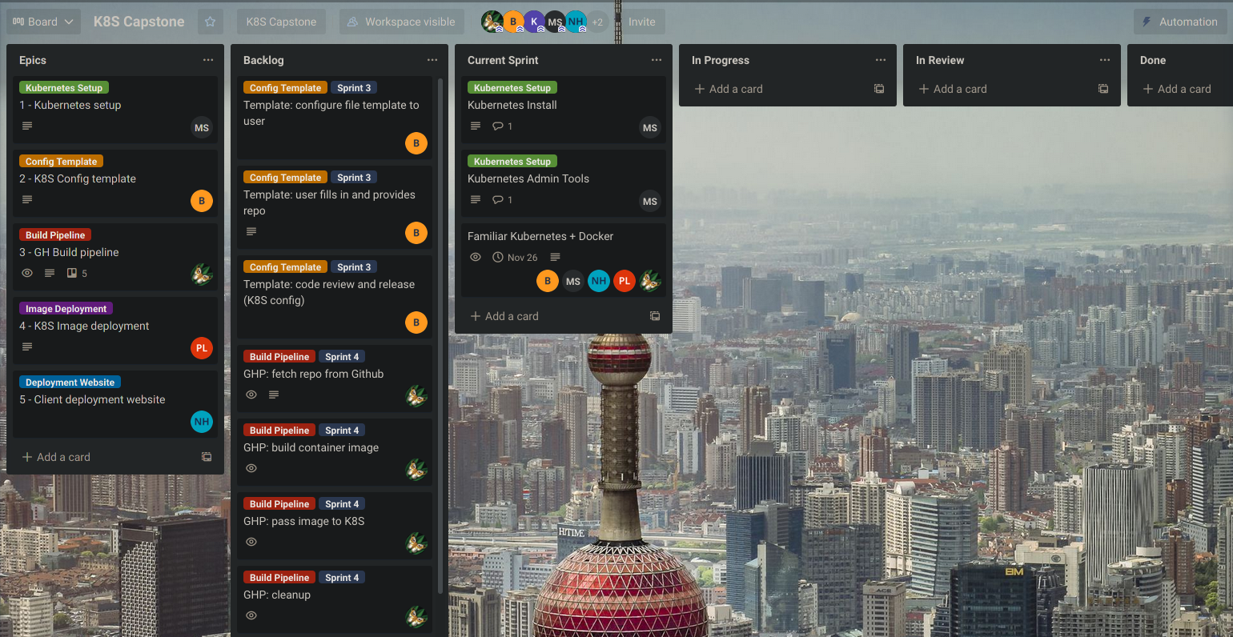
Trello board

Slide 33
Sprint Goals

Slide 34
Sprint 2 (11/1 to 11/21)
Planned Deliverables:
Installation & configuration of cluster
Kubernetes
K8S Lens
Dependencies:
None

Slide 35
Sprint 3 (11/22 to 12/12)
Planned Deliverables:
Configuration files for K8S can be generated from user options
Lens is installed and running on the cluster
Dependencies:
K8S is installed and working on the devices

Slide 36
Sprint 4 (1/3 to 1/23)
Planned Deliverables:
Pipeline functional
Builds image from GitHub repo
Image then detected and launched by K8S
UI hosted and accessible on cluster
Site can pass app config to and trigger build pipeline
Dependencies:
K8S is installed and working on the devices
K8S config files can be generated from user options

Slide 37
Sprint 5 (1/24 to 2/13)
Planned Deliverables:
Authentication required for pipeline UI to prevent unauthorized attempts to access the cluster
Admin tools from Lens exposed by UI
Dependencies:
K8S is installed and working on the devices
Lens running on cluster
UI running on cluster

Slide 38
Sprint 6 (2/14 to 3/6)
Planned Deliverables:
Integration testing completed
Dependencies:
All previous deliverables

Slide 39
Sprint 7 (3/28 to 4/17)
Planned Deliverables:
Beta testing complete
Dependencies:
Integration finished

