Slide 1
CS 352 | Heuristic Evaluation Assignment
Robert Detjens
OSU Class Search / Scheduler
https://classes.oregonstate.edu
Notes:
First, click File, Make a Copy to add your own, editable copy of the slide deck to your Google Drive.
Then, replace the Bullet Point Text on this slide
with your full name;
the name of the Website/App/Physical Device you reviewed and;
the Website/App URL.
Once you are ready to submit your assignment, click File, Download, PDF Document and submit that PDF file in Canvas.

Slide 2
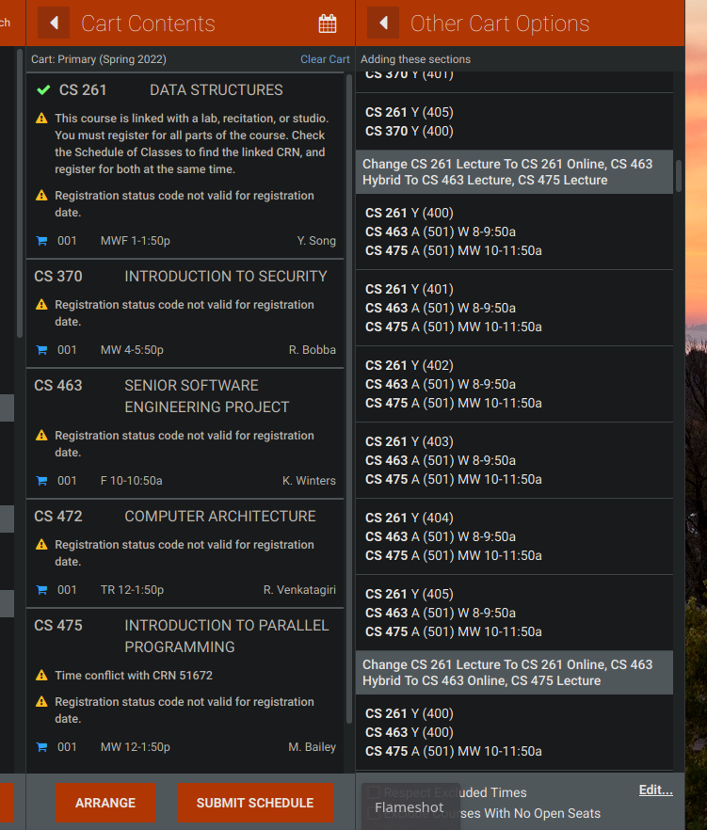
#6: Recognititon Rather than Recall
This is the menu that pops up when the “Arrange” button is clicked in the cart.
  This menu does not provide enough information for the user to know how the changed time would fit in with the rest of the selected classes, until it is added to the cart.
  This forces the user to remember when all of their other classes are to know what new sections would work in a new schedule.
  This is a large problem as the point of the registration scheduler is to let the user create the schedule of classes, and not giving the user enough information to let them create this schedule easily is not a good user experience.
3 - It is important to fix this, and should be given high priority.
Notes:
Review a design against Nielsen’s 10 Heuristics.
Once you find an issue, take a photo or make a screenshot clearly illustrating the observed or experienced issue and place the photo/screenshot in the left, white panel.
Enter on the right panel:
The full name of the heuristic which was violated.
An explanation why the heuristic is violated:
Explain the issue experienced and what happened.
Then relate that issue to the identified heuristic, which you named on top.
Based on that and your reasoning, conclude why this is a i) cosmetic, ii) minor, iii) major problem or even a iv) usability catastrophe (ignore cosmetic problems).
Use around 150 words minimum for your explanation
The text will resize automatically once you start writing.
The assessed severity of the Problem.
Nielsen’s 10 heuristics: https://www.nngroup.com/articles/ten-usability-heuristics/
Nielsen’s severity ratings: https://www.nngroup.com/articles/how-to-rate-the-severity-of-usability-problems/
This is an slide you can use to edit and create your first heuristic assessment.

Slide 3
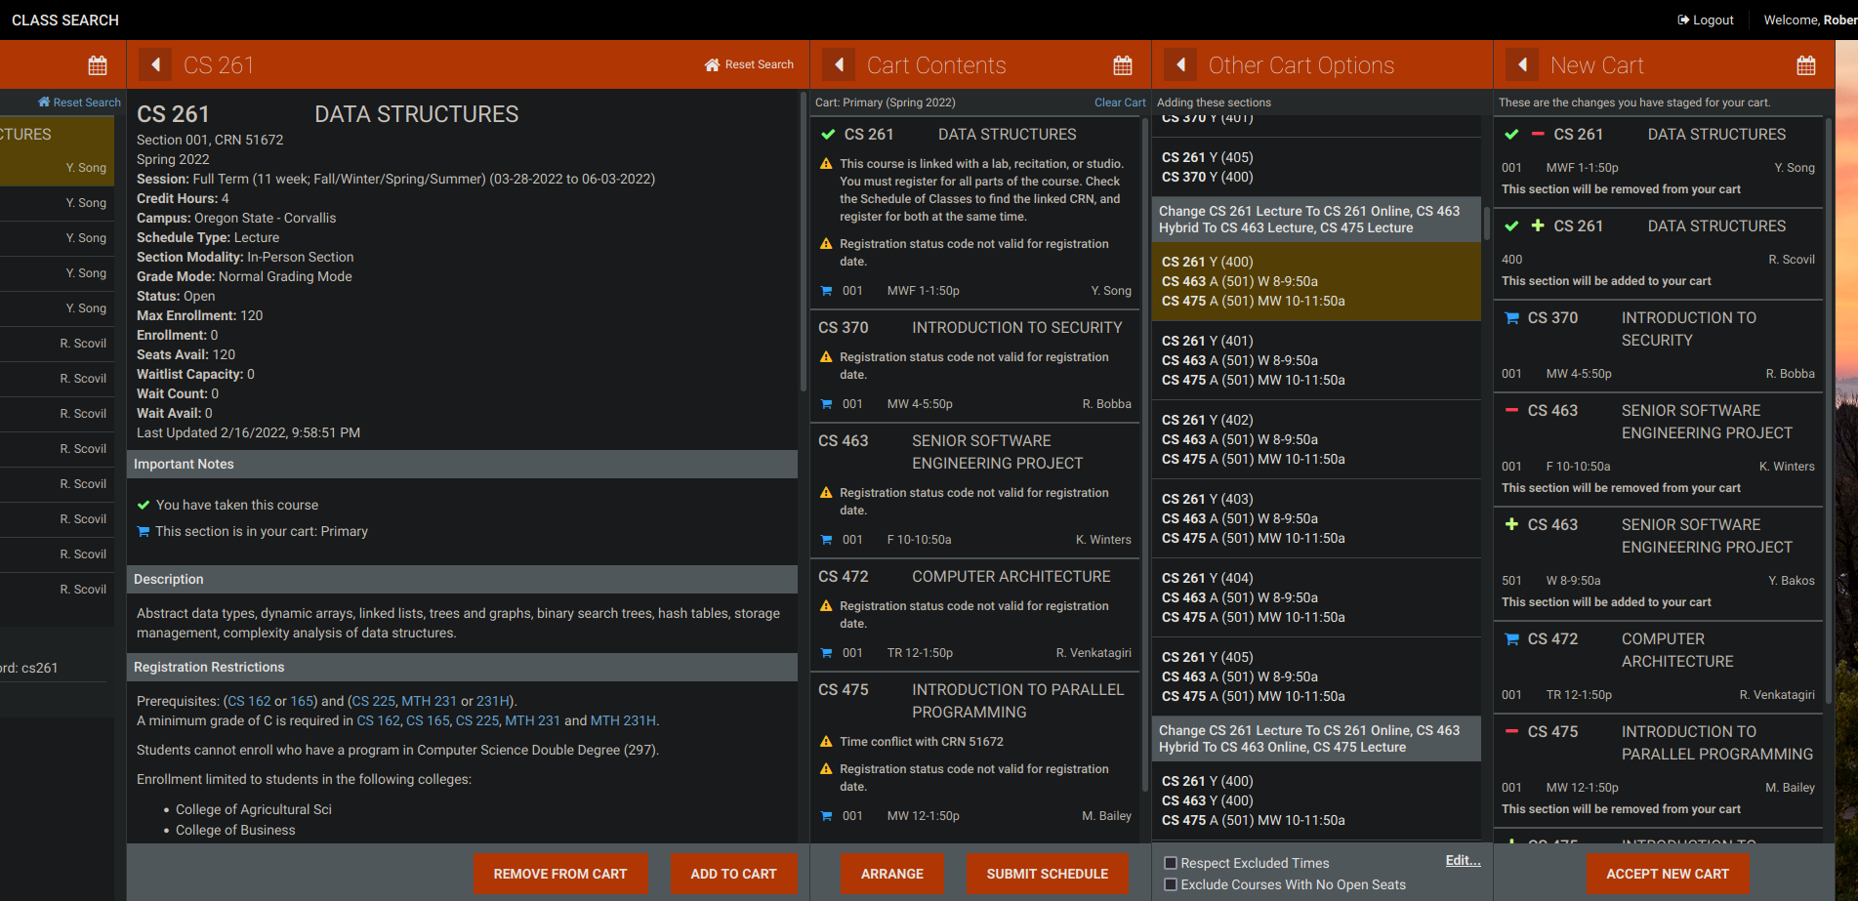
6: Recognition Rather than Recall
As you add things to your cart and rearrange your schedule, the pane-based interface forces information off the side of the screen.
  When rearranging this example cart, I was looking at the list of tines for 261, which is now off the side of the screen.
  This now forces me to remember what those times were, rather than keeping that information present.
  This is a minor problem, somewhat caused by the confusing scheduling dance required as detailed on the previous slide. This is not a large deal, as the details pane also contains this information lower down, but on smaller screen sizes (e.g. on mobile or when not maximized) this becomes more of an issue.
2 – Fixing this should be low priority.
Notes:
Review a design against Nielsen’s 10 Heuristics.
Once you find an issue, take a photo or make a screenshot clearly illustrating the observed or experienced issue and place the photo/screenshot in the left, white panel.
Enter on the right panel:
The full name of the heuristic which was violated.
An explanation why the heuristic is violated:
Explain the issue experienced and what happened.
Then relate that issue to the identified heuristic, which you named on top.
Based on that and your reasoning, conclude why this is a i) cosmetic, ii) minor, iii) major problem or even a iv) usability catastrophe (ignore cosmetic problems).
Use around 150 words minimum for your explanation
The text will resize automatically once you start writing.
The assessed severity of the Problem.
Nielsen’s 10 heuristics: https://www.nngroup.com/articles/ten-usability-heuristics/
Nielsen’s severity ratings: https://www.nngroup.com/articles/how-to-rate-the-severity-of-usability-problems/
This is an slide you can use to edit and create your second heuristic assessment.

Slide 4
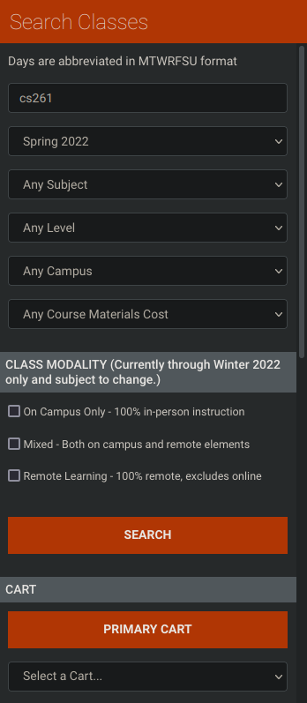
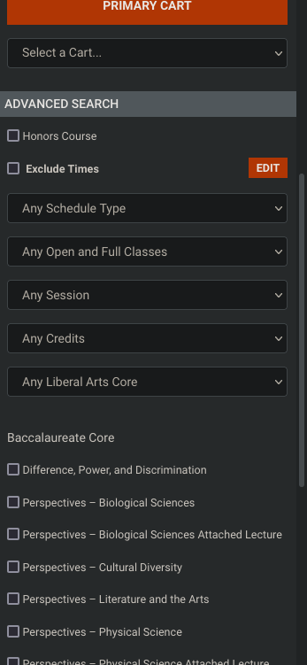
8: Asthetic and Minimal Design
There are too many search options exposed by default.
  Every possible toggle for the class search is shown by default. This makes it complicated to find the option you want when there are so many others competing for space and the user’s cognitive attention. Users need to spend time parsing what each option is.
  This heuristic states that there should be as little information as possible displayed while still showing the user what they need. All of these options are not needed all the time, and could be hidden behind and “advanced search” toggle or similar.
  Similarly, the Bacc Core selection also presents too many options – I have never selected more than one at a time, and this could be served with another select dropdown.
  Based on that, this is a low priority problem. The most-used modifiers are at the top of the stack, so users do not need to search much for their desired option. However, this is still a cluttered sidebar and can take a bit to find a less-used option.
2 – Fixing this should be a low priority.
Notes:
Review a design against Nielsen’s 10 Heuristics.
Once you find an issue, take a photo or make a screenshot clearly illustrating the observed or experienced issue and place the photo/screenshot in the left, white panel.
Enter on the right panel:
The full name of the heuristic which was violated.
An explanation why the heuristic is violated:
Explain the issue experienced and what happened.
Then relate that issue to the identified heuristic, which you named on top.
Based on that and your reasoning, conclude why this is a i) cosmetic, ii) minor, iii) major problem or even a iv) usability catastrophe (ignore cosmetic problems).
Use around 150 words minimum for your explanation
The text will resize automatically once you start writing.
The assessed severity of the Problem.
Nielsen’s 10 heuristics: https://www.nngroup.com/articles/ten-usability-heuristics/
Nielsen’s severity ratings: https://www.nngroup.com/articles/how-to-rate-the-severity-of-usability-problems/
This is an slide you can use to edit and create your third heuristic assessment.

Slide 5
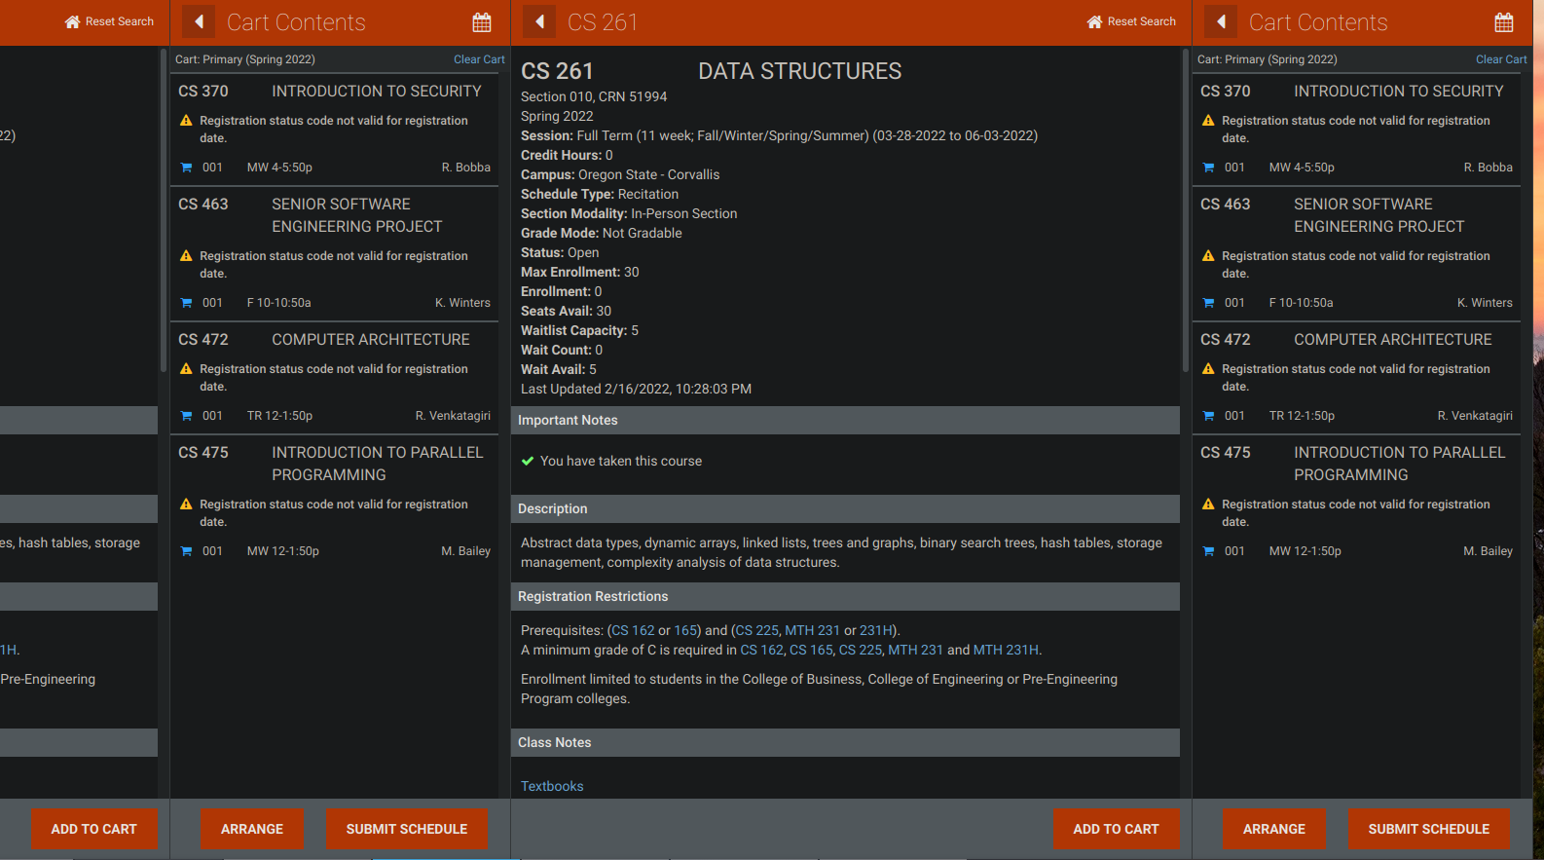
8: Asthetic and Minimal Design
When adding and removing classes from the registration card, the tabs continue to expand and you get duplicate panes.
  To remove a class from the cart, a user needs to click on the class in the cart (left) which brings up the detailed info for that class (center) and click the “Remove from cart” button in the bottom (now “Add to cart”). Once removed, the page opens a new cart pane, while leaving both the old card and the old class open and in the center of the screen.
  This creates a duplication of information, as now there are two identical carts open and it is not clear which of these the user should continue to work off of.
  This is a minor problem, as both carts are functionally the same and both are updated with the removed class. This is a result of the pane-oriented architecture of this page.
2 – Fixing this is a low priority.
Notes:
Review a design against Nielsen’s 10 Heuristics.
Once you find an issue, take a photo or make a screenshot clearly illustrating the observed or experienced issue and place the photo/screenshot in the left, white panel.
Enter on the right panel:
The full name of the heuristic which was violated.
An explanation why the heuristic is violated:
Explain the issue experienced and what happened.
Then relate that issue to the identified heuristic, which you named on top.
Based on that and your reasoning, conclude why this is a i) cosmetic, ii) minor, iii) major problem or even a iv) usability catastrophe (ignore cosmetic problems).
Use around 150 words minimum for your explanation
The text will resize automatically once you start writing.
The assessed severity of the Problem.
Nielsen’s 10 heuristics: https://www.nngroup.com/articles/ten-usability-heuristics/
Nielsen’s severity ratings: https://www.nngroup.com/articles/how-to-rate-the-severity-of-usability-problems/
This is an slide you can use to edit and create your fourth heuristic assessment.

