Slide 1

Sarah Kronheim, Dianne Etmanski, Anabel Scaranelo, and Brenda Wardhaugh

Slide 2

Rationale
Lack of clean water and sanitation and inadequate infection prevention and control promotes the spread of microbes, some of which can be resistant to antimicrobial treatment.
Some bacteria have developed resistance to antibiotics that were once commonly used to treat them. (Classic example of Neisseria gonorrhea and benzyl penicillin).
Antimicrobial resistance (AMR) is a global threat.

Slide 3
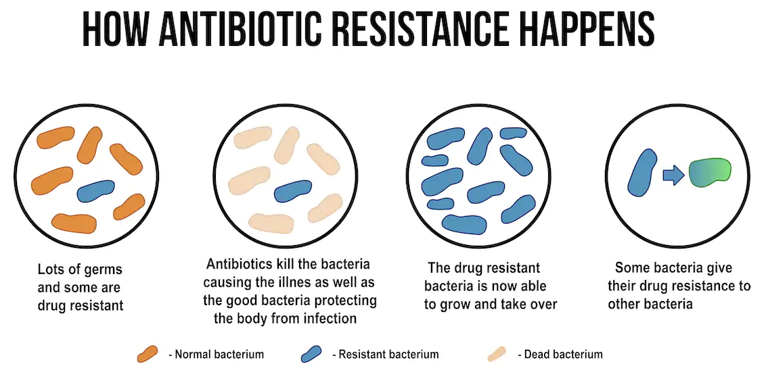
Source: How to train the body's own cells to combat antibiotic resistance (theconversation.com)

Slide 4
Goal
To provide an interactive way to examine data published on the burden of antimicrobial resistance (AMR) by region and its correlation with regional health spending.

Slide 5

Methods
Data extraction:
Download csv datasets (AMR, country coordinates, health spending)
Website scraping (countries in each region)
Data cleaning:
Clean csv datasets
Load cleaned csv files into sqlite database
Interactive charts :
Metadata – countries in each region
Metadata – number of datapoints
AMR burden and healthcare spending visualizations

Slide 6
Data Sources
The AMR data was sourced from the publication "Global burden of antimicrobial resistance: essential pieces of a global puzzle" by Charani et al published in The Lancet
The health spending data was sourced from the Global Health Expenditure Database via the World Health Organization (WHO)
The coordinates for each country were sourced from a dataset on Kaggle
The list of countries belonging to each region was scraped from the Global Health Data Exchange website (which is the site where the AMR data is posted)

Slide 7
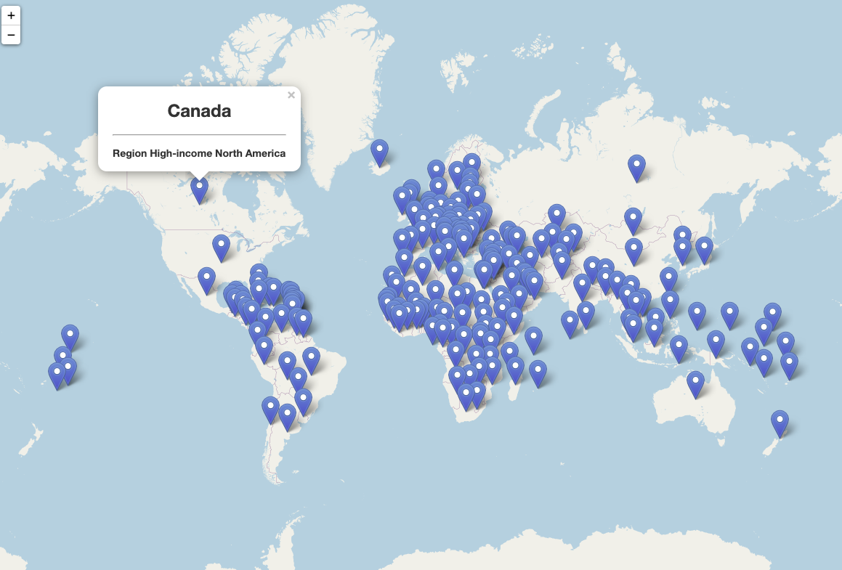
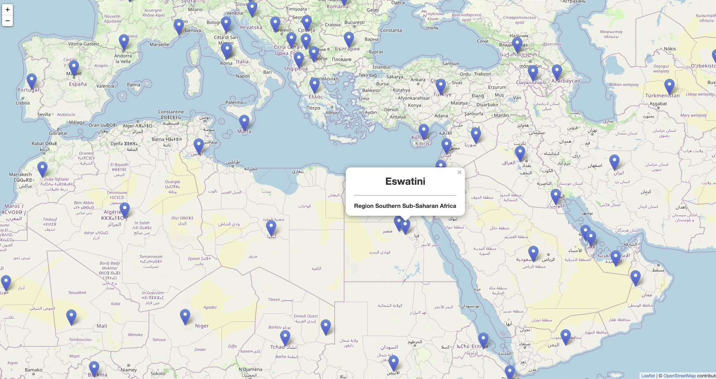
Regions

Slide 8
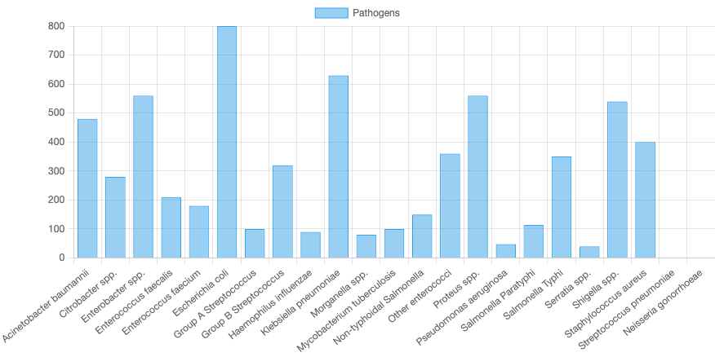
Datapoints

Slide 9
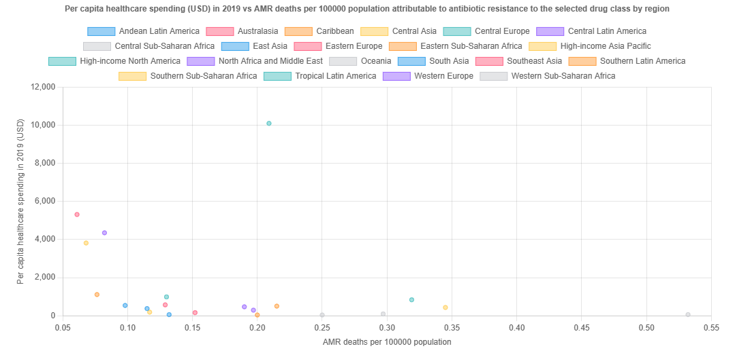
AMR data

Slide 10

HTML
With a FULL interactive demonstration to class

Slide 11
Limitations
1. Data availability
2. Methodological choices made by the authors.
The analysis compared health spending and AMR burden using data available by region and country.
Countries not listed as part of a region were not included in the analysis.
Only data from 2019 was considered for the analysis of discrete health spending compared to AMR burden.

Slide 12
Limitations
The AMR data is only available by region while the health spending data is only available by country, so countries belonging to each region as defined by the Global Health Data Exchange was used to compare health spending to AMR burden. This means that any country in the health spending dataset that was not listed as part of a region in the Global Health Data Exchange is omitted from the analysis.
The AMR data is only available for 2019. This means that while health spending data is available for many different years, in the analysis of discrete health spending compared to AMR burden only 2019 is considered.

Slide 13

Conclusions
This project provided interactive ways for people interested in know more about antimicrobial resistance.

