Slide 1

Sarah Kronheim, Dianne Etmanski, Anabel Scaranelo, and Brenda Wardhaugh

Slide 2

Overview
What is Antimicrobial Resistance?
How are these pathogens spread?
At risk populations
Our Analysis looked at the following:
Which Pathogens, Antibiotic Classes and Infectious syndromes are associated with death?
Which regions of the world are most at risk and why?
Does the amount of healthcare spending affect the risk of the population to AMR’s?

Slide 3
Data Sources
The AMR data was sourced from the publication "Global burden of antimicrobial resistance: essential pieces of a global puzzle" by Charani et al published in The Lancet
The health spending data was sourced from the Global Health Expenditure Database via the World Health Organization (WHO)
The coordinates for each country were sourced from a dataset on Kaggle
The list of countries belonging to each region was scraped from the Global Health Data Exchange website (which is the site where the AMR data is posted)

Slide 4
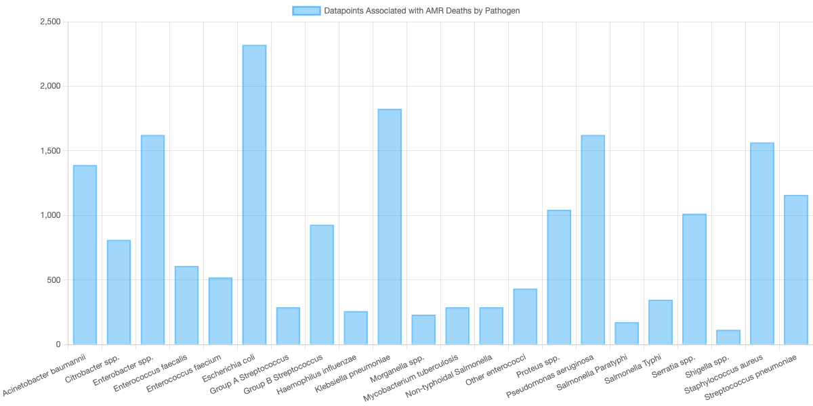
Analysis: Pathogens associated with Death

Slide 5
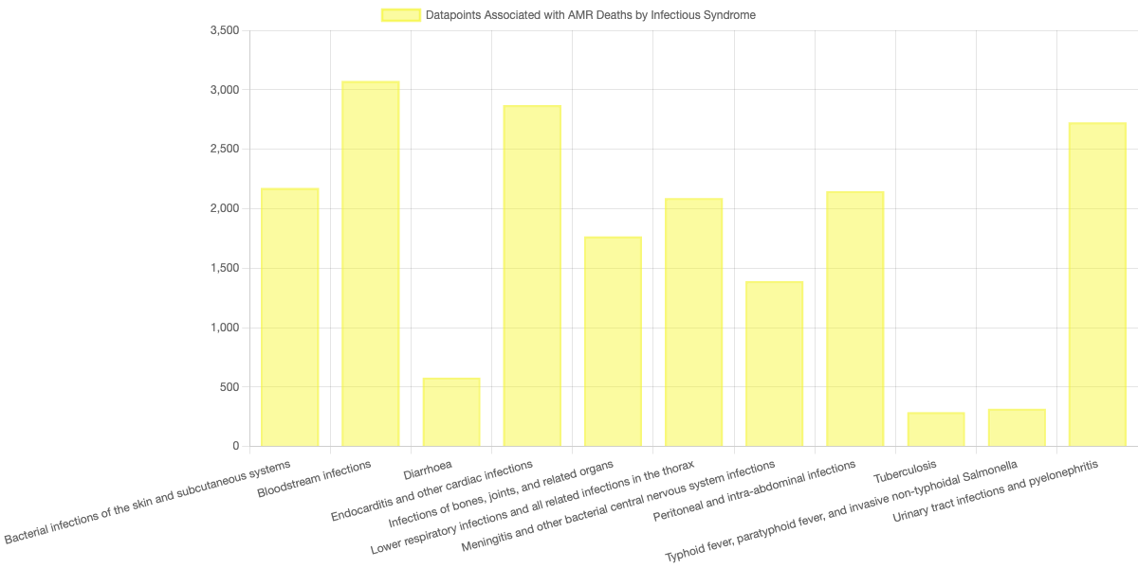
Analysis: Infectious Syndromes associated with Death

Slide 6
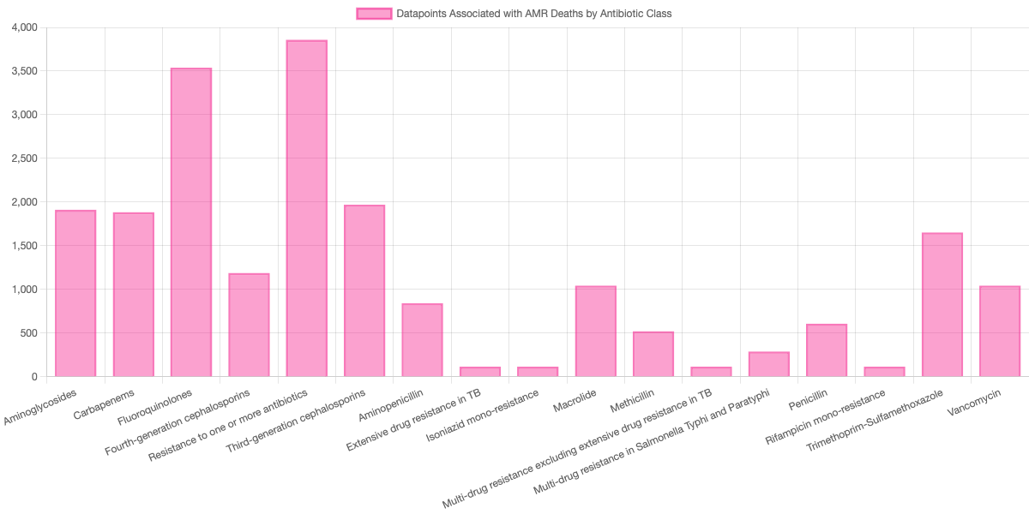
Analysis: Antibiotic Class associated with Death

Slide 7
Analysis

Slide 8
Limitations
The AMR data is only available by region while the health spending data is only available by country, so countries belonging to each region as defined by the Global Health Data Exchange was used to compare health spending to AMR burden. This means that any country in the health spending dataset that was not listed as part of a region in the Global Health Data Exchange is omitted from the analysis.
The AMR data is only available for 2019. This means that while health spending data is available for many different years, in the analysis of discrete health spending compared to AMR burden only 2019 is considered.

Slide 9

Conclusions

Slide 10

HTML
Insert Link to webpage

