Slide 1

Catheter Placement using Nerve Segmentation on Ultrasound Images
Presented To:
Dr. Pritee Khanna
Members:
Shivani Singh 2018234
Pranay Reddy 2018033
Vipul Goel 2018285

Slide 2
Introduction
Digital image processing has become an important part of the medical imaging. With the help of image segmentation we can highlight the important part in any medical image that is useful for the doctors to study.
So it is very important to accurately segment the image and provide the useful information that can be used by the doctors without any difficulty for the different medical purposes. Ultrasound scans are very useful and widely used because of their less cost, portability and safety but due to the poor image quality of the ultrasound scans we need some processing that can provide us more information to operate based on the ultrasound scans.

Slide 3
Objective
With our segmentation model, we aim to create a mask that helps doctors finding the nerve very easily because it includes the segmentation of these nerves in ultrasound images.
This application is further extended to train the system with this data so that it can be used worldwide.

Slide 4
Workflow
Taking ultrasound scans as the input.
Applying preprocessing on the raw images.
Carrying out Canny Edge Detection to identify Nerves.
Training the segmentation model on the scans and their corresponding masks.
Infering the masks with respect to the location of catherer.
Generating masks to identify the location to administer the catherer.

Slide 5
Technical Stack
Model: Unet architecture for Semantic Segmentation.
Framework: Keras and Tensorflow.
Libraries: OpenCV, Numpy, Matplotlib, scikit-learn.

Slide 6
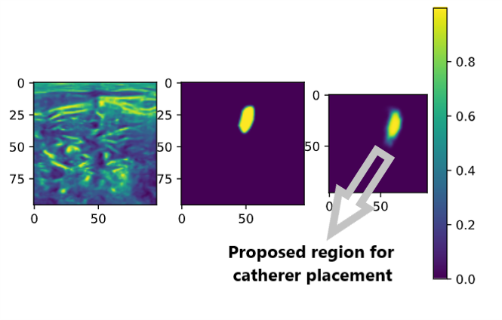
Results:
Original Scan
Segmented Image

Slide 7
References
[1] Olaf Ronneberger, Philipp Fischer, & Thomas Brox. (2015). U-Net: Convolutional Networks for Biomedical Image Segmentation.
[2] Dataset: https://www.kaggle.com/c/ultrasound-nerve-segmentation/data

