Slide 1
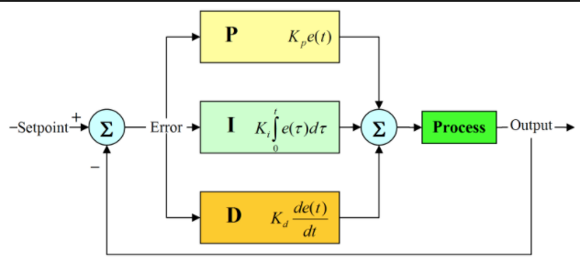
Base on idea of PID controller
Using “P” and “D” component in final product

Slide 2



$${∂T}_{1}$$
$${∂T}_{2}$$
$$∂∂T={∂T}_{1}−{∂T}_{2}$$

Slide 3
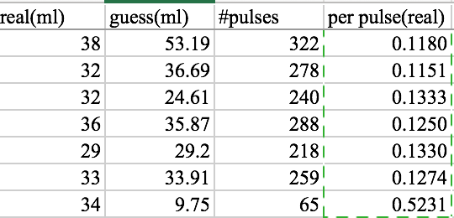

Slide 4
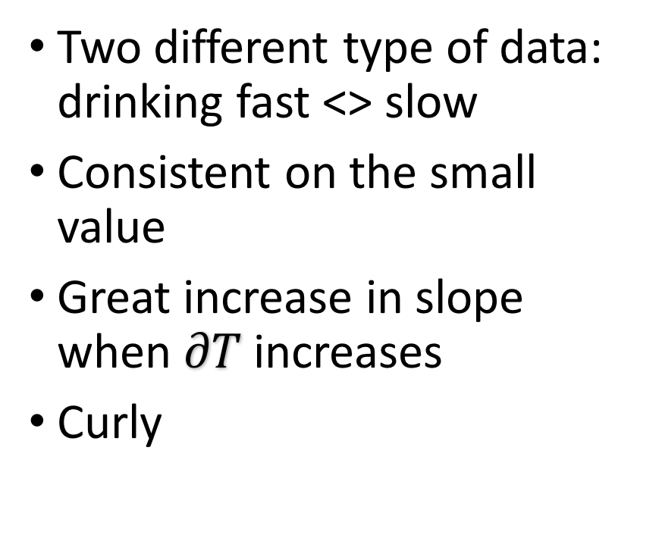
Two different type of data: drinking fast <> slow
Consistent on the small value
Great increase in slope when $∂T$ increases
Curly

Slide 5
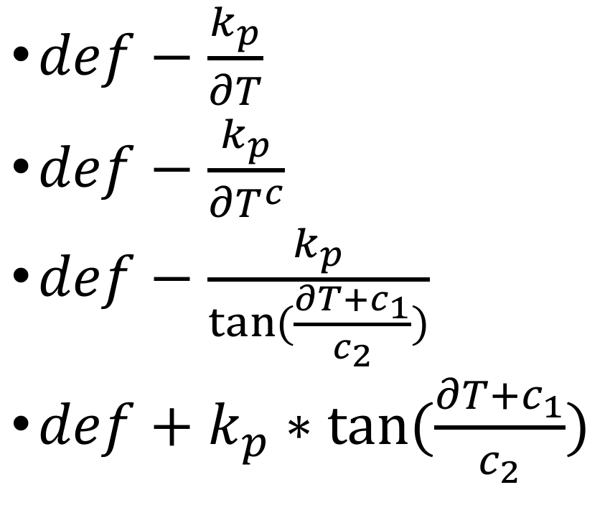
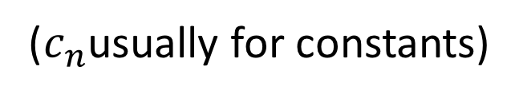
$def−\frac{k_{p}}{∂T}$
$def−\frac{k_{p}}{{∂T}^{c}}$
$def−\frac{k_{p}}{\tan{(\frac{∂T+c_{1}}{c_{2}})}}$
$def+k_{p}∗\tan{(\frac{∂T+c_{1}}{c_{2}})}$
Simple / no curve
Relatively simple / flat
Enough curly / upper limit
Enough curly / better limit
($c_{n}$usually for constants)

Slide 6
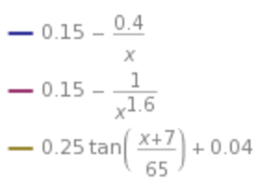
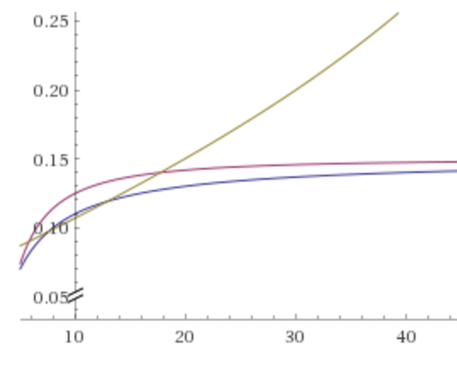

$def−\frac{k_{p}}{∂T}$
$def−\frac{k_{p}}{{∂T}^{c}}$
$def−\frac{k_{p}}{\tan{(\frac{∂T+c_{1}}{c_{2}})}}$
$def+k_{p}∗\tan{(\frac{∂T+c_{1}}{c_{2}})}$

Slide 7
Thread / process
Multithreading
Asynchronous job
Handler
Inter-process communication
Message Queue
Bluetooth Socket & Protocol
Reliable & ordered. Like TCP
No remote synchronization needed

Slide 8
