Slide 1
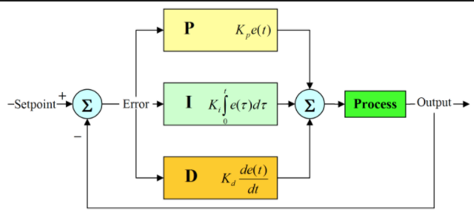
Flow Sensor Compensation
Base on idea of PID controller
Using “P” and “D” component in final product

Slide 2



$$∂∂T={∂T}_{1}−{∂T}_{2}$$
$${∂T}_{1}$$
$${∂T}_{2}$$
Terms used later

Slide 3
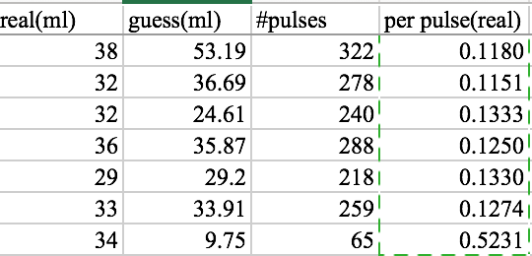
Flow sensor compensation - Data

Slide 4
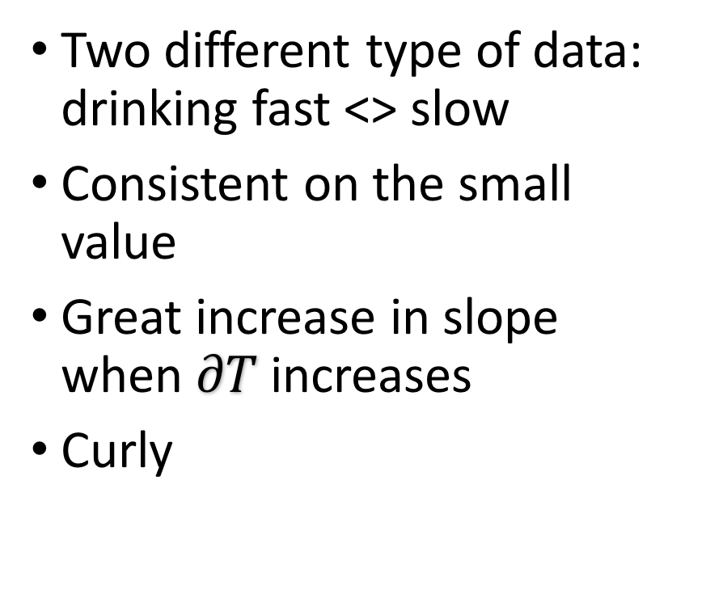
Flow sensor compensation - Data
Two different type of data: drinking fast <> slow
Consistent on the small value
Great increase in slope when $∂T$ increases
Curly

Slide 5
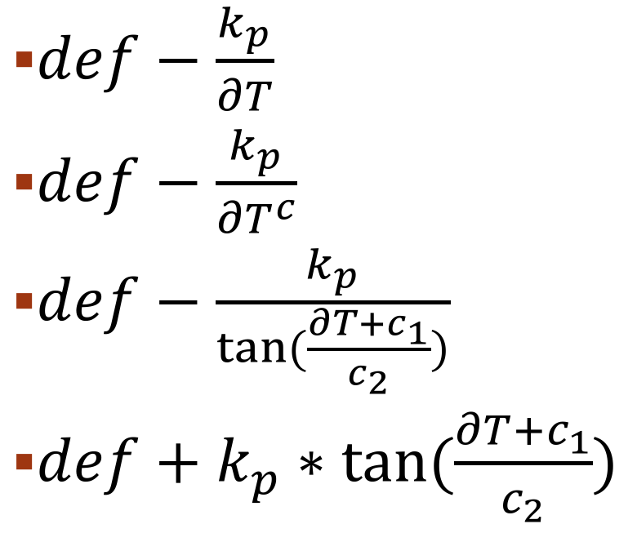
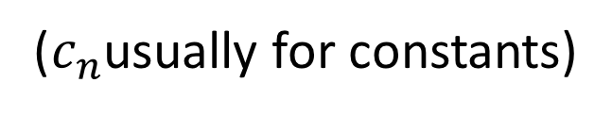
Flow sensor compensation - Formula
$def−\frac{k_{p}}{∂T}$
$def−\frac{k_{p}}{{∂T}^{c}}$
$def−\frac{k_{p}}{\tan{(\frac{∂T+c_{1}}{c_{2}})}}$
$def+k_{p}∗\tan{(\frac{∂T+c_{1}}{c_{2}})}$
Simple / no curve
Relatively simple / flat
Enough curly / upper limit
Enough curly / better limit
($c_{n}$usually for constants)

Slide 6
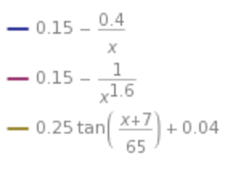
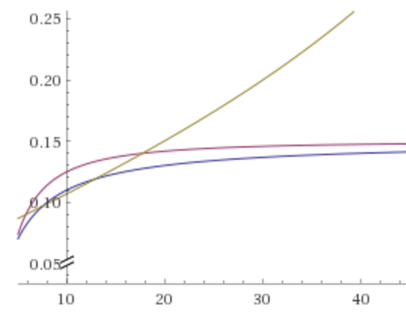
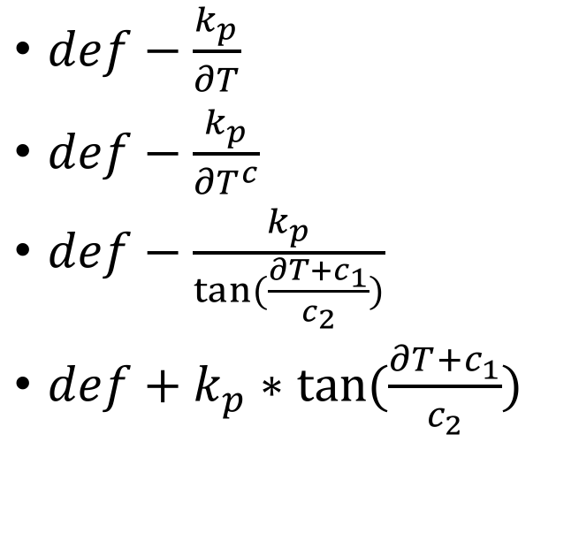
Formula
$def−\frac{k_{p}}{∂T}$
$def−\frac{k_{p}}{{∂T}^{c}}$
$def−\frac{k_{p}}{\tan{(\frac{∂T+c_{1}}{c_{2}})}}$
$def+k_{p}∗\tan{(\frac{∂T+c_{1}}{c_{2}})}$

Slide 7
App Design - Concepts
Thread / process
Multithreading
Asynchronous job
Handler
Inter-process communication
Message Queue
Bluetooth Socket & Protocol
Reliable & ordered. Like TCP
No remote synchronization needed

Slide 8
