Slide 1


Network Security
Miti Mazmudar, Sajin Sasy and Parjanya Vyas
Notes:
Introduce myself. Welcome. Go through schedule and register on netsim. Has everyone registered?

Slide 2
What will we do by the end of this workshop?
Define the foundations of internet computer networks
Define security and its role in networks
Execute (simulated) attacks against a network
Identify real world implications and defenses
Notes:
Learning Outcomes:
Participants will be able to recognize and explain the relationships between concepts such as packets, protocols and networking devices.
You’ll also be able to define aspects of security in the context of networks.
Execute network security attacks within the confines of the game
Be able to discuss the implications of attacks and defenses in network security

Slide 3
Netsim Registration info.
Register for Netsim at:
https://cs.uwaterloo.ca/~m2mazmud/netsim/
Alternatively: https://netsim.erinn.io/
Passwords cannot be recovered. Progress will be lost.

Slide 4
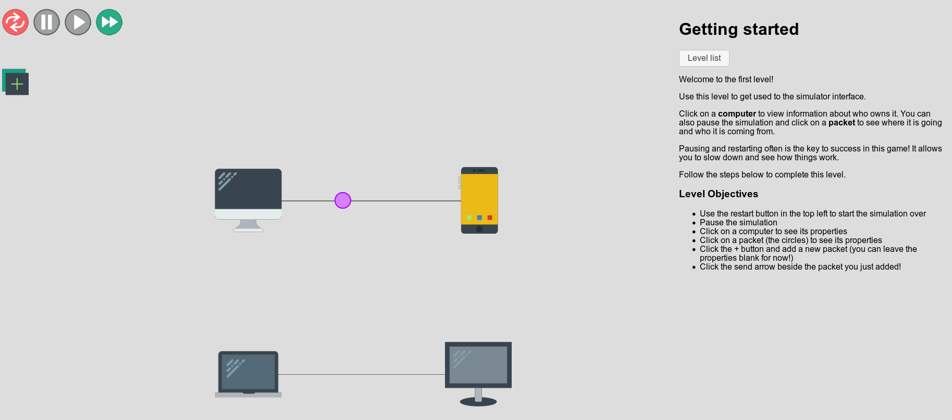
Netsim Interface
Notes:
So this is what the game looks like. Instructions are on the right hand side. You can pause, restart and fast-forward the animation with the buttons on the top left.
Casing may matter. Pay attention to what is capitalized. If all else fails and you think you are right, refresh.
The first game just familiarizes you with the interface.

Slide 5
Outline
Security foundations
Computer networks background
Activities: Basics + Spoofing
Walkthrough: Stealing packets
Activities: DoS, Distributed DoS
Walkthrough: Man-in-the-middle attack
Real-world consequences
Notes:
We are going to start by first introducing security and privacy matters.
I’ll then introduce some of the network terms you will see in the first exercises
We will then cover some foundational ideas about what security is.
You then get to go try out the game and try to win a few activities.
We’ll come back in and I’ll walk you through some of the security activities.
Finally, we will wrap up by discussing some real world implications of the attacks from today and some of the defenses

Slide 6
Why care about security and privacy?

Slide 7

Notes:
Why does any of this matter? Today, bigger data breaches are happening more frequently.

Slide 8
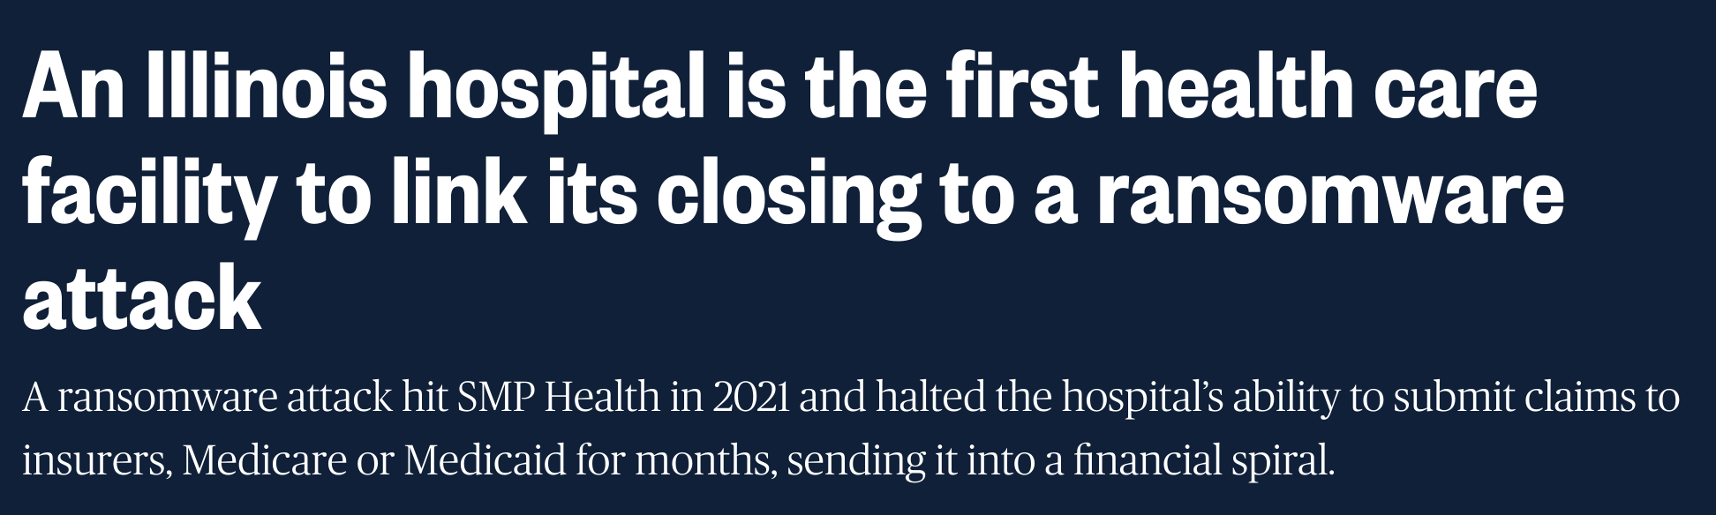
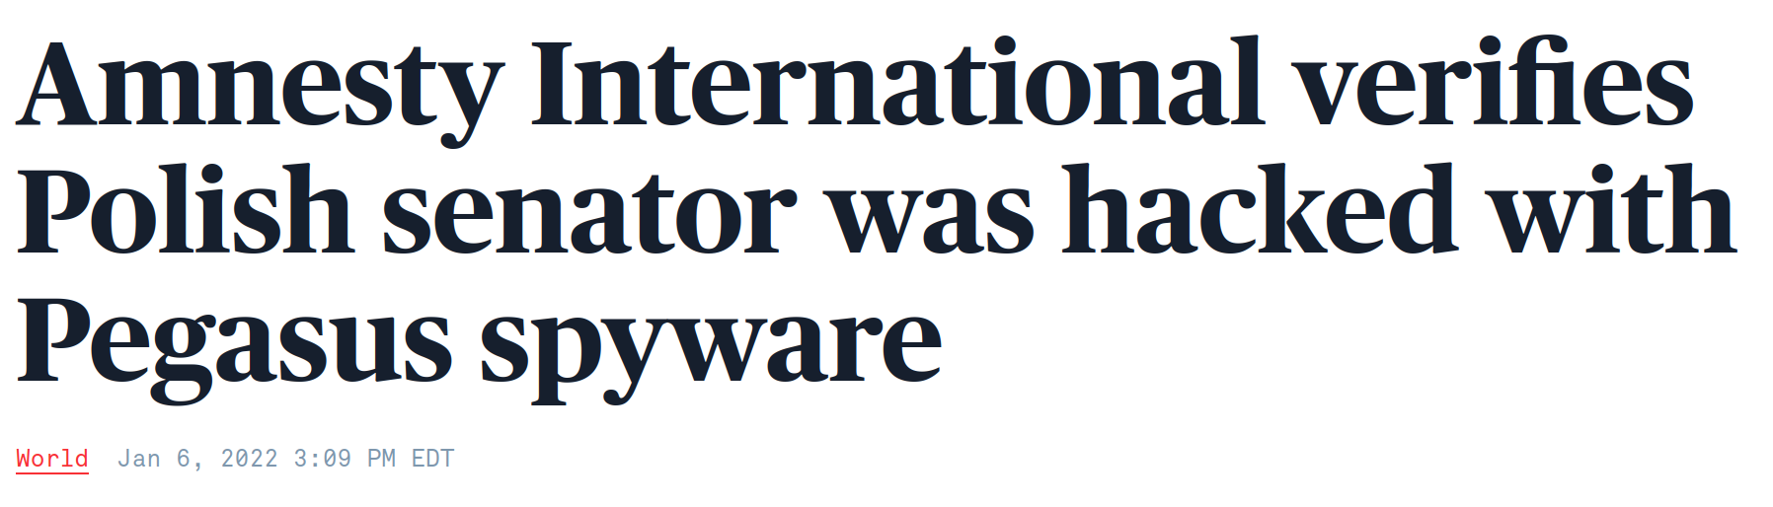

Notes:
Ransomware is being used to attack hospitals. As this example shows, an Illinois hospital had to shut down in the years following the attack.
Spyware poses considerable risks to the lives of journalists and activists, as well as government officials. Spyware has been used to spy on government officials in opposition parties around the world. As such, spyware could impact democracy.

Slide 9
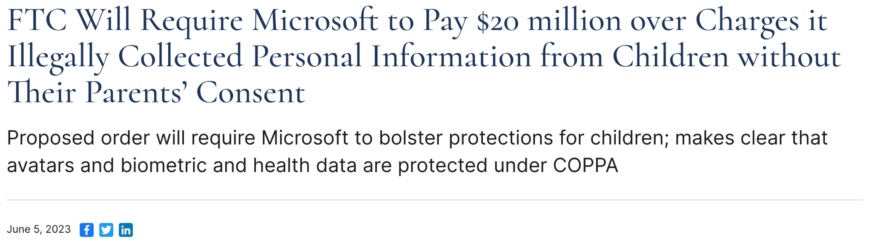
Privacy & compliance
Notes:
Organizations often mishandle users’ data. Consumer privacy and data protection authorities regularly fine companies for privacy violations.. For instance, FTC charges Microsoft for collecting childrens’ biometric, health data and avatars without their parents’ consent. Since the start of the year, FTC has fined an online therapy service, BetterHelp and a telemedicine company GoodRx, and the edtech company Chegg. It has ordered these companies to limit collecting data to that which is necessary for providing the service, and to stop sharing sensitive data with advertisers and so on.

Slide 10
What is Security?
Notes:
With that motivation, we can move on to defining aspects of security.

Slide 11
Adversary can attack...
Hardware
Software
Data
Notes:
When we talk about security, we have an attacker in mind, who has some goals, whether it is financial gain or stealing information or causing personal harm.
The adversary can attack the hardware, software and steal data.
So, the attacker causes harm to the user or to the system to achieve their goals.
Ways in which the attacker can cause harm, are known as threats.

Slide 12
Threats: cause harm to user or system
Fabrication (e.g. spoofing)
Interception (e.g. stealing packets, man-in-the-middle)
Interruption (e.g. DoS)
Notes:
We will come across three broad types of threats in our game today.
First, an attacker can come up with fake data that is intended to deceive you. This is the fabrication threat. The spoofing activity is an example of a fabrication threat.
Second, an attacker can intercept or seize your data, when you meant to send the data to someone else. We have two activities as examples of the interception threat: the stealing packets activity and the man-in-the-middle activity.
Third, an attacker may just stop a service or turn off a machine that you are trying to access. The DoS activity is an example of the interruption threat.

Slide 13
Security & Reliability Goals
Safeguard access to systems: Authorization, Authentication
Hiding data from others: Confidentiality (Encryption)
Keeping data correct: Integrity
Keeping systems accessible at all times: Availability
Notes:
A security engineer would have four broad goals:
To prevent people who shouldn’t be accessing the system from doing so --- we say that the access should be authorized and authenticated.
Second, some data should only be shared between a set of parties, and should be hidden from others --- that is, it should be kept confidential.
We also want to keep the data correct --- ensure its integrity.
Finally, we want to have access to the system at all times (in light of the interruption threat) --- this is availability.

Slide 14
Basic Networking Terms

Slide 15
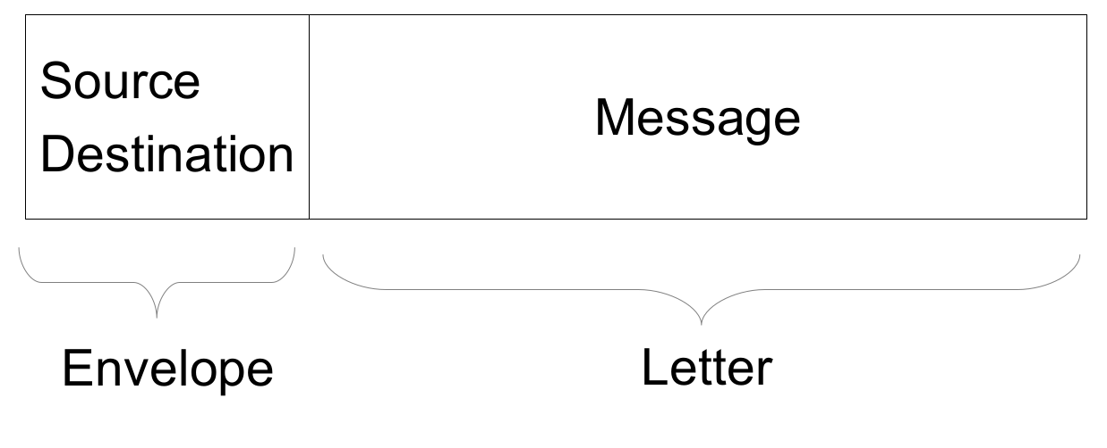

Internet: Packets are what it’s made of
Address label on Box
Cat Costume
Notes:
When we communicate on the internet, we use packets.
So much like packages, packets have addresses on them and they carry a message.
These addresses are known as IP addresses — we’ll get to the IP part in just a bit.
Packets have a source address — where the packet is coming from and a destination address — where the packet is going to.
Source is abbreviated as SRC and destination is abbreviated as DST in this game.

Slide 16
Packets have Layers: Onions
Source Destination | Type of message | Message
Network layer (IP) | Transport layer | Application layer
Notes:
So packets have layers — much like onions and cakes.
The actual message that you sent is surrounded by layers of additional information that helps devices process this packet.
We have the network layer, the transport layer and the application layer.
The network layer deals with addressing packets, and figures out how to get a packet from a source to a destination.
In our game, the transport layer describes the type of message that is being sent.
In real-life, the transport layer manages how fast to send packets and manage connections between devices on the internet.
Finally, the innermost layer of our onion-shaped packet is the application layer, and we find our message here.
So here we have the application layer towards the end of the packet.

Slide 17
Protocols
Source Destination | Type of message | Message
Network layer (IP, ICMP) | Transport layer | Application layer
Notes:
Each of these layers have different protocols: a protocol is a convention between two or more parties.
The network layer is the one most relevant to us today.
The Internet Protocol or IP is a common network protocol. The Internet Protocol helps getting packets from a source to a destination.
So those addresses we talked about are Internet Protocol or IP addresses.
Another example of a network protocol is the Internet Control Message Protocol or ICMP — you don’t need to remember these names, the game will guide you through activities with these protocols.

Slide 18
Getting Started: LET’S BREAK THINGS
Notes:
With that, let’s get started.

Slide 19
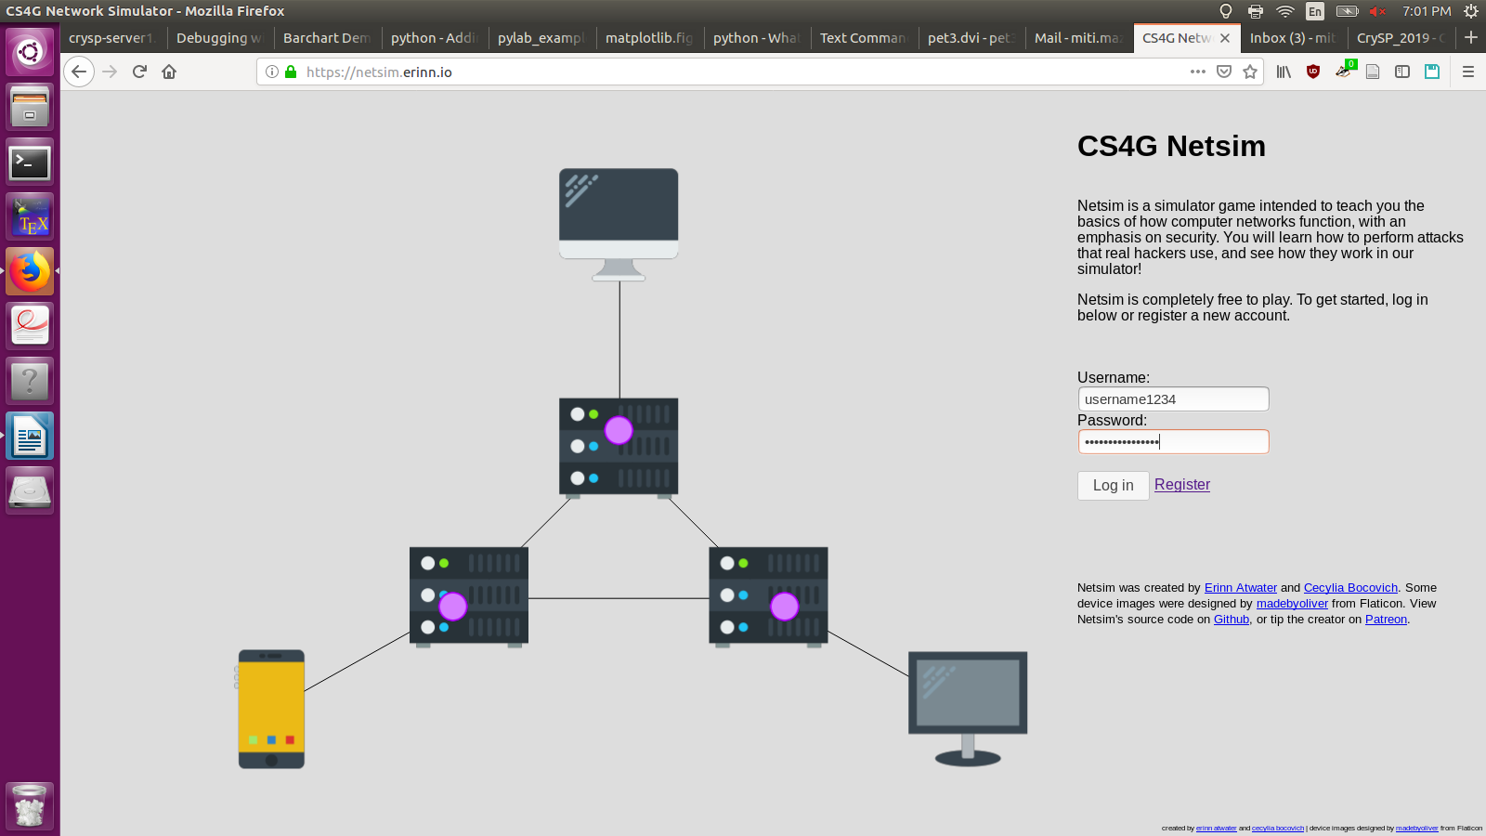
https://cs.uwaterloo.ca/~m2mazmud/netsim
WARNING: PASSWORDS CANNOT BE RECOVERED!!!!!!!
Progress would be lost.

Slide 20
Activities - Basics and Learning Interception
All Basics section activities
IP Spoofing and Stealing Packets (come back)
Basic DoS and Distributed DoS
And Man-in-the-middle
Notes:
Do the first set of exercises in Basics. We’re going to go through the first set of activities in Basics and then go through the IP spoofing activity.
We’ll then do another set of activities and work through the last security activity.

Slide 21
Stealing packets - attack logic
Alice want to convince the switch to send a (response) that was intended from Google to Charlie.
We know how to spoof packets, so Alice can send a request, pretending to be Charlie.
What packet should Alice create? (srcIP, dstIP, proto)
Notes:
So let’s start with the previous question — we managed to spoof packets. So here, Alice wants to convince the switch to send a response that was intended from Google to Charlie. We know how to spoof packets, so Alice can send a request pretending to be Charlie. What packet should Alice create? Write down the source IP, the destination IP and the protocol field.

Slide 22
Stealing packets - attack logic
Alice want to convince the switch to send a (response) that was intended from Google to Charlie.
We know how to spoof packets, so Alice can send a request, pretending to be Charlie.
What packet should Alice create? (srcIP, dstIP, proto)
  srcIP: Charlie, dstIP: Google, proto: ICMP
When should Alice send this packet?
  We need to understand the switch behaviour.
Notes:
So now the question is — when should Alice send this packet? We need to understand the switch behaviour. We’re gonna look closely at the simulation.

Slide 23
Stealing packets - switch table
The switch has a table, which associates a link (black line between devices) with an IP address.
  {link 1} → {Miti’s IP}
With each packet that the switch receives on a link:
How does the switch use the switch table?
How does the switch update the switch table?
Notes:
So here’s an example of what a switch table looks like. It maps a link to an IP address and for this example as well as the game, we just use people’s names in place of their IP address. And we number links here.
With each packet that the switch receives on the link, we want to answer two important questions about the switch’s behaviour. How does the switch use the switch map? And how does it update the switch map?

Slide 24
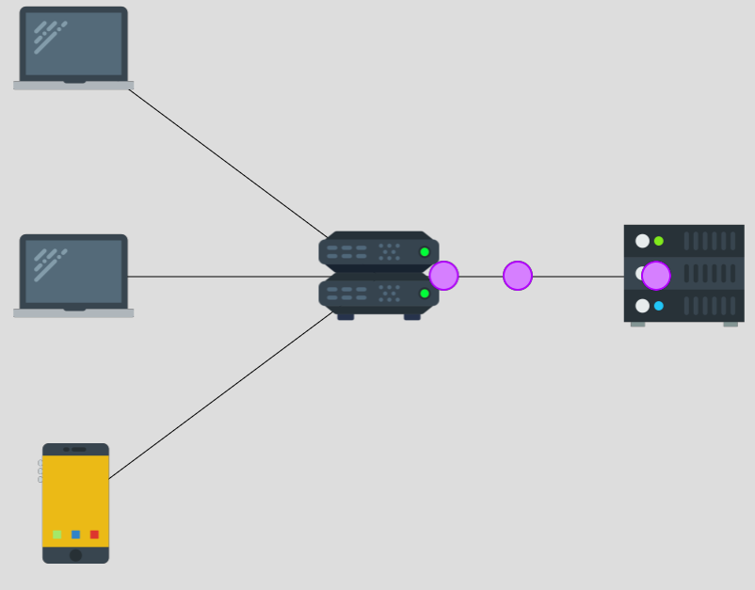
At switch: Google to Bob
Packet info
srcip | Google
dstip | Bob
Switch table
IP | Link
Black lines connecting devices are links.
Notes:
Now the switch gets the first packet from the right link, which has a source IP of Google and a dest IP of Bob, so this packet should go to Bob.
Whenever the switch sees a packet coming on a link, it first looks at its switch table. The switch wants to find out what link it should send the packet to, or rather, what link Bob is on.
The switch map is empty, so the switch does not know which link Bob is on.

Slide 25
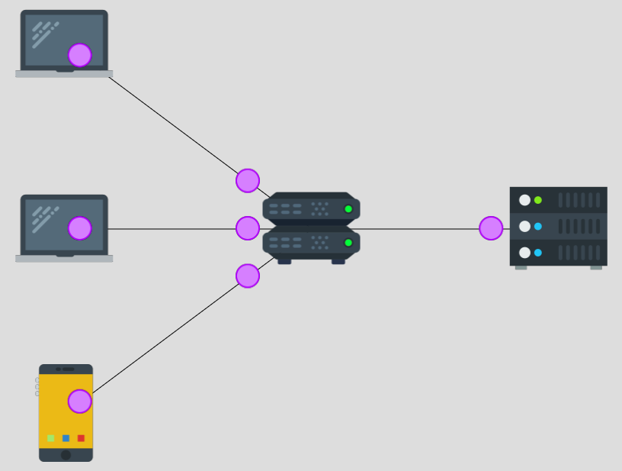
Switch processes: Google to Bob
Packet info
srcip | Google
dstip | Bob
Switch table
IP | Link
Google | Right
Notes:
When the switch map is empty, the switch simply sends the packet on all other links connected to it. So you can see in the next step, the switch sends the packet on all three links on the left-hand side, so Bob gets the packet, and additionally, Alice and Charlie also get the packet.
Importantly, once the switch gets this first packet, it learns something. It learns that packets on the right link come from the source IP of Google, so it learns that “Google is on the right link”. So, it updates its switch table by adding this entry.
In other words, whenever the switch receives a packet on a link, it adds an entry, or updates an existing entry.
The new entry associates the source IP of the packet, to the link that the switch received the packet on.

Slide 26
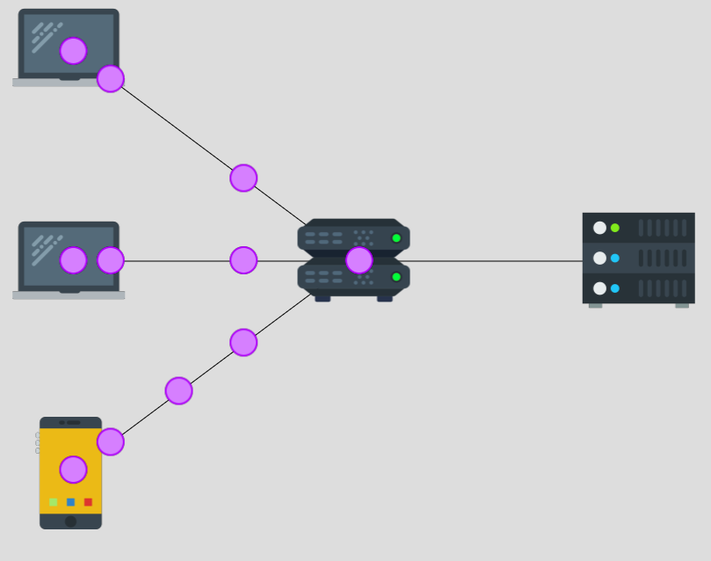
At switch: Charlie to Google
Packet info
srcip | Charlie
dstip | Google
proto | ICMP
Switch table
IP | Link
Google | Right
Notes:
Now the switch gets those two packets from the bottom link with the destination IP of Google. They are in the red boxes here. So the switch looks at the switch table again, to figure out where to send these packets to. The switch wants to know which link corresponds to Google.
This time, the switch map is not empty, as we just discussed. In fact, the switch map contains one entry, which maps Google to the right link.

Slide 27
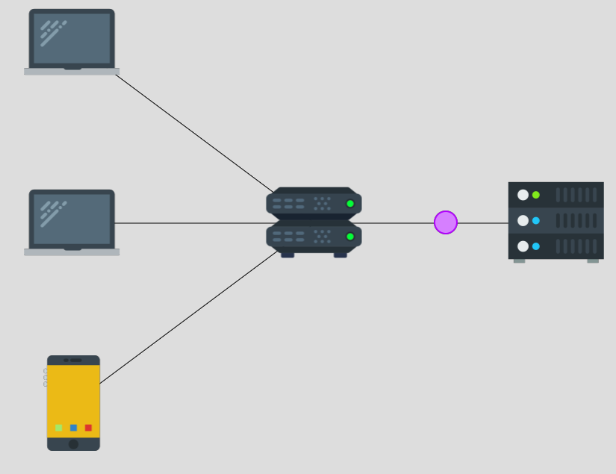
Switch processes: Charlie to Google
Packet info
srcip | Charlie
dstip | Google
proto | ICMP
Switch table
IP | Link
Google | Right
Charlie | Bottom
Notes:
So the switch sends the packets from the bottom link, only to the right link.
The switch also updates its switch table, after it has processed the first packet from the bottom link.
The switch got a packet from the bottom link with the source IP of Charlie, so it adds an entry mapping the bottom link to Charlie’s IP. (Based on source addresses)

Slide 28
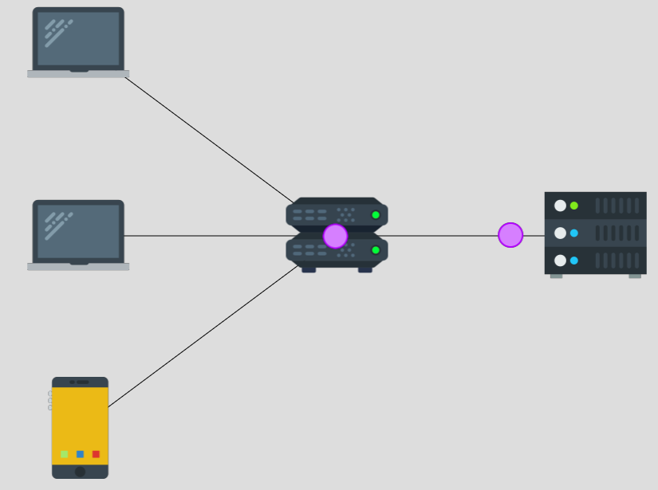
At switch: Google to Charlie
Packet info
srcip | Google
dstip | Charlie
proto | ICMP
Switch table
IP | Link
Google | Right
Charlie | Bottom
Notes:
So now when the switch gets the packets *from* Google on the right link, it sends them back on the bottom link, precisely because of this second entry in its switch map.
The switch considers adding an entry to its switch table, with the source IP of the packet it just received. But, the switch does not need to add an entry to its switch table. Can someone tell me why?
The switch would’ve added an entry associating Charlie to the bottom link. But the second entry in the table is exactly that — so the switch does not need to add another entry or update this entry.

Slide 29
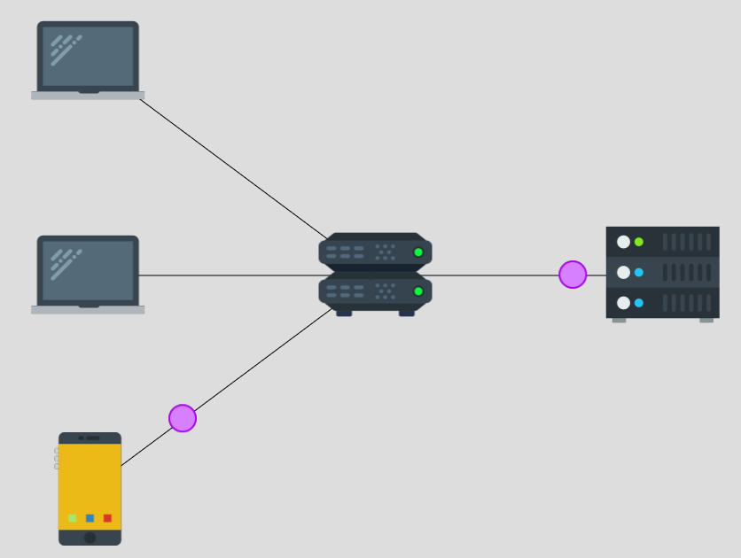
Switch processes: Google to Charlie
Packet info
srcip | Google
dstip | Charlie
proto | ICMP
Switch table
IP | Link
Google | Right
Charlie | Bottom
Notes:
And the switch correctly send these packets from Google to Charlie on the right link.

Slide 30
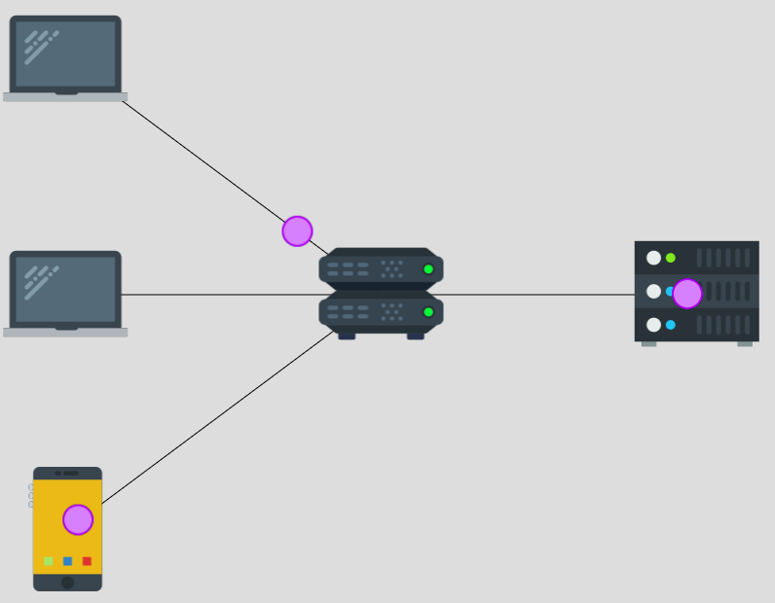
At switch: Charlie (sent by Alice) to Google
Packet info (as Alice)
srcip | Charlie
dstip | Google
proto | ICMP
Switch table
IP | Link
Google | Right
Charlie | Bottom Top
Alice sends a packet on the top link, pretending to be Charlie.
The switch updates its switch table.
But, depending on the timing, the switch table could change again. Google’s ICMP response might not go to the top link.
Notes:
So as Alice, our goal is to steal a packet from Google to Charlie. So Alice should receive a packet with a source IP of Google and a dest IP of Charlie, under the ICMP protocol. So to do that, Google would have received a packet, from Charlie. From the previous activity, we know Alice can spoof her own source IP. So we send this spoofed packet as Alice.
When the switch receives this packet, it will update the existing entry from “Charlie: Top” to “Charlie: Bottom”.
However, depending on the timing, the switch table could change again.
The switch table could look different by the time the switch gets a packet from Google. So the switch might not direct Google’s ICMP response back to the top link.

Slide 31
Timing options
Alice can send the spoofed packet either:
Before the switch processes any packets from real Charlie
After the switch processes the 1st packet from real Charlie but before it processes the 2nd packet.
After the switch processes both packets from real Charlie.
After the switch processes both packets from Google to real Charlie.
Notes:
So we can send our spoofed packet at different times and that would have different impacts on the switch table.
Let’s start with the first case: sending the spoofed packet before the switch processes any packets from the real Charlie.

Slide 32
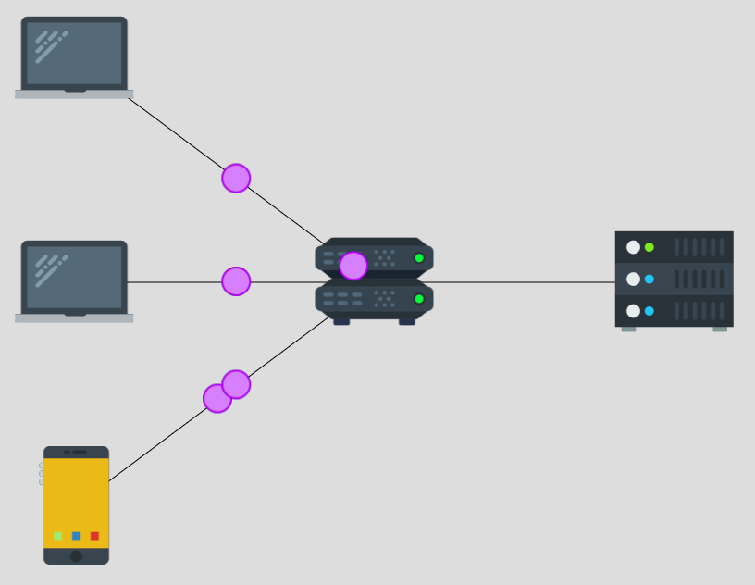
Before any packets from (real) Charlie
Packet info (sent by Alice)
srcip | Charlie
dstip | Google
proto | ICMP
Switch table
IP | Link
Google | Right
Charlie | Bottom Top ????
Send our packet (in red box) before any packets from the real Charlie (in white box) arrive at the switch
Notes:
So we have a diagram for this case, with our spoofed packet in the red box and real Charlie’s first packet in the white box.
Once the switch processes our packet, it would update the switch table’s row associating Charlie to the bottom link and instead associates Charlie with the top link.
Now the switch would process the packet in the white box, which comes from real Charlie.
Can someone tell me what happens to the switch table, once the switch processes the packets from the real Charlie?

Slide 33
Before any packets from (real) Charlie
Packet info (sent by Alice)
srcip | Charlie
dstip | Google
proto | ICMP
Switch table
IP | Link
Google | Right
Charlie | Bottom Top Bottom
Send our packet (in red box) before any packets from the real Charlie (in white box) arrive at the switch
Notes:
Well, the first packet from Charlie updates the switch table, and the switch goes back to associating the bottom link with Charlie. So Alice’s attack is not successful.

Slide 34
After real Charlie’s first packet but before the 2nd packet
Packet info (as Alice)
srcip | Charlie
dstip | Google
proto | ICMP
Switch table
IP | Link
Google | Right
Charlie | Bottom Top Bottom
Send our packet (in red box) after the switch processes the 1st packet from the real Charlie (in white box), but before the 2nd packet arrives at the switch.
Notes:
In the second case, we send the packet a bit later. Here, you can see our spoofed packet packet in a red box, is reaching the switch after the first packet (in a white box on the right) from the real Charlie has reached Google.
But before the real Charlie sends the second packet from their yellow phone, in the bottom.
What happens to the switch table in this case?
Again, due to the second packet, the switch associates Charlie with the bottom link.

Slide 35
Timing options
Alice can send the spoofed packet either:
Before the switch processes any packets from real Charlie: Too early
After the switch processes the 1st packet from real Charlie but before it processes the 2nd packet: Too early
After the switch processes both packets from real Charlie.
After the switch processes both packets from Google to real Charlie.
Notes:
In both first and second cases, we send the packet early, and the packets from real Charlie reset the switch table reset back to what it was initially. So we can send our spoofed packet later.

Slide 36
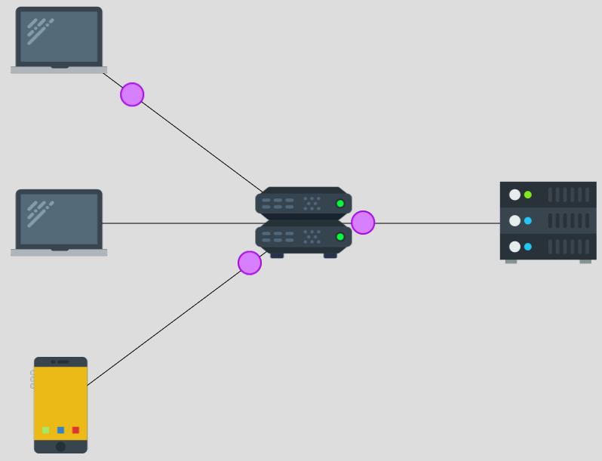
After both packets from real Charlie
Packet info (as Alice)
srcip | Charlie
dstip | Google
proto | ICMP
Switch table
IP | Link
Google | Right
Charlie | Bottom Top
Send our packet (in red box) after the switch processes the 2nd packet from the real Charlie (in white box). Also after any packets from Google (in blue box).
Notes:
In this diagram, we send the spoofed packet after both packets from real Charlie (to Google) have been processed at the switch. So by this time, the switch has also processed the first packet back from Google. When the switch gets the second packet from Google, it now sends this packet on the top link. Then Google responds to Alice’s spoofed packet, and the switch also directs this response on the top link.

Slide 37
Timing options
Alice can send the spoofed packet either:
Before the switch processes any packets from real Charlie: Too early
After the switch processes the 1st packet from real Charlie but before it processes the 2nd packet: Too early
After the switch processes both packets from real Charlie: Perfect timing
After the switch processes both packets from Google to real Charlie: Perfect timing
Notes:
We can send our spoofed packet even later — after the switch has processed both responses from Google. Again, there will be no changes to the switch table after the switch processes Alice’s spoofed packet.
You should be able to win the game if you time your packet under both third and fourth cases. The only difference between the third and fourth cases is the number of packets that Alice manages to steal. In the fourth case, Alice only gets Google’s response to its own spoofed packet. In the third case, Alice *also* steals the packet from Google to the real Charlie, which was in response to real Charlie’s 2nd packet.

Slide 38
Activities - Basics and Learning Interception
All Basics section activities
IP Spoofing and Stealing Packets (break)
(continue) Basic DoS and Distributed DoS
Man-in-the-middle (come back to main room before solving)
Notes:
Implications

Slide 39

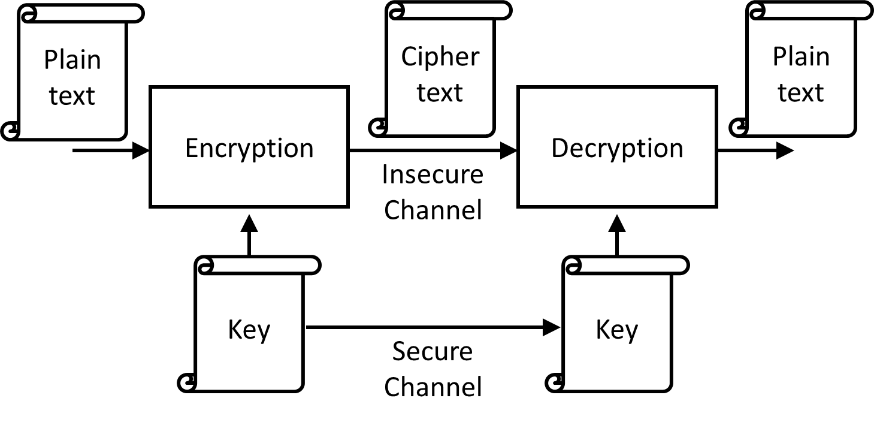



Ciphers
Notes:
Earlier we discussed that as a security engineer, we strive to have confidentiality. Going to our package delivery example, I’m ordering a package on Amazon. I use an ethernet cable connection from my home, and Sajin is my Internet Service Provider, like Rogers or Bell. I don’t trust Sajin and I don’t want Sajin to be able to read my order. So I want to communicate confidentially with Amazon.
In fact, I don’t even want Sajin to be able to change my order, and that is known as integrity.
So to communicate with confidentiality on the internet, we use ciphers. Amazon and I in this case, know of a secret key that no one, not even Sajin knows about. At its core, a cipher consists of two operations: encryption, and decryption, and these two operations are inverses of each other, just as addition and subtraction are inverses of each other. Whenever I want to send a message, or a plaintext, I garble it into a ciphertext, using the encryption operator. The garbled output of encryption is known as ciphertext.
Now I can give the ciphertext to Sajin and let Sajin send the message to Amazon. As I said earlier, decryption is the inverse of encryption. So Amazon takes the ciphertext, and the secret key, and decrypts the ciphertext to get the plaintext message which was my order for a package.
The cool thing about ciphers is that as long as Sajin doesn’t know the secret key, Sajin won’t be able to do the thing that Amazon does — Sajin won’t be able to decrypt the ciphertext.

Slide 40
Caesar cipher example: encryption
Encryption: Each letter in the plaintext alphabet is replaced by the k^{th} letter after it, to form the ciphertext. Example with k = 5:
Plaintext: “NETSIM IS GREAT”, Key: k = 5
Ciphertext: ??????
Plain | A | B | C | D | E | F | G | H | I | J | K | L | M | N | O | P | Q | R | S
Cipher | F | G | H | I | J | K | L | M | N | O | P | Q | R | S | T | U | V | W | X
Plain | T | U | V | W | X | Y | Z
Cipher | Y | Z | A | B | C | D | E
Notes:
So we start with an example of a millenia old cipher: the Caesar cipher. We work with alphabet letters in our example. I’ve defined the encryption operation in the Caesar cipher. Encryption replaces each letter in the plaintext alphabet by the k^{th} letter after it, to form the ciphertext. Here k is the key. The two tables on the slide compute an output ciphertext letter for a given input plaintext letter. I want to encrypt the plaintext: Netsim is great with the key k=5. I want you to compute the first word of the ciphertext.

Slide 41
Caesar cipher example: encryption
Encryption: Each letter in the plaintext alphabet is replaced by the k^{th} letter after it, to form the ciphertext. Example with k = 5:
Plaintext: “NETSIM IS GREAT”, Key: k = 5
Ciphertext: “SJYXNR NX LWJFY”
Plain | A | B | C | D | E | F | G | H | I | J | K | L | M | N | O | P | Q | R | S
Cipher | F | G | H | I | J | K | L | M | N | O | P | Q | R | S | T | U | V | W | X
Plain | T | U | V | W | X | Y | Z
Cipher | Y | Z | A | B | C | D | E
Notes:
So the correct ciphertext is shown on this slide.

Slide 42
Caesar cipher example: decryption
Encryption: Each letter in the plaintext alphabet is replaced by the k^{th} letter after it, to form the ciphertext.
Decryption should invert the encryption operation. It should take as input the ciphertext and the key, and output the plaintext.
Notes:
Now we want the decryption operation to invert or undo the effects of the encryption operation. It should take as input the ciphertext and the key, and output the plaintext. Can someone tell me what the decryption operation can be defined as?

Slide 43
Caesar cipher example: decryption
Each letter in the ciphertext alphabet is replaced by the k^{th} letter before it, to form the plaintext. Example with k = 5:
Check that ciphertext: “XJHZWNYD NX LWJFY” with key k=5 decrypts to plaintext: “SECURITY IS GREAT”
Cipher | F | G | H | I | J | K | L | M | N | O | P | Q | R | S | T | U | V | W | X
Plain | A | B | C | D | E | F | G | H | I | J | K | L | M | N | O | P | Q | R | S
Cipher | Y | Z | A | B | C | D | E
Plain | T | U | V | W | X | Y | Z
Notes:
So we can define the decryption operation to as replacing each ciphertext letter with the kth letter before it. I’ve just moved the ciphertext and plaintext rows in our table, to help us easily calculate the plaintext for our example with k=5. In fact, you can check that the ciphertext decrypts to “netsim is great”.

Slide 44
Caesar cipher
sjyxnr nx lwjfy
Caesar cipher
Replace by k^{th} letter after plaintext
Caesar cipher
Replace by k^{th} letter before plaintext
netsim is great
netsim is great
k = 5
k = 5
Notes:
So going back to our example, we see the Caesar cipher and its encryption and decryption operations here.

Slide 45
Keeping the key secret (or not)
Alice and Bob need to know a secret key to communicate confidentially.
What if Alice just creates the secret key and sends it to Bob? If Bob doesn’t like the key, Bob can send his own key and send it back to Alice.
This simple protocol is flawed, as we will see in the Man-in-the-middle activity.

Slide 46
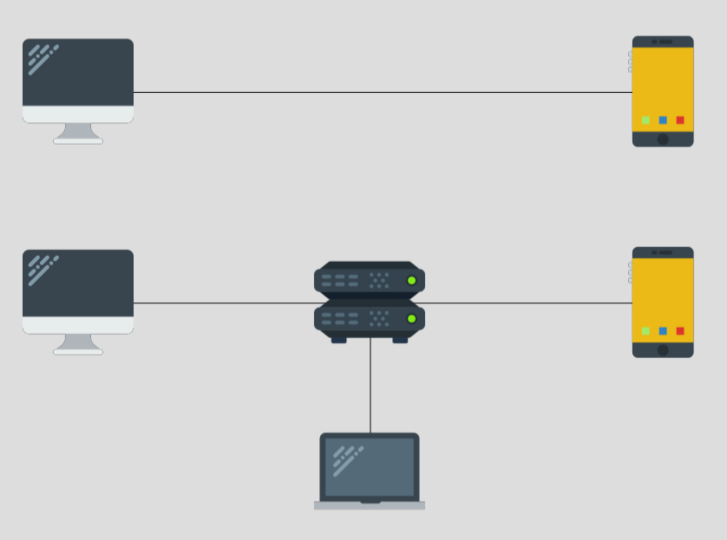
Man-in-the-middle (MITM) activity
Example Alice
Example Bob
Alice
Router
Bob
Eve
Notes:
So let’s move on to the ‘man-in-the-middle attack’ activity. This activity includes three parties: Alice, Bob, Eve.
The top of the activity has an example animation with example Alice and example Bob. Alice and Bob want to communicate confidentially.
The bottom of the activity has a router and Eve is connected to the router. Eve is an attacker. Eve tries to eavesdrop on Alice and Bob’s communication. Eve wants to break confidentiality and obtain plaintext messages. You’re going to be inserting packets into the bottom of the activity.

Slide 47
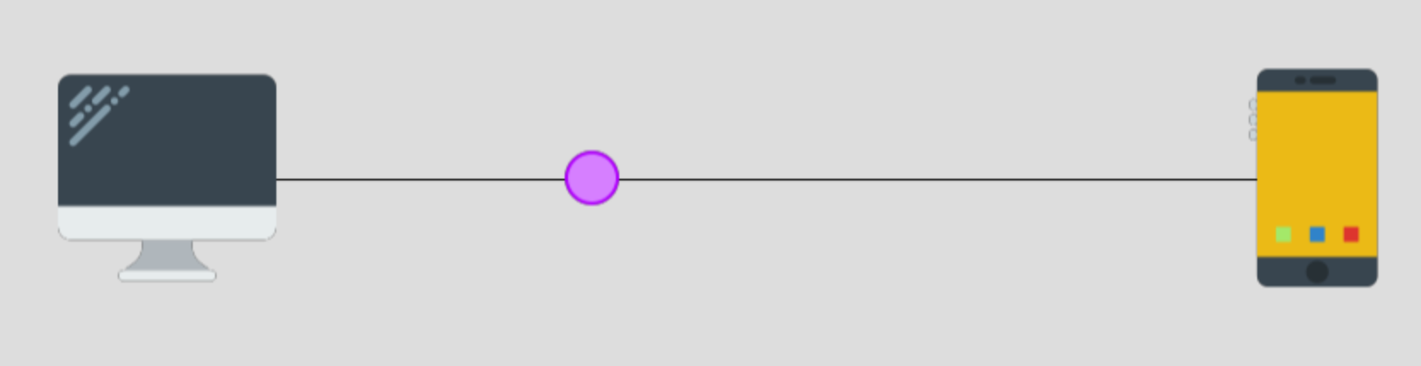
Keyrequest
Example Alice
Example Bob
Packet info
srcip | Example Alice
dstip | Example Bob
proto | encryption
type | keyrequest
key | 123456
Example Alice says to Example Bob: Can we use the key 123456?
Notes:
Alice sends a keyrequest message to Bob.

Slide 48
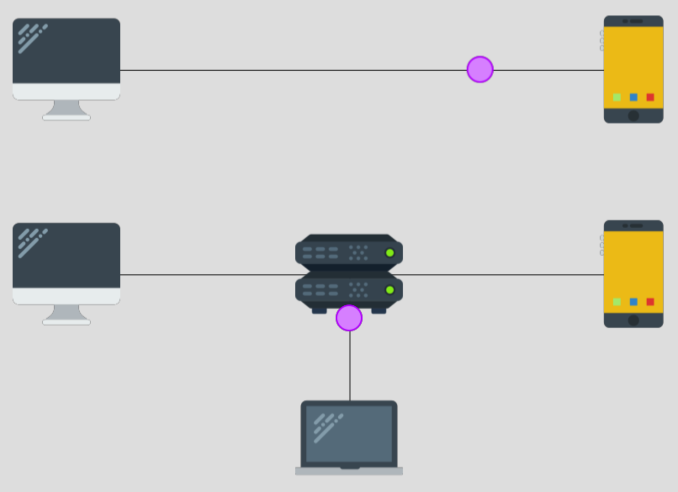
Keyresponse
Example Alice
Example Bob
Packet info
srcip | Example Bob
dstip | Example Alice
proto | encryption
type | keyresponse
key | 123456
Example Bob says to Example Alice: Sure, let’s use the key 123456.
Note: Bob can also send a different key in a packet of the keyresponse type.
Notes:
Alice receives a keyresponse message from Bob.

Slide 49
Encrypted message
Example Alice
Example Bob
Packet info
srcip | Example Alice
dstip | Example Bob
proto | encryption
type | message
key | 123456
Example Alice encrypts the plaintext message “message” to Example Bob, using the key 123456.

Slide 50
Keyrequest: bottom animation
Example Alice
Example Bob
Packet info
srcip | Alice
dstip | Bob
proto | encryption
type | keyrequest
key | 123456
Alice says to Bob: “Can we use the key 123456?”
Eve steals Alice’s packet (previous activity!). Bob doesn’t get Alice’s packet!
Notes:
Eve has control over a router between Alice and Bob. She can see all messages that pass through this router and she can spoof messages from either Alice or Bob.

Slide 51
Bottom animation: Goals
You are Eve. You want to have two separate conversations with Alice and Bob, while misleading them into thinking they’re talking to each other.
You’ve stolen Alice’s keyrequest packet. Respond back to Alice’s keyrequest packet. Trick Alice into encrypting her message with Eve's key: 31337.
Trick Bob into thinking he got the encrypted message from Alice, with Alice's key: 123456.
Notes:
In this activity, you are the attacker or eavesdropper Eve. You should have two separate conversations with Alice, Bob, deluding each into believing that they are talking with the other.
You’ve stolen Alice’s keyrequest packet. You have two goals, so you’ll be sending two packets. First, as Eve, respond back to this packet with a keyresponse. Trick Alice into encrypting her message with Eve’s key 31337.
Second, you need to trick Bob into thinking he got an encrypted message from Alice, with Alice’s key.

Slide 52
Bottom animation: Goals
You are Eve. You want to have two separate conversations with Alice and Bob, while misleading them into thinking they’re talking to each other.
You’ve stolen Alice’s keyrequest packet. Respond back to Alice’s keyrequest packet. Trick Alice into encrypting her message with Eve's key: 31337.
  Eve can send a spoofed packet of type: keyresponse, setting Bob as the srcIP, key:31337 and other fields (proto:encryption).
Trick Bob into thinking he got the encrypted message from Alice, with Alice's key: 123456.
  Eve can send a spoofed packet of type:message, setting Alice as the srcIP, key: 123456 and other fields (proto:encryption).
Notes:
So for the first goal, Eve can use her spoofing skills to pretend to be Bob. Eve will send a spoofed packet of type: keyresponse, setting Bob as the srcIP and the key 31337. So let’s try to do that. Keep in mind we’ll also need to set the proto field of the packet, as in the simulation.
Now moving on to the second goal, Eve wants to trick Bob into thinking he got an encrypted message from Alice.
Again, Eve can spoof a packet to Bob, pretending to be Alice. This packet will contain a ciphertext message and so its type will be ‘message’.
Eve can set Alice as the srcIP, key: 123456 and other fields (proto:encryption).
So that concludes the man in the middle attack.

Slide 53
Man-in-the-middle attack
Learning outcomes:
One party cannot simply send a key to another party. It can be intercepted by others.
In real-life, both parties use key exchange schemes to compute a shared secret key. Even if Eve tries to intercept their communication, she will not be able to compute this secret key.

Slide 54
Beyond Simulation Implications
Notes:
Wrap up and what this workshop means and you should take away

Slide 55
Control the Risk
Systems have vulnerabilities
Adversaries attack vulnerabilities
We want to control the vulnerabilities

Slide 56
Defend Against the Threat
Notice an attack - detecting it
Stop it from happening - preventing it
Make it really difficult
Make something else seem more attractive to attack
Counterbalance the effects of the attack - mitigating it

Slide 57
Real-world defenses & resources
Encryption and Public Key Cryptography
  Visual resource: https://idea-instructions.com/public-key/
Protecting against man-in-the-middle attacks: HTTPS
  Activating HTTPS features of sites that you visit: HTTPS Everywhere - https://www.eff.org/https-everywhere/faq
  Support HTTPS on your website: Certbot - https://certbot.eff.org/
Assessing your digital security and privacy:
  Consumer Reports Security Planner: https://securityplanner.consumerreports.org/

Slide 58
Takeaways
These simulated attacks have real world implications
Attacks like these often exist because the technology was built without considering the potential implications
Integrating security within a design can help you later
Access talk later: https://dettanym.github.io
Miti Mazmudar
Notes:
Integrating security within design
Lots of these things happen and were found because security wasn’t first. It wasn’t until there were consequences

