Slide 1

SQL Sales Performance Analysis
Jithin Varghese
Henry
Vanessa ZAMORA
Nikita
Mahender REDDY

Slide 2
Contents
Project Overview
Data Ingestion and Cleaning
Exploratory Data Analysis (EDA)
Visualizations
Challenges Faced
Conclusion
Q&A

Slide 3
Project Overview
Analyze sales data using SQL to identify trends, popular products, and customer behavior.
Data Source:
https://www.kaggle.com/datasets/mkechinov/ecommerce-purchase-history-from-electronics-store/data
https://rees46.com/
Raw Sales data from CSV files.

Slide 4

Project Overview
Table Structure:
CREATE TABLE sales (
event_time TIMESTAMP with TIME ZONE,
order_id BIGINT,
product_id BIGINT,
category_id BIGINT,
category_code CHARACTER VARYING(100),
brand CHARACTER VARYING(100),
price MONEY,
user_id BIGINT
);

Slide 5
ABOUT DATASET
Sales data of 2020 from a large home appliances and electronics online store.
Each row in the table represents an event.
All events are related to products and users.
Each event is like many-to-many relation between products and users.
A session can have multiple purchase events because it's a single order.

Slide 6
Data Ingestion And Cleaning
Imported Data from Flat File to ‘sales’ table
COPY sales (event_time, order_id, product_id, category_id, category_code, brand, price, user_id) FROM 'D:\kz.csv\kz.csv'DELIMITER ',' CSV HEADER ENCODING 'UTF8’;
Created Index for improving Read performance
Updating Missing Values/Blank Spaces to NULL values
Example: UPDATE sales SET category_code = NULL WHERE TRIM(category_code)=‘’;
Input Missing values for Price based on Average price of that Category
UPDATE sales AS s SET price = COALESCE(s.price, t1.price::MONEY) FROM ( SELECT ROUND(AVG(price::NUMERIC)) AS price, category_id FROM sales GROUP BY category_id) t1 WHERE s.category_id = t1.category_id AND s.price IS NULL;

Slide 7
DATA LOADING
COPY sales (event_time, order_id, product_id, category_id, category_code, brand, price, user_id)
FROM 'D:\kz.csv\kz.csv'
DELIMITER ','
CSV HEADER
ENCODING 'UTF8';

Slide 8
DATA CLEANING
UPDATE sales
SET category_code = NULL
WHERE TRIM(category_code)=‘’;
UPDATE sales
SET brand = NULL
WHERE TRIM(brand)=‘’;
UPDATE sales
SET price = NULL
WHERE price=‘’;

Slide 9
EXPLORATORY DATA ANALYSIS (EDA)
GETTING INSIGHTS FROM THE DATA

Slide 10
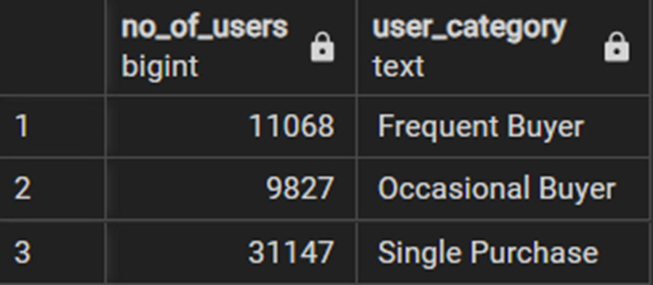
CATEGORISING USERS
Categorised users based on orders
WITH t1 AS (SELECT
user_id,
CASE
WHEN COUNT(*) = 1 THEN 'Single Purchase'
WHEN COUNT(*) = 2 THEN 'Occasional Buyer'
WHEN COUNT(*) >= 3 THEN 'Frequent Buyer'
ELSE 'No Purchases'
END AS user_category
FROM sales
WHERE user_id IS NOT NULL
GROUP BY user_id)
SELECT COUNT(user_id) AS no_of_users, user_category
FROM t1
GROUP BY user_category;
Information can be used to prevent Customer Churning

Slide 11
Visualizations

Slide 12
MONTHLY SALES TREND

Slide 13
MONTHLY SALES TREND

Slide 14
Popular PRODUCTS IN APRIL

Slide 15
SEASONAL TRENDS

Slide 16
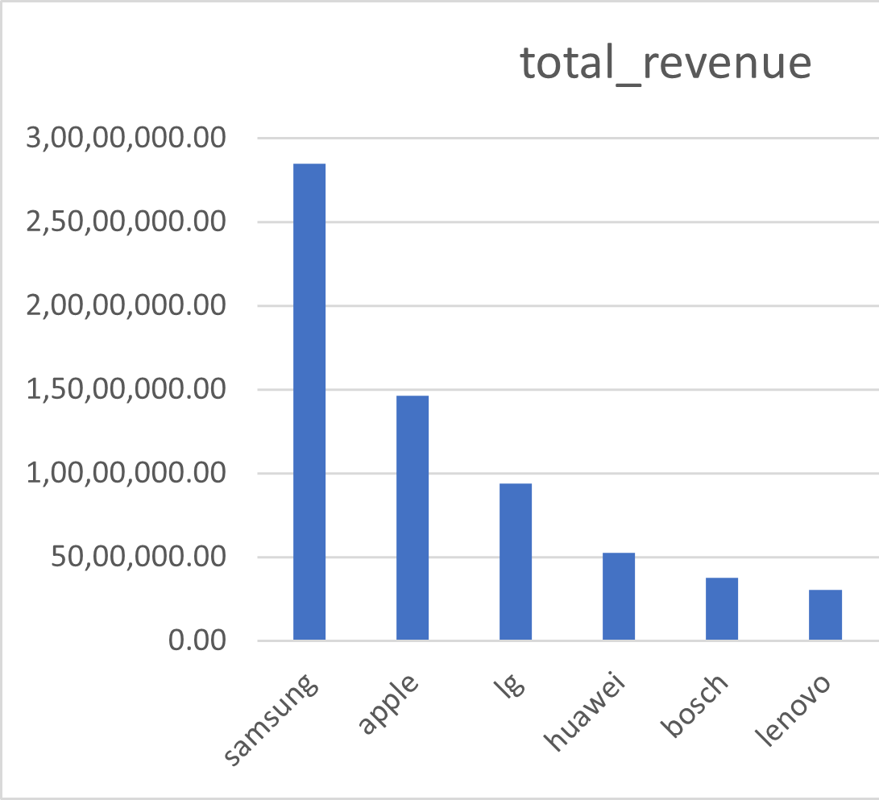
BEST SELLING BRANDS

Slide 17
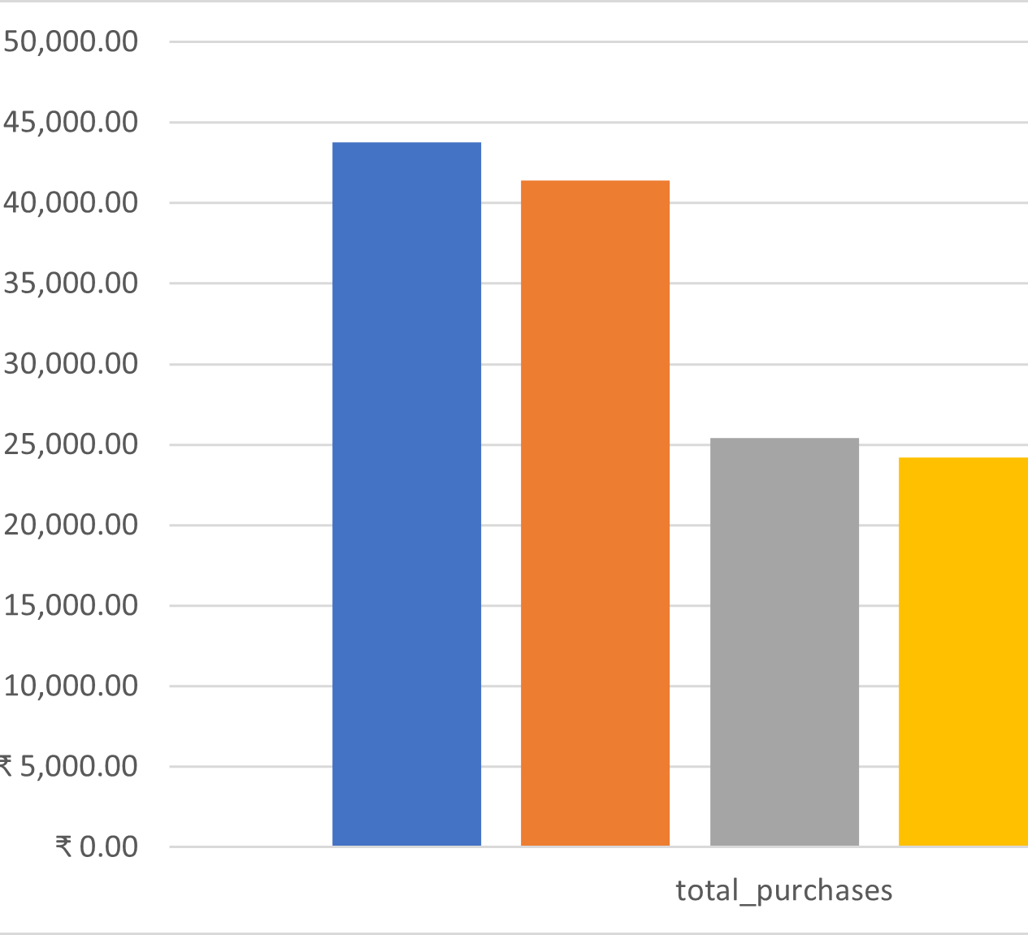
IDENTIFYING LOYAL CUSTOMERS

Slide 18
Challenges faced
Dealing with missing values and outliers
Incomplete data or inconsistent file formats
Lack of domain expertise hindered interpretation of results

Slide 19
Conclusion
Data Quality Matters
Business Understanding Is Essential
Effective Communication

Slide 20

Q & A

