Slide 1
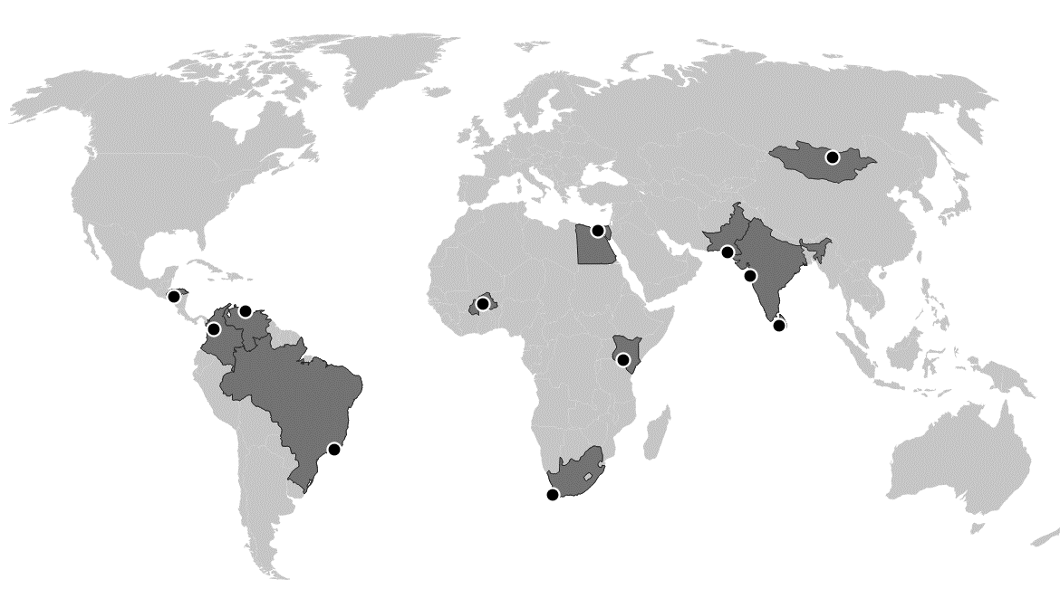

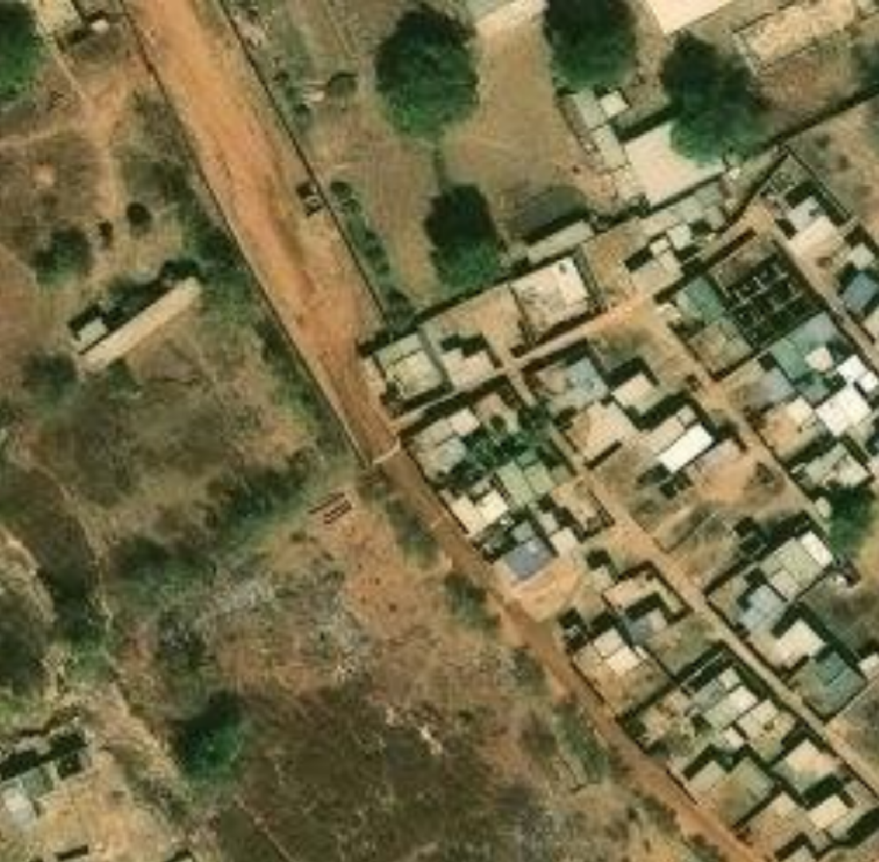
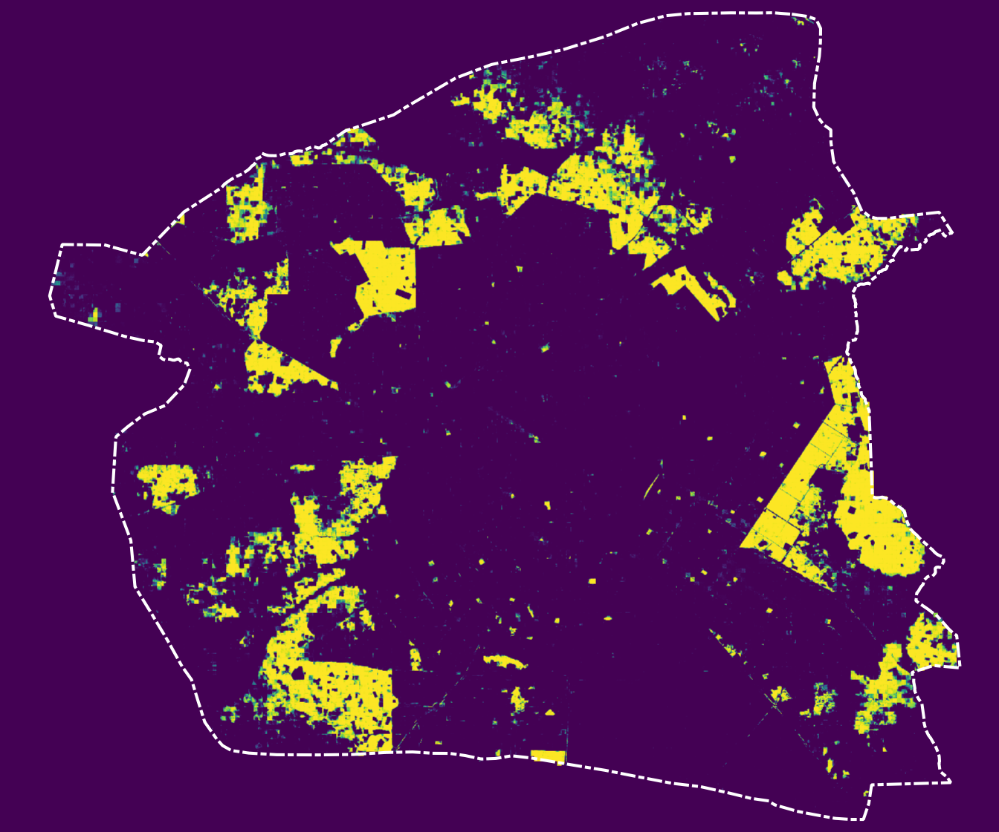
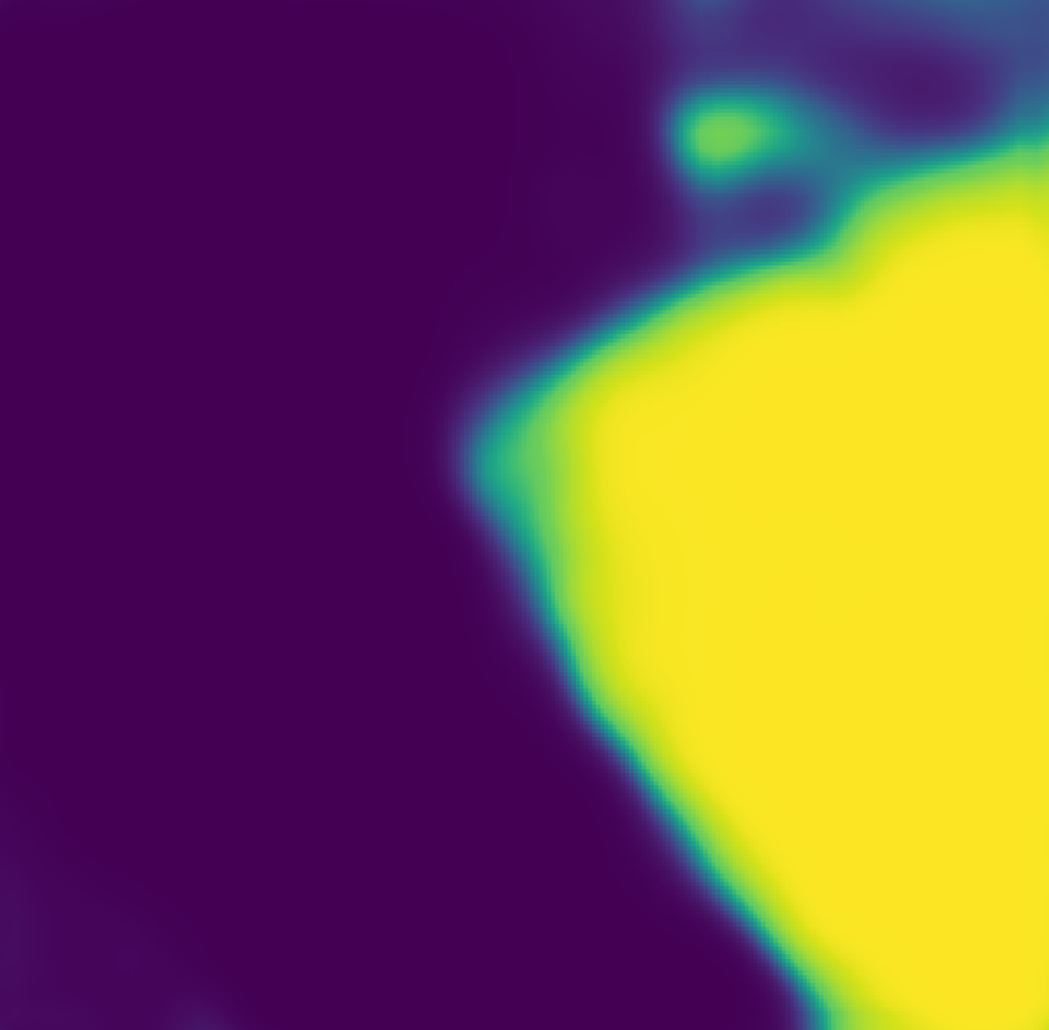

Ulaanbaatar
(ULN)
Cairo
(CAI)
Karachi
(KHI)
Tegucigalpa
(TGU)
Caracas
(CCS)
Ouagadougou
(OUA)
Mumbai
(BOM)
Medellin
(MDE)
Colombo
(CMB)
Nairobi
(NBO)
Rio de
Janeiro (RIO)
Cape Town
(CPT)
OUA, January 2024
12.505
12.4352
12.255
12.4339
-1.687
Probability of slum (p)
-1.412
-1.4378
-1.4364
0
1
Detected slums (p > 0.5)

