Slide 1
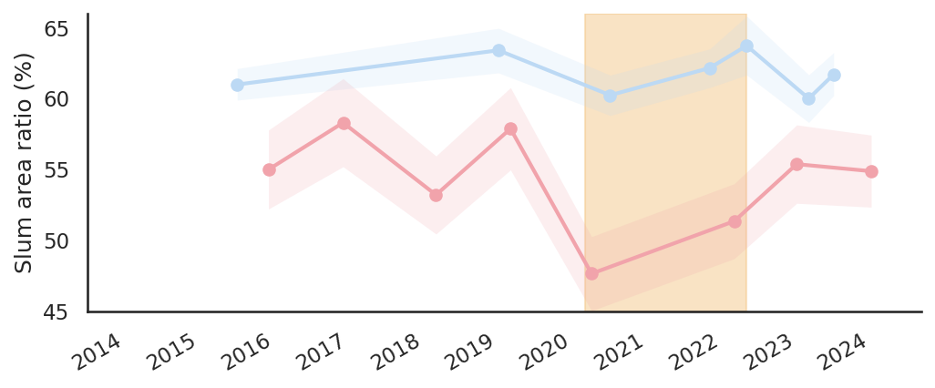

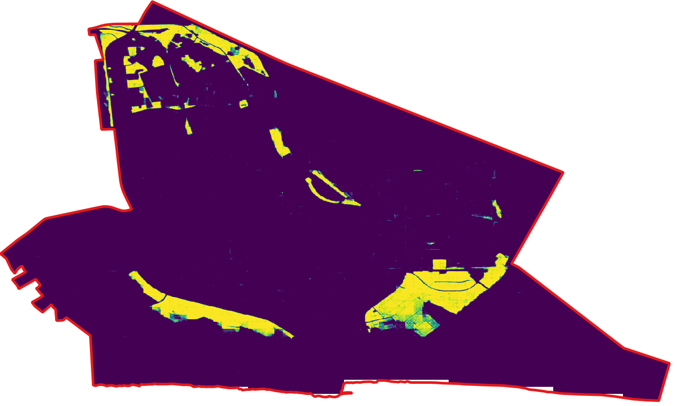
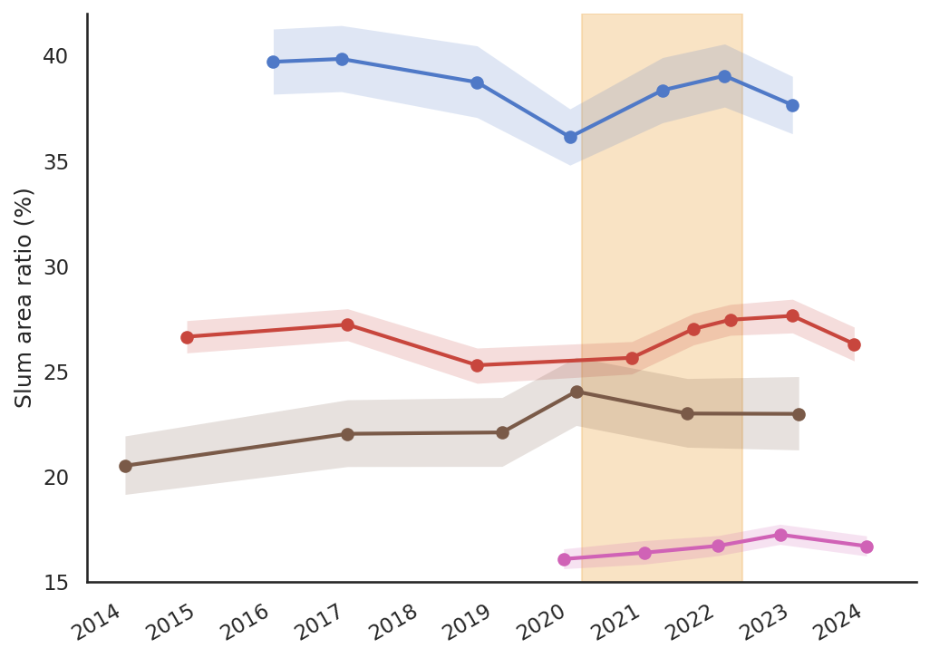
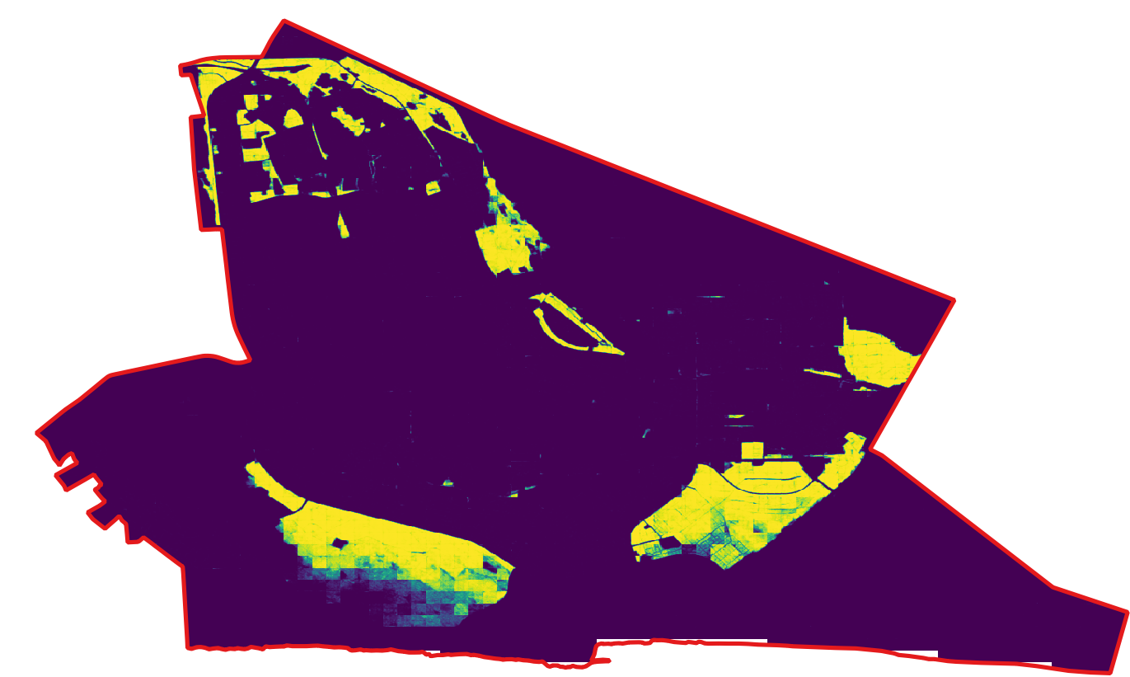
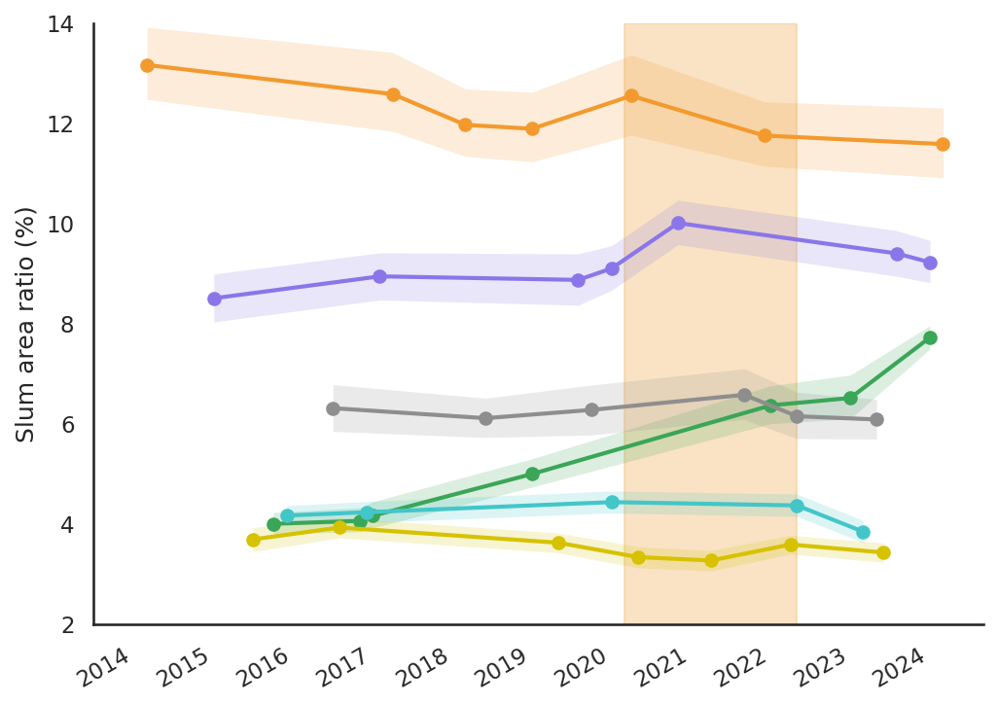
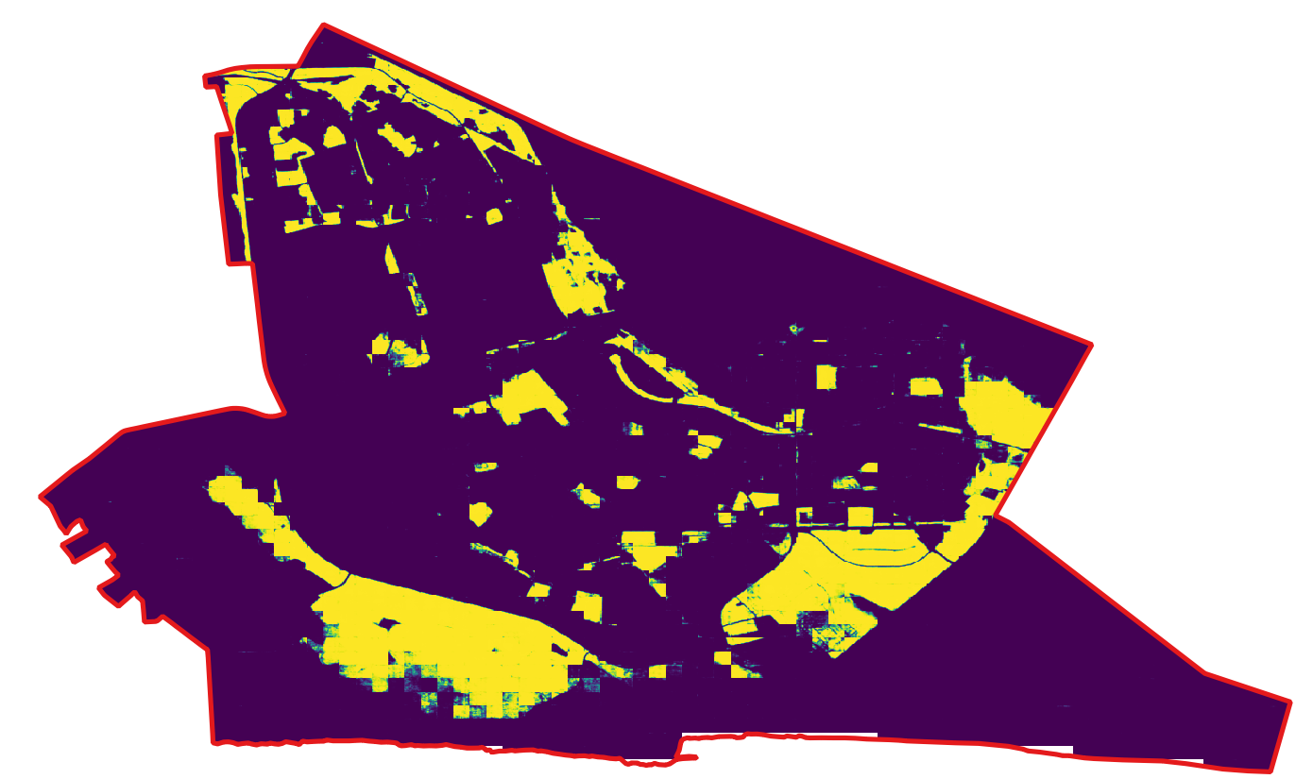
A
Covid-19 Lockdown
B
65
Cape Town (selected districts)
Cairo
2015
55
Tegucigalpa
45
41
Mumbai
2019
28
Karachi
Nairobi
Slum area ratio in total unban area (%)
15
Ouagadougou
14
Caracas
2024
Medellin
8
Cape Town
Rio de Janeiro
Colombo
Ulaanbaatar
2
0
2
4km
2014
Jan
2015
Jan
2016
Jan
2017
Jan
2018
Jan
2019
Jan
2020
Jan
2021
Jan
2022
Jan
2023
Jan
2024
Jan
Probability of slum (p)
0
1

