Slide 1
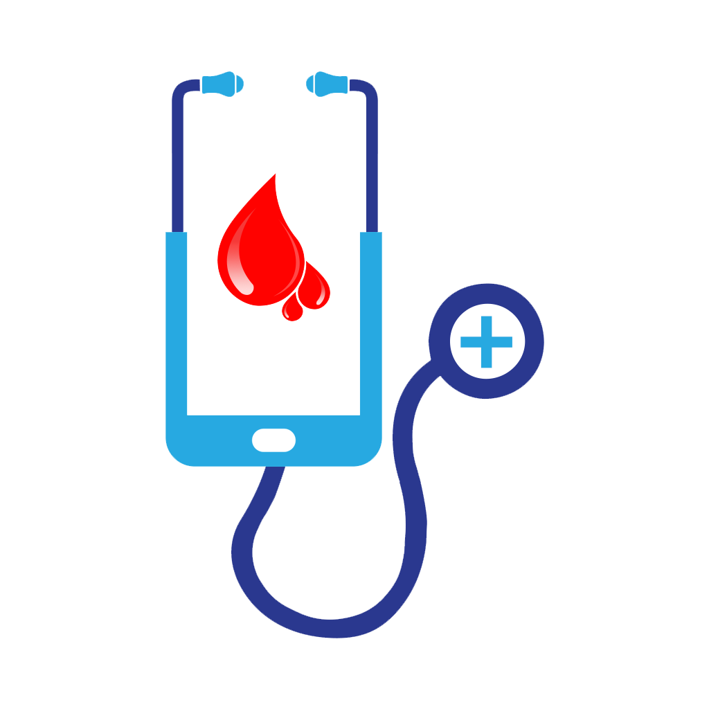
A PROPOSAL DEFENSE ON ‘E-BLOOD BANK’
PRESENTED BY:
DIPESH DEUJA
KAREENA BADE
SANAM SUWAL
sujata shrestha

Slide 2
CONTENTS
Introduction
Objective
Scope
Literature review
Methodology [context diagram, use-case diagram, tools and platform]
Expected result

Slide 3
introduction
background
Idea behind the title
an Android application that allows the users to search and notify donors of specific blood group based on their location, in a short period of time.
not only display the list of donors but also facilitated with tracking the location of the nearby donors through global positioning system
notify the donors via the alert buzzer in mobile app or the sms if required

Slide 4
objective
To bridge the communication/information gap between blood banks, hospitals, donors and needy people using android user interface and GPS tracking service

Slide 5
scope
Real-time availability of donor as per blood group.
Willing person can donate where needed which fulfils any shortage in blood bank.
Blood donation campaign or any other related social awareness information can notify to all the registered users with ease.
This system will build maintain a proper communication between donor and recipients including blood banks, hospitals and health centres.

Slide 6
Literature review
S.N. | RESEARCH PAPERS | REVIEWS
1. | Blood Bank Connect Android Application | Blood Bank Automation using Android application in which blood inventory will be managed and automated on line, User can quickly check for blood banks or hospitals in the emergency situation you can find the matching of particular or related blood group and reach to the particular location through the App
2. | Blood Donor Tracker By using GPS | Included login page where in the user is required to register and only then can view the availability of blood and may also register to donate blood, helps to select the right donor online instantly using medical details along with the blood group
3. | Tracking System for Blood Donor Using GPS | Locates the nearest blood donor in cases of emergencies in fastest & easiest way using GPS, Data analysis was done based on the questionnaire received from few users
4. | Blood Bank Application Using Cloud Computing | Android application which allows the user to search donors of specific blood group based on their location, in a short period of time, facilitated with tracking the location of the nearby donors and providing SMS alerts, GPS module is included to locate the donors
5. | Location Based Online Blood Bank System | Global Positioning System and nearest neighbour algorithm used for primary blood transfusion services, SMS and email services
6. | Online Blood Bank Management System Using Android Application | Included price variations along with stock handlings, increase in blood types which may lead to increase in human blood infrastructure and categories to be managed

Slide 7
methodology

Slide 8
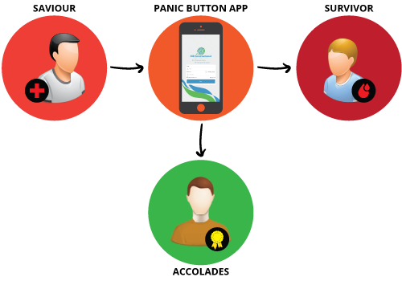
Proposed e-blood bank
Registration
Android Application
Request Generation
Location Detection
Notification
GPS navigation

Slide 9
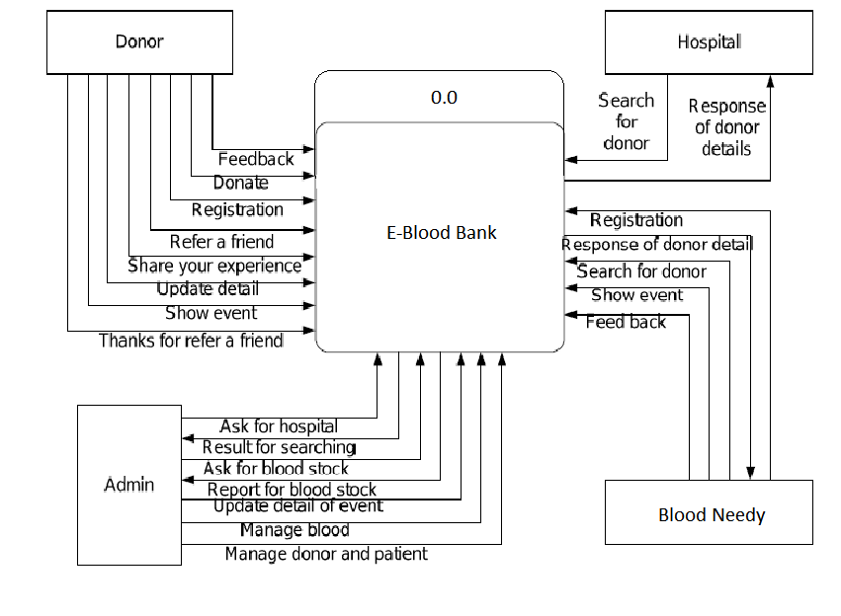
Context diagram

Slide 10
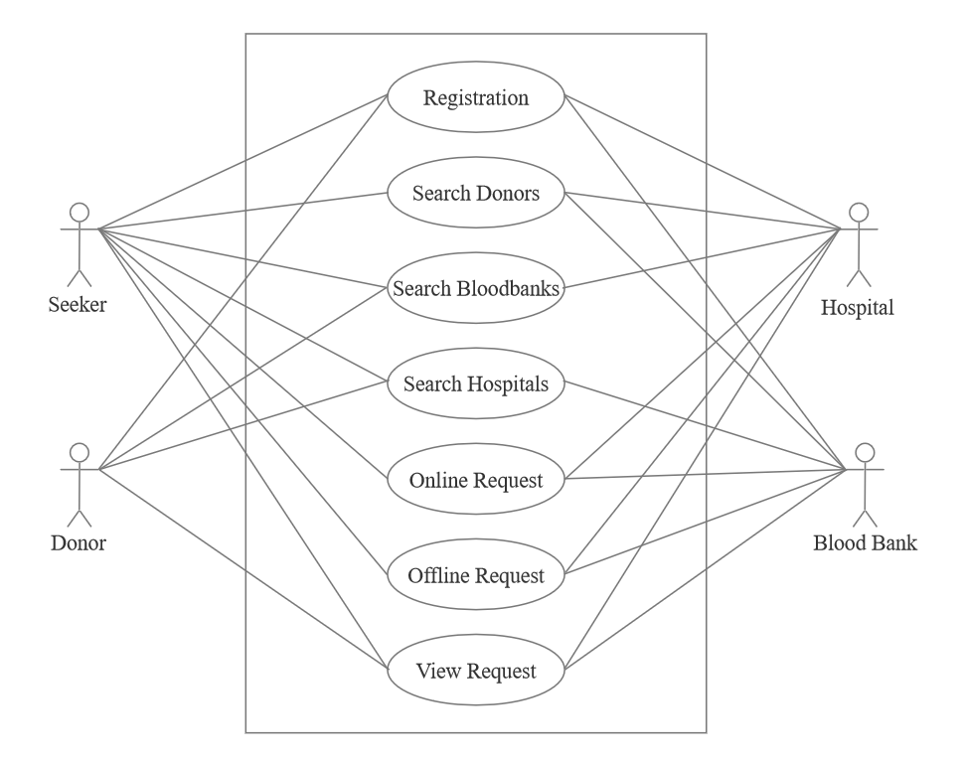
Use-case diagram
Panic button

Slide 11
Tools & platform
VS Code IDE
Flutter
Android Studio
Windows
Android device

Slide 12
Expected result
E-Blood Bank will be able to notify the users as per their role in our system
When there is any need of blood for recipient, he/she will press an emergency button for the demand of the blood mentioning a blood group and place
Then our system will scan the donors registered in the app near the area.
The donor that would take least time to reach the blood seeker will be prioritized first which will be calculated by our system
Available possible donors residing nearby locations will be notified via alert buzzer in app or SMS if required and the location information through GPS system will be provided
Our system will also notify our users about the upcoming or ongoing related campaigns as well

Slide 13
Thank you!!!

