Slide 1
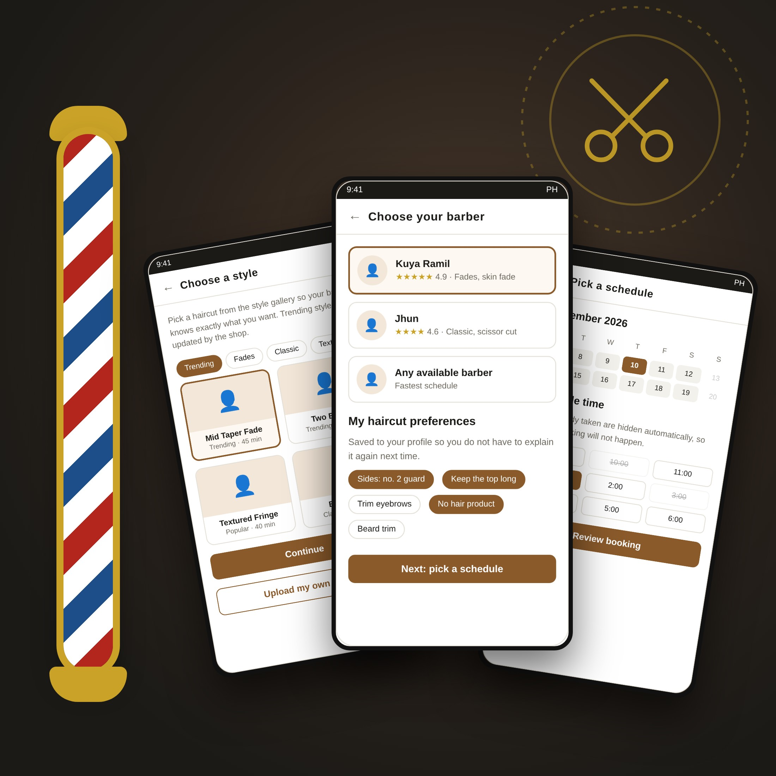
CAPSTONE PROJECT PROPOSAL | PRELIMINARY PRESENTATION
BarberBook PH
An Online Appointment and Haircut Preference System for Local Barbershops
Proponents
[Member 1] · [Member 2] · [Member 3] · [Member 4]
Adviser
[Name of Adviser]
[College / Department], [Name of School]
October 2026
Notes:
Good [morning/afternoon]. We are [group name/members], and our proposed capstone project is BarberBook PH, an online appointment and haircut preference system for local barbershops. In the next few minutes we will show you the problem we observed, what the system will do, the theories behind it, what other studies have done, and how we plan to build and evaluate it.

Slide 2
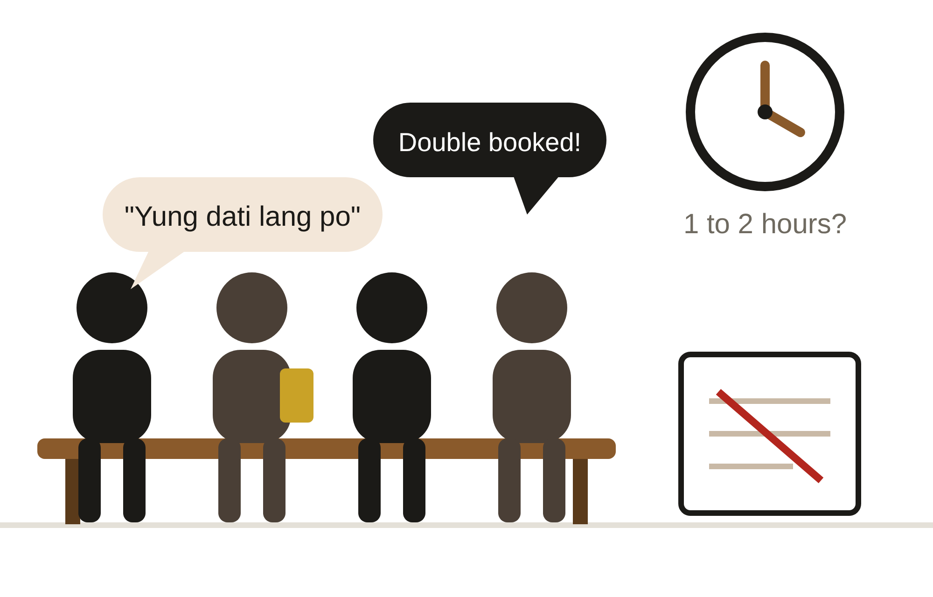





The problem we saw at the barbershop
Walk-ins, chat reservations, and a notebook are still the "system" in most local shops
Long, uncertain waiting
1 to 2 hours on weekends, paydays, and before school events or fiestas.
Overlapping reservations
Bookings through Messenger or text get buried, and two customers end up in the same slot.
Hard to explain the haircut
"Semi-kalbo," "short on the sides," "yung dati lang po." Nothing is written down.
Forgotten appointments
No confirmation or reminder, so reserved slots go to waste.
No organized customer records
The owner can't easily see weekly customers, regulars, or the most requested barber.
Based on the proponents' initial observation. Replace the waiting-time figure with your actual interview data from the partner barbershop.
Notes:
These are the five problems we observed. [Share one real story from your interview here.] Notice that the third problem, explaining the haircut, is the one most booking systems ignore. That will be our main selling point.

Slide 3
Why this matters now
Customers are already online, and barbershops are part of the MSME backbone
98M
137M
99.63%
90.43%
internet users in the Philippines
cellular mobile connections
of Philippine businesses are MSMEs
are micro enterprises
83.8% of the population
more connections than people
1,241,733 of 1,246,373 enterprises (2023)
small budgets, little room for paid software
Kemp (2026)
Kemp (2026)
DTI (n.d.)
DTI (n.d.)
So what? Filipino customers already book rides, food, and bills on their phones. A free, web-based booking tool built for small barbershops fits both the customer's habits and the owner's budget.
Sources: Kemp, S. (2026). Digital 2026: The Philippines. DataReportal. | Department of Trade and Industry. (n.d.). 2023 Philippine MSME statistics.
Notes:
These numbers come from DataReportal and the DTI. The point is simple: customers are ready for online booking, and barbershops are micro enterprises that need something affordable.

Slide 4
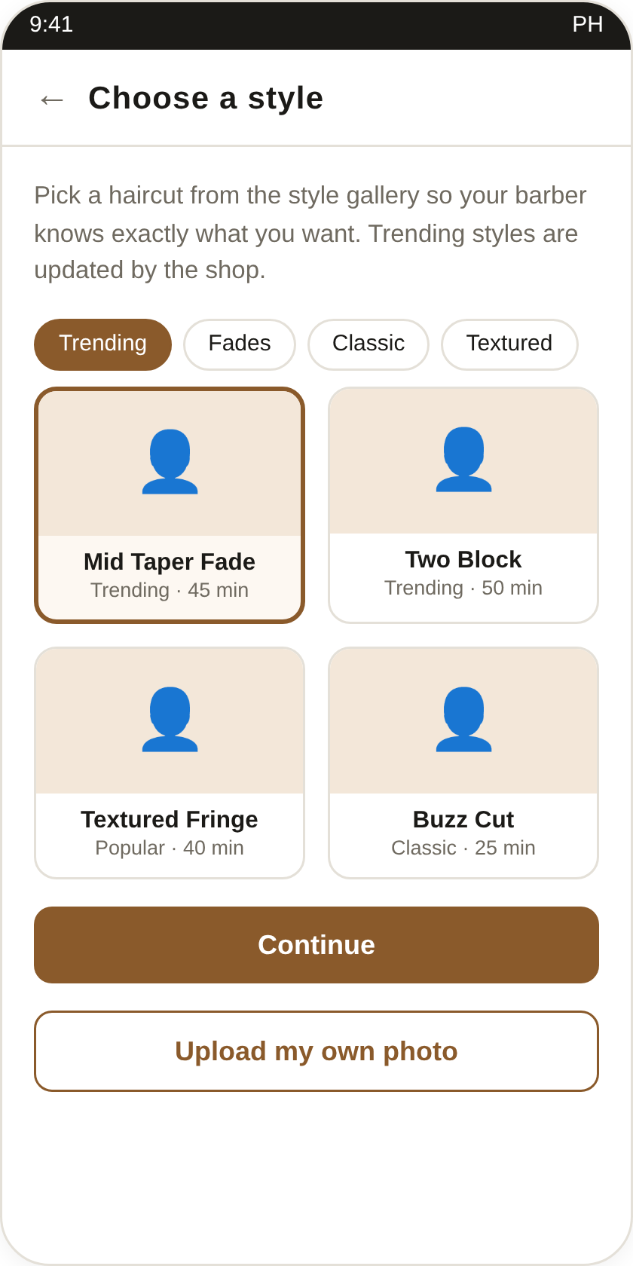
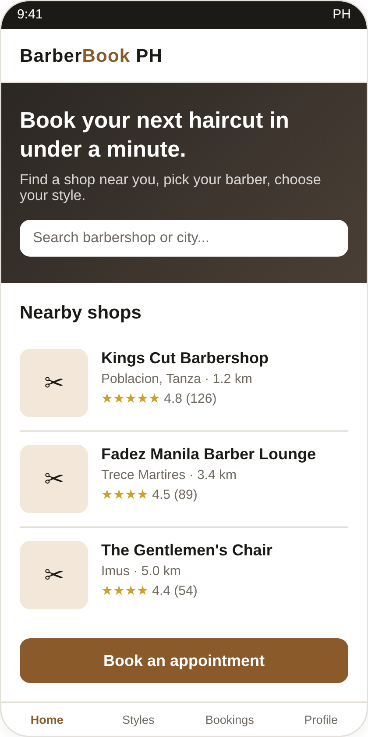
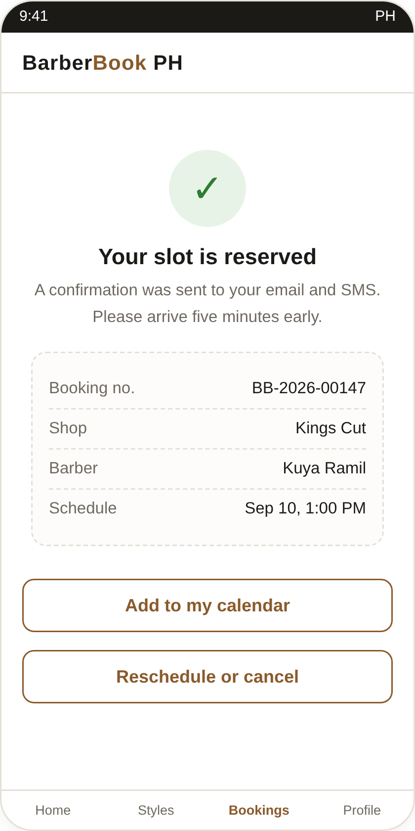




Introducing BarberBook PH
A mobile-friendly website where customers book a slot, pick their barber, and save exactly how they want their hair cut, before they even arrive.
Book a real time slot
Taken slots are hidden, so double booking can't happen.
Choose a style from photos
Trending, fades, classic, textured, or upload your own.
Save your preferences
Guard number, length on top, beard trim, notes for the barber.
Proposed screens (from the group's UI mockup)
Give the owner a dashboard
Daily queue, barber schedules, and simple booking reports.
Notes:
This is BarberBook PH. It is web-based, so it opens in any phone browser with no download. The four key features are the time slot booking, the style gallery, saved preferences, and the owner dashboard.

Slide 5
Statement of the Problem
Six questions this study will answer
1
Existing practices
2
Problems encountered
3
Needed features
Scheduling, customer info, barber availability, haircut preference records, confirmation and tracking
Waiting time, scheduling conflicts, communicating preferences, missed appointments, customer records
Online scheduling, barber availability, preference selection, notifications, profile and history, shop management
4
How it improves
5
Acceptability
6
Improvements
Booking appointments and communicating haircut preferences between customers and barbershops
Functionality, usability, efficiency, reliability, and user satisfaction
Enhancements proposed from the evaluation and user feedback
Notes:
These are our six research questions. Questions 1 and 2 are answered by the interview, observation, and survey. Question 3 becomes our feature list. Question 4 is answered by the developed system. Questions 5 and 6 come from the evaluation.

Slide 6








Every feature answers a problem
FEATURE
PROBLEM IT ANSWERS
Online slot booking
Long waiting time and double booking
Hairstyle gallery
Difficulty in explaining the desired haircut
Preferred barber
Can't request a favorite barber in advance
Saved preferences
Barber asks the same questions every visit
Email / SMS reminders
Forgotten appointments and no-shows
Owner dashboard
Schedule only written in a notebook
Rating and feedback
No record of customer satisfaction
Notes:
We built the feature list directly from the problems. If a panelist asks why a feature exists, we can point to the problem it solves.

Slide 7
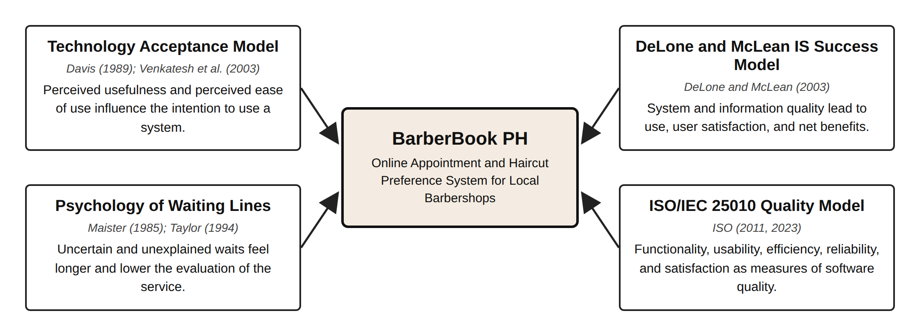
Theoretical Framework
Four theories and models the study stands on
In short: people use it if it is useful and easy (TAM), it succeeds if it satisfies users and helps the shop (DeLone and McLean), a known appointment feels better than an unknown wait (Maister), and ISO/IEC 25010 tells us how to measure its quality.
Notes:
Explain each box in one sentence. TAM by Davis 1989: usefulness and ease of use. DeLone and McLean 2003: quality leads to use, satisfaction, and benefits. Maister 1985: uncertain waits feel longer. ISO/IEC 25010: the basis of our evaluation questionnaire.

Slide 8
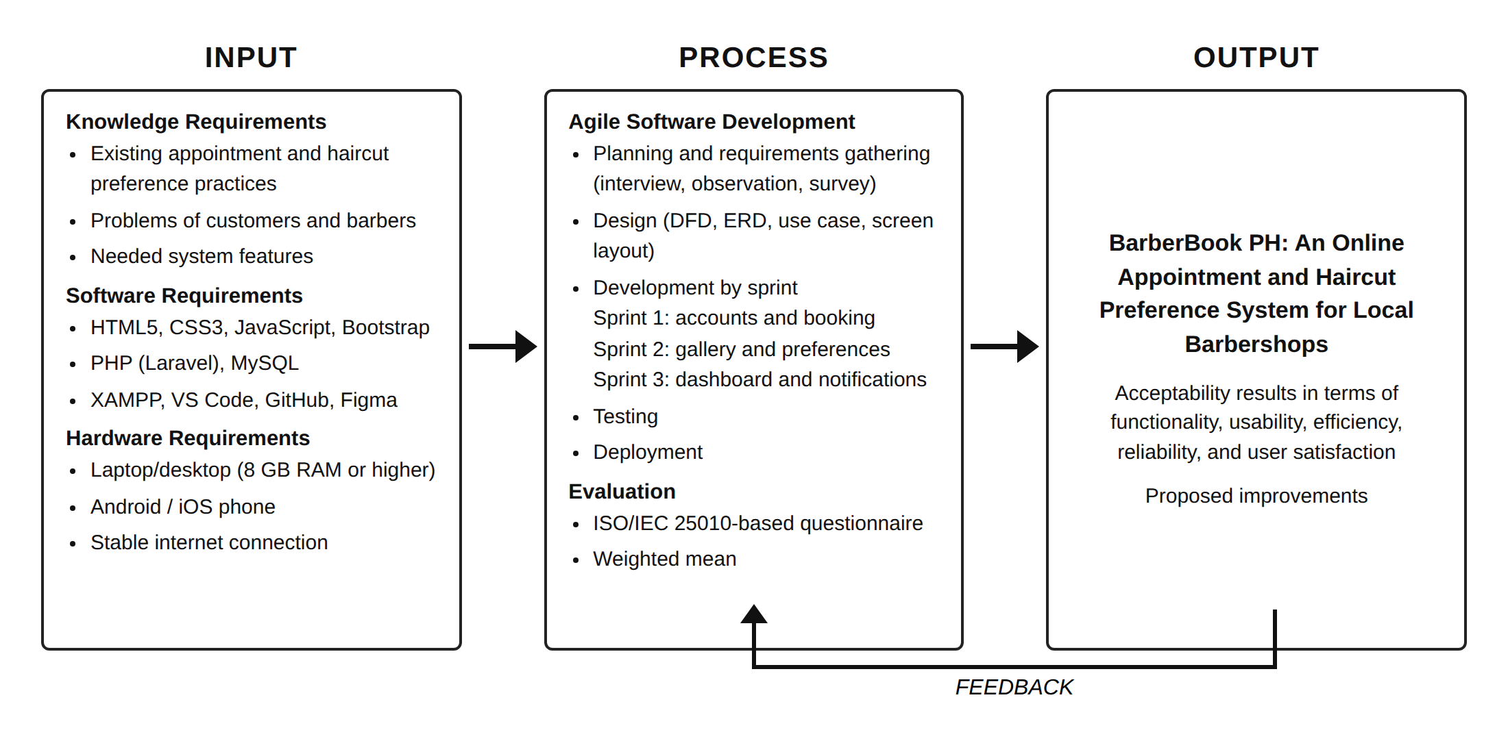
Conceptual Framework
Input-Process-Output model with a feedback loop
Notes:
Input is what we need: knowledge, software, and hardware. Process is Agile development in three sprints, then evaluation. Output is the system and its acceptability results. The feedback arrow means user comments go back into improving the system after every sprint.

Slide 9
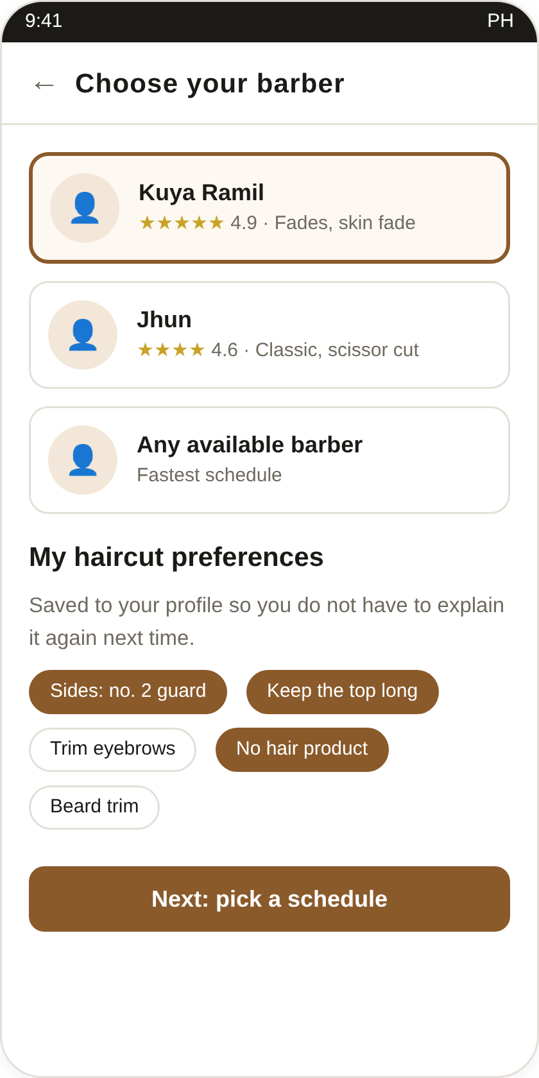
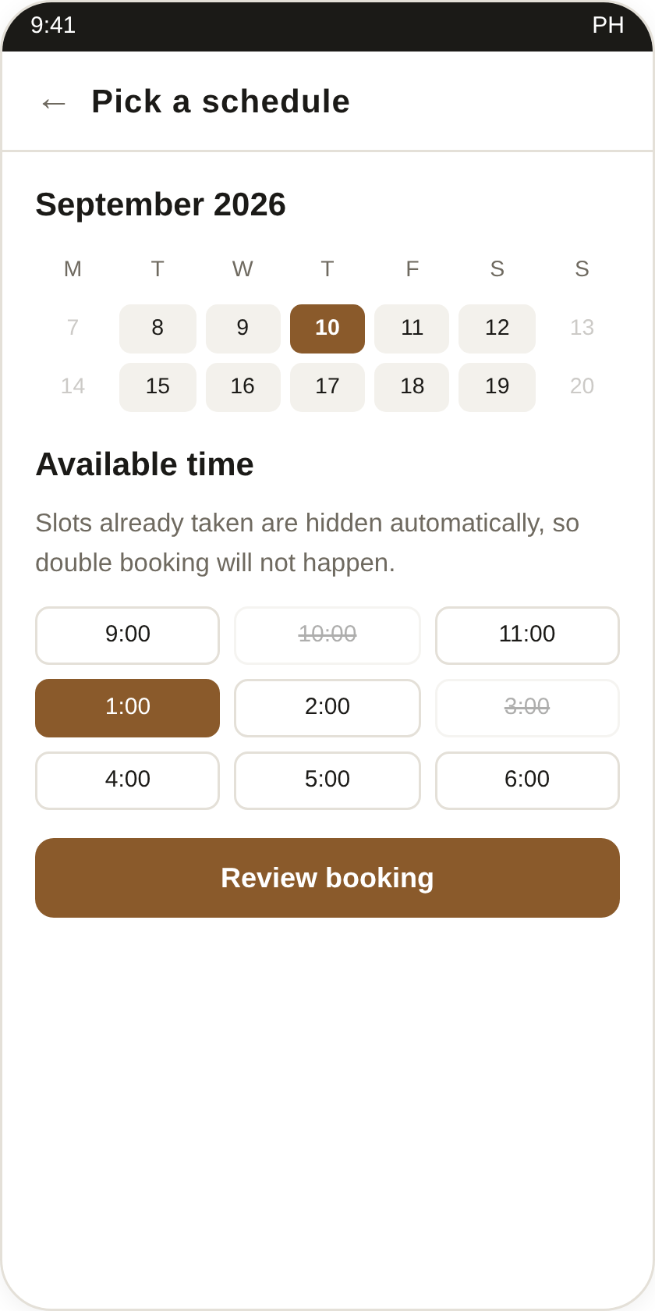
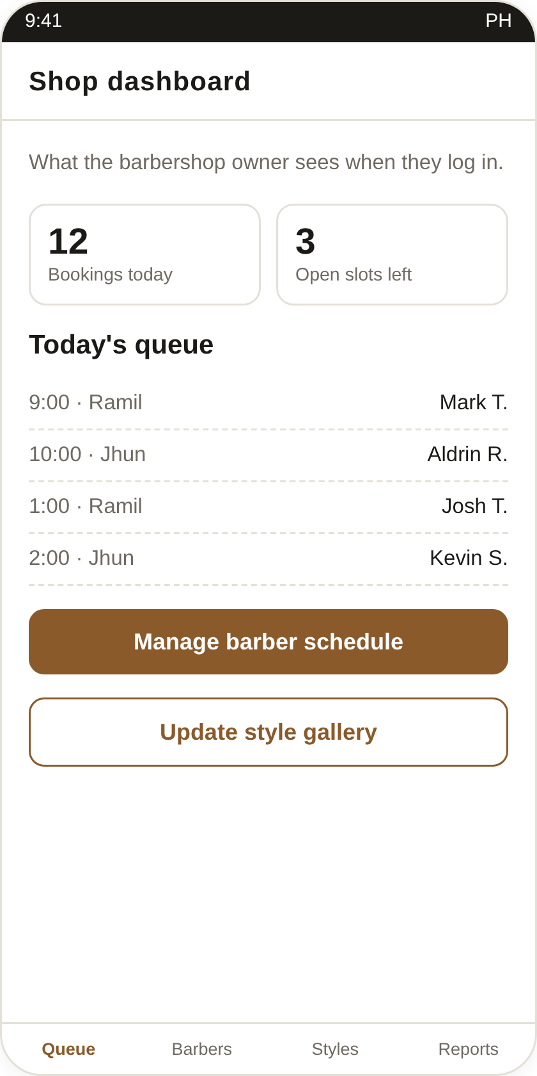
How it works: from home screen to confirmed slot
1
2
3
4
5
6
Find a shop
Choose a style
Pick barber + preferences
Pick a free slot
Get confirmation
Owner sees the queue
Screens 1 to 5 are the customer side. Screen 6 is the barbershop owner's dashboard.
Notes:
Walk through the six screens. Emphasize screen 3: the saved haircut preferences. Also mention that taken slots on screen 4 are hidden automatically, which prevents double booking.

Slide 10

What 46 sources told us
Review of Related Literature and Studies
8
Indonesia studies
barbershop booking systems (web, Android, Laravel, CodeIgniter)
KEY LESSONS WE TOOK
Uncertain waits feel longer
Maister (1985); Taylor (1994)
SMS reminders increase attendance
Guy et al. (2012)
2
Malaysia studies
barber booking app and centralized barbershop management
Barber-client trust drives loyalty
Price and Arnould (1999)
WhatsApp/chat bookings cause clashes
Hidayat and Wibowo (2023)
8
Philippines studies
appointment and reservation systems + MSME record-keeping studies
Cancellation and reports need extra care
Rusdi and Isnin (2024)
ISO 25010 is standard in PH system studies
Concepcion et al. (2026); Ramento et al. (2024)
Notes:
Our Chapter 2 has 46 references. The foreign studies show barbershops in Indonesia and Malaysia already face the same problems. The local studies show that online reservation systems are well accepted by Filipino users when evaluated with ISO 25010.

Slide 11

The research gap
Most systems stop at the schedule. The haircut itself is left out.
What reviewed systems focus on
What BarberBook PH adds
Online booking of a date and time
Queue numbers and waiting estimates
Avoiding schedule clashes
Online payment (some systems)
Mostly built for Indonesia, Malaysia, or non-barbershop settings in the PH
Hairstyle gallery attached to the booking
Saved haircut preferences the barber reads before the cut
Preferred barber or "any available"
Reminders + owner dashboard + reports in one system
Built and evaluated for a Filipino barbershop
Based on the published descriptions of the studies reviewed in Chapter 2.
Notes:
This is our contribution. Existing systems handle the schedule. We also handle the haircut itself, through the gallery and saved preferences, which the literature shows is important for customer satisfaction and loyalty in personal services.

Slide 12


Scope and delimitations
What the system will and will not do
IN SCOPE
OUT OF SCOPE
Customer registration and login
Shop listing with hours, services, prices
Online payment (paid at the shop)
Hairstyle gallery by category
Preferred barber selection
Payroll, inventory, full accounting
Saved preferences and notes
Calendar and time-slot booking
AI or AR hairstyle preview
Reschedule and cancel
Email / SMS confirmation and reminder
More than one partner shop during testing
Owner dashboard and booking reports
Rating and feedback
Offline use (needs internet)
Setting: [Partner Barbershop], [Municipality/City] | Period: October 2026 to March 2027 | Walk-ins are still encoded manually by the owner.
Notes:
Delimitations protect the study. If asked why there is no online payment: most local barbershops still collect cash, a payment gateway adds fees and security requirements, and our focus is waiting, scheduling, and communication.

Slide 13




How we will build it: Agile, in three sprints
Show the owner a working part after every sprint, then improve it right away
Oct 2026
Oct to Nov
Nov to Dec
Dec 2026
Jan 2027
Jan to Feb
Feb 2027
Mar 2027
Topic approval and concept paper
Interview, survey, requirements
System design, Chapters 1 to 3
Sprint 1: accounts and booking
Sprint 2: gallery and preferences
Sprint 3: dashboard and notifications
Testing and evaluation
Revision, documentation, defense
Front end
Back end
Database
Design and versioning
HTML5, CSS3, JavaScript, Bootstrap
PHP with Laravel
MySQL (XAMPP for local testing)
Figma, VS Code, GitHub
Notes:
We chose Agile because the owner will likely have new requests after seeing the first version. The gold dots are the three development sprints. All tools are free, which keeps the system affordable for a micro enterprise.

Slide 14





How we will evaluate it
ISO/IEC 25010-based questionnaire, four-point Likert scale, weighted mean
RESPONDENTS (PURPOSIVE SAMPLING)
CRITERIA
INTERPRETATION SCALE
1
owner
Functionality
Scale | Mean range | Interpretation
4 | 3.26 to 4.00 | Highly Acceptable
3 | 2.51 to 3.25 | Acceptable
2 | 1.76 to 2.50 | Slightly Acceptable
1 | 1.00 to 1.75 | Not Acceptable
Usability
3 to 5
barbers
Efficiency
Reliability
30
regular customers
Proposed scale. Confirm the ranges and descriptors with your adviser.
User satisfaction
Notes:
The evaluation instrument is adapted from ISO/IEC 25010. Respondents rate each item from 1 to 4. We compute the weighted mean per criterion and interpret it using this scale.

Slide 15
Proposed title options for approval
We prepared three options for the adviser's guidance
OPTION 1 · RECOMMENDED
OPTION 2
OPTION 3
BarberBook PH
TrimTime
GupitGo
An Online Appointment and Haircut Preference System for Local Barbershops
A Web-Based Appointment Scheduling and Hairstyle Preference Management System for Barbershops in [Municipality]
A Mobile-Responsive Booking and Haircut Preference Recording System for Local Barbershops with Customer Records Management
Current working title. Already matches the Statement of the Problem.
More technical wording and a specific locale.
Local and catchy, with a record-keeping angle.
Notes:
We would like the adviser's guidance on the final title. Option 1 is our recommendation because it already matches our research questions.

Slide 16


Salamat po!
We welcome your questions, comments, and suggestions.
BarberBook PH
[Member 1] · [Member 2] · [Member 3] · [Member 4]
Notes:
Thank the panel and open the floor. Refer to the "Questions Your Panel Will Probably Ask" section of the group guide to prepare.

