Slide 1
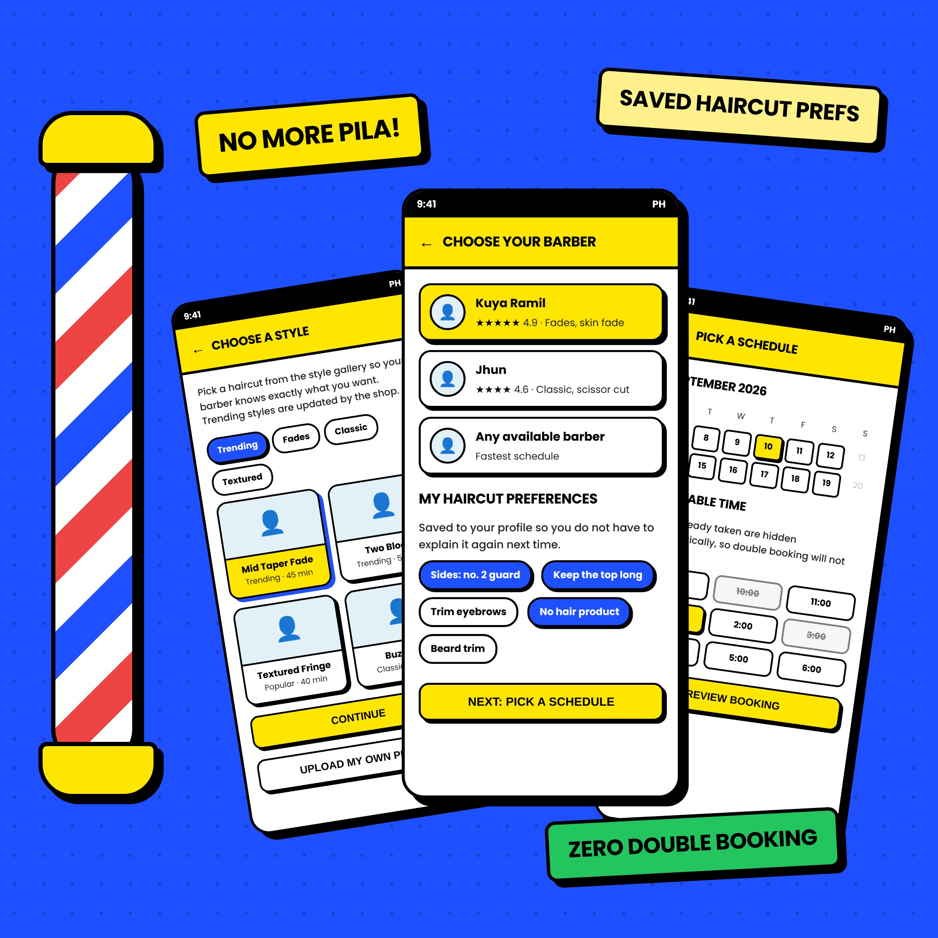
CAPSTONE PROPOSAL · PRELIMINARY
BARBERBOOK
PH
An Online Appointment and Haircut Preference System for Local Barbershops
PROPONENTS
[Member 1] · [Member 2] · [Member 3] · [Member 4]
ADVISER
[Name of Adviser]
[College / Department], [Name of School]
October 2026
Notes:
Good [morning/afternoon]. We are [group name/members], and our proposed capstone project is BarberBook PH, an online appointment and haircut preference system for local barbershops. The look you see here, cobalt blue, yellow, thick black outlines, is the actual theme we will use for the website itself.

Slide 2
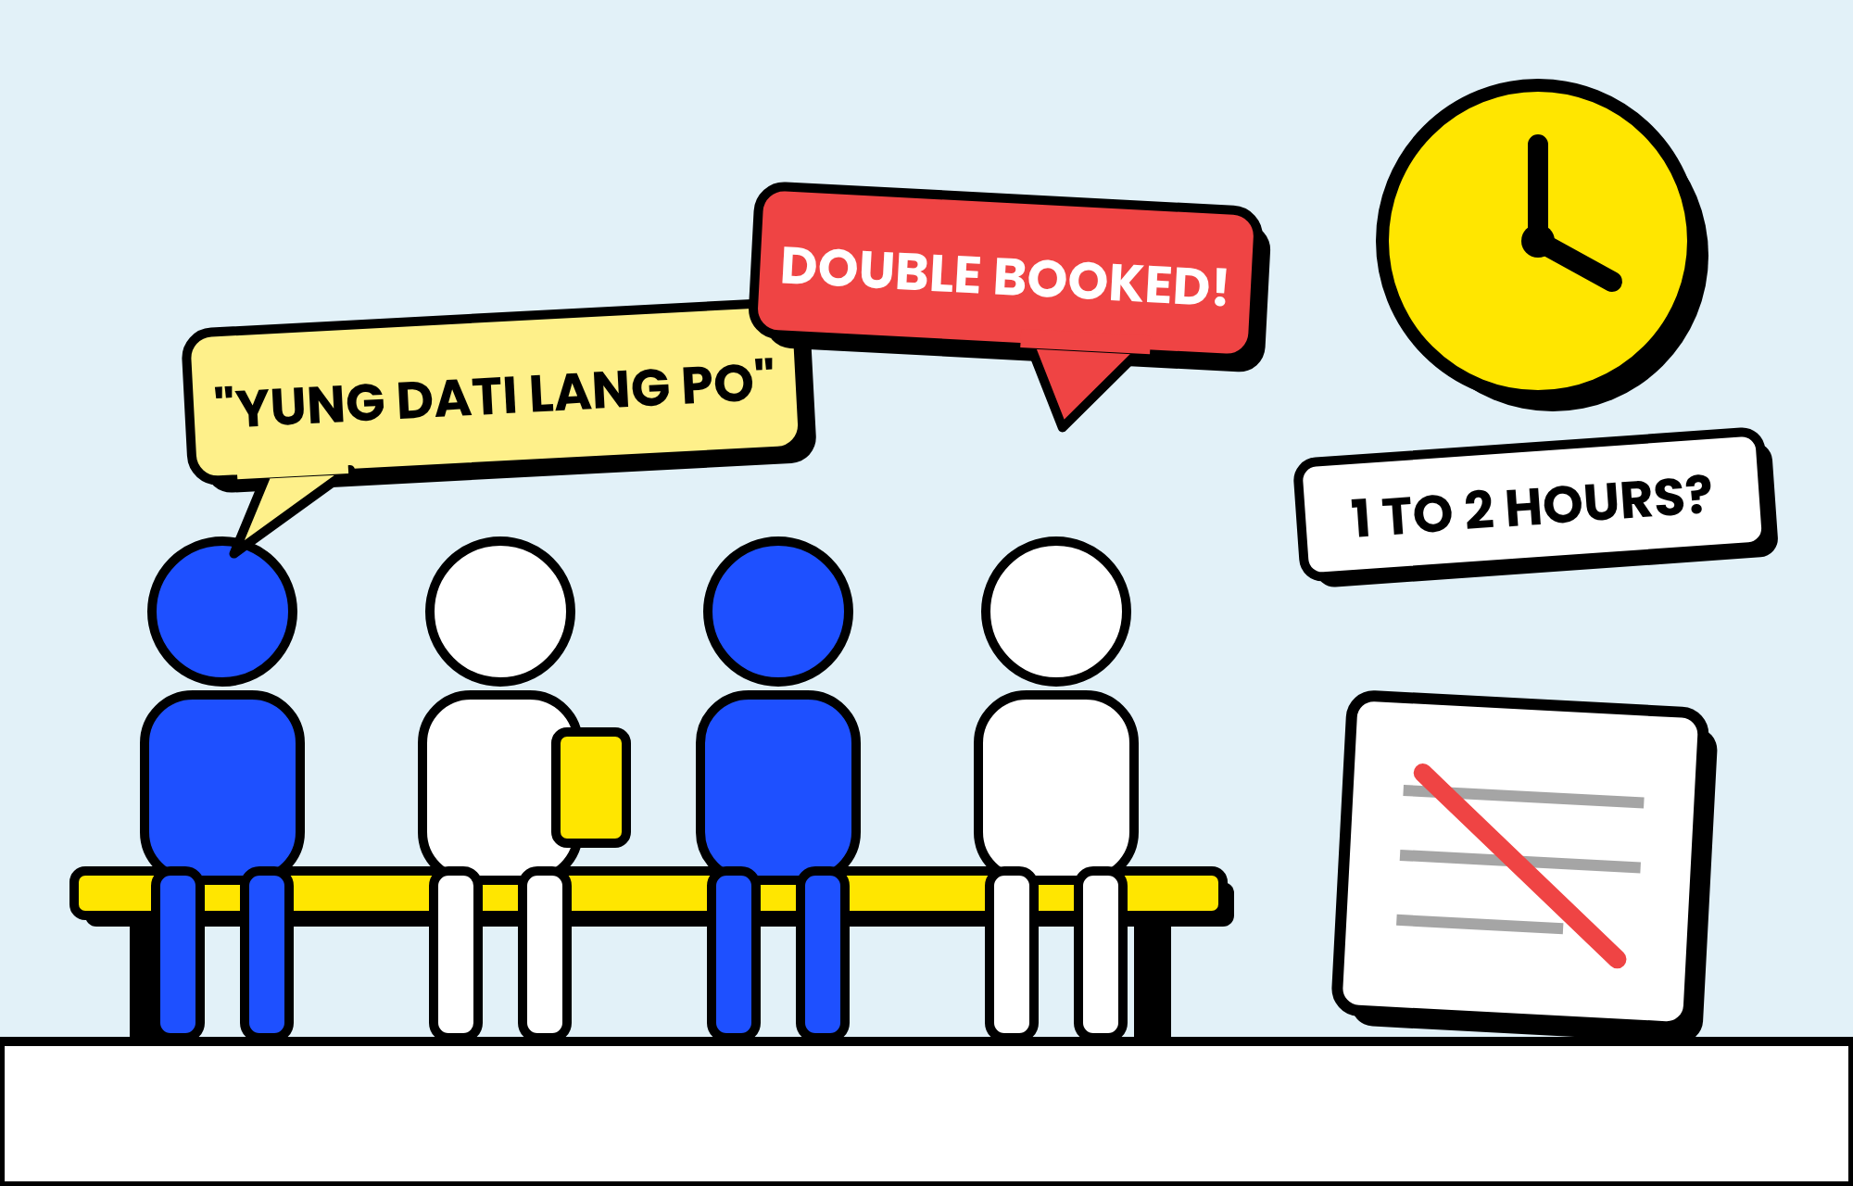





THE PROBLEM
WHAT WE SAW AT THE BARBERSHOP
Walk-ins, chat reservations, and a notebook are still the "system" in most local shops
LONG, UNCERTAIN WAITING
1 to 2 hours on weekends, paydays, and before fiestas.
OVERLAPPING RESERVATIONS
Messenger and text bookings get buried and clash.
HARD TO EXPLAIN THE HAIRCUT
"Semi-kalbo," "yung dati lang po." Nothing is written down.
FORGOTTEN APPOINTMENTS
No confirmation or reminder, so slots go to waste.
NO ORGANIZED CUSTOMER RECORDS
No easy view of regulars or the most requested barber.
Based on the proponents' initial observation. Replace the waiting-time figure with your actual interview data from the partner barbershop.
Notes:
These are the five problems we observed. [Share one real story from your interview here.] The third one, explaining the haircut, is the one most booking systems ignore. That is our main selling point.

Slide 3
WHY NOW
WHY THIS MATTERS NOW
Customers are already online, and barbershops are part of the MSME backbone
98M
137M
99.63%
90.43%
INTERNET USERS IN THE PHILIPPINES
CELLULAR MOBILE CONNECTIONS
OF PH BUSINESSES ARE MSMES
ARE MICRO ENTERPRISES
83.8% of the population
more connections than people
1,241,733 of 1,246,373 (2023)
small budgets, no room for paid software
Kemp (2026)
Kemp (2026)
DTI (n.d.)
DTI (n.d.)
SO WHAT? Filipinos already book rides, food, and bills on their phones. A free, web-based booking tool fits both the customer's habits and the owner's budget.
Sources: Kemp, S. (2026). Digital 2026: The Philippines. DataReportal. | Department of Trade and Industry. (n.d.). 2023 Philippine MSME statistics.
Notes:
These numbers come from DataReportal and the DTI. Customers are ready for online booking, and barbershops are micro enterprises that need something affordable.

Slide 4
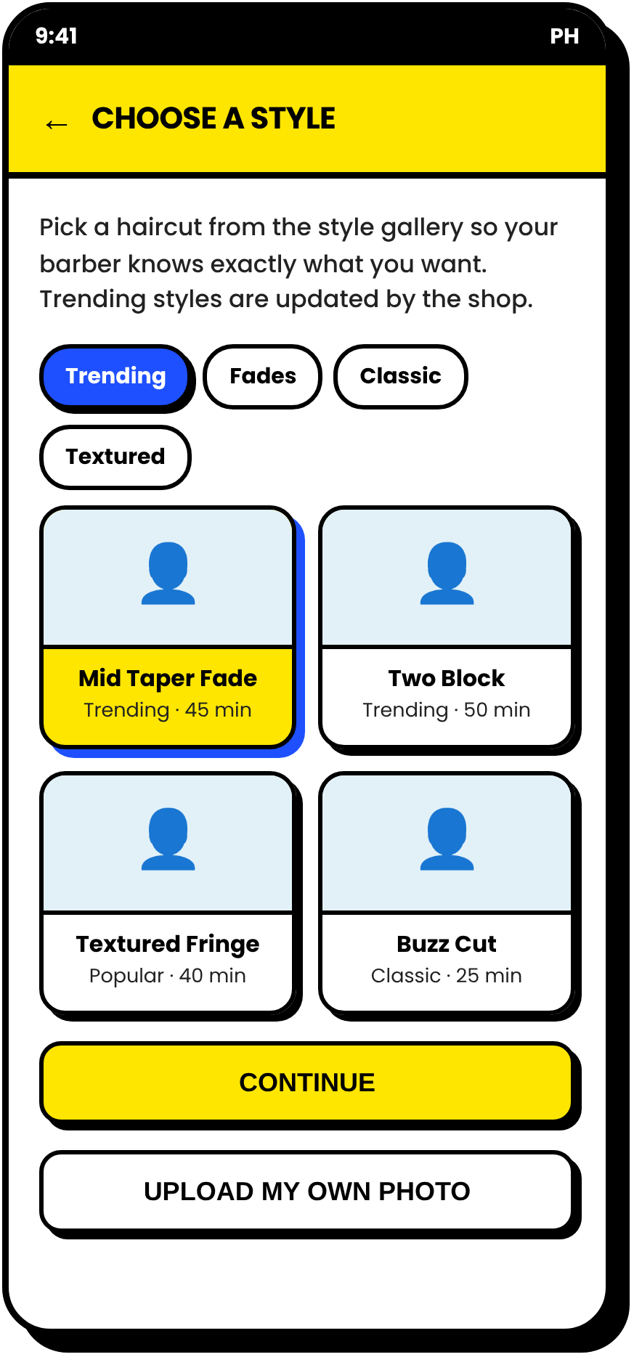
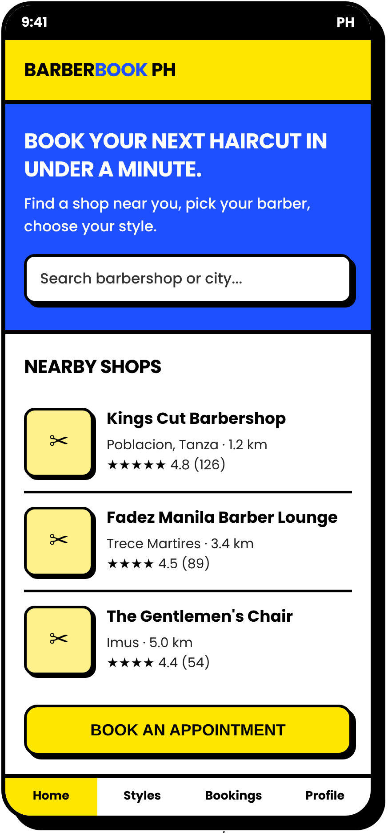
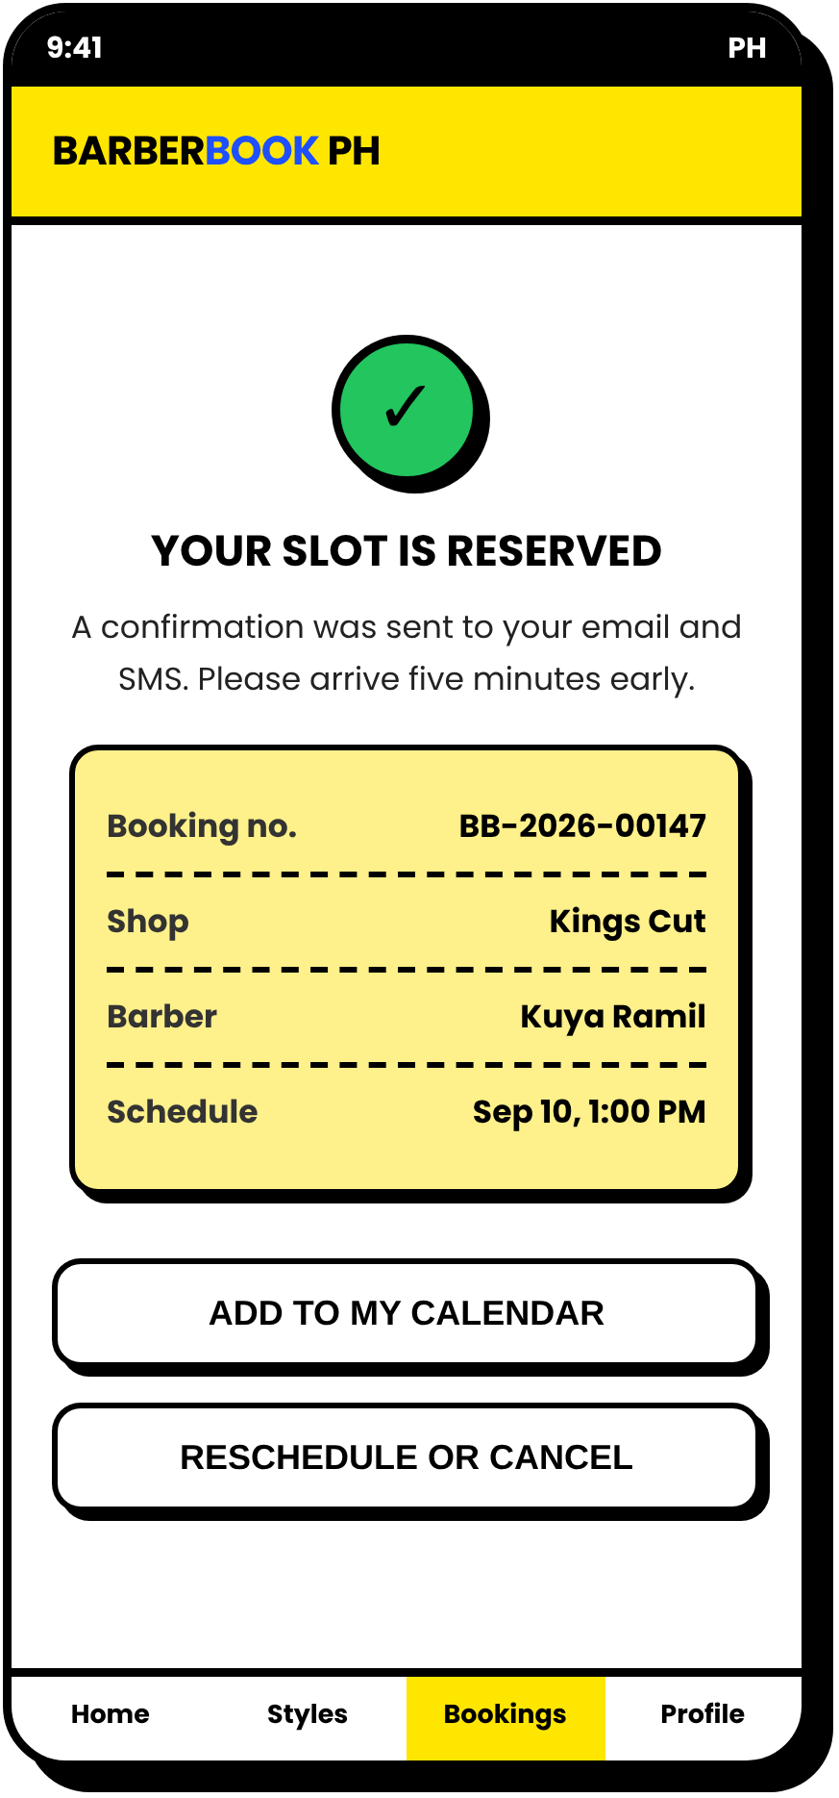




MEET THE SYSTEM
INTRODUCING BARBERBOOK PH
NO DOWNLOAD NEEDED
A mobile-friendly website where customers book a slot, pick their barber, and save exactly how they want their hair cut, before they even arrive.
BOOK A REAL TIME SLOT
Taken slots are hidden. No double booking.
CHOOSE A STYLE FROM PHOTOS
Trending, fades, classic, textured, or upload.
SAVE YOUR PREFERENCES
Guard no., length on top, beard trim, notes.
OWNER DASHBOARD
Daily queue, schedules, booking reports.
Notes:
This is BarberBook PH. It is web-based, so it opens in any phone browser with no download. The four key features are time-slot booking, the style gallery, saved preferences, and the owner dashboard.

Slide 5
CHAPTER 1
STATEMENT OF THE PROBLEM
Six questions this study will answer
1
EXISTING PRACTICES
2
PROBLEMS ENCOUNTERED
3
NEEDED FEATURES
Scheduling, customer info, barber availability, preference records, confirmation and tracking
Waiting time, scheduling conflicts, communicating preferences, missed appointments, records
Online scheduling, availability, preference selection, notifications, profile, shop management
4
HOW IT IMPROVES
5
ACCEPTABILITY
6
IMPROVEMENTS
Booking appointments and communicating haircut preferences between customers and shops
Functionality, usability, efficiency, reliability, and user satisfaction
Enhancements proposed from the evaluation and user feedback
Notes:
Questions 1 and 2 are answered by the interview, observation, and survey. Question 3 becomes our feature list. Question 4 is answered by the developed system. Questions 5 and 6 come from the evaluation.

Slide 6








FEATURES
EVERY FEATURE ANSWERS A PROBLEM
ONLINE SLOT BOOKING
Long waiting time and double booking
HAIRSTYLE GALLERY
Difficulty in explaining the desired haircut
PREFERRED BARBER
Can't request a favorite barber in advance
SAVED PREFERENCES
Barber asks the same questions every visit
EMAIL / SMS REMINDERS
Forgotten appointments and no-shows
OWNER DASHBOARD
Schedule only written in a notebook
RATING AND FEEDBACK
No record of customer satisfaction
Notes:
We built the feature list directly from the problems. If a panelist asks why a feature exists, we point to the problem it solves.

Slide 7
CHAPTER 1
THEORETICAL FRAMEWORK
Four theories and models the study stands on
TECHNOLOGY ACCEPTANCE MODEL
Davis (1989); Venkatesh et al. (2003)
People use it if it is useful and easy to use.
DELONE & MCLEAN IS SUCCESS
DeLone and McLean (2003)
Quality leads to use, satisfaction, and net benefits.
BARBERBOOK PH
Online Appointment and Haircut Preference System
PSYCHOLOGY OF WAITING LINES
Maister (1985); Taylor (1994)
Uncertain waits feel longer. A fixed slot fixes that.
ISO/IEC 25010 QUALITY MODEL
ISO (2011, 2023)
The basis of our evaluation questionnaire.
Notes:
Explain each box in one sentence. TAM (Davis, 1989): usefulness and ease of use. DeLone and McLean (2003): quality leads to use, satisfaction, and benefits. Maister (1985): uncertain waits feel longer. ISO/IEC 25010: the basis of our evaluation questionnaire.

Slide 8
CHAPTER 1
CONCEPTUAL FRAMEWORK
Input-Process-Output model with a feedback loop
INPUT
PROCESS
OUTPUT
KNOWLEDGE
Existing practices, problems, and needed features
SOFTWARE
HTML5, CSS3, JS, Bootstrap, PHP (Laravel), MySQL, XAMPP, VS Code, GitHub, Figma
HARDWARE
Laptop (8 GB RAM+), Android/iOS phone, internet
AGILE DEVELOPMENT
Requirements > design (DFD, ERD, use case, UI) > Sprint 1: booking > Sprint 2: gallery and preferences > Sprint 3: dashboard and notifications > testing > deployment
EVALUATION
ISO/IEC 25010 questionnaire, weighted mean
BARBERBOOK PH
Online Appointment and Haircut Preference System
RESULTS
Acceptability in functionality, usability, efficiency, reliability, user satisfaction
PROPOSED IMPROVEMENTS
FEEDBACK
Notes:
Input is what we need: knowledge, software, and hardware. Process is Agile development in three sprints, then evaluation. Output is the system and its acceptability results. The feedback loop means user comments go back into improving the system after every sprint.

Slide 9
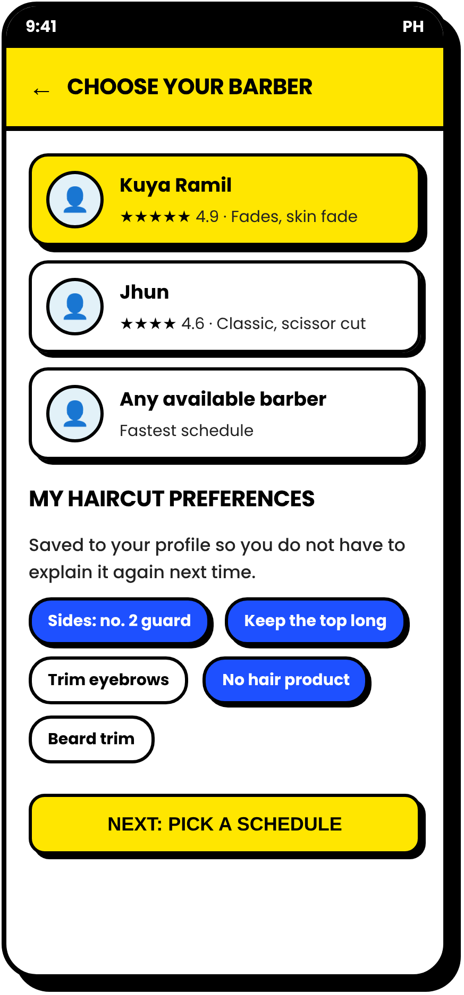
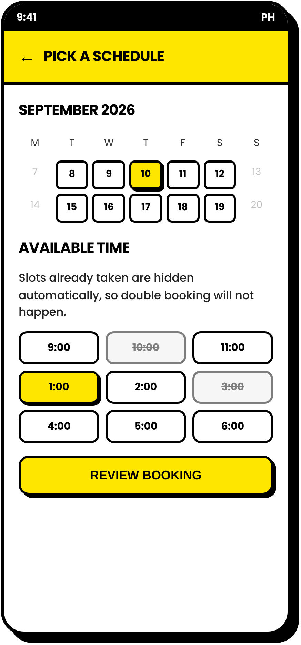
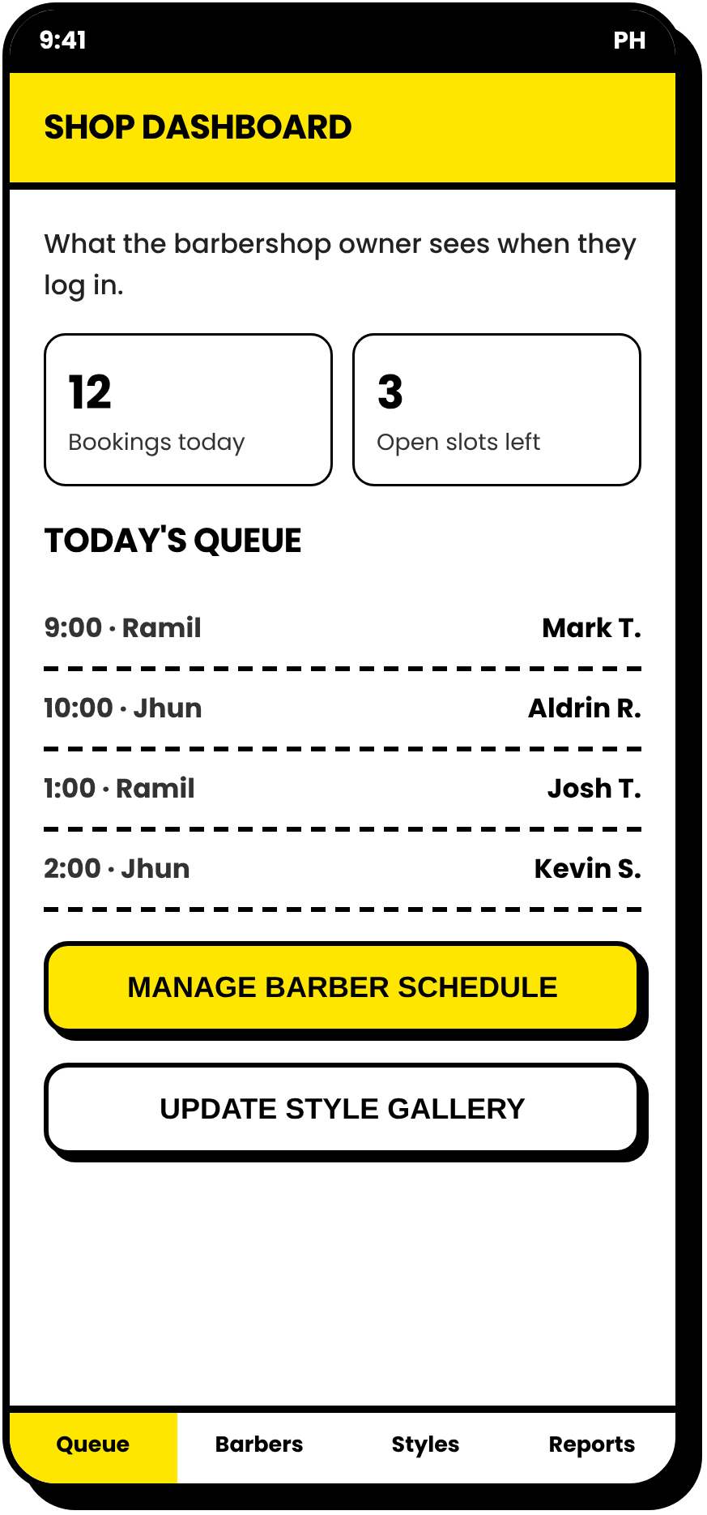
USER JOURNEY
FROM HOME SCREEN TO CONFIRMED SLOT
1 FIND A SHOP
2 CHOOSE A STYLE
3 BARBER + PREFS
4 PICK A FREE SLOT
5 CONFIRMED!
6 OWNER QUEUE
Screens 1 to 5: customer side. Screen 6: the barbershop owner's dashboard. Proposed design in the website's actual theme.
Notes:
Walk through the six screens. Emphasize screen 3, the saved haircut preferences, and screen 4, where taken slots are hidden automatically so double booking cannot happen.

Slide 10

CHAPTER 2
WHAT 46 SOURCES TOLD US
Review of Related Literature and Studies
KEY LESSONS
8
INDONESIA STUDIES
barbershop booking systems (web, Android, Laravel, CodeIgniter)
Uncertain waits feel longer
Maister (1985); Taylor (1994)
SMS reminders increase attendance
Guy et al. (2012)
2
MALAYSIA STUDIES
barber booking app and centralized barbershop management
Barber-client trust drives loyalty
Price and Arnould (1999)
Chat bookings cause schedule clashes
Hidayat and Wibowo (2023)
Cancellation and reports need extra care
Rusdi and Isnin (2024)
8
PHILIPPINES STUDIES
appointment and reservation systems + MSME record-keeping studies
ISO 25010 is standard in PH system studies
Concepcion et al. (2026); Ramento et al. (2024)
Notes:
Chapter 2 has 46 references. The foreign studies show barbershops in Indonesia and Malaysia face the same problems. The local studies show online reservation systems are well accepted by Filipino users when evaluated with ISO 25010.

Slide 11

RESEARCH GAP
MOST SYSTEMS STOP AT THE SCHEDULE
The haircut itself is left out. That is where we come in.
OUR EDGE
WHAT REVIEWED SYSTEMS FOCUS ON
WHAT BARBERBOOK PH ADDS
Online booking of a date and time
Queue numbers and waiting estimates
Avoiding schedule clashes
Online payment (some systems)
Mostly built abroad or for non-barbershop settings in the PH
Hairstyle gallery attached to the booking
Saved haircut preferences the barber reads before the cut
Preferred barber or "any available"
Reminders + owner dashboard + reports in one
Built and evaluated for a Filipino barbershop
Based on the published descriptions of the studies reviewed in Chapter 2.
Notes:
Existing systems handle the schedule. We also handle the haircut itself, through the gallery and saved preferences, which the literature shows matters for satisfaction and loyalty in personal services.

Slide 12


CHAPTER 1
SCOPE AND DELIMITATIONS
What the system will and will not do
IN SCOPE
OUT OF SCOPE
Customer registration and login
Shop listing with hours, services, prices
Online payment (paid at the shop)
Hairstyle gallery by category
Preferred barber selection
Payroll, inventory, full accounting
Saved preferences and notes
Calendar and time-slot booking
AI or AR hairstyle preview
Reschedule and cancel
Email / SMS confirmation and reminder
More than one partner shop in testing
Owner dashboard and reports
Rating and feedback
Offline use (needs internet)
Setting: [Partner Barbershop], [Municipality/City] · October 2026 to March 2027 · Walk-ins are still encoded manually by the owner.
Notes:
Delimitations protect the study. If asked why there is no online payment: most local barbershops still collect cash, a payment gateway adds fees and security requirements, and our focus is waiting, scheduling, and communication.

Slide 13




METHODOLOGY
HOW WE WILL BUILD IT: AGILE, IN THREE SPRINTS
Show the owner a working part after every sprint, then improve it right away
OCT 2026
OCT-NOV
NOV-DEC
DEC 2026
JAN 2027
JAN-FEB
FEB 2027
MAR 2027
Topic approval, concept paper
Interview, survey, requirements
System design, Chapters 1-3
Sprint 1: accounts and booking
Sprint 2: gallery and preferences
Sprint 3: dashboard, notifications
Testing and evaluation
Revision, documentation, defense
3 SPRINTS
FRONT END
BACK END
DATABASE
DESIGN / VERSIONING
HTML5, CSS3, JavaScript, Bootstrap
PHP with Laravel
MySQL (XAMPP locally)
Figma, VS Code, GitHub
Notes:
We chose Agile because the owner will likely request changes after seeing the first version. The yellow dots are the three development sprints. All tools are free, which keeps the system affordable for a micro enterprise.

Slide 14





EVALUATION
HOW WE WILL EVALUATE IT
ISO/IEC 25010-based questionnaire, four-point Likert scale, weighted mean
RESPONDENTS
CRITERIA
INTERPRETATION SCALE
1
OWNER
FUNCTIONALITY
Scale | Mean | Interpretation
4 | 3.26-4.00 | Highly Acceptable
3 | 2.51-3.25 | Acceptable
2 | 1.76-2.50 | Slightly Acceptable
1 | 1.00-1.75 | Not Acceptable
USABILITY
3-5
BARBERS
EFFICIENCY
RELIABILITY
30
REGULAR CUSTOMERS
Proposed scale. Confirm ranges and descriptors with your adviser.
USER SATISFACTION
Notes:
The instrument is adapted from ISO/IEC 25010. Respondents rate each item from 1 to 4, we compute the weighted mean per criterion, and interpret it using this scale.

Slide 15
FOR APPROVAL
PROPOSED TITLE OPTIONS
Three options for the adviser's guidance
RECOMMENDED
OPTION 1
OPTION 2
OPTION 3
BARBERBOOK PH
TRIMTIME
GUPITGO
An Online Appointment and Haircut Preference System for Local Barbershops
A Web-Based Appointment Scheduling and Hairstyle Preference Management System for Barbershops in [Municipality]
A Mobile-Responsive Booking and Haircut Preference Recording System for Local Barbershops with Customer Records Management
Current working title. Already matches the Statement of the Problem.
More technical wording and a specific locale.
Local and catchy, with a record-keeping angle.
Notes:
We would like the adviser's guidance on the final title. Option 1 is our recommendation because it already matches our research questions.

Slide 16

SALAMAT PO!
QUESTIONS? SUGGESTIONS? WE'RE READY.
BARBERBOOK PH
[Member 1] · [Member 2] · [Member 3] · [Member 4]
Notes:
Thank the panel and open the floor. Use the "Questions Your Panel Will Probably Ask" section of the group guide to prepare.

