Slide 1
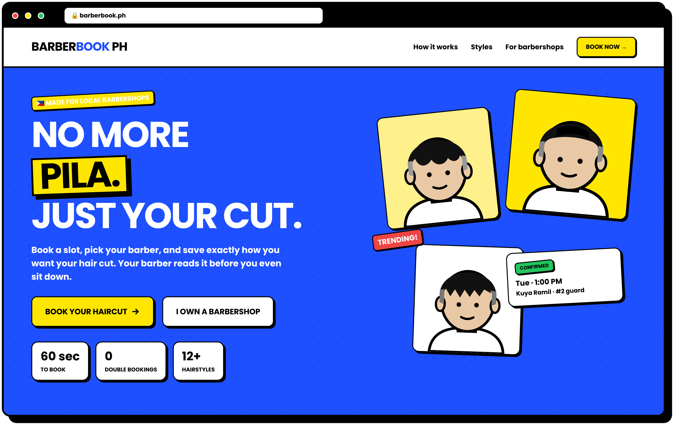
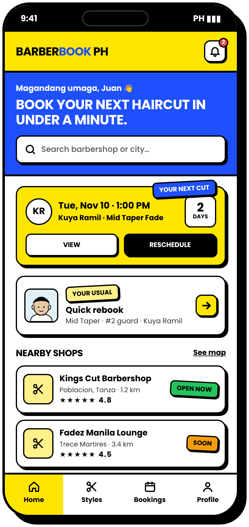
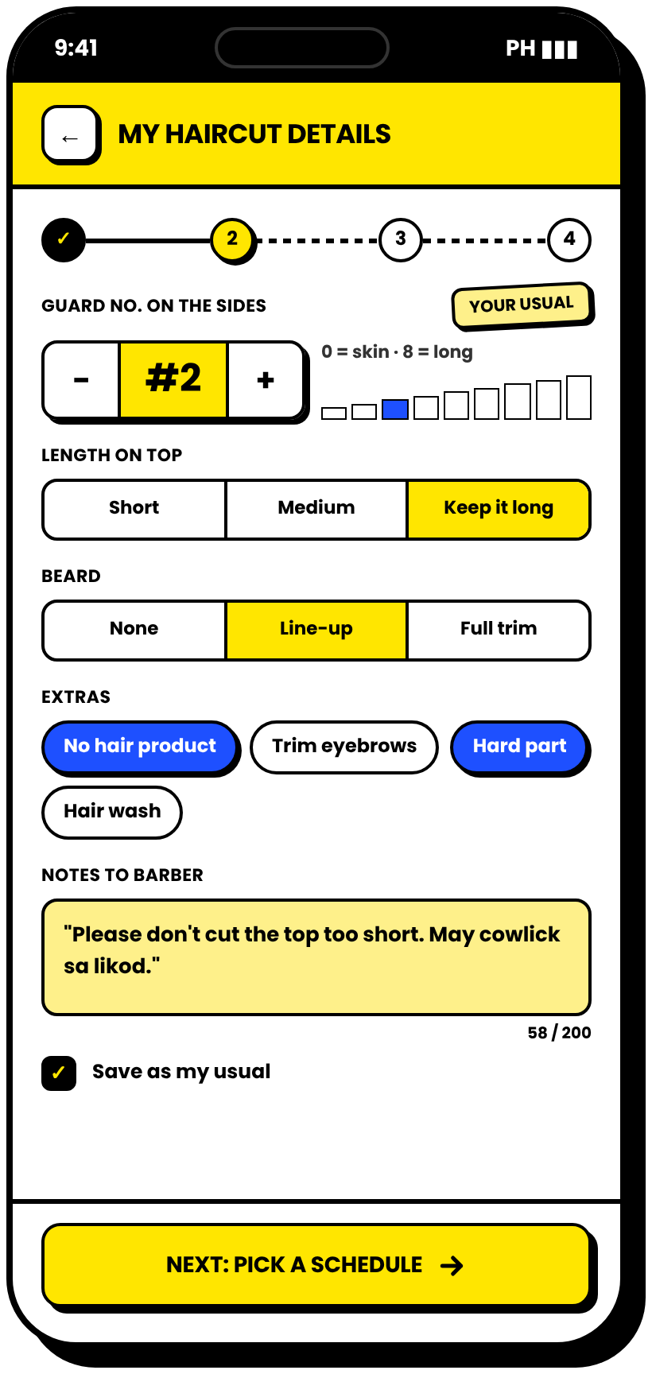
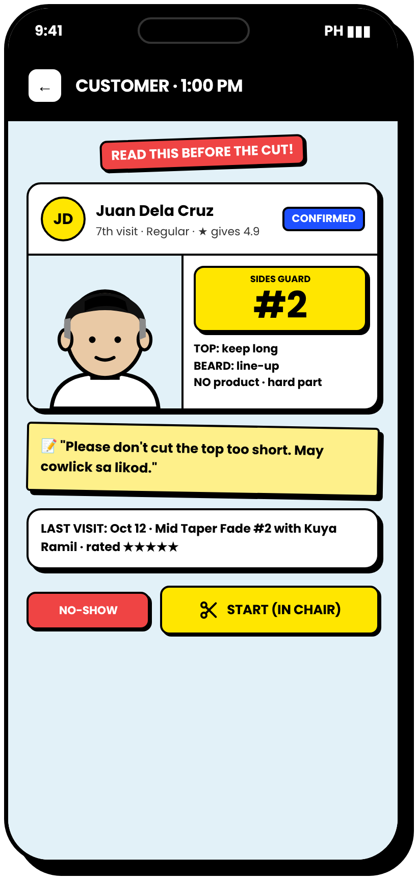
UI SHOWCASE · MOBILE + WEB
THIS IS HOW
BARBERBOOK PH
WILL LOOK.
Sample screens for the customer app and the barbershop dashboard, in the actual theme of the website.
17
MOBILE SCREENS
9
WEB SCREENS
1
DESIGN SYSTEM
Notes:
This deck shows sample screens of BarberBook PH. Everything uses the actual website theme: cobalt blue, yellow, thick black outlines, and hard shadows. These are proposed designs, and the final screens will be adjusted after the interview with the partner barbershop.

Slide 2
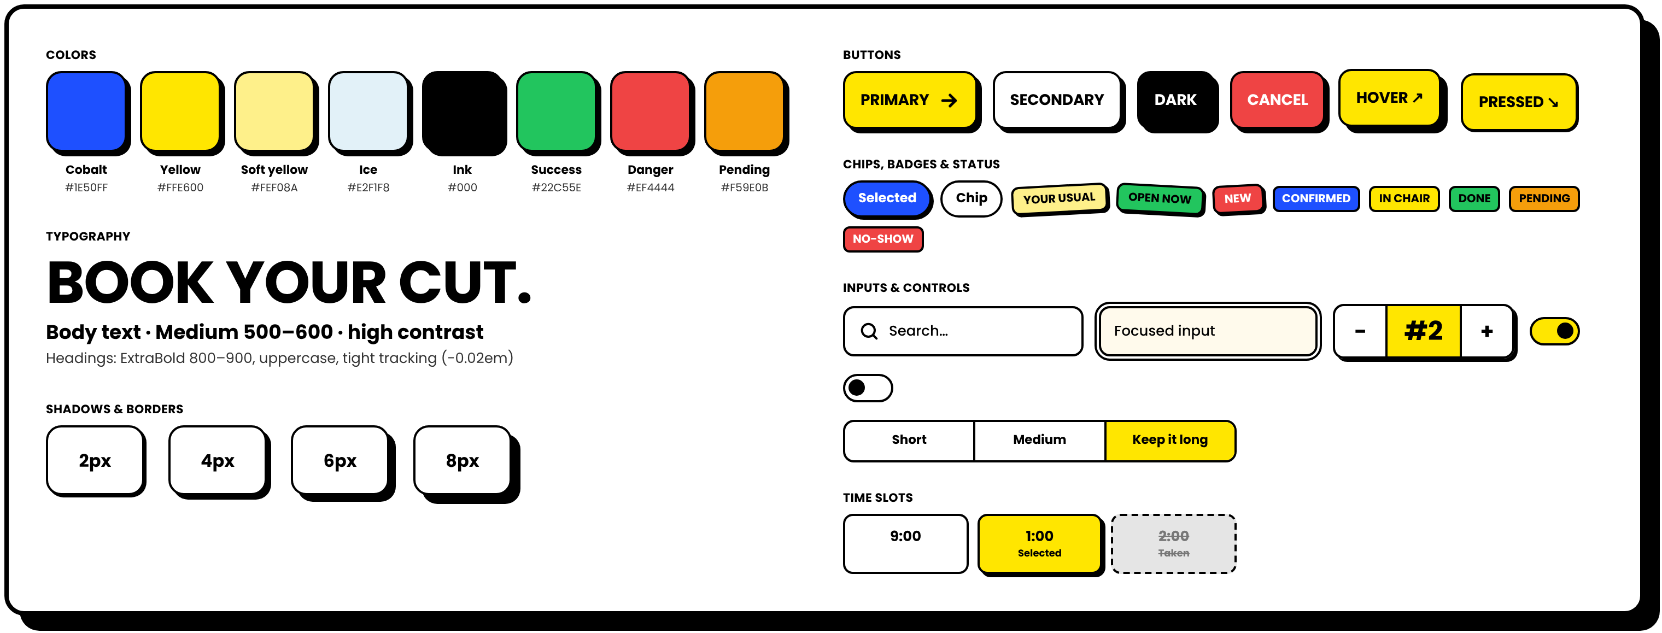
DESIGN SYSTEM
ONE LOOK, EVERY SCREEN
Neo-Brutalism: bold colors, thick outlines, hard shadows, buttons that feel like real buttons
PRESS ME! →
Why this style? High contrast makes every button easy to find on a small phone screen, even outdoors or for older customers. It also makes the brand memorable.
Notes:
This is the design system. Every screen uses the same colors, fonts, buttons, and controls, so the system looks consistent. Buttons shift when pressed, like physical buttons.

Slide 3
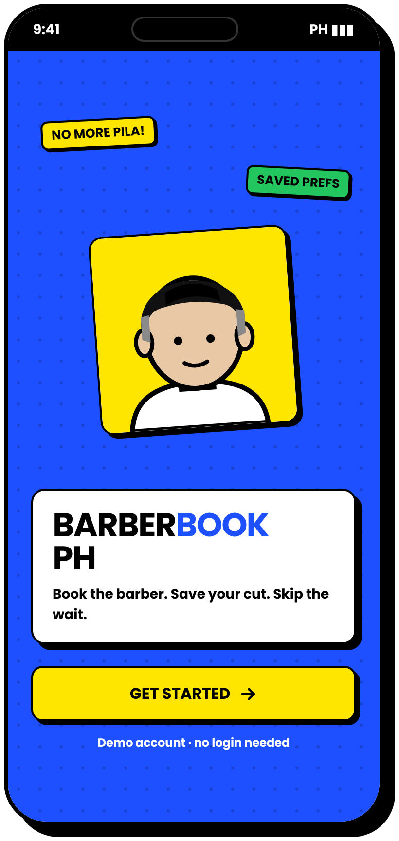
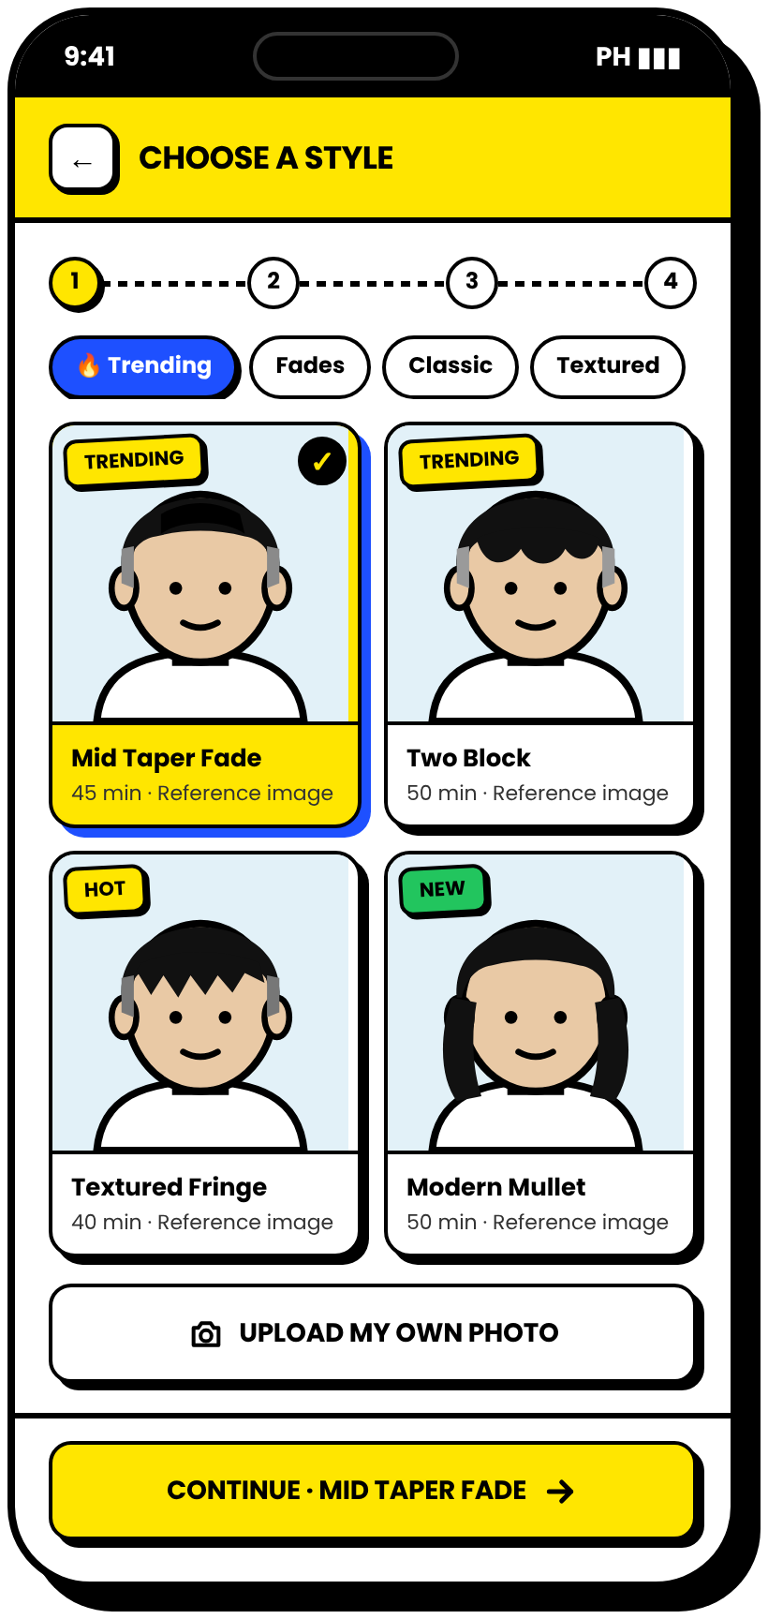
01
THE CUSTOMER APP
Mobile-first. Opens in any phone browser, no download needed. From home screen to confirmed slot in under a minute.
Notes:
Part one: the customer side on mobile. Most customers will book using their phones.

Slide 4
FIRST IMPRESSION
WELCOME AND HOME
Friendly, fast, and personal from the first tap
1
NO LOGIN IN THE DEMO
The prototype opens straight to a sample account, "Juan."
2
YOUR NEXT CUT
Upcoming booking with a countdown, plus View and Reschedule.
3
QUICK REBOOK
One tap books "your usual": same style, same barber, same guard.
4
NEARBY SHOPS
Open-now badges, ratings, and distance. More shops can be added later.
SPLASH
HOME
Notes:
The home screen shows the next appointment and a quick rebook card. Quick rebook uses the saved haircut preferences, which is a key feature.

Slide 5
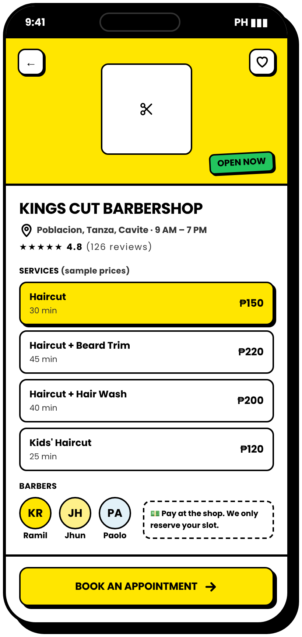
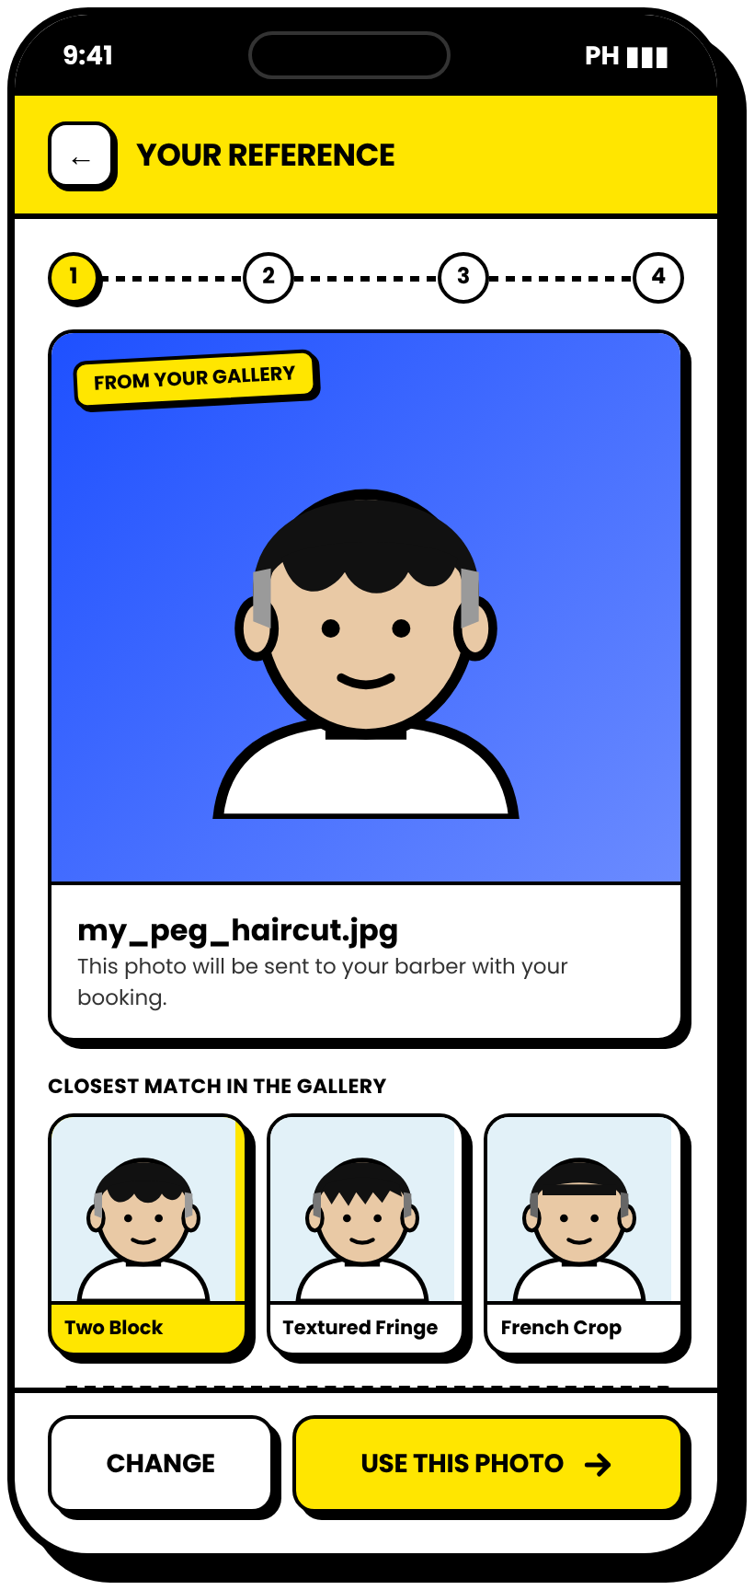
STEP 1
SHOP AND STYLE GALLERY
Customers show exactly what they want, before they arrive
1
SERVICES AND PRICES
Sample prices. Payment is still made at the shop.
2
TRENDING STYLES
The shop updates the gallery, so new styles show up here.
3
UPLOAD YOUR OWN
Customers can send their own reference photo to the barber.
SHOP
STYLE GALLERY
OWN PHOTO
Notes:
Step 1 is choosing a haircut. Customers pick from the gallery or upload their own photo, which answers the problem of explaining the haircut.

Slide 6
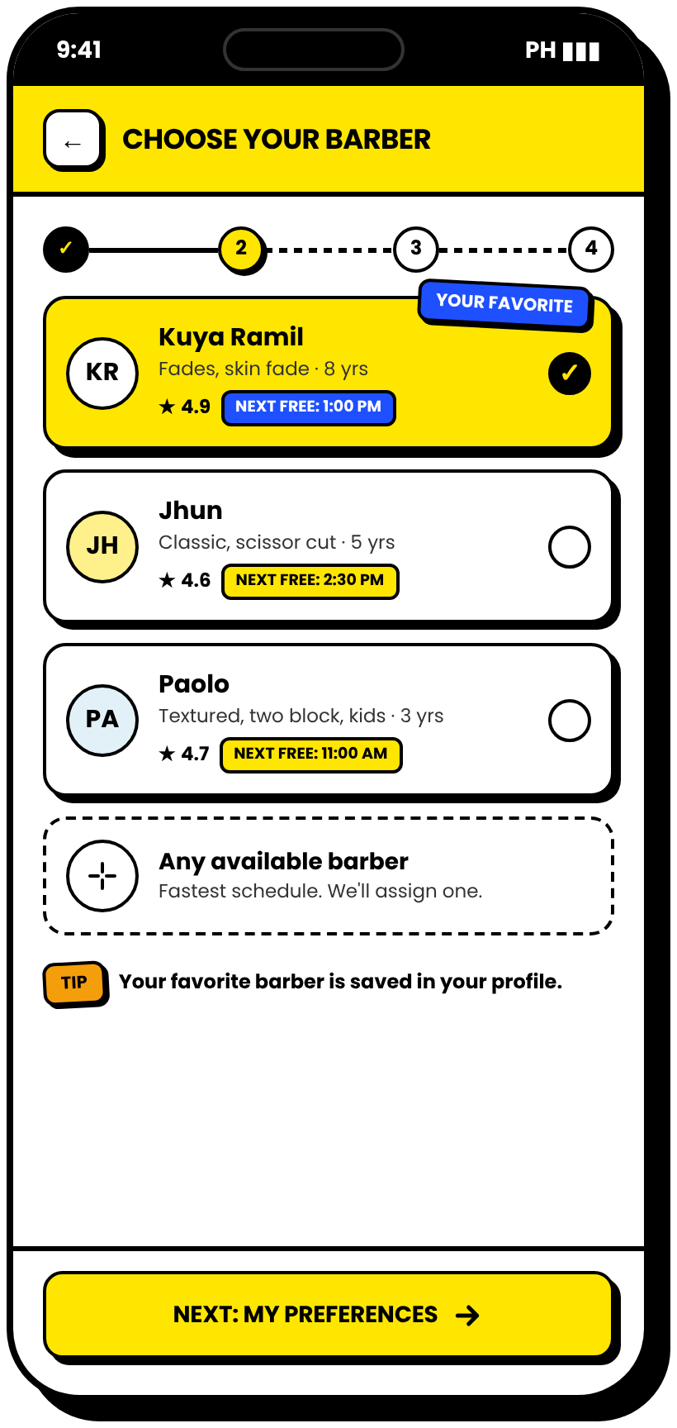
STEP 2 · OUR MAIN FEATURE
BARBER + HAIRCUT PREFERENCES
Guard number, top length, beard, extras, and notes, saved for next time
1
FAVORITE BARBER
Shows each barber's next free time, or "any available."
2
GUARD NUMBER STEPPER
From #0 skin to #8. No more guessing "semi-kalbo."
3
TOP, BEARD, EXTRAS
Simple taps instead of long explanations.
4
NOTES + SAVE AS USUAL
Written once, remembered every visit.
THE PART NOBODY ELSE DOES
PICK A BARBER
MY DETAILS
Notes:
This is our main feature. The customer records exactly how they want their haircut, and it is saved to the profile. The barber will see all of this before the cut.

Slide 7
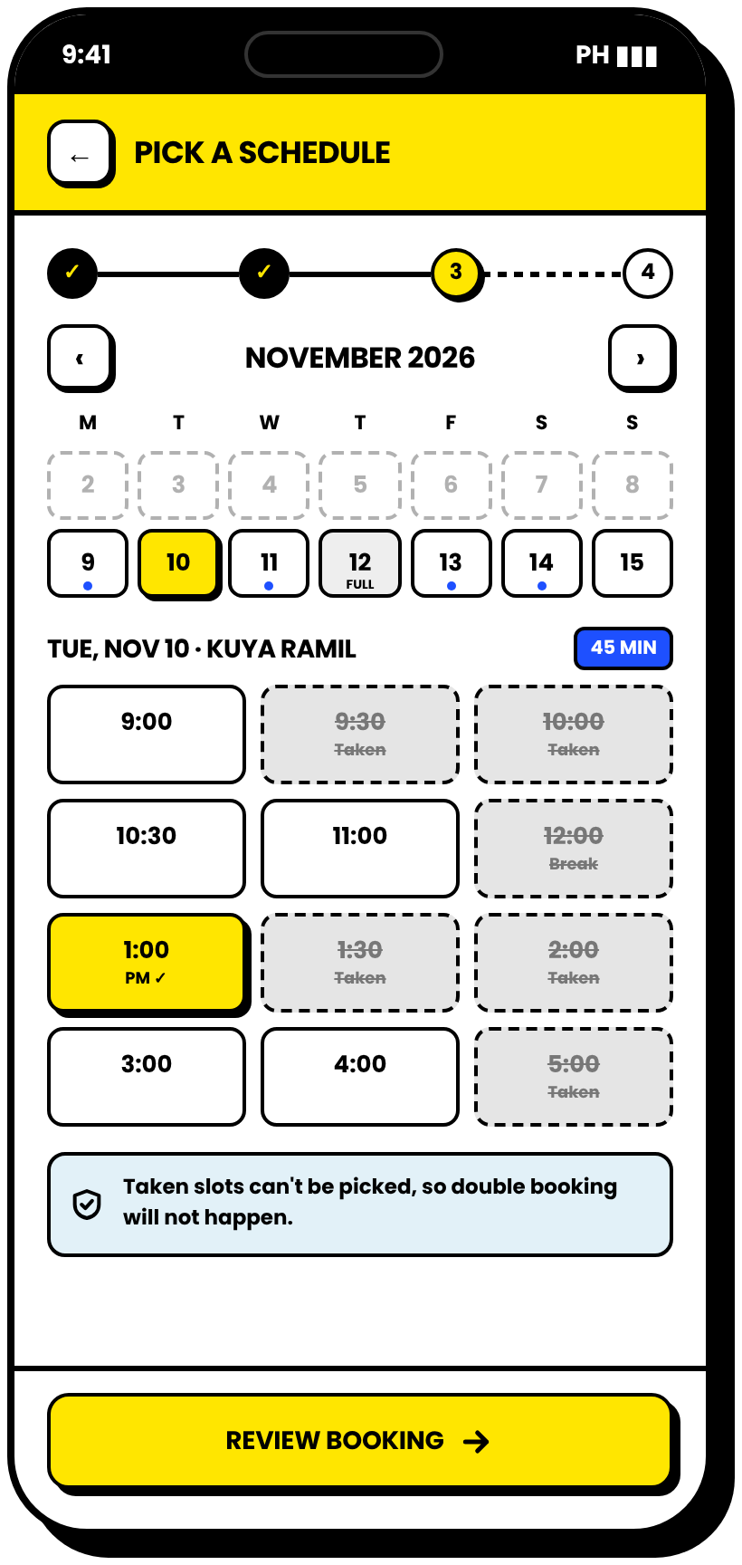
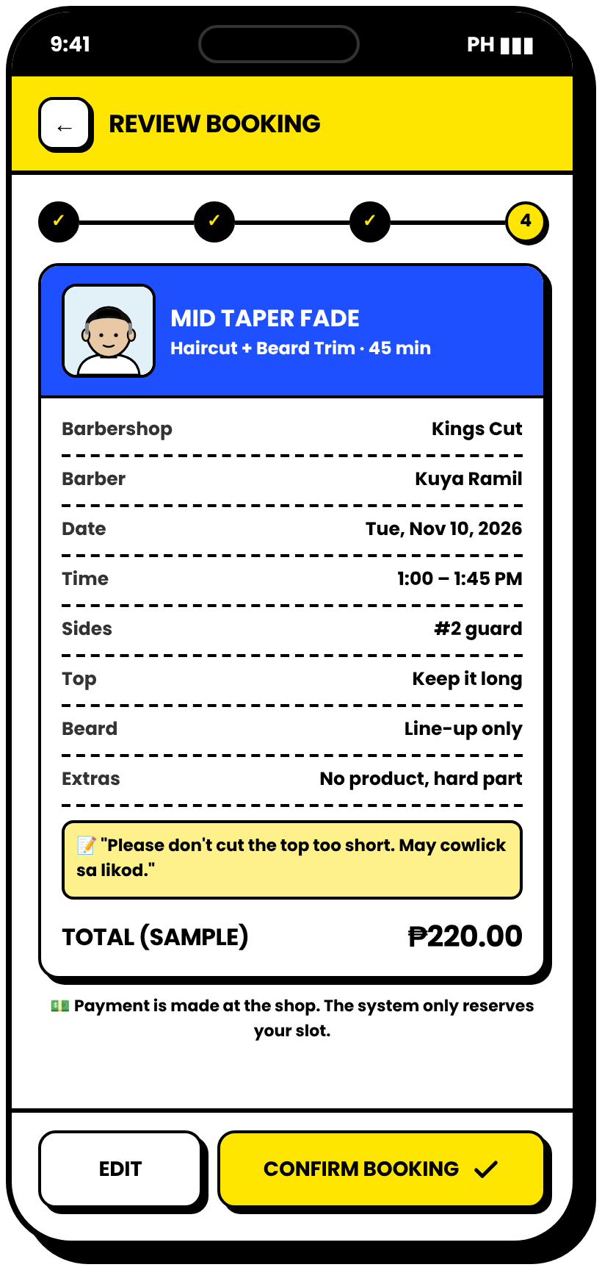
STEP 3–4
SCHEDULE AND REVIEW
Only free slots can be picked. Everything is checked before confirming.
1
SMART CALENDAR
Past days and days off are disabled. Full days are tagged.
2
NO DOUBLE BOOKING
Taken slots and breaks are crossed out and can't be tapped.
3
DURATION-AWARE
A 45-minute cut only fits where 45 free minutes exist.
4
FULL SUMMARY
Style, preferences, notes, time, and sample total before confirming.
PICK A SLOT
REVIEW
Notes:
The schedule screen solves double booking. Taken slots cannot be selected, and the system checks the style duration so bookings never overlap.

Slide 8
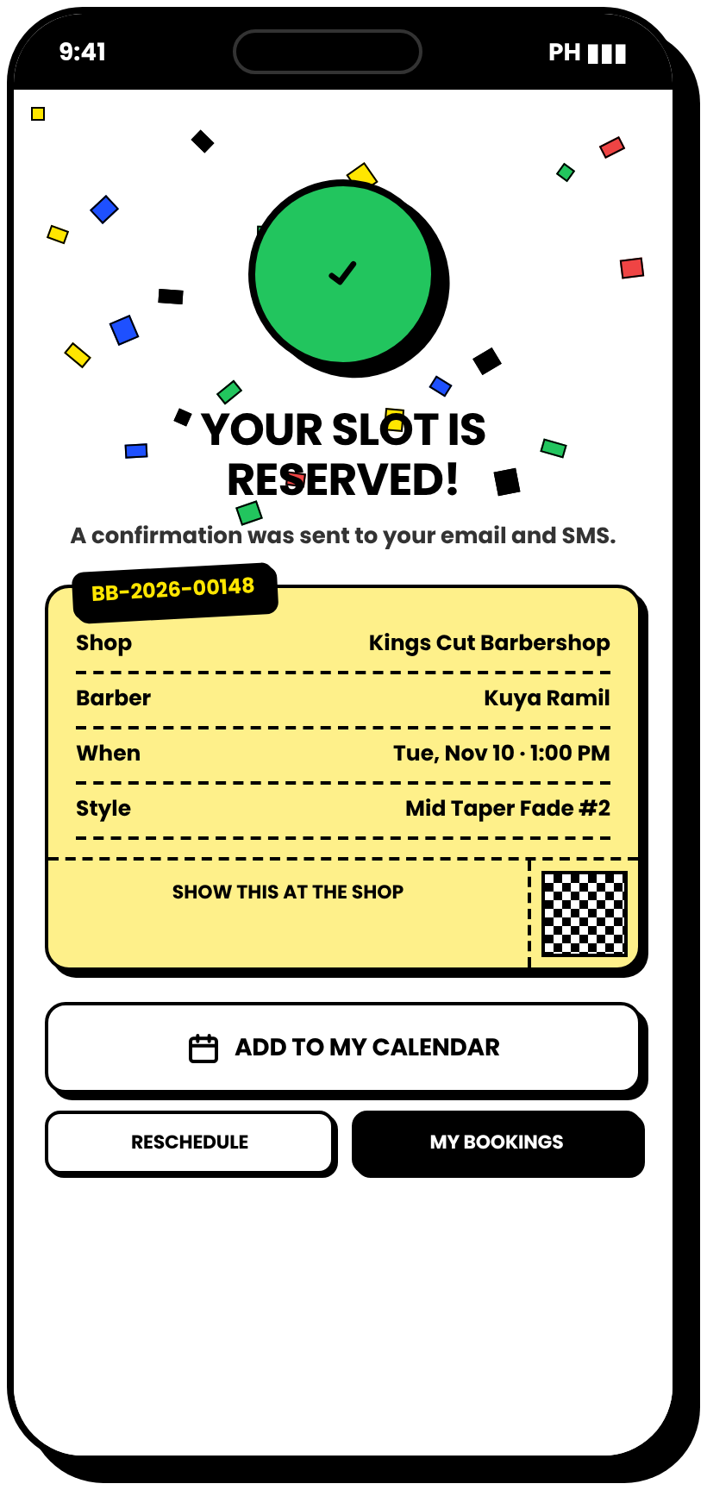
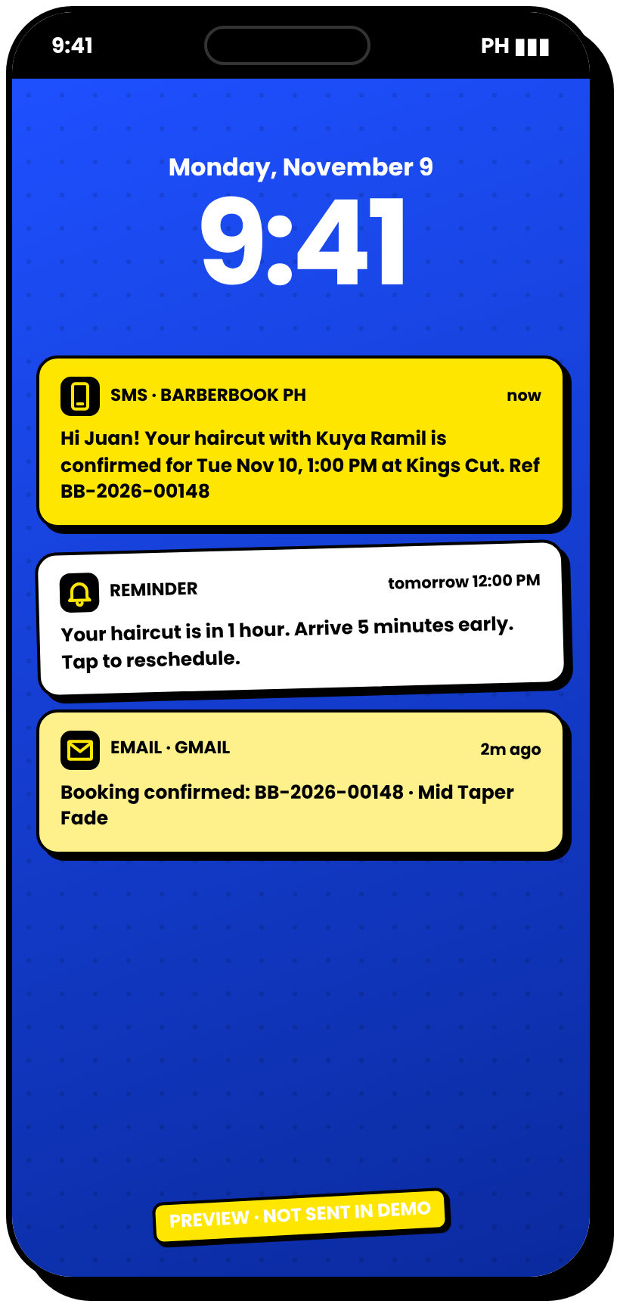
CONFIRMATION
CONFIRMED, REMINDED, NEVER FORGOTTEN
Instant confirmation plus email and SMS reminders
1
BOOKING NUMBER
A ticket to show at the shop, and it can be added to the phone calendar.
2
SMS CONFIRMATION
Sent right after booking.
3
REMINDER
Sent before the appointment to cut no-shows (Guy et al., 2012).
4
EMAIL COPY
For customers who prefer email.
CONFIRMED!
NOTIFICATIONS
Notes:
After confirming, customers get a booking number and notifications. Research shows SMS reminders increase attendance, which is why we included them.

Slide 9
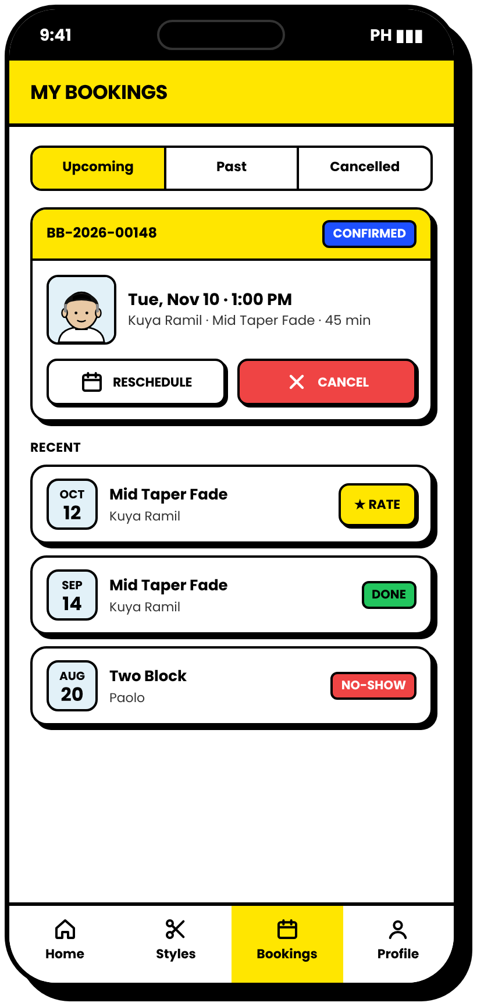
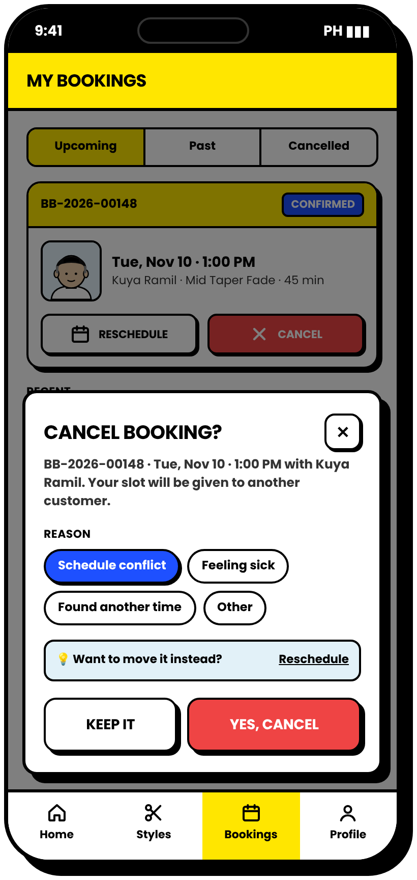
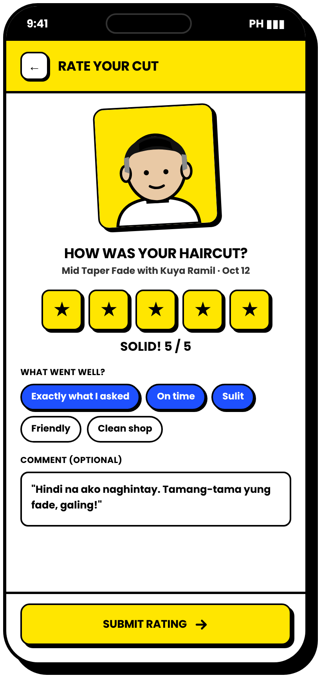
MY BOOKINGS
RESCHEDULE, CANCEL, RATE
Customers stay in control, and the shop gets feedback
1
EASY CHANGES
Reschedule keeps the same booking number.
2
CANCEL WITH A REASON
The slot is freed for other customers right away.
3
RATE THE CUT
Stars and quick tags measure user satisfaction.
MY BOOKINGS
CANCEL
RATE YOUR CUT
Notes:
Customers can reschedule, cancel with a reason, and rate their haircut. Ratings feed the owner dashboard and support the user-satisfaction evaluation.

Slide 10
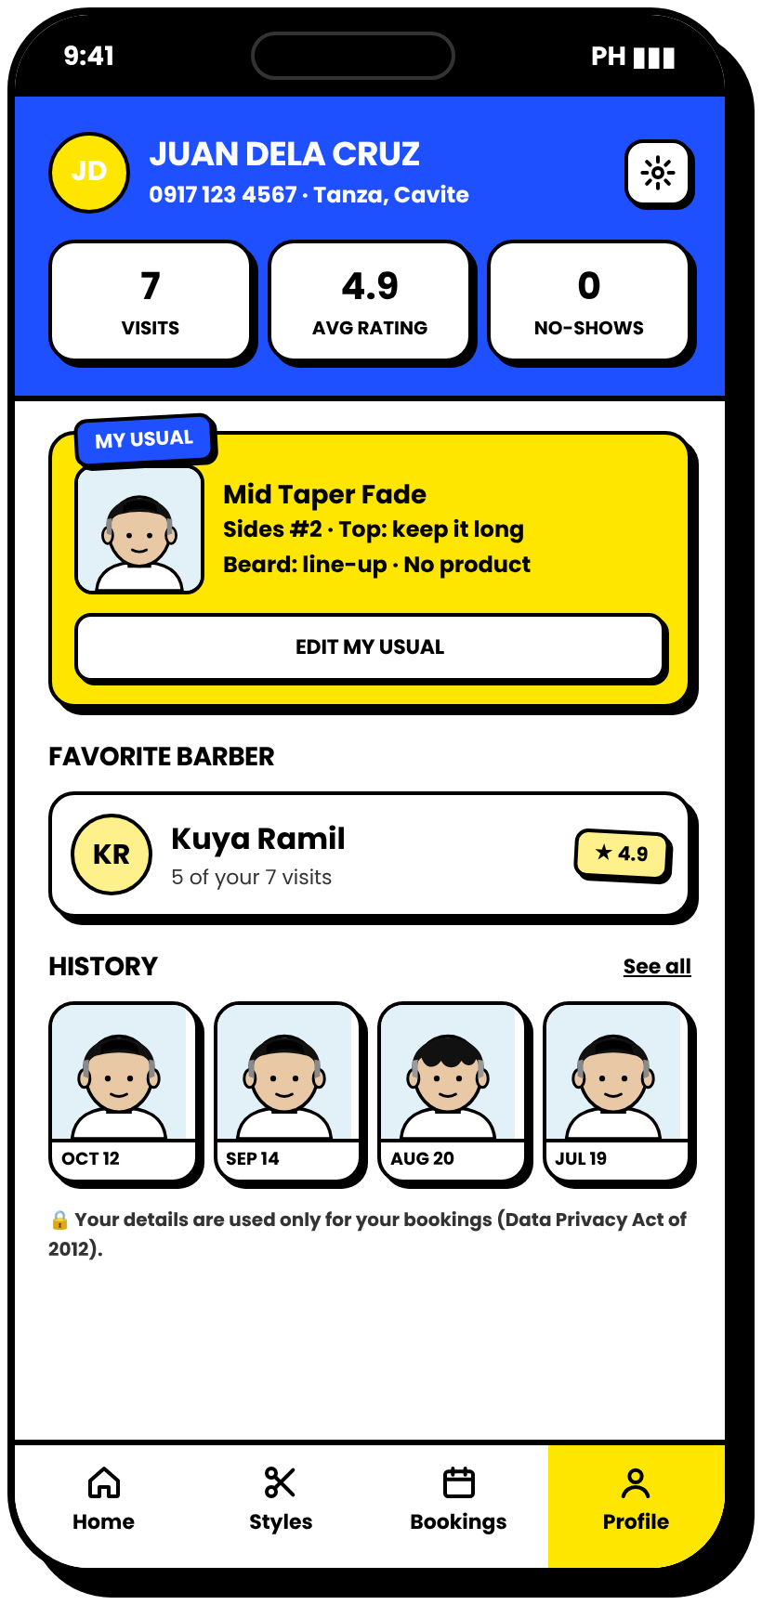
PROFILE
IT REMEMBERS YOU
Saved preferences and appointment history in one place
1
MY USUAL
Style, guard number, top, beard, and extras, editable anytime.
2
FAVORITE BARBER
Based on the customer's own history.
3
VISUAL HISTORY
Every past haircut with the date, useful for "same as last time."
4
DATA PRIVACY
Details are used only for bookings, following RA 10173.
PROFILE
Notes:
The profile keeps the customer's preferences and history. This directly answers the research question about customer profile and appointment history.

Slide 11
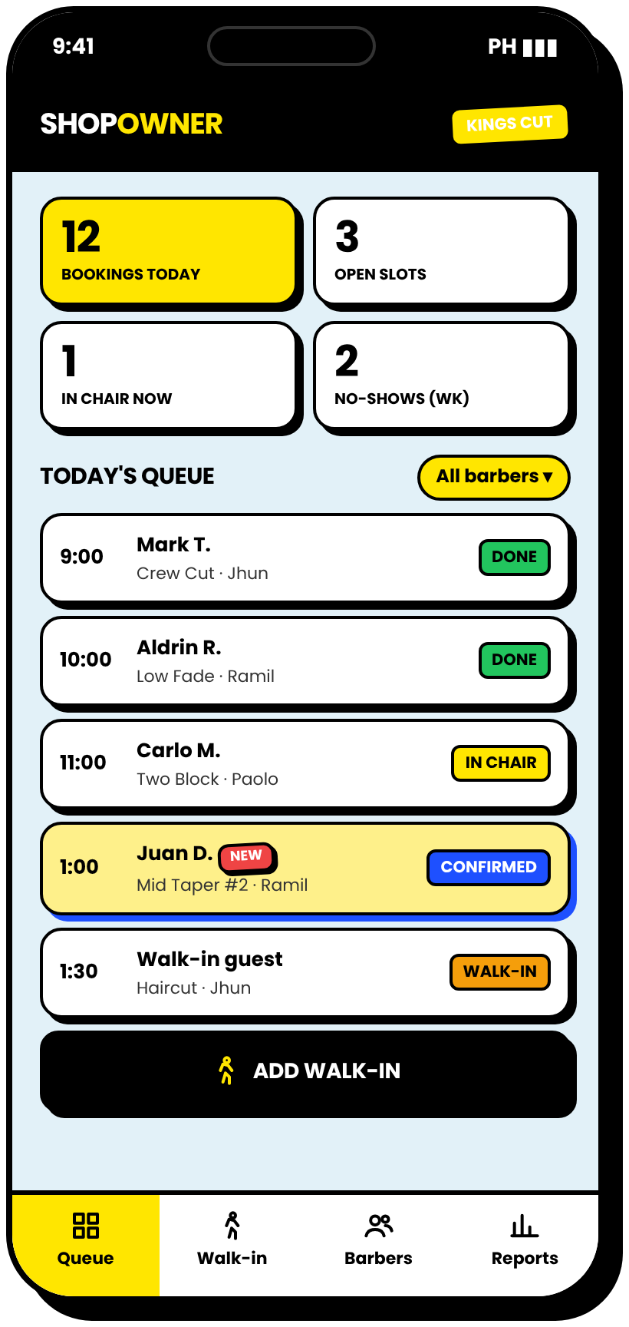
02
FOR THE BARBERSHOP
The owner and barbers see the day at a glance, on the phone or on a computer.
Notes:
Part two: the barbershop side. The owner can use the dashboard on a phone during the day.

Slide 12
OWNER · MOBILE
THE QUEUE IN YOUR POCKET
Today's bookings, walk-ins, and the preference card
1
LIVE QUEUE
New online bookings pop in with a NEW badge.
2
STATUS IN ONE TAP
Confirmed, in chair, done, or no-show.
3
READ BEFORE THE CUT
The barber sees the style, the guard number, and the notes.
4
WALK-INS TOO
Encoded by the owner so the schedule stays complete.
TODAY'S QUEUE
BEFORE THE CUT
Notes:
On the phone, the owner sees the queue, and the barber opens the preference card before starting the haircut. This is where our main feature pays off.

Slide 13
03
THE WEB VERSION
The same system on a laptop: a public landing page, desktop booking, and the full owner dashboard.
Notes:
Part three: the web version for laptops and desktop computers, which is what the owner will use at the counter.

Slide 14
LANDING PAGE
BARBERBOOK.PH
The public website that customers and shop owners see first
1
BOLD PROMISE
"No more pila. Just your cut."
2
TWO PATHS
Book a haircut, or sign up a barbershop.
3
PROOF POINTS
Booking time, zero double booking, style count.
4
SAME THEME
Matches the app, so the brand stays consistent.
Notes:
This is the landing page. It explains the value in one line and gives two clear actions.

Slide 15
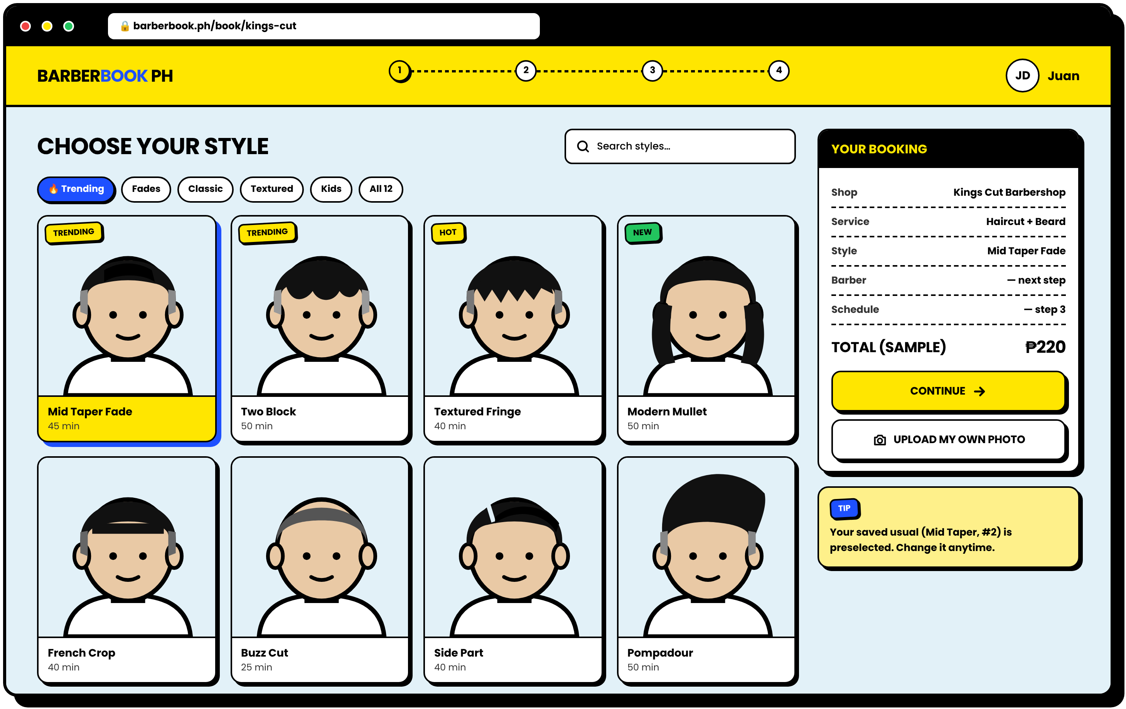
DESKTOP BOOKING
BOOK ON A BIG SCREEN
Style grid, step tracker, and a live booking summary
1
4-STEP TRACKER
Style, barber, schedule, review. Always visible.
2
BIGGER GALLERY
4 columns of styles with search and filters.
3
LIVE SUMMARY
The booking card updates as the customer picks.
Notes:
Customers can also book on a laptop. The summary on the right updates with every choice.

Slide 16
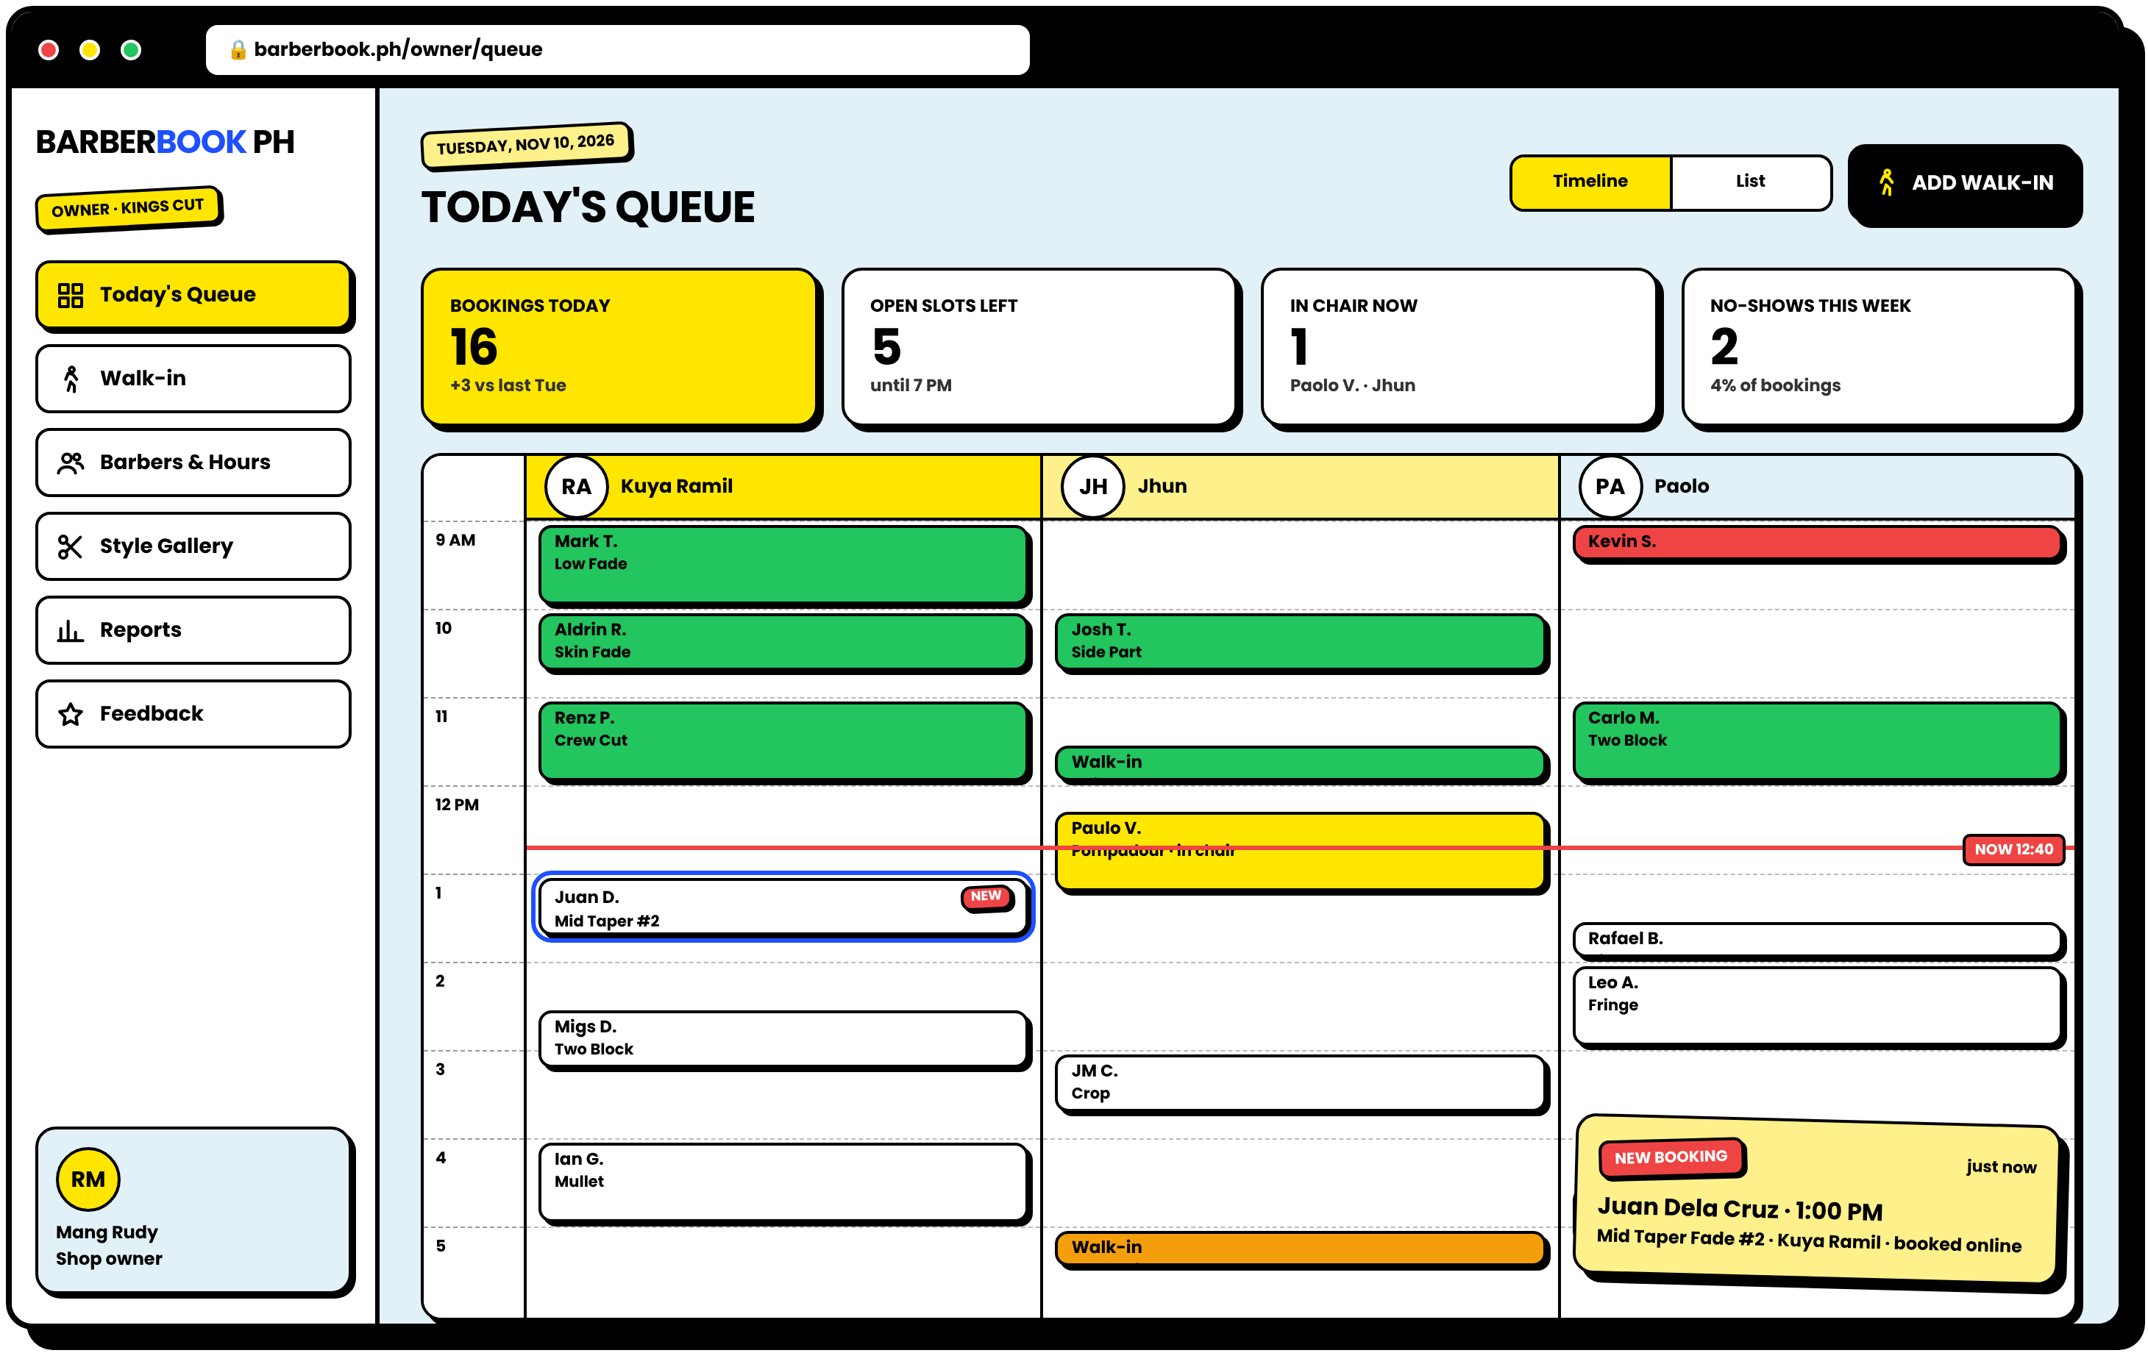
OWNER DASHBOARD
TODAY'S QUEUE
Every barber, every booking, one timeline
1
KPI CARDS
Bookings, open slots, in chair, no-shows.
2
BARBER TIMELINE
Color-coded by status, with a live "NOW" line.
3
NEW BOOKING ALERT
Online bookings pop up instantly with a NEW badge.
4
ADD WALK-IN
One button away, always on top.
Notes:
This replaces the notebook. The owner sees all barbers and bookings on one timeline, color-coded by status.

Slide 17
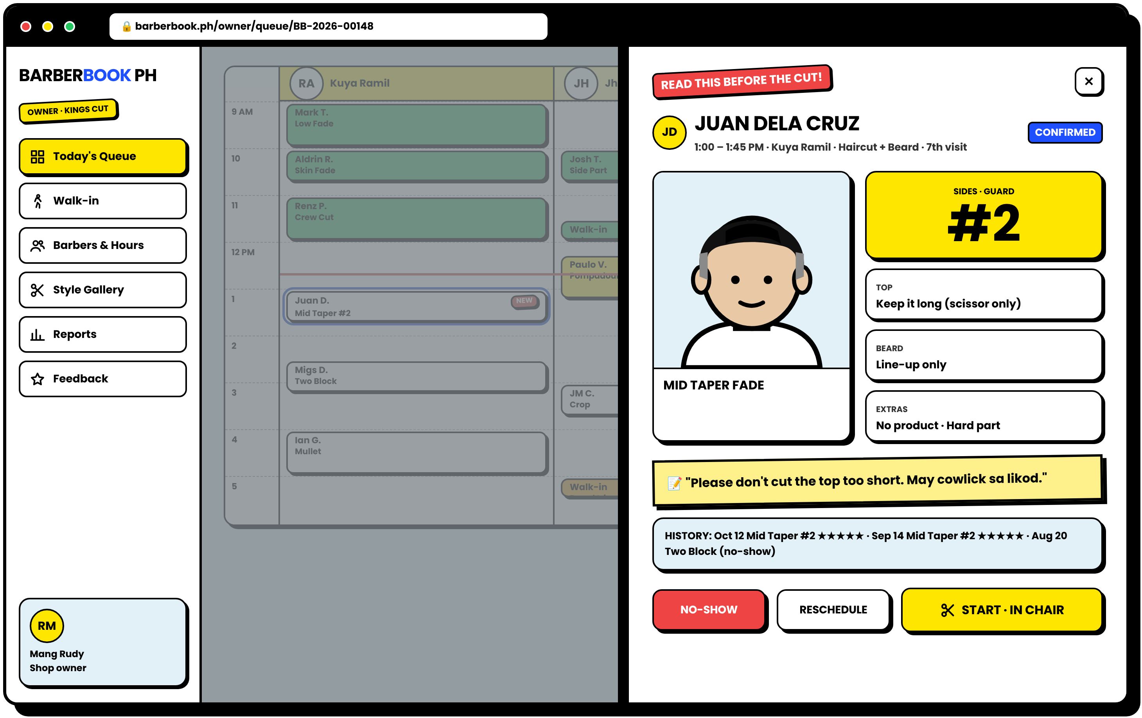
THE HERO SCREEN
READ THIS BEFORE THE CUT
Click any booking and the barber sees exactly what the customer wants
1
STYLE REFERENCE
Gallery image or the customer's own photo.
2
GUARD IN BIG NUMBERS
#2 is impossible to miss.
3
TOP, BEARD, EXTRAS
Clear, one line each.
4
NOTES + HISTORY
The customer's own words and past visits.
SOLVES "YUNG DATI LANG PO"
Notes:
This is the most important screen for the barber. It turns vague requests like "yung dati lang po" into exact, written instructions.

Slide 18
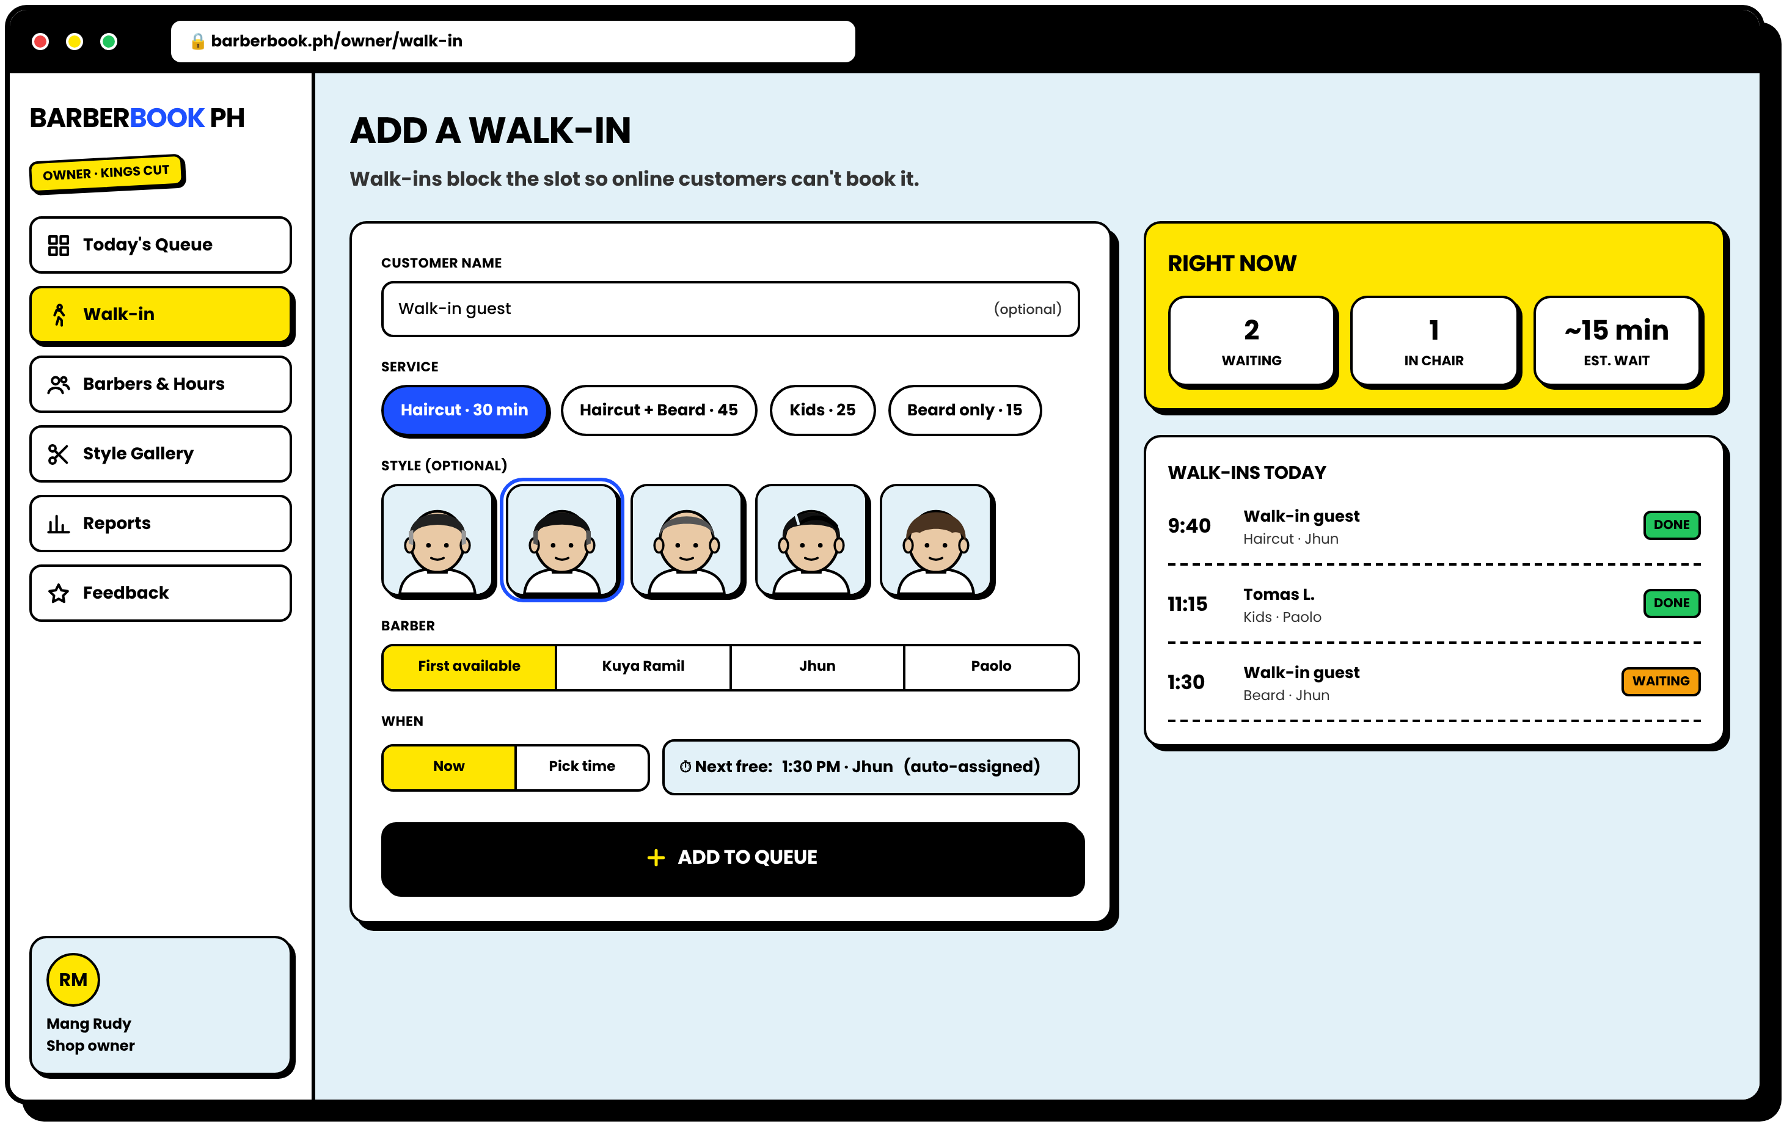
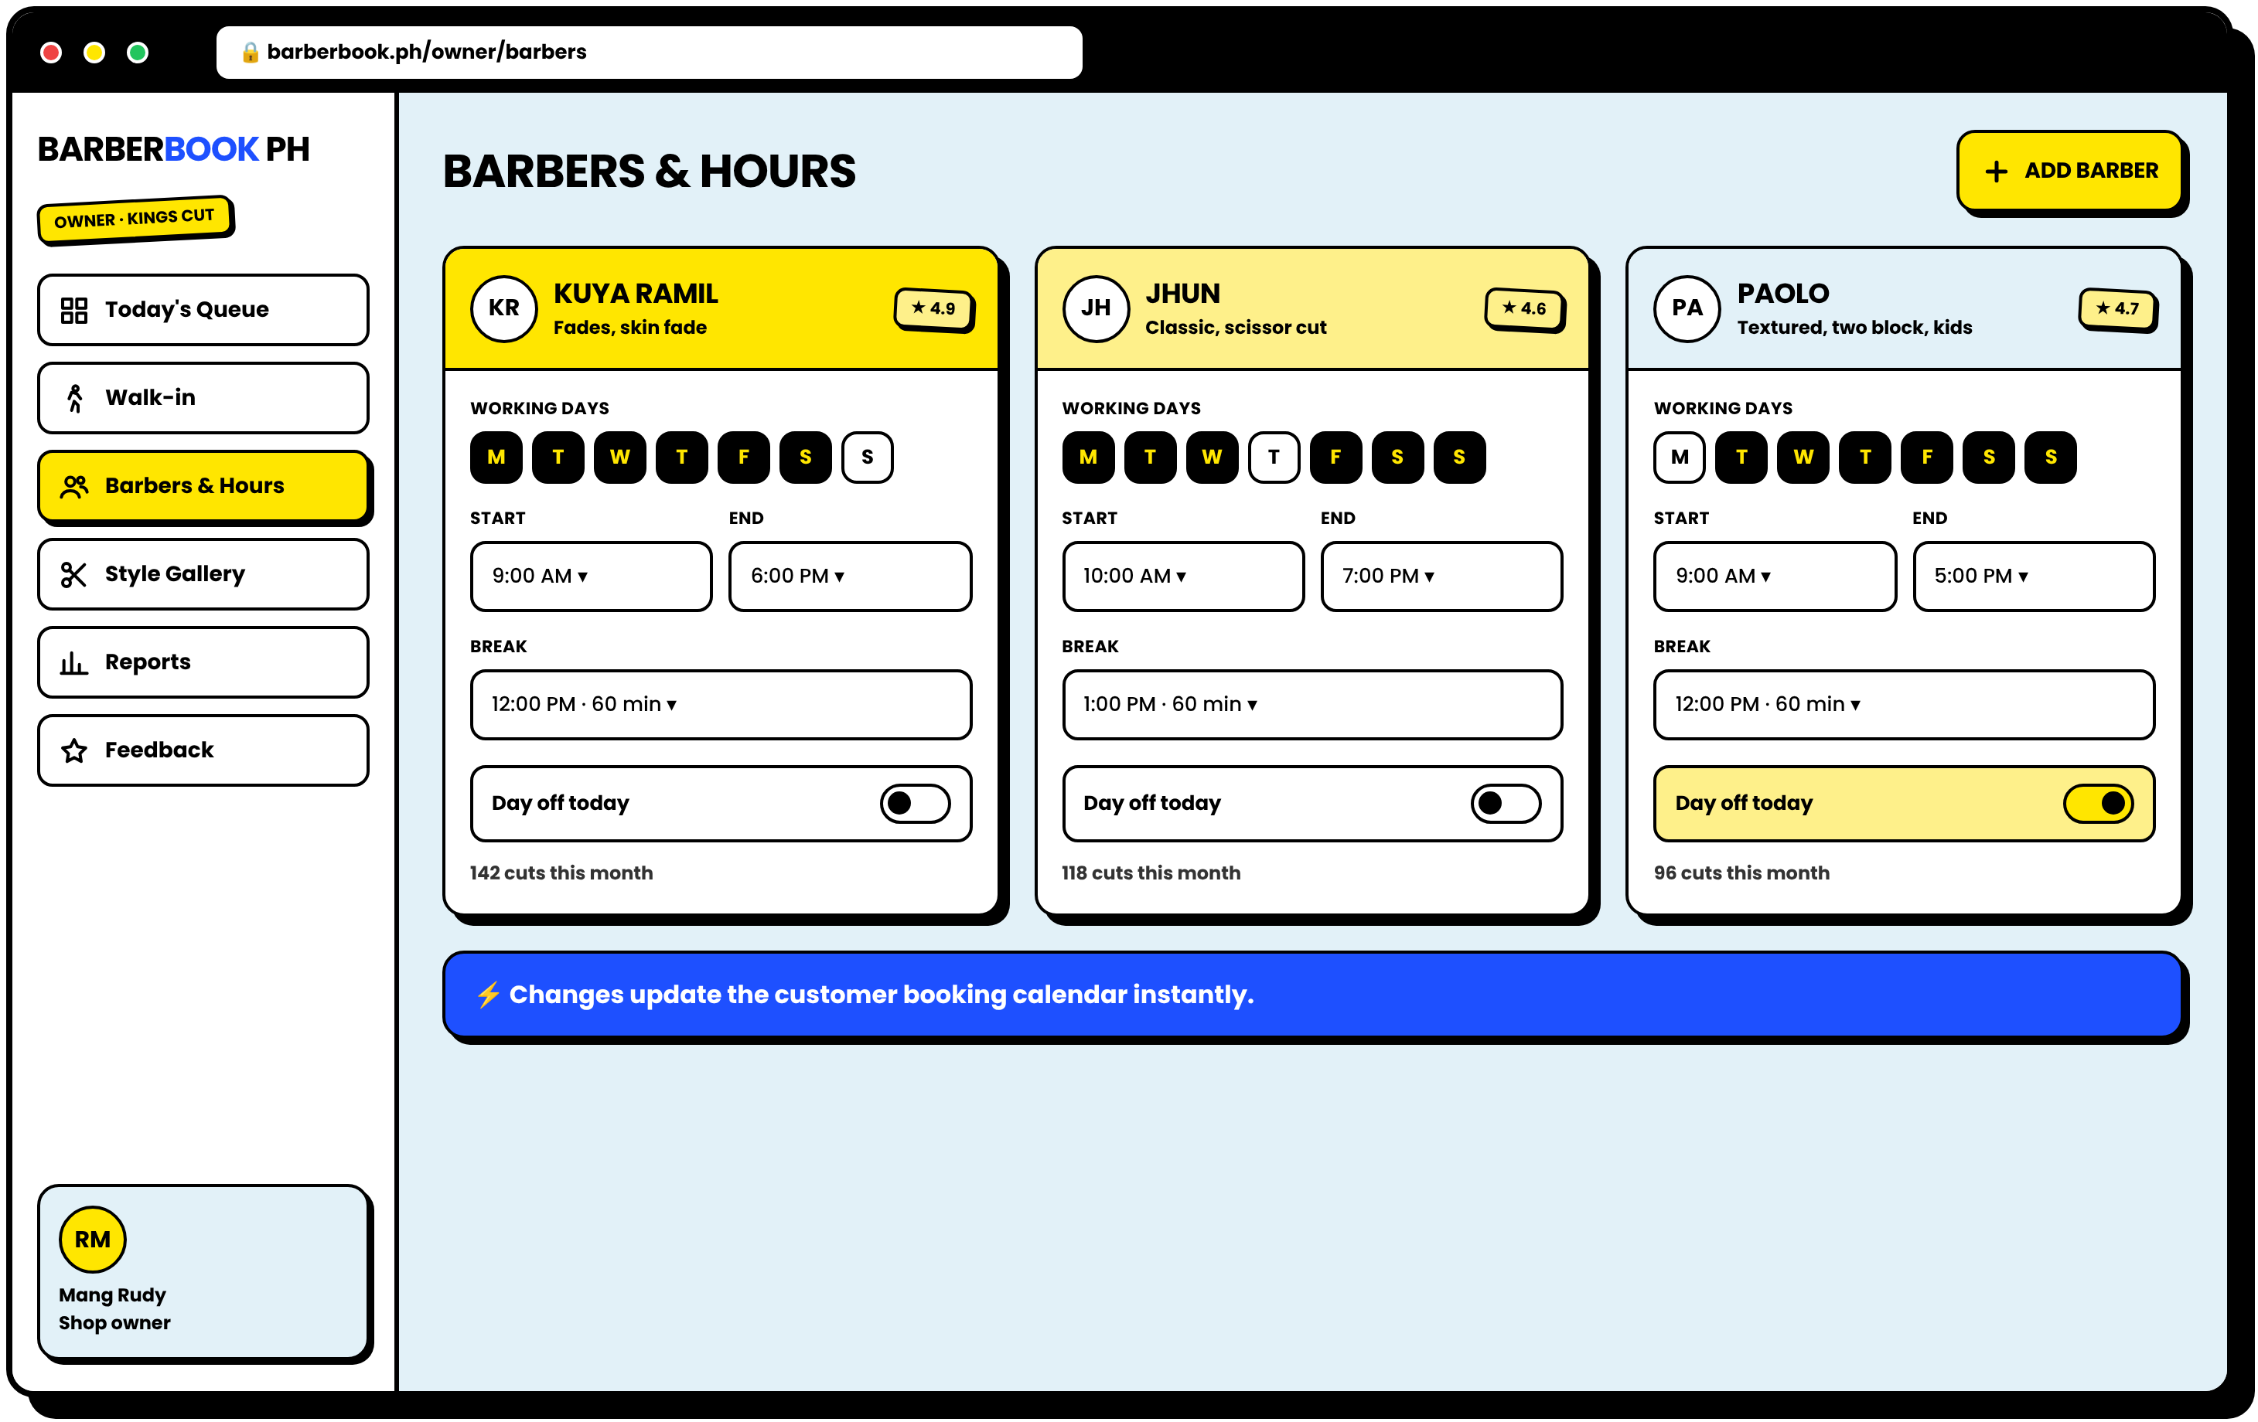
SHOP MANAGEMENT
WALK-INS AND BARBER HOURS
Walk-ins block the slot for online customers, and hours update the calendar instantly
WALK-IN FORM
BARBERS & HOURS
Walk-ins still welcome. Customers without internet are served as usual. The owner encodes them in seconds so there is never a double booking between walk-ins and online bookings.
Notes:
Walk-ins are still accepted, as stated in our delimitations. The owner encodes them, and the slot is blocked for online customers.

Slide 19
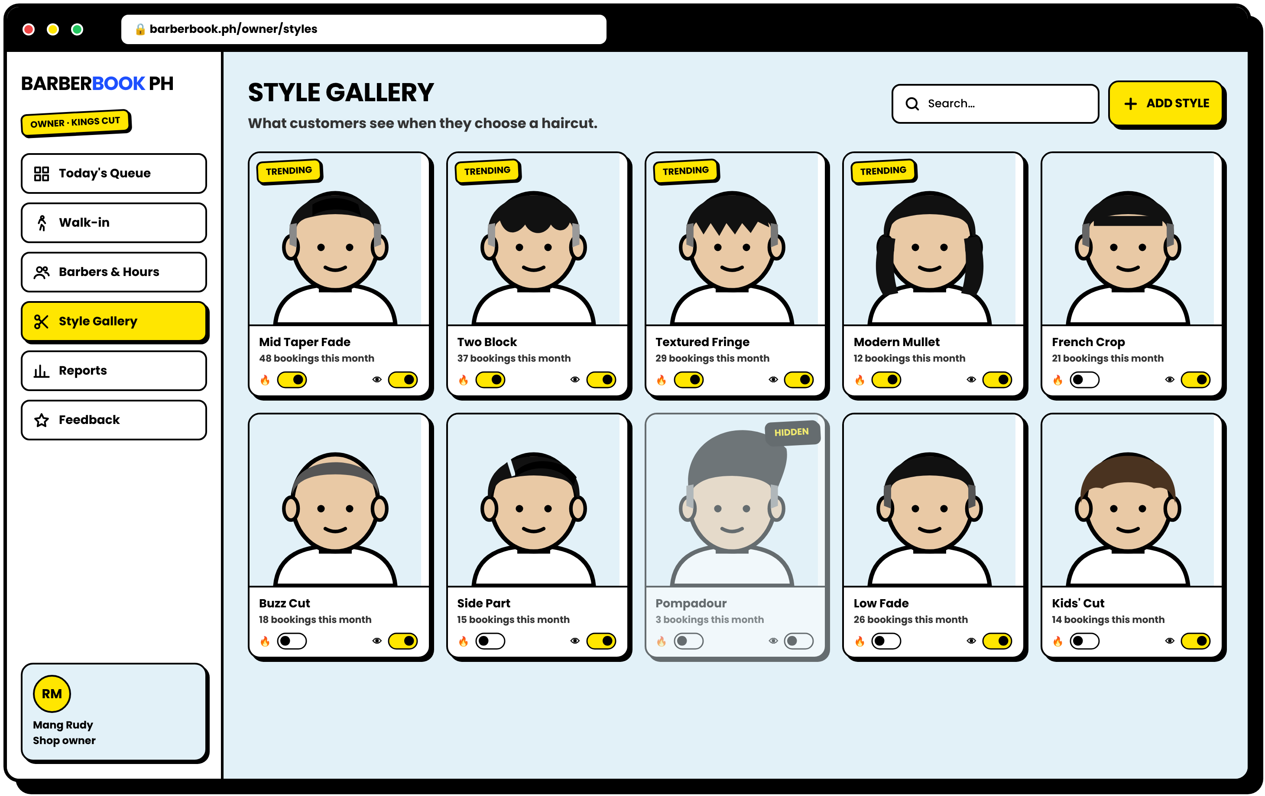
STYLE GALLERY MANAGER
THE SHOP CONTROLS THE GALLERY
Mark styles as trending, hide old ones, add new ones
1
TRENDING TOGGLE
Moves a style into the Trending tab for customers.
2
HIDE OR SHOW
Retired styles disappear from the app.
3
USAGE COUNT
See which styles customers book the most.
Notes:
The owner manages the hairstyle gallery, so trending styles stay updated, which is one of our objectives.

Slide 20
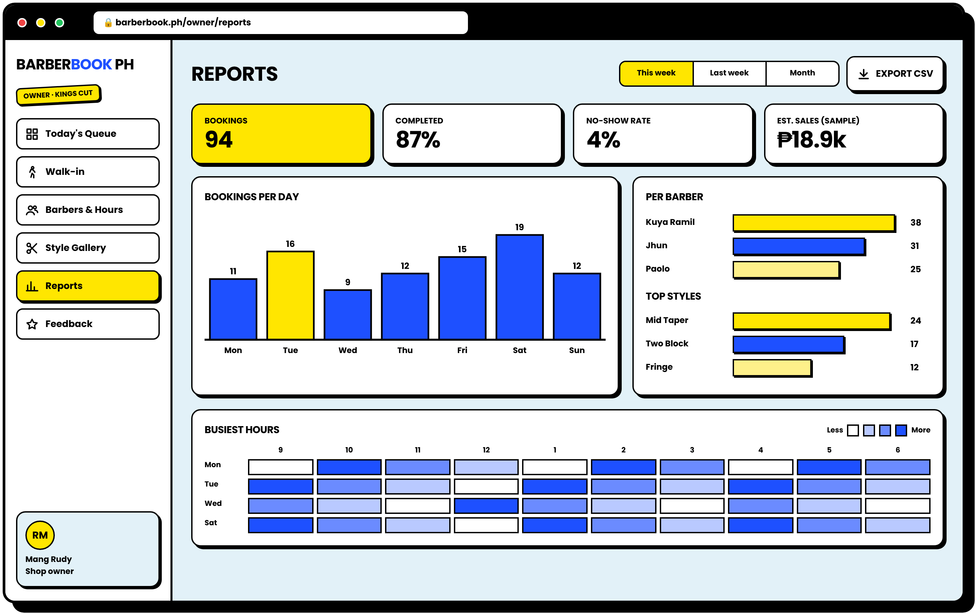
REPORTS
NUMBERS THE OWNER CAN USE
Bookings per day, per barber, top styles, and busiest hours
1
WEEKLY KPIS
Bookings, completion rate, no-show rate.
2
PER DAY AND PER BARBER
Helps decide staffing and days off.
3
BUSIEST HOURS
A heat map for shop hours and promos.
4
EXPORT CSV
For records and simple bookkeeping.
Notes:
Reports help the owner decide on shop hours and staffing. This supports the significance of the study for barbershop owners.

Slide 21
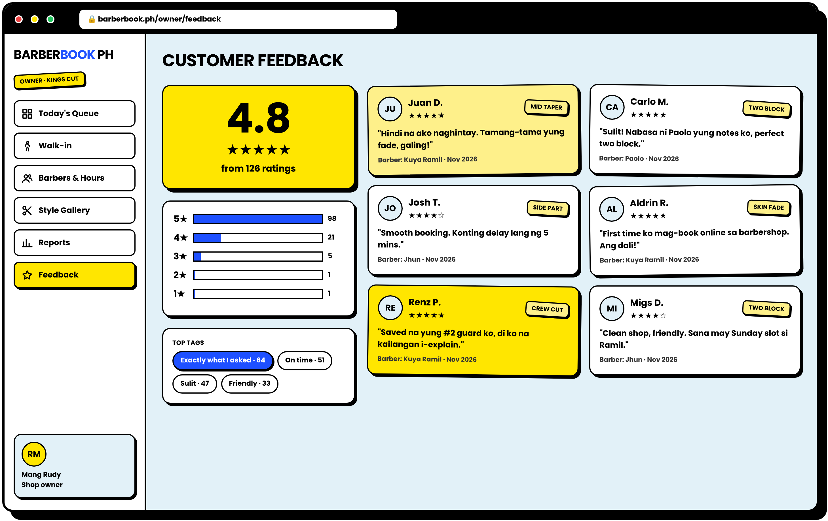
FEEDBACK
WHAT CUSTOMERS ARE SAYING
Ratings and comments after every appointment
1
AVERAGE RATING
A big, simple score.
2
TOP TAGS
"Exactly what I asked" shows the preference feature works.
3
PER-BARBER REVIEWS
Useful for coaching and recognition.
Notes:
Feedback gives a record of customer satisfaction, which the old notebook system never had.

Slide 22
THE WOW MOMENT
ONE BOOKING, TWO SCREENS, INSTANTLY
The customer confirms on the phone, and it appears in the shop dashboard right away
LIVE! NO REFRESH
→
CUSTOMER · PHONE
OWNER · LAPTOP
Notes:
This is what we will demo live. When a customer confirms, the booking appears on the owner's dashboard right away, and the slot is blocked so no one else can take it.

Slide 23
EVERY SCREEN
17 MOBILE SCREENS, 9 WEB SCREENS
A complete, consistent system, customer and shop side
Notes:
Here are all 17 mobile screens together. They share one design system, so the app feels like one product.

Slide 24
EXCITED?
SO ARE WE.
Coming to [Partner Barbershop] · 2027
Proposed designs only. Final colors, photos, and shop details will follow the interview with the partner barbershop.
Notes:
Close by reminding the panel that these are proposed designs and will be refined with the partner barbershop.

