Slide 1
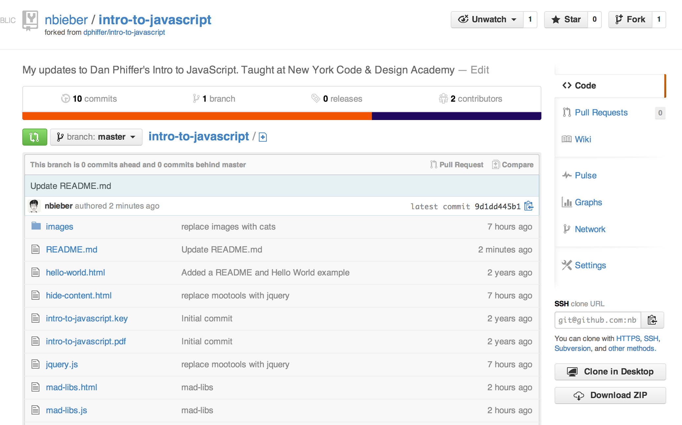


Welcome! Please download today’s lesson files:
https://github.com/nbieber/nycda-iwdd-lesson-1
Click here!
Plus, if you don’t already have them:
Google Chrome
Sublime Text
www.google.com/chrome‎
www.sublimetext.com

Slide 2
Introduction to Web Design & Development
Lesson One
Nicole Bieber

Slide 3

Introduction to Me
Software Developer at Amplify
Makes educational apps
Studied computer science at MIT
Favorite TV Show: Dr Who

Slide 4
“Everything is deeply intertwingled. In an
important sense there are no “subjects” at all; there is only all knowledge, since the cross- connections among the myriad topics of this world simply cannot be divided up neatly.”
—Ted Nelson, Computer Lib/Dream Machines

Slide 5
“When human beings acquired language, we
learned not just how to listen but how to speak. When we gained literacy, we learned not just how to read but how to write. And as we move into an increasingly digital reality, we must learn not just how to use programs but how to make them.”
—Douglas Rushkoff, Program or Be Programmed

Slide 6
“The single most significant change in the politics of cyberspace is the coming of age of this simple idea: The code is law. The architectures of cyberspace are as important as the law in defining and defeating the liberties of the Net.”
—Lawrence Lessig, The Code Is the Law

Slide 7
Course Overview
Tuesdays & Thursdays – 6:30-9:30
15 min. break at 8pm
Short (5-10 min) quizzes on Thursdays
Homework – short assignment for each class
Recommended activities/resources

Slide 8
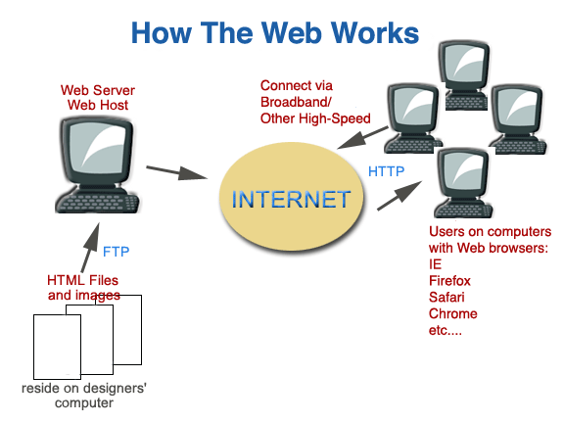

Slide 9
Parts of a Website
HTML – content markup
CSS - layout/styling
JavaScript – client-side behavior
Ruby on Rails – server-side behavior

Slide 10
What is HTML?
Hyper Text Markup Language
Marks up text
With CSS, associates style information
HTML files contain tags and regular text

Slide 11
Creating an HTML File
Quick demonstration –what you see, what the browser sees
An HTML file can be created in any plain text editor - it is a plain text file that ends in .htm or .html.
HTML files are typically edited in applications like Sublime Text 2, TextWrangler, and BBEdit.
Notes:
Open index.html in browser and in Sublime Text

Slide 12
HTML tags
An tag is enclosed in 2 angle brackets (<>)
A closing tag has a / before the keyword
For instance, <html> is the opening tag,
</html> is the closing tag of the document

Slide 13
Other Tag Info
Tags, much of the time, have other tags inside of them
Beware of improper nesting:
<b>
<li>
</b>
</li>

Slide 14
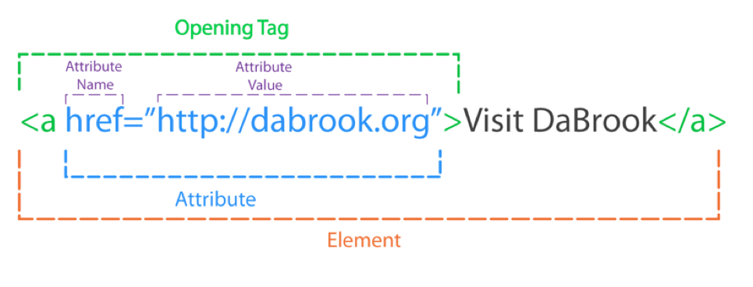
Elements

Slide 15
HTML Attributes
HTML elements can have attributes
Attributes provide additional information about an element
Attributes are always specified in the start tag
Attributes come in name/value pairs like: name="value"

Slide 16
More on links
Target attribute, to open the link in a new window
ID to specify an anchor.
<a href="http://google.com" target="_new" id="google">Google</a>
An anchor allows you to send people to a certain part of your page using another link.
<a href="#google">Visit our Link to Google</a>

Slide 17
More on anchors
Anchors can be used in any link to the page as well.
<a href="page.html#google">Visit the Link to Google on the Page!</a>

Slide 18
Anatomy of a Webpage
Doctype
tells the browser what HTML version you’re using. Always use:
<!DOCTYPE html>
HTML
Head section - loaded first, user does not see it
Body section - Page content

Slide 19
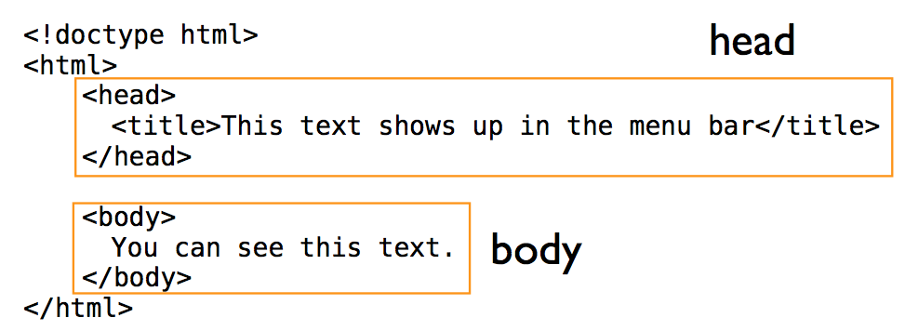
Notes:
Open up Sublime Text, write this out
Have everybody change their title

Slide 20
HTML Tags
<!DOCTYPE html>
<html></html>
<head></head>
<title></title>
<body></body>

Slide 21
The <head> Section
The <head> section of your file contains more then just the title of your document
This section of your document is meant to enclose links to external files as well
You can also create CSS or JavaScript in this space that will work with your page

Slide 22
HTML Tags 2
<p></p>
<h1></h1>, <h2></h2>, etc.
<a></a>
<img>
Notes:
Have students duplicate the tiger page

Slide 23
Lists
Lists are declared with the <ul> tag, which denotes an unordered list.
List items are declared with the <li> tag.
<ul> <li>Item one </li><li>Item two</li></ul>

Slide 24
HTML Text Formatting
Although text should be styled with CSS in most cases, there are tags to format text within HTML itself
<b> makes text bold</b>
<i> makes it italic</i>,
<u> creates an underline</u>

Slide 25
Notes
NEVER forget the end tag!
Use tabs for easier to read code

Slide 26
Marking Up
Let’s mark up a document with HTML!

Slide 27
Tables
Tables are an important layout element, but have mostly been replaced by <div> and <span> tags for basic page layout
Only use tables for tabular data!

Slide 28
Tables
A table begins with a <table> tag
A row starts with the table row tag, <tr>
A column with the row starts with a <td>, or table data, tag

Slide 29
Sample Table
<table>
<tr>
<td>
Hello!
</td>
</tr>
</table>

Slide 30
iFrames
An Iframe is another HTML page or website viewed in a frame inside your HTML page
This is how some websites create embeddable widgets
<iframe src="page.html"></iframe>

Slide 31
Embedding Javascript
To embed JavaScript in your page, use the script tag.
<script type="text/javascript" src="yourfile.js"></script>

Slide 32
Create Your Own
Markup your own page.
Feel free to use Google to look things up.
www.w3schools.com is a great resource!

Slide 33
<div> and <span>
<div> represents a generic element (a “division”) – you can style it however you want
<span> is similar – used for inline text styling
<div>
<p>This is a paragraph.</p>
<p>This is another paragraph.</p>
</div>

Slide 34
Resources
w3schools
Codecademy
http://prework.flatironschool.com/#html

