Slide 1


Internet stvari i servisa
Filip Dojčinović 18135

Slide 2
Sadržaj
Arhitektura
Filter service
Dashboard service
Grafana
Ekuiper
Command
Docker
Testing

Slide 3












Arhitektura
analytics.data
Sensor/data
Filter service
Sensor/data
analytics.data
Sensor service
Sensor/data
Dashboard service
Actions/+
Actions/+
Command service
websocket event
Client

Slide 4
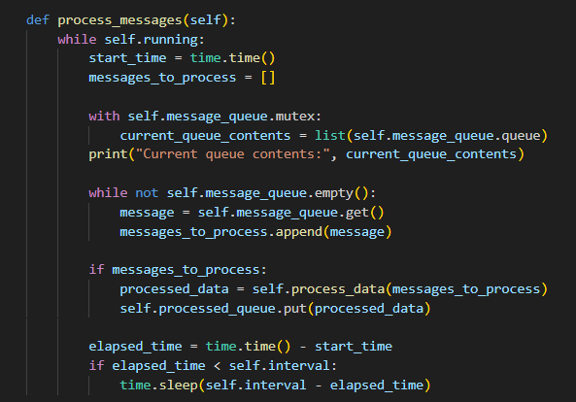
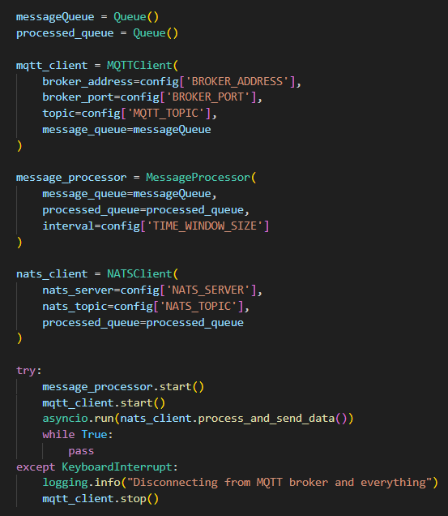
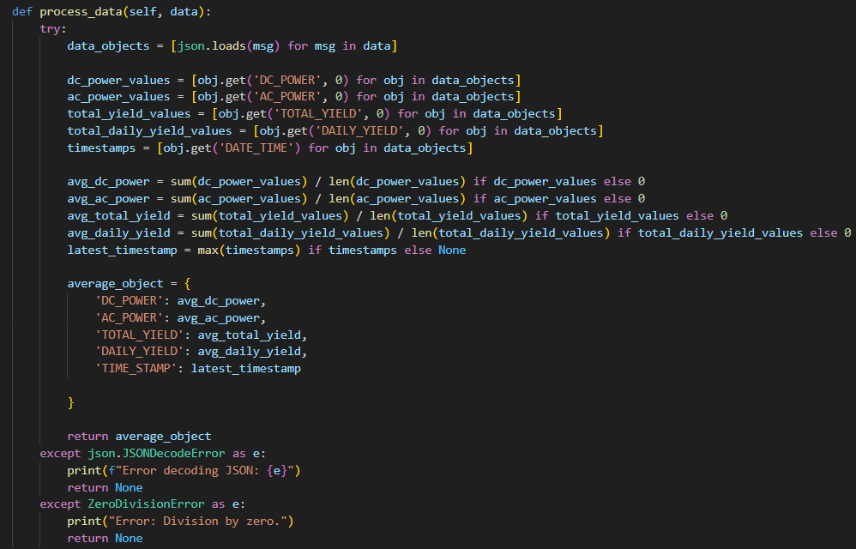
Filter service

Slide 5
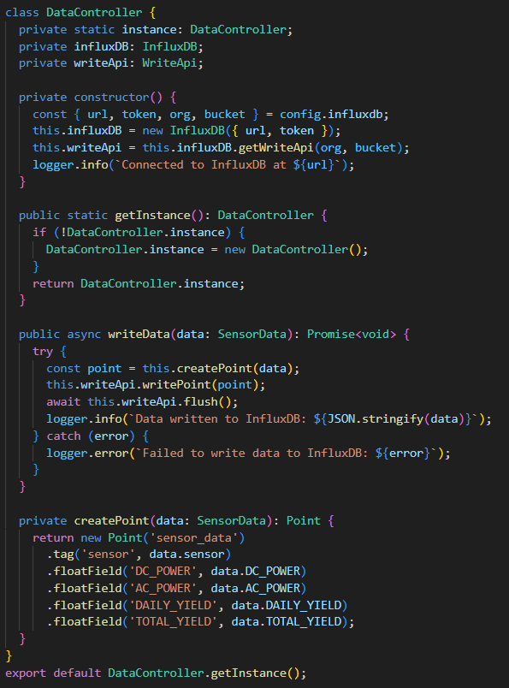
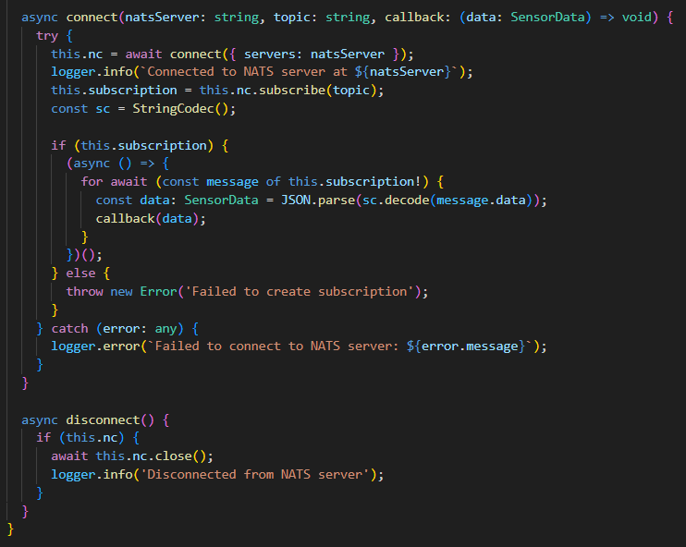
Dashboard service
INFLUXDB CONTROLLER
NATS CONNECTION

Slide 6
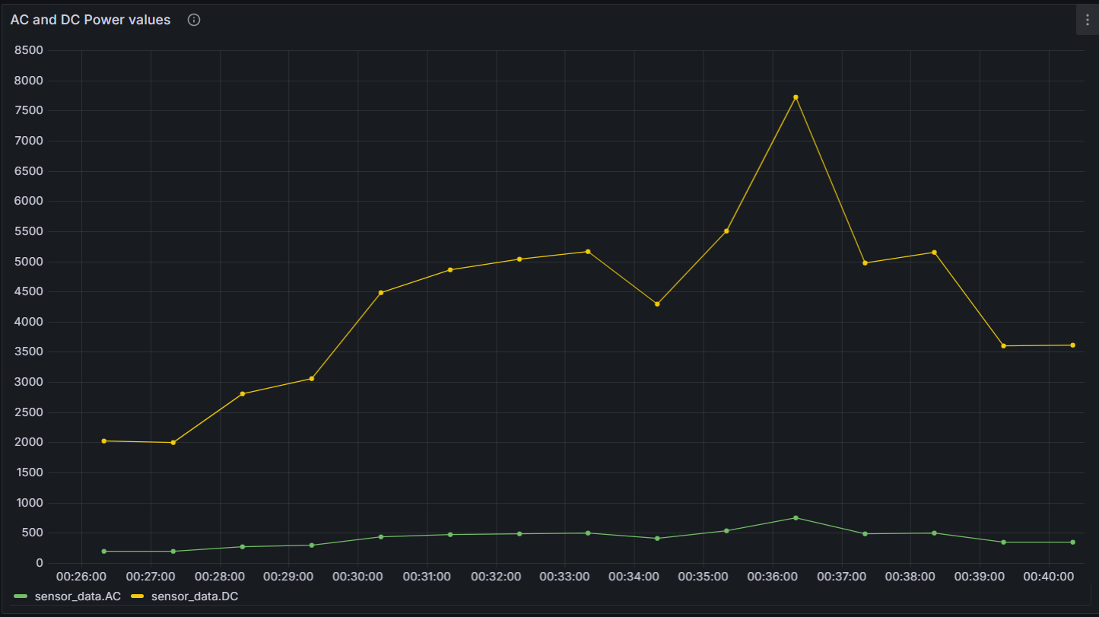
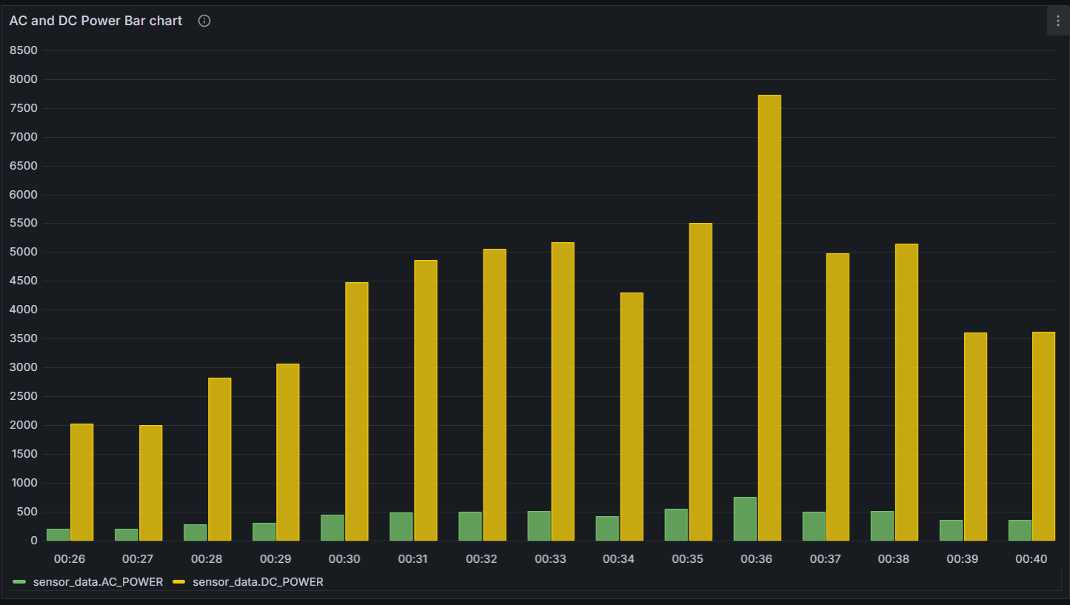
Grafana

Slide 7
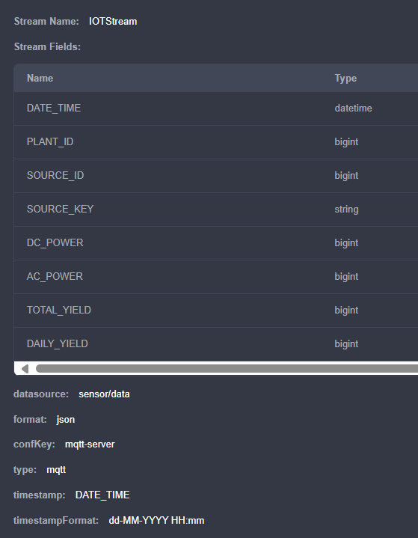

Ekuiper
Data Stream
Ekuiper rules

Slide 8
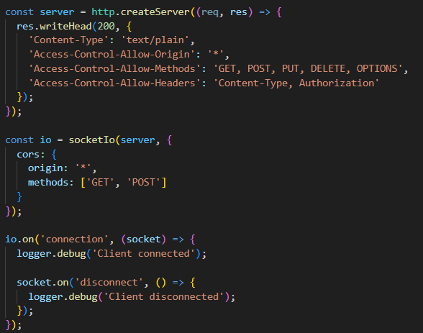
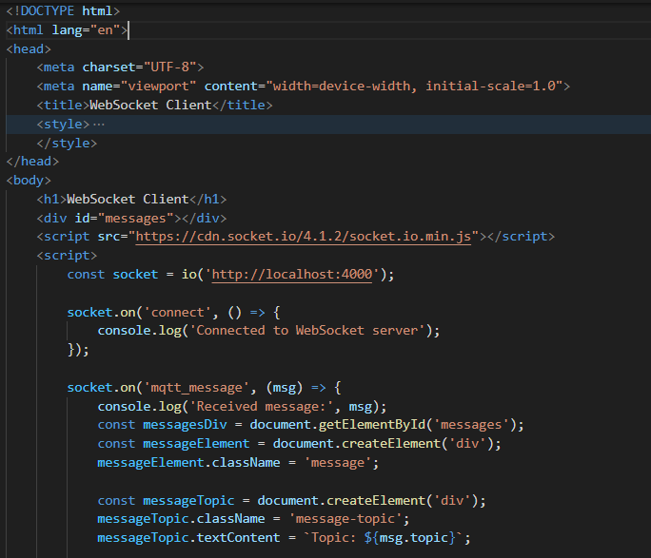
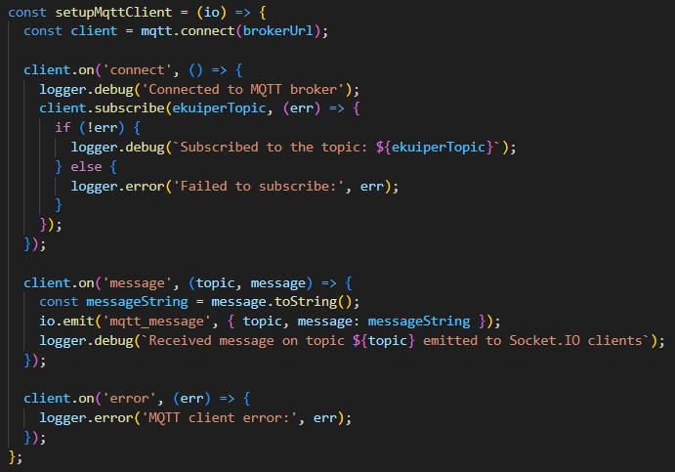
Command service
&

Slide 9
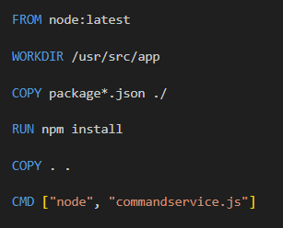
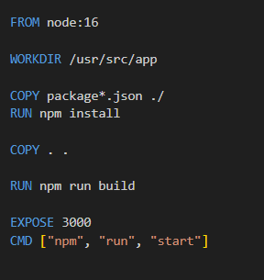
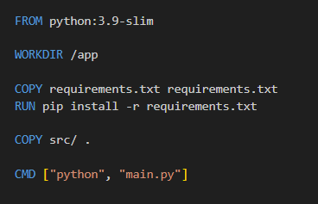

Docker images

Slide 10
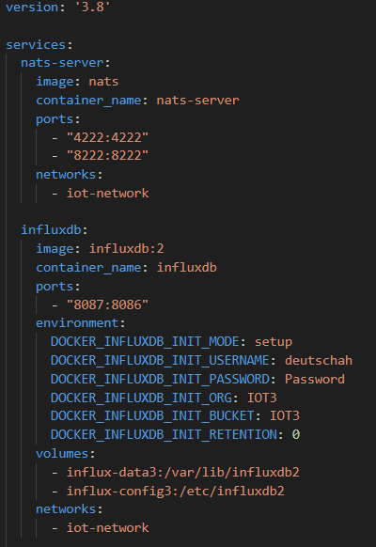
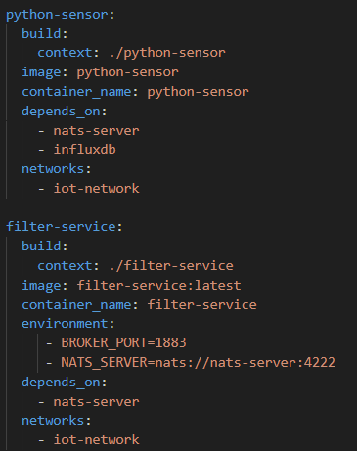
Docker compose

Slide 11
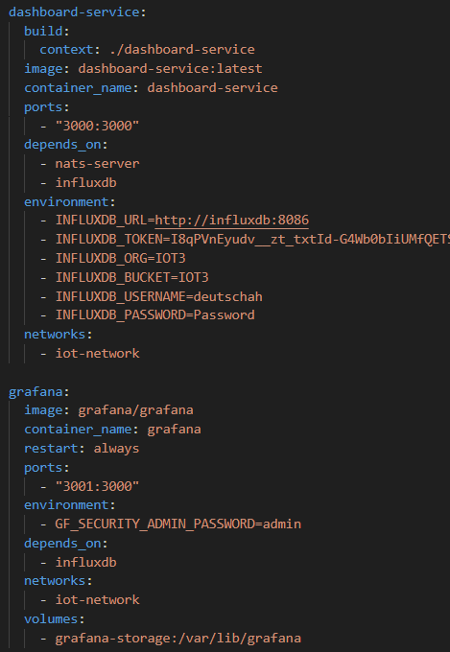
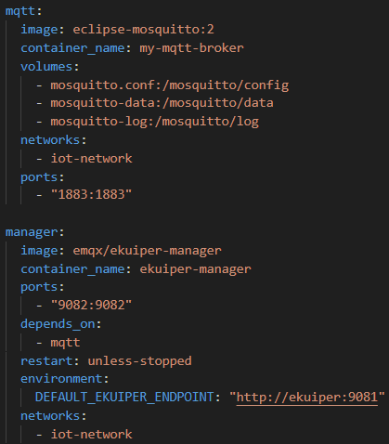
Docker compose

Slide 12
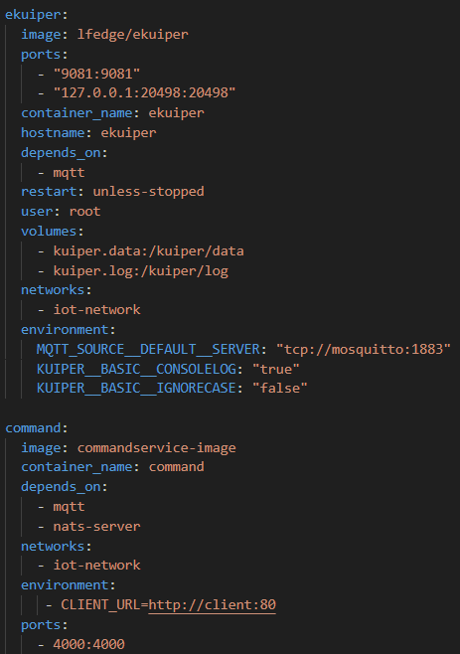
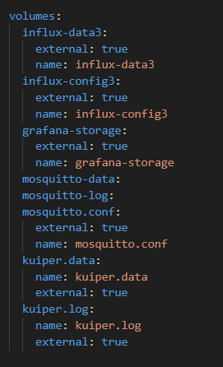
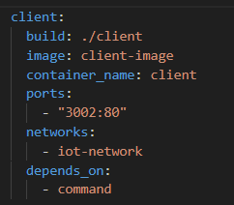
Docker compose

Slide 13
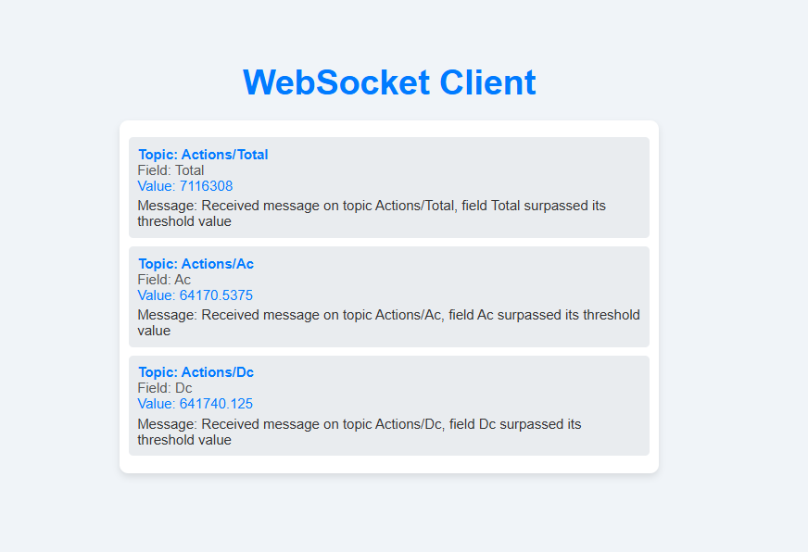
Testing

Slide 14
HVALA

