Slide 1


Group 4
Value Stream and Process
Santiago
Bernardo
Crucillo
Delos Santos
Llena
Mendoza
Profugo
Ruidera
Tagle

Slide 2


Value Stream
Description
Example
Real life scenarios
General Idea
Process

Slide 3
Process
Description
Example
Real life scenarios
General Idea

Slide 4
Value Stream (Description)
Is a series of steps that an organization uses to create and deliver products and services to a service consumer.
back

Slide 5
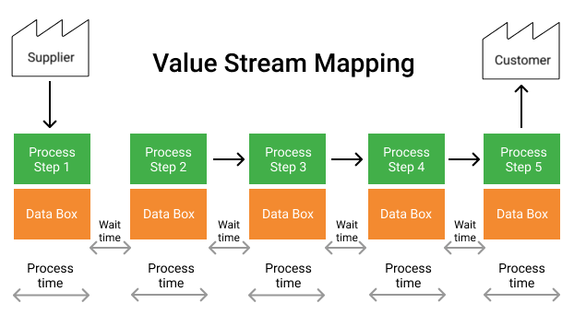
Value Stream (Example)
back

Slide 6
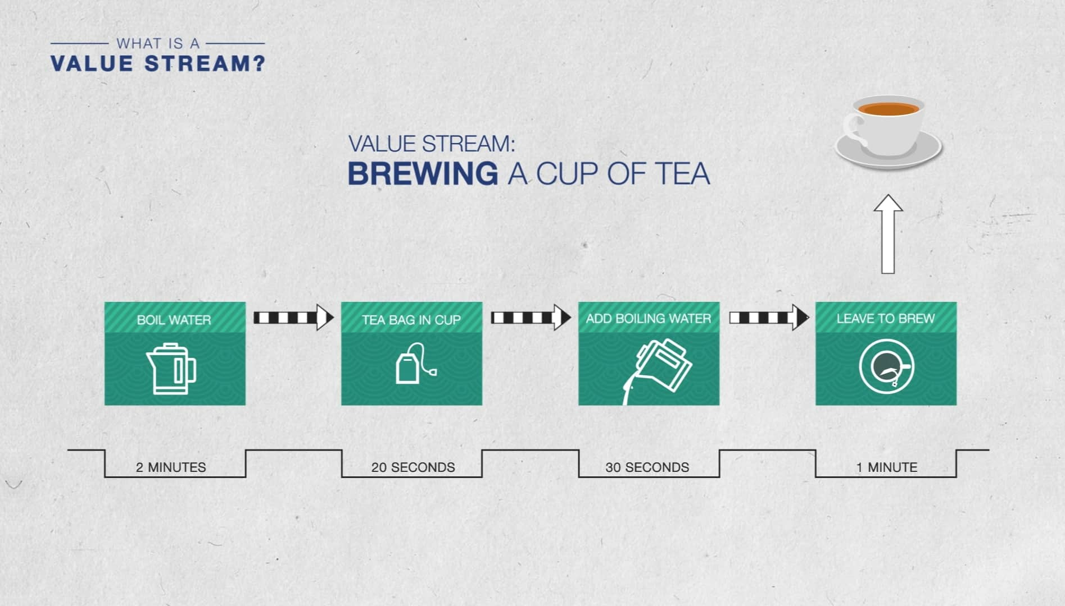
Value Stream (Real Life Scenarios)
back

Slide 7
Value Stream General Idea
back
If an underlying process is right the outcome will be reliable.

Slide 8
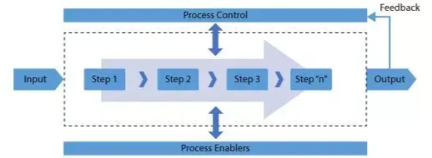
Process (Description)
A set of interralated or interacting activities that transforms inputs into outputs.
back

Slide 9

Process (Example)
A call center may purchase internet services from a supplier and then use those services to provide customer relationship management services for its customers.
back

Slide 10

Process (Real Life Scenarios)
A process takes one or more defined inputs and turns them into defined outputs. Processes define the sequence of actions and their dependencies.
back

Slide 11
Process General Idea
Set of activities that transforms input into output.

Slide 12
Group 4
Thank You for
Listening
Value Stream and Process
Santiago
Bernardo
Crucillo
Delos Santos
Llena
Mendoza
Profugo
Ruidera
Tagle

