Slide 1
One case. One trail. Full visibility.
RecoverIQ
QUASAR 5.0 · PS-01 FINTECH · AI-POWERED DEBT COLLECTIONS
RecoverIQ — an explainable, offline-first, compliance-by-design debt collections platform for banks and NBFCs
18 / 18
0
34
essential requirements built
payments marked paid without the gateway
automated browser checks passing
Notes:
Open with the line: an NBFC agent starts the day with an Excel sheet of 300 overdue accounts and no idea which 20 matter. RecoverIQ fixes that. The three numbers are facts about the working prototype, not projections.

Slide 2
The team behind RecoverIQ
TEAM
Photo
Photo
Photo
Photo
Member name
Member name
Member name
Member name
College · Year
College · Year
College · Year
College · Year
Backend & Data
Frontend & Mobile
AI & Integrations
Product & Pitch
FastAPI, state machine, payments & webhooks, audit chain, offline sync
Manager console, agent PWA, maps, borrower pay page
Scorecard + self-cure model, multilingual sentiment, contact policy
Demo story, compliance content, testing, decks and video
Notes:
Replace the four member cards with your names, colleges and photos before submitting. Keep one skill per person that maps to a part of the product.

Slide 3
Collections still run on spreadsheets, phone calls and trust
THE PROBLEM
1
Every account treated alike
~40%
A ₹4,000 account 5 days late gets the same visit as a ₹4 lakh account 85 days late.
2
No field visibility
of fresh NPAs in FY24 came from retail non-home loans, much of it through NBFC and fintech digital lending.
Managers can't see who visited whom, or whether the visit happened at all.
3
Promises go missing
"I'll pay on the 10th" lives in a notebook. Broken promises go unnoticed for weeks.
4
Payments posted by hand
Double-posting, and cases marked paid when the money never arrived.
Source: RBI Financial Stability Report, June 2024 (as summarised in the plan's sources)
5
Compliance hard to prove
RBI expects contact only 8 AM–7 PM and fair conduct, with no reliable log to show it.
Notes:
Walk through one branch's morning. Lists come as Excel, split by hand. Every account gets the same treatment. Managers can't see visits. Promises live in notebooks. Payments get posted by hand. Compliance can't be proven. The RBI number frames why lenders care right now.

Slide 4
Fragmented tools mean there is no single case record
ROOT CAUSE
Today
With RecoverIQ
Excel lists split by whoever is free
One case per account, ranked by explainable priority
Phone and WhatsApp updates at day's end
GPS-stamped visits that sync even from offline phones
Payment status typed in by staff
PAID only on a signed gateway webhook
No record of contact times
Contact Policy Engine blocks 8 PM calls and logs why
Same treatment for every borrower
Field visit, call or digital nudge chosen per case
Notes:
Contrast the two columns. The root cause is not lazy agents; it's that there is no single shared record of the case, so nothing can be prioritised, verified or audited.

Slide 5
Everyone in the collection chain gets something concrete
BENEFICIARIES
1
2
3
Lenders
Field agents
Managers
Banks, NBFCs, MFIs: faster recovery, lower cost to collect, provable compliance
A ranked worklist that works offline and credit only for verified work
Live field map, allocation, escalations, one consistent record
4
5
Built for Bharat-scale field operations: patchy networks, many languages, strict fair-practice rules.
Borrowers
Regulators & auditors
Contact only in fair hours, in Hindi, Marathi or English; self-pay link, instant receipt
Tamper-evident trail of every contact, reveal and payment
Notes:
Borrowers are a beneficiary, not an afterthought: respectful contact in their language, a self-pay page, and receipts. Regulators get provable compliance.

Slide 6
The lifecycle of one case, end to end
OUR SOLUTION
1
2
3
4
5
6
Intake
Score
Route
Work
Pay
Learn
CSV / Excel, one case per account, row-level errors
0–100 risk with reasons + self-cure %
Field · Tele · Digital by versioned rules
Allocation, offline agent app, nudges
Link / UPI QR → gateway → signed webhook
Outcomes retrain the model; manager approves
Every step writes to one shared case record and a hash-chained audit trail
Same case open on three screens updates together over WebSocket · status changes only through the backend state machine · PAID and CLOSED only from the payment service
Notes:
This is the whole product in one picture. Each box is a working screen in the demo. The bottom band is the point: every step lands in the same case record and the audit chain.

Slide 7
Seven ideas that make RecoverIQ different
WHAT'S NEW
1
Explainable dual-layer scoring
2
Payment truth from the gateway
Rule scorecard shows every point; a logistic self-cure model adds exact per-feature attributions.
HMAC-verified webhooks, unique payment IDs, reconciliation for lost webhooks.
3
Offline-first agent app
4
Compliance as code
IndexedDB outbox with client UUIDs, idempotent sync, conflicts ruled out by design.
Every SMS, WhatsApp, email and call passes the 8 AM–7 PM window, caps and opt-outs.
5
Tamper-evident audit
6
Multilingual sentiment map
SHA-256 hash chain; the database refuses UPDATE and DELETE on the log.
Hindi, Marathi, English notes → mood and reason → state, city, borrower.
7
Human-approved learning loop
Retrain → shadow comparison → manager approves → rollback any time.
Notes:
Pick two or three to say out loud depending on time; the slide carries the rest.

Slide 8
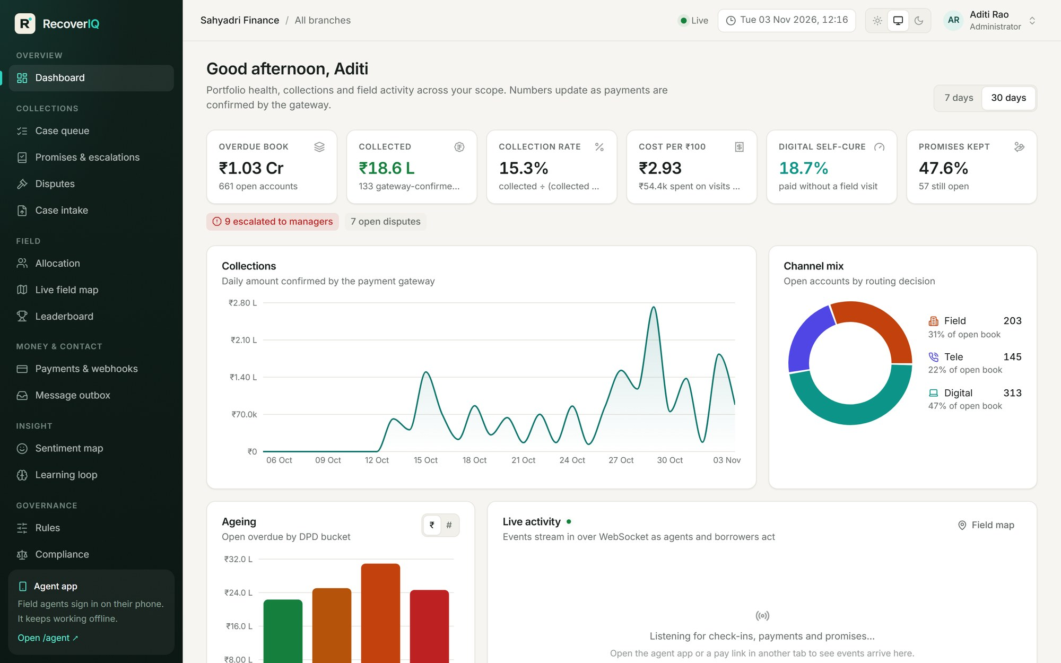
Portfolio health at a glance, live
PRODUCT TOUR · MANAGER CONSOLE
Six KPIs
Overdue book, collected, collection rate, cost per ₹100, digital self-cure, promises kept
Ageing & channel mix
DPD buckets SMA-0 → NPA and Field / Tele / Digital split
Live activity
Check-ins, payments and broken promises arrive in real time
Scoped by role
Branch, region or all-India; PII masked for managers
Notes:
Collected money on this dashboard is only gateway-confirmed money. Cost per ₹100 uses configurable visit and message costs. The live activity feed streams check-ins and payments over WebSocket.

Slide 9
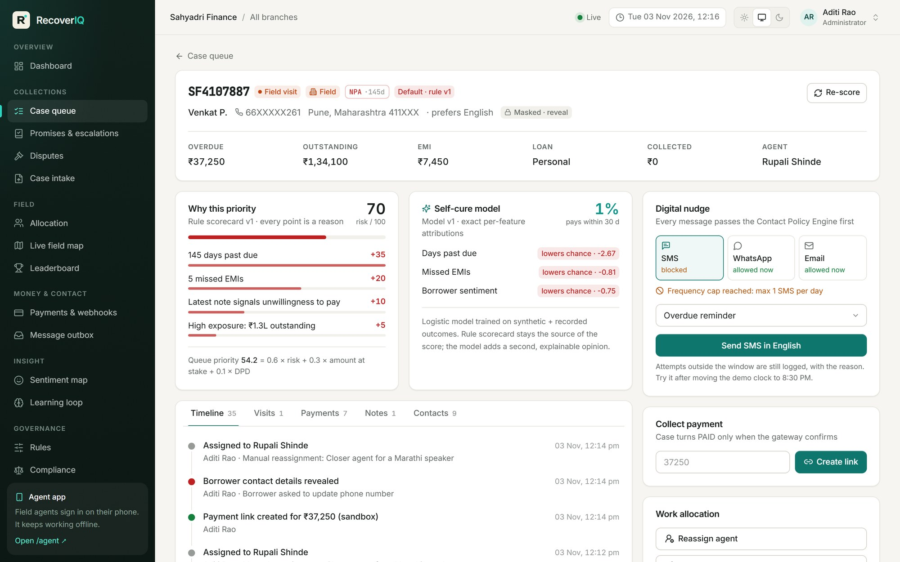
Every score comes with its reasons
PRODUCT TOUR · EXPLAINABLE PRIORITY
Scorecard reasons
Each point added or removed is shown, with the rule version used
Self-cure model
Probability of paying in 30 days with its top three drivers
One timeline
Intake, routing, visits, notes, nudges, payments: one record
Actions with reasons
Reassign, override channel, reveal PII: all audited
Notes:
Point at the reasons: +35 for DPD, +20 for missed EMIs. The model card shows exact attributions because for a linear model SHAP equals coefficient times deviation. On the right: nudges are policy-checked before they are sent.

Slide 10
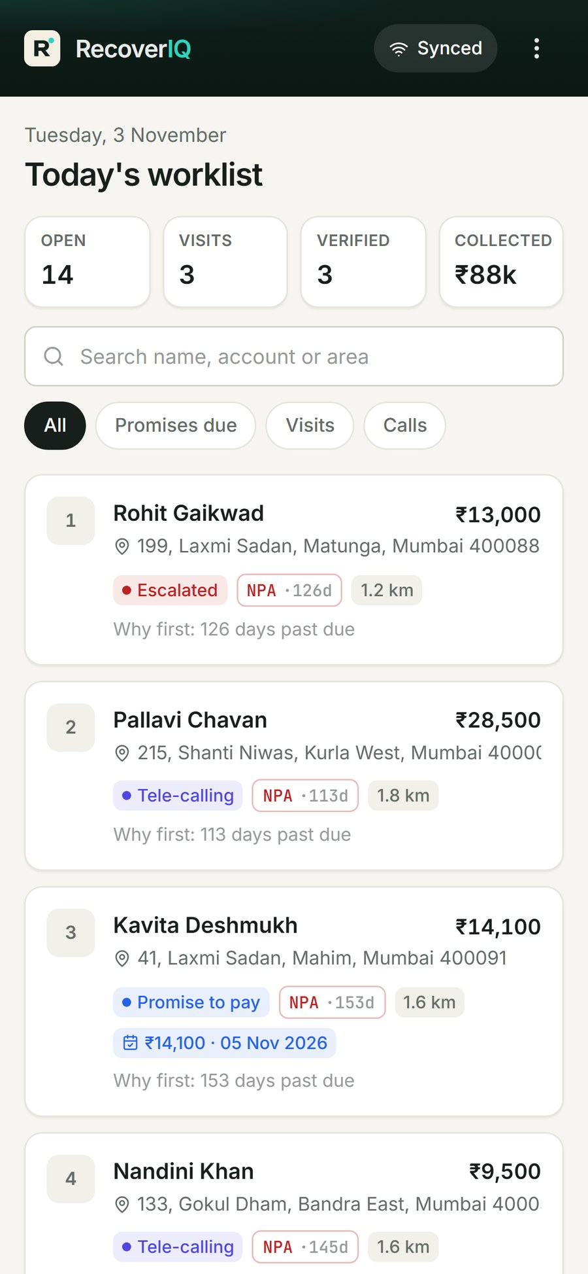
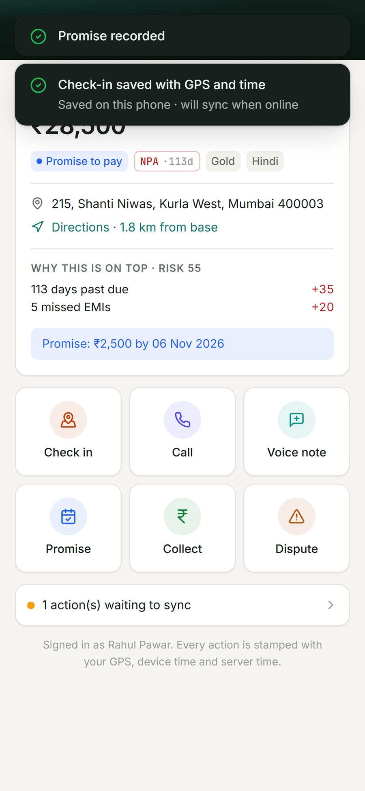
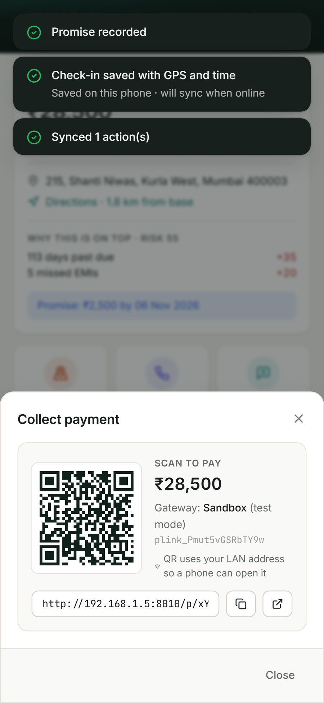
A worklist that keeps working with no network
PRODUCT TOUR · FIELD AGENT APP
GPS + time on every check-in
Within 300 m = verified; far, low-accuracy or impossible travel speed = flagged
Outbox with client UUIDs
Visits, notes, promises sync later; the server applies each exactly once
Voice notes
Record and transcribe in Hindi, Marathi or English; edit before saving
Installable PWA
Add to home screen on any Android or iPhone
Ranked worklist
Offline: actions queued
UPI QR to collect
Notes:
Demo: toggle 'Simulate no network', check in and take a Marathi note, then reconnect. The outbox syncs and the server reports duplicates as already applied, so nothing is posted twice. Payments are never written offline.

Slide 11
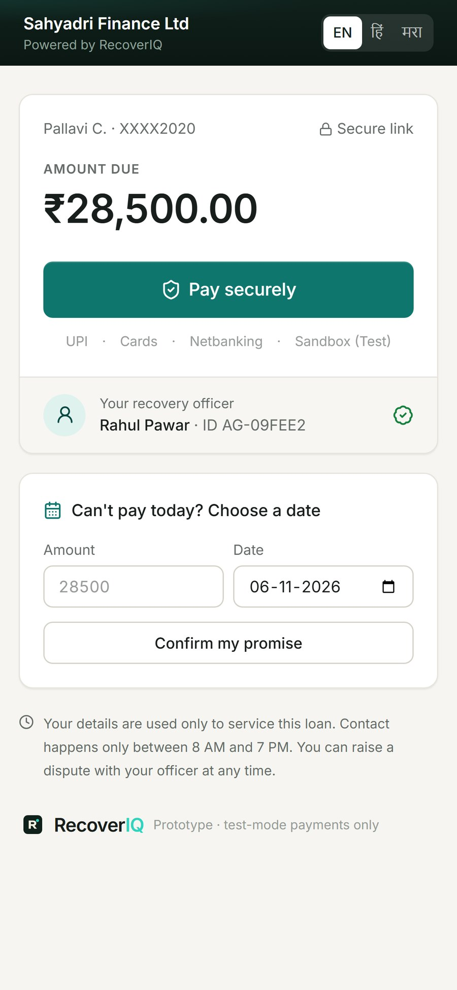
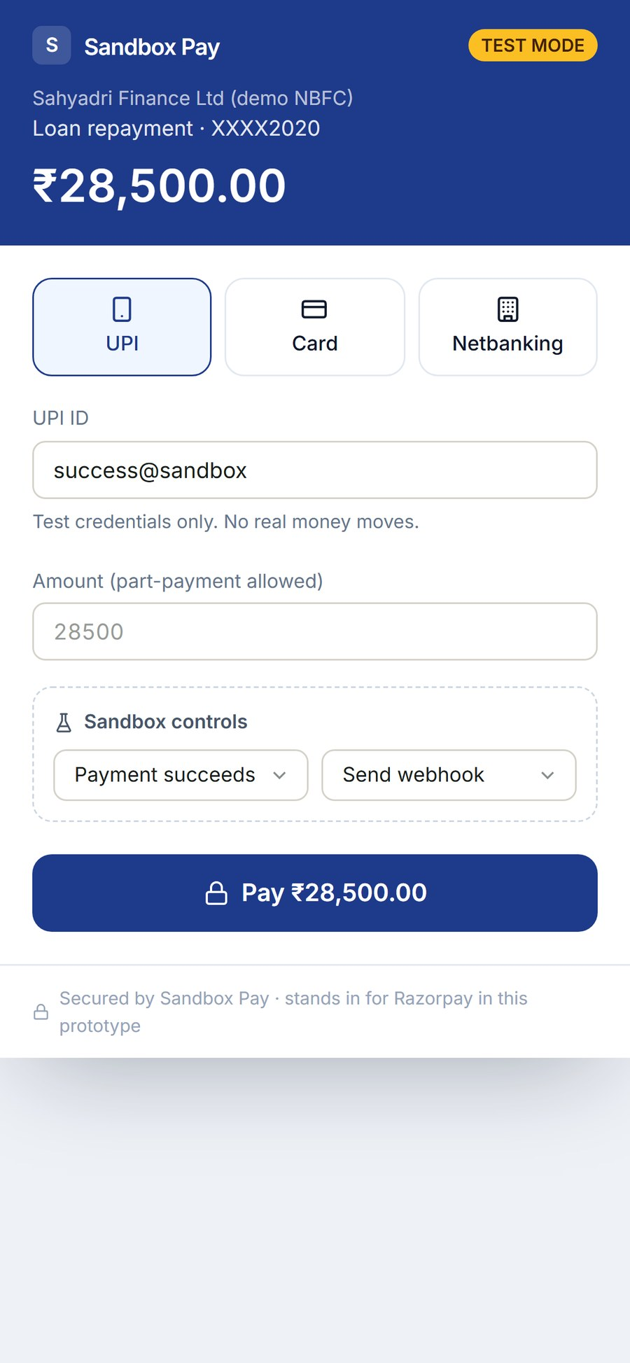
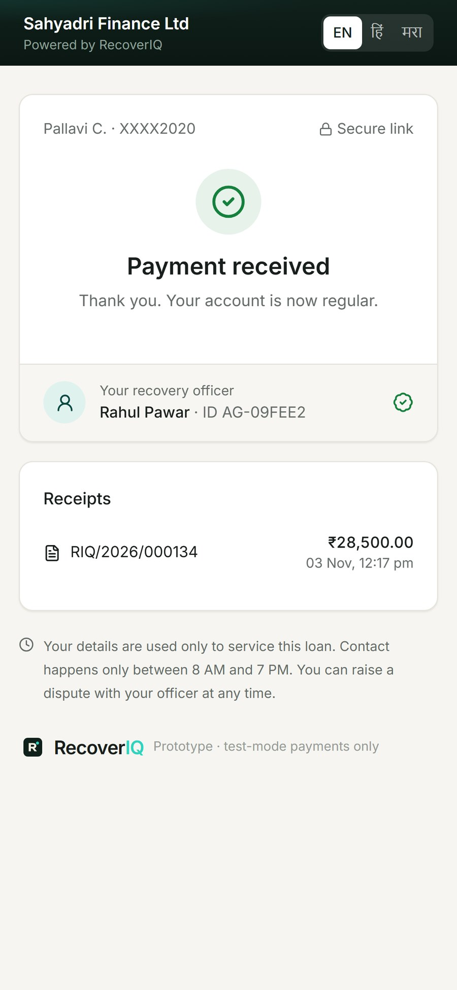
A case turns PAID only when the gateway says so
PRODUCT TOUR · PAYMENT TRUTH
Proven in the demo
Signed webhook
HMAC-SHA256 verified before anything is posted
Replay → duplicate_ignored
Unique gateway payment ID: no double posting
Forged event → 401
Wrong signature is rejected and logged
Lost webhook → reconciliation
Job asks the gateway and posts what's missing
Instant receipt
1 · Borrower pay page
2 · Gateway checkout
3 · Confirmed + receipt
PDF receipt for the borrower and the branch
Notes:
Live moment for judges: scan the QR, pay in test mode, watch the case flip to Paid on the manager screen only after the signed webhook lands. Then press 'Replay webhook' (duplicate ignored) and 'Forged webhook' (401 rejected).

Slide 12
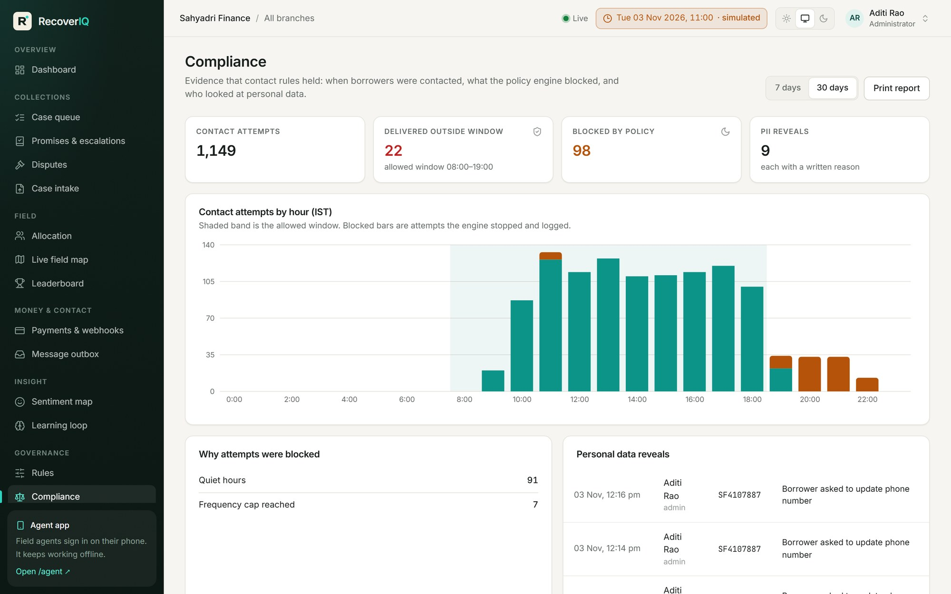
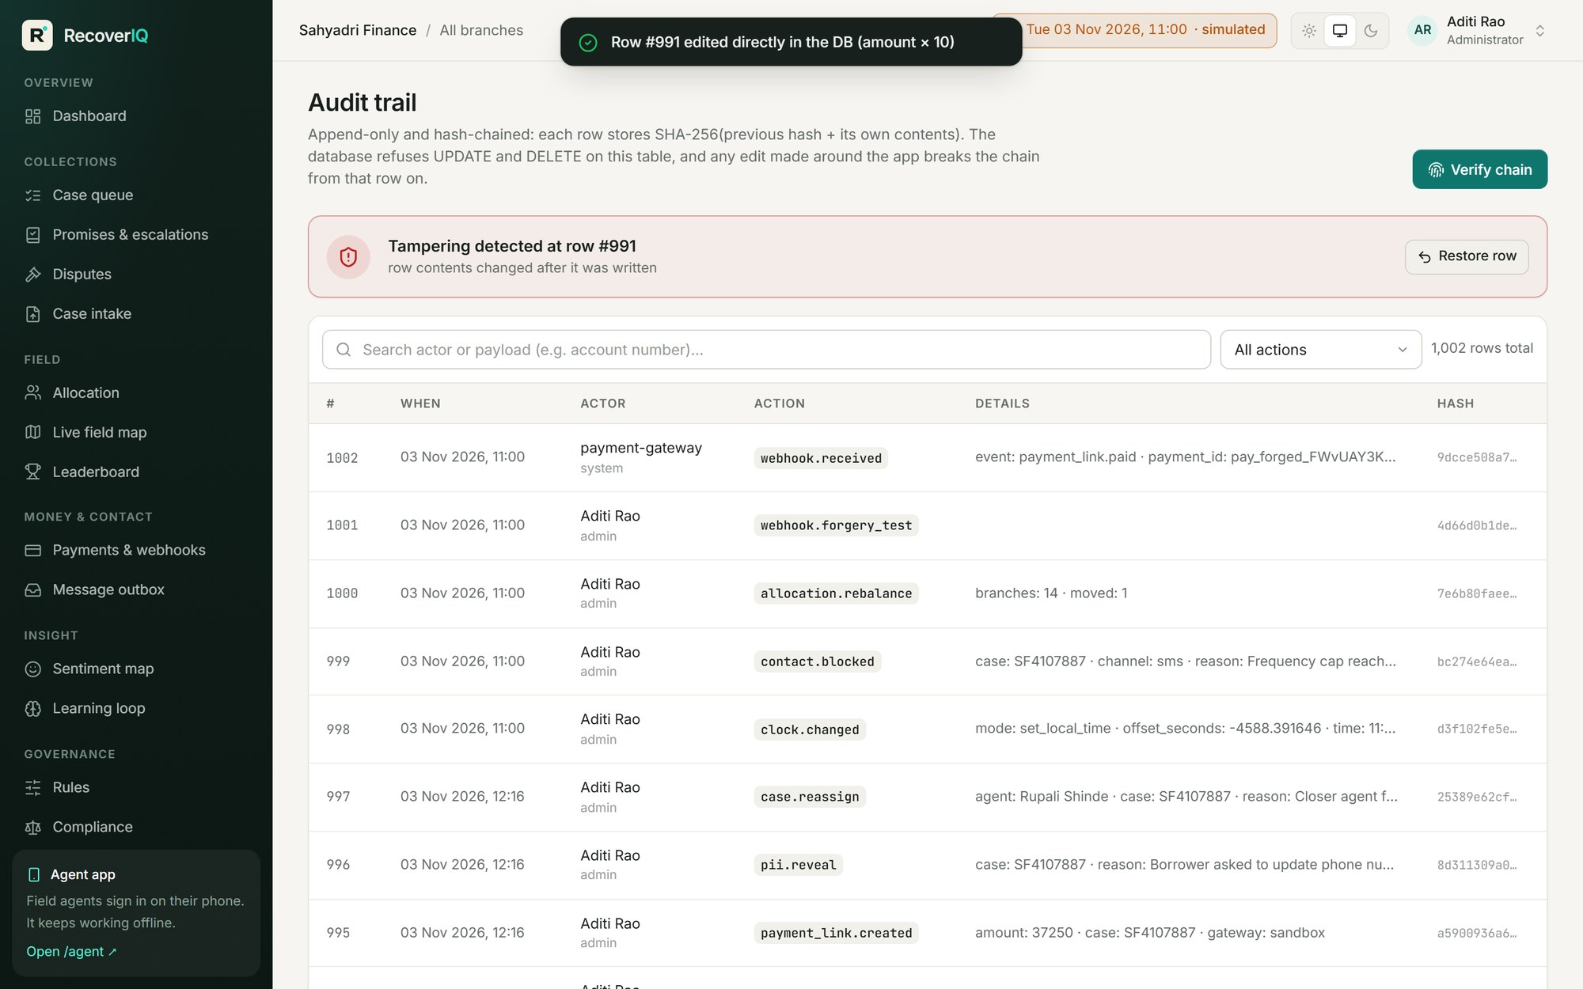
Fair-practice rules enforced in code, and provable
PRODUCT TOUR · COMPLIANCE BY DESIGN
Contact attempts by hour: nothing delivered outside 8 AM–7 PM; blocked attempts logged with the reason.
Audit trail: an edit made directly in the database breaks the hash chain at that exact row.
Notes:
Show the compliance chart: zero deliveries outside the window, and the blocked attempts that prove the engine works. Then the audit page: press 'Simulate insider tampering' — verification points at the exact row. Restore and it's intact again.

Slide 13
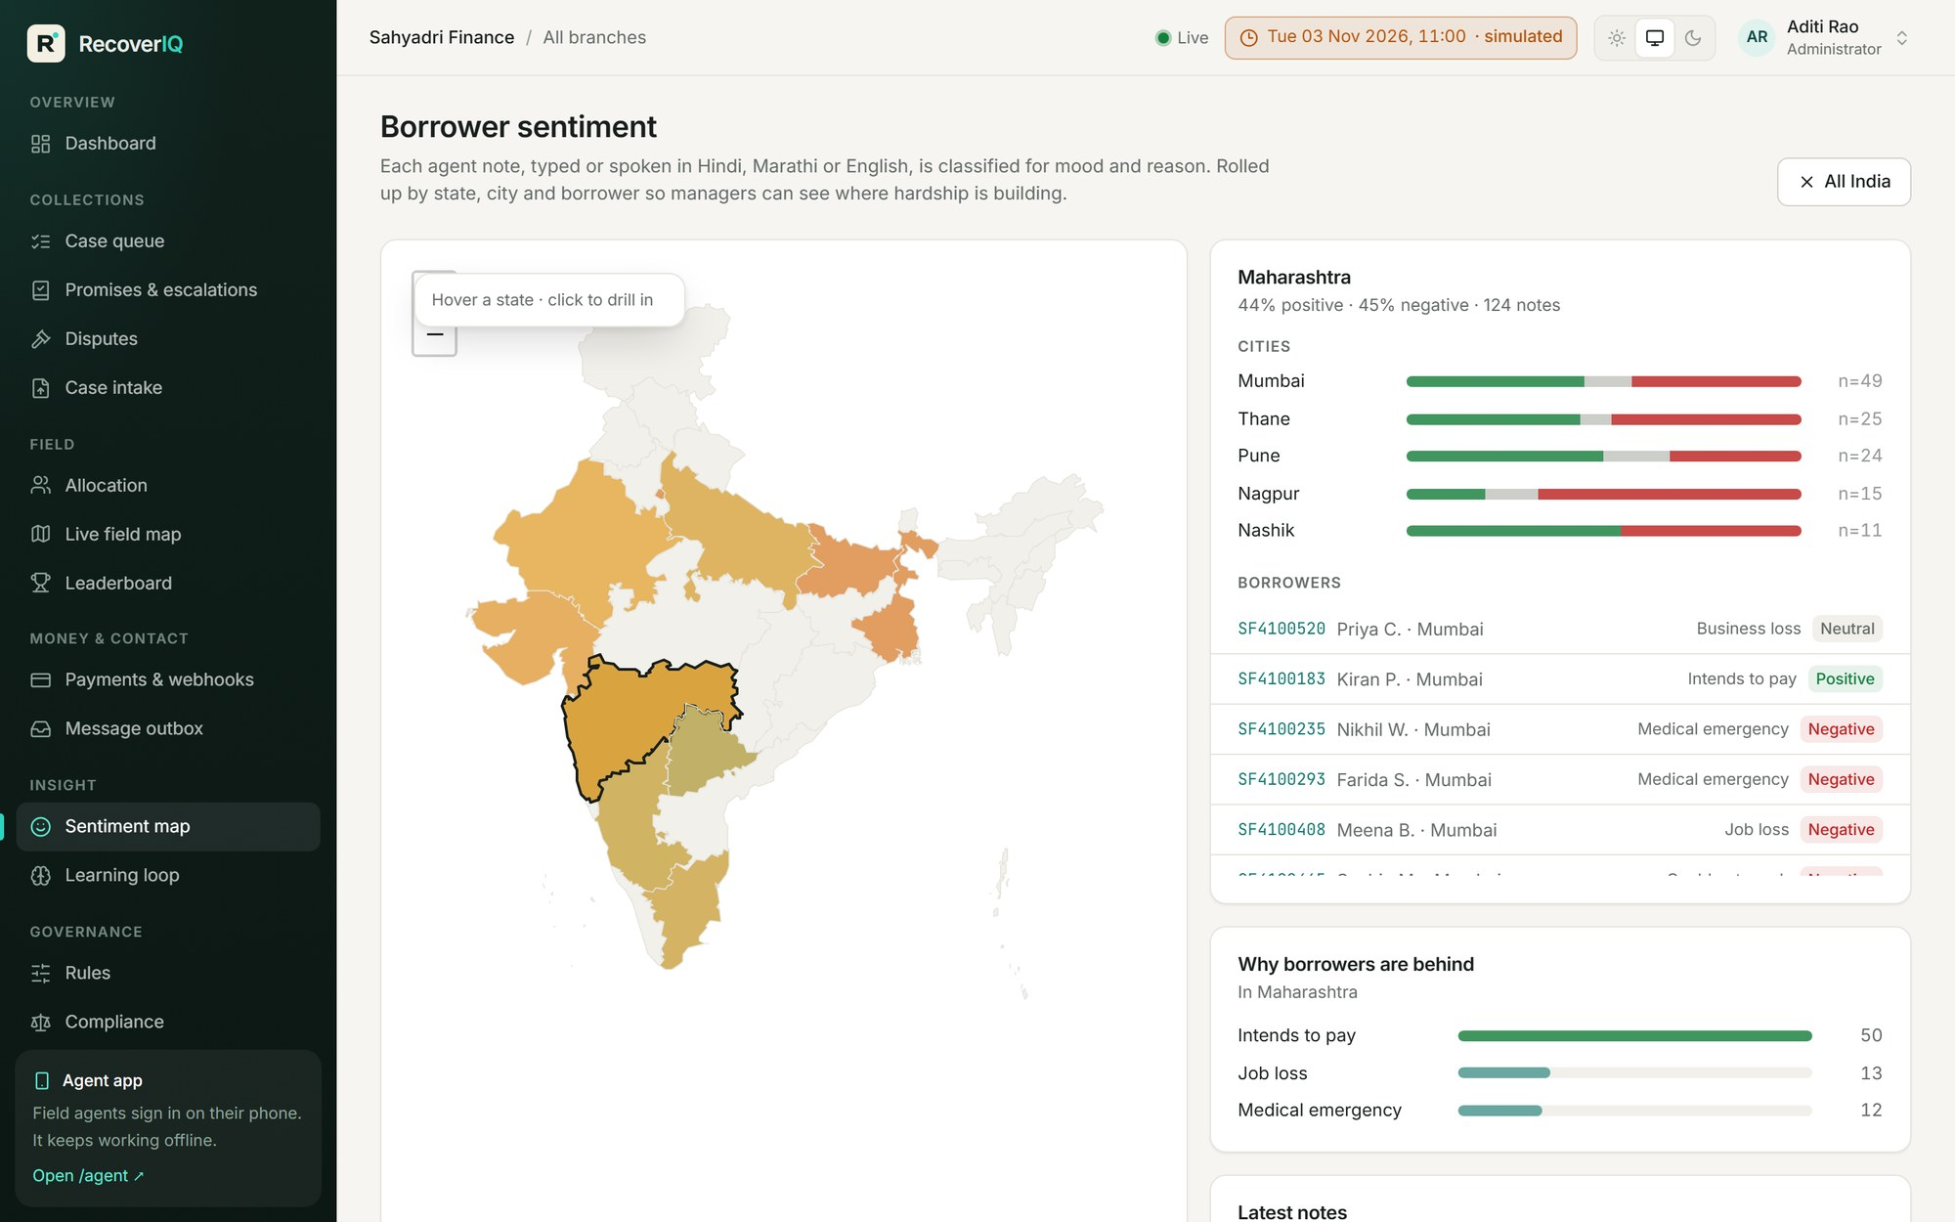
Hardship mapped from what borrowers actually say
PRODUCT TOUR · BORROWER SENTIMENT
Three languages
Hindi, Marathi, English and Hinglish, typed or spoken
Mood + reason
Job loss, medical, business loss, dispute, unwilling, intends to pay
State → city → borrower
India map with drill-down and recent notes
Feeds the score
An 'unwilling to pay' note adds risk points, visibly
Notes:
Notes in Devanagari Hindi and Marathi and romanised Hinglish are analysed offline by a multilingual lexicon; with an API key, Claude adds a translation. Click a state to see cities and borrowers.

Slide 14
18 of 18 essential requirements, each with a live proof
REQUIREMENT COVERAGE
Requirement | Proof in the demo
1 Case intake | Re-upload same CSV → 0 new cases
2 Risk scoring | Reasons panel on every case
3 Channel decision | Change threshold → cases re-route
4 Allocation | Rebalance evens workload bars
5 Agent app | Ranked worklist on a phone
6 Visit tracking | GPS check-in → verified / flagged
7 Digital nudges | 8:30 PM nudge blocked + logged
8 Payment collection | UPI QR, pay link, PDF receipt
9 Payment confirmation | Replay webhook → no double post
Requirement | Proof in the demo
10 PTP & escalation | +3 days → promise breaks → escalates
11 Dashboards | Live KPIs, ageing, field map
12 Offline | No network → check-in → sync
13 Permissions | Exec sees 98XXXXX321; reveal needs reason
14 Audit & compliance | Verify chain; tamper → detected
15 Default rule | Edit expression → reclassify
16 Sentiment view | India map, state → city → borrower
17 Note capture | Hindi / Marathi voice → text
18 Single case record | Same case updates on 3 screens
Notes:
This table is the answer to 'did you cover the problem statement?' Each row has a demo action that proves it.

Slide 15
Stateless API, one source of truth, payment truth from the gateway
ARCHITECTURE
CLIENTS
CORE (FASTAPI)
DATA & EXTERNAL
Agent PWA
REST API + RBAC scope
SQL database
IndexedDB outbox · GPS · mic · offline
JWT · Argon2id · lockout · PII masking
Cases · events · append-only hash-chained audit
Manager console
Domain services
Payment gateway
React · charts · Leaflet maps
State machine · scorecard · ML · allocation · contact policy
Razorpay test mode or built-in sandbox
Borrower pay page
Webhook receiver + WebSocket hub
AI services
Signed link · EN / हिं / मरा
HMAC verify · idempotent posting · live events
Self-cure model · lexicon + optional Claude
Background jobs: promise-break scheduler (every minute) · gateway reconciliation (every 10 minutes) · nightly retrain → shadow → approve
Notes:
Today the whole stack runs from one command on a laptop (SQLite, in-process scheduler) so the demo never depends on venue Wi-Fi. The same code targets Postgres and separate workers for the pilot.

Slide 16
Three constraints carry most of the correctness
DATA MODEL
UNIQUE(account_no)
16 tables
One case per loan account. Re-uploading a file updates, never duplicates.
cases
borrowers (encrypted PII)
case_events
assignments
UNIQUE(gateway_payment_id)
visits
contact_attempts
A replayed or duplicate webhook can't post money twice.
promises
payment_links
payments
webhook_events
notes
disputes
UNIQUE(client_id)
rule_versions
model_versions
Offline actions carry device-made UUIDs, so a resent outbox applies once.
audit_log (hash-chained)
users · branches · regions
Notes:
Mention optimistic versioning on cases and the encrypted PII columns. The three constraints on the left are what judges can test live.

Slide 17
Chosen so the demo works on stage, every time
TECH STACK & ENGINEERING QUALITY
Frontend
React 18 · TypeScript · Vite · Tailwind · Recharts · Leaflet · Dexie (IndexedDB) · PWA
21
34
Backend
Python · FastAPI · SQLAlchemy 2 · Pydantic v2 · WebSocket
unit & API tests passing
browser steps passing, 0 console errors
Data
SQLite (WAL) for the laptop demo; Postgres-ready via DATABASE_URL
AI / ML
scikit-learn logistic model, exact attributions · multilingual lexicon · optional Claude
5 roles × 31
740
Security
JWT + refresh · Argon2id · AES-GCM PII · HMAC webhooks · RBAC scopes
endpoints smoke-tested, 0 server errors
synthetic accounts across 14 branches
Payments
Razorpay Payment Links (test) or built-in sandbox gateway
Notes:
Numbers on the right are from the test suites in the repository: pytest for domain and API rules, Playwright for the browser walk-through, and a live smoke test that calls every endpoint as all five roles.

Slide 18
Targets for a one-branch pilot, not claims
EXPECTED IMPACT
20–30%
↓ cost
0
Same day
of low-risk accounts self-cure digitally, no visit needed
to collect: visits go to the accounts where they matter
contacts outside 8 AM–7 PM, with the log to prove it
visibility of every visit, promise and payment
Business model
Customers
Pricing
Go-to-market
NBFCs, small finance banks, MFIs, co-op banks, fintech lenders, agencies
Per active delinquent case per month, or per agent seat; enterprise VPC tier
Pilot one branch → measure cost per recovery & self-cure → expand by region
Notes:
Say clearly that these are pilot targets to be measured, and that all prototype data is synthetic. The business model is per active delinquent case per month, or per agent seat.

Slide 19
From one branch to multi-region, and on to the finale
SCALABILITY & ROADMAP
Pilot
Region
Multi-region
1 branch · 20 agents · ~5k cases
10 branches · 300 agents · ~100k cases
5k agents · ~5M cases
1 API · managed Postgres
API autoscale · worker pools · read replica
Partition by tenant + region · OLAP for dashboards
Done
Round 0 · Dec
Round 1 · Jan
Finale · 23–24 Jan
Next
Working prototype: all 18 requirements, tests, demo data
This deck + 90-second demo video
5-minute engineering pitch + live link
Judge feedback → build → 'You said, we built'
Voice-bot reminders · route optimiser · Account Aggregator affordability
Notes:
The scale path is standard: stateless API, worker pools, partitioning, read replicas. The finale plan is to capture judge feedback in the first session and show a 'You said → We built' slide.

Slide 20
Seven minutes, eight moments judges can verify
LIVE DEMO
1
Intake
2
Score & route
Upload sample CSV twice: 0 duplicates
Open a case: reasons; move a threshold: cases re-route
3
Allocate
4
Agent phone
Rebalance: workload bars even out
Offline check-in + Marathi note → reconnect → synced
5
Payment truth
6
Compliance
Judge scans QR, pays → PAID after webhook; replay → ignored
8:30 PM nudge blocked; tamper → chain breaks
7
Visibility
8
Close
Dashboard, sentiment map, leaderboard with proofs
One case. One trail. Full visibility.
Notes:
Rehearse with the demo clock: set it to 8:30 PM for the blocked nudge, then +3 days for broken promises. Reset to real time at the end.

Slide 21
One case. One trail. Full visibility.
RecoverIQ
Thank you. We'd love to hear what would make this deployable at your bank tomorrow.
Run it: python run.py → http://localhost:8000 · demo password Demo@1234
Notes:
Close by inviting feedback: in the finale we will build what the judges ask for in the first session.

