Slide 1
Latent Semantic Analysis
Ravi Satvik (202018008), Omkar Chavan (202018037)
Dev Patel (202018055), Smit Gandhi (202018057)
Dhirubhai Ambani Institute of Information and Communication Technology

Slide 2
What is Latent Semantic Analysis?
INTRODUCTION
METHODOLOGY
EXPERIMENTAL RESULTS
CONCLUSION
Latent semantic analysis (LSA) is a technique in natural language processing, in particular distributional semantics, of analysing relationships between a set of documents and the terms they contain by producing a set of concepts related to the documents and terms.
LSA assumes that words that are close in meaning will occur in similar pieces of text.
E.g. Two Sports Document will have more similarity than a Sport and Movie Document.
This is because similar topic will have words which are close in meaning with that topic.

Slide 3
Why LSA?
INTRODUCTION
METHODOLOGY
EXPERIMENTAL RESULTS
CONCLUSION
Latent Semantic Analysis is a technique for creating a vector representation of a document.
Having a vector representation of a document gives you a way to compare documents for their similarity by calculating the distance between the vectors.
This in turn means you can do handy things like classifying documents to determine which of a set of known topics they most likely belong to.

Slide 4
Why LSA different from classification?
INTRODUCTION
METHODOLOGY
EXPERIMENTAL RESULTS
CONCLUSION
Classification implies you have some known topics that you want to group documents into, and that you have some labelled training data.
If you want to identify natural groupings of the documents without any labelled data, you can use clustering.
LSA uses words meaning to assign them to a Topic

Slide 5
Steps to LSA
INTRODUCTION
METHODOLOGY
EXPERIMENTAL RESULTS
CONCLUSION
First we have to form doc-term matrix of the TF-IDF(term frequency–inverse document frequency) scores of the word frequency in each document.
This matrix contain 1000’s of vector.
Then we will do the dimensionality reduction with SVD(singular-value decomposition)
The SVD step does more than just reduce the computational load–that is large number of features for a smaller set of better features.
Paragraphs are then compared by taking the cosine of the angle between the two vectors (or the dot product between the normalizations of the two vectors) formed by any two columns.
Values close to 1 represent very similar paragraphs while values close to 0 represent very dissimilar paragraphs.

Slide 6
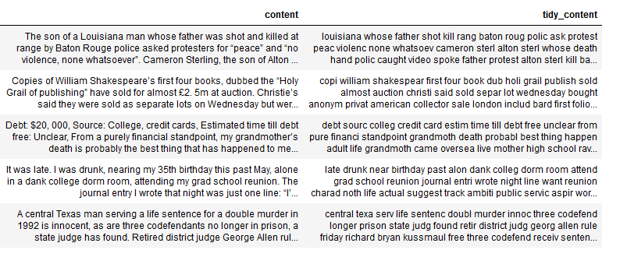
Pre-processing
INTRODUCTION
METHODOLOGY
EXPERIMENTAL RESULTS
CONCLUSION
Cleaning the Document which includes removal of unnecessary symbols, stop words removal, stemming, etc..

Slide 7

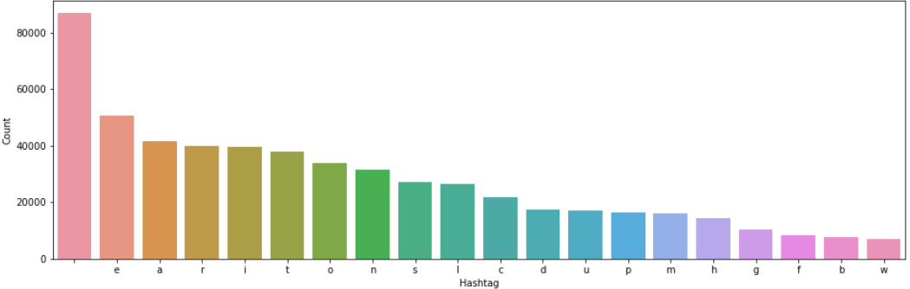
Visualizations
INTRODUCTION
METHODOLOGY
EXPERIMENTAL RESULTS
CONCLUSION
Word Cloud
Showing up a word cloud. The bigger the font the more is the occurrence.
Frequency Distribution
Plotting the frequency distribution of top 20 most frequent words.

Slide 8
Feature Extraction
INTRODUCTION
METHODOLOGY
EXPERIMENTAL RESULTS
CONCLUSION
Count Vectorizer
Count vectorizer just count the frequency of each word in a document for all the words in the corpus.
TF - IDF Vectorizer
TF-IDF vectorizer counts the TF-IDF score of each word for all the words in the corpus. Typically, the tf-idf weight is composed by two terms: the first computes the normalized Term Frequency (TF), aka. the number of times a word appears in a document, divided by the total number of words in that document; the second term is the Inverse Document Frequency (IDF), computed as the logarithm of the number of the documents in the corpus divided by the number of documents where the specific term appears.

Slide 9
Feature Extraction
INTRODUCTION
METHODOLOGY
EXPERIMENTAL RESULTS
CONCLUSION
Term Document Matrix
A term-document matrix describes the frequency of terms that occur in a collection of documents. This is a matrix where each row represents one document and each column represents one term (word)
Cosine Similarity
Cosine similarity is a measure of similarity between two non-zero vectors of an inner product space. It is defined to equal the cosine of the angle between them, which is also the same as the inner product of the same vectors normalized to both have length 1.
Here, Cosine similarity can be seen as a method of normalizing document length during comparison. The cosine similarity of two documents will range from 0 to 1, since the term frequencies (using tf–idf weights) cannot be negative.

Slide 10
LSA Implementation
INTRODUCTION
METHODOLOGY
EXPERIMENTAL RESULTS
CONCLUSION
LSA
LSA is a vector-based method that assumes that words that share the same meaning also occur in the same texts (Landauer and Dumais, 1997:215). This is done by first simplifying the document-term matrix using Singular Value Decomposition (SVD), before finding close related terms and documents. This is done by using the principles of vector-based cosine similarities.
SVD (singular-value decomposition)
In linear algebra, the singular-value decomposition (SVD) is a factorization of a real or complex matrix. It is the generalization of the eigen decomposition of a positive semidefinite normal matrix (for example, a symmetric matrix with positive eigenvalues) to any m × n matrix via an extension of the polar decomposition. It has many useful applications in signal processing and statistics.
Truncated SVD will assign different weight to all the word features for different topics. We are considering 5 topics for our convenience

Slide 11
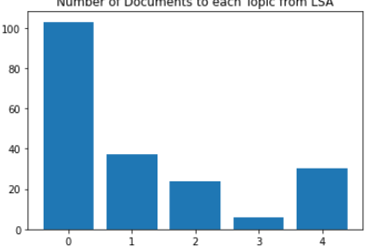
DOCUMENT CLASSIFICATION
INTRODUCTION
METHODOLOGY
EXPERIMENTAL RESULTS
CONCLUSION
We use the following functions to perform document classification.
Score
When passed a document it will calculate it's score for all the five topics and return a list of scores.
Topic_Num
Topic_num will take Score as input and will return the index with the maximum value in that list.
This will help giving the document a cluster number

Slide 12
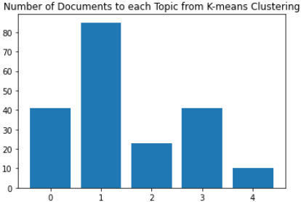
DOCUMENT CLASSIFICATION
INTRODUCTION
METHODOLOGY
EXPERIMENTAL RESULTS
CONCLUSION
K-means clustering
K-means clustering is a method of vector quantization, originally from signal processing, that is popular for cluster analysis in data mining. k-means clustering aims to partition n observations into k clusters in which each observation belongs to the cluster with the nearest mean, serving as a prototype of the cluster. This results in a partitioning of the data space into Voronoi cells.
We use the k-means clustering from the sklearn package.

Slide 13
DOCUMENT CLASSIFICATION
INTRODUCTION
METHODOLOGY
EXPERIMENTAL RESULTS
CONCLUSION
We use the following functions to perform document classification.
Score
When passed a document it will calculate it's score for all the five topics and return a list of scores.
Topic_Num
Topic_num will take Score as input and will return the index with the maximum value in that list.
This will help giving the document a cluster number

Slide 14
COMPARING LSA AND K- MEANS
INTRODUCTION
METHODOLOGY
EXPERIMENTAL RESULTS
CONCLUSION
Total Document pair possible from 200 documents is 19900
Total Document Pair classified in same Topic through LSA Method is 6645.(May vary with different executions)
Total Document Pair classified in same Topic from K-means out of those 6645 document is 2893. .(May vary with different executions)

Slide 15
Thank You!

