Slide 1
Purpose
For Software Change Notices (SCNs), install the SCN, Installation, and Migration PDF Collection for the required Experion point release.
Overview
ETN Quick Start Guide

Slide 2
Planning & Design
Batch Overview and Planning Guide
Control Hardware Planning Guide
Fault Tolerant Ethernet Overview and Implementation Guide
Getting Started with Experion Software Guide
Guidelines for replacing Hiway Boxes with LCN-connected C300 Emulations
Network and Security Planning Guide
Server and Client Planning Guide
Site Planning Guide
Windows Domain and Workgroup Planning Guide

Slide 3
Installation & Upgrades
Control Firewall Users Guide
Control Hardware Installation Guide
ControlNet Fiber Optic Implementation Guide
ControlNet Installation Guide
DELL OPTIPLEX 3010 Station Installation and Configuration Guide
DELL OPTIPLEX 3020 Planning Installation and Service Guide Ethernet Implementation Guide
EXTIO 1 Remote Peripheral Solutions Installation Kit Instruction
EXTIO 2 Remote Peripheral Solutions Installation Kit Instruction
Fault Tolerant Ethernet Bridge Implementation Guide
Fault Tolerant Ethernet Installation and Service Guide
Honeywell Icon Series Console Planning Installation Service Guide
Honeywell Icon Series Console Read Me First
Honeywell Modbus TCP Firewall Users Guide
HP DL 380 G7 Honeywell Planning Installation and Service Guide
HP ProLiant DL360P Gen8 Honeywell Server Planning Installation and Service Guide
ML200 Installation and Commissioning Guide
OEP IKB and Touch Screen Device Adapters Installation Instructions
PE SC1430 Honeywell Server Planning Installation and Service Guide
PE2850 Honeywell Server Planning Installation and Service Guide PE2900 Honeywell Server Planning Installation and Service Guide PE2900III Honeywell Server Planning Installation and Service Guide
PE2950 Honeywell Server Planning Installation and Service Guide PE2950III Honeywell Server Planning Installation and Service Guide
PROFIBUS Interface Implementation Guide
R320 Honeywell Server Planning Installation Service Guide
R5500 Honeywell Workstation Planning Installation and Service Guide
R710 Honeywell Server Planning Installation and Service Guide R7610 Honeywell Workstation Planning Installation Service Guide Redundant Power Supply Installation Guide
Supplementary Installation Tasks Guide
T105 Honeywell Server Planning Installing and Service Guide
T310 Honeywell Server Planning Installation and Service Guide
T320 Honeywell Server Planning Installation Service Guide
T3400 Honeywell Workstation Planning Installing and Service Guide
T3500 Honeywell Workstation Planning Installation and Service Guide
T3600XL Honeywell Workstation Planning Installation Service Guide
T5400 Honeywell Workstation Planning Installation and Service Guide
T5500 Honeywell Workstation Planning Installation and Service Guide
T610 Honeywell Server Planning Installation and Service Guide Virtualization Planning and Implementation Guide
Virtualization with Blade Center S Guide
Windows Domain and Workgroup Implementation Guide
Windows Domain Implementation Guide for Windows Server 2008 R2
Windows Domain Implementation Guide for Windows Server 2012 WS490 Honeywell Workstation Planning Installation and Service Guide
Wyse R10L Remote Peripheral Solution Installation Instructions
Wyse Z90DE7 Thin Client Planning Installation and Service Guide
Z620 Honeywell Planning Installation and Service Guide

Slide 4
Configuration
Application Control Environment Users Guide
Batch Implementation Guide
C300 Controller Users Guide
CL Server Users Guide
Collaboration Station Users Guide
Configuration Studio Overview Guide
Configuration Utility Users Guide
Control Building Users Guide
Custom Algorithm Block and Custom Data Block Users Guide DeviceNet Interface Implementation Guide
Enterprise Model Builder Users Guide
Experion Mobile Access Users Guide
FMC 722 on ACE Configuration Guide
Gas Operations Suite Configuration Guide
GUS Basic Script Users Guide
GUS Display Authoring Tutorial
GUS Display Builder Users Guide
GUS Display Scripting Users Guide
GUS Display Search Tool Users Guide
GUS Display Translator Users Guide
GUS Faceplate Alarm and Message Scripting Users Guide
HART I/O Implementation Guide
HCI/OPC Data Access Users Guide
Hiway Slot Emulation Creator User Guide
HMIWeb Display Building Guide
IEC61850 SCADA Configuration Guide
Integrated Experion-TPS Users Guide
LCNP Status User Guide
LLMUX2 TC and RTD FTAs User Guide
MasterLogic Experion Integration Users Guide
Peer Control Data Interface Implementation Guide
Procedure and Sequence Custom Display Building Guide PROFIBUS Gateway Module Users Guide
Qualification and Version Control Users Guide
Quick Builder Users Guide
Rail I/O Series A Implementation Guide
Rail I/O Series H Implementation Guide
Redirection Manager Users Guide
Safety Manager Integration Guide
SafeView Users Guide
Search Utility Users Guide
Secure Communications User Guide
Sequential Control Users Guide
Serial Interface Module Implementation Guide
Series A Fieldbus Module Interface Users Guide
Series C Fieldbus Interface Module Users Guide
Series C IEC 61850 Interface Module Users Guide
Series C I/O Users Guide
Server and Client Configuration Guide
SIM-ACE Users Guide
SIM-C300 Users Guide
SIM-C200E Implementation Guide
SIM-FFD User Guide
Switch Configuration Tool Users Guide
System Management Configuration Guide
TPN Server Users Guide
TPS File Transfer Installation and User's Guide
Turbine Control Users Guide

Slide 5
Operations
Fault Tolerant Ethernet Status Server and Auxiliary Display Users Guide
Gas Operations Suite Users Guide
GUS Remote Displays Users Guide
ML200 CPU and SoftMaster Users Guide
Native Window Users Guide
Operators Guide
Parallel Operation Keyboard Users Guide
System Management Operations Guide

Slide 6
System Administration
Startup and Shutdown
System Administration Guide

Slide 7
Reference
Allen-Bradley Drive Interface through ControlNet Reference
Allen Bradley Interface Reference
Application Development Guide
ASEA Interface Reference
Bristol Babcock Interface Reference
Bristol Babcock OpenBSI Interface Reference
Control Builder Components Reference
Control Builder Components Theory
Control Builder Error Code Reference
Control Builder Parameter Reference
Control Component Library (CCL) Reference
Controller Hardware Notification Theory
Dictionary
DNP3 Interface Reference
Enron Modbus Interface Reference
Experion Cluster Communication for ACE Interface Reference Experion Legacy I/O Link Module Parameter Reference Dictionary FMC 722 on ACE Parameter Reference
GE Fanuc Series 90 Interface Reference
GEC GEM80 Interface Reference
GUS Basic Scripting Language Reference
Hardware and Point Build Reference
Hitachi Interface Reference
HMIWeb Object Specification
HMIWeb Solution Pack Operator and Alarm Philosophy
Honeywell DPR Interface Reference
Honeywell FSC Integration Reference
Honeywell LCS620 Interface Reference
Honeywell Series 9000 Integration Reference
Honeywell TDC 3000 Data Hiway Interface Reference
Honeywell Turbine Control Solution Parameter Reference Guide Honeywell UDC Integration Reference
Honeywell Universal Modbus Interface Reference
IEC60870 SCADA Configuration Reference
IEC60870 SCADA Parameter Reference Guide
METTLER TOLEDO Integration Reference
Modbus Interface Reference
Moore Mycro Interface Reference
Omni Interface Reference
OPC Client Interface Reference
OPC Gateway for ACE Interface Reference
Parameter Definition Editor Reference
PROFIBUS Gateway Module Parameter Reference Guide
Server Scripting Reference
Siemens S7 Interface Reference
Spirit IT Flow-X Interface Reference
Yamatake MA500 Interface Reference

Slide 8
Troubleshooting & Maintenance
C200/C200E Troubleshooting and Maintenance Guide
Diagnostic Studio Users Guide
PM I/O Hardware Troubleshooting and Maintenance Guide
System Alarms Reference
Troubleshooting Guide

Slide 9
Help
The Adobe Acrobat Search command is more powerful and flexible than the Find command. You can search across multiple documents and define advanced query criteria. Search is faster than the Find command because it reads an index rather than an entire document.
Displaying the Search window
You can search for a simple word or phrase, or you can expand your search query by using Boolean operators. You can use the search options to further refine your search.
Do one of the following:
Choose Edit > Advanced Search (Shift+Ctrl+F).
On the Find toolbar, click the arrow and choose Open Full Acrobat Search. To display the Find toolbar, choose Edit > Find (Ctrl+F).
The Search window appears as a separate window that you can move, resize, minimize, or arrange partially or completely behind this PDF window.
In the Search window, click Arrange Windows to automatically arrange Adobe Reader windows (such as document windows and the Search window) to not overlap.
Advanced search options
By default, the Search window displays basic search options. Click Show More Options near the bottom of the window to display advanced search options. To restore basic search options, click Show Less Options near the bottom of the window.
In the Adobe Acrobat preferences, you can set the “more search options” to always appear by default in the Search window.
More information
For more information about how to use the Search options, see the Adobe Reader help, and locate the “Searching and indexing” topics.
Additional help topics
Searching two or more PDF collections

Slide 10
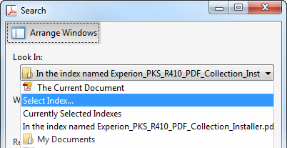
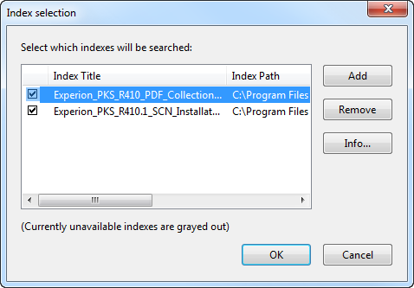
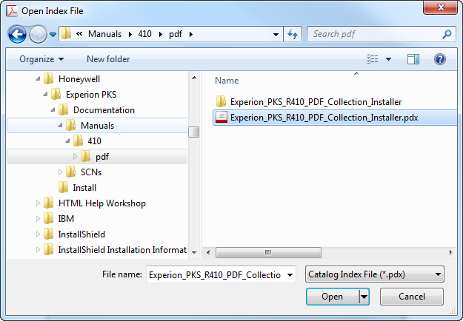
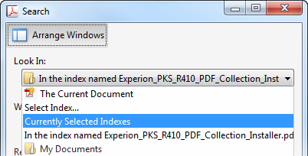
Additional Help
Searching two or more PDF collections
The default behavior for Adobe Reader is to search the index of the displayed PDF collection. If you want to search multiple PDF collections, such as the Experion System Documentation PDF Collection and the SCN, Installation, and Migration PDF Collection, you will need to configure an index selection.
Step 1 – Open the Index selection
Open the Search window with the Show More Options displayed.
In the Look In list, click Select Index.
Step 2 – Select the indexes
In the Index selection window, add the index file (.pdx) for each PDF Collection (and remove indexes not required).
Example .pdx location: C:\Program Files (x86)\Honeywell\Experion PKS\Documentation\Manuals\410\pdf
More information
For more information about how to use the Search options, see the Adobe Reader help, and locate the “Searching and indexing” topics.
Searches using the selected indexes
Open the Search window with the Show More Options displayed.
In the Look In list, click Currently Selected Indexes.
Enter the remaining search criteria, as required.

