Slide 1
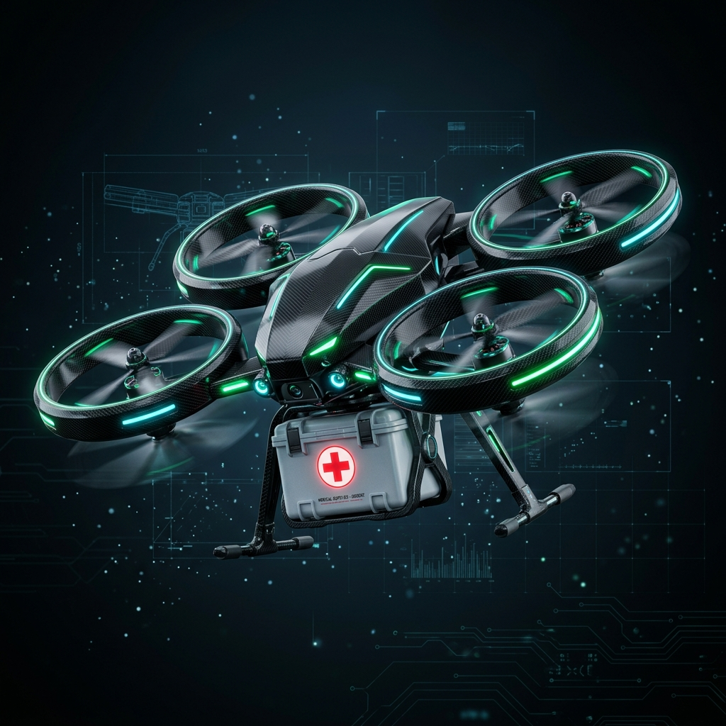
CONVERTIBLE MEDICAL DELIVERY DRONE
Applied Electromechanics Course Project: Design & Avionics Architecture
Flight Platform: Arduino UNO | Stabilizer: MPU6050 IMU | Radio Link: FS-CT6B 6CH

Slide 2
// CONVERTIBLE DRONE AVIONICS
02 / 09
Dual Locomotion: Flying & Rolling
• The Hybrid Concept: A medical delivery vehicle designed to travel on flat roads (rolling mode) to conserve battery, and take off (flying mode) to clear terrain obstructions.
• Mercedes Propellers: Custom 3D-printed propellers enclosed in rigid outer rings that serve as flight blades and ground rolling wheels.
• Servo Actuation: Two high-torque MG9966 servos actuate left and right motor blocks, rotating the assemblies 90 degrees between positions.
• Tilt Lock System: Mechanical locking mechanisms at the limits (0° and 90°) relieve weight load from the servo motors once the transition completes.
MODE SWITCH PIPELINE
1. FLIGHT MODE (Propellers Facing Up)
▼
2. TRANSITION (Servos Actuated 90°)
▼
3. ROLLING MODE (Propellers Facing Sideways)

Slide 3
// CONVERTIBLE DRONE AVIONICS
03 / 09
Components & Pin Mappings
• Processing Core: Arduino UNO acts as the central brain, running the MVP state machine, receiving inputs, and coordinating ESCs and servos.
• Telemetry Link: FS-CT6B 6-channel receiver captures joystick pulses for manual navigation control.
• Actuation System: Four 1000kv BLDC motors drive propellers, two MG9966 servos actuate transitions, and four limit switches monitor lock status.
• Power & Telemetry: A 3S LiPo battery powers the ESC bus; a BEC steps down to 5V to run the Arduino, and a piezo buzzer sounds system telemetry alarms.
ARDUINO PIN | CONNECTED PART | TYPE
D3, D5, D6, D9 | Propulsion ESCs | PWM Output
D10, D11 | Left & Right Servos | Servo PWM
D2, D4, D7, D8 | FS-CT6B Rx Channels | Pulse Input
A0 to A3 | Arm Limit Switches | Input Pullup
A4 / D12 | Voltage divider / Buzzer | Analog / Digital

Slide 4
// CONVERTIBLE DRONE AVIONICS
04 / 09
MPU6050 & PID Stabilization Loop
• Vibration Isolation: The MPU6050 is mounted on sponge pads to dampen structural motor noise. Low-pass software filters are applied to isolate actual drone tilt.
• Triple Axis PID Loops: Attitude correction values are calculated at 250Hz for the Roll, Pitch, and Yaw axes based on pilot joystick references.
• Proportional & Integral Actions: P (Proportional) provides primary corrective torque. I (Integral) eliminates steady-state tilt offset errors.
• Derivative Damping Action: D (Derivative) tracks the rate of change of errors, dampening overshoot and stabilizing flight dynamics.
PID MATHEMATICS & PSEUDOCODE
// Math Equation:
Correction = Kp*e(t) + Ki*∫e(t)dt + Kd*de/dt
// Firmware Loop Execution (250Hz):
error = target_angle - current_angle;
error_integral += error * dt;
// Prevent integral windup
error_integral = constrain(error_integral, -I_MAX, I_MAX);
error_derivative = (error - prev_error) / dt;
prev_error = error;
pid_output = Kp*error + Ki*error_integral + Kd*error_derivative;

Slide 5
// CONVERTIBLE DRONE AVIONICS
05 / 09
FS-CT6B Transmitter Telemetry
• Reliable Communication: Operates on 2.4 GHz AFHDS (Automatic Frequency Hopping Digital System) protocol to prevent signals from overlapping with neighboring devices.
• Hardware Interrupt Capture: Arduino captures receiver pulse widths using pin state change interrupts. This avoids the blocking pulseIn function, saving CPU processing cycles.
• Failsafe Lockout Loop: The firmware constantly checks pulse intervals. If connection is lost, it immediately disarms all ESC outputs to 1000 us (minimum spin/lock).
• Dual Mode Selector Switch: Channels 5 and 6 act as binary switches for switching between flight and rolling modes, and as emergency safety disarms.
CHANNEL | MAPPED FUNCTION | PULSE WIDTH (us)
CH 1 / CH 2 | Roll & Pitch Control | 1000 to 2000 us
CH 3 | Throttle (propulsion power) | 1000 to 2000 us
CH 4 | Yaw Control (steering) | 1000 to 2000 us
CH 5 / CH 6 | Mode switch / Disarm | Boolean High/Low

Slide 6
// CONVERTIBLE DRONE AVIONICS
06 / 09
Mechanical Transition & Safety Rules
• Servo Output Pins D10/D11: High-torque MG9966 servos act on command signals to rotate the adjacent side arms (FL-BL and FR-BR) between flight and ground rolling postures.
• Verification Switches A0-A3: Hardware microswitches confirm mechanical locking at 0 deg (flight) and 90 deg (rolling). Transition states are verified before motor re-arming.
• Throttle Safety Interlock: The firmware blocks servo transit commands unless the throttle channel pulse measures completely at zero (1000 us).
• Arming Stabilization Check: IMU accelerometers must read a stable, leveled horizontal posture (+/- 5 degrees) before transition triggers are accepted.
TRANSITION SAFETY CHECKLIST
1. Check throttle == 0 [PASSED]
2. Check motors disarmed [PASSED]
3. Trigger MG9966 Servo move [ACTIVE]
4. Read Limit SW A0/A2 (0°) [RELEASED]
5. Read Limit SW A1/A3 (90°) [ENGAGING...]
6. Confirm lock & re-arm [WAITING]

Slide 7
// CONVERTIBLE DRONE AVIONICS
07 / 09
Rolling Speed Control & Steering
• Propeller Wheel Load: Propellers encounter high static resistance when rolling on wheels. Low voltage can stall motors. The firmware uses PWM speed control instead of voltage reductions.
• Anti-Stall Pulse Ranges: Drive commands are restricted to a range between 1100 us and 1300 us to prevent ESC stalling and maintain control.
• Differential Tank Steering: Steering is managed using a tank drive model. Changing the speed ratio between left and right motor wheels causes a differential torque turn.
• Stutter Prevention: A minimum spin speed threshold (1100 us) is written into the firmware to overcome wheel friction during starts.
DIFFERENTIAL DRIVE CALCULATIONS
FORWARD ROLL └ Left: 1200 us | Right: 1200 us (Standard straight ground roll)
STEER RIGHT └ Left: 1250 us | Right: 1100 us (Left motors push, right motor slows)
STEER LEFT └ Left: 1100 us | Right: 1250 us (Right motors push, left motor slows)
STATIC BOUND └ Command limits: 1100 us to 1300 us (Anti-stall threshold boundaries)

Slide 8
// CONVERTIBLE DRONE AVIONICS
08 / 09
Power Bus & Telemetry Alarms
• 3S LiPo Battery Source: An 11.1V nominal Lithium Polymer battery (2200mAh capacity) powers the high-load propulsion motors and ESCs.
• 5V BEC Voltage Regulator: Steps down raw voltage to 5V to run the Arduino and MPU6050, shielding logic circuits from motor back-EMF noise.
• Voltage Telemetry Monitor: A resistor voltage divider feeds scaled battery levels to analog pin A4, triggering low-voltage safety warnings.
• Piezo Buzzer Status Alarms: Active warnings are emitted on pin D12 for startup status (1 beep), low battery (slow pulsing), and RX signal loss failsafes (rapid pulsing).
POWER DISTRIBUTION TOPOLOGY
3S LiPo Battery (11.1V) Raw power source for flight system
├── ESCs & BLDC Motors High current draw propulsion circuit
└── 5V BEC Regulator Regulates voltage for control logic
├── Arduino UNO Core Processes state inputs and calculations
└── MPU6050 & Servos Senses orientation and drives joints

Slide 9
// CONVERTIBLE DRONE AVIONICS
09 / 09
Project Status & Summary
• MVP State Machine Active: Control loop modes (IDLE, TRANSITIONING, FLYING, ROLLING, FAILSAFE) are implemented and active in firmware.
• Safety Interlocks Validated: Limit switches (A0-A3) prevent transitions unless throttle is at zero, motors are disarmed, and orientation is stable.
• Next Step: Interrupt Capture: Transitioning receiver pulse reads to hardware interrupt capture registers to reduce main CPU execution latency.
• Next Step: PID Flight Tuning: Calibrating MPU6050 sensor values to tune PID flight coefficients on roll and pitch axes.
✔
AVIONICS MODEL DEPLOYED
The integrated system of Arduino UNO execution, MPU6050 feedback, and limit-switch safety transitions completes the core hardware design checklist.

