Slide 1
Welcome to SESSION 7
Give your Attendance(ID) in the Chat Box

Slide 2
Today’s Topic Academic Achievement and Higher Education Part 2
Give your Attendance(ID) in the Chat Box

Slide 3
Higher Education - Checklist
Academic Transcripts (Direct/Evaluated)
Recommendation Letter (LOR)
Passport
Resume/CV
GRE/IELTS/TOEFL Scores
Others:
Search universities and Contact with Professors
Research Proposal
Financial Document
Medical Certificate
Phone Interview
Statement of Purpose (SOP)
Give your Attendance in the Chat Box

Slide 4
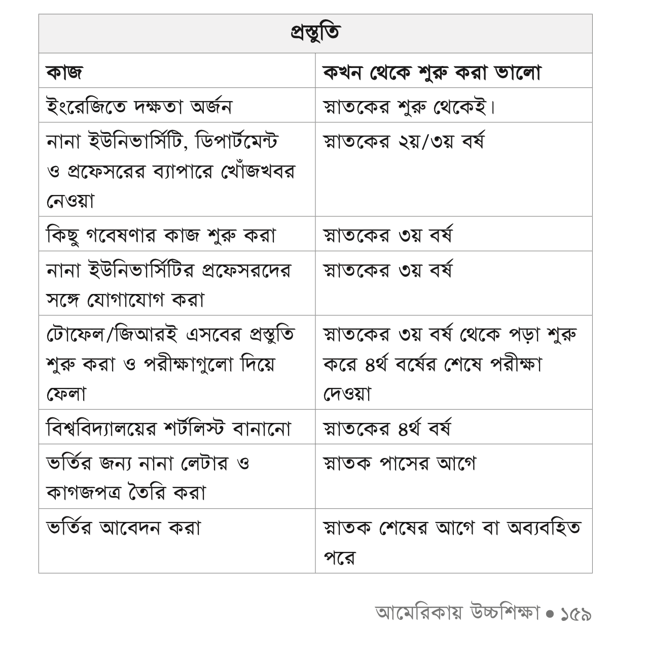

Higher Education - Checklist
fb.com/phdinusa
Give your Attendance in the Chat Box

Slide 5
Funding for Graduate Studies
Fully Funded – Tuition Fee Waived and Stipend
(Ph.D. Students)
Partially Funded - Out-of-State Tuition Fee Waived and Stipend
(Mainly for MS Students)
Scholarship / Graduate Research Assistantship/ Teaching Assistantship
Give your Attendance in the Chat Box

Slide 6
Funding for Graduate Studies
GENERAL CRITERIA
✔ Academic Results ✔ GRE, TOEFL/IELTS Scores ✔ Statement of Purpose and Recommendation Letters ✔ Publications ✔ Work Experience ✔ Extra-Curricular Activities
Give your Attendance in the Chat Box

Slide 7
Funding for Graduate Studies
MAIN PROBLEMS FOR BANGLADESHI GRADUATE APPLICANTS
1. Communication Skills
(Specially Writing Email, when contacting respective professor for Funding)
2. Resume
3. Not Emphasizing Extra-Curricular Activities
4. Networking with Existing Graduate Students in USA
5. Starting the Process for Funding
Give your Attendance in the Chat Box

Slide 8
Academic Achievement
SCHOLARSHIP
🥇 CGPA 4.00 – 10% Scholarship on tuition fees
🥈 CGPA 3.80 -3.99 – 05% Scholarship on tuition fees
AWARDS
🥇 3.90 and up - VC’s List
🥈 3.8 – 3.89 - Dean’s List
Give your Attendance in the Chat Box

Slide 9
Thank You
Give your Attendance in the Chat Box

Slide 10
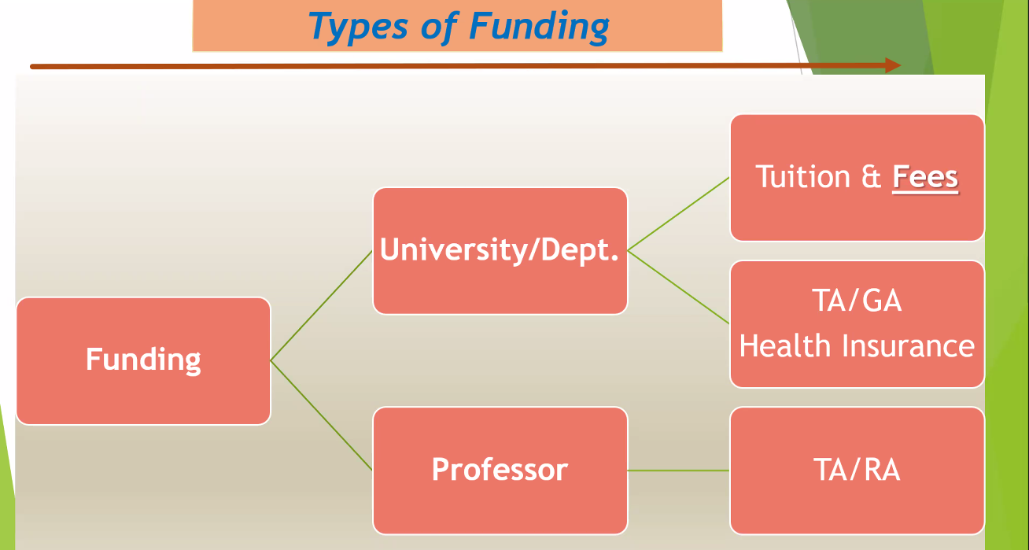

Slide 11
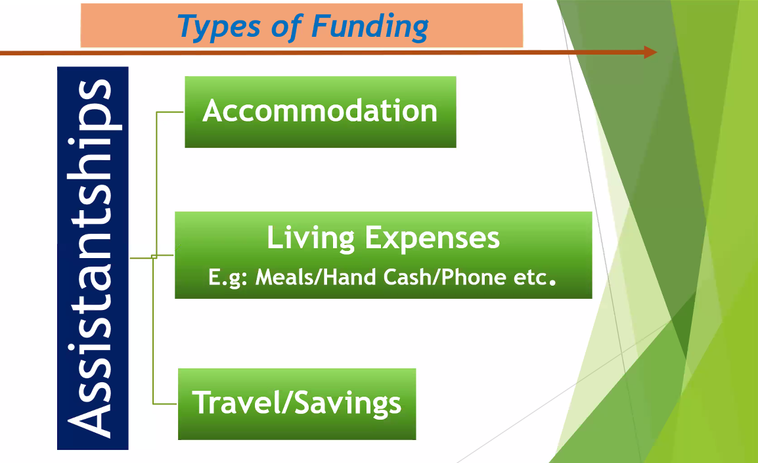

Slide 12


Slide 13
Email Etiquette at University Level
1. USE AN APPROPRIATE SALUTATION
✔ Dear
✖ Hey
2. ADDRESS THE RECIPIENT APPROPRIATELY
(both title and name)
✔ Dr [surname] / Professor [surname]/
Prof. [surname]
✔ Sir or Madam
✖ Gendered addresses like ‘Mr.’ or ‘Mrs.’
3. INTRODUCE YOURSELF
Tell your lecturer who you are, especially if this is the first email you've written to them.
4. KEEP THE BODY SHORT AND STRAIGHT TO THE POINT
Tell your lecturer who you are, especially if this is the first email you've written to them.
5. END WITH A CLEAR CLOSING
✔ Yours sincerely,
Name
ID
Department, Batch
Give your Attendance(ID) in the Chat Box

Slide 14
Sample
Subject: [Subject code] - [question about / request for etc.]
(2) Dear (3) Dr [insert surname] / Professor [insert surname] / Prof. [insert surname], or [preferred name of lecturer / tutor / coordinator],
(4) I am a student in your [insert subject name] lecture.
(5) I have a question regarding the lecture presented last [insert day/date] which I couldn't find the answer to………
Should our essay draw only on readings listed on the syllabus or can I incorporate scholarly articles I read on my own, as long as it fits with the subject of the assignment?
I look forward to hearing from you.
(6) Yours sincerely,
Name
ID
Department, Batch

Slide 16
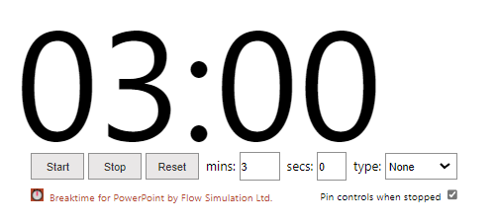
MEETING STARTS IN:

Slide 17
Welcome to the Mentorship Program
Fall Semester 2021

Slide 18
Outline
Introduction Session, Meet the Teachers, Class Routine & Google Classroom
What is the Meaning of the Term “UNIVERSITY”, Etiquettes and Manners
Zoom, Google Form, Excel
Student Portal, University Website, Payment Method, and Important Phone Numbers
Introducing with GUB Events Calendar, Email Writing
Presentation and Assignment (Part 1)
Presentations and Assignment (Part 2), Department Club Engagement
Academic Achievement and Higher Education
Pre-registration and Teacher Evaluation

Slide 19
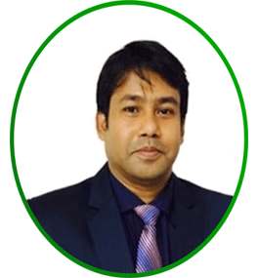
Faculty Member
PROF. DR. MD. SAIFUL AZAD
Professor,
Chairman Dept. of CSE
Email - chairman@cse.green.edu.bd
https://green.edu.bd/faculty-profile-dept/dept-of-cse/

Slide 20
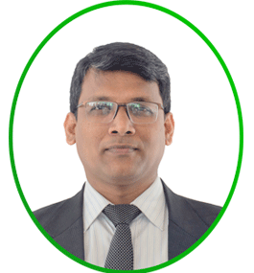
Faculty Member
DR. MUHAMMAD AMINUR RAHAMAN
Associate Professor,
Campus Director (Permanent campus)
Email -aminur@cse.green.edu.bd

Slide 21
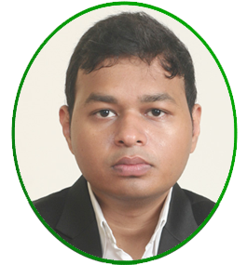
Faculty Member
DR. FAIZ AL FAISAL
Assistant Professor ,
Associate Chairperson of CSE Department
Email - faisal@cse.green.edu.bd

Slide 22
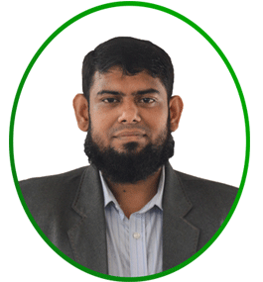
Faculty Member
MD. SOLAIMAN MIA
Assistant Professor,
Moderator, Green University Computer Club(Permanent Campus)
Email - solaiman@cse.green.edu.bd

Slide 23
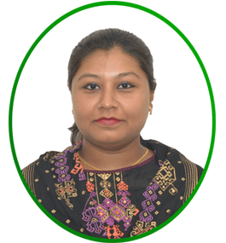
Faculty Member
MS. FARHANA AKTER SUNNY
Senior Lecturer,
Program Coordinator of GUB Permanent Campus
Email - farhana@cse.green.edu.bd

Slide 24
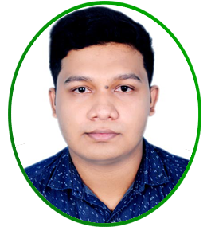
Faculty Member
MD. SULTANUL ISLAM OVI
Lecturer,
Mentor Moderator Green university (Permanent Campus CSE Dept.)
Email - sultanul@cse.green.edu.bd

Slide 25
Faculty Member
MD. SULTANUL ISLAM OVI
Lecturer,
Mentor Moderator Green university (Permanent Campus CSE Dept.)
Email - sultanul@cse.green.edu.bd

Slide 26
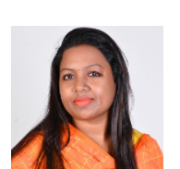
Faculty Member
MS. MAZEDA KHANAM
Dept. Coordination Officer(pc)
Email: mkchapa.sc@green.edu.bd

Slide 27
Thank You
Give your Attendance in the Chat Box

