Slide 1

Analytics

Slide 2

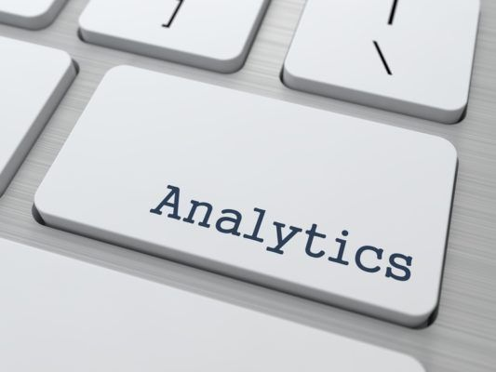
Basics
Analytics is all about the analysis and that is where it comes from. There are two parts to it, a business part and; a technology path.
Analytics provides us with meaningful information which may otherwise be hidden from us within large quantities of data.
Information has long been considered as a great weapon, and analytics is the forge that creates it.

Slide 3
Types of
Analytics

Slide 4
Basics
Prescriptive
Descriptive analytics describes what has happened over a given period of time. Have the number of views gone up? Are sales stronger this month than last?
Diagnostic analytics focuses more on why something happened. This involves more diverse data inputs and a bit of hypothesizing. Did the weather affect beer sales? Did that latest marketing campaign impact sales?
Predictive
Diagnostic
Descriptive
Notes:
Slide must include application of machine learning - both commercial and non commercial

Slide 5
Basics
Prescriptive
Predictive analytics moves to what is likely going to happen in the near term. What happened to sales the last time we had a hot summer? How many weather models predict a hot summer this year?
Prescriptive analytics suggests a course of action. If the likelihood of a hot summer is measured as an average of these five weather models is above 58%, we should add an evening shift to the brewery and rent an additional tank to increase output.
Predictive
Diagnostic
Descriptive
Notes:
Slide must include application of machine learning - both commercial and non commercial

Slide 6
Thank You...

