Slide 1

BASIC STATISTICS -
DATA, TYPES OF DATA AND ITS FUNCTIONALITIES

Slide 2

Basics
In the world of data analytics, information comes in various forms, so we have to structure it before we can train our model or use the same for data analysis.
Information can be defined as some entity or some defined area. We have information all around us. Once we start extracting meaningful information, it takes the form of the data.
A dataset is defined as a collection of related information or records.
Column
INDEX | A | B | C
1 | aaa | aaa | aaa
2 | bbb | bbb | bbb
Data
Row

Slide 3
Types of Data

Slide 4
Types of Data
Data can be broadly divided into 2 categories:
Quantitative
It is defined as the data having numerical values. It can be discrete or continuous. It relates to the information about the quantity of the data – hence it can be measured.
Qualitative
It is defined as the data having categorical / qualitative values. It can be discrete or continuous. It relates to the information about the quality of the data or object – hence cannot be measured.

Slide 5
Types of Data
Problem 1: From the employee table given below, you have to identify the quantitative and qualitative.
Employee Name | Designation | Age | Department | Salary
Aman | Manager | 32 | Admin | 600000
Nitish | Associate | 28 | IT | 500000
Shweta | Associate | 25 | HR | 800000
Saurabh | Sr. Manager | 30 | IT | 600000
Employee Name | Designation | Age | Department | Salary
Solution:
Quantitative data - Age, Salary
Qualitative data – Department, Employee Name, Designation

Slide 6
Level of Measurement

Slide 7
Level of Measurement
Ratio
Data can be broadly divided into 2 categories:
Nominal: It has no numeric value, but a named value.
Ordinal: It is having nominal data properties, but also be naturally ordered.
Interval: It is the numeric value for which not only the ordered is known but the exact difference between the values is known.
Ratio: It is the numeric value for which exact values can be measured. They can have positive values only.
Interval
Ordinal
Nominal

Slide 8
Graphical Representation
Of The Data

Slide 9
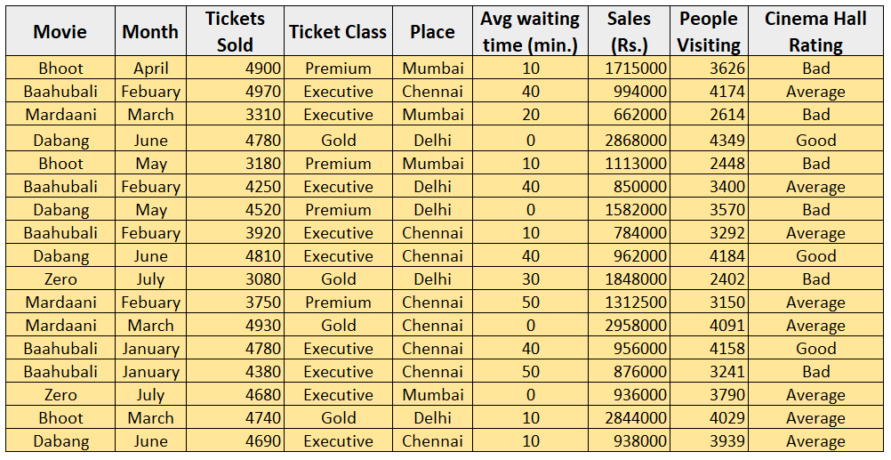
Graphical Representation of the Data
Example1:
There is movie dataset that was collected from various cinemas. We have to study the type of data involved and the statistical operations.
You can check in the type of the data

Slide 10
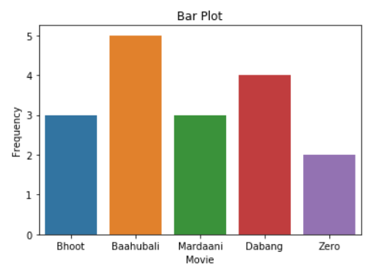
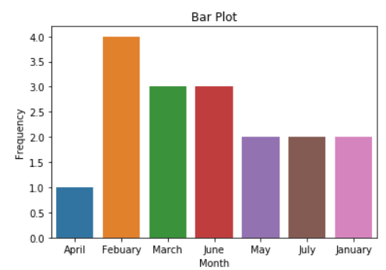
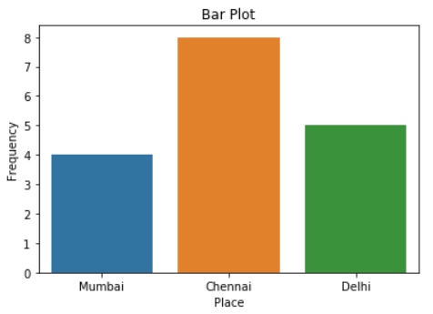
Graphical Representation of the Data
Nominal Data

Slide 11
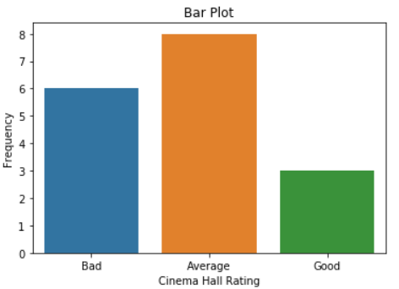
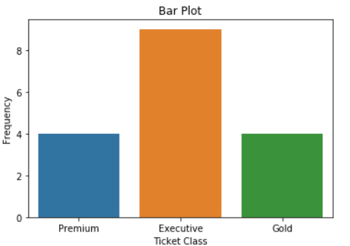
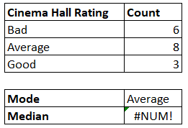
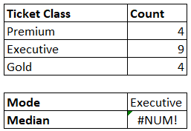
Graphical Representation of the Data
Ordinal Data

Slide 12
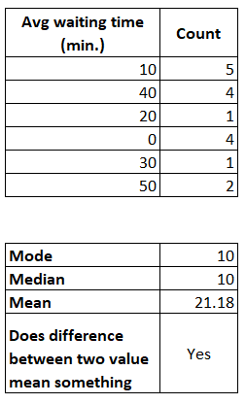
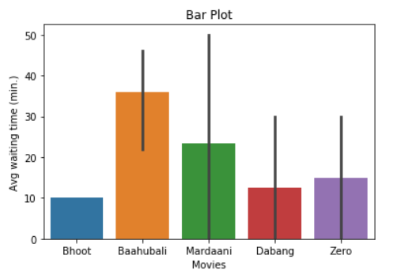
Graphical Representation of the Data
Interval Data

Slide 13
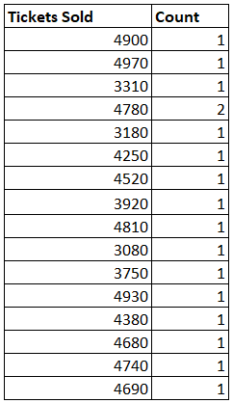
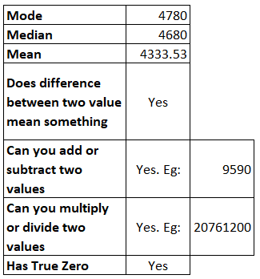
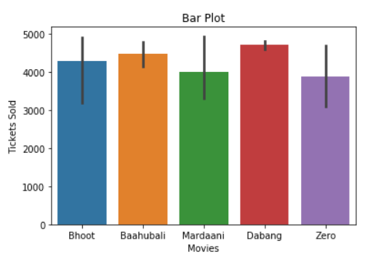
Graphical Representation of the Data
Ratio Data

Slide 14
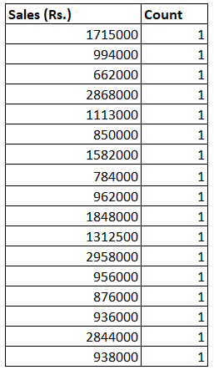
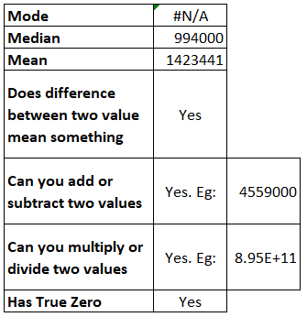
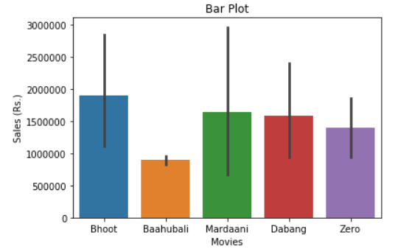
Graphical Representation of the Data
Ratio Data

Slide 15
Thank You...

