Slide 1

DESCRIPTIVE STATISTICS-
CONCEPTS AND PRACTICAL

Slide 2

Basics
Population and Sample
Population is defined as the entire dataset in a whole. It gives you all the information needed to make assumptions about the data or extract the inferences.
Sample is defined a piece of the population that helps to reflects information about the entire population. Sample size can vary from 1 to population size – 1.
The sample size varies from 1 to population size – 1. We have are excluding 0 and population array itself.
Formula: sample size = (2) ^{population size} – 2

Slide 3

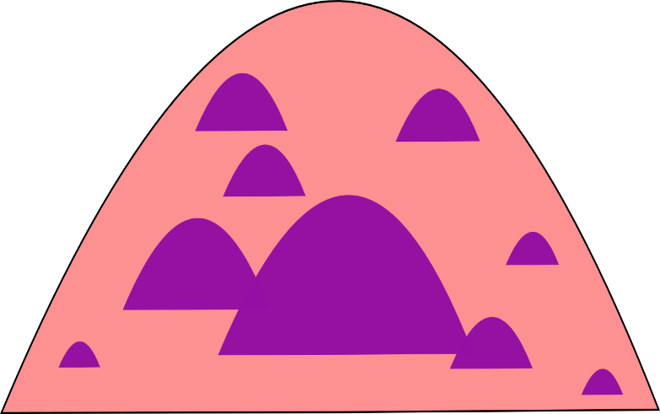
Basics
Samples can take small or large size and always lie within the scope of the population.
To help you visualize it, we are using below figures just for representation purpose.
As sample size increases, it moves more and more towards the mean.

Slide 4
CENTRAL TENDENCY

Slide 5
Central Tendency

Slide 6
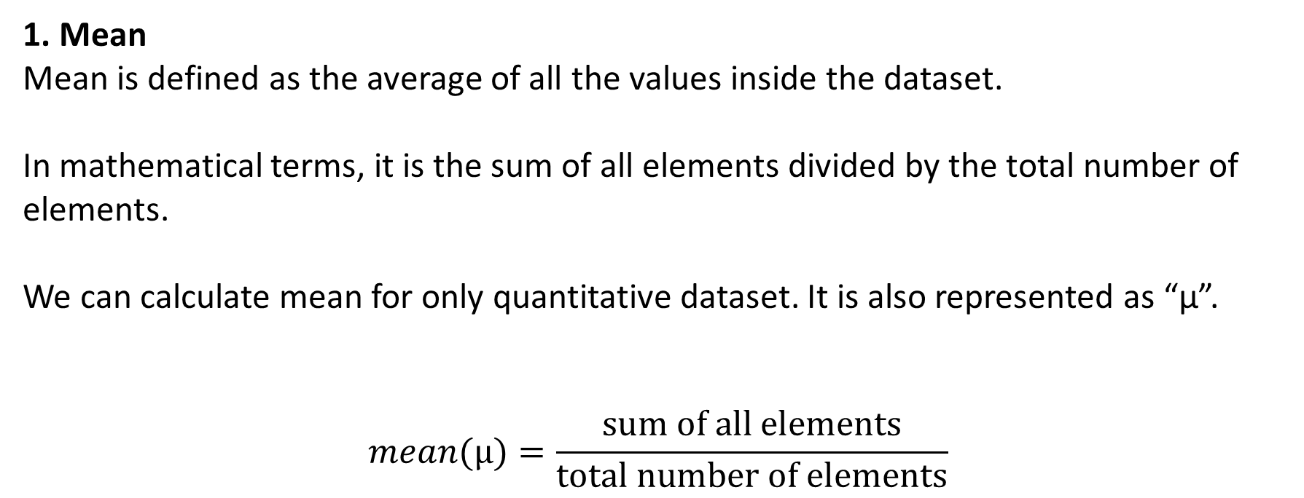
Central Tendency Statistics

Slide 7



Central Tendency Statistics
1. Mean
Example:
series = [10,11,10,11,10,11,10,10,20,30,40,25]
Example:
series = [8,9,7,5,8,9,7,5,9,8,7,3,1,0]

Slide 8
Central Tendency Statistics
2. Mode
Mode is defined as element having the most frequency or occurrence.
It may or may not lie in the central value of the dataset.
It has few drawbacks.
It will be the element occurring the most so it can lie on the extreme left or extreme right of the histogram, giving no information.
The dataset having unique values has no common element and has no mode. Although we can have median and mean.

Slide 9
Central Tendency Statistics
2. Mode
Example:
series = [10,11,10,11,10,11,10,10,20,30,40,25]
Example:
series = [10,11,10,11,10,11,10,10,20,30,40,25]
Example:
series = [8,9,7,5,8,9,7,5,9,8,7,5]
Mode = 10
Mode = 8

Slide 10
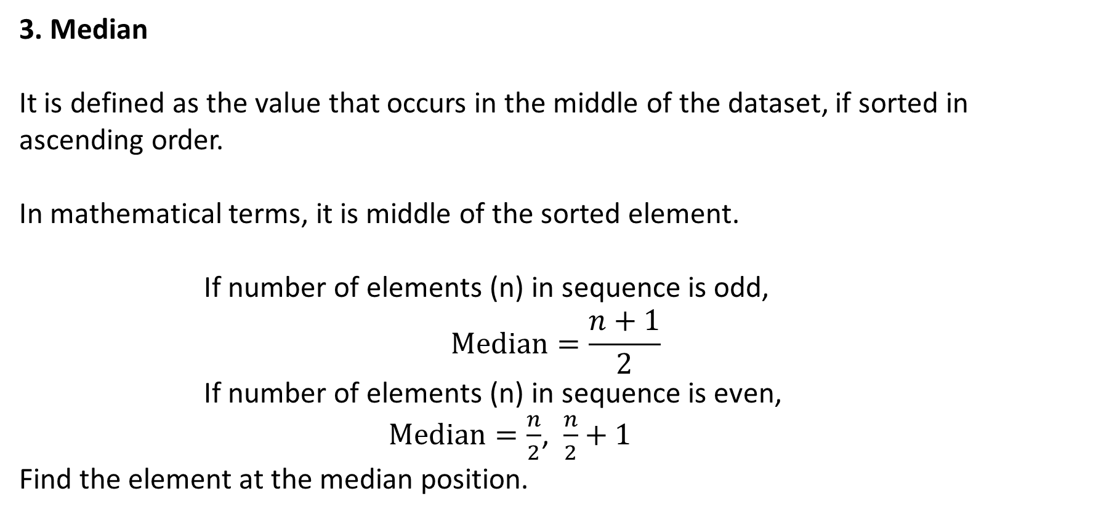
Central Tendency Statistics

Slide 11
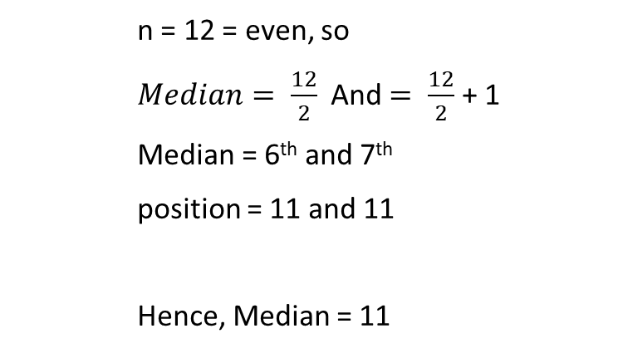
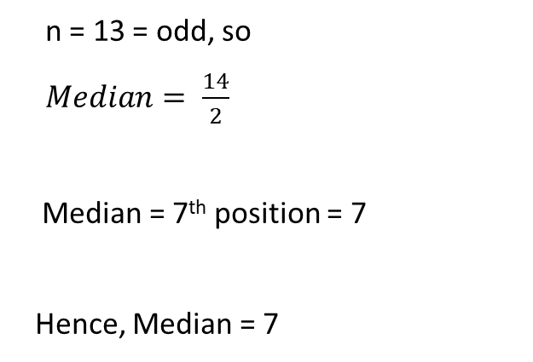
Central Tendency Statistics
3. Median
Example:
series = [10,11,10,11,10,11,10,10,20,30,40,25]
Example:
series = [8,9,7,5,8,9,7,5,8,7,3,1,0]
Sorted series = [10, 10, 10, 10, 10, 11, 11, 11, 20, 25, 30, 40]
Sorted series = [0, 1, 3, 5, 5, 7, 7, 7, 8, 8, 8, 9, 9]

Slide 12
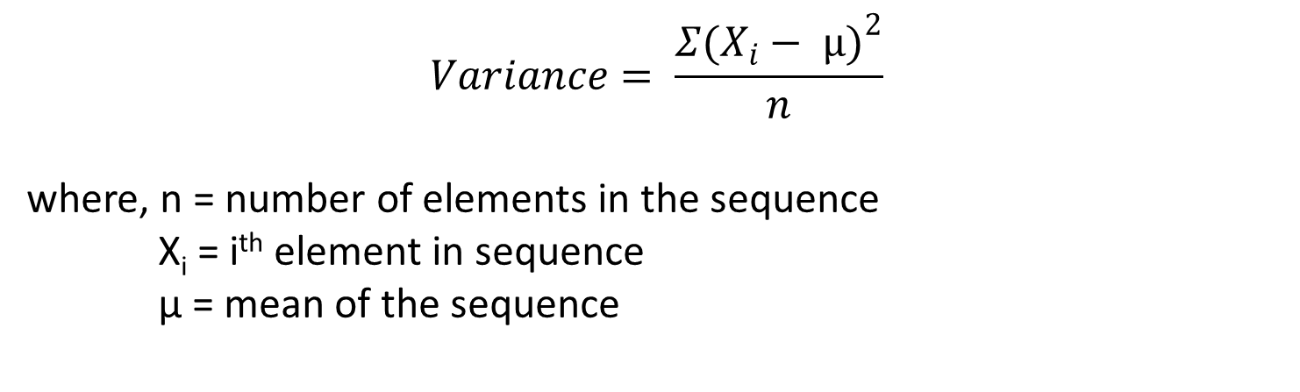
a) Measure of spread (Variance)
Variance is defined as the spread of the data in the feature space, i.e., how fare the records from each other.
It varies from 0 to ∞.

Slide 13
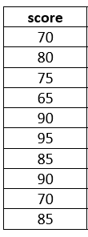
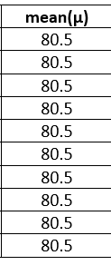
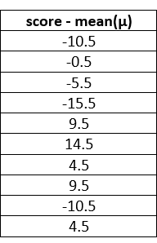
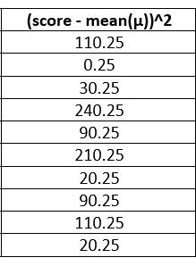
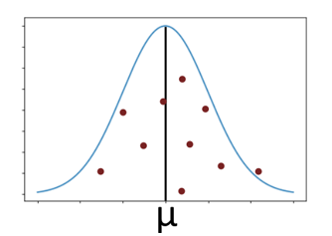

a) Measure of spread (Variance)
Example: We have a score card for a student having 10 subjects.

Slide 14
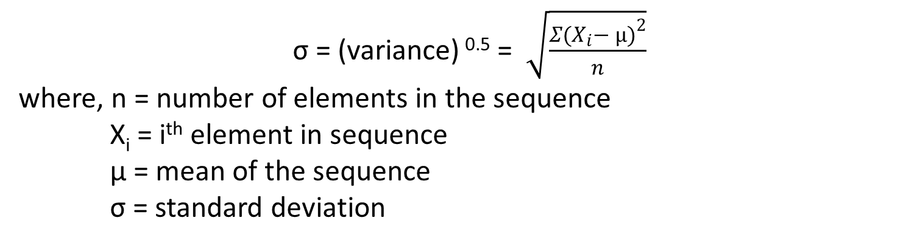
b) Standard Deviation
Standard deviation is defined as the measure or amount of dispersion of data points.
It is represent by sigma (σ).

Slide 15

b) Standard Deviation
Example: We have a score card for a student having 10 subjects.

Slide 16
c) Quartiles and Percentiles
The quartile measures the spread of values above and below the mean by dividing the distribution into four groups.
It divides data into three points – a lower quartile, median, and upper quartile – to form four groups of the data set.
Quartiles are used to calculate the interquartile range, which is a measure of variability around the median.

Slide 17
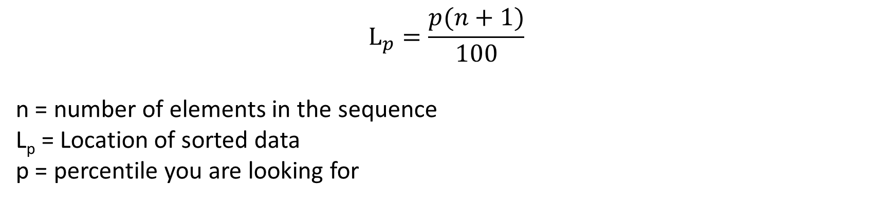
c) Quartiles and Percentiles
Percentile value = lower location value + location decimal (upper value – lower value)

Slide 18
c) Quartiles and Percentiles
Inter Quartile Range (IQR) is defined as the region between the 3rd quartile and 2nd quartile.
It is helpful in calculating the region for maximum data points.
IQR = Q₃ – Q₁ = 75 percentile value – 25 percentile value
Q2 is also called as the median value of the dataset.
IQR has an application in making boxplot for the datasets.

Slide 19


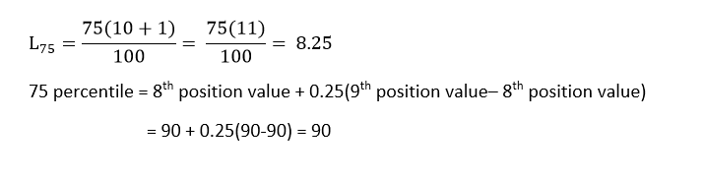
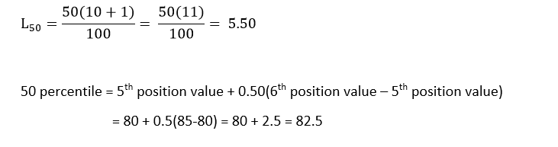
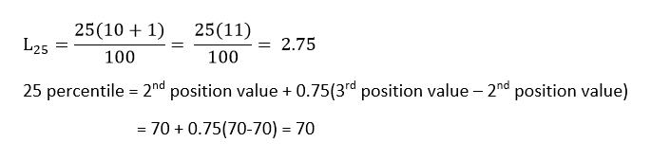

c) Quartiles and Percentiles
Example: We have a score card for a student having 10 subjects. We have to find all percentiles.

Slide 20
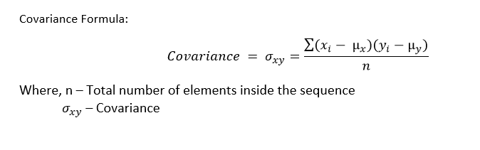
d) Covariance
Covariance is a statistical measure used to calculate the directional relationship between two variables.
In simple terms, it tells how the trend of one variable with respect to other variable is.
It can vary from -∞ to +∞.
It mainly depends on the size of the attributes

Slide 21
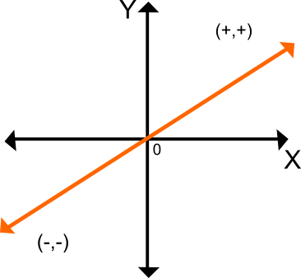
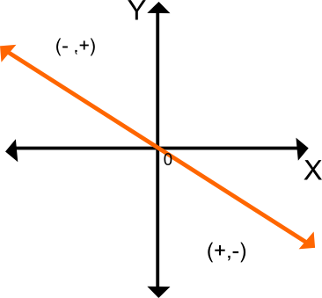
d) Covariance
Positive Covariance - Indicates that two variables tend to move in the same direction.
Negative covariance - Indicates that two variables tend to move in inverse directions.
Positive Covariance
Negative Covariance

Slide 22
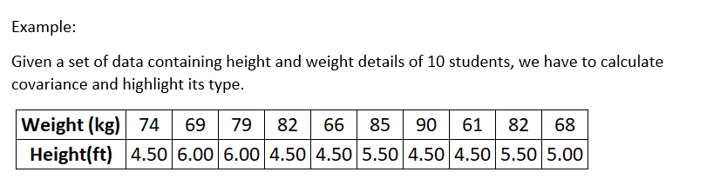

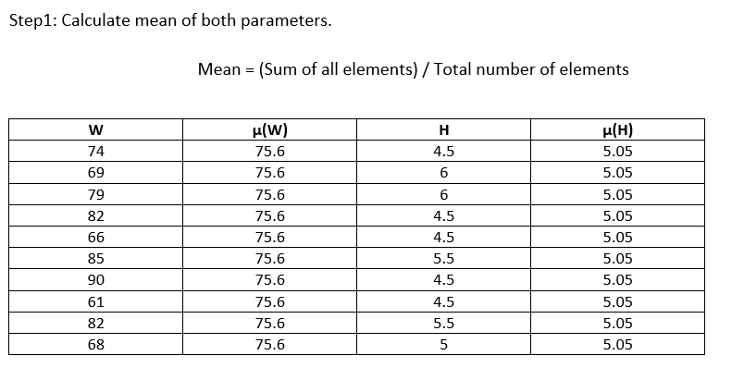
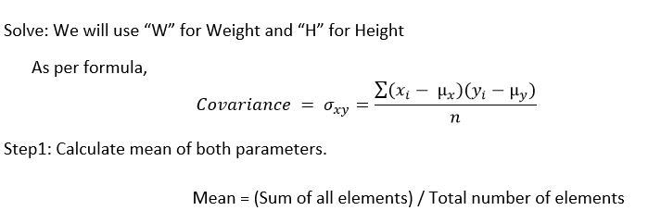
d) Covariance

Slide 23
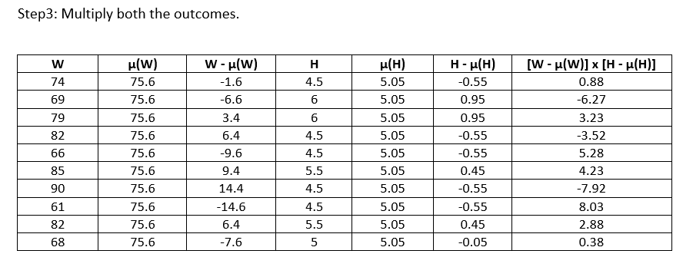
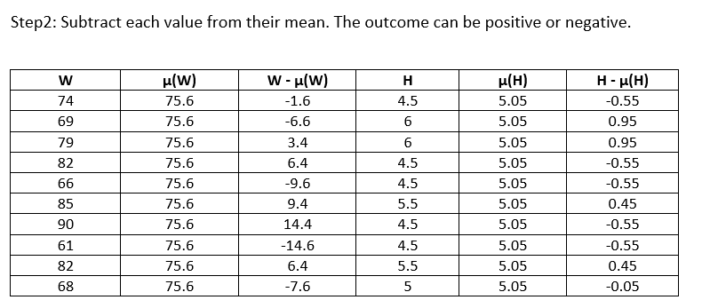
d) Covariance

Slide 24
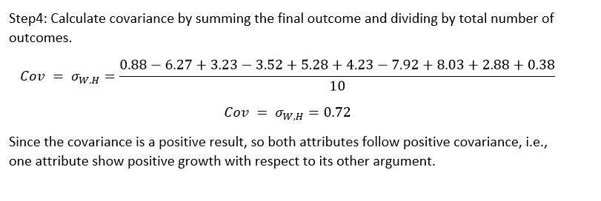
d) Covariance

Slide 25
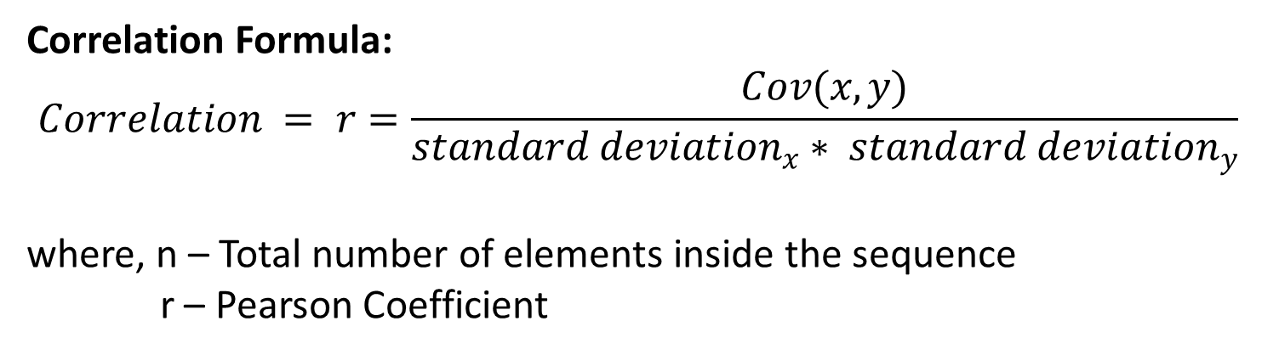
e) Correlation
Correlation is a statistical measure used to calculate the directional relationship between two variables, also adding some surety or strength in it.
In simple terms, it tells how much the trend of one variable affects the trend of other variable.
It can vary from -1 to +1. It depends on the size of the attributes.

Slide 26
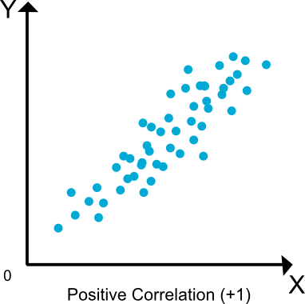
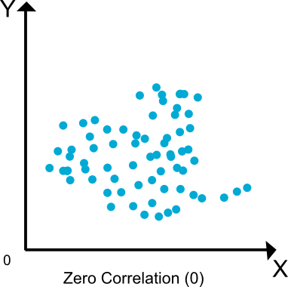
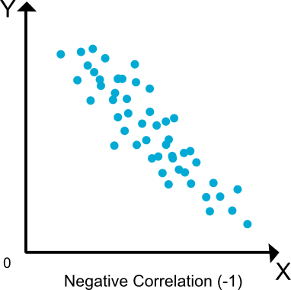
e) Correlation
Positive Correlation - Indicates that two variables tend to show some similar characteristics.
Zero Correlation - Indicates that two variables tend to show no characteristics.
Negative Correlation - Indicates that two variables tend to show some dissimilar characteristics.

Slide 27
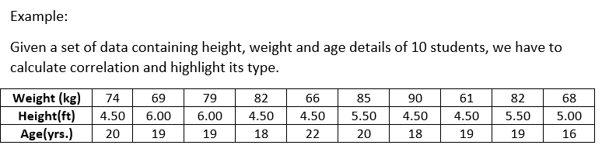
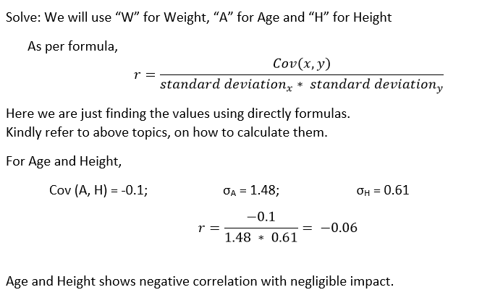
e) Correlation

Slide 28
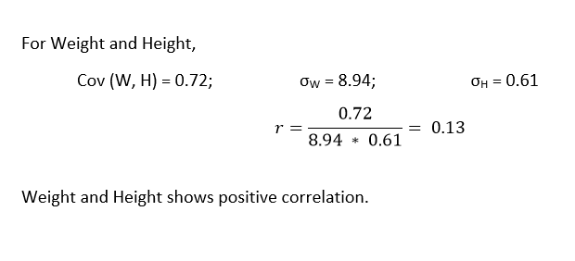
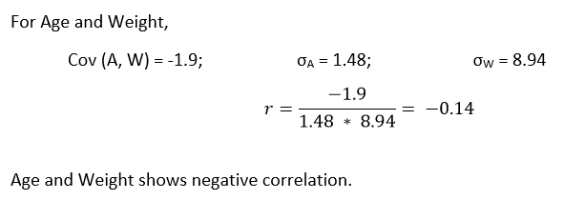
e) Correlation

Slide 29
Covariance
Correlation
Covariance indicates the direction of the linear relationship between variables.
Covariance can vary between -∞ and +∞ .
Covariance is affected by the change in scale.
Correlation on the other hand measures both the strength and direction of the linear relationship between two variables.
Correlation ranges between -1 and +1.
Correlation is not influenced by the change in scale.

Slide 30
Thank You...

