Slide 1

CSC 3315
Programming Paradigms
Data Analysis, Python vs R
Hamid Harroud
School of Science and Engineering,
Al Akhawayn University
Notes:
SENG697: Agent-based Software Engineering
2007 (Fall)
http://www.enel.ucalgary.ca/People/far/Lecture/SENG697/

Slide 2
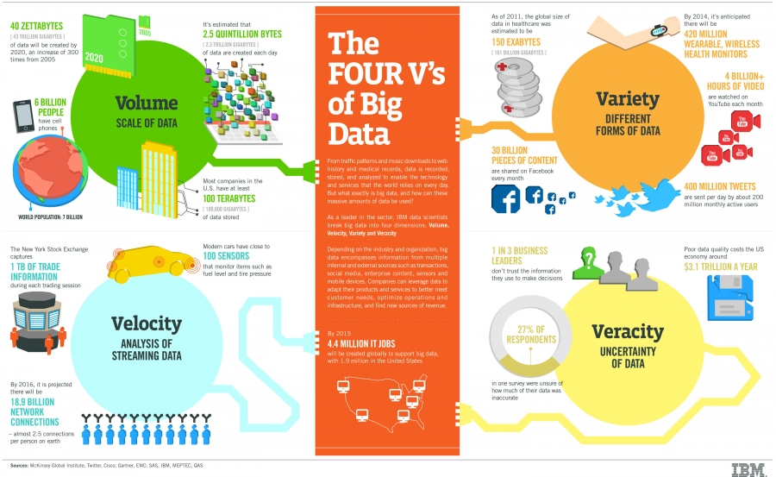
Big Data
http://www.ibmbigdatahub.com/infographic/four-vs-big-data

Slide 3
Big Data
The 4 Vs
  Volume: How much data is out there
  Variety: Types of Data
  Velocity: Streaming Data
  Veracity: Uncertainty of Data

Slide 4
Variety: Types of Data
Structured Data
  (relational) database tables
  CSV files
Semi-structured Data
  XML
  JSON
Unstructured Data
  text data (documents, Web pages, short texts (e.g., social media))
Multimedia Data (images, videos, audios)
Other types of data
  matrices, graphs, sequences, time-series, spatio-temporal

Slide 5
Velocity: Streaming Data
Stock Trades
Highway Sensors
Weather Data
Social Media
Telephone Calls
Video Streaming

Slide 6
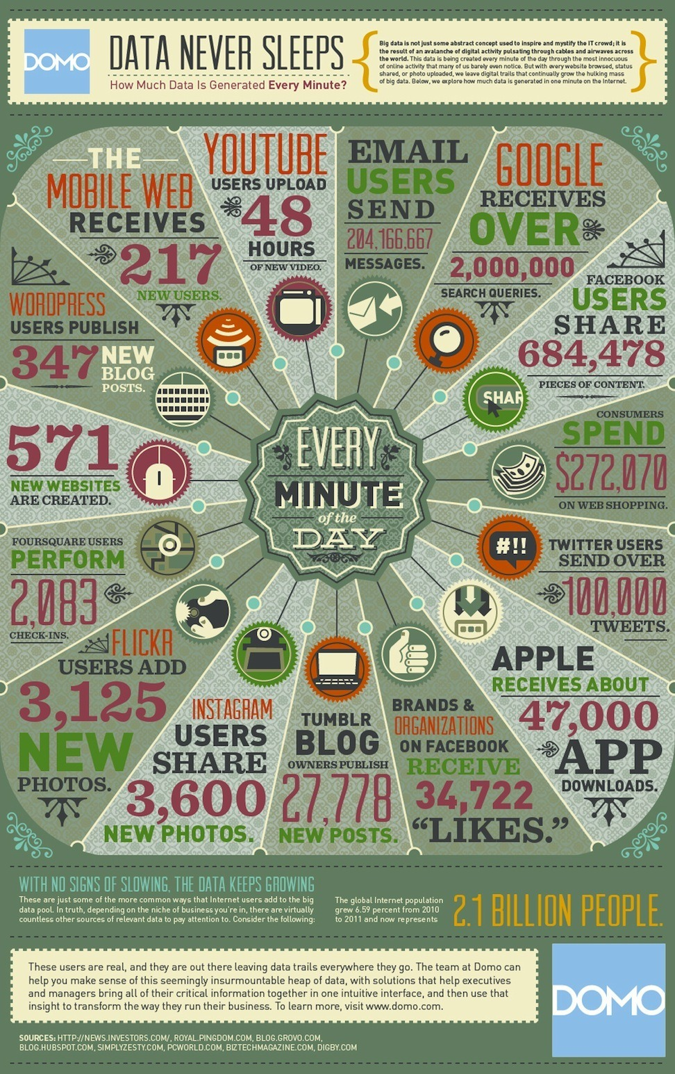
Every Minute of the Day

Slide 7
Datasets
Amazon Public Data Sets
Data.gov
Linked Open Data
Knowledge Bases, Encyclopedia
Yahoo! Webscope
Bibliography Databases
Network/Graph Datasets
UCI Machine Learning Repository
UCR Time Series Classification/Clustering
Time Series Data Library
KDnuggets Dataset List
KDD Cup Datasets

Slide 8
Amazon Public Data Sets
http://aws.amazon.com/public-data-sets/
  NASA NEX: A collection of Earth science data sets maintained by NASA, including climate change projections and satellite images of the Earth's surface
  Common Crawl Corpus: A corpus of web crawl data composed of over 5 billion web pages
  1000 Genomes Project: A detailed map of human genetic variation
  Google Books Ngrams: A data set containing Google Books n-gram corpuses
  US Census Data: US demographic data from 1980, 1990, and 2000 US Censuses
  Freebase Data Dump: A data dump of all the current facts and assertions in the Freebase system, an open database covering millions of topics

Slide 9
Data.gov
http://www.data.gov/ (137,608 datasets)
  Consumer Complaint Database
  U.S. International Trade in Goods and Services: Monthly report that provides national trade data including imports, exports, and balance of payments for goods and services.
  DTV Reception Maps
  Climate Data Online
  Food Access Research Atlas — presents a spatial overview of food access indicators for low-income and other census tracts using different measures of supermarket...
  U.S. Hourly Precipitation Data
  Great Chile Earthquake of May 22, 1960
  Consumer Expenditure Survey
  Campus Security Data
  Farmers Markets Geographic Data: longitude and latitude, state, address, name, and zip code of Farmers Markets in the United States
  Crimes - 2001 to present (City of Chicago)

Slide 10
Government Data
Government spending
http://www.usaspending.gov/
Campaign finance
http://www.fec.gov/disclosure.shtml
http://www.opensecrets.org/
Congress voting record
http://www.govtrack.us/ Members of Congress, Bills & Resolutions, Voting Records, Committees
Census
  http://www.census.gov/main/www/access.html

Slide 11
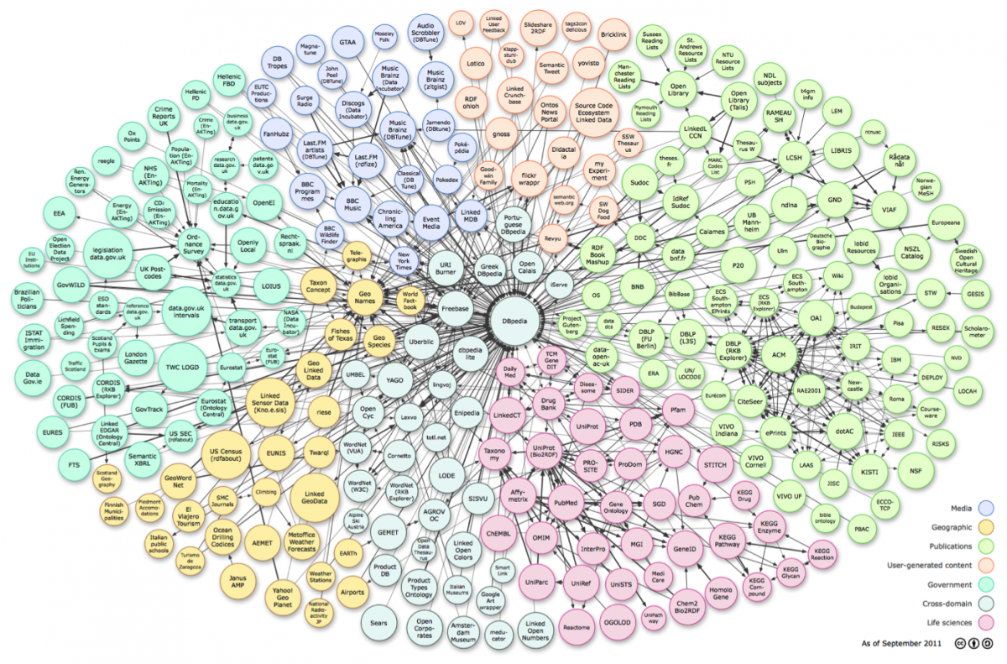
Linked Data
http://linkeddata.org/ (hundreds of datasets, billions of RDF triples)

Slide 12
Knowledge Bases, Encyclopedia
  Wikipedia, Dbpedia
  Freebase/Google Knowledge Graph
  YAGO
  Probase
  LibraryThing

Slide 13
Yahoo! Webscope Datasets
  Language Data
  Graph and Social Data
  Ratings and Classification Data
  Advertising and Market Data
  Competition Data
  Computing Systems Data
  Image Data

Slide 14
Bibliography Databases
  Google Scholar, Microsoft Academic Search, DBLP, arXiv.org, CiteSeer, Arnetminer
Drug and Disease Databases
  Drug Bank, DailyMed, OMIM, KEGG Drug
Gene and Protein Databases
  UniProt, Protein Data Bank, Genbank

Slide 15
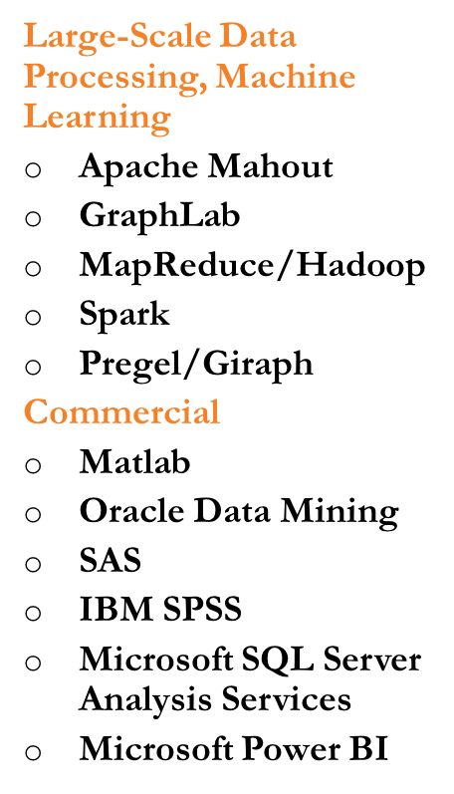
Data Mining Software
Free, open-source
  RapidMiner
  Weka: Data mining tool in java
  SCaVis: scientific computation and visualization, Java
  Orange: Python suite
  Scikit-learn: Python machine learning lbirary
  NumPy/SciPy/Ipython/ mlpy (python modules for scientific computing, scientific library, interactive computing, machine learning)
  R: statistical computing and graphic
  RattleGUI: data mining GUI using R
  Octave: numerical analysis
  Shogun: machine learning toolkit in C++
Text Mining Tools
  NLTK (NLP Toolkit): NLP suite for Python
  SenticNet API: sentiment analysis
  Stanford NLP software
  UIMA

Slide 16

Python Introduction
An interpreted, compiled, and interactive, object-oriented, dynamic, imperative, and open source programming language.
Created in early 90's by Guido von Rossum at Stichting Mathematisch Centrum in the Netherlands.
The name comes from the Monty Python and not from the snake.
There is a big community of Python programmers, with conferences and magazines: http://pycon.org/
Web site: www.python.org.

Slide 17
Features of Python
Interactive: one can launch a Python console and run instructions directly it.
Portable: available on most existing systems. It only requires a C compiler to be ported to any new platform.
Structure: functions, classes, modules.
It is easy to embed Python with C and C++.
The user can write their own code in C or C++ and compile it as Python modules or functions. That makes Python extensible.
Usual applications: scripts including CGI scripts, GUIs, scientific computing.
Many existing libraries for all sort of purposes.

Slide 18
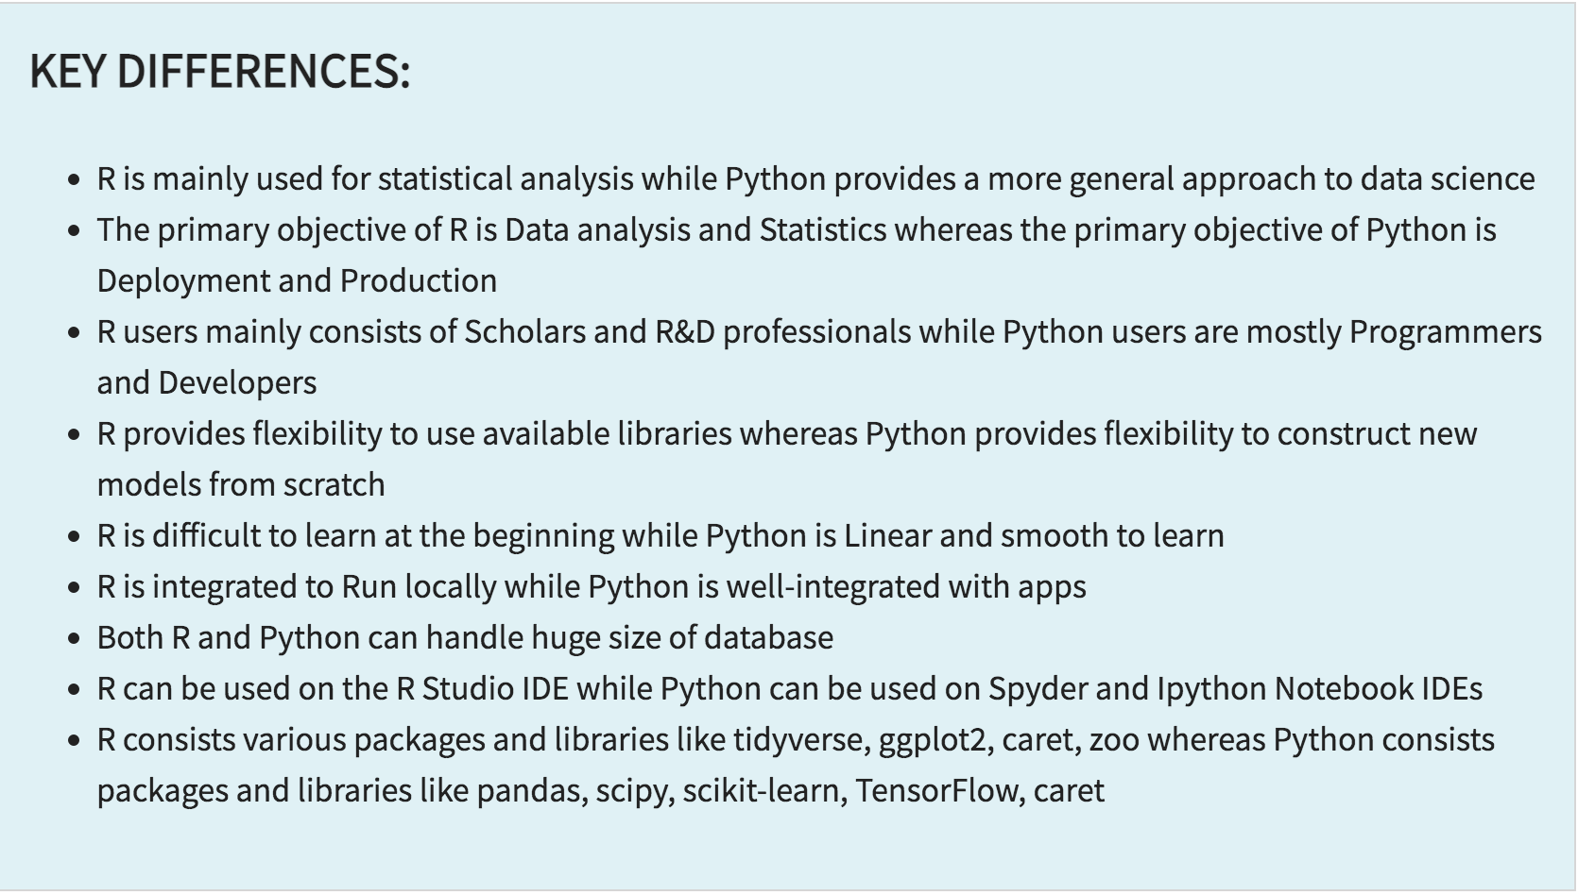
Python vs R
Notes:
Why choose it instead of MATLAB, R, SAS, Stata and others?
- It is free and open source
- Intuitive and easy to learn
- Extremely versatile – examples – websites, planes, robots, data
- Large and friendly community
- packages
Very important in industry and academia

Slide 19
Python today
Developed a large and active scientific computing and data analysis community
One of the most important languages for
  Data science
  Machine learning
  General software development
Packages: NumPy, pandas, matplotlib, SciPy, scikit-learn, statsmodels
Notes:
Why choose it instead of MATLAB, R, SAS, Stata and others?
- It is free and open source
- Intuitive and easy to learn
- Extremely versatile – examples – websites, planes, robots, data
- Large and friendly community
- packages
Very important in industry and academia

Slide 20
2 Modes
IPython
Python can be run interactively
Used extensively in research
2. Python scripts
What if we want to run more than a few lines of code?
Then we must write text files in .py
Notes:
Python has 2 modes of running
- IPython stands for Interactive Python
Python can be interpreted – good for a calculator
Live demo!

Slide 21
Syntax Rules
The syntax is designed to be simplified as compared to other languages like C/C++.
Every compound instruction ends with ":"
There are no blocks of code; blocks are implicitly created by indentation.
Expressions: usual arithmetic operators, named logic operators: and, or, not.
Assignments use the = sign but they don't have to end with ";"
Comments start with # as in shell scripting.
Variables are declared by assigning them a value and they are local to the block where they appear first.

Slide 22
Control Structures
Conditional:
if condition:
instructions
elif condition: #*
instructions
else: # optional
instructions
Loops:
while condition:
instructions
else: # optional
instructions
for var in S:
instructions
else: # optional
instructions
for i in range(n):
instructions

Slide 23
Built-in Data Structures
Lists: linked lists implementing the subscript operator:
x = [1,2,3]
x.append(4)
print x[2] # result: 3
Tupples: constant kind of arrays
x = (1,2,3)
Dictionaries: association lists
x = {}
x["word"] = reference
for k in x.keys():
print x[k]

Slide 24
Functions and Parameters
Function definition:
def function_name (par1, par2, ...):
body of the function
It supports default values for parameters.
All parameters are value parameters.
Any variable storing a complex data structure contains a reference to it. Any changes to the content of such a data structure in the function will affect the variable passed in the function call.
Assignments involving a complex data structure don't make a copy of it.

Slide 25
More Built-in Functions
Function type: returns the type of an object.
type(0) – returns <type ‘int’>
Checking if something is an integer:
if type(x) == type(0): ...
Reading a value from the terminal: input()
x = input()
Returning a value from a function:
return True

Slide 26
Example of Conditional
def check_type(x):
if type(x) == type(0):
print x, "is an integer"
elif type(x) == type(1.0):
print x, "is a float"
elif type(x) == type(""):
print x, "is a string"
elif type(x) == type([]):
print x, "is an array"
...

Slide 27
Example of while/else
def Euler(a, b):
if b==0:
return a
r = a % b
while r:
a = b
b = r
r = a % b
else:
print "a divisible by b"
return b
return r

Slide 28
Booleans
Truth values: True and False.
False is equivalent with 0, and empty list [], an empty dictionary {}.
Anything else is equivalent to True.
Example:
  x = 0
  if not x:
    print “0 is False”

Slide 29
Default Values for Parameters
Default values:
def function (var1 = value, var2 = value, ...):
Just like in C++, all the parameters that have default values must be grouped at the end.
def GCD1(a=10, b=20): ...
GCD1() -> 10
GCD1(125) -> 5
GCD1(12, 39) -> 3

Slide 30
Variables and Scope
Module: one python file.
Global scope: exists in the module in which they are declared.
Local scope: local to the function inside which it is declared.
Global variables in a module can be accessed from somewhere else using the notation module.variable.
Example: string.digits contains ‘0123456789’.

Slide 31
Example Scope
def test_scope():
for i in range(4):
for j in range (3):
x = i*10+j
if x>20:
print x,
print x
test_scope()
21 22 30 31 32 32

Slide 32
Try - Except
Try: attempts to execute an instruction.
If the operation is successful, it moves on.
If not, we have the option of doing something else with the instruction
except:
Another option:
except error_type:
which does something only for a particular type of exception.

