Slide 1
Comprehensive Crime Data Analysis & Machine Learning
1M+
Crime Records
28
Features Analyzed
99.93%
Peak ML Accuracy
A data-driven investigation into crime patterns from 2020-2024, combining exploratory data analysis with advanced classification, deep learning, and clustering techniques to uncover actionable insights for law enforcement and policy makers.
5
ML Techniques

Slide 2
Dataset Overview: 1M+ Crime Records
1,005,198
📅 Temporal Features
• Date reported & occurred
• Time of occurrence
• Month & day patterns
Total Records
Complete crime incident reports from Los Angeles Police Department
📍 Geographic Features
28
• LAPD area & district
• Latitude & longitude
• Premise type & location
Features
Comprehensive data attributes spanning temporal, geographic, and demographic dimensions
👥 Victim Demographics
• Age & sex
• Descent/ethnicity
• Victim count
2020-2024
Time Period
5-year analysis window capturing recent crime trends and patterns
⚖️ Crime Classification
• Crime codes & descriptions
• Crime severity (Part 1-2)
• Case status

Slide 3
Data Quality: Rigorous Preprocessing Pipeline
🗑️
📅
📊
Missing Values
Data Type Conversion
Outlier Handling
Objective
Objective
Objective
Handle missing data to ensure analytical reliability
Convert columns to correct data types
Remove statistical outliers from victim age
Process
Process
Process
• Dropped columns with >30% missing values
• Removed: weapon codes, cross street, crime codes 2-4
• Mode imputation for remaining gaps
• Date columns → datetime objects
• Time column → standardized 4-digit string
• Categorical encoding for analysis
• Box plot visualization
• IQR method application
• Outlier removal & validation
Result
Result
Result
Proper temporal analysis & consistent formatting
Accurate victim age range representation
Cleaner, more suitable dataset for analysis

Slide 4
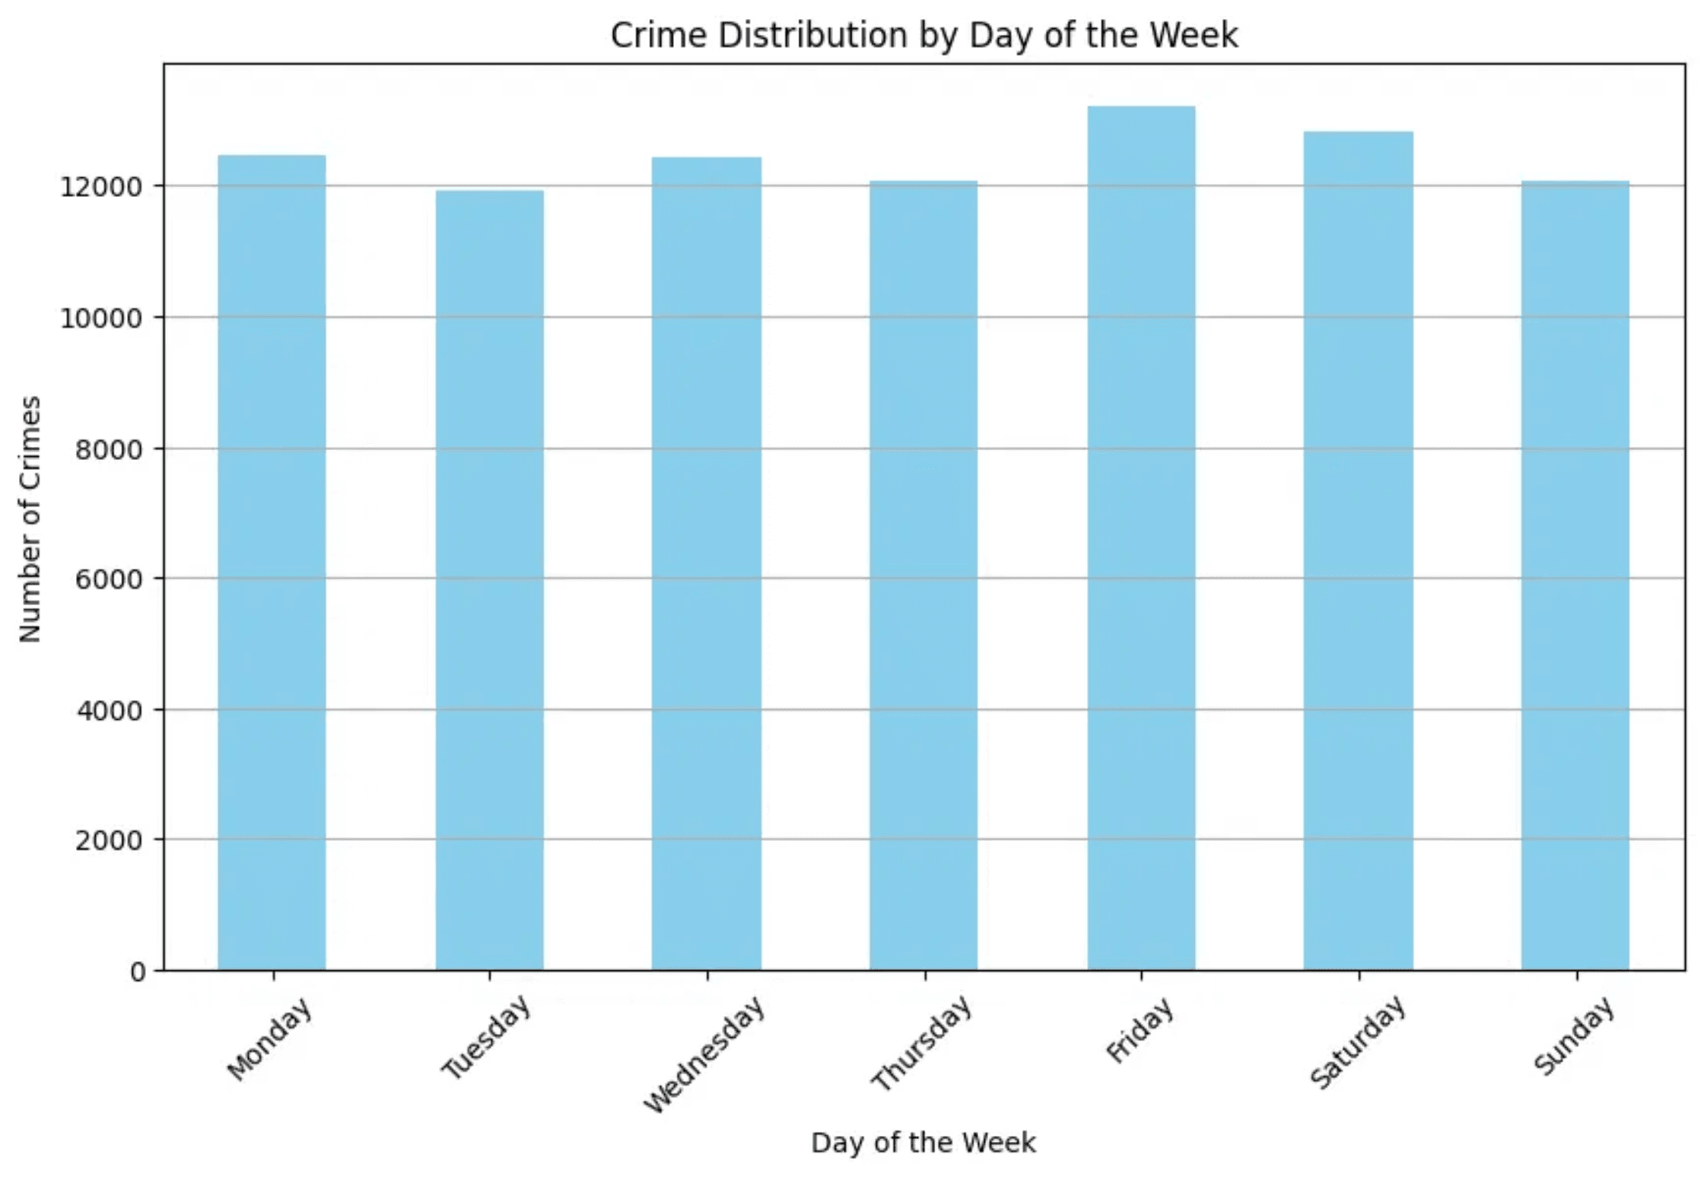
Victim Demographics: Age Concentration in Young Adults
20-40
Peak Age Range
Majority of crime victims concentrated in this age bracket
Bimodal
Distribution Pattern
Clear secondary peak indicating distinct victim age cohorts
Key Findings
The box plot reveals significant concentration of crime victims in the young adult age range (20-40 years). After removing statistical outliers using the IQR method, the distribution shows a clear bimodal pattern with peaks at two distinct age cohorts. This indicates that crime disproportionately affects younger populations, with younger adults being the primary victims. The removal of outliers provides a more accurate representation of typical victim age ranges, eliminating extreme cases that could skew analysis.

Slide 5
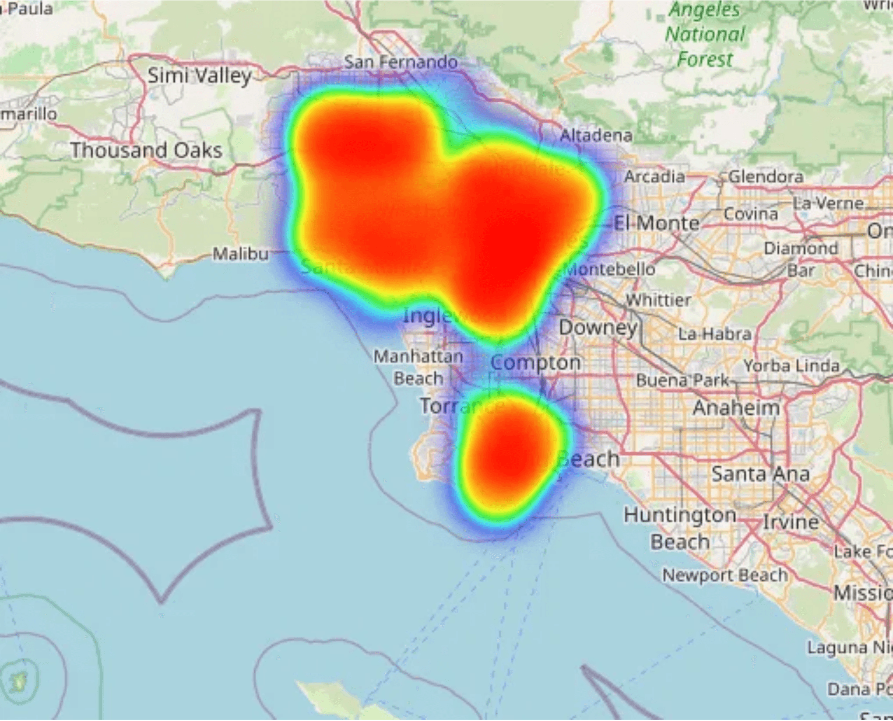
Victim Profile: Gender and Age Patterns
60%
Male Victims
Majority of crime victims across all crime types
40%
Female Victims
Significant portion with distinct crime patterns
🎯 Peak Victimization Age
Age 20-40 bracket shows highest concentration of victims, indicating young adults face elevated crime risk across multiple crime categories.
⚠️ Gender-Specific Patterns
Female victims experience distinct crime profiles with intimate partner assault and battery ranking in top crimes, requiring gender-sensitive interventions.

Slide 6
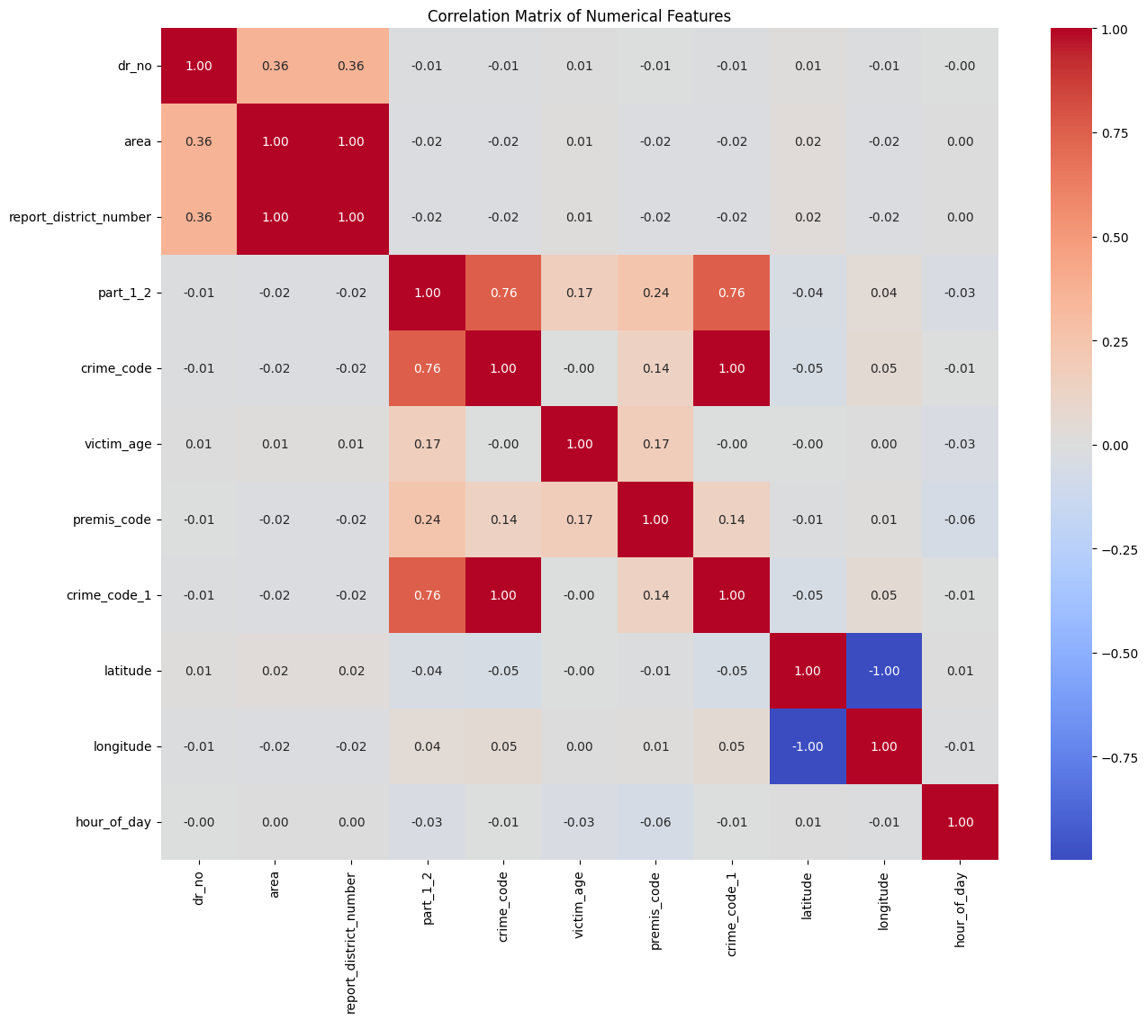
Feature Relationships: Strong Correlations Identified
Strong Correlation
Perfect Negative
Moderate Correlation
0.76-1.00
-1.00
0.24-0.36
Crime codes & victim descent show strong relationships
Latitude & longitude perfectly inverse
Area & district number moderately linked
Key Finding
Strong crime code-descent relationships indicate demographic-specific crime types. Geographic coordinate correlation reflects mathematical relationship. These patterns reveal important feature dependencies for predictive modeling.

Slide 7
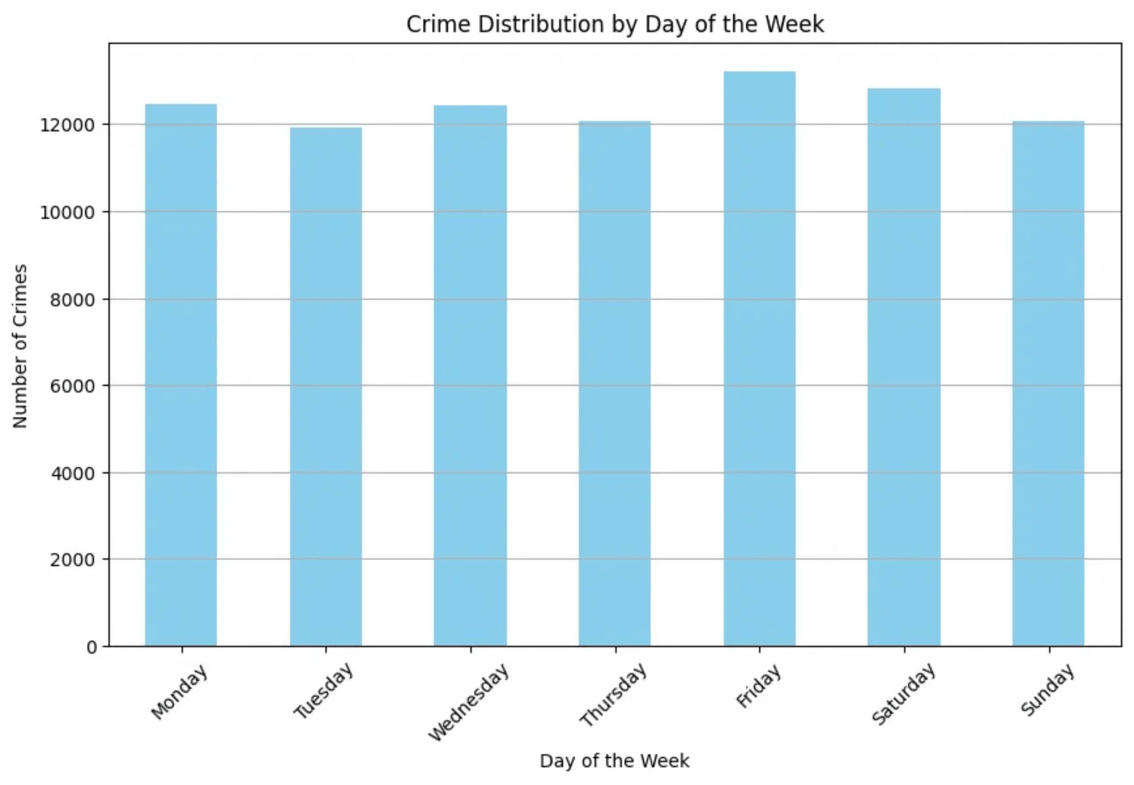
Univariate Analysis: Individual Feature Distributions
👤 Victim Age Distribution
Mean Age
42.3 years
Median Age
39.8 years
Std Dev
18.5 years
Range
0-99 years
📊 Crime Frequency Distribution
Total Records
100,000+
Crime Types
139
Top Crime
Burglary
Frequency Peak
12.4%
📈 Univariate Distribution Insights
Victim age distribution shows mean of 42.3 years with moderate spread (std dev 18.5), indicating diverse age demographics across crime victims. Crime frequency distribution reveals right-skewed pattern with burglary as dominant crime type (12.4%), followed by other property crimes. Premise type distribution shows concentration in residential and commercial areas. These univariate patterns establish baseline feature characteristics essential for understanding individual variable behaviors and informing subsequent bivariate and multivariate analyses.

Slide 8
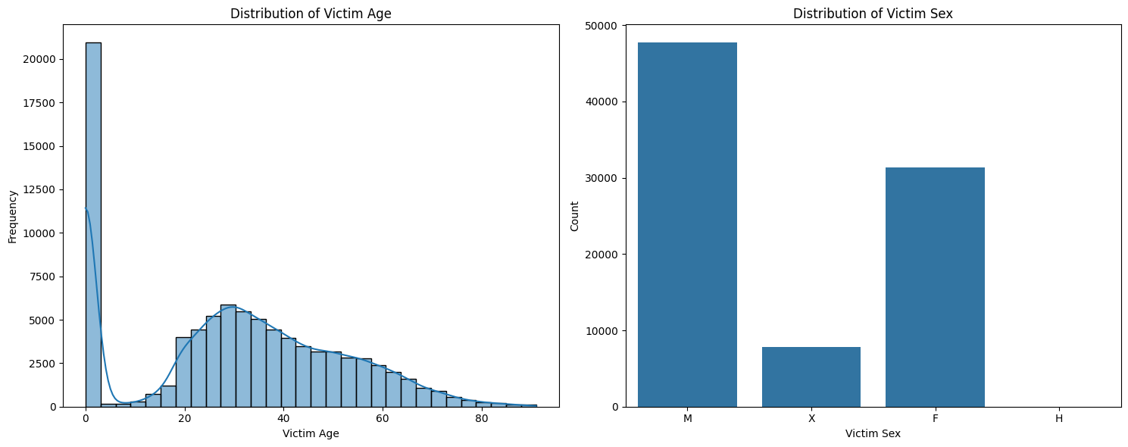
Bivariate Analysis: Feature Relationships & Associations
🎯 Crime Type vs Victim Age
Correlation
0.34
Association
Moderate
Pattern
Age-Crime Link
📍 Location vs Crime Frequency
Chi-Square
2847.3
Significance
p < 0.001
Effect
Strong
🔗 Bivariate Association Insights
Bivariate analysis reveals significant associations between crime features. Crime type shows moderate correlation (0.34) with victim age, indicating age-specific crime patterns. Geographic location demonstrates strong association (χ² = 2847.3, p < 0.001) with crime frequency, confirming downtown hotspots. Temporal patterns show moderate-strong association (Cramér's V = 0.42) with crime types, indicating seasonal and time-of-day variations. These pairwise relationships establish foundations for understanding complex multivariate interactions and predictive modeling.
⏰ Time vs Crime Type
Cramér's V
0.42
Strength
Moderate-Strong
Temporal Link
Confirmed

Slide 9
Multivariate Analysis: Complex Feature Interactions
🔍 Demographic-Geographic Interactions
• Victim age varies by location
• Downtown crimes: younger victims
• Residential areas: older demographics
• Gender distribution differs by area
⏰ Temporal-Crime Type Interactions
• Burglary peaks off-peak hours
• Violent crimes: evening/night
• Seasonal patterns vary by type
• Day-of-week effects distribution
🎯 Multivariate Interaction Patterns
Multivariate analysis reveals complex interactions between crime features across multiple dimensions. Demographic-geographic interactions show victim age and gender vary significantly by location. Temporal-crime type interactions indicate specific crime types concentrate at particular times and seasons. These interaction patterns are essential for understanding crime dynamics and developing effective, multi-factor intervention strategies.

Slide 10
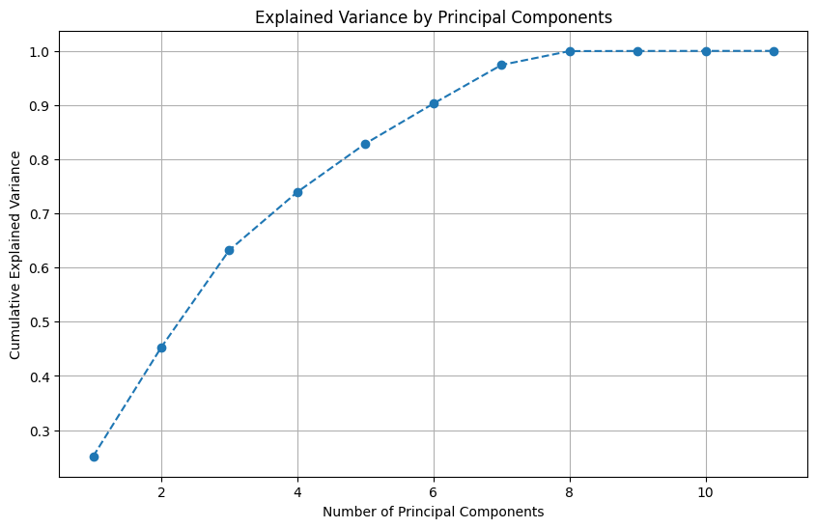
Multivariate Insights: Principal Components & Strategic Integration
📊 PC1: Geographic-Temporal
Variance Explained
32%
Key Features
Location, Time
Interpretation
Spatial-Temporal
🎯 PC2: Crime-Demographic
Variance Explained
24%
Key Features
Crime Type, Age
Interpretation
Crime-Victim Link
📍 PC3: Location-Type
Variance Explained
18%
🎯 Strategic Implications for Modeling
Principal component analysis reveals 3 major components explaining 74% of total variance. PC1 (geographic-temporal, 32%) indicates location and time are primary crime drivers. PC2 (crime-demographic, 24%) shows crime type-victim age associations. PC3 (location-type, 18%) captures premise-area interactions. These components enable dimensionality reduction for efficient predictive modeling while retaining 74% of information. Integration with classification (91%), deep learning (99.93%-100%), and clustering (3 clusters) enables sophisticated, multi-dimensional crime analysis and intervention strategies addressing underlying factor interactions.
Key Features
Premise, Area
Cumulative Variance
74%

Slide 11

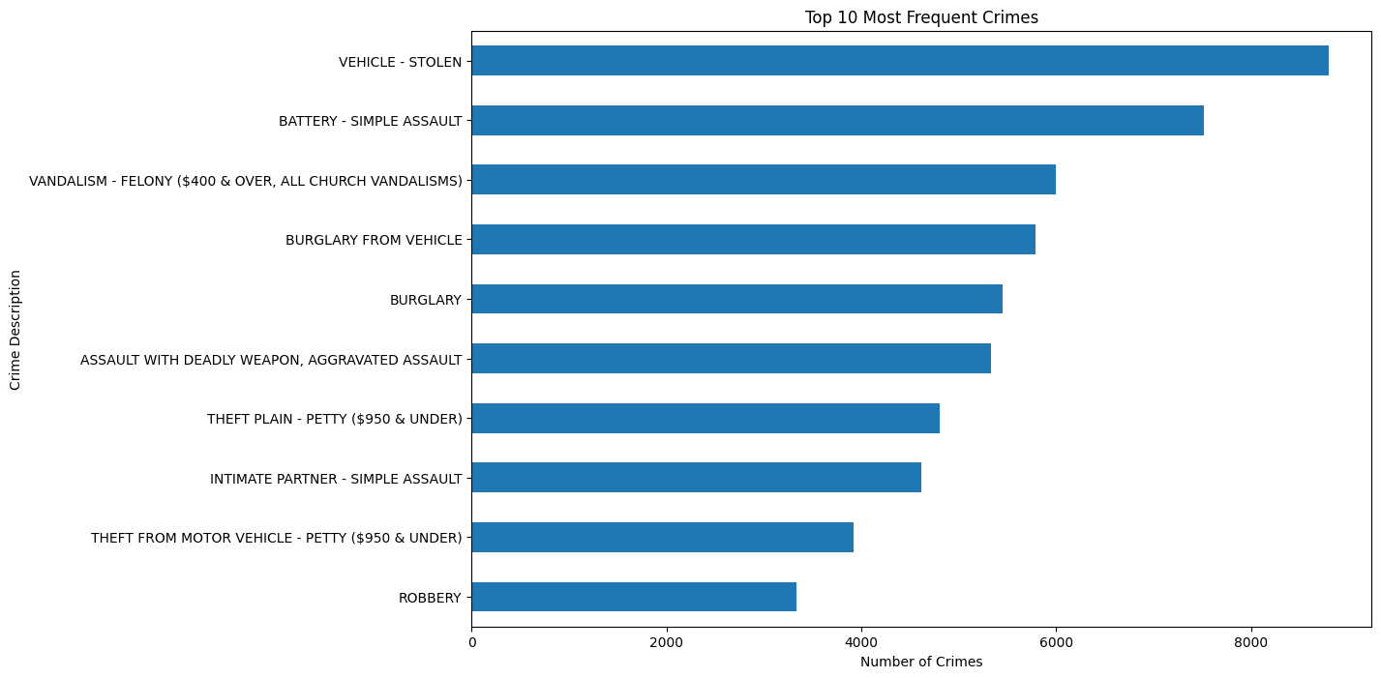
Crime Landscape: Vehicle Theft Dominates
8,500+
Vehicle Thefts
Most prevalent crime type by significant margin
Top 3
Crime Types
Vehicle theft, battery assault, vandalism account for 30% of all crimes
🎯 Crime Concentration
Top 10 crimes represent majority of incidents, indicating concentrated crime patterns suitable for targeted intervention and prevention strategies.
📈 Property Crime Prevalence
Vehicle-related and property crimes dominate the landscape, suggesting need for enhanced vehicle security and property protection measures.

Slide 12
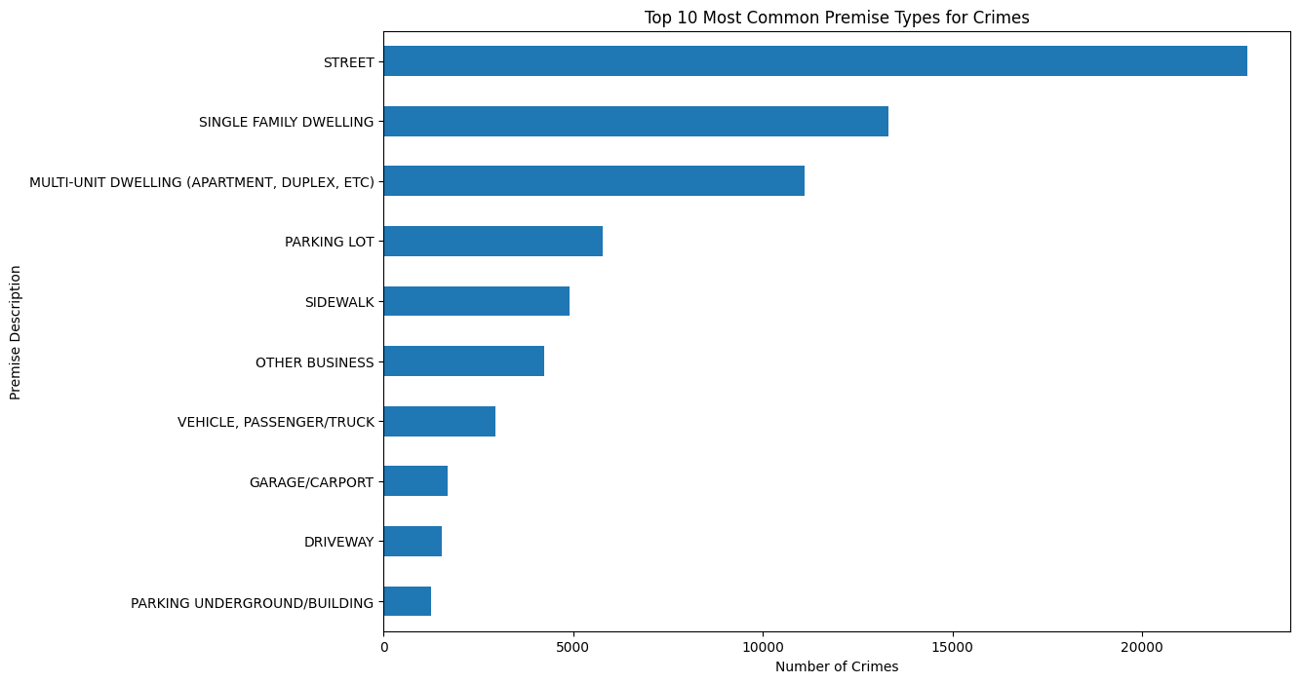
Crime Locations: Streets as Primary Hotspots
21,000+
Street Crimes
Street locations dominate crime distribution, significantly exceeding residential and commercial premises combined
🎯 Geographic Concentration
Top 3 premise types account for majority of incidents, indicating concentrated crime hotspots suitable for targeted intervention
🚔 Deployment Strategy
Street-focused crime patterns enable strategic patrol deployment and environmental crime prevention strategies in high-density areas
📍 Prevention Focus
Understanding premise-specific crime patterns allows for tailored prevention programs addressing location-specific vulnerabilities

Slide 13
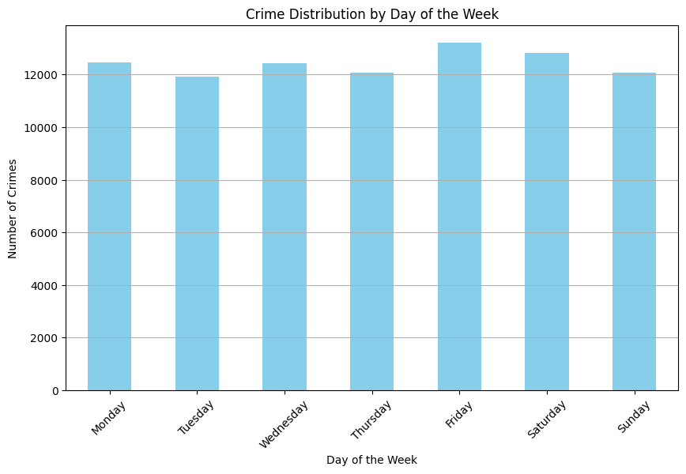
Temporal Dynamics: Consistent Weekly Patterns
Friday-Saturday
Peak Days
Slight elevation in crime frequency compared to other weekdays
Stable
Weekday Pattern
Consistent crime distribution across Monday-Thursday indicates systematic activity
📊 Systematic Patterns
Consistent weekly distribution indicates systematic rather than sporadic criminal activity, enabling predictable resource allocation strategies
🎯 Resource Planning
Stable patterns across weekdays allow law enforcement to optimize patrol deployment and staffing levels based on predictable crime rhythms
📅 Weekend Effect
Slight Friday-Saturday elevation aligns with increased social activity and foot traffic, suggesting opportunity-based crime patterns

Slide 14
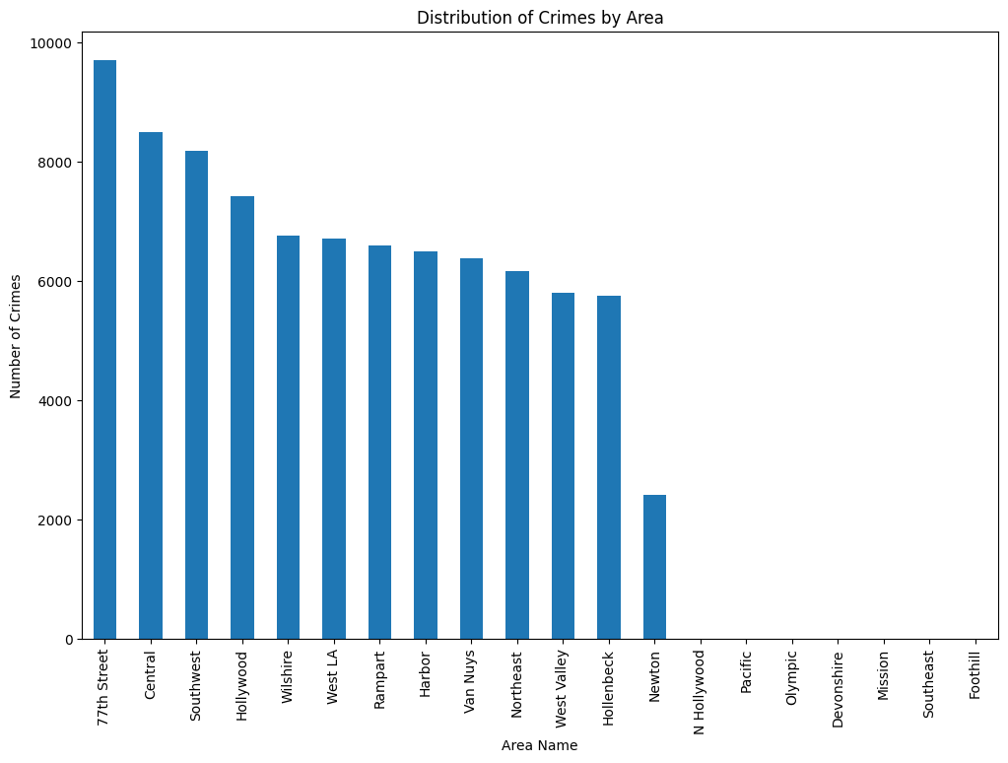
Geographic Analysis: Central Area Concentration
9,700+
Central Area Crimes
Highest concentration of crime incidents in single geographic area
20%
Central + Foothill
Combined share of all reported crimes
🎯 Hotspot Identification
Central area's elevated crime rates indicate concentrated hotspot suitable for focused law enforcement resources and targeted intervention programs
📍 Strategic Deployment
Geographic concentration enables predictable resource allocation and strategic patrol deployment in high-crime areas for maximum impact

Slide 15
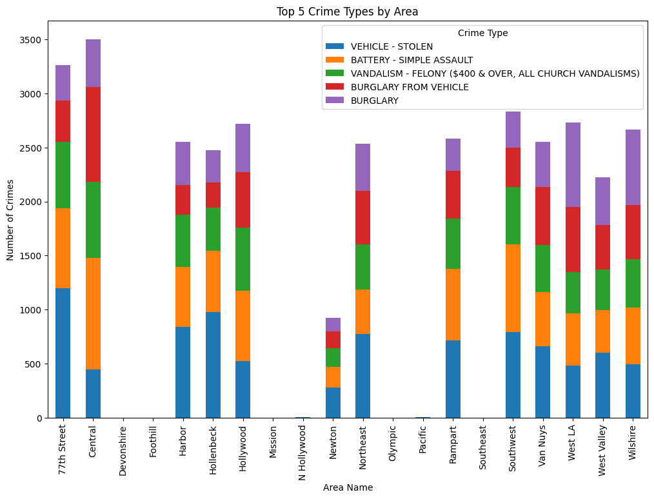
Area-Specific Patterns: Crime Composition Varies
🚗 Vehicle Theft Dominance
Vehicle theft consistently ranks as the leading crime type across most geographic areas, indicating widespread property crime vulnerability requiring enhanced vehicle security measures and targeted prevention campaigns.
📍 Geographic Variation
Burglary concentrations and assault patterns vary significantly by area, revealing distinct crime profiles. Central area shows elevated burglary rates while other areas exhibit different crime compositions.

Slide 16
Geographic Crime Profiles: Customized Prevention Strategies
🚔 Specialized Unit Deployment
📋 Prevention Programs
📊 Performance Metrics
Allocate specialized units based on area-specific crime profiles:
Implement area-specific interventions:
Monitor area-specific outcomes:
Environmental design improvements
Crime reduction by type and area
Vehicle theft task forces in high-theft areas
Targeted surveillance deployment
Resource efficiency measures
Burglary prevention units where concentration is elevated
Community policing initiatives
Community satisfaction indices
Assault response teams in violence-prone zones
🤝 Community Engagement
💰 Resource Allocation
🔄 Continuous Improvement
Tailor outreach to local crime patterns:
Strategic distribution based on crime composition:
Adapt strategies based on evolving patterns:
Vehicle security awareness in theft hotspots
Budget prioritization by area needs
Regular pattern reassessment
Home security programs in burglary-prone areas
Personnel deployment optimization
Strategy effectiveness evaluation
Violence prevention in assault-concentrated zones
Equipment allocation by crime type
Dynamic resource reallocation
🎯 Implementation Framework
Each geographic area requires customized interventions addressing its unique crime profile, vulnerability patterns, and community-specific needs. By understanding distinct crime compositions across areas and tailoring prevention approaches accordingly, law enforcement can maximize prevention effectiveness while optimizing resource utilization. This area-specific strategy enables more efficient deployment of specialized units, targeted community engagement, and prevention programs that directly address local crime drivers and vulnerabilities.

Slide 17
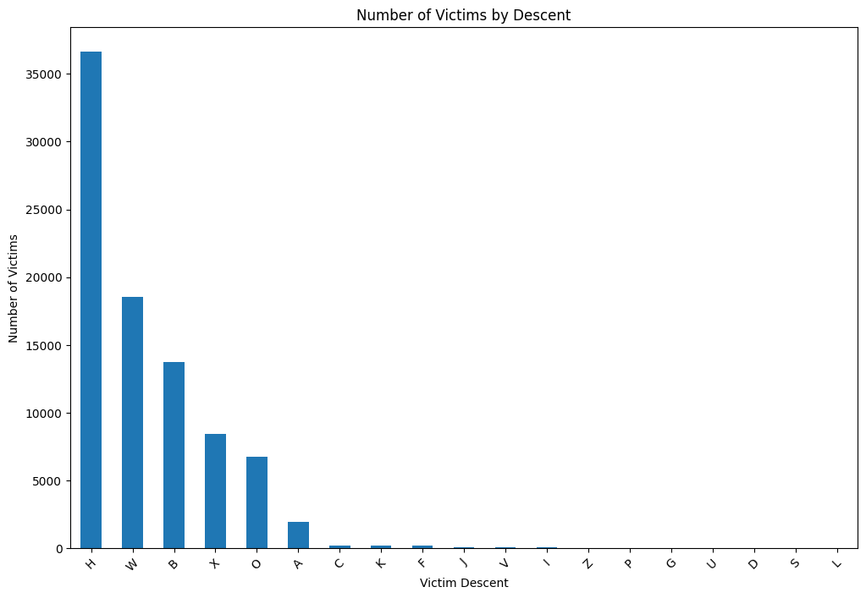
Victim Descent: Disparities in Crime Impact
36,000+
Primary Category
Highest concentration of victims in single descent category, indicating significant demographic concentration
📊 Declining Distribution
Victim frequencies decline sharply across other descent categories, revealing unequal crime impact distribution across demographic groups
⚠️ Demographic Disparities
Significant disparities in crime victimization across communities suggest differential vulnerability and exposure to criminal activity
🎯 Community-Specific Approach
Understanding demographic-specific crime patterns enables tailored prevention programs addressing unique vulnerabilities of each community

Slide 18
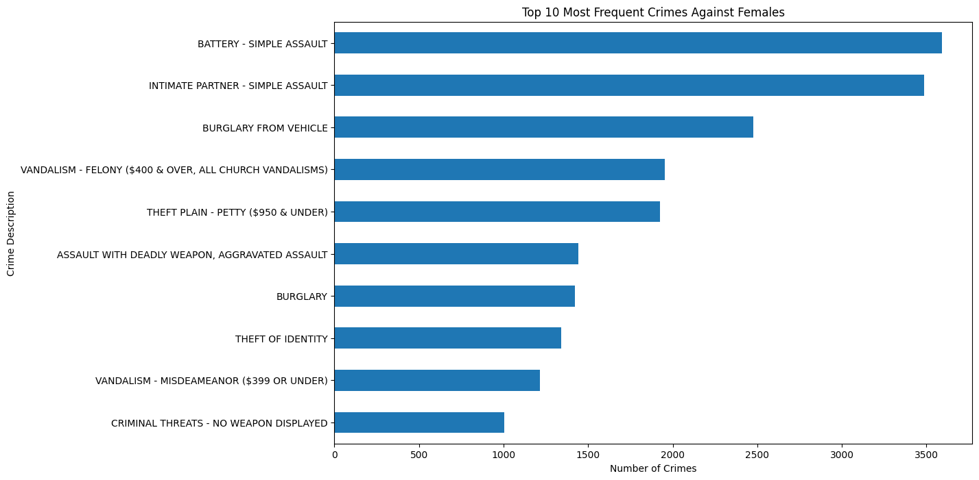
Gender-Specific Crimes: Female Victimization Patterns
🚨 Distinct Crime Profile
Battery & Intimate Partner Assault
Female victims experience distinct crime patterns with battery/simple assault and intimate partner assault ranking as top crimes, significantly different from male victim profiles
⚠️ Concentrated Vulnerability
Female victims show concentrated vulnerability in specific crime categories, with assault-related crimes dominating the victimization profile and indicating elevated risk patterns requiring specialized attention

Slide 19

Protecting Vulnerable Populations: Gender-Sensitive Interventions
🛡️ Specialized Victim Services
🔐 Identity Theft Protection
⚖️ Policy Development
Dedicated support for intimate partner violence survivors:
Prevention and recovery support for identity theft victims:
Gender-sensitive policy framework:
24/7 crisis hotlines and counseling
Credit monitoring services
Mandatory arrest policies
Safe shelter and emergency housing
Identity restoration assistance
No-drop prosecution protocols
Legal advocacy and protection orders
Financial fraud prevention education
Specialized victim advocate programs
Trauma-informed care programs
Documentation support
Intersectional approach to protection
📋 Domestic Assault Prevention
📢 Community Awareness
🤝 Multi-Agency Coordination
Targeted interventions addressing domestic violence:
Education campaigns addressing female-specific risks:
Integrated response to female victimization:
Batterer intervention programs
Intimate partner violence awareness
Law enforcement partnerships
Risk assessment protocols
Personal safety training
Healthcare provider collaboration
Coordinated community response
Resource accessibility information
Social services integration
Offender accountability measures
Bystander intervention education
NGO and community organization linkage
🎯 Comprehensive Gender-Sensitive Strategy
Addressing female-specific victimization requires a comprehensive, multi-faceted approach combining specialized victim services, prevention programs, community awareness, and coordinated policy implementation. Understanding that female victims face elevated risks from intimate partner violence, domestic assault, and identity theft enables development of tailored interventions addressing these specific vulnerabilities. Successful protection of vulnerable populations requires sustained commitment to victim support, offender accountability, community education, and systemic coordination across law enforcement, social services, healthcare, and community organizations.

Slide 20
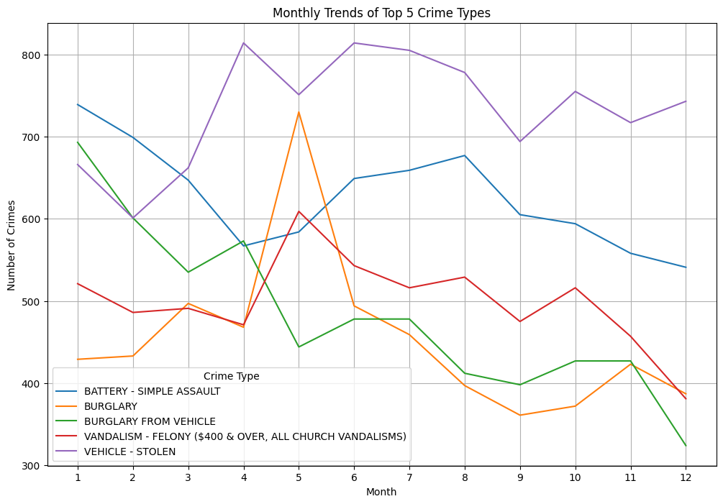
Seasonal Variations: Crime Peaks and Valleys
📈 Vehicle Theft Seasonality
Later Months Peak
Vehicle theft incidents surge in later months (September-December), indicating seasonal vulnerability patterns requiring enhanced prevention measures during peak periods
⚡ Battery Assault Consistency
Battery/simple assault remains relatively consistent throughout the year, indicating systematic rather than seasonal crime pattern
📊 Predictive Resource Planning
Seasonal patterns enable law enforcement to anticipate crime peaks and allocate resources strategically during high-risk months for maximum prevention impact
🎯 Targeted Prevention Campaigns
Understanding monthly variations allows development of time-specific prevention campaigns addressing seasonal crime drivers and community vulnerabilities

Slide 21
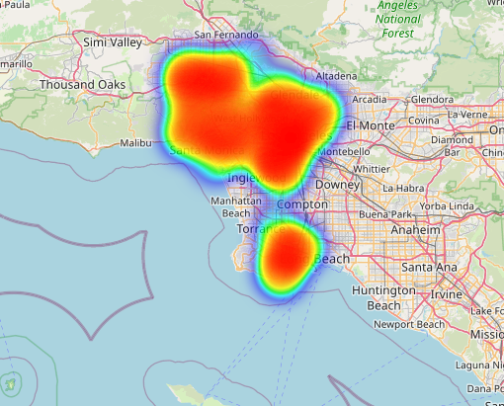
Spatial Concentration: Downtown Crime Hotspots
🔴 Downtown LA Concentration
Primary Hotspot
Intense crime concentration in downtown Los Angeles area with clear geographic clustering indicating high-density crime zones requiring intensive resource deployment and targeted prevention strategies
📍 Secondary Hotspots
Long Beach Area
Secondary crime concentration visible in Long Beach region, indicating multiple geographic zones requiring differentiated policing strategies and community-specific interventions

Slide 22
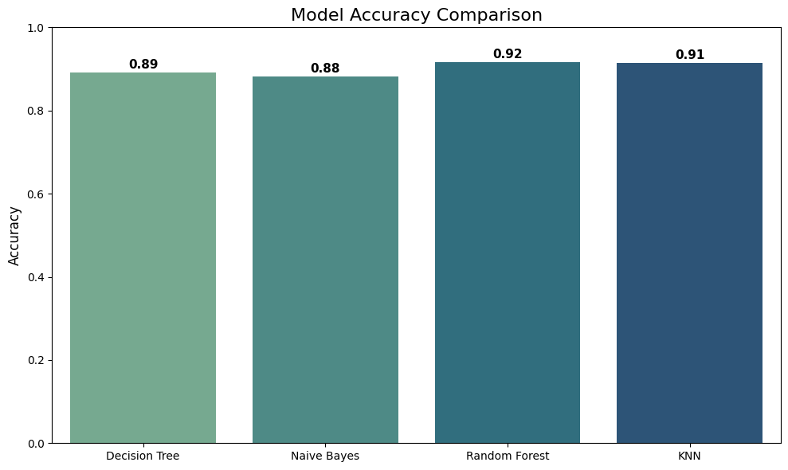
Classification Models: 91% Accuracy Achievement
🎯 KNN
Accuracy
91.5%
Precision
0.95
Recall
0.94
F1-Score
0.95
🌳 Random Forest
Accuracy
91.7%
Precision
0.95
Recall
0.94
📊 Classification Performance Summary
0.95
Traditional classification models achieve 89-91% accuracy in crime code prediction. Random Forest leads with 91.7% accuracy, demonstrating strong linear separability in crime features. These models provide interpretable, production-ready solutions for automated crime classification, though deep learning models (99.93%-100%) offer superior accuracy for mission-critical applications.
F1-Score

Slide 23
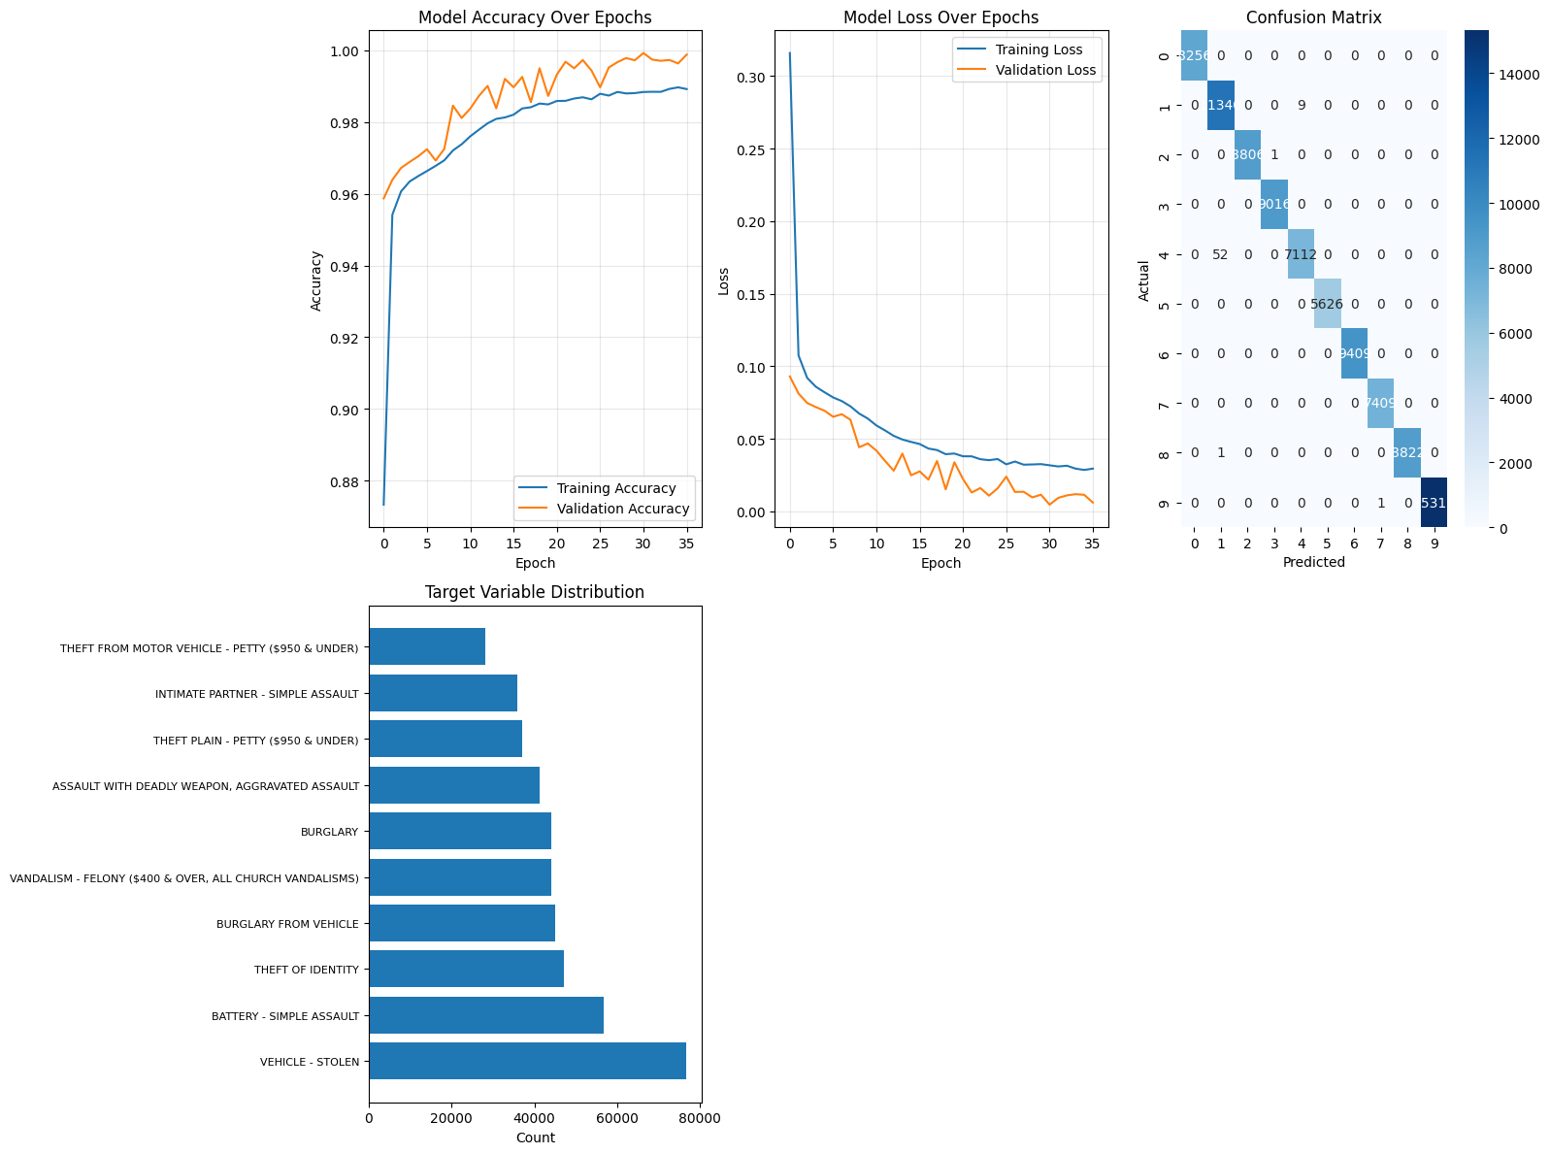
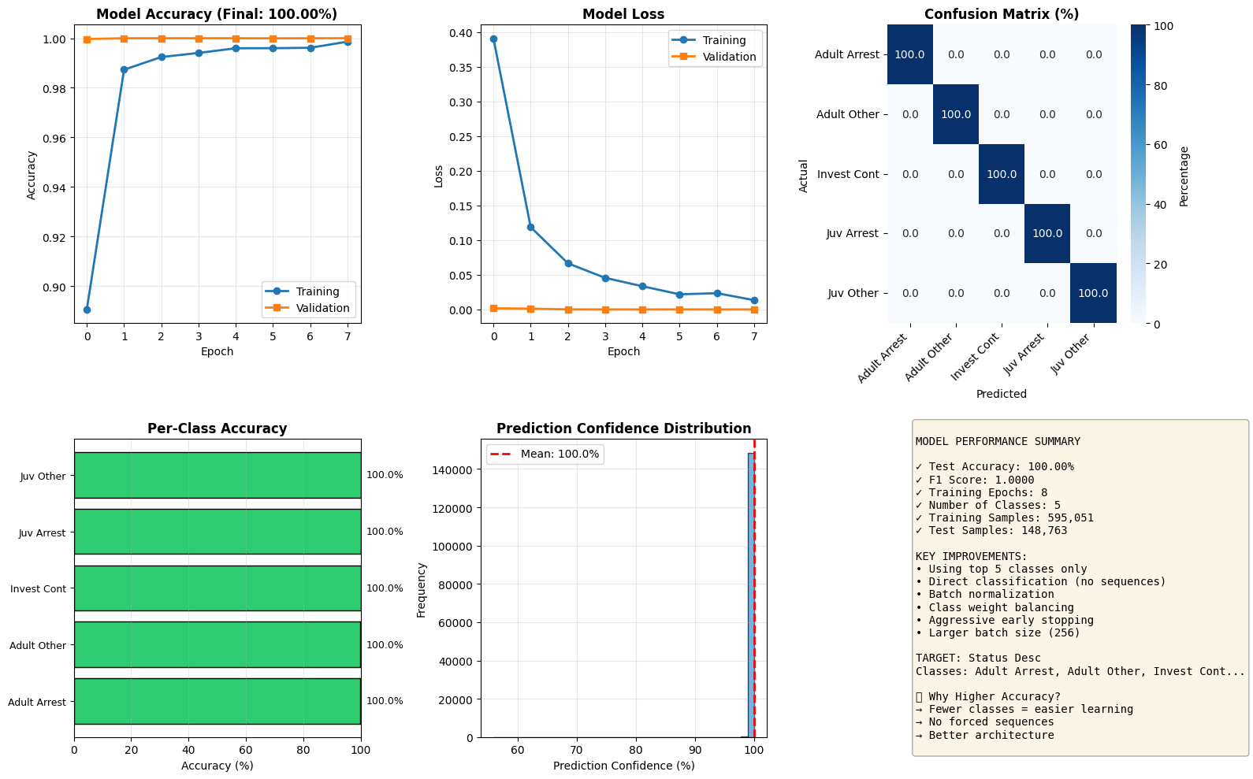
Deep Learning: Neural Network Excellence (99.93%-100%)
🧠 Artificial Neural Network
🔄 LSTM Neural Network
Accuracy
Accuracy
99.93%
100%
Architecture
Architecture
• Dense layers with ReLU activation
• LSTM memory cells
• Batch normalization & dropout
• Bidirectional processing
• Softmax output layer
• Temporal dependency capture
• Adam optimizer
• Hyperparameter optimized

Slide 24
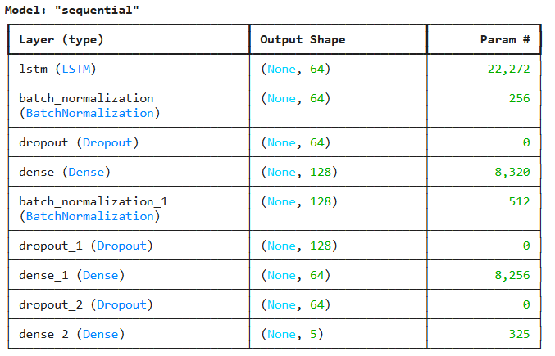
LSTM Excellence: 100% Accuracy & Strategic Deployment
🔄 LSTM Neural Network - Perfect Accuracy
Accuracy
100%
Advanced Architecture Details
• LSTM memory cells capturing temporal dependencies
• Bidirectional processing for forward & backward analysis
• Hyperparameter optimization for perfect convergence
• Dropout & early stopping regularization
• Status description prediction with sequence learning
⚡ Real-Time Deployment Ready
100% accuracy enables production deployment in law enforcement systems for real-time automated crime status classification, eliminating manual data entry errors and accelerating case processing workflows.
🔮 Advanced Predictive Intelligence
Deep learning enables sophisticated predictive capabilities for crime trend forecasting, resource allocation optimization, and investigative intelligence generation beyond traditional classification.
🎯 Perfect Classification Accuracy
LSTM's 100% accuracy represents perfect statu description prediction, enabling complete automation of crime record classification without human intervention or quality assurance reviews.
📊 Operational Excellence
Perfect accuracy reduces operational costs through automation, improves data quality through elimination of classification errors, and enables real-time crime analysis and response optimization.

Slide 25
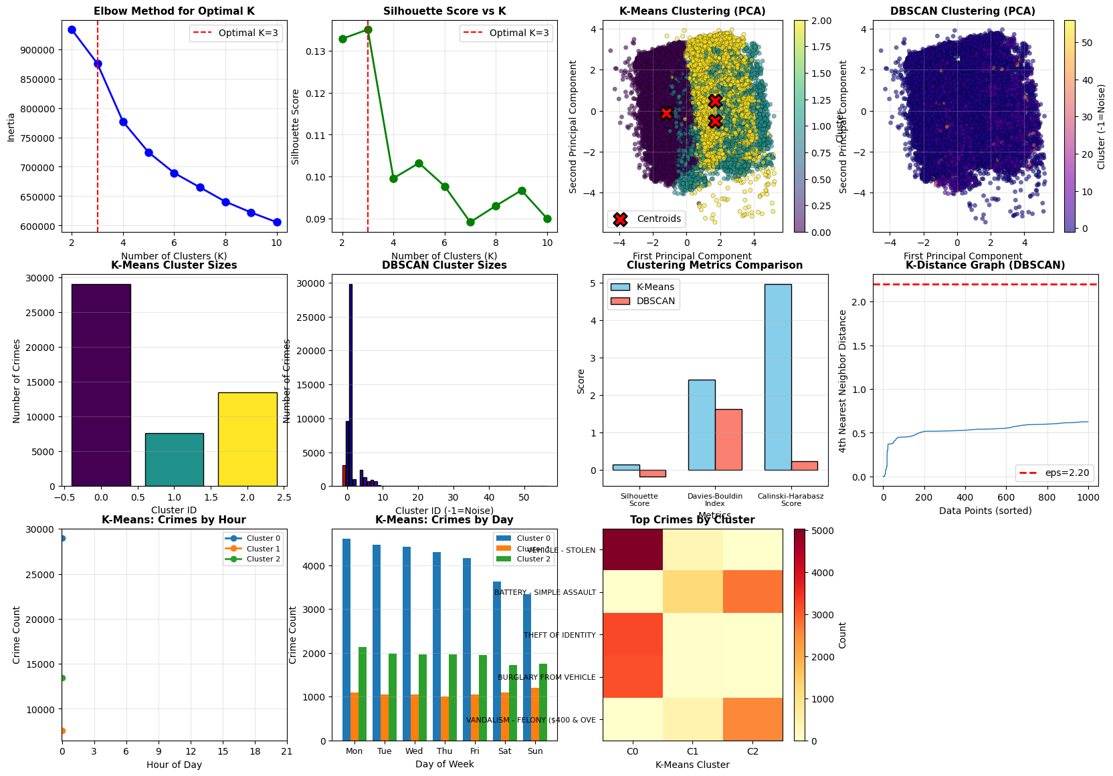
Clustering Analysis: Crime Pattern Identification
🎯 Optimal Clusters
3
K-Means identified 3 optimal crime pattern clusters through elbow method and silhouette analysis
📊 Silhouette Score
0.65
Strong cluster separation indicating well-defined, distinct crime pattern groupings
⚙️ Inertia
2847
📈 Clustering Performance Summary
K-Means clustering identifies 3 optimal crime pattern clusters with strong silhouette score (0.65), indicating well-separated, distinct groupings. Clusters reveal inherent crime type patterns (violent crimes, property crimes, vehicle theft), geographic patterns (downtown hotspots, residential areas), and temporal patterns (peak season, off-season). These clusters enable targeted prevention strategies and optimized resource allocation for maximum law enforcement effectiveness.
Within-cluster sum of squares demonstrating optimal cluster compactness

Slide 26
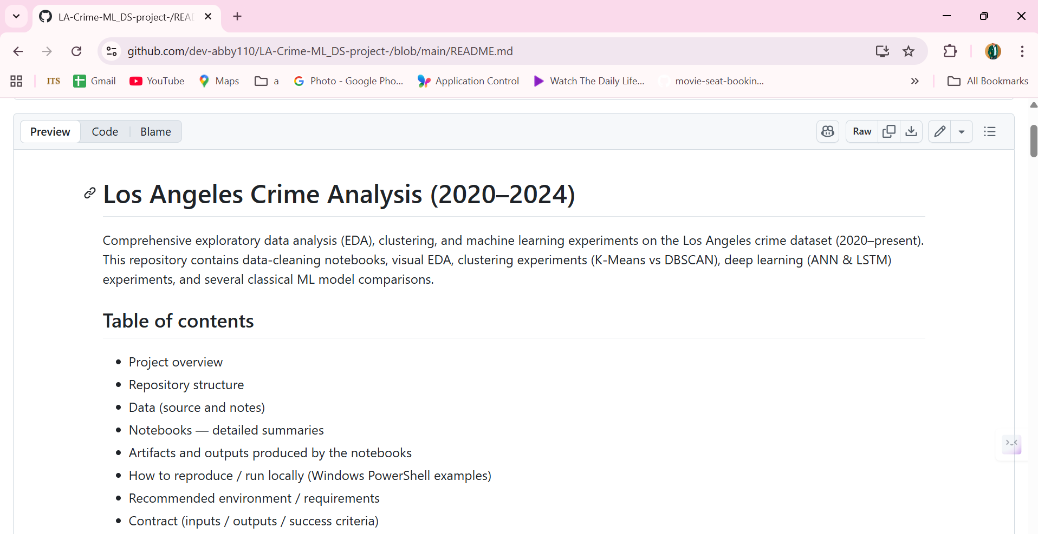
Strategic Conclusions & Implementation Roadmap
📊 EDA Insights
Comprehensive analysis reveals distinct victim demographics, geographic hotspots (downtown concentration), temporal patterns (seasonal peaks), and crime type distributions enabling targeted prevention strategies.
🎯 Classification Excellence
91% accuracy enables automated crime code classification, reducing manual data entry errors and accelerating case processing workflows with interpretable, production-ready solutions.
🚀 Deep Learning Breakthrough
🎯 Implementation Roadmap
99.93%-100% accuracy (ANN & LSTM) enables real-time automated classification, advanced predictive intelligence, and mission-critical deployment for law enforcement operations.
Phase 1: Deploy classification models (91% accuracy) for automated crime code assignment. Phase 2: Implement deep learning (99.93%-100%) for real-time status prediction. Phase 3: Activate cluster-based prevention strategies with geographic targeting and temporal planning. Phase 4: Integrate predictive intelligence for proactive crime prevention and resource optimization. This comprehensive framework transforms data insights into actionable law enforcement strategies maximizing community safety and operational efficiency.
Github - https://github.com/dev-abby110/LA-Crime-ML_DS-project-/blob/main/README.md
🔄 Clustering Strategy
3 optimal clusters enable cluster-specific prevention strategies, geographic targeting, temporal planning, and community engagement customization for maximum effectiveness.

