Slide 1
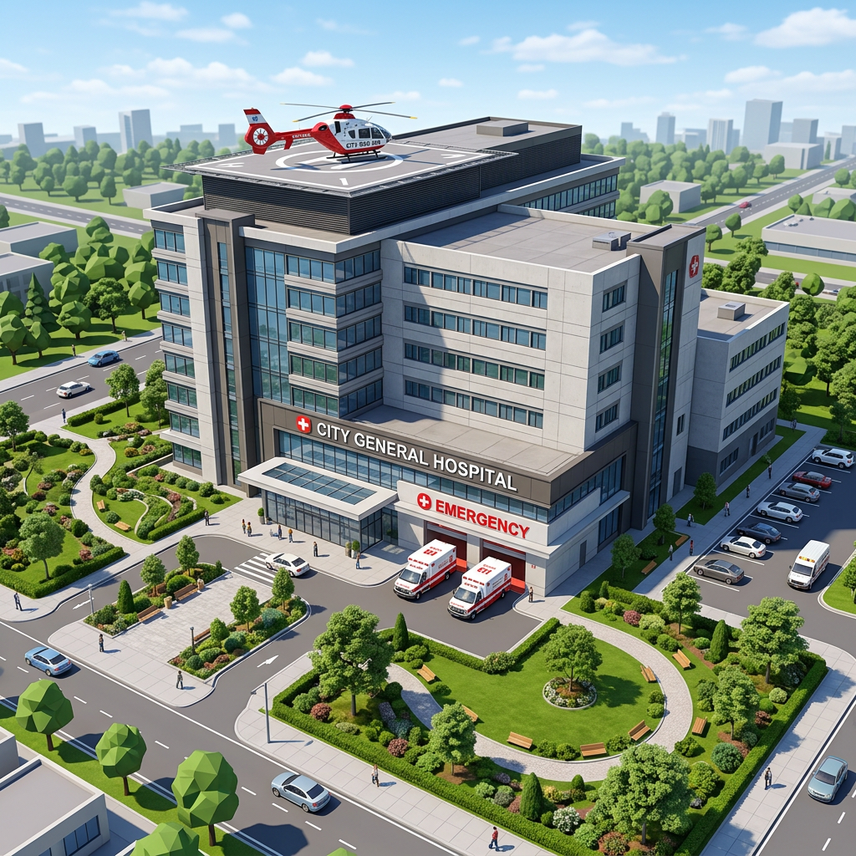
Our Town
Healthcare System Project

Slide 2
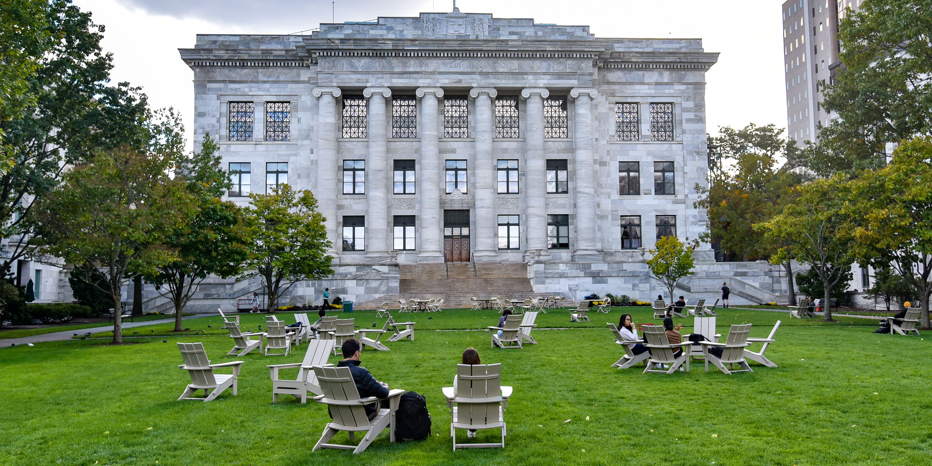
OUR TOWN: Healthcare System Project
Design a realistic digital town around a medical university.
Meet residents’ healthcare and everyday needs.
Stay within the $10,000,000 budget.

Slide 3

Your Mission
Work in groups of 2; no more than 3 people.
Create and present a digital town.
The entire project must be completed in Canva or Google Slides.
Your design, buildings, budget, explanations, and references must be included.

Slide 4
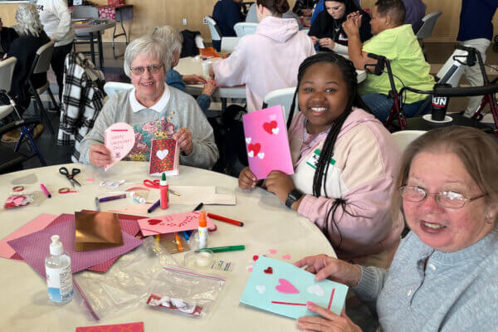
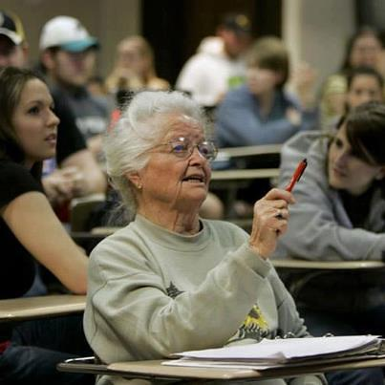

Who Lives in Your Town?
50% college students
30% middle-aged adults with families
20% adults over age 65
Your healthcare and community choices should fit these residents.

Slide 5
Required Parts of the Town
Original town name
1 University Medical School — required and free
1 Housing Development — required and free
At least 7 different healthcare facilities
At least 3 other community locations
A unique name for every building/location
A realistic layout with roads and logical placement

Slide 6
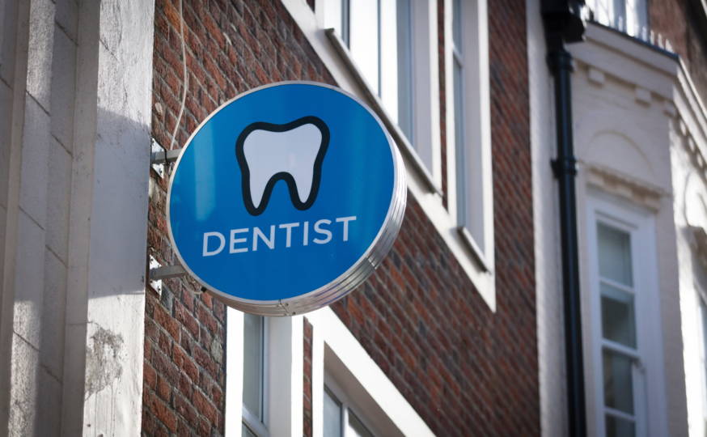
Every Building Needs a Name
Do not use only generic labels such as Hospital, Dental Office, or Restaurant.
Use realistic names such as Riverstone General Hospital, Bright Smile Dental, or Town Square Café.
Every healthcare facility, business, school, park, and other location should have a specific name.

Slide 7
Digital Town Layout
Build the town directly in Canva or Google Slides.
Use shapes, icons, pictures, text boxes, roads, and labels.
Show where major buildings and services are located.
Use more than one layout slide if needed.
Do not simply paste a list of buildings onto a slide.

Slide 8
Presentation Requirements
At least 10 CONTENT slides
Title/intro slide does not count toward the 10-slide minimum.
Reference slide does not count toward the 10-slide minimum.
Slides should be neat, readable, and visually appealing.
Use key points instead of large paragraphs. NO Large paragraphs!
Every group member must contribute and participate.

Slide 9


Suggested Slide Topics
Title/Intro
Town Overview
Population & Demographics
Healthcare Facilities
Why These Facilities Are Needed
Digital Town Layout
Location & Placement Explanation
Community Locations
Budget
Decision-Making
Conclusion
References

Slide 10
Healthcare Facility Pricing — Part 1
General Hospital — $1,500,000
Specialty Hospital — $1,250,000
Government Hospital — $750,000
University Medical Center — $2,000,000
Skilled Nursing & Rehab LTCF — $1,000,000
Assisted Living & Memory Care LTCF — $750,000
Hospice — $500,000
Mental Health Facility — $500,000
Medical Office (specify kind) — $400,000
Dental Office — $300,000

Slide 11
Healthcare Facility Pricing — Part 2
Clinics — $200,000
Optical Centers — $300,000
Emergency Care Services — $400,000
Laboratories — $100,000
Home Health Care — $300,000
Genetic Counseling Center — $150,000
Rehabilitation Centers — $750,000
Industrial Health Care Center — $550,000
School Health Service — $450,000
Health Department — $250,000
Non-Profit Agency (specify kind) — $100,000

Slide 12
Community Location Pricing
Fast Food Restaurant (specify kind) — $100,000
Restaurant (specify kind) — $250,000
Wal-Mart/Target — $500,000
Mall — $1,000,000
Other Retail Store (specify kind) — $500,000
Coffee Shop — $100,000
Grocery Store — $100,000
Post Office — $150,000
Park/Playground — $200,000
School System — $300,000
Museum — $500,000

Slide 13
Budget Rules
Starting amount: $10,000,000
University Medical School is required and free.
Housing Development is required and free.
List each purchased item and its cost.
Show the total amount spent.
Show the money remaining.
Your total spending cannot exceed $10,000,000.

Slide 14
Think About Placement
Consider access, emergency response, traffic, and neighborhoods.
Decide which services should be near one another.
Think about what college students, families, and adults over 65 need.
Be prepared to explain WHY each major facility was placed in that area of town.

Slide 15
Final Checklist
Original town name
Every building/location has a specific name
University Medical School and Housing Development included
At least 7 healthcare facilities
At least 3 community locations
Roads and buildings clearly shown
Locations logically placed
Budget is $10,000,000 or less
At least 10 content slides plus title and references
Choices and placement explained
All group members participated

Slide 16
Your Goal
Create a town that is realistic, organized, within budget, and designed around the needs of its residents.
Make your choices make sense — and be ready to explain why.
You will present this project

