Slide 1

HAVENBROOK
A COMMUNITY PLANNED AROUND CARE
Our Town Healthcare System Project
[ GROUP MEMBERS — ADD NAMES ] · [ CLASS / PERIOD ]

Slide 2
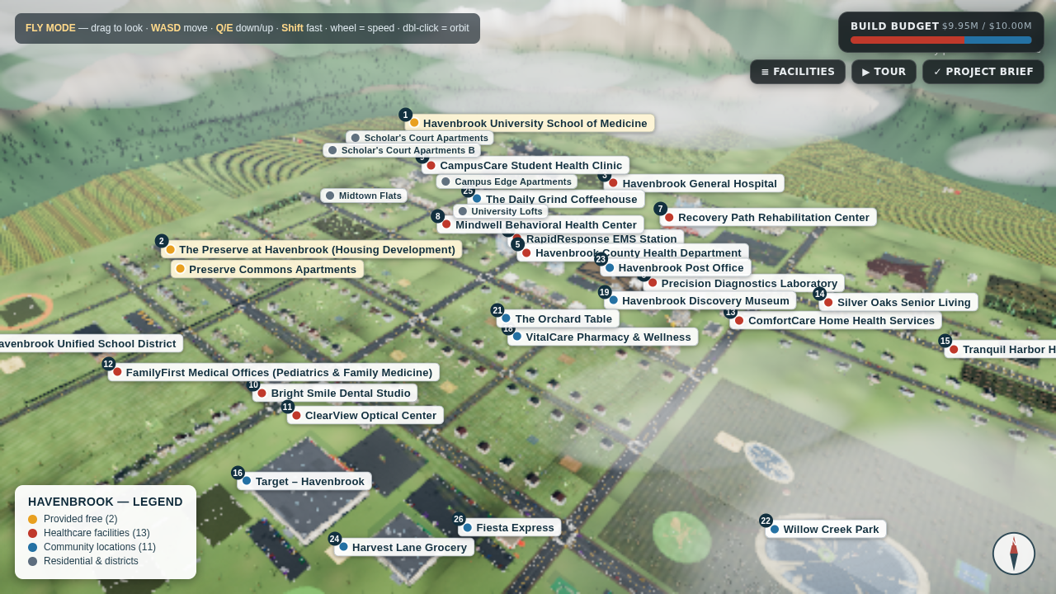
CONTENT 1 OF 14
Town Overview
HAVENBROOK
▪ Havenbrook is a growing town designed around a medical university — every district is planned so care is never more than a few minutes away.
▪ The town is zoned into six districts: University (NW), Medical (N), Senior (E), Downtown (center), Residential (W), and Commercial (S) — each built around the people who use it most.
▪ 13 healthcare facilities and 11 community locations are placed on a legible street grid: four arterials carry the load while residential streets stay quiet.
▪ Every one of the 27 sites has a unique name — from Havenbrook General Hospital to The Daily Grind Coffeehouse.
▪ Total build cost: $9,950,000 of $10,000,000 — the entire town is fully explorable in 3D, day or night.
Aerial view of Havenbrook — numbered facilities, named streets

Slide 3
CONTENT 2 OF 14
Population & Demographics
HAVENBROOK
50%
Havenbrook University School of Medicine anchors the NW quadrant. Students get CampusCare Clinic, Mindwell Behavioral Health, The Daily Grind, Fiesta Express and the mall — all on foot.
COLLEGE STUDENTS
30%
The Preserve housing development sits between the K-12 school and Willow Creek Park. FamilyFirst pediatrics, grocery and dental line their daily routes.
ADULTS WITH FAMILIES
20%
Silver Oaks Senior Living and Tranquil Harbor Hospice form a quiet east-side senior district beside the park — with ComfortCare home health on call.
ADULTS OVER 65

Slide 4
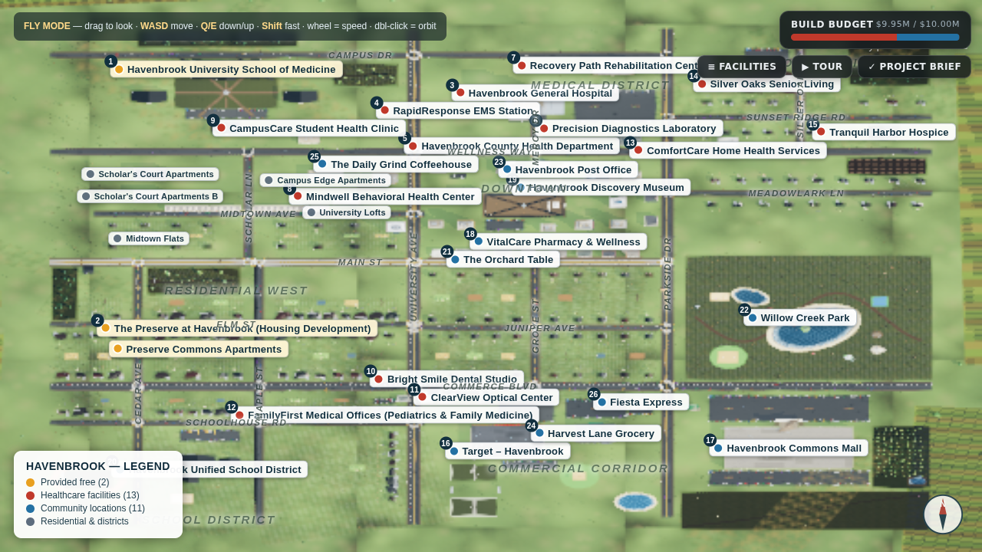
CONTENT 3 OF 14
Digital Town Layout
HAVENBROOK
Flat map of Havenbrook — every facility numbered and named, all 18 streets labeled, district names shown. Numbers match the budget sheet.

Slide 5
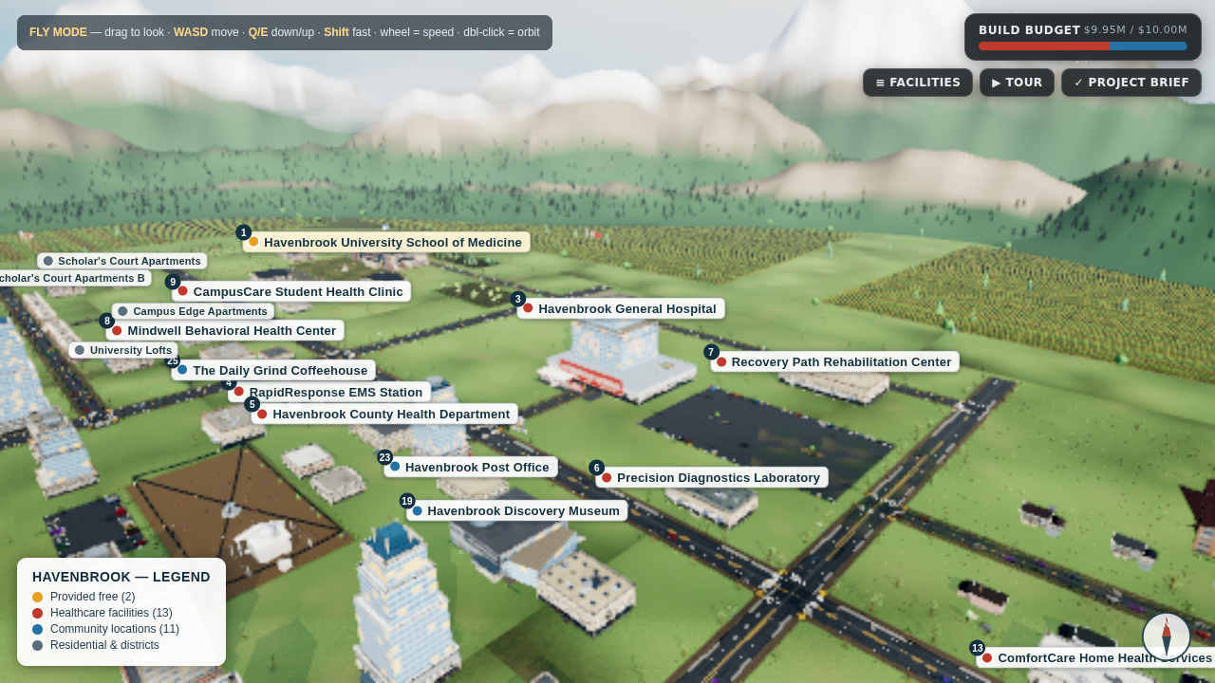
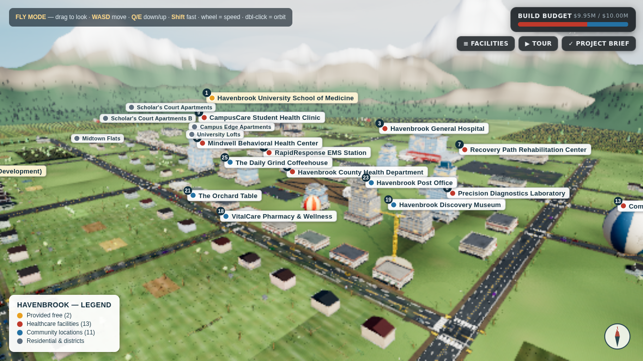
CONTENT 4 OF 14
Layout — Medical Core & Downtown
HAVENBROOK
Medical District (N): General Hospital (#3), Rehab (#7), Lab (#6) and EMS (#4) cluster on Wellness Way — the care spine.
Downtown & University (center/NW): medical school (#1) on Campus Dr; civic row, museum (#19) and post office (#23) on Wellness Way.

Slide 6
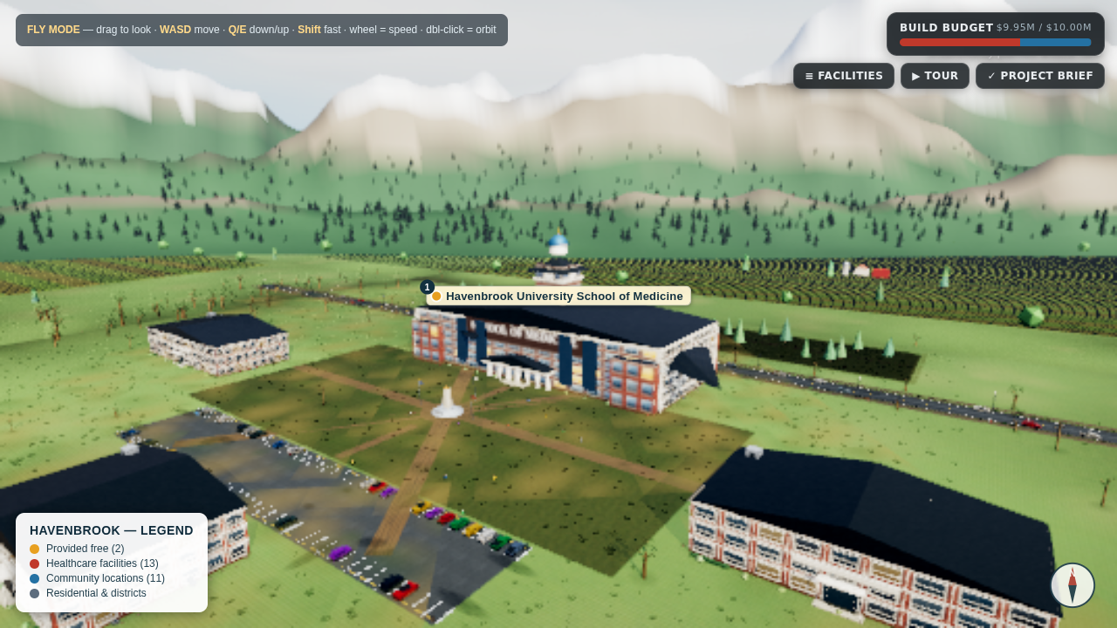
CONTENT 5 OF 14
The Medical College — FREE (Required)
HAVENBROOK
▪ Havenbrook University School of Medicine — site #1 on the map.
▪ The town’s signature landmark: a 124 m × 52 m main hall with a domed clock tower, 7-column entry colonnade and twin end pavilions.
▪ Full campus quad — obelisk monument, flag court and paths linking the Medical Library, Anatomy & Research Hall and Clinical Sciences Hall.
▪ Cost: FREE — required by the project; does not count against the $10M budget.
▪ Everything else in town is planned around it — the town literally grows south and east from the campus.

Slide 7
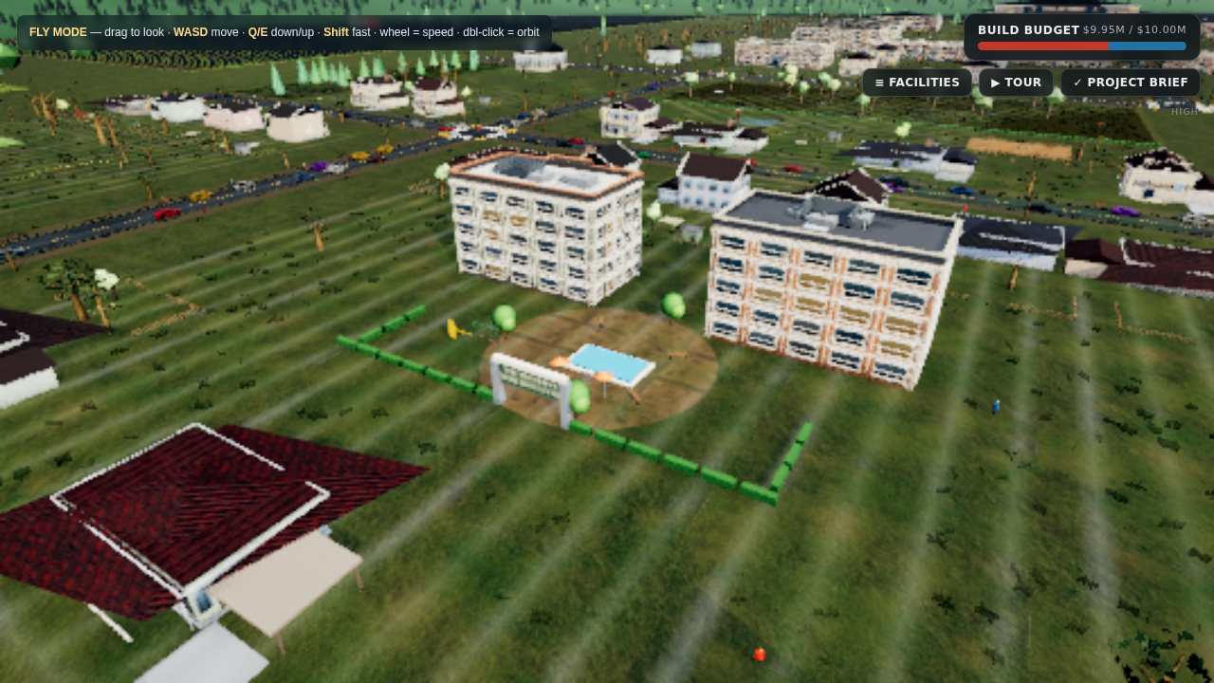
CONTENT 6 OF 14
The Housing District — FREE (Required)
HAVENBROOK
▪ The Preserve at Havenbrook — site #2 on the map, filling Residential West.
▪ Preserve Commons Apartments — twin 5-storey landmark blocks around a paved resident courtyard, the district’s anchor.
▪ Cottage rows, duplexes and townhouses spread the population mix through the district — student apartments nearest campus, family homes by the school, senior cottages by the park.
▪ Cost: FREE — required housing development; does not count against the $10M budget.
▪ 5-minute walk to the school district and Willow Creek Park — housing was placed around daily life, not leftover land.

Slide 8
CONTENT 7 OF 14
Healthcare Facilities (1 of 2)
HAVENBROOK
# | FACILITY NAME | TYPE (price-sheet category) | COST
3 | Havenbrook General Hospital | General Hospital | $1,500,000
4 | RapidResponse EMS Station | Emergency Care Services | $400,000
5 | Havenbrook County Health Department | Health Department | $250,000
6 | Precision Diagnostics Laboratory | Laboratory | $100,000
7 | Recovery Path Rehabilitation Center | Rehabilitation Center | $750,000
8 | Mindwell Behavioral Health Center | Mental Health Facility | $500,000
9 | CampusCare Student Health Clinic | Clinic | $200,000

Slide 9
CONTENT 8 OF 14
Healthcare Facilities (2 of 2)
HAVENBROOK
# | FACILITY NAME | TYPE (price-sheet category) | COST
10 | Bright Smile Dental Studio | Dental Office | $300,000
11 | ClearView Optical Center | Optical Center | $300,000
12 | FamilyFirst Medical Offices | Medical Office — Pediatrics & Family Medicine | $400,000
13 | ComfortCare Home Health Services | Home Health Care | $300,000
14 | Silver Oaks Senior Living | Assisted Living & Memory Care LTCF | $750,000
15 | Tranquil Harbor Hospice | Hospice | $500,000
13 healthcare facilities — far beyond the 7 required — subtotal $6,250,000

Slide 10
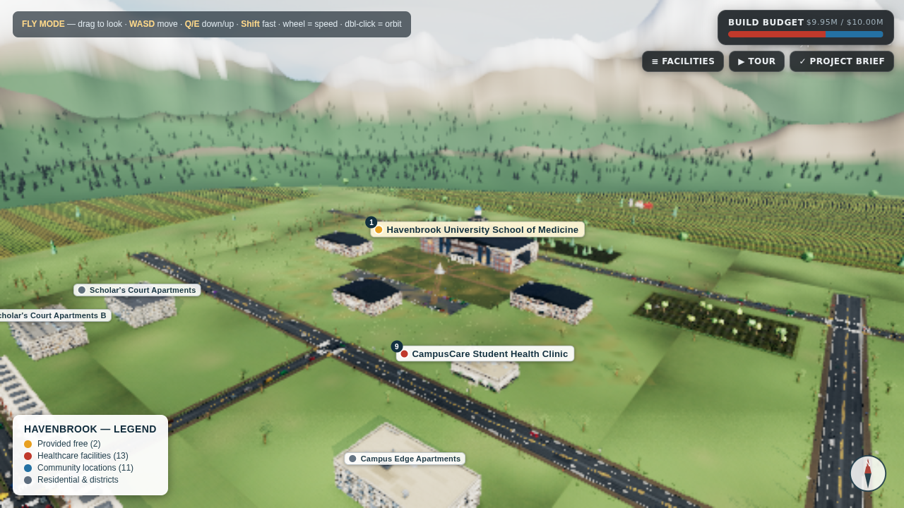
CONTENT 9 OF 14
Why These Facilities Are Needed
HAVENBROOK
▪ Students (50%): CampusCare Clinic for low-cost urgent care, Mindwell for counseling — both within the campus walk-shed, plus dental/optical on the commercial corridor.
▪ Families (30%): FamilyFirst pediatrics beside the school district, the General Hospital ER one arterial away, and the Health Department running immunization programs.
▪ Seniors (20%): Silver Oaks assisted living + memory care, Tranquil Harbor Hospice, ComfortCare home visits, and Recovery Path rehab — a full ageing-in-place loop on the quiet east side.
▪ Everyone: RapidResponse EMS sits at the town's central junction; Precision Diagnostics handles labs beside the hospital; the County Health Department covers public-health services.
University District — medical school (#1), CampusCare (#9) and Mindwell (#8) on the campus edge

Slide 11
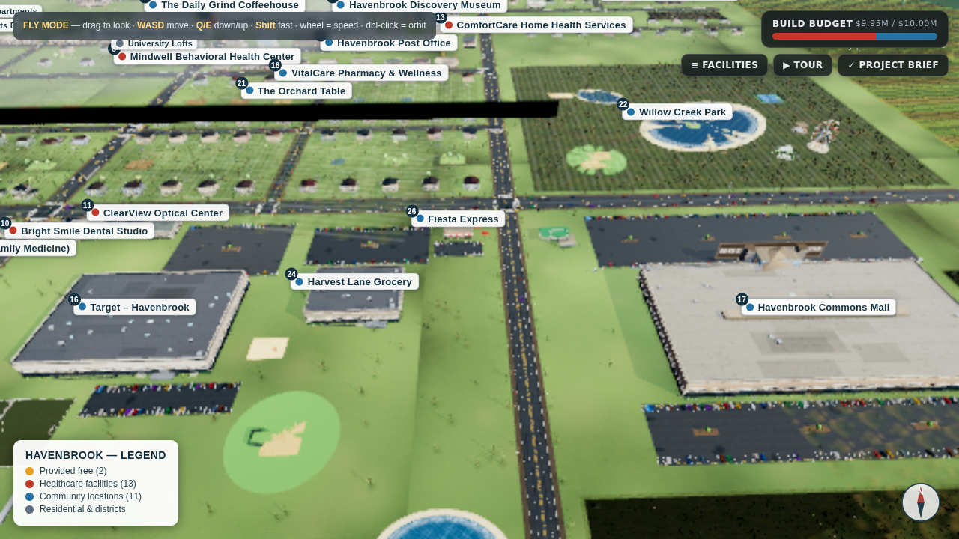
CONTENT 10 OF 14
Location & Placement Explanation
HAVENBROOK
▪ Hospital + EMS + rehab + lab cluster on Wellness Way — one "care spine" so ambulances move between them without crossing town.
▪ EMS at the Midtown/Main junction — geometric center; every district reachable along arterials in minutes.
▪ Senior district (E) borders the park — Silver Oaks and the hospice sit on quiet Silver Oak Dr beside Willow Creek's paths and pond.
▪ Medical school NW at Campus Dr — the town literally grows south and east from the campus quad.
▪ Housing in Residential West — Preserve Commons Apartments anchor the district; school and park both within a 5-minute walk.
▪ Commercial on Commerce Blvd (S) — Target, mall, grocery and restaurants concentrate traffic on the south arterial instead of residential streets.
Commercial corridor — Target (#16), mall (#17), grocery (#24), Fiesta Express (#26)

Slide 12
CONTENT 11 OF 14
Community Locations
HAVENBROOK
# | FACILITY NAME | TYPE (price-sheet category) | COST
16 | Target — Havenbrook | Wal-Mart/Target | $500,000
17 | Havenbrook Commons Mall | Mall | $1,000,000
18 | VitalCare Pharmacy & Wellness | Other Retail — pharmacy | $500,000
19 | Havenbrook Discovery Museum | Museum | $500,000
20 | Havenbrook Unified School District | School System | $300,000
21 | The Orchard Table | Restaurant — farm-to-table | $250,000
22 | Willow Creek Park | Park/Playground | $200,000
23 | Havenbrook Post Office | Post Office | $150,000
24 | Harvest Lane Grocery | Grocery Store | $100,000
25 | The Daily Grind Coffeehouse | Coffee Shop | $100,000
26 | Fiesta Express | Fast Food — Mexican grill | $100,000
11 community locations — more than 3× the requirement — subtotal $3,700,000. Plus free amenities: pocket parks, groves, orchard pond, band shell, library.

Slide 13
CONTENT 12 OF 14
Budget — $9,950,000 of $10,000,000
HAVENBROOK
# | FACILITY / LOCATION | TYPE | COST
1 | Havenbrook University School of Medicine | University Medical School | FREE (required)
2 | The Preserve at Havenbrook (incl. Preserve Commons Apartments) | Housing Development | FREE (required)
3 | Havenbrook General Hospital | General Hospital | $1,500,000
4 | RapidResponse EMS Station | Emergency Care Services | $400,000
5 | Havenbrook County Health Department | Health Department | $250,000
6 | Precision Diagnostics Laboratory | Laboratory | $100,000
7 | Recovery Path Rehabilitation Center | Rehabilitation Center | $750,000
8 | Mindwell Behavioral Health Center | Mental Health Facility | $500,000
9 | CampusCare Student Health Clinic | Clinic | $200,000
10 | Bright Smile Dental Studio | Dental Office | $300,000
11 | ClearView Optical Center | Optical Center | $300,000
12 | FamilyFirst Medical Offices | Medical Office — Pediatrics & Family Medicine | $400,000
13 | ComfortCare Home Health Services | Home Health Care | $300,000
14 | Silver Oaks Senior Living | Assisted Living & Memory Care LTCF | $750,000
15 | Tranquil Harbor Hospice | Hospice | $500,000
16 | Target — Havenbrook | Wal-Mart/Target | $500,000
17 | Havenbrook Commons Mall | Mall | $1,000,000
18 | VitalCare Pharmacy & Wellness | Other Retail — pharmacy | $500,000
19 | Havenbrook Discovery Museum | Museum | $500,000
20 | Havenbrook Unified School District | School System | $300,000
21 | The Orchard Table | Restaurant — farm-to-table | $250,000
22 | Willow Creek Park | Park/Playground | $200,000
23 | Havenbrook Post Office | Post Office | $150,000
24 | Harvest Lane Grocery | Grocery Store | $100,000
25 | The Daily Grind Coffeehouse | Coffee Shop | $100,000
26 | Fiesta Express | Fast Food — Mexican grill | $100,000
 | TOTAL SPENT |  | $9,950,000
 | REMAINING |  | $50,000

Slide 14
CONTENT 13 OF 14
Decision-Making & Trade-offs
HAVENBROOK
▪ Biggest spend: the hospital ($1.5M). A general hospital was non-negotiable for a medical-university town — it anchors the whole care system.
▪ Mall over a second hospital. With $1.45M left near the end we weighed a Specialty Hospital ($1.25M) vs. Havenbrook Commons Mall ($1M) — the mall won because residents rated everyday needs (retail, food, gathering) as the bigger gap; the general hospital already covers specialty referrals.
▪ Two cheap clinics instead of one pricey one. CampusCare ($200k) + ComfortCare ($300k) reach students and seniors for less than one Specialty Hospital.
▪ What we could NOT afford: a Government Hospital, a University Medical Center ($2M — the free medical school already covers teaching-care), a Skilled Nursing LTCF (Silver Oaks + ComfortCare split the need), and Industrial Health Care (little industry in Havenbrook).
▪ Leftover $50,000 is deliberately kept as a maintenance/emergency cushion — real towns don't spend to zero.

Slide 15
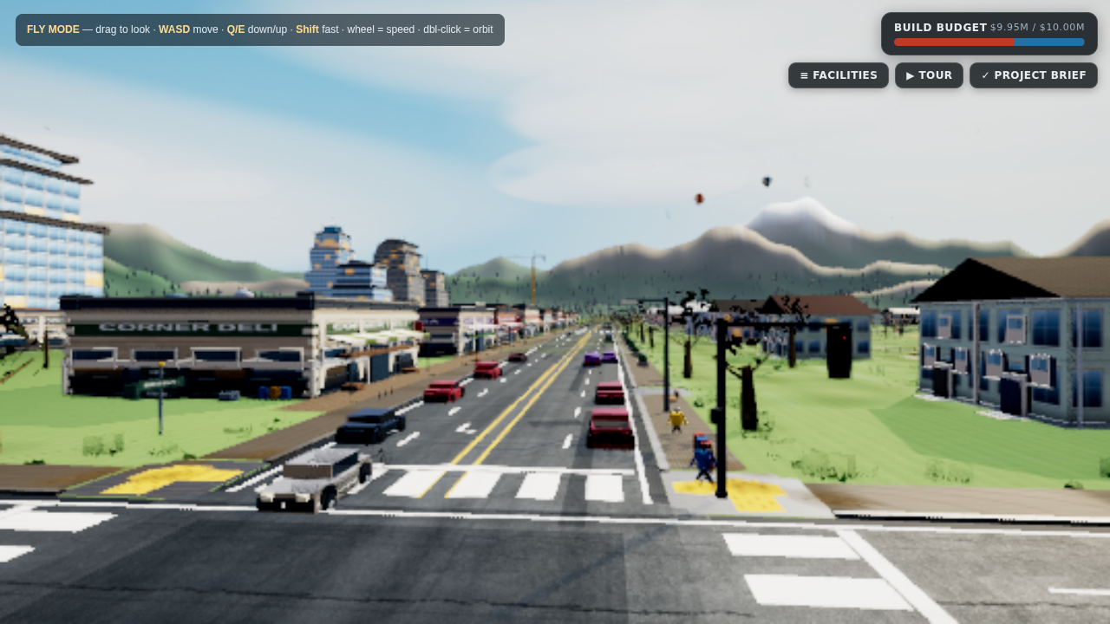
CONTENT 14 OF 14
Conclusion
HAVENBROOK
▪ Havenbrook meets every requirement: 27 named locations, 13 healthcare facilities, 11 community locations, a free medical school and free housing — all inside a $9.95M budget.
▪ Demographics drive the design: students, families and seniors each get facilities on their daily routes, not across town.
▪ The town is explorable: the full 3D model (github repo: Digital-Town) supports a guided tour, day/night cycle, weather, and a labeled map — the same model these screenshots come from.
▪ A community planned around care — healthcare is the spine, but parks, shops, schools and cafes make it a town people actually live in.
Main Street at eye level — storefront row, dental (#10), optical (#11), café (#25)

Slide 16
NOT A CONTENT SLIDE
References
HAVENBROOK
▪ Town model, layout, budget tracker and all screenshots: procedurally generated Havenbrook — github.com/dev-abhinavmishra/Digital-Town
▪ Healthcare facility types and pricing: "Our Town" Healthcare System Project — official price sheet (class handout).
▪ Town demographics: project brief — 50% college students, 30% adults with families, 20% adults 65+.
▪ Rendering engine: Three.js (threejs.org), open-source WebGL library. Landmark assets authored in Blender (blender.org).
▪ All imagery on these slides was rendered from the actual town model — no stock photos.

