Slide 1
CONGRESSIONAL APP CHALLENGE
ResistanceAI
Software that helps cancer doctors choose treatments less likely to fail.
Abhinav Mishra Python and Streamlit trained on free public data
Notes:
Hi, I'm Abhinav. Doctors who treat cancer face a hard problem: even with a tumor's DNA report in hand, it is hard to know which drug will actually work. I built a small app that estimates that up front. In about three minutes I will show you the whole thing, live.

Slide 2
Cancer starts when DNA instructions go wrong.
A tumor's DNA is its damaged instruction manual.
Labs can now read that damage letter by letter.
Some DNA errors have drugs built to block them.
Matching the error to the drug is precision oncology.
Notes:
A quick primer for anyone without a biology background. Cancer begins when a cell's DNA is damaged and the cell grows out of control. Clinics now sequence a tumor's DNA, and for many of the errors they find, called mutations, there is a drug designed to hit that exact weakness. That matching is called precision oncology.

Slide 3
Knowing which drug will work takes experts most hospitals lack.
A sequencing report can list hundreds of mutations.
Specialist panels read them, mostly at big centers.
A community oncologist often reads it alone.
A wrong first choice can cost months.
WHAT AN ONCOLOGIST IS
The doctor who treats cancer.
When the DNA report arrives, they choose the drug. The report is long, the evidence is scattered, and the clock is running.
Notes:
When a tumor report comes back, a panel of specialists called a molecular tumor board can review it and recommend a drug. Those panels mostly exist at large academic cancer centers. The oncologist, the cancer doctor treating most patients, is often reading that report alone under time pressure, and a drug that cannot work still costs the patient weeks on the clock.

Slide 4
So the model learned from real patients, not rules I wrote.
26,064
WHERE THE DATA CAME FROM
Two public research datasets from Memorial Sloan Kettering, one of the largest cancer centers in the world.
cancer patients whose tumors were sequenced, with outcomes on record.
Source: MSK-IMPACT (Zehir et al., Nat Med 2017) and MSK-CHORD (Nature 2024) via cBioPortal.
Notes:
Instead of writing rules by hand, I trained the model on two public datasets from Memorial Sloan Kettering Cancer Center: MSK-IMPACT and MSK-CHORD. After cleaning, 26,064 patients had both a sequenced tumor and a recorded outcome. Every number the app produces traces back to those real cases.

Slide 5
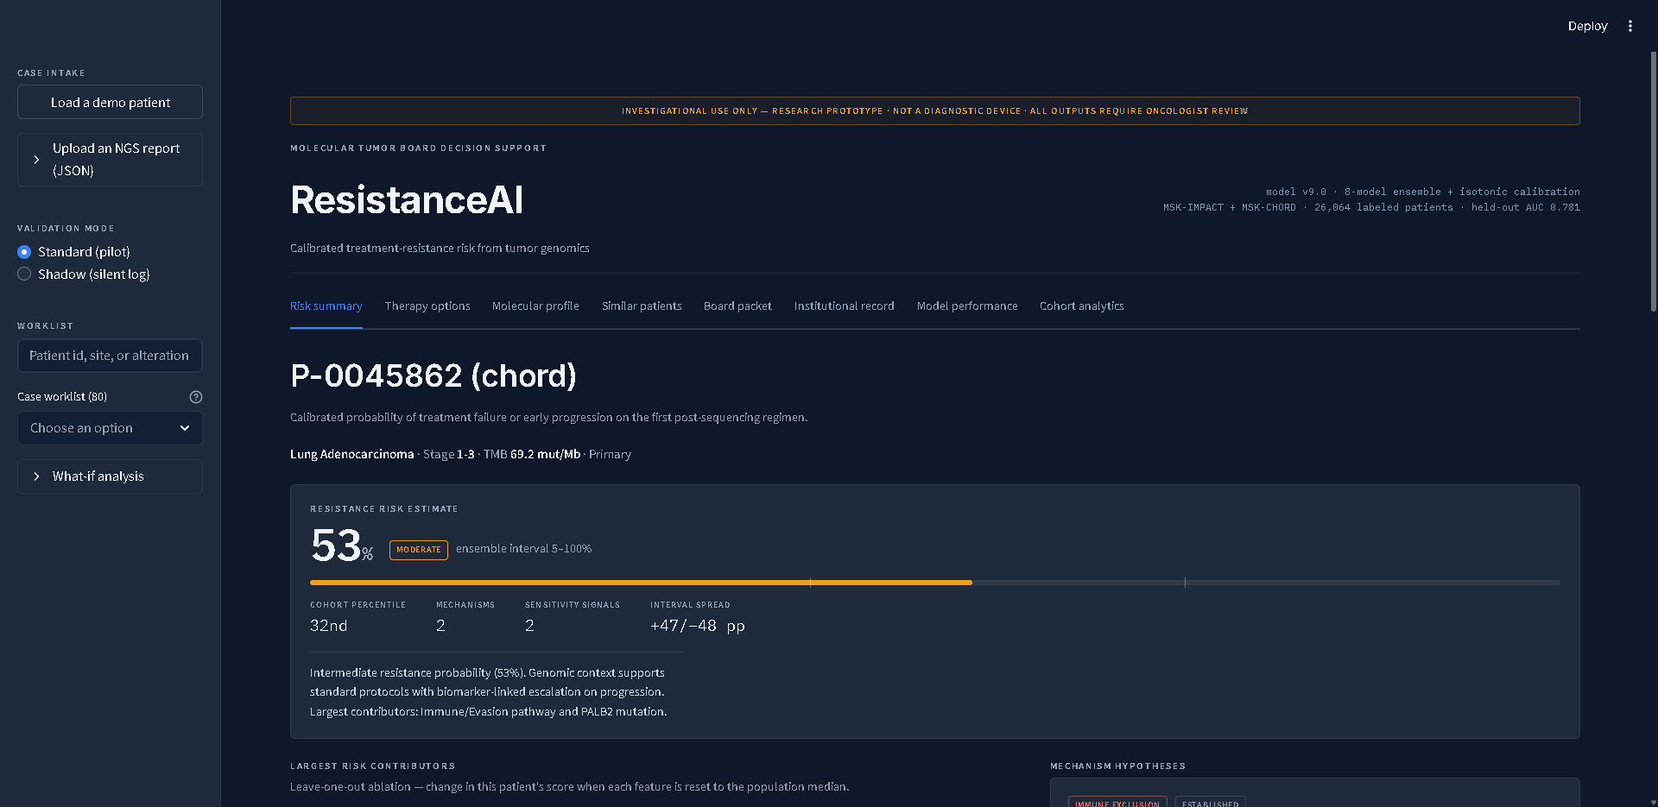
It estimates the chance the next treatment fails.
Load a patient in one click.
One read: 53 percent.
Plus an honest range.
Notes:
Here it is running. I load a real lung cancer patient and the app scores a 53 percent chance the next treatment fails. Notice the range beside it: the model is honest that this profile is unusual, and unusual is exactly when a doctor should slow down.

Slide 6
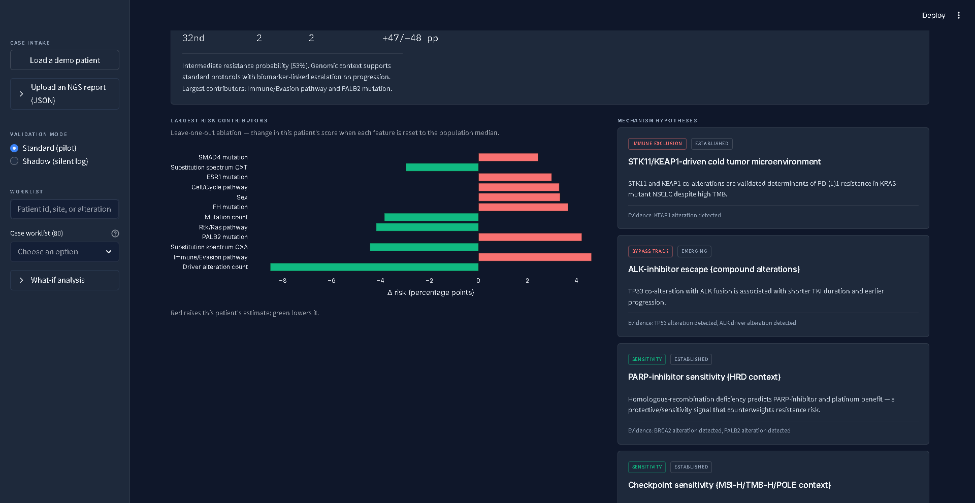
It shows exactly which evidence moved the number.
Left: each feature's push on the score. Right: escape routes to watch, each citing the mutation it found.
Notes:
Judges and doctors ask the same question: why this number. The chart on the left removes each feature one at a time and measures how much the score moves. The cards on the right name biological escape routes the tumor might use, and each card cites the specific mutation it found in this patient's DNA.

Slide 7
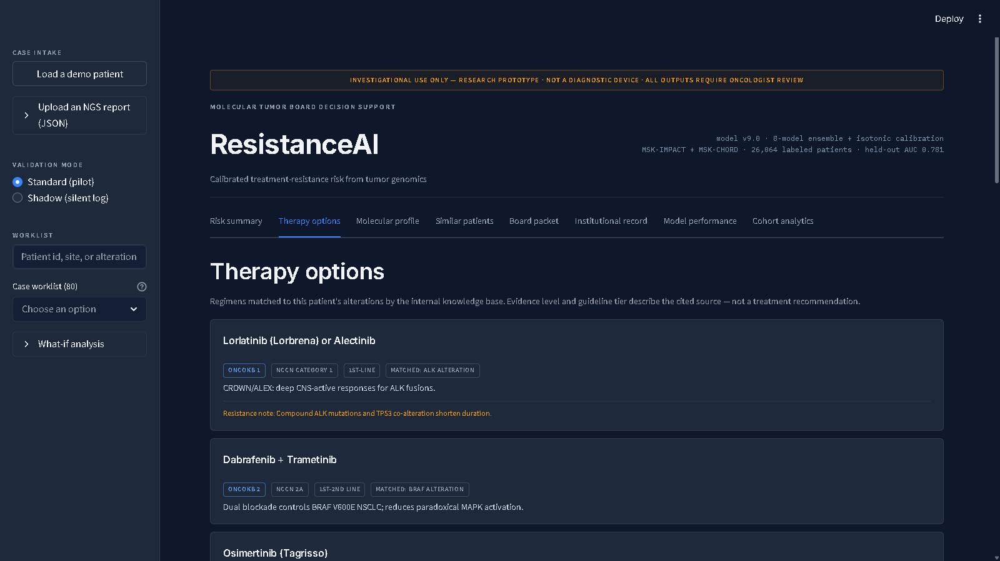
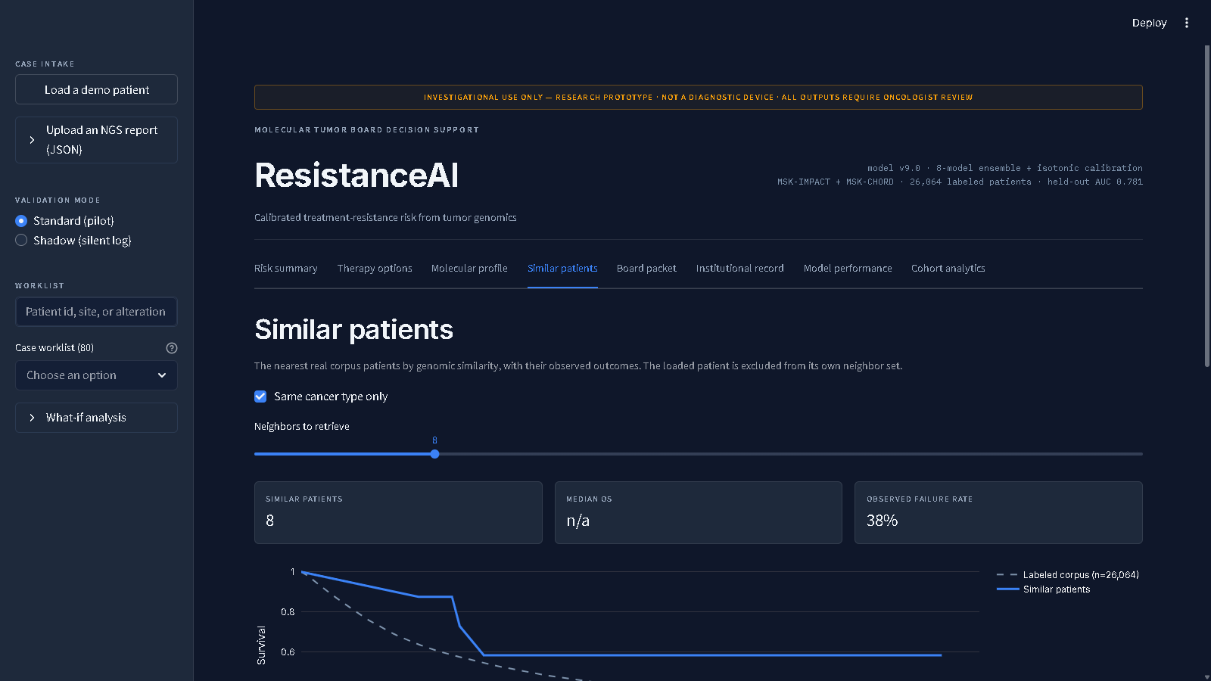
Then it lines up what is worth trying next.
Drugs matched to this tumor's mutations. Recruiting trials, searched live. Outcomes of similar patients.
Notes:
A risk score alone does not help anyone act. So the app maps the patient's mutations to treatment regimens with their evidence grades, searches ClinicalTrials.gov live for recruiting studies, and shows what actually happened to the eight most similar patients in the data.

Slide 8
Behind the screen, four steps a doctor can inspect.
1
2
3
4
›
›
›
DNA report in
201 signals
8 models vote
A probability
sequencing file
mutations and history
each sees different patients
calibrated, with a range
Nothing is hidden. Each step leaves a record a clinician can audit.
Notes:
Technically the pipeline is four steps. The DNA report is cleaned into a fixed list of 201 signals. Eight gradient boosting models, each trained on a different slice of patients, each make a prediction. A final calibration step turns their average vote into a true probability: 60 percent means about 60 percent of similar patients really did fail.

Slide 9
It even scores how sure it is.
# eight models each make a call
Eight models vote, we take the average.
Their disagreement becomes the band.
Wide band means slow down and look closer.
votes = [m.predict(X) for m in self.models]
mean = float(np.mean(votes)) # the estimate
spread = float(np.std(votes)) # the disagreement
# disagreement becomes the band on screen
low, high = calibrate(mean - 2*spread,
mean + 2*spread)
backend/ensemble.py
Notes:
This is the honest part, in the actual code. The eight models vote, we take the mean, then we measure how much they disagree. Large disagreement becomes a wide band on screen. The app never pretends to be sure when it is not.

Slide 10
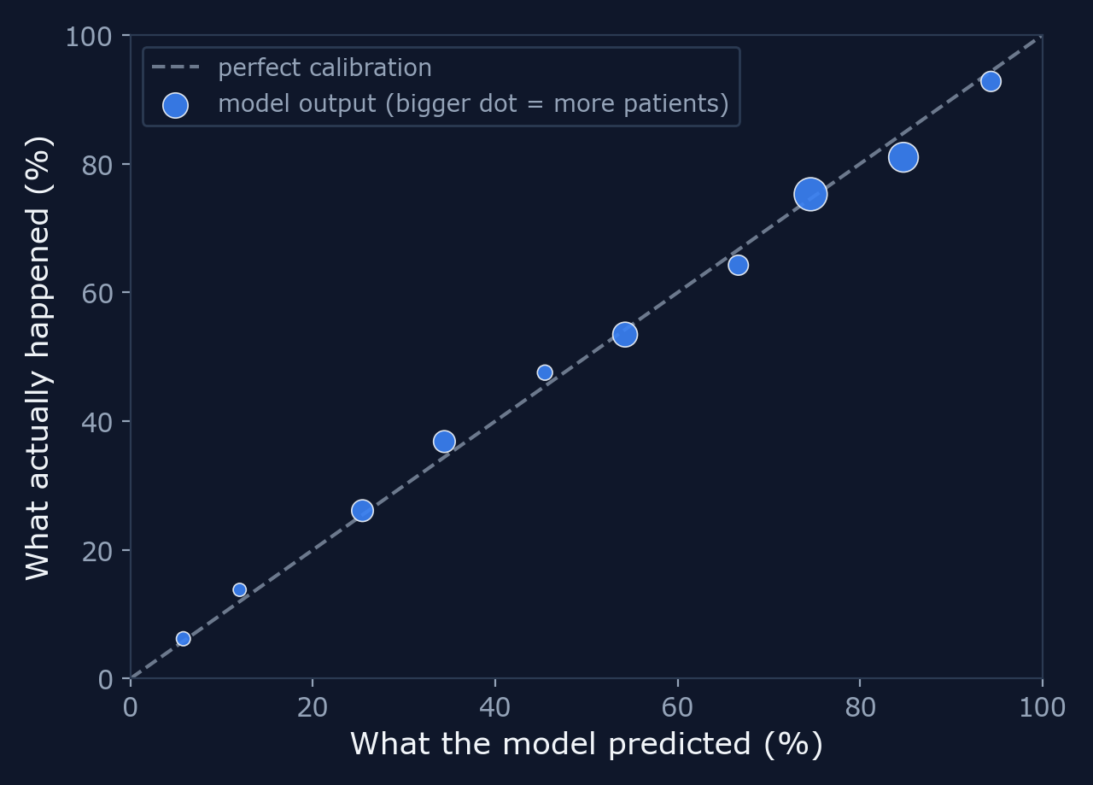
Tested on patients it never saw, the numbers hold.
When it said 60%, about 60% failed.
Graded on 5,213 patients it never trained on.
Those limits are printed inside the app.
Source: backend/artifacts/model_metrics.json. ROC AUC 0.78, calibration error 0.017.
Notes:
Here is the report card on 5,213 patients the model never trained on. Each dot asks the same question: when the model predicted a number, what share of patients actually failed. The dots sit near the diagonal, which is what honest probability looks like. It is not a crystal ball, and the app says that on the screen.

Slide 11
Doctors should not have to guess alone.
Free public data. Open code. Real patients.
Watch it live: load a demo patient and judge for yourself.
Notes:
That is ResistanceAI. It gives a doctor the kind of read an expert panel would give, in seconds, with the reasoning left on the screen. Everything you saw is the running app on real public data. Thanks for watching.

Slide 12
Sources
Zehir et al. MSK-IMPACT cohort, Nature Medicine 2017, via cBioPortal.
MSK-CHORD cohort, Nature 2024, PMID 39506116, via cBioPortal.
ClinicalTrials.gov API v2, US National Library of Medicine.
Evaluation: backend/artifacts/model_metrics.json, test n = 5,213.
Screenshots captured from the running app.
Notes:
Every number in this deck traces to one of these sources or to the app's own evaluation artifacts in the repository.

