Slide 1

Airbnb Price Prediction
Advisor: Dr. Thomas Wakefield

Slide 2
Introduction
What is Airbnb?
Why price prediction is important?
What is Machine Learning?

Slide 3

The Data
Source: Kaggle
About 50,000 observations and 16 features.

Slide 4
Data Preparation
Handling Missing Values
1
Dealing with categorical inputs
2
Dealing with multicollinearity
3
Variable Screening
4

Slide 5

Handling Missing values
Dropped Features with too many missing values
Imputed or dropped the observations
[ Depends on features]

Slide 6
Dealing with categorical inputs
Dummy coding
Dropped features with too many levels

Slide 7

Dealing with multicollinearity
Removed highly correlated predictors

Slide 8
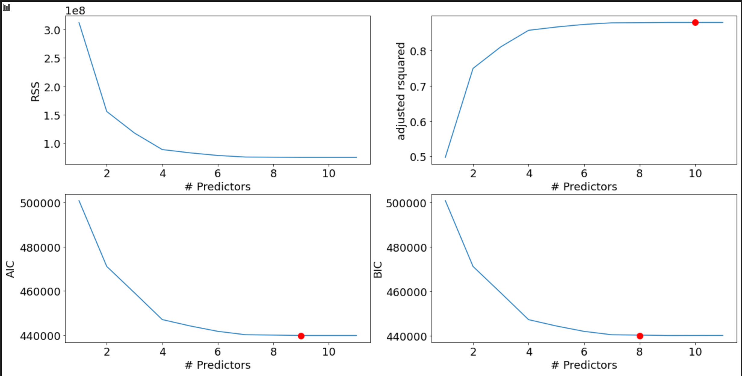
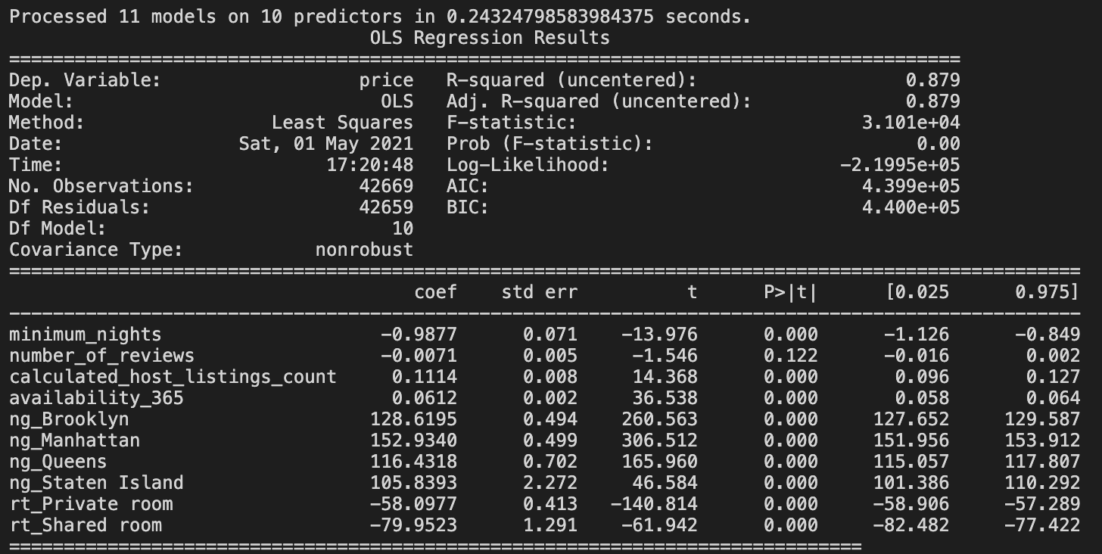
Variable Screening
Best Subset Regression

Slide 9

Models
Linear Regression
Ridge Regression
Decision Tree Regression
Random Forest Regression

Slide 10
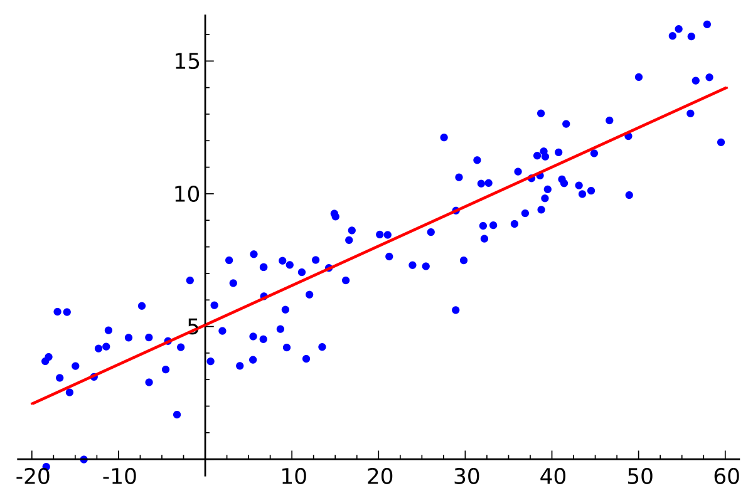
Linear Regression

Slide 11
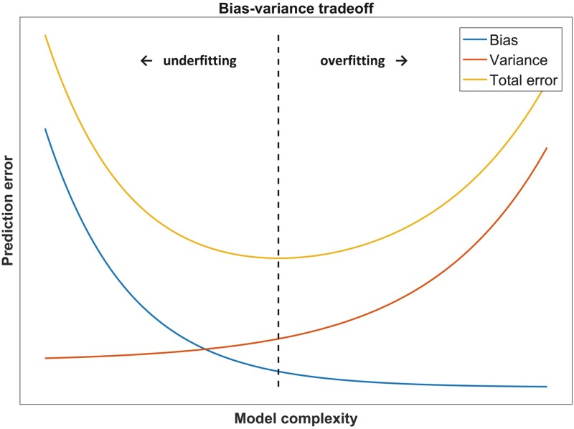
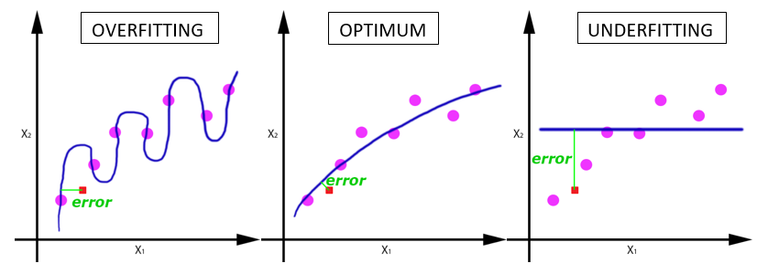
Bias vs Variance tradeoff

Slide 12
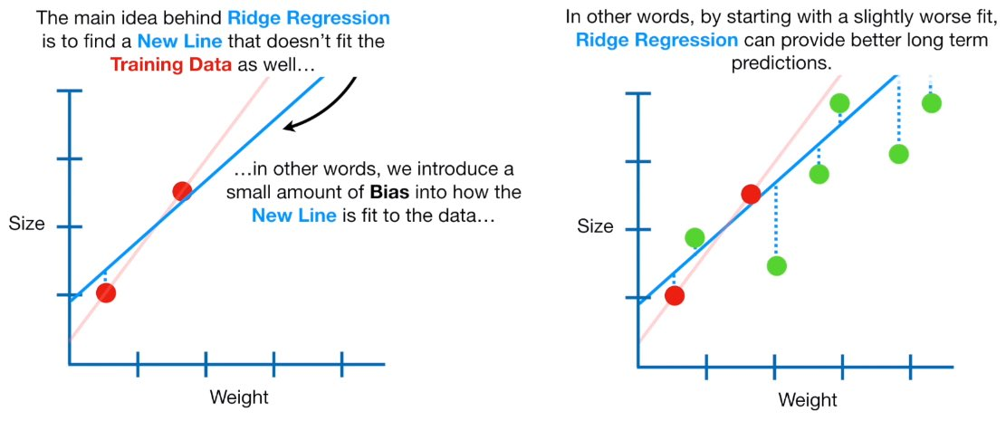
Ridge Regression

Slide 13
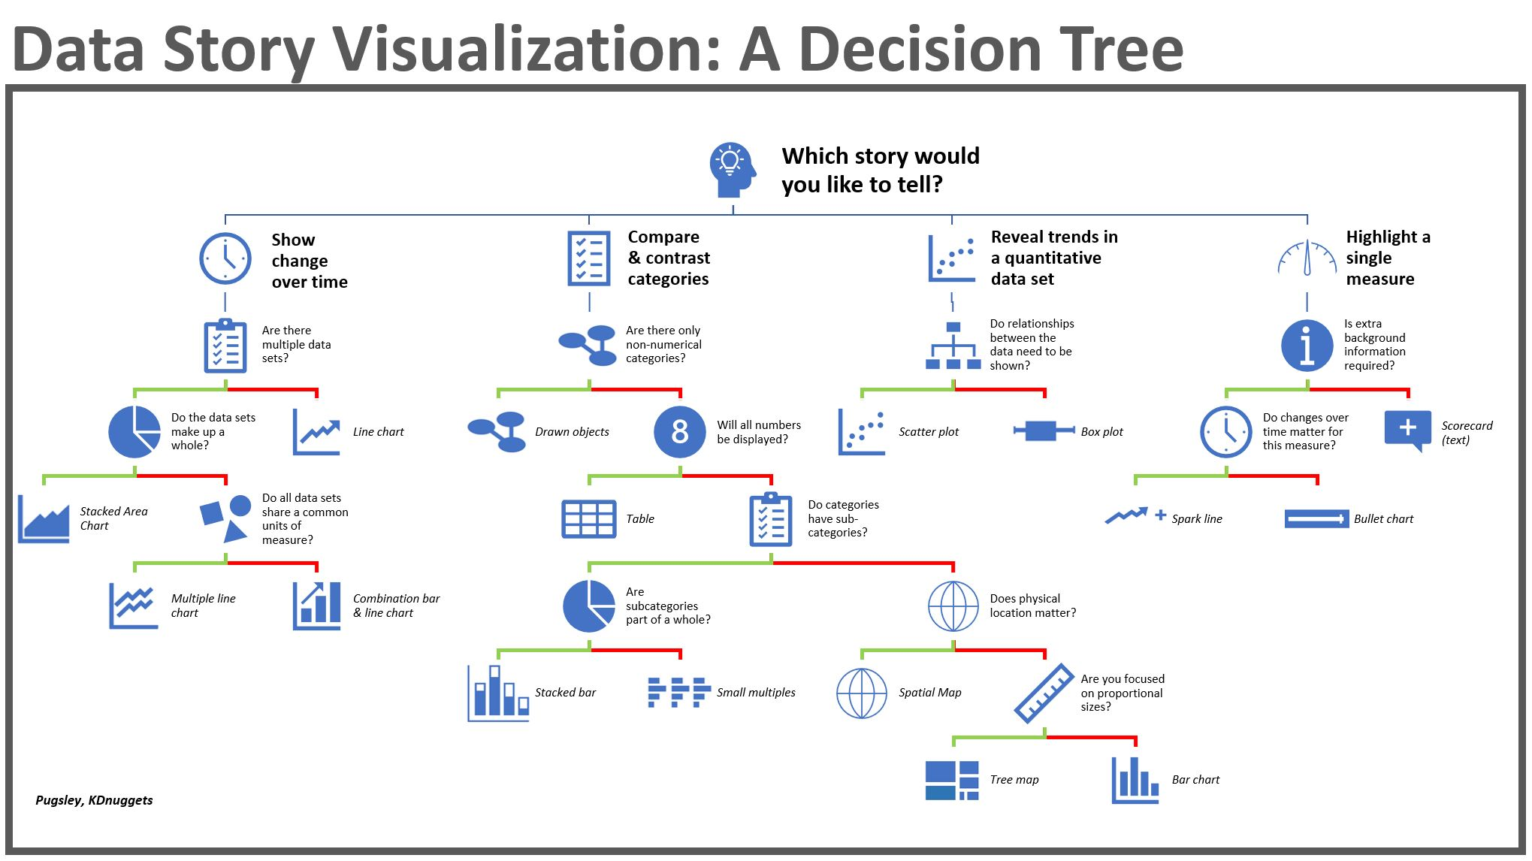
Decision Tree Regression

Slide 14
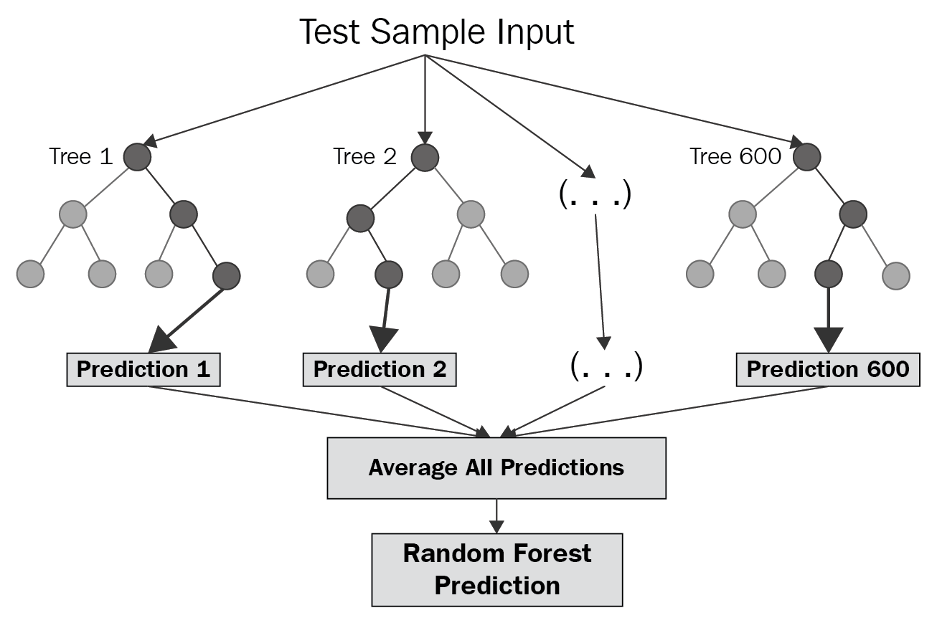
Random Forest Regression

Slide 15
Goal
Compare models to find best price prediction model on our dataset

Slide 16
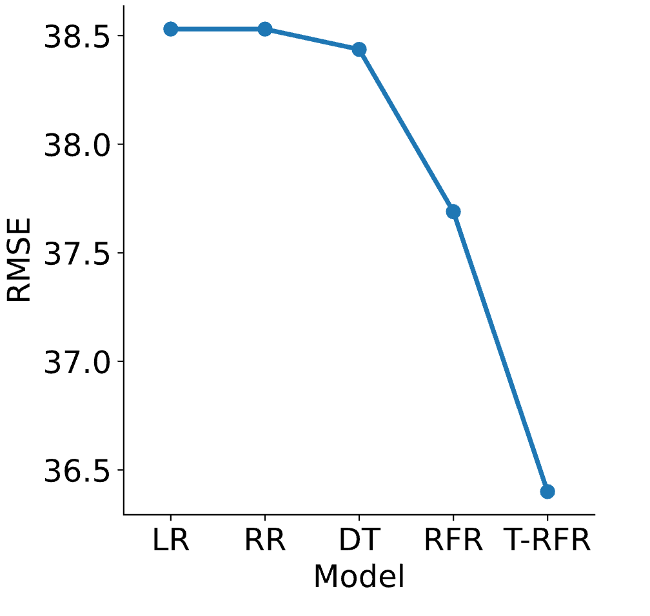
Results
Tuned Random Forest Performed Best Overall

Slide 17
Other Applications of Price Prediction
Housing Price Prediction
Rental Price Prediction
Stock Price Prediction

Slide 18

Question?

Slide 19

THE END

