Slide 1

Senior project
Weather pattern recognition and energy consumption optimization
Advisor – Dr. Alina Lazar

Slide 2
Introduction
Number of datasets: 2 (Weather dataset for two years and electricity consumption dataset for 2 years)
1
Linear Regression Model used for the prediction of energy consumption using the weather patterns
2

Slide 3
Training Data Set and Testing Data Set
Training data set – 70% of the original dataset.
Testing data set- 30% of the original dataset.

Slide 4
Data Preparation:
Handled missing values in the datasets by imputing relevant statistics such as median, mean, etc.
Point anomaly detection
Collective anomaly detection

Slide 5

Linear Regression Model
Assumptions:
Linearity
Independence
Normality
Homoscedasticity

Slide 6
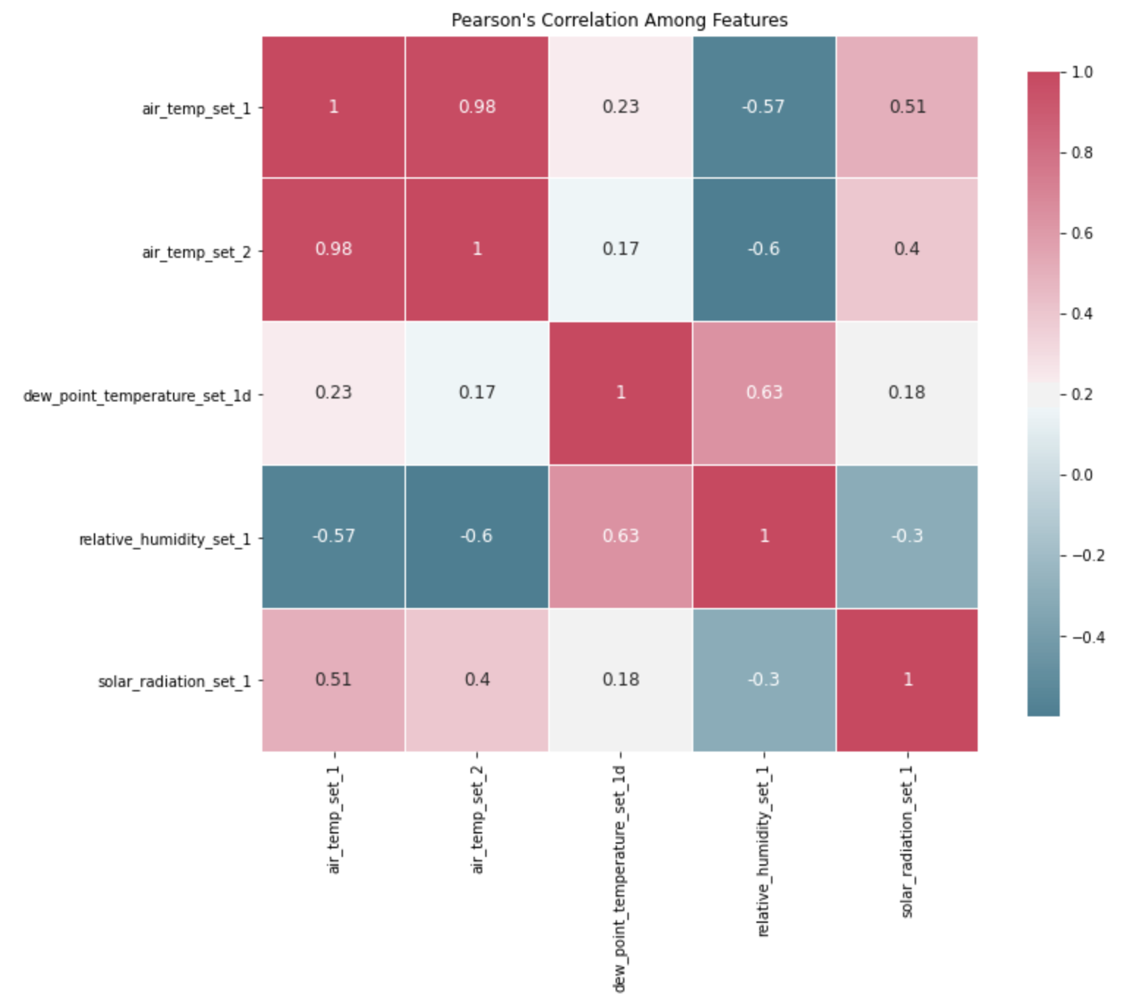
Detecting inter-dependencies between features

Slide 7
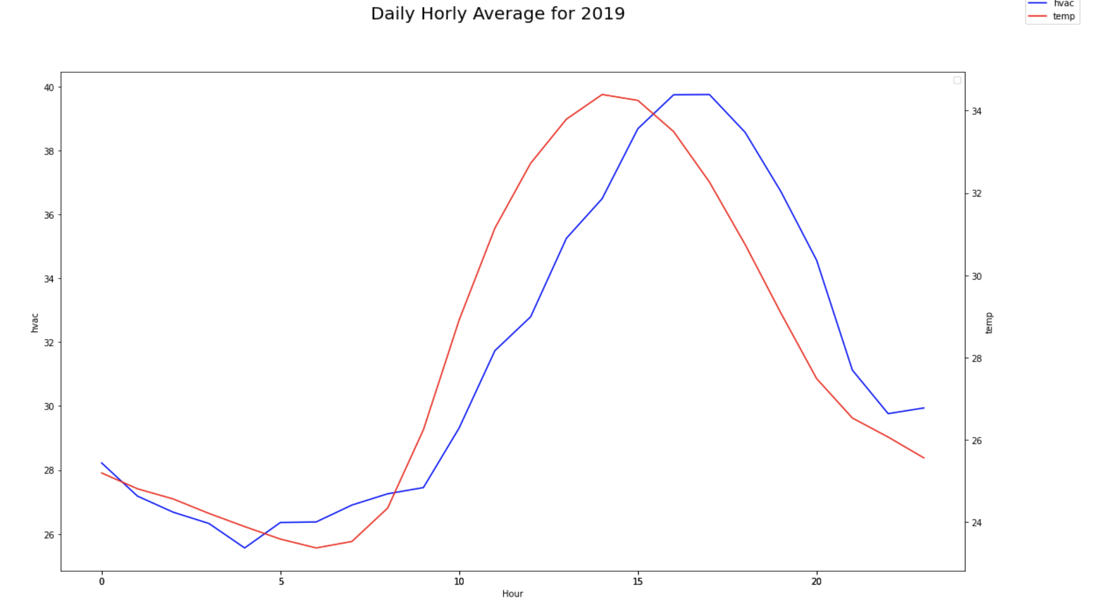
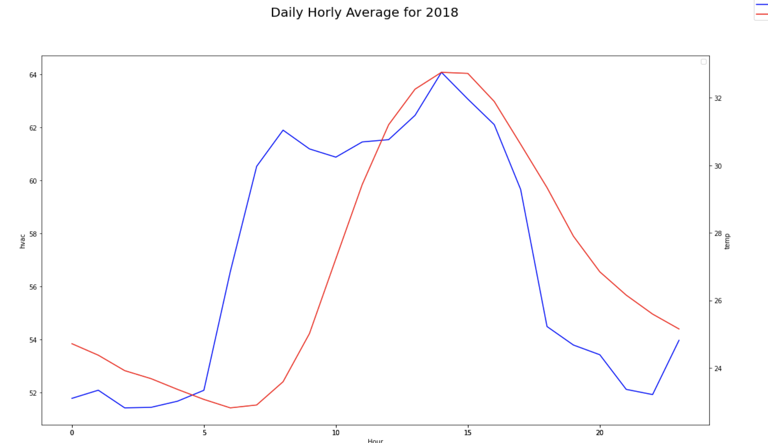
Weather Pattern

Slide 8
Strength of Model.
The model was able to predict the energy consumption well in the training data.

Slide 9
Weakness in Model
Main limitation of Linear Regression is the assumption of linearity between the dependent variable and the independent variables. In the real world, the data is rarely linearly separable. It assumes that there is a straight-line relationship between the dependent and independent variables which is incorrect many times. Therefore, the model was not able to predict well in the test data.

Slide 10
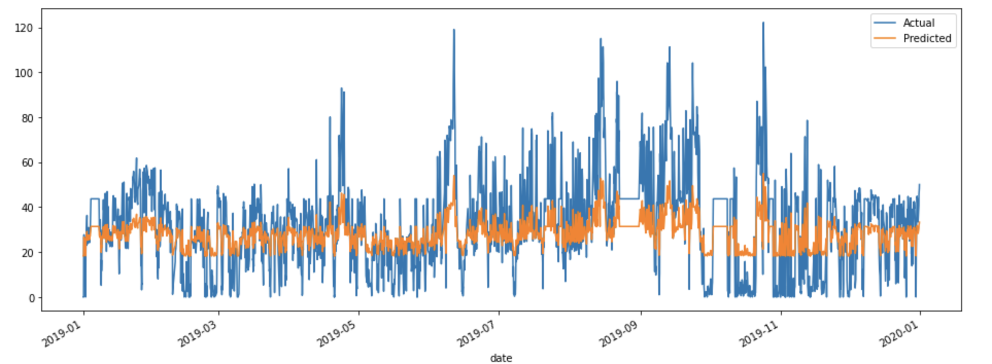
Prediction vs Actual

Slide 11
Further works that can be done:
Inclusion of more variables would lead to better prediction.
The problem of overfitting could be resolved through cluster analysis and many other machine learning techniques.

