Slide 1

Senior project
Weather pattern recognition and energy consumption optimization
Advisor – Dr. Alina Lazar

Slide 2
Introduction
Number of datasets: 2 (Weather dataset for two years and electricity consumption dataset for 2 years)
1
Linear Regression Model used for the prediction of energy consumption using the weather patterns
2

Slide 3
Data Preparation:
Handled missing values in the datasets by imputing relevant statistics such as median, mean, etc.
Point anomaly detection
Collective anomaly detection

Slide 4
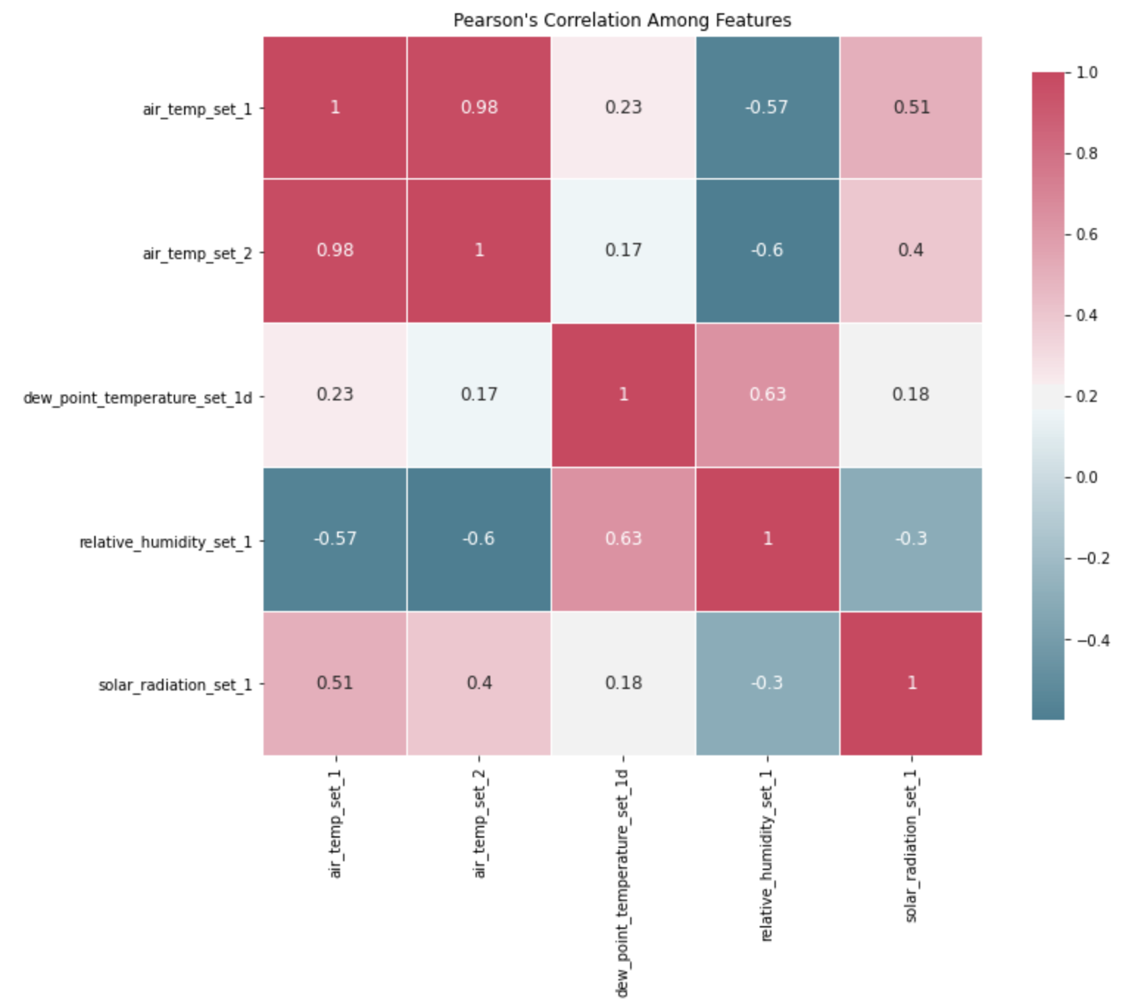
Detecting inter-dependencies between features

Slide 5
Outlier Analysis
Point Anomaly Detection
Collective Anomaly Detection

Slide 6
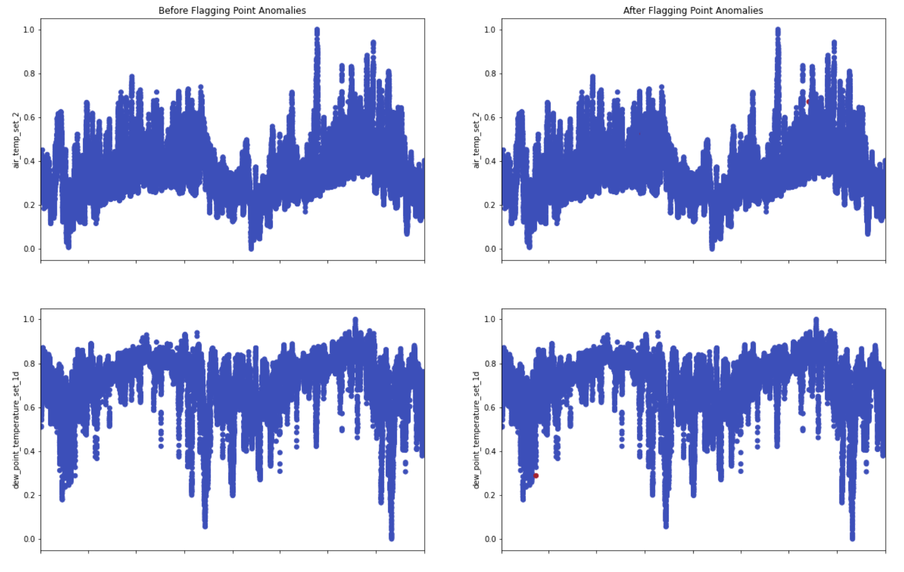
Point Anomaly Detection

Slide 7
Collective Anomaly Detection

Slide 8
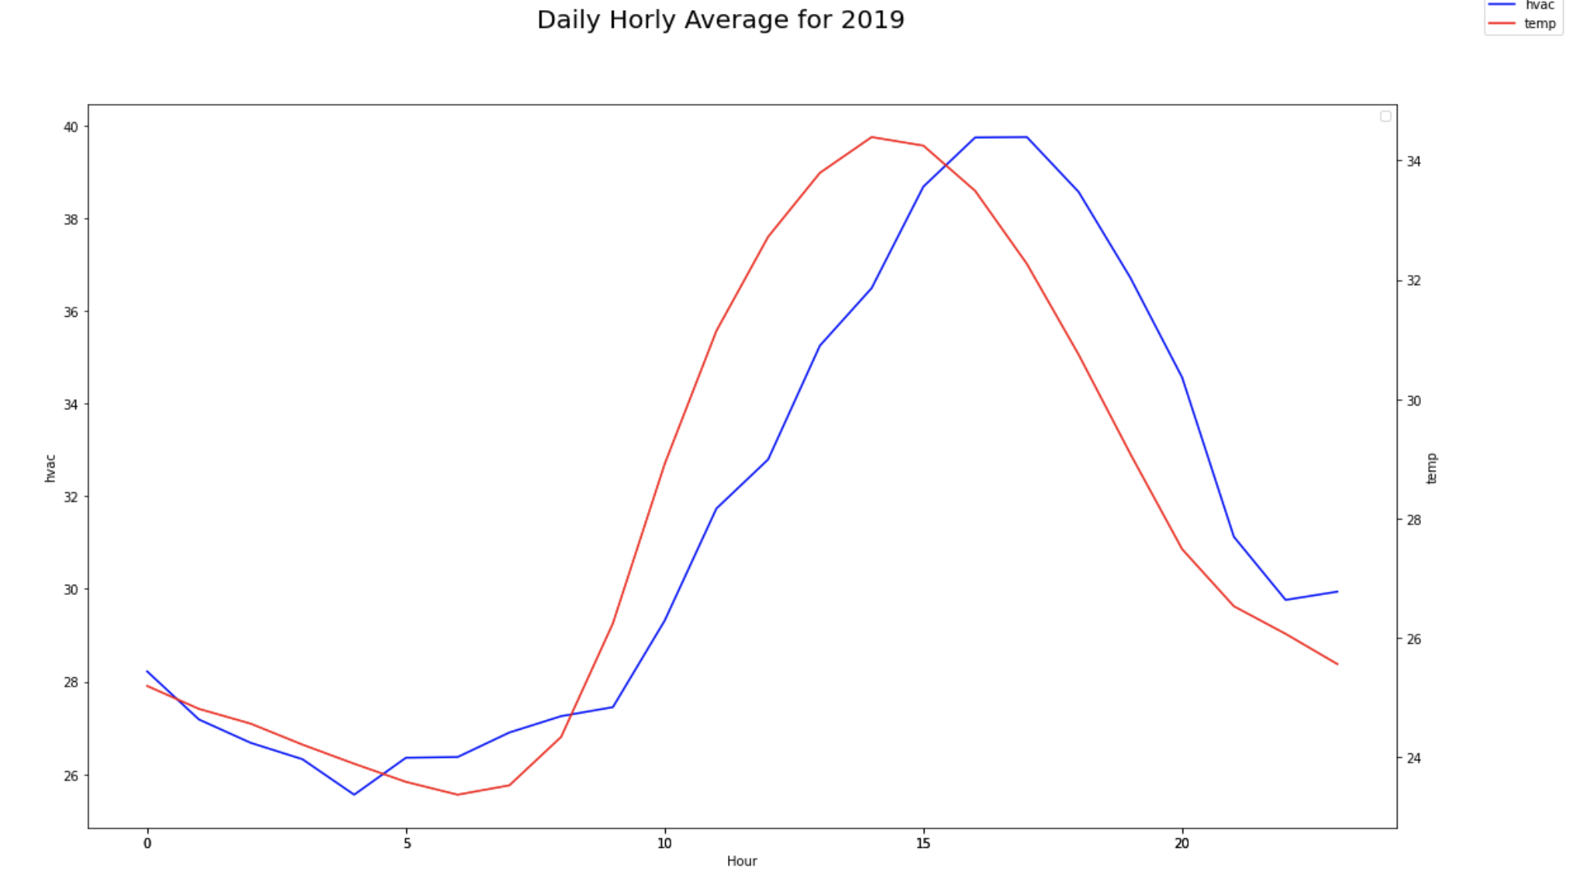
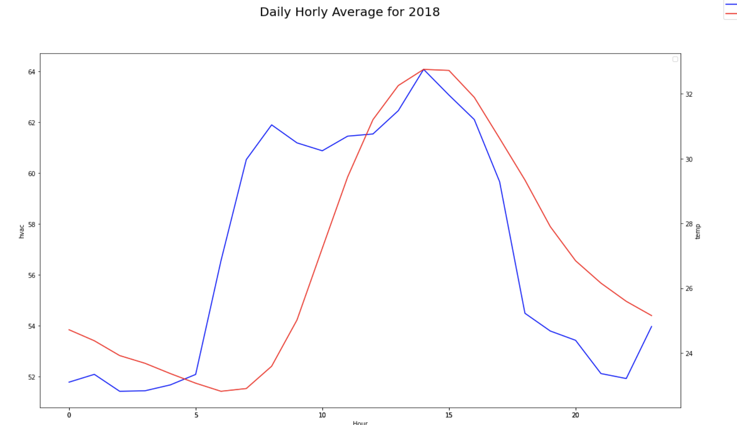
Weather Pattern

Slide 9

Linear Regression Model
Assumptions:
Linearity
Independence
Normality
Homoscedasticity

Slide 10
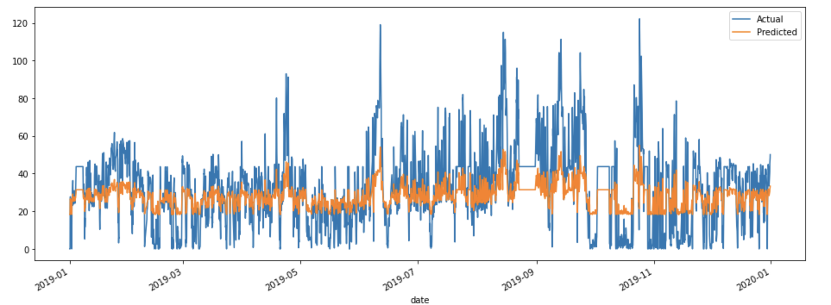
Prediction vs Actual

