Slide 1
Ledgerwise
The agent that explains why the money does not add up
Track 02: The Agent That Can Explain Why
Built on Zetaris, NVIDIA Nemotron and Meterless
Notes:
Ledgerwise investigates payment settlement gaps and explains them with evidence.

Slide 2
Settlements are short, and nobody can say why
NGN 4,200,000
The processor, the ledger, the bank file and support tickets each tell a different story
Reconciliation analysts spend hours in spreadsheets, and the money stays missing
Causes stack: a duplicate webhook, a timezone cutoff and a fee mismatch can all hit the same day
short on one day's settlement
Ledgerwise · Open Agent Hackathon 2026 · Track 02
2

Slide 3
Who it is for
The user
The job
A finance operations or reconciliation analyst at a payments company or fintech.
Secondary: the engineer on call for a payment incident.
Turn "the numbers do not match" into "here is exactly why, here is the proof, here is what to do".
Starting with Nigerian payment rails: NIP transfers, WAT business days, a 20:00 UTC bank cutoff.
Ledgerwise · Open Agent Hackathon 2026 · Track 02
3

Slide 4
How the investigation works
1
2
3
4
5
Ask
Plan
Query
Disprove
Report
One question, one value date
Checks ordered by the sign of the gap
Federated SQL across four sources
A second query tries to prove each cause wrong
Amounts in code, evidence for every claim
The agent only reads. Actions are drafts that a person approves. Nothing is executed.
Ledgerwise · Open Agent Hackathon 2026 · Track 02
4

Slide 5
Architecture
Browser UI
plain HTML/JS
FastAPI
SSE stream
Investigator
detect, disprove, reconcile
SQL guard
Zetaris
Zetaris federates three physical systems:
Nemotron Ultra
summary
Meterless
second check
Processor DB (Postgres): transactions, ledger, merchants
Webhook log and support tickets (Postgres)
Bank settlement files (Parquet)
Amounts are integer kobo end to end. Models never produce a number.
Ledgerwise · Open Agent Hackathon 2026 · Track 02
5

Slide 6
Stack
Layer | What we use
Data access | Zetaris Lightning SQL (REST), Spark SQL
Sources | Postgres x2, Parquet files; synthetic data from a seeded generator
Backend | Python, FastAPI, SSE, sqlglot SQL guard, Pydantic
Models | NVIDIA Nemotron Ultra (summary), Meterless Nightshift (check)
Frontend | Plain HTML, CSS, JS. No build step
Quality | 38 tests, 21-scenario eval with a held-out set
Ledgerwise · Open Agent Hackathon 2026 · Track 02
6

Slide 7
How Zetaris was used
Every query goes through Zetaris Lightning SQL
Postgres sources via CREATE DATASOURCE, bank Parquet via CREATE LIGHTNING FILESTORE TABLE
One statement joins processor, webhook log, tickets and bank files
3 to 9 queries per investigation, no ETL, no copies
Found by running it
No DuckDB connector, so sources moved to Postgres.
Spark SQL only: a Postgres-style query silently returned NULLs.
Local files must sit under the driver's shared root.
Ledgerwise · Open Agent Hackathon 2026 · Track 02
7

Slide 8
Nemotron writes it. Meterless checks it
NVIDIA Nemotron Ultra
Meterless Nightshift
Writes the plain-language summary from the structured report.
A validator rejects output that cites an unknown evidence id or contains a number not in the facts.
It never chooses queries or computes amounts.
A second, independent model checks every sentence against the facts: PASS or FAIL.
FAIL falls back to a template. The report shows the routed model and the compute receipt.
Tested on correct and deliberately wrong summaries.
Ledgerwise · Open Agent Hackathon 2026 · Track 02
8

Slide 9
What is distinctive
It tries to prove itself wrong
Math in code
Each cause gets a second query built to disprove it. Failed causes are dropped and listed.
Amounts, remainder and confidence are computed in Python from query results.
Honest uncertainty
Read-only by design
Unexplained money is reported as unexplained, not given an invented cause.
SQL guard, ticket text never reaches a query, humans approve every action.
Ledgerwise · Open Agent Hackathon 2026 · Track 02
9

Slide 10
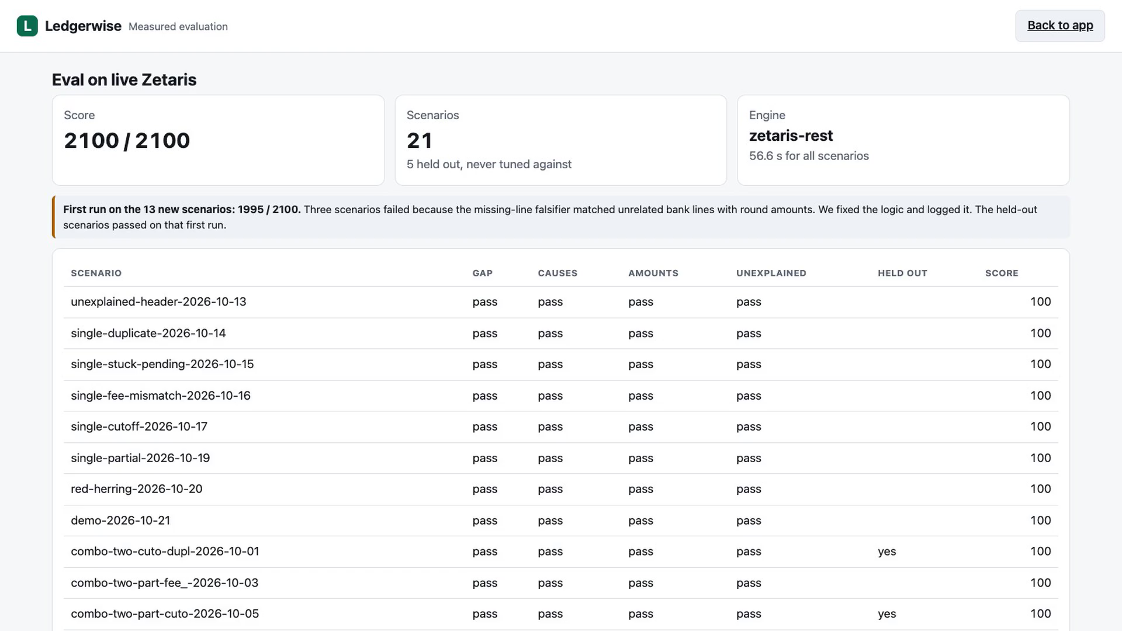
Measured, including the failure
2100 / 2100
21 scenarios on live Zetaris. 5 held out and never tuned against. Includes red herrings and two cases that must stay unexplained.
First run on the 13 new scenarios: 1995 / 2100. A falsifier matched unrelated bank lines with round amounts. We fixed the logic and logged it in docs/EVAL_LOG.md.
Ledgerwise · Open Agent Hackathon 2026 · Track 02
10

Slide 11
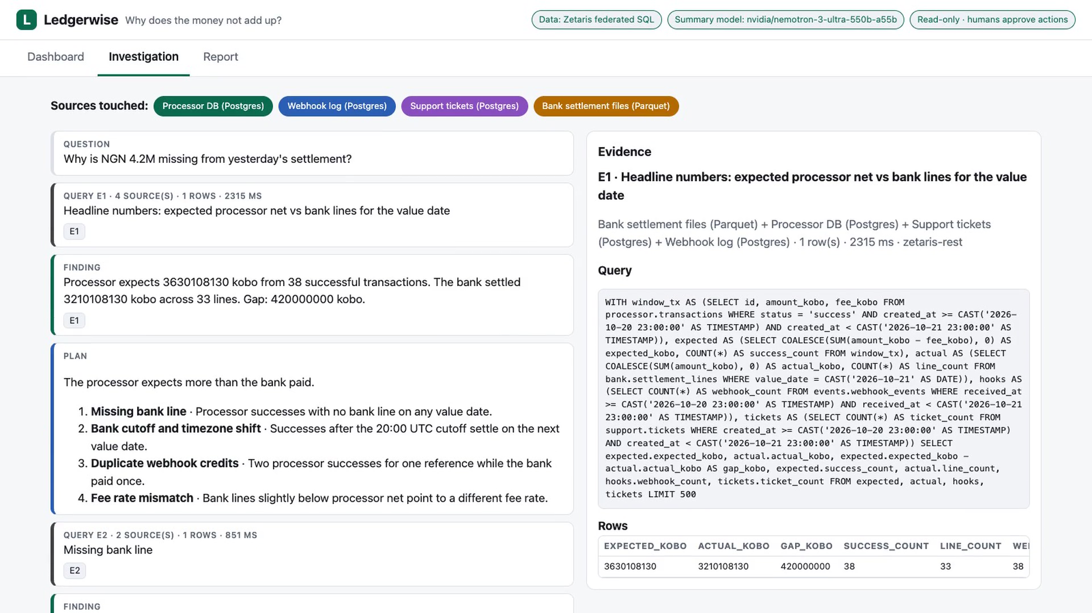
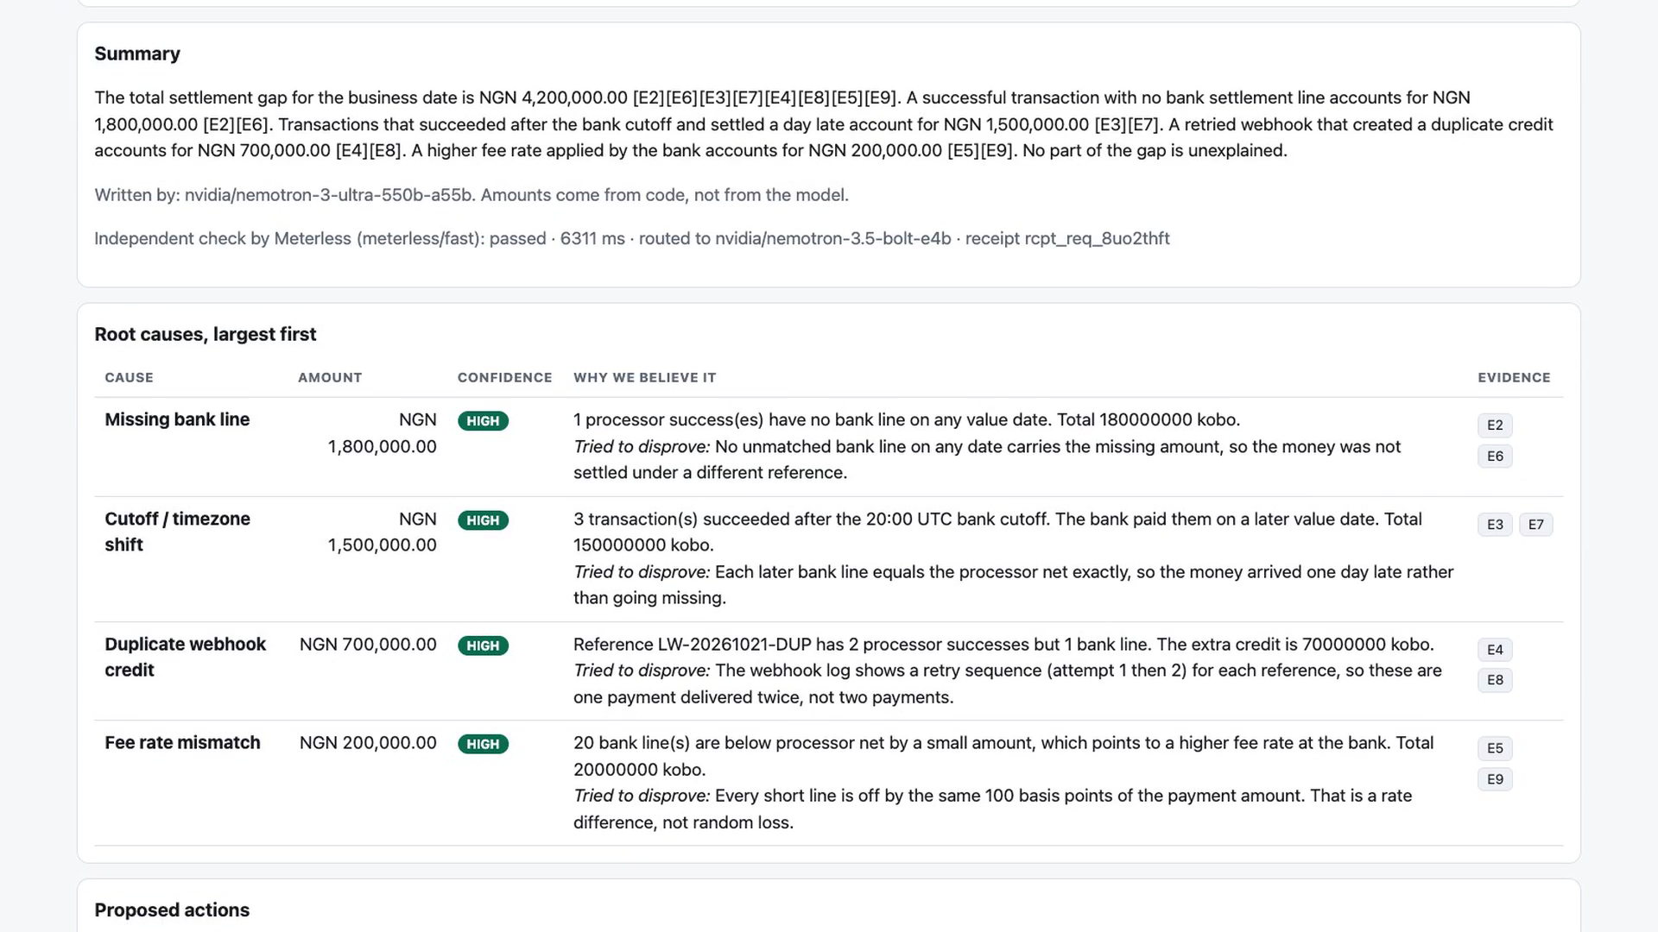
The product
Live timeline with an evidence panel (left). Report with causes, confidence and approvals (right).
Ledgerwise · Open Agent Hackathon 2026 · Track 02
11

Slide 12
Limits and what comes next
Limits, stated plainly
Next
Rules plus falsification, not an LLM planner.
Six cause types covered; reversals, rounding, duplicate bank lines and chargebacks are not.
Synthetic data. No public deployment: Zetaris runs locally.
More fault types and an independent held-out set.
Zetaris masking policies.
An LLM planner that proposes new checks inside the same SQL guard.
A pilot with an African payments operator.
Ledgerwise · Open Agent Hackathon 2026 · Track 02
12

Slide 13
Ledgerwise
Read-only. Evidence for every claim. Humans approve.
github.com/dev-ayomide/ledgerwise

