Slide 1
UI FLOW
1. Onboarding portal (open src/index.html)
2. Onboard BANK A ( open src/index.html and sign in as a bank , mention password as one of the available ganache/testrpc address )
3. Onboard BANK B ( open src/index.html and sign in as a bank , mention password as one of the available ganache/testrpc address)
4. Bank A perform KYC for Customer C
5. Bank B logins and access (View KYC) of Customer C done by Bank A. It gets access denied and approval form customer.
6. Customer C registers on BlockChain through Customer Portal ( open src/indexCustomer.html) and first register and then login.
7.Customer C logins and see (through View requests tab) and approve/reject Bank B requests.
8. If Customer C approves the request , Bank B able to view KYC details of Customer C
1

Slide 2
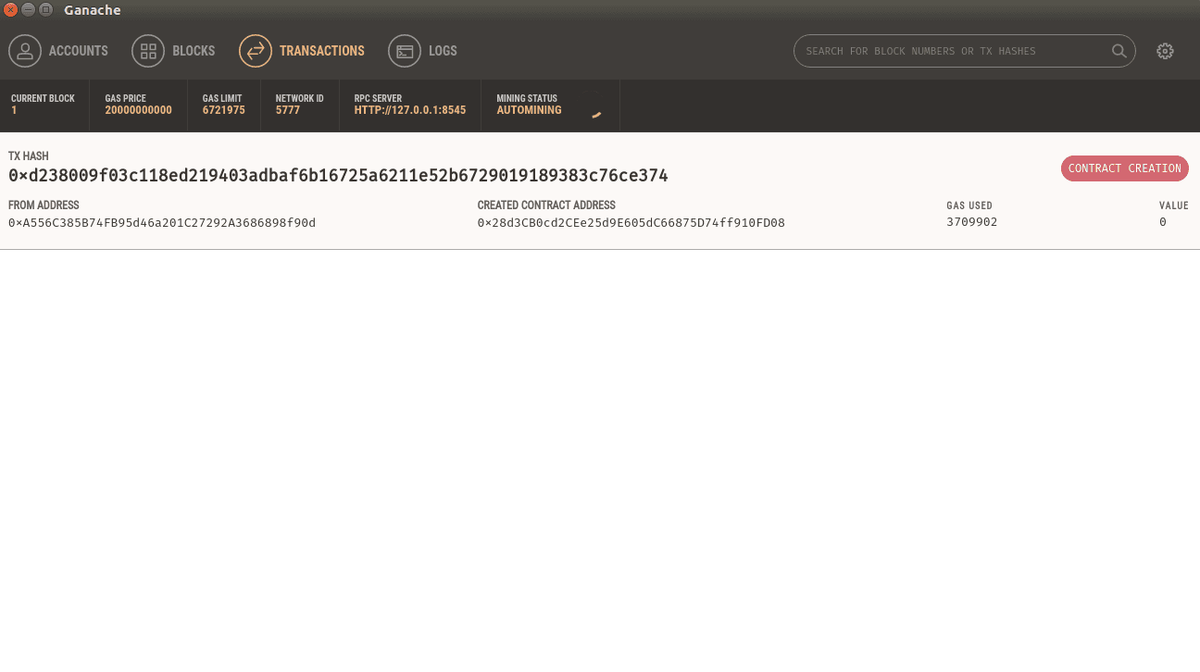
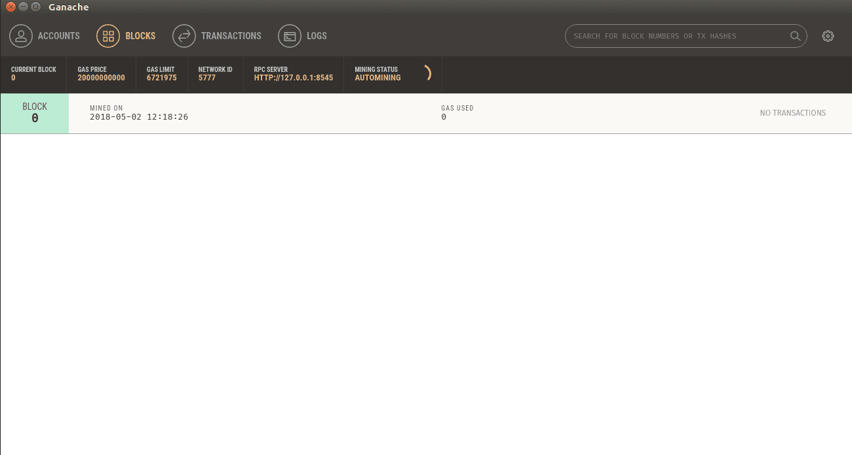
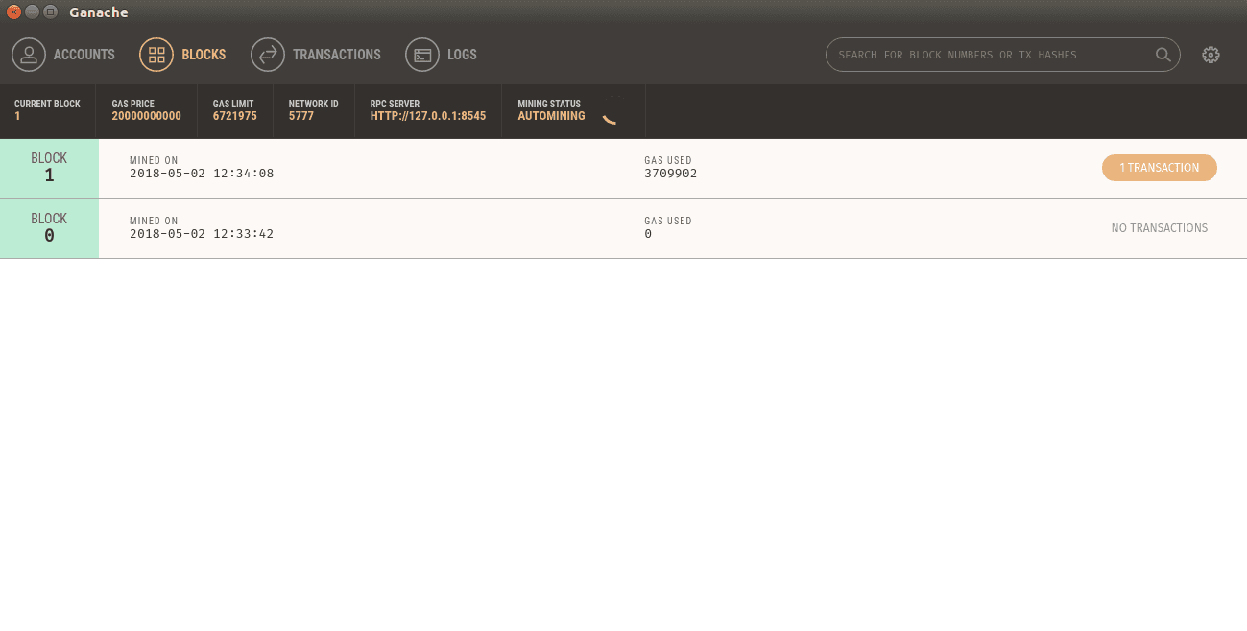
KYC- BLOCKCHAIN EXPLORER
BLOCKCHAIN INITIAL STATE - GENESIS
1. Deploy SMART Contract
1

Slide 3
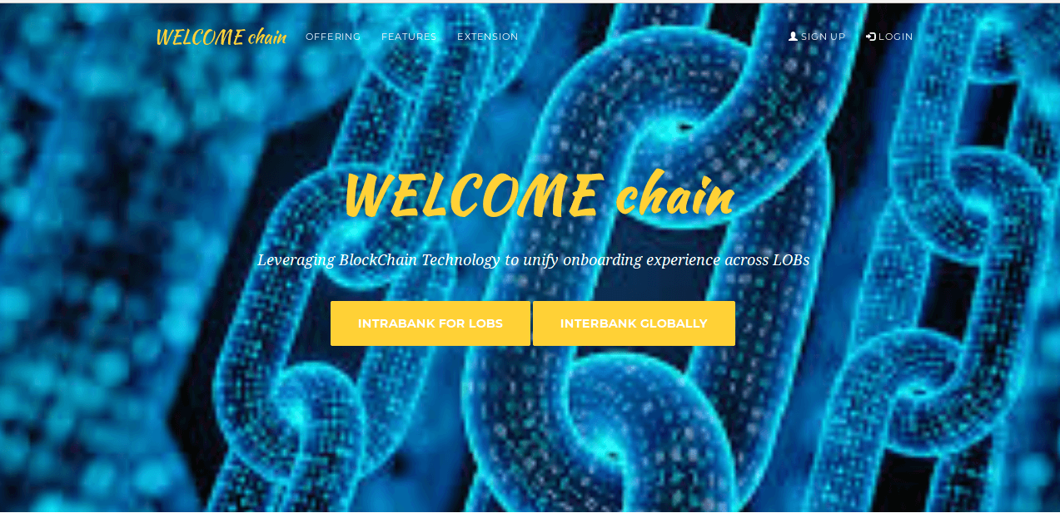
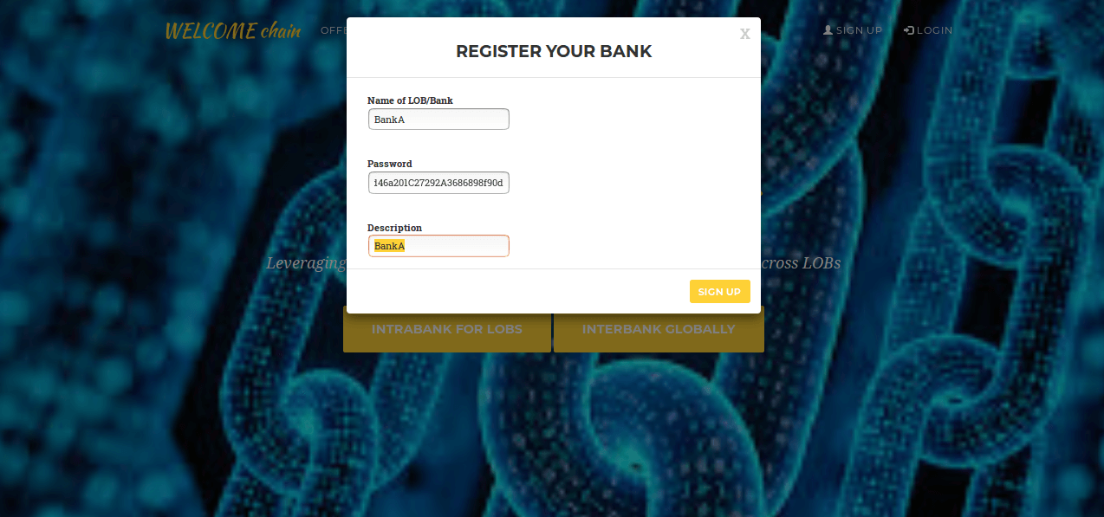
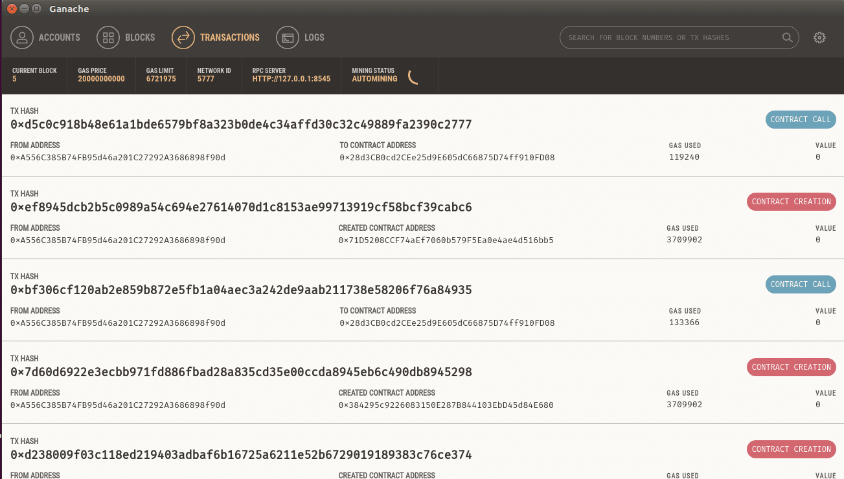
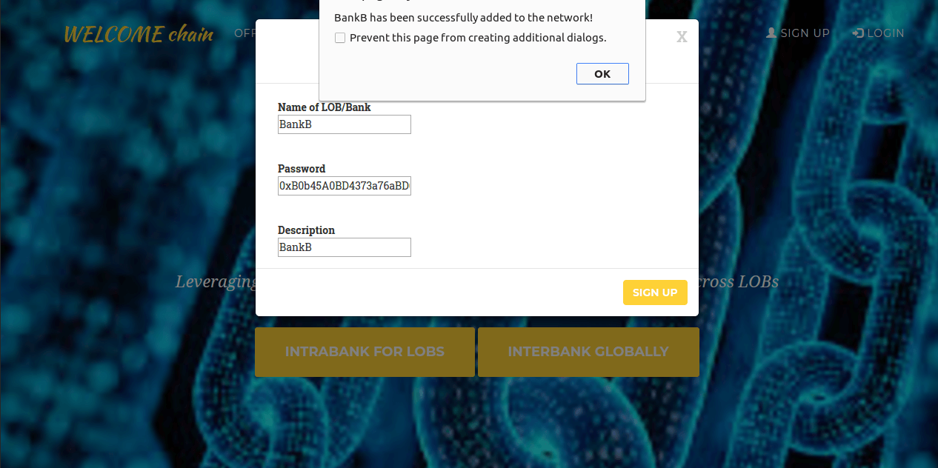
KYC- Registration of Banks
Onboarding Portal
1. Deploy SMART Contract
2.Onboard Bank A
3. Onboard Bank B
Registration Transactions - Explorer
3. Onboard Bank B
1

Slide 4
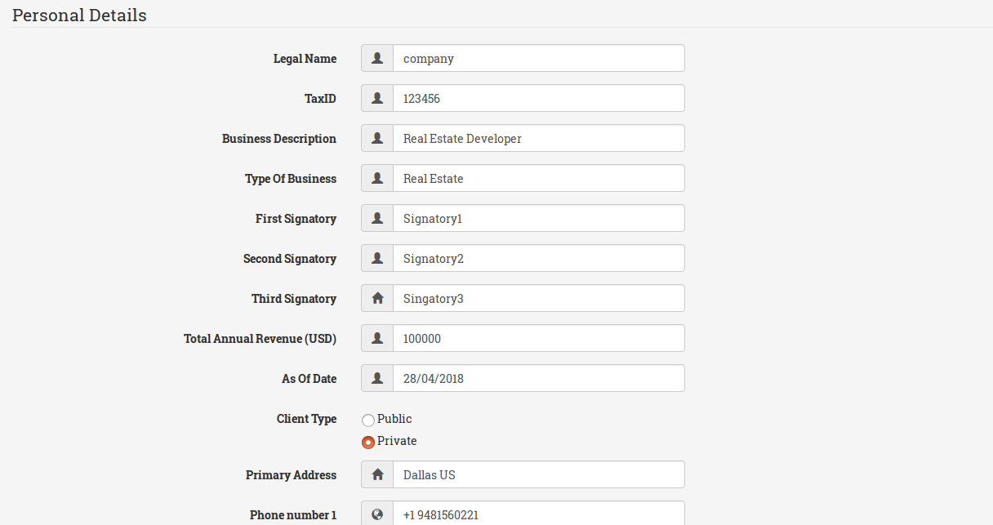
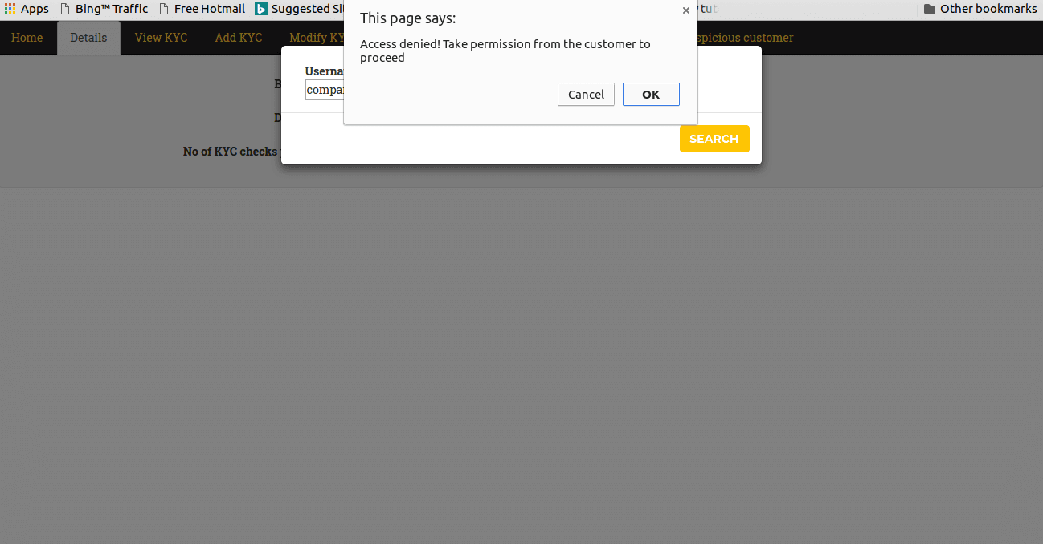
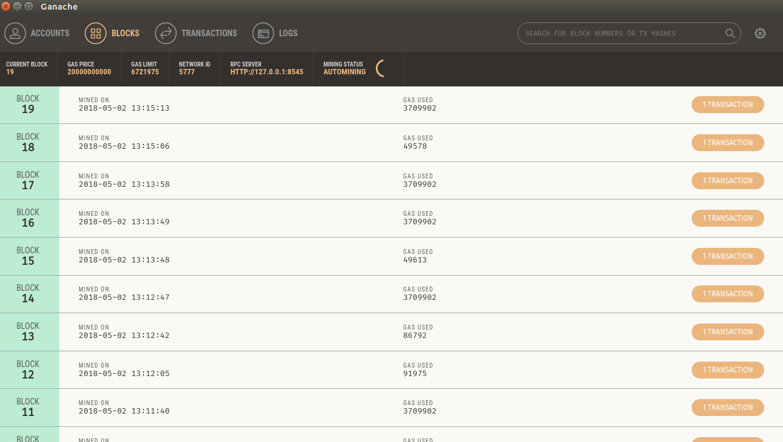
KYC- Upload/Access Customer
4.Bank A performs KYC for Customer C
5.Bank B accesses KYC of Customer C
KYC Transactions Explorer
1

Slide 5
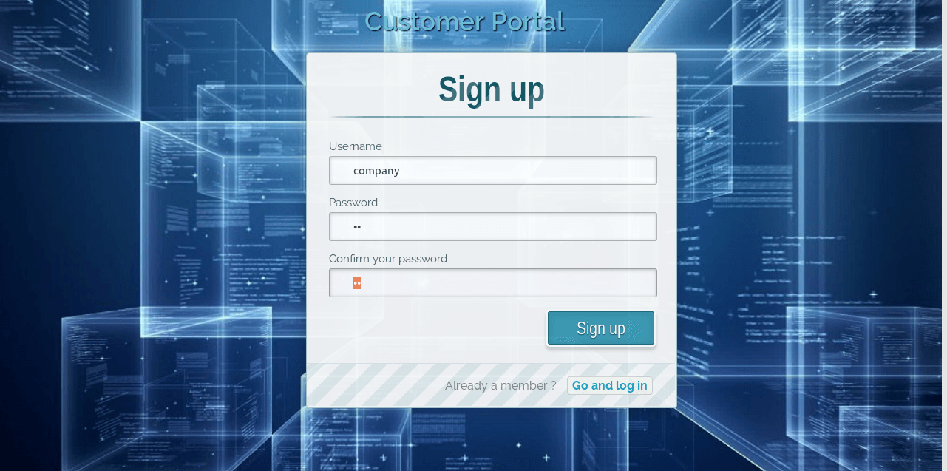
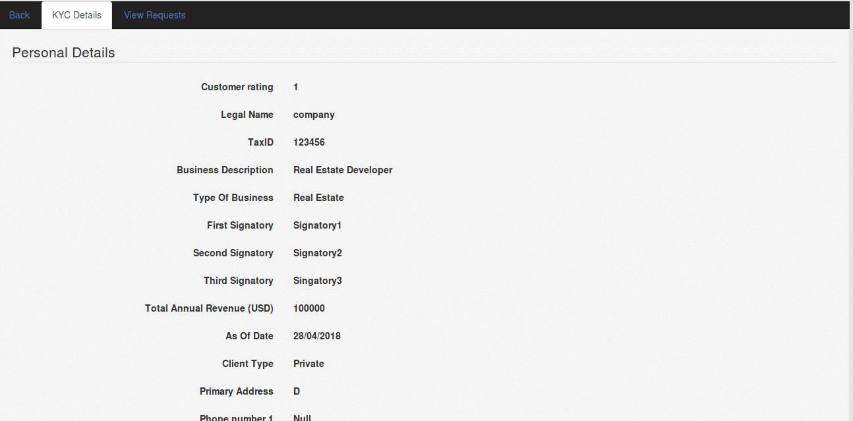
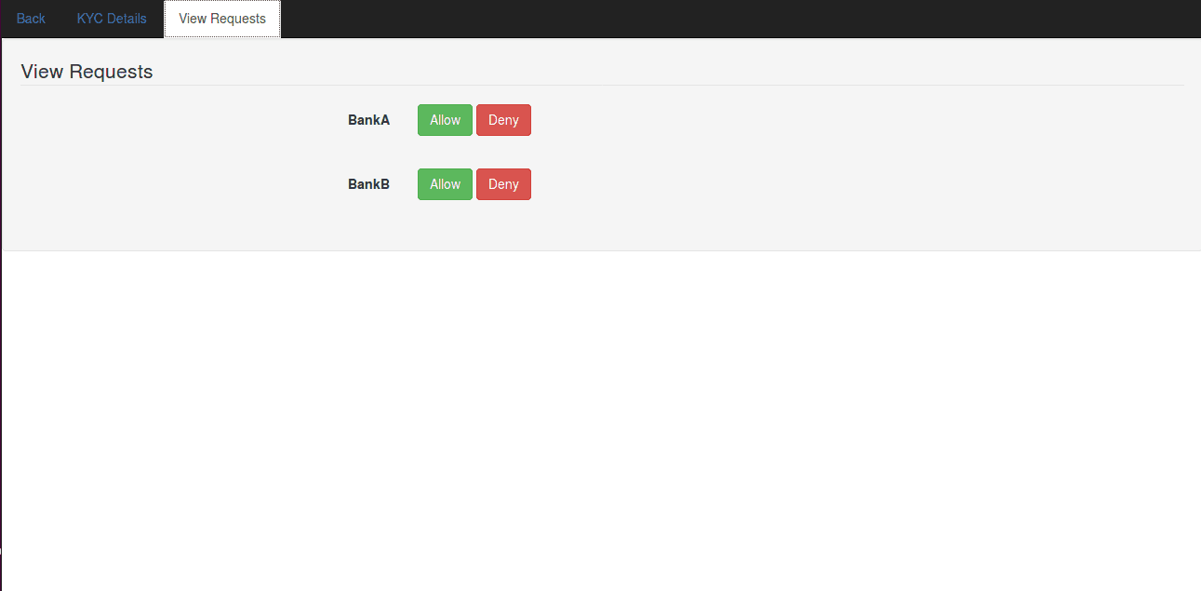
KYC- Customer Portal
6. Customer C registers on Blockchain
Customer Login Page
7. Customer C logins and approve/reject Bank B request
Reject/Approve Transactions
1

Slide 6
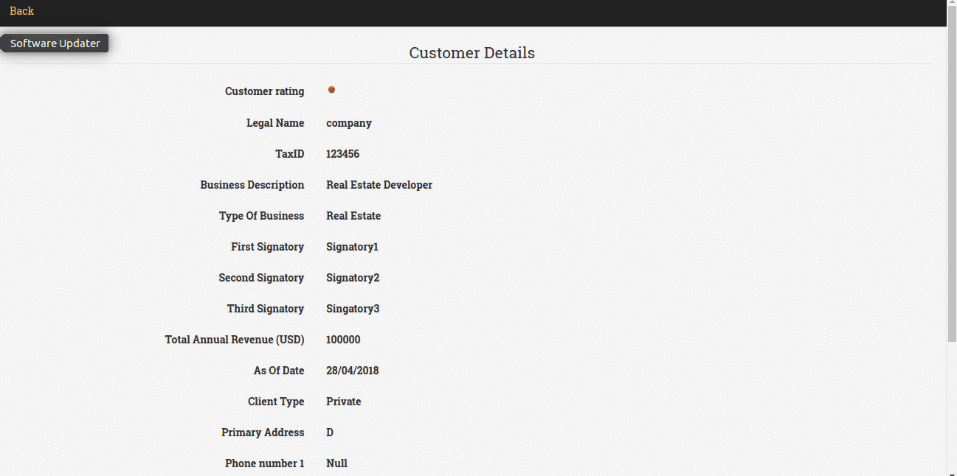
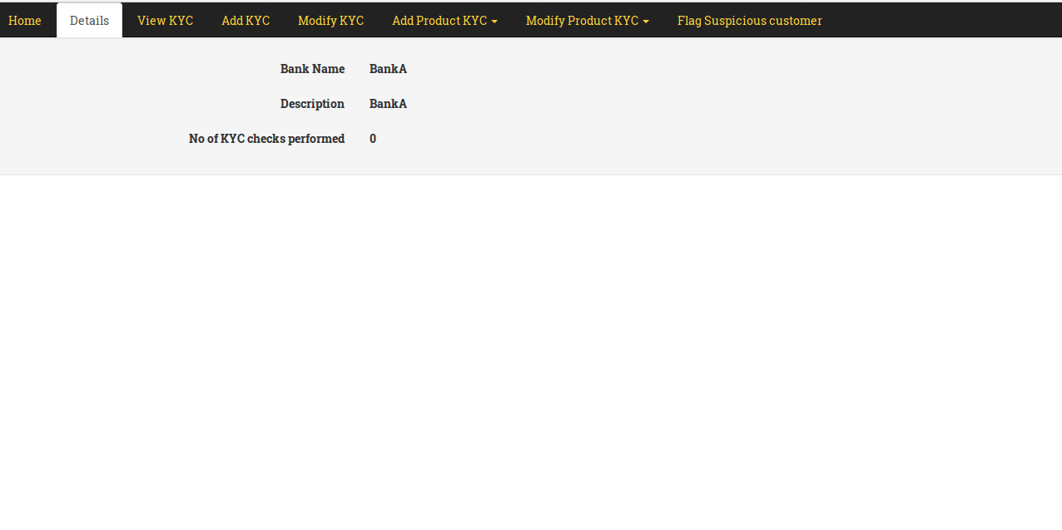
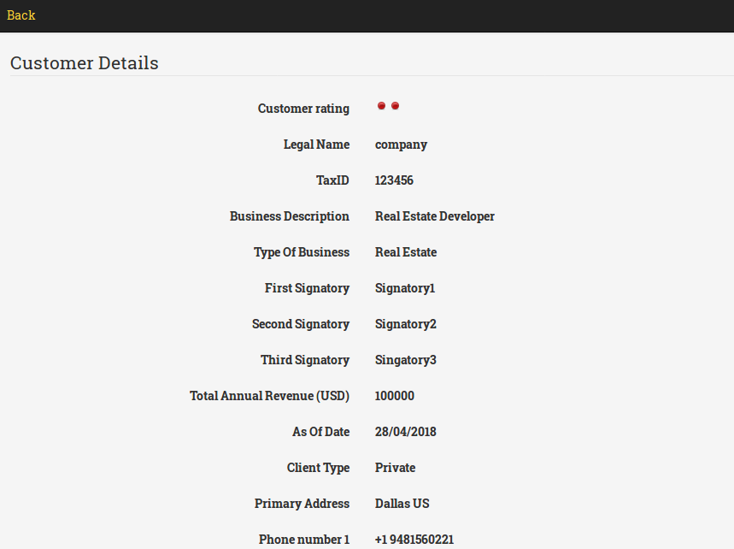
KYC- Flag Suspicious Customer
8. Bank B able to access Customer Details
9. Flag Suspicious Customer
10. All Banks can access Flagged information
1

Slide 7
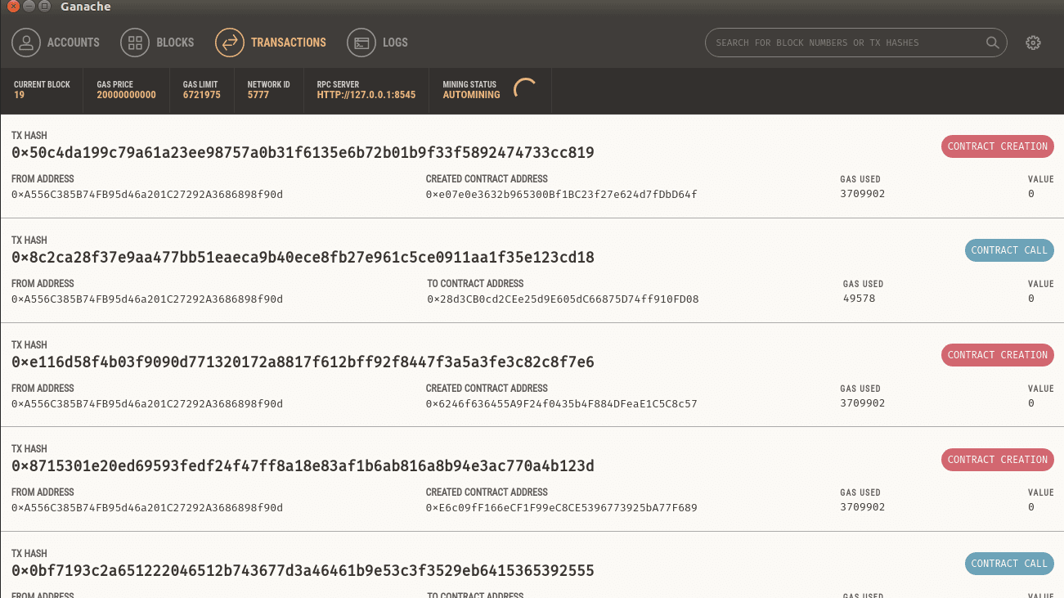

KYC- Flag Suspicious Customer
All Transactions Explorer
All Blocks Explorer
1

