Slide 1
Twitter Sentiment Analysis for Bungie and Destiny 2
Sebastian Alvis
SpringBoard Data Science Bootcamp

Slide 2
Overview
What’s Bungie / Destiny 2?
Getting Data From Twitter
Exploratory Data Analysis
Machine Learning Analysis
Conclusions

Slide 3
Overview
What’s Bungie / Destiny 2?
Getting Data From Twitter
Exploratory Data Analysis
Machine Learning Analysis
Conclusions

Slide 4

What’s Bungie / Destiny 2?
Bungie
Game Company
They’re in Bellevue
Destiny 2
Hit game by Bungie
Magic space ninjas with guns

Slide 5
Social Media Presence
Official Twitter Accounts
@Bungie
@DestinyTheGame
Lots of tweets
Announcements
Etc
Use Twitter data
What do players think of recent updates to Destiny 2?
What do people think of Bungie?

Slide 6
Overview
What’s Bungie / Destiny 2?
Getting Data From Twitter
Exploratory Data Analysis
Machine Learning Analysis
Conclusions

Slide 7
Data Acquisition
Twitter Standard Search API
Get tweets from the last 7 – 10 days
Not exhaustive ($$$)
Search terms
Search for 4 types of tweets
Tweets about Destiny 2 (21.4k)
Tweets about Bungie (24.7k)
@DestinyTheGame’s tweets (46)
@Bungie’s tweets (107)

Slide 8
Data Cleaning
Missing / misaligned data
Reduced columns
320 to 50
Kept the data as 4 DataFrames
Concatenate them when appropriate
Datetime columns

Slide 9
Overview
What’s Bungie / Destiny 2?
Getting Data From Twitter
Exploratory Data Analysis
Machine Learning Analysis
Conclusions

Slide 10
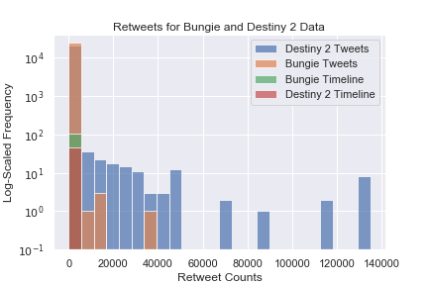
How Do I Measure Engagement?
Retweets
Official accounts don’t get many compared to other accounts

Slide 11
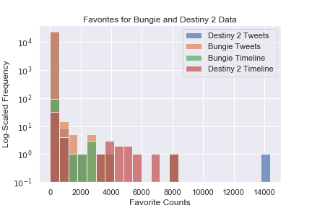
How Do I Measure Engagement?
Retweets
Official accounts don’t get many compared to other accounts
Favorites
Official accounts do get at least as many as other accounts

Slide 12
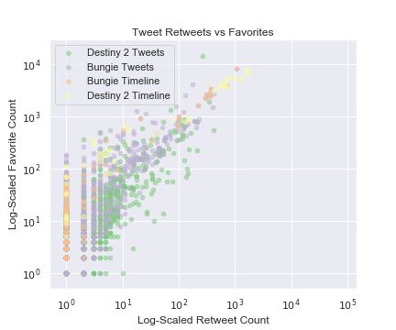
Do Favorites and Retweets Correlate?
Only if you log scale them both
Darn outliers
Generally more favorites than retweets!
The outliers ruin the visuals

Slide 13
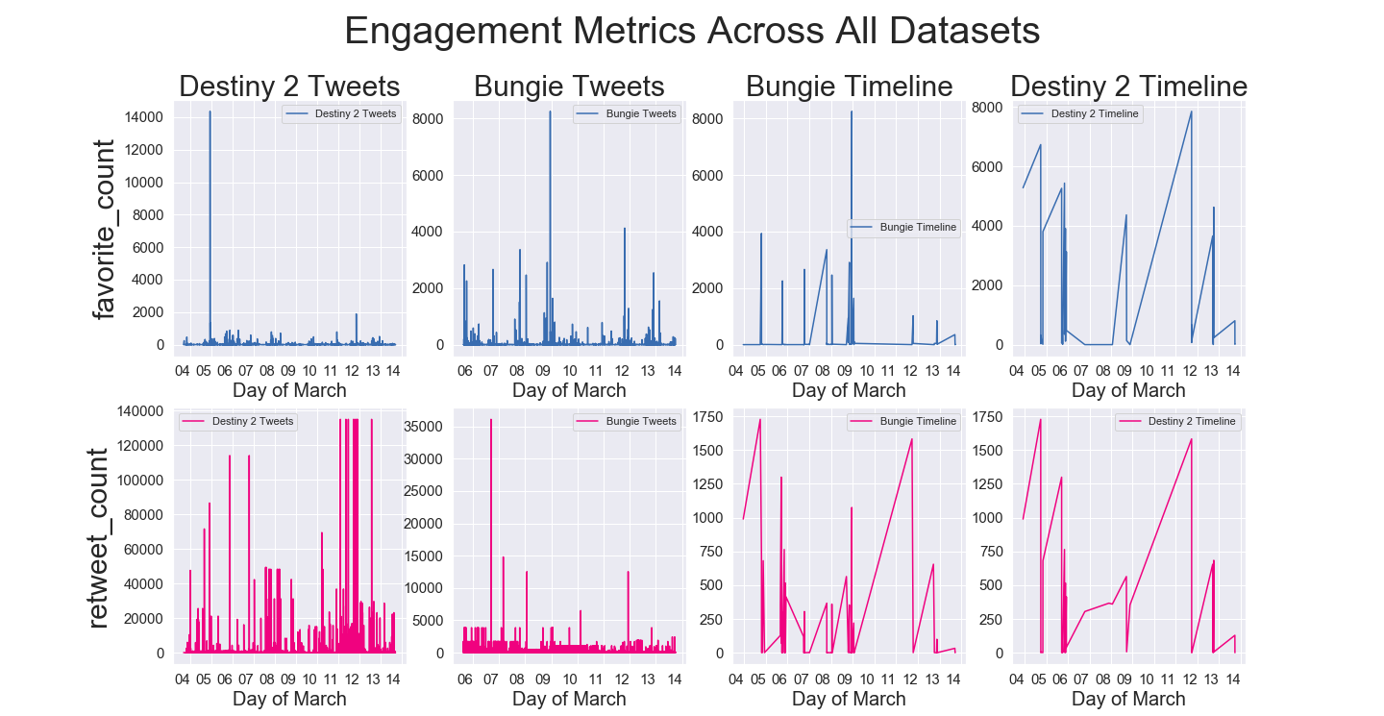
Time Correlations?
Only on the official accounts

Slide 14
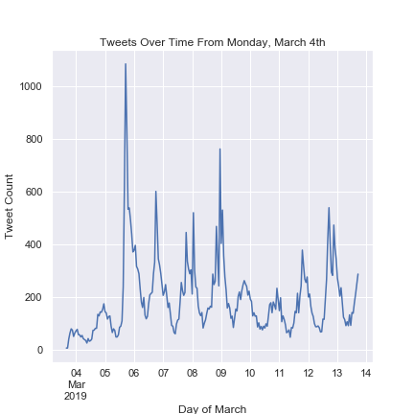
Speaking of Time…
When are these tweets posted?
March 3rd – 13th
Note:
The Destiny 2 tweets start on the 3rd
Bungie tweets start on the 5th
Tweets posted in the evening, mostly on weekdays

Slide 15
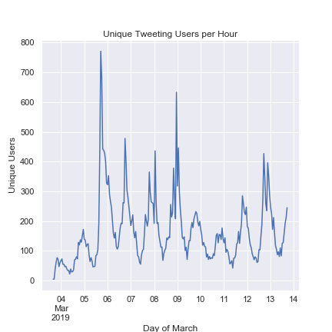
Speaking of Time…
When are these tweets posted?
March 3rd – 13th
Note:
The Destiny 2 tweets start on the 3rd
Bungie tweets start on the 5th
Tweets posted in the evening, mostly on weekdays
Unique users mirrors the same trend

Slide 16
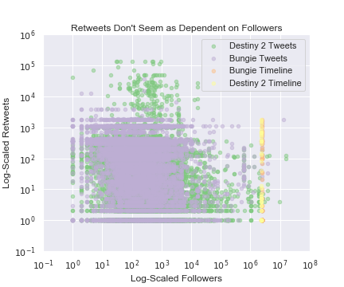
What Drives Engagement?
First Guess: Followers
More people will see your tweets, and then interact with it?
Apparently not for retweets

Slide 17
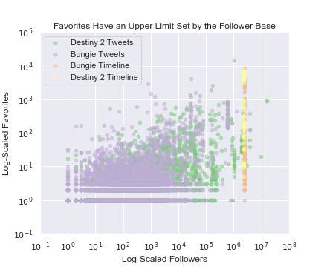
What Drives Engagement?
First Guess: Followers
More people will see your tweets, and then interact with it?
Apparently not for retweets
Maybe for favorites
These are single tweets
Aggregate over each user and check again

Slide 18
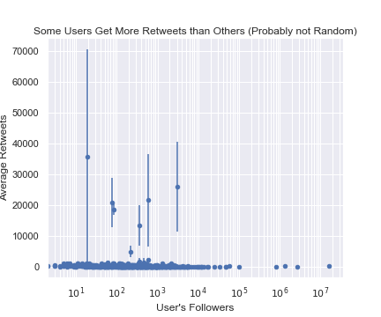
Engagement per User
See if this gets us better results
Can do a z-test
Average retweets
Compare to the baseline of 0
Error bars are the 95% confidence interval for average retweets
Some users definitely get more retweets

Slide 19
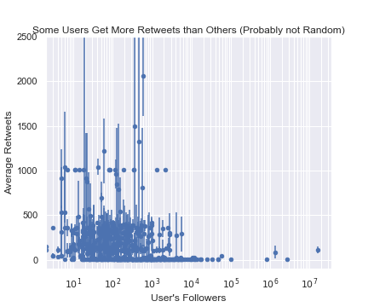
Engagement per User
See if this gets us better results
Can do a z-test
Average retweets
Compare to the baseline of 0
Error bars are the 95% confidence interval for average retweets
Some users definitely get more retweets
Zooming in, more evidence

Slide 20
What Drives Engagement?
Timing?
Can check time of day
Time since @Bungie or @DestinyTheGame tweeted?

Slide 21
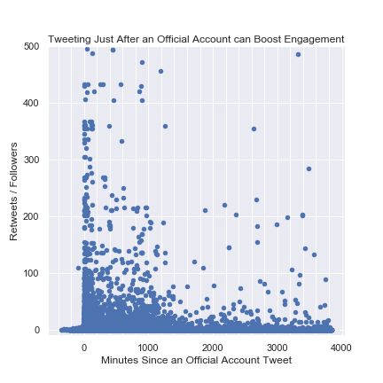
What Drives Engagement?
Timing?
Can check time of day
Time since @Bungie or @DestinyTheGame tweeted?
Negative correlation
Official tweets can boost your signal

Slide 22
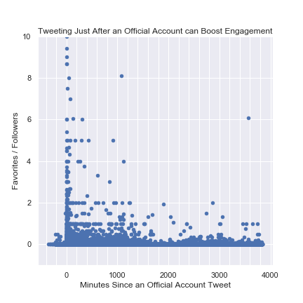
What Drives Engagement?
Timing?
Can check time of day
Time since @Bungie or @DestinyTheGame tweeted?
Negative correlation
Official tweets can boost your signal

Slide 23
Overview
What’s Bungie / Destiny 2?
Getting Data From Twitter
Exploratory Data Analysis
Machine Learning Analysis
Conclusions

Slide 24
NLP
Don’t want to label ~48k tweets with sentiments
Package to do that for me?
Feature Engineering rather than Machine Learning
VADER
In NLTK

Slide 25

Valence Aware Dictionary and sEntiment Reasoner
https://github.com/cjhutto/vaderSentiment
Specializes in social media text
Can interpret special text cases
Emojis
ALL CAPS
Excessive punctuation

Slide 26
VADER Scores
Vader will score Strings
Multivariate
Positive: Proportion of words in the text that are positive
Negative: Proportion of words in the text that are negative
Neutral: Proportion of words in the text that are neutral
Univariate
Compound: Score between -1 and 1

Slide 27
VADER Score Examples
Neg: 0.815 “@Bungie Cancer”
Comp: -0.8552 “@Bungie It’s worst in Gambit Prime killed 3 envoys with hammerhead and we killed the prime evil only 2% increase are we serious \U0001f633”
Pos: 0.879 “@DestinyTheGame @Bungie Yes yes yes yes YES!”
Comp: 0.9836 “AAAAAAHHHH I forgot how fun Destiny 2 is. Gambit Prime is intense but super fun. :) :) :) :0 :)”
Neu: 1.0 “RT @DestinyTheGame: Season of the Drifter is underway and the latest Bungie ViDoc outlines what to expect all season long. \U0001f4a0”
Notes:
\U0001f633 is flushed face
\U0001f4a0 is diamond shape with a dot inside

Slide 28
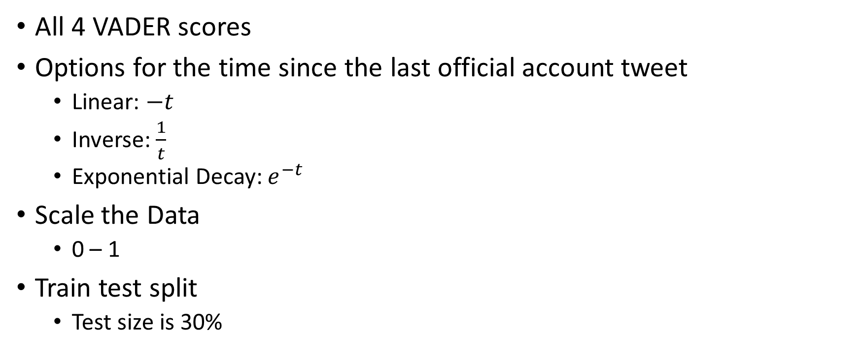
Feature Engineering and Processing
All 4 VADER scores
Options for the time since the last official account tweet
Linear: $−t$
Inverse: $\frac{1}{t}$
Exponential Decay: $e^{−t}$
Scale the Data
0 – 1
Train test split
Test size is 30%

Slide 29
ML Model 1
Predict number of retweets
Best metric for Twitter engagement
Linear Regression
Vary the time column
Vary the scaling
Remove negative time values
Performed terribly
All the R-squared values were very low (> 0.0007)

Slide 30
ML Model 1
Exact retweet numbers
Lots of randomness
Would need a hugely complex model to get a good accuracy
Tried a random forest regressor
Also did not perform well
What now?

Slide 31
ML Model 2
Retweets are important
Predict a range
Class 0: 0 – 99 retweets
Class 1: 100 – 9999 retweets
Class 2: 10000+ retweets
Classification problem
K Nearest Neighbors
Random Forests

Slide 32
ML Model 2
K Nearest Neighbors Classifier
Test Score: 0.901
After hyperparameter tuning: 0.915
Confusion matrix:
Predictions | Class 0 | Class 1 | Class 2
Actual Class 0 | 11020 | 340 | 3
Actual Class 1 | 800 | 1546 | 1
Actual Class 2 | 25 | 0 | 9

Slide 33
ML Model 2.1
Class imbalance -> Upsample!
About 5 times more Class 0 data than Class 1
About 332 times more Class 0 data than Class 2
Retry K Nearest Neighbors: 0.921
Hyperparameter tuning: 0.951
Predictions | Class 0 | Class 1 | Class 2
Actual Class 0 | 9714 | 1596 | 52
Actual Class 1 | 52 | 11681 | 3
Actual Class 2 | 0 | 0 | 11355

Slide 34
ML Model 2.1
Model works great!
Might be biased with repeated data for “nearest neighbors”
Interpret the model…
I can’t
K Nearest Neighbors is a black box
Try Random Forests

Slide 35
ML Model 3
Normal data sampling: 0.920
Hyperparameter tuning: 0.924
Confusion matrix has the same trends as K Nearest Neighbors
Predictions | Class 0 | Class 1 | Class 2
Actual Class 0 | 11206 | 157 | 0
Actual Class 1 | 860 | 1487 | 0
Actual Class 2 | 31 | 0 | 3

Slide 36
ML Model 3.1
Upsampled data: 0.973
Hyperparameter tuning: 0.975
Again, same trends as K Nearest Neighbors with upsampled data
Only this time, I can extract feature importances
Predictions | Class 0 | Class 1 | Class 2
Actual Class 0 | 10583 | 771 | 8
Actual Class 1 | 84 | 11647 | 5
Actual Class 2 | 0 | 0 | 11355

Slide 37
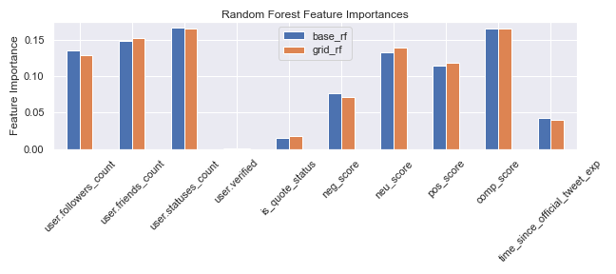
Random Forest Feature Importances

Slide 38
ML Model 3.1 Correlation Problems
VADER Scores
Higher positive correlates with higher compound
Higher negative correlates with lower compound
Higher neutral correlates with compound closer to 0
I want to know if positive or negative tweets get more engagement
Keep positive and negative scores
See which is more important

Slide 39
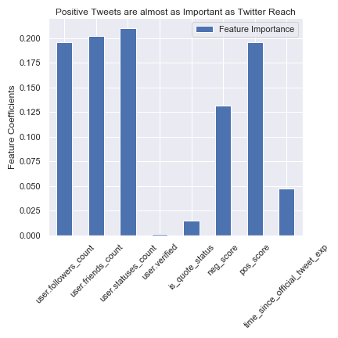
ML Model 3.2
Drop neutral and compound scores
Use features that hyperparameter tuning found for v3.1
Test Score: 0.971
Very similar
Careful, feature importance is not necessarily positive

Slide 40
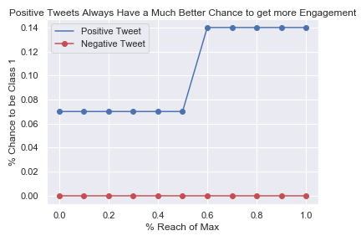
Positive vs Negative: Which Gets More Retweets?
Predict class probabilities on simulated data
One has positive sentiment, one has negative
Everything else controlled

Slide 41
Overview
What’s Bungie / Destiny 2?
Getting Data From Twitter
Exploratory Data Analysis
Machine Learning Analysis
Conclusions

Slide 42
Conclusions
Wanted to draw conclusions from social media data
Found that:
People are more active on Twitter in the evening
People can tweet right after Bungie or Destiny to get a small engagement boost
ML models can predict if tweets will fall into a certain range
Can repurpose this to help Bungie craft tweets that should get more engagement
People like positive tweets about Bungie and Destiny 2 way more than negative ones!

Slide 43
Future Work
Collect cleaner data
More exhaustive exploratory analysis
Use sentiment scores better
Log-scale retweets and retry linear regression
More categories for the ML models
Run a ML model on only official account tweets

