Slide 1
Twitter Sentiment Analysis for Bungie and Destiny 2
Sebastian Alvis
SpringBoard Data Science Bootcamp

Slide 2
Overview
What’s Bungie / Destiny 2?
Getting Data From Twitter
Exploratory Data Analysis
Machine Learning Analysis
Conclusions

Slide 3
Overview
What’s Bungie / Destiny 2?
Getting Data From Twitter
Exploratory Data Analysis
Machine Learning Analysis
Conclusions

Slide 4

What’s Bungie / Destiny 2?
Bungie
Game Company
They’re in Bellevue
Destiny 2
Hit game by Bungie
Magic space ninjas with guns

Slide 5
Social Media Presence
Official Twitter Accounts
@Bungie
@DestinyTheGame
Lots of tweets
Announcements
Etc
Use Twitter data
What do players think of recent updates to Destiny 2?
What do people think of Bungie?

Slide 6
Overview
What’s Bungie / Destiny 2?
Getting Data From Twitter
Exploratory Data Analysis
Machine Learning Analysis
Conclusions

Slide 7
Data Acquisition
Twitter Standard Search API
Get tweets from the last 7 – 10 days
Not exhaustive ($$$)
Search terms
Searches (~10 days)
Tweets about Destiny 2 (21.4k)
Tweets about Bungie (24.7k)
@DestinyTheGame’s tweets (46)
@Bungie’s tweets (107)

Slide 8
Data Cleaning
Missing / misaligned data
Reduced columns
320 to 50
Kept the data as 4 DataFrames
Concatenate them when appropriate

Slide 9
Overview
What’s Bungie / Destiny 2?
Getting Data From Twitter
Exploratory Data Analysis
Machine Learning Analysis
Conclusions

Slide 10
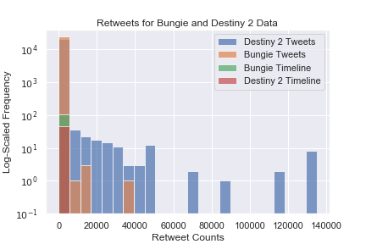
How Do I Measure Engagement?
Retweets
Official accounts don’t get many compared to others

Slide 11
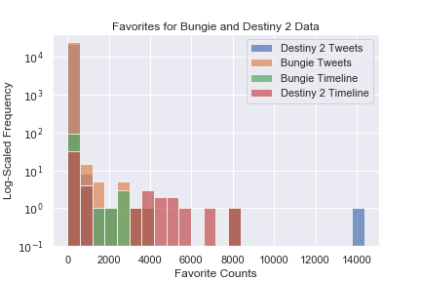
How Do I Measure Engagement?
Retweets
Official accounts don’t get many compared to other accounts
Favorites
Official accounts do get at least as many as other accounts

Slide 12
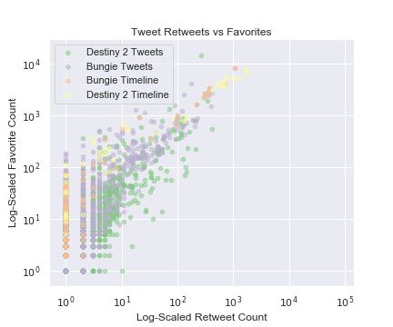
Do Favorites and Retweets Correlate?
Only if you log scale them both
Darn outliers
Generally more retweets than favorites
CHECK THIS
DID I MIX UP AXES

Slide 13
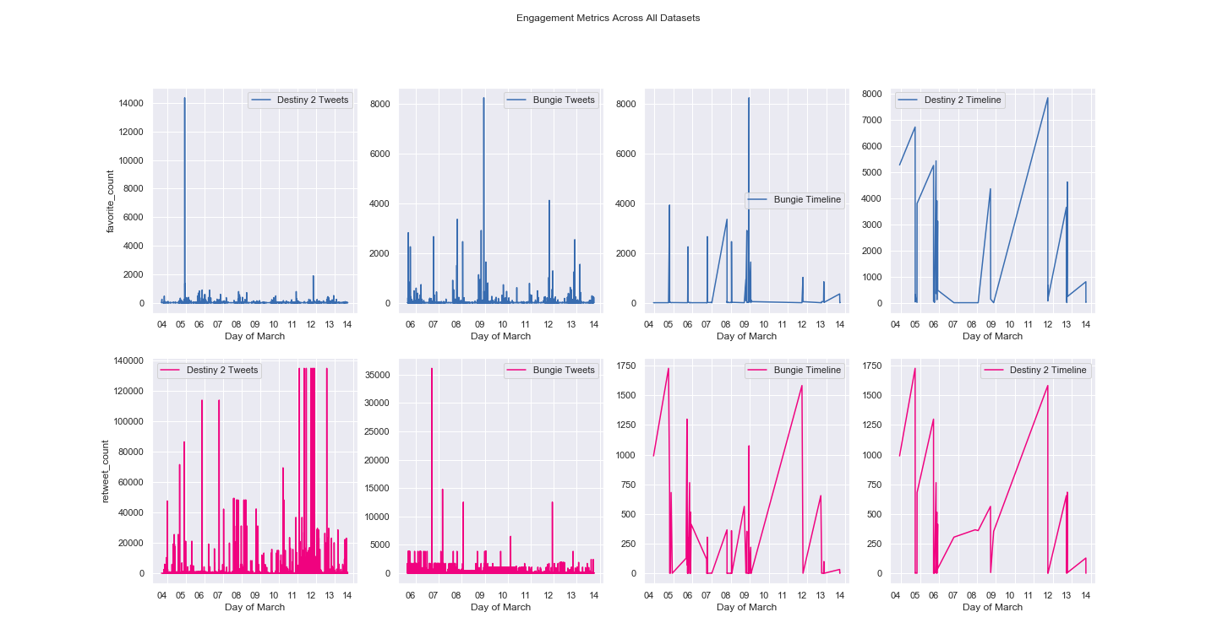
Time Correlations?
Only on the official accounts

Slide 14
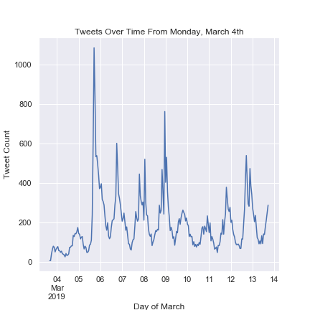
Speaking of Time…
When are these tweets posted?
March 3rd – 13th
Note:
The Destiny 2 tweets start on the 3rd
Bungie tweets start on the 5th
Tweets posted in the evening, mostly on weekdays

Slide 15
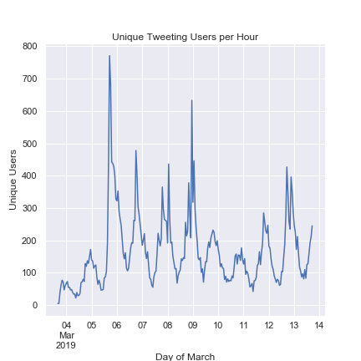
Speaking of Time…
When are these tweets posted?
March 3rd – 13th
Note:
The Destiny 2 tweets start on the 3rd
Bungie tweets start on the 5th
Tweets posted in the evening, mostly on weekdays
Unique users mirrors the same trend

Slide 16
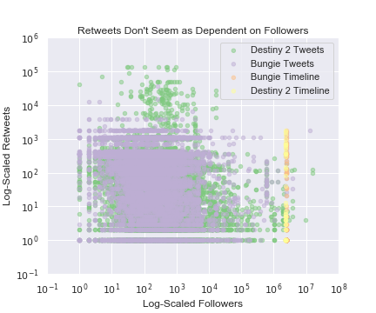
What Drives Engagement?
First Guess: Followers
More people will see your tweets, and then interact with it?
Apparently not for retweets

Slide 17
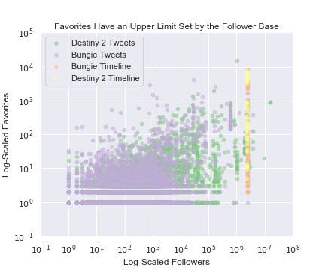
What Drives Engagement?
First Guess: Followers
More people will see your tweets, and then interact with it?
Apparently not for retweets
Maybe for favorites
These are single tweets
Aggregate over each user and check again

Slide 18
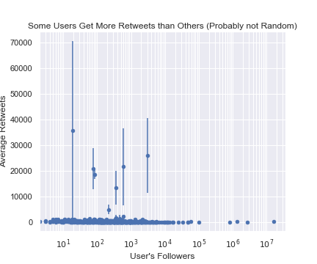
Engagement per User
See if this gets us better results
Can do a z-test
Average retweets
Compare to the baseline of 0
Error bars are the 95% confidence interval for average retweets
Some users definitely get more retweets

Slide 19
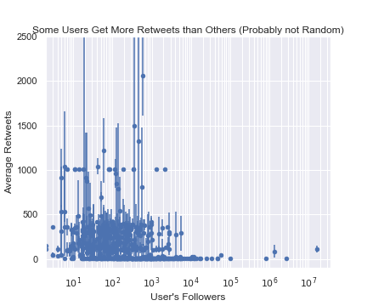
Engagement per User
See if this gets us better results
Can do a z-test
Average retweets
Compare to the baseline of 0
Error bars are the 95% confidence interval for average retweets
Some users definitely get more retweets
Zooming in, more evidence

Slide 20
What Drives Engagement?
Timing?
Can check time of day (SHOULD)
Time since @Bungie or @DestinyTheGame tweeted?

Slide 21
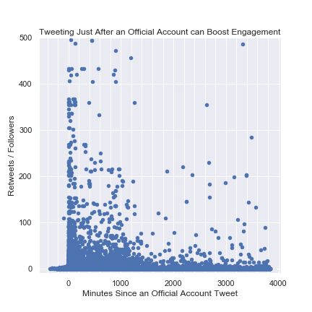
What Drives Engagement?
Timing?
Can check time of day (SHOULD)
Time since @Bungie or @DestinyTheGame tweeted?
Negative correlation
Official tweets can boost your signal

Slide 22
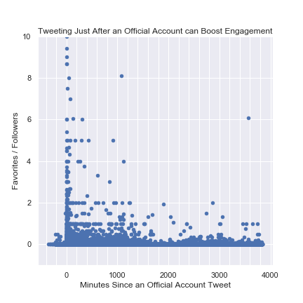
What Drives Engagement?
Timing?
Can check time of day (SHOULD)
Time since @Bungie or @DestinyTheGame tweeted?
Negative correlation
Official tweets can boost your signal

Slide 23
Overview
What’s Bungie / Destiny 2?
Getting Data From Twitter
Exploratory Data Analysis
Machine Learning Analysis
Conclusions

Slide 24
Overview
What’s Bungie / Destiny 2?
Getting Data From Twitter
Exploratory Data Analysis
Machine Learning Analysis
Conclusions

